Slide 1


Strategic Planning
Strategic Planning

Slide 2

Strategy Monitoring
Chapter 11

Slide 3
Learning Objectives
Discuss the strategy-evaluation process, criteria, and methods used.
Discuss three activities that comprise strategy evaluation.
Describe and develop a Balanced Scorecard.
Identify and describe published sources of strategy-evaluation information.
Identify and describe six characteristics of an effective strategy-evaluation system.
Discuss the nature and role of contingency planning in strategy evaluation.
Explain the role of auditing in strategy evaluation.
Identify and discuss three twenty-first-century challenges in strategic management.
Identify and describe 17 guidelines for effective strategic management.
Notes:
After studying this chapter, you should be able to do the following:
9-1. Discuss the strategy-evaluation process, criteria, and methods used.
9-2. Discuss three activities that comprise strategy evaluation.
9-3. Describe and develop a Balanced Scorecard.
9-4. Identify and describe published sources of strategy-evaluation information.
9-5. Identify and describe six characteristics of an effective strategy-evaluation system.
9-6. Discuss the nature and role of contingency planning in strategy evaluation.
9-7. Explain the role of auditing in strategy evaluation.
9-8. Identify and discuss three twenty-first-century challenges in strategic management.
9-9. Identify and describe 17 guidelines for effective strategic management.

Slide 4
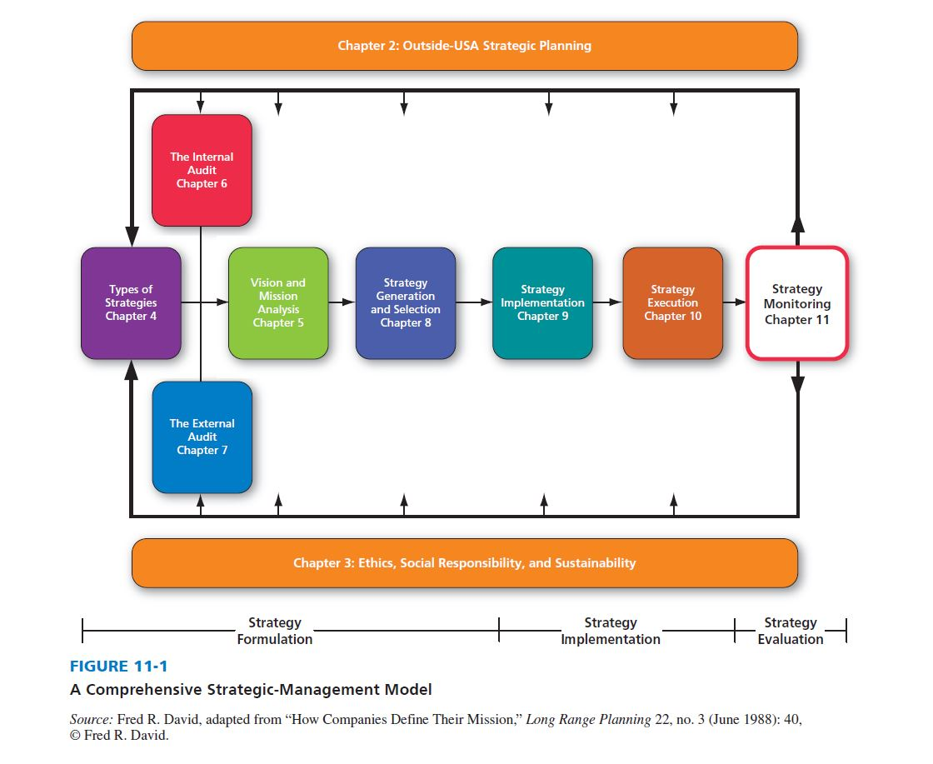
A Comprehensive Strategic-Management Model
Notes:
This chapter is highlighted in the strategic management model.

Slide 5
Strategy Evaluation
Three basic activities:
Examine the underlying bases of a firm’s strategy.
Compare expected results with actual results.
Take corrective actions to ensure that performance conforms to plans.
Notes:
Strategy evaluation is vital to an organization’s well-being; timely evaluations can alert management to problems or potential problems before a situation becomes critical. The strategy-evaluation process includes three basic activities.

Slide 6
Strategy Evaluation Criteria
Consonance
Consistency
Advantage
Feasibility
Notes:
It is impossible to demonstrate conclusively that a particular strategy is optimal or even to guarantee that it will work. One can, however, evaluate it for critical flaws. Richard Rumelt offered four criteria that could be used to evaluate a strategy.

Slide 7
Why Strategy Evaluation is
More Difficult Today
A dramatic increase in the environment’s complexity
The increasing difficulty of predicting the future with accuracy
The increasing number of variables
The rapid rate of obsolescence of even the best plans
Notes:
Strategy evaluation is becoming increasingly difficult with the passage of time, for many reasons. Domestic and world economies were more stable in years past, product life cycles were longer, product development cycles were longer, technological advancement was slower, change occurred less frequently, there were fewer competitors, foreign companies were generally weak, and there were more regulated industries. Other reasons why strategy evaluation is more difficult today include the trends on the next two slides.

Slide 8
Why Strategy Evaluation is
More Difficult Today
The increase in the number of both domestic and world events affecting organizations
The decreasing time span for which planning can be done with any degree of
certainty

Slide 9
The Process of Evaluating Strategies
Strategy evaluation should initiate managerial questioning of expectations and assumptions, should trigger a review of objectives and values, and should stimulate creativity in generating alternatives and formulating criteria of evaluation.
Notes:
Strategy evaluation is necessary for all sizes and kinds of organizations.

Slide 10
The Process of Evaluating Strategies
Evaluating strategies on a continuous rather than on a periodic basis allows benchmarks of progress to be established and more effectively monitored.
Successful strategies combine patience with a willingness to promptly take corrective actions when necessary.
Notes:
Some strategies take years to implement; consequently, associated results may not become apparent for years.

Slide 11
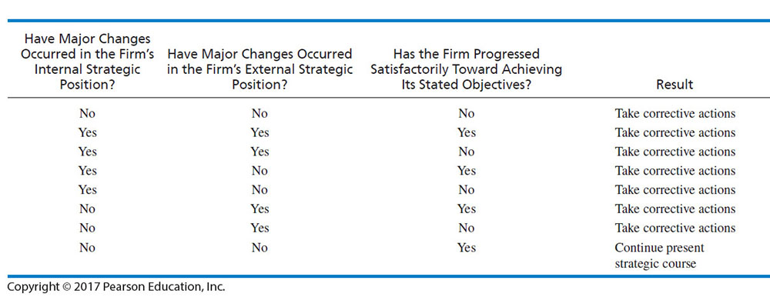
Strategy-Evaluation Assessment Matrix
Notes:
Table 9-2 summarizes the three strategy-evaluation activities in terms of key questions that should be addressed, alternative answers to those questions, and appropriate actions for an organization to take.

Slide 12
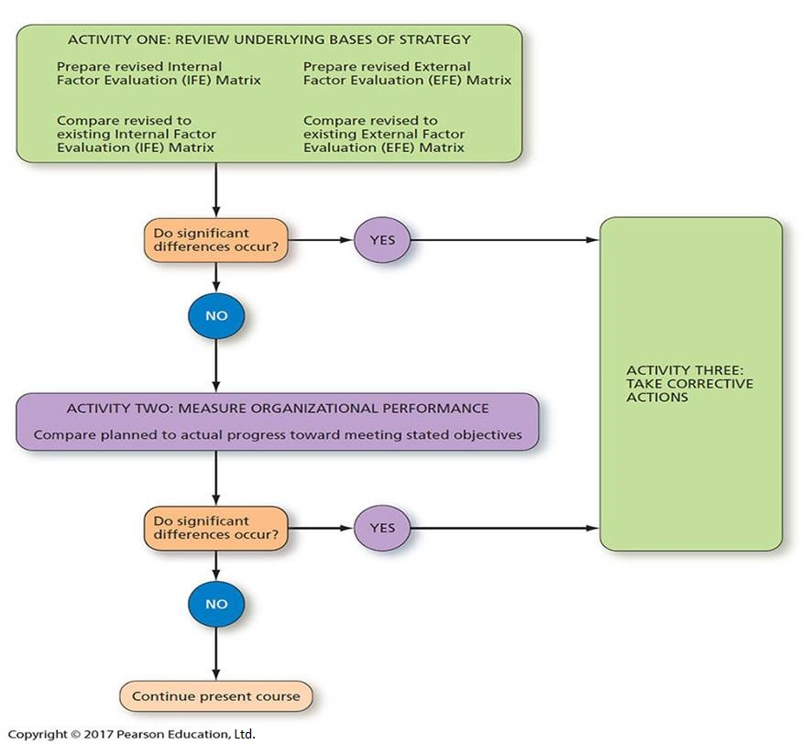
A Strategy-Evaluation Framework
Notes:
Reviewing the underlying bases of an organization’s strategy could be approached by developing a revised EFE Matrix and IFE Matrix.

Slide 13
Reviewing Bases of Strategy
How have competitors reacted to our strategies?
How have competitors’ strategies changed?
Have major competitors’ strengths and weaknesses changed?
Why are competitors making certain strategic changes?
Notes:
Analysis could also address the questions included on the next two slides.

Slide 14
Reviewing Bases of Strategy
Why are some competitors’ strategies more successful than others?
How satisfied are our competitors with their present market positions and profitability?
How far can our major competitors be pushed before retaliating?
How could we more effectively cooperate with our competitors?

Slide 15
Measuring Organizational Performance
Strategists use common quantitative criteria to make three critical comparisons:
Comparing the firm’s performance over different time periods
Comparing the firm’s performance to competitors’
Comparing the firm’s performance to industry averages
Notes:
Measuring organizational performance includes comparing expected results to actual results, investigating deviations from plans, evaluating individual performance, and examining progress being made toward meeting stated objectives.

Slide 16
Key Questions to Address in Evaluating Strategies
How good is the firm’s balance of investments between high-risk and low-risk projects?
How good is the firm’s balance of investments between long-term and short-term projects?
How good is the firm’s balance of investments between slow-growing markets and fast-growing markets?
Notes:
Some additional key questions that reveal the need for judgments in strategy evaluation are on the next two slides.

Slide 17
Key Questions to Address in Evaluating Strategies
How good is the firm’s balance of investments among different divisions?
To what extent are the firm’s alternative strategies socially responsible?
What are the relationships among the firm’s key internal and external strategic factors?
How are major competitors likely to respond to particular strategies?

Slide 18
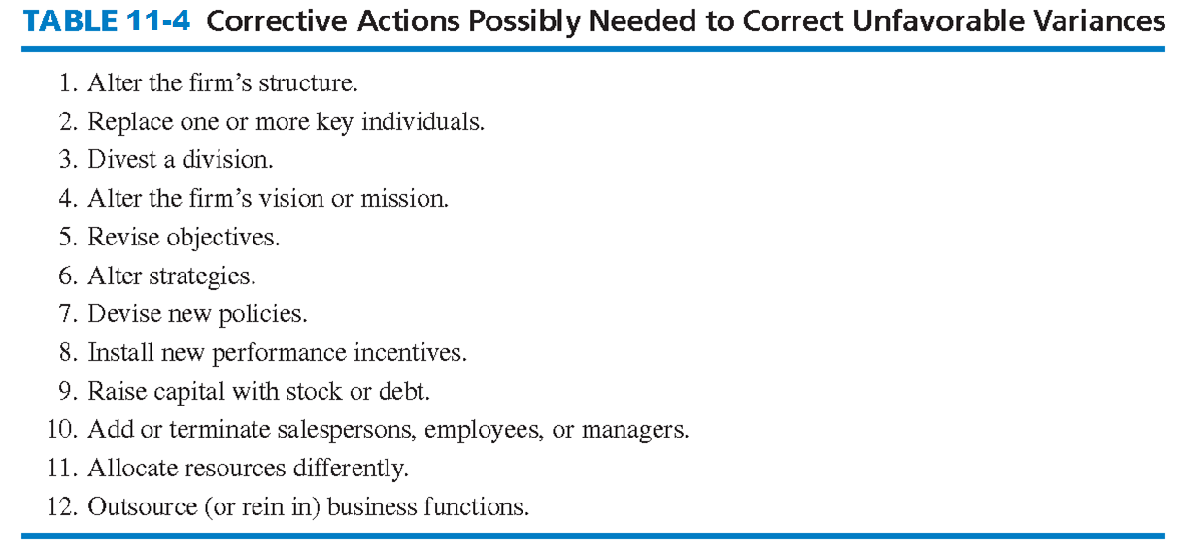
Corrective Actions
Notes:
The final strategy-evaluation activity, taking corrective actions, requires making changes to competitively reposition a firm for the future. As indicated in Table 9-4, examples of changes that may be needed are altering an organization’s structure, replacing one or more key individuals, selling a division, or revising a business mission.

Slide 19
The Balanced Scorecard
Is the firm continually improving and creating value along measures such as innovation, technological leadership, product quality, operational process efficiencies, and so on?
Is the firm sustaining and even improving on its core competencies and competitive advantages?
How satisfied are the firm’s customers?
Notes:
The Balanced Scorecard is a strategy evaluation and control technique. Balanced Scorecard derives its name from the perceived need of firms to “balance” financial measures that are oftentimes used exclusively in strategy evaluation and control with nonfinancial measures such as product quality and customer service. An effective Balanced Scorecard contains a carefully chosen combination of strategic and financial objectives tailored to the company’s business.

Slide 20
The Balanced Scorecard
The Balanced Scorecard approach to strategy evaluation aims to balance long-term with short-term concerns, to balance financial with nonfinancial concerns, and to balance internal with external concerns.
Notes:
As a tool to manage and evaluate strategy, the Balanced Scorecard is currently in use at Sears, United Parcel Service, 3M Corporation, Heinz, and hundreds of other firms.

Slide 21
Characteristics of an Effective
Evaluation System
Strategy evaluation activities must be economical
  too much information can be just as bad as too little information
  too many controls can do more harm than good
Activities should be meaningful
  should specifically relate to a firm’s objectives
Notes:
The strategy-evaluation process must exhibit several characteristics to be effective.

Slide 22
Characteristics of an Effective
Evaluation System
Activities should provide timely information
Activities should be designed to provide a true picture of what is happening
Activities should not dominate decisions
  should foster mutual understanding, trust, and common sense

Slide 23
Contingency Planning
Contingency Plans can be defined as alternative plans that can be put into effect if certain key events do not occur as expected.
Notes:
A basic premise of good strategic management is that firms strive to be proactive, planning ways to deal with unfavorable and favorable events before they occur. Too many organizations prepare contingency plans just for unfavorable events; this is a mistake, because both minimizing threats and capitalizing on opportunities can improve a firm’s competitive position.

Slide 24
Contingency Planning
If a major competitor withdraws from particular markets as intelligence reports indicate, what actions should our firm take?
If our sales objectives are not reached, what actions should our firm take to avoid profit losses?
Notes:
Some contingency plans commonly established by firms include the elements on the next two slides.

Slide 25
Contingency Planning
If demand for our new product exceeds plans, what actions should our firm take to meet the higher demand?
If certain disasters occur, what actions should our firm take?
If a new technological advancement makes our new product obsolete sooner than expected, what actions should our firm take?

Slide 26
Effective Contingency Planning
Identify both good and bad events that could jeopardize strategies.
Determine when the good and bad events are likely to occur.
Determine the expected pros and cons of each contingency event.
Develop contingency plans for key contingency events.
Determine early warning trigger points for key contingency events.
Notes:
Linneman and Chandran suggest that effective contingency planning involves a five-step process.

Slide 27
Auditing
Auditing
  “a systematic process of objectively obtaining and evaluating evidence regarding assertions about economic actions and events to ascertain the degree of correspondence between these assertions and established criteria, and communicating the results to interested users”
Notes:
A frequently used tool in strategy evaluation is the audit.

Slide 28
Twenty-First-Century Challenges in Strategic Management
Deciding whether the process should be more an art or a science
Deciding whether strategies should be visible or hidden from stakeholders
Deciding whether the process should be more top-down or bottom-up in their firm
Notes:
Three particular challenges or decisions face all strategists today.

Slide 29
Guidelines for Effective Strategic Management
Keep the process simple and easily understandable.
Eliminate vague planning jargon.
Keep the process nonroutine; vary assignments, team membership, meeting formats, settings, and even the planning calendar.
Welcome bad news and encourage devil’s advocate thinking
Do not allow technicians to monopolize the planning process.
To the extent possible, involve managers from all areas of the firm.
Notes:
Failing to follow certain guidelines in conducting strategic management can foster criticisms of the process and create problems for the organization.

