Slide 1
Strategic Planning
Strategic Planning

Slide 2
Ethics/Social Responsibility/ Sustainability
Chapter 3

Slide 3
Learning Objectives
Explain why good ethics is good business in strategic management.
Explain why whistle-blowing, bribery, and workplace romance are strategic issues.
Discuss why social responsibility and policy are key issues in strategic planning.
Discuss the nature of environmental sustainability and why it is a key issue in strategic planning.
Explain why animal welfare is a strategic issue for firms.
Notes:
After studying this chapter, you should be able to do the following:
10-1. Explain why good ethics is good business in strategic management.
10-2. Explain why whistle-blowing, bribery, and workplace romance are strategic issues.
10-3. Discuss why social responsibility and policy are key issues in strategic planning.
10-4. Discuss the nature of environmental sustainability and why it is a key issue in strategic
planning.
10-5. Explain why animal welfare is a strategic issue for firms.

Slide 4
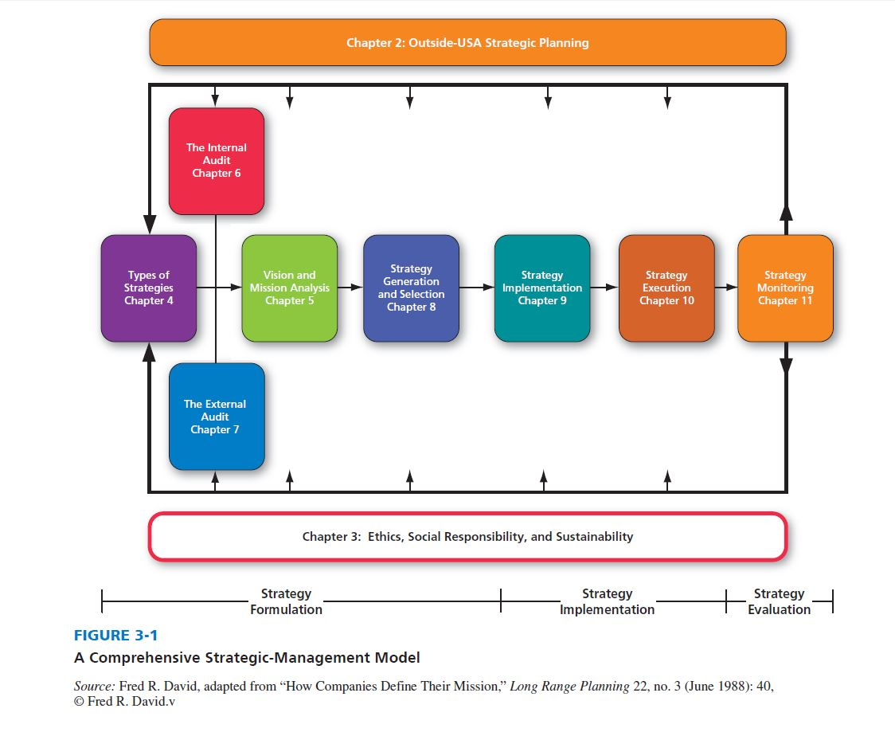
A Comprehensive Strategic-Management Model
Notes:
This chapter is highlighted in the strategic management model on this slide. Note that the material in this chapter informs all of the earlier steps in the model.

Slide 5
Business Ethics
Business Ethics
principles of conduct within organizations that guide decision making and behavior
Notes:
Good business ethics is a prerequisite for good strategic management; good ethics is just good business!

Slide 6
Social Responsibility, Environmental Sustainability
Social Responsibility
actions an organization takes beyond what is legally required to protect or enhance the well-being of living things
Sustainability
the extent that an organization’s operations and actions protect, mend, and preserve rather than harm or destroy the natural environment
Notes:
Business ethics, social responsibility, and environmental sustainability issues are interrelated and impact all areas of the strategic management process.

Slide 7
Seven Principles of Admirable Business Ethics
Be trustworthy
Be open-minded
Honor commitments and obligations
Do not misrepresent, exaggerate, or mislead
Be a visibly responsible community citizen
Utilize your accounting practice to eliminate questionable activities
Do unto others as you would have them do unto you
Notes:
All strategy formulation, implementation, and evaluation decisions have ethical ramifications. It does pay to be ethical; high-performing companies generally exhibit high business ethics.

Slide 8
Establish an Ethics Culture
Code of Business Ethics
To ensure that the code of ethics is read, understood, believed, and remembered, periodic ethics workshops are needed to sensitize people to workplace circumstances in which ethics issues may arise.
Notes:
A key ingredient for establishing an ethics culture is to develop a clear code of business ethics. Merely having a code of ethics, however, is not sufficient to ensure ethical business behavior.

Slide 9
An Ethics Culture
Whistle-blowing
refers to employees reporting any unethical violations they discover or see in the firm
Notes:
Employees should practice whistle-blowing, and organizations should have policies that encourage whistle-blowing.

Slide 10
An Ethics Culture
Ethics training programs should include messages from the CEO or owner of the business emphasizing ethical business practices, the development and discussion of codes of ethics, and procedures for discussing and reporting unethical behavior.
Notes:
Firms can align ethical and strategic decision making by incorporating ethical considerations into strategic planning, by integrating ethical decision making into the performance appraisal process, by encouraging whistle-blowing, and by monitoring departmental and corporate performance regarding ethical issues.

Slide 11
Avoid Bribery
Bribery
the offering, giving, receiving, or soliciting of any item of value to influence the actions of an official or other person in discharge of a public or legal duty
a crime in most countries of the world, including the United States
Notes:
The gift may be any money, goods, actions, property, preferment, privilege, emolument, object of value, advantage, or merely a promise or undertaking to induce or influence the action, vote, or influence of a person in an official or public capacity.

Slide 12
Workplace Romance
Workplace romance can be detrimental to morale and productivity
favoritism complaints can arise
confidentiality of records can be breached
reduced quality and quantity of work could result
personal arguments can lead to work arguments
whispering secrets can lead to tensions
sexual harassment charges may ensue
conflicts of interest could arise
Notes:
Workplace romance is an intimate relationship between two consenting employees, as opposed to sexual harassment, which the Equal Employment Opportunity Commission (EEOC) defines broadly as unwelcome sexual advances, requests for sexual favors, and other verbal or physical conduct of a sexual nature.

Slide 13
Social Responsibility and Policy
Ralph Nader proclaims that organizations have tremendous social obligations.
Milton Friedman asserts that organizations have no obligation to do any more for society than is legally required.
Notes:
Some strategists agree with Ralph Nader, who proclaims that organizations have tremendous social obligations. Friedman may contend that it is irresponsible for a firm to give monies to charity.

Slide 14
Social Policy
Social Policy
concerns what responsibilities the firm has to employees, consumers, environmentalists, minorities, communities, shareholders, and other groups
Firms should strive to engage in social activities that have economic benefits
Notes:
The term social policy embraces managerial philosophy and thinking at the highest level of the firm, which is why the topic is covered in this text.

Slide 15
Environmental Sustainability
Employees, consumers, governments, and society are especially resentful of firms that harm rather than protect the natural environment.
Conversely, people today are especially appreciative of firms that conduct operations in a way that mends, conserves, and preserves the natural environment.
Notes:
The ecological challenge facing all organizations requires managers to formulate strategies that preserve and conserve natural resources and control pollution.

Slide 16
Sustainability Reports
Sustainability report:
reveals how a firm’s operations impact the natural environment
discloses to shareholders information about the firm’s labor practices, product sourcing, energy efficiency, environmental impact, and business ethics practices
Notes:
A bad sustainability record will hurt the firm in the market, jeopardize its standing in the community, and invite scrutiny by regulators, investors, and environmentalists.

Slide 17
ISO 14000/14001 Certification
The ISO 14000 family of standards concerns the extent to which a firm minimizes harmful effects on the environment caused by its activities and continually monitors and improves its own environmental performance.
Notes:
Based in Geneva, Switzerland, the International Organization for Standardization (ISO) is a network of the national standards institutes of 147 countries, with one member per country. The ISO is the world’s largest developer of sustainability standards.

Slide 18
ISO 14000/14001 Certification
ISO 14001 is a set of standards adopted by thousands of firms worldwide to certify to their constituencies that they are conducting business in an environmentally friendly manner
Results in an Environmental Management System (EMS)
Notes:
The ISO 14001 standard offers a universal technical standard for environmental compliance that more and more firms are requiring not only of themselves but also of their suppliers and distributors.

Slide 19
6 Major Requirements of an EMS
Show commitments to prevention of pollution, continual improvement in overall environmental performance, and compliance with all applicable statutory and regulatory requirements.
Identify all aspects of the organization’s activities, products, and services that could have a significant impact on the environment, including those that are not regulated.
Notes:
There are six major requirements of an EMS under ISO 14001 detailed on the next three slides.

Slide 20
6 Major Requirements of an EMS
Set performance objectives and targets for the management system that link back to three policies: (1) prevention of pollution, (2) continual improvement, and (3) compliance.
Meet environmental objectives that include training employees, establishing work instructions and practices, and establishing the actual metrics by which the objectives and targets will be measured.

Slide 21
6 Major Requirements of an EMS
Conduct an audit operation of the EMS.
Take corrective actions when deviations from the EMS occur.

Slide 22
Wildlife Welfare
Consumers globally are becoming increasingly intolerant of any business or nation that directly or indirectly destroys wildlife, especially endangered wildlife, such as tigers, elephants, whales, songbirds, and coral reefs.
Notes:
Affected businesses range from retailers that sell ivory chess pieces to restaurants that sell whale meat.

Slide 23
Food Suppliers and Animal Welfare
Consumers expect humane treatment of animals.
Consumers are flocking to organic products.
Notes:
Many consumers expect that animals will be treated humanely and that organic options be available.

