Slide 1


Strategic Planning
Strategic Planning

Slide 2
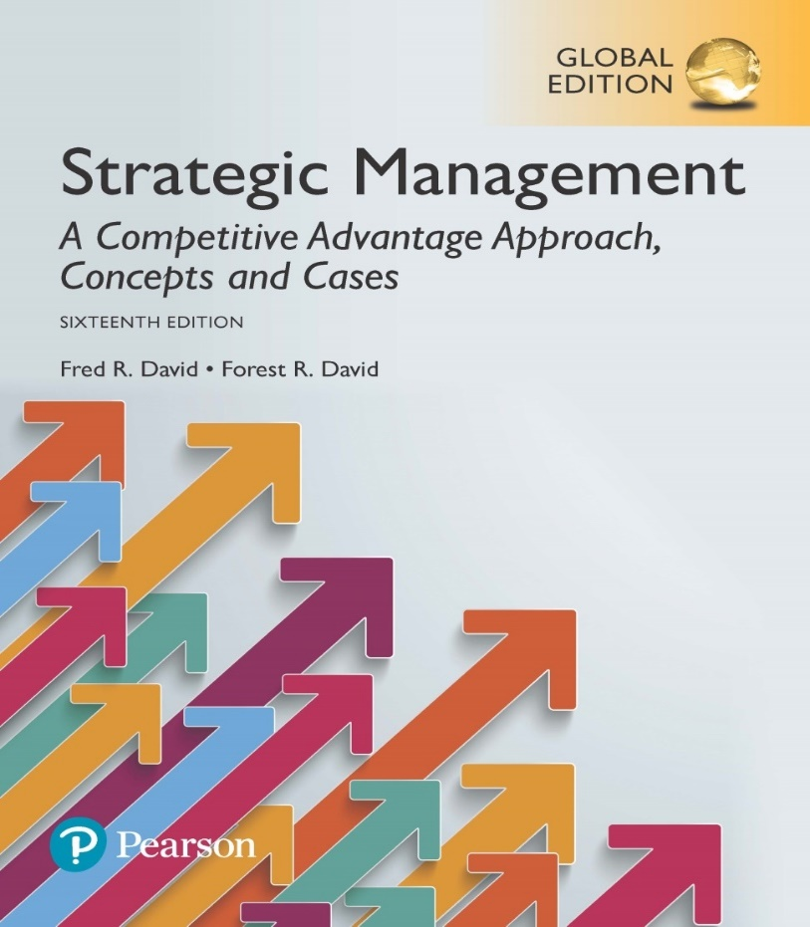
Strategic Management Essentials
Chapter 1

Slide 3
Learning Objectives
Describe the strategic-management process.
Discuss the three stages of strategy formulation, implementation, and evaluation activities.
Explain the need for integrating analysis and intuition in strategic management.
Define and give examples of key terms in strategic management.
Notes:
After studying this chapter, you should be able to:
Describe the strategic-management process.
Discuss the three stages of strategy formulation, implementation, and evaluation activities.
Explain the need for integrating analysis and intuition in strategic management.
Define and give examples of key terms in strategic management.

Slide 4
Learning Objectives (cont.)
Illustrate the comprehensive strategic-management model.
Describe the benefits of engaging in strategic management.
Explain why some firms do no strategic planning.
Describe the pitfalls in actually doing strategic planning.
Discuss the connection between business and military strategy.
Notes:
Illustrate the comprehensive strategic-management model.
Describe the benefits of engaging in strategic management.
Explain why some firms do no strategic planning.
Describe the pitfalls in actually doing strategic planning.
Discuss the connection between business and military strategy.

Slide 5
Defining Strategic Management
Strategic Management
  the art and science of formulating, implementing, and evaluating cross-functional decisions that enable an organization to achieve its objectives
Notes:
Strategic management is defined as the art and science of formulating, implementing, and evaluating cross-functional decisions that enable an organization to achieve its objectives. It focuses on integrating management, marketing, finance and accounting, production and operations, research and development (R&D), and information systems to achieve organizational success.

Slide 6
Defining Strategic Management
Strategic management is used synonymously with the term strategic planning in this course.
Sometimes the term strategic management is used to refer to strategy formulation, implementation, and evaluation, with strategic planning referring only to strategy formulation.
Notes:
Strategic management in this text is used synonymously with the term strategic planning. Sometimes the term strategic management is used to refer to strategy formulation, implementation, and evaluation, with strategic planning referring only to strategy formulation.
The purpose of strategic management is to exploit and create new and different opportunities for tomorrow.

Slide 7
Defining Strategic Management
A strategic plan is a company’s game plan.
A strategic plan results from tough managerial choices among numerous good alternatives, and it signals commitment to specific markets, policies, procedures, and operations.
Notes:
A strategic plan is, in essence, a company’s game plan. Just as a football team needs a good game plan to have a chance for success, a company must have a good strategic plan to compete successfully. A strategic plan results from tough managerial choices among numerous good alternatives, and it signals commitment to specific markets, policies, procedures, and operations in lieu of other, “less desirable” courses of action.

Slide 8
Stages of Strategic Management
Strategy formulation
Strategy implementation
Strategy evaluation
Notes:
The strategic-management process consists of three stages: strategy formulation, strategy implementation, and strategy evaluation.

Slide 9
Stages of Strategic Management
Strategy Formulation
  developing a vision and mission
  identifying an organization’s external opportunities and threats
  determining internal strengths and weaknesses
  establishing long-term objectives
  generating alternative strategies
  choosing particular strategies to pursue
Notes:
Strategy formulation includes developing a vision and mission, identifying an organization’s external opportunities and threats, determining internal strengths and weaknesses, establishing long-term objectives, generating alternative strategies, and choosing particular strategies to pursue.
Strategy-formulation decisions commit an organization to specific products, markets, resources, and technologies over an extended period of time.

Slide 10
Strategy Formulation Decisions
What new businesses to enter
What businesses to abandon
Whether to expand operations or diversify
Whether to enter international markets
Whether to merge or form a joint venture
How to avoid a hostile takeover
Notes:
Strategy formulation involves many types of decisions including:
What new businesses to enter
What businesses to abandon
Whether to expand operations or diversify
Whether to enter international markets
Whether to merge or form a joint venture
How to avoid a hostile takeover.

Slide 11
Stages of Strategic Management
Strategy Implementation
  requires a firm to establish annual objectives, devise policies, motivate employees, and allocate resources so that formulated strategies can be executed
  often called the action stage
Notes:
Strategy implementation requires a firm to establish annual objectives, devise policies, motivate employees, and allocate resources so that formulated strategies can be executed and is often called the action stage. Strategy implementation includes developing a strategy-supportive culture, creating an effective organizational structure, redirecting marketing efforts, preparing budgets, developing and using information systems, and linking employee compensation to organizational performance.

Slide 12
Stages of Strategic Management
Strategy Evaluation
  Determining which strategies are not working well
  Three fundamental activities:
    reviewing external and internal factors that are the bases for current strategies
    measuring performance
    taking corrective actions
Notes:
Strategy evaluation is the final stage in strategic management. Managers desperately need to know when particular strategies are not working well; strategy evaluation is the primary means for obtaining this information. All strategies are subject to future modification because external and internal factors constantly change.

Slide 13
Key Terms in Strategic Management
Competitive Advantage
  any activity a firm does especially well compared to activities done by rival firms,
  or
  any resource a firm possesses that rival firms desire.
A firm must strive to achieve sustained competitive advantage
Notes:
Strategic management is all about gaining and maintaining competitive advantage. This term can be defined as any activity a firm does especially well compared to activities done by rival firms, or any resource a firm possesses that rival firms desire.
A firm must strive to achieve sustained competitive advantage by (1) continually adapting to changes in external trends and events and internal capabilities, competencies, and resources; and (2) effectively formulating, implementing, and evaluating strategies that capitalize on those factors.

Slide 14
Key Terms in Strategic Management
Strategists
  Individuals most responsible for the success or failure of an organization
  Help an organization gather, analyze, and organize information
Vision and Mission Statements
  A vision statement answers the question “What do we want to become?”
  A mission statement answers the question “What is our business?”
Notes:
Strategists are the individuals most responsible for the success or failure of an organization. They have various job titles, such as chief executive officer, president, owner, chair of the board, executive director, chancellor, dean, and entrepreneur.
Many organizations today develop a vision statement that answers the question “What do we want to become?” Developing a vision statement is often considered the first step in strategic planning, preceding even development of a mission statement. Mission statements are “enduring statements of purpose that distinguish one business from other similar firms. A mission statement identifies the scope of a firm’s operations in product and market terms.”

Slide 15
Key Terms in Strategic Management
External Opportunities and Threats
  economic, social, cultural, demographic, environmental, political, legal, governmental, technological, and competitive trends and events that could significantly benefit or harm an organization
Internal Strengths and Internal Weaknesses
  an organization’s controllable activities that are performed especially well or poorly
  determined relative to competitors
Notes:
External opportunities and threats are largely beyond the control of a single organization—thus the word external.
Internal strengths and weaknesses are an organization’s controllable activities that are performed especially well or poorly and are determined relative to competitors.

Slide 16
Some Opportunities and Threats
Availability of capital can no longer be taken for granted.
Consumers expect green operations and products.
Marketing is moving rapidly to the Internet.
Commodity food prices are increasing.
An oversupply of oil is driving oil and gas prices down.
Notes:
Table 1-2 in the textbook lists several categories of external opportunities and threats.

Slide 17
Key Terms in Strategic Management
Long-Term Objectives
  specific results that an organization seeks to achieve in pursuing its basic mission
  long-term means more than one year
  should be challenging, measurable, consistent, reasonable, and clear
Notes:
Objectives are essential for organizational success because they provide direction; aid in evaluation; create synergy; reveal priorities; focus coordination; and provide a basis for effective planning, organizing, motivating, and controlling activities.

Slide 18
Key Terms in Strategic Management
Strategies
  the means by which long-term objectives will be achieved
  may include geographic expansion, diversification, acquisition, product development, market penetration, retrenchment, divestiture, liquidation, and joint ventures
Notes:
Strategies are the means by which long-term objectives will be achieved. They may include geographic expansion, diversification, acquisition, product development, market penetration, retrenchment, divestiture, liquidation, and joint ventures.
Strategies are potential actions that require top-management decisions and large amounts of the firm’s resources.

Slide 19
Key Terms in Strategic Management
Annual objectives
  short-term milestones that organizations must achieve to reach long-term objectives
  should be measurable, quantitative, challenging, realistic, consistent, and prioritized
  should be established at the corporate, divisional, and functional levels in a large organization
Policies
  the means by which annual objectives will be achieved
Notes:
Annual objectives are short-term milestones that organizations must achieve to reach long-term objectives. They should be measurable, quantitative, challenging, realistic, consistent, and prioritized. They should be established at the corporate, divisional, and functional levels in a large organization. A set of annual objectives is needed for each long-term objective. These objectives are especially important in strategy implementation, whereas long-term objectives are particularly important in strategy formulation.
Policies include guidelines, rules, and procedures established to support efforts to achieve stated objectives.

Slide 20
The Strategic-Management Model
Where are we now?
Where do we want to go?
How are we going to get there?
Notes:
There are three important questions to answer in developing a strategic plan:
Where are we now?
Where do we want to go?
How are we going to get there?

Slide 21
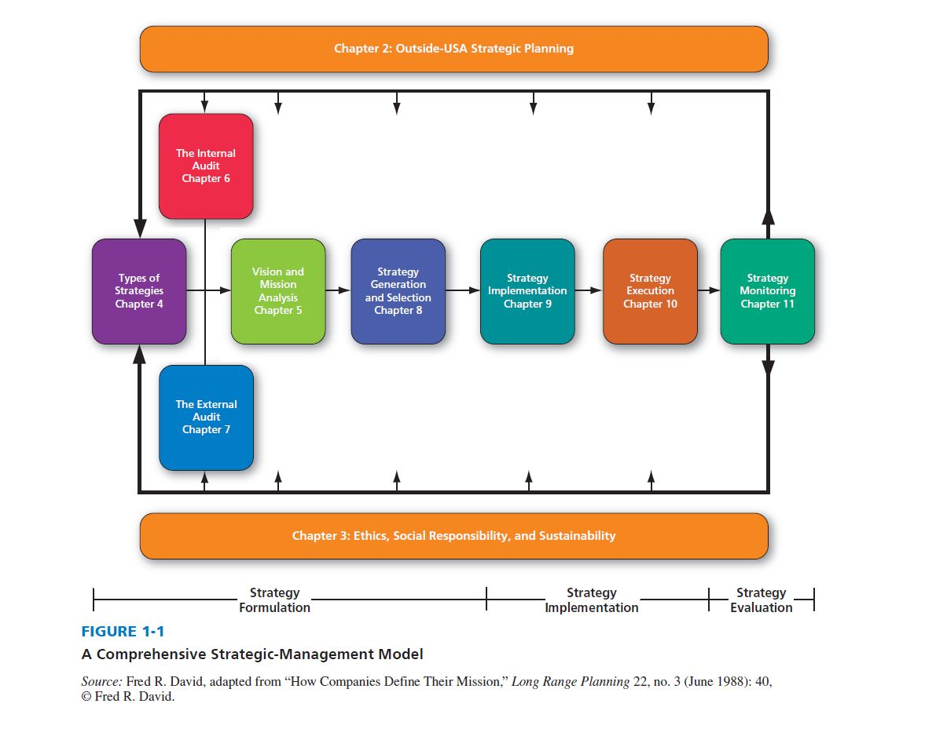
Comprehensive Strategic-Management Model
Notes:
The framework illustrated in Figure 1-1 is a widely accepted, comprehensive model of the strategic-management process. This model does not guarantee success, but it does represent a clear and practical approach for formulating, implementing, and evaluating strategies.
Relationships among major components of the strategic-management process are shown in the model, which appears in all subsequent chapters with appropriate areas shaped to show the particular focus of each chapter.

Slide 22
Benefits of Strategic Management
Strategic management allows an organization to be more proactive than reactive in shaping its own future;
It allows an organization to initiate and influence (rather than just respond to) activities—and thus to exert control over its own destiny.
Notes:
Historically, the principal benefit of strategic management has been to help organizations formulate better strategies through the use of a more systematic, logical, and rational approach for decision making.

Slide 23
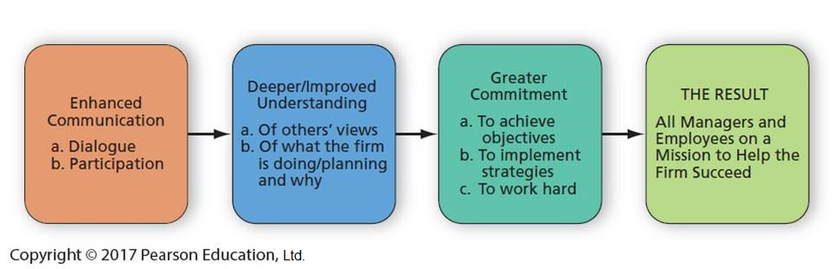
Benefits to a Firm That Does Strategic Planning
Notes:
Figure 1-2 illustrates the intrinsic benefit of a firm engaging in strategic planning. Communication is a key to successful strategic management. Communication may be the most important word in management.

Slide 24
Financial Benefits
Businesses using strategic-management concepts show significant improvement in sales, profitability, and productivity compared to firms without systematic planning activities
High-performing firms tend to do systematic planning to prepare for future fluctuations in their external and internal environments
Notes:
Businesses using strategic-management concepts show significant improvement in sales, profitability, and productivity compared to firms without systematic planning activities.
High-performing firms tend to do systematic planning to prepare for future fluctuations in their external and internal environments. High-performing firms seem to make more informed decisions with good anticipation of both short- and long-term consequences.

Slide 25
Nonfinancial Benefits
Enhanced awareness of external threats
Improved understanding of competitors’ strategies
Increased employee productivity
Reduced resistance to change
Clearer understanding of performance–reward relationships
Notes:
Besides helping firms avoid financial demise, strategic management offers other tangible benefits, such as enhanced awareness of external threats, improved understanding of competitors’ strategies, increased employee productivity, reduced resistance to change, and a clearer understanding of performance–reward relationships. Strategic management enhances the problem-prevention capabilities of organizations because it promotes interaction among managers.

Slide 26
Why Some Firms Do No Strategic Planning
No formal training in strategic management
No understanding of or appreciation for the benefits of planning
No monetary rewards for doing planning
No punishment for not planning
Too busy “firefighting” (resolving internal crises) to plan ahead
View planning as a waste of time, since no product/service is made
Notes:
Ten reasons (excuses) often given for poor or no strategic planning in a firm are as follows:
1. No formal training in strategic management
2. No understanding of or appreciation for the benefits of planning
3. No monetary rewards for doing planning
4. No punishment for not planning
5. Too busy “firefighting” (resolving internal crises) to plan ahead
6. View planning as a waste of time, since no product/service is made

Slide 27
Why Some Firms Do No Strategic Planning
Laziness; effective planning takes time and effort; time is money
Content with current success; failure to realize that success today is no guarantee for success tomorrow; even Apple Inc. is an example
Overconfident
Prior bad experience with strategic planning done sometime/somewhere
Notes:
Additional reasons include:
7. Laziness; effective planning takes time and effort; time is money
8. Content with current success; failure to realize that success today is no guarantee for success tomorrow; even Apple Inc. is an example
9. Overconfident
10. Prior bad experience with strategic planning done sometime/somewhere

Slide 28
Pitfalls in Strategic Planning
Using strategic planning to gain control over decisions and resources
Doing strategic planning only to satisfy accreditation or regulatory requirements
Too hastily moving from mission development to strategy formulation
Failing to communicate the plan to employees, who continue working in the dark
Top managers making many intuitive decisions that conflict with the formal plan
Top managers not actively supporting the strategic-planning process
Failing to use plans as a standard for measuring performance
Notes:
Being aware of potential pitfalls and being prepared to address them is essential to success.
Here are some pitfalls to watch for and avoid in strategic planning:
• Using strategic planning to gain control over decisions and resources
• Doing strategic planning only to satisfy accreditation or regulatory requirements
• Too hastily moving from mission development to strategy formulation
• Failing to communicate the plan to employees, who continue working in the dark
• Top managers making many intuitive decisions that conflict with the formal plan
• Top managers not actively supporting the strategic-planning process
• Failing to use plans as a standard for measuring performance

Slide 29
Pitfalls in Strategic Planning
Delegating planning to a “planner” rather than involving all managers
Failing to involve key employees in all phases of planning
Failing to create a collaborative climate supportive of change
Viewing planning as unnecessary or unimportant
Becoming so engrossed in current problems that insufficient or no planning is done
Being so formal in planning that flexibility and creativity are stifled
Notes:
Additional pitfalls include:
• Delegating planning to a “planner” rather than involving all managers
• Failing to involve key employees in all phases of planning
• Failing to create a collaborative climate supportive of change
• Viewing planning as unnecessary or unimportant
• Becoming so engrossed in current problems that insufficient or no planning is done
• Being so formal in planning that flexibility and creativity are stifled

Slide 30
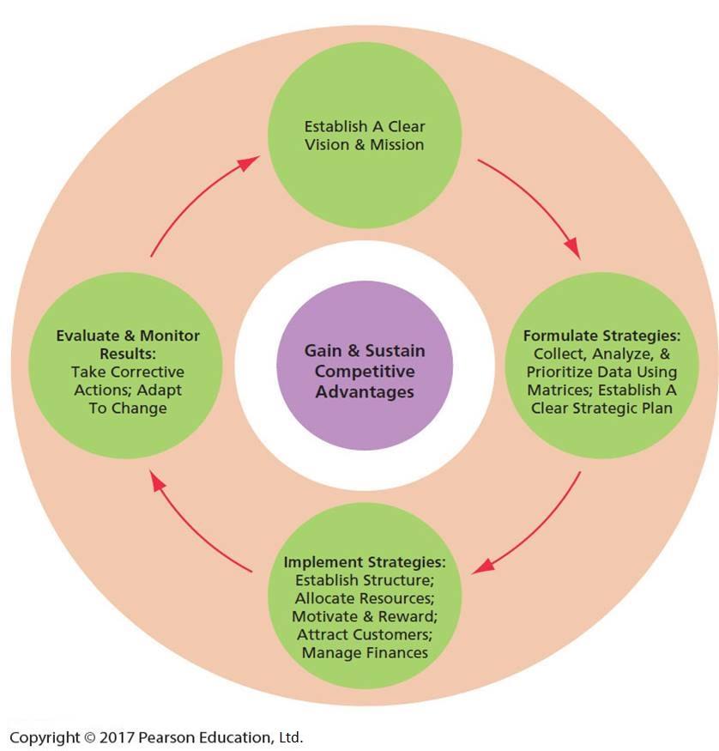
How to Gain and Sustain Competitive Advantage
Notes:
Figure 1-3 reveals that to gain and sustain competitive advantages, a firm must create and nurture a clear vision and mission, and then systematically formulate, implement, and evaluate strategies.

Slide 31
Comparing Business and
Military Strategy
A fundamental difference between military and business strategy is that business strategy is formulated, implemented, and evaluated with an assumption of competition, whereas military strategy is based on an assumption of conflict
Both business and military organizations must adapt to change and constantly improve to be successful
Notes:
A strong military heritage underlies the study of strategic management. Terms such as objectives, mission, strengths, and weaknesses were first formulated to address problems on the battlefield. A fundamental difference between military and business strategy is that business strategy is formulated, implemented, and evaluated with an assumption of competition, whereas military strategy is based on an assumption of conflict.
Both business and military organizations must adapt to change and constantly improve to be successful.

Slide 32
Excerpts from Sun Tzu’s The Art of War Writings
War is a matter of vital importance to the state: a matter of life or death, the road either to survival or ruin. Hence, it is imperative that it be studied thoroughly
Know your enemy and know yourself, and in a hundred battles you will never be defeated
Skillful leaders do not let a strategy inhibit creative counter-movement
Notes:
Sun Tzu’s The Art of War has been applied to many fields well outside of the military. Much of the text is about how to fight wars without actually having to do battle: It gives tips on how to outsmart one’s opponent so that physical battle is not necessary. Table 1-4 provides several excerpts.

Slide 33
