Slide 2
Principles of Managerial Finance
Chapter 10
Capital Budgeting Techniques
Notes:
If this PowerPoint presentation contains mathematical equations, you may need to check that your computer has the following installed:
1) MathType Plugin
2) Math Player (free versions available)
3) NVDA Reader (free versions available)

Slide 3
Learning Goals (1 of 2)
LG 1 Understand the key elements of the capital budgeting process.
LG 2 Calculate, interpret, and evaluate the payback period.
LG 3 Calculate, interpret, and evaluate the net present value (NPV) and economic value added (EVA).

Slide 4
Learning Goals (2 of 2)
LG 4 Calculate, interpret, and evaluate the internal rate of return (IRR).
LG 5 Use net present value profiles to compare NPV and IRR techniques.
LG 6 Discuss NPV and IRR in terms of conflicting rankings and the strengths of each approach.

Slide 5
10.1 Overview of Capital Budgeting (1 of 9)
Capital Budgeting
The process of evaluating and selecting long-term investments that contribute to the firm’s goal of maximizing owners’ wealth
Motives for Capital Expenditure
Capital Expenditure
An outlay of funds by the firm that the firm expects to produce benefits over a period of time greater than 1 year
Operating Expenditure
An outlay of funds by the firm resulting in benefits received within 1 year

Slide 6
10.1 Overview of Capital Budgeting (2 of 9)
Capital Budgeting Process
Consists of five distinct but interrelated steps: proposal generation, review and analysis, decision making, implementation, and follow-up
Steps in the Process
1. Proposal Generation
Managers at all levels in a business make proposals for new investment projects that are reviewed by finance personnel
Proposals that require large outlays receive greater scrutiny than less costly ones
2. Review and Analysis
Financial managers perform formal review and analysis to assess the merits of investment proposals

Slide 7
10.1 Overview of Capital Budgeting (3 of 9)
Steps in the Process
3. Decision Making
Firms typically delegate capital expenditure decisions on the basis of dollar limits
Generally, the board of directors or a team of very senior executives must authorize expenditures beyond a certain amount
Often, plant managers have authority to make decisions necessary to keep the production line moving

Slide 8
10.1 Overview of Capital Budgeting (4 of 9)
Steps in the Process
4. Implementation
Following approval, firms make expenditures and implement projects; expenditures for a large project often occur in phases
5. Follow-up
Managers monitor results and compare actual costs and benefits to the projections that they originally used to justify making the investment
Managers may take actions to expand, contract, or shut down investments when actual outcomes differ from projected ones

Slide 9
10.1 Overview of Capital Budgeting (5 of 9)
Basic Terminology
Independent versus Mutually Exclusive Projects
Independent Projects
Projects whose cash flows are unrelated to (or independent of) one another; accepting or rejecting one project does not change the desirability of other projects
Mutually Exclusive Projects
Projects that compete with one another so that the acceptance of one eliminates from further consideration all other projects that serve a similar function

Slide 10
10.1 Overview of Capital Budgeting (6 of 9)
Basic Terminology
Unlimited Funds versus Capital Rationing
Unlimited Funds
The financial situation in which a firm is able to accept all independent projects that provide an acceptable return
Capital Rationing
The financial situation in which a firm has only a fixed number of dollars available for capital expenditures and numerous projects compete for these dollars

Slide 11
10.1 Overview of Capital Budgeting (7 of 9)
Basic Terminology
Accept–Reject versus Ranking Approaches
Accept–Reject Approach
The evaluation of capital expenditure proposals to determine whether they meet the firm’s minimum acceptance criterion
Ranking Approach
The ranking of capital expenditure projects on the basis of some predetermined measure, such as how much value the project creates for shareholders

Slide 12
10.1 Overview of Capital Budgeting (8 of 9)
Capital Budgeting Techniques
To ensure that the investment projects a firm selects have the best chance of increasing the value of the firm, financial managers need tools to help them evaluate the merits of individual projects and to rank competing investments
A number of techniques are available for performing such analyses
The best techniques take into account the time value of money as well as the tradeoff between risk and return
Project evaluation methods that fail to account for money’s time value or for risk may not lead to shareholder value maximization

Slide 13
10.1 Overview of Capital Budgeting (9 of 9)
Capital Budgeting Techniques
Bennett Company’s Relevant Cash Flows
We will use one basic problem to illustrate all the techniques described in this chapter
The problem concerns Bennett Company, a medium-sized metal fabricator that is currently contemplating two projects with conventional cash flow patterns
Project A requires an initial investment of $420,000, and project B requires an initial investment of $450,000
The projected cash flows for the two projects appear in Table 10.1 and on the timelines in Figure 10.1

Slide 14
Table 10.1 Capital Expenditure Data for Bennett Company
Blank | Project A | Project B
Initial investment | −$420,000 | −$450,000
Year | Operating cash inflows
1 | $140,000 | $280,000
2 | 140,000 | 120,000
3 | 140,000 | 100,000
4 | 140,000 | 100,000
5 | 140,000 | 100,000

Slide 15
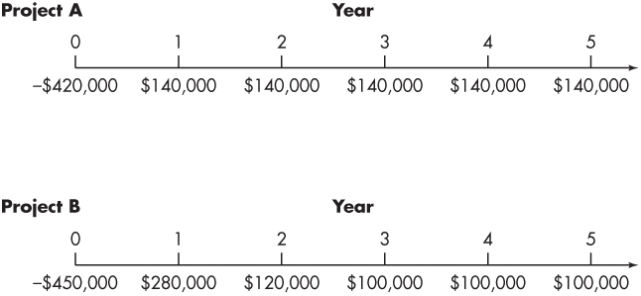
Figure 10.1 Bennett Company’s Projects A and B

Slide 16
10.2 Payback Period (1 of 3)
Payback Period
The time it takes an investment to generate cash inflows sufficient to recoup the initial outlay required to make the investment
Decision Criteria
If the payback period is less than the maximum acceptable payback period, accept the project
If the payback period is greater than the maximum acceptable payback period, reject the project

Slide 17
Example 10.1 (1 of 2)
We can calculate the payback period for Bennett Company’s projects A and B, using the data in Table 10.1. For project A, which is an annuity, the payback period is 3.0 years ($420,000 initial investment ÷ $140,000 annual cash inflow). Because project B generates a mixed stream of cash inflows, the calculation of its payback period is not as clear-cut. In year 1, the firm will recover $280,000 of its $450,000 initial investment. By the end of year 2, $400,000 ($280,000 from year 1 + $120,000 from year 2) will have been recovered. At the end of year 3, $500,000 will have been recovered. Only 50% of the year-3 cash inflow of $100,000 is needed to complete the payback of the initial $450,000. The payback period for project B is therefore 2.5 years (2 years + 50% of year 3).

Slide 18
Example 10.1 (2 of 2)
If Bennett’s maximum acceptable payback period were 2.75 years, project A would be rejected and project B would be accepted. If the maximum acceptable payback period were 2.25 years, both projects would be rejected. If the projects were being ranked, B would be preferred over A because it has a shorter payback period. Note, however, that no matter what payback period Bennett requires, it is unclear from payback analysis which investment will do the most to increase shareholder wealth. All we can say is that project B recoups the initial investment more rapidly than does project A.

Slide 19
Matter of Fact
Payback in India
A 2017 survey of firms in India found that two-thirds of those firms always or almost always conducted payback analysis when they made major investment decisions. Similar to results found in U.S. firms, small companies in India were more likely than large firms to use the payback approach. For all its flaws, the payback approach still sees widespread use around the world.

Slide 20
10.2 Payback Period (2 of 3)
Pros and Cons of Payback Analysis
Large firms sometimes use the payback approach to evaluate small projects (or as one of several metrics used to judge a larger project’s merits), and small firms use it to evaluate most projects
The payback method’s popularity results from its simplicity and intuitive appeal
By measuring how quickly the firm recovers its initial investment, the payback period also gives at least some consideration to the timing of cash flows

Slide 21
10.2 Payback Period (3 of 3)
Pros and Cons of Payback Analysis
Likewise, the payback approach offers a crude way to adjust for project risk if managers require a faster payback on riskier endeavors
The major weakness of the payback period is that the appropriate payback period is merely a subjectively determined number
No firm connection exists between the payback period and the goal of shareholder wealth maximization

Slide 22
Personal Finance Example 10.2 (1 of 2)
Gabriela Perez is considering investing $20,000 to obtain a 5% interest in a rental property. Her good friend and real estate agent, Josh Williams, put the deal together, and he estimates that Gabriela should receive between $4,000 and $6,000 per year in cash from her 5% interest in the property. Gabriela expects to remain in the 25% income-tax bracket for quite a while, and she will not make an investment unless the after-tax cash flows pay back the initial cost in fewer than 7 years.
Gabriela’s calculation of the payback period on this deal begins with computing the range of annual after-tax cash flow:
After-tax cash flow = (1 − tax rate) × Pre-tax cash flow
= (1 − 0.25) × $4,000 = $3,000
= (1 − 0.25) × $6,000 = $4,500

Slide 23
Personal Finance Example 10.2 (2 of 2)
The after-tax cash flow ranges from $3,000 to $4,500. Dividing the $20,000 initial investment by each of the estimated after-tax cash flows, we get the payback period:
Because Gabriela’s proposed rental property investment will pay itself back in either scenario in fewer than 7 years, the investment is acceptable.

Slide 24
Example 10.3
DeYarman Enterprises, a small medical appliance manufacturer, is considering two mutually exclusive projects named Gold and Silver (i.e., DeYarman can invest in only one project, not both). The firm uses the payback period to choose projects, and it requires any investment to recover its initial cost within 4 years. The cash flows and payback period for each project appear in Table 10.2. Both projects have 3-year payback periods, which would suggest that they are equally desirable. But comparing the cash flow patterns of each investment immediately reveals that Silver produces more cash flow sooner than Gold. In year 1, Silver generates $40,000 in cash inflow compared to just $5,000 for Gold. We know that because money has a time value, it is preferable to receive cash flow sooner rather than later. The payback approach fails to recognize that benefit. Any capital budgeting tool that properly accounts for the time value of money would suggest that project Silver is better for shareholders than project Gold.

Slide 25
Table 10.2 Relevant Cash Flows and Payback Periods for DeYarman Enterprises’ Projects
Blank | Project Gold | Project Silver
Initial investment | −$50,000 | −$50,000
Year | Operating cash inflows
1 | $ 5,000 | $40,000
2 | 5,000 | 2,000
3 | 40,000 | 8,000
4 | 10,000 | 10,000
5 | 10,000 | 10,000
Payback period | 3 years | 3 years

Slide 26
Example 10.4
Rashid Company, a software developer, has two investment opportunities, X and Y. Data for X and Y appear in Table 10.3. The payback period for project X is 2 years; for project Y, it is 3 years. Strict adherence to the payback approach suggests that project X is preferable to project Y. However, if we look beyond the payback period, we see that project X returns only an additional $1,200 ($1,000 in year 3 + $100 in year 4 + $100 in year 5), whereas project Y returns an additional $7,000 ($4,000 in year 4 + $3,000 in year 5). On the basis of this information, project Y appears preferable to X. The payback approach ignored the cash inflows occurring after the end of the payback period.

Slide 27
Table 10.3 Calculation of the Payback Period for Rashid Company’s Two Alternative Investment Projects
Blank | Project X | Project Y
Initial investment | −$10,000 | −$10,000
Year | Operating cash inflows
1 | $5,000 | $3,000
2 | 5,000 | 4,000
3 | 1,000 | 3,000
4 | 100 | 4,000
5 | 100 | 3,000
Payback period | 2 years | 3 years

Slide 28
10.3 Net Present Value (NPV) (1 of 8)
Net Present Value (NPV)
A capital budgeting technique that measures an investment’s value by calculating the present value of its cash inflows and outflows
NPV = Present Value of Cash Inflows – Initial Investment

Slide 29
10.3 Net Present Value (NPV) (2 of 8)
Net Present Value (NPV)
Not every investment opportunity has this kind of standard cash flow pattern
Sometimes firms receive money up front and have to pay out cash in later years
Other times a project requires several years of cash outflows before inflows begin
Therefore, a more general equation for an investment’s NPV is

Slide 30
10.3 Net Present Value (NPV) (3 of 8)
Decision Criteria
If the NPV is greater than $0, accept the project
If the NPV is less than $0, reject the project

Slide 31
Example 10.5 (1 of 4)
We can illustrate the NPV approach by using the Bennett Company data presented in Table 10.1. Figure 10.2 shows the calculation of the NPV for projects A and B, assuming that Bennett discounts project cash flows at 10%. These calculations result in net present values for projects A and B of $110,710 and $109,244, respectively. Both projects are acceptable because the net present value of each is greater than $0. If the projects were being ranked, however, project A would be considered superior to B because its net present value is higher than that of B.

Slide 32
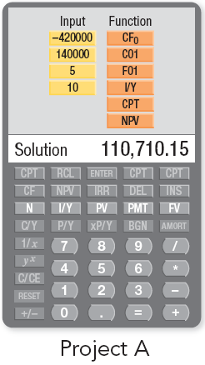
Example 10.5 (2 of 4)
Calculator use We can use the cash flow register CF and preprogrammed NPV function in a financial calculator to perform the NPV calculation. The keystrokes for project A begin with entering the investment amount as a cash outflow at time 0, CF₀ = −420,000, then entering the first annuity cash inflow, CF₁ = 140,000, and then indicating the frequency of the annuity’s cash inflow, F01 = 5. After entering the discount rate, I/Y = 10, compute the NPV.

Slide 33
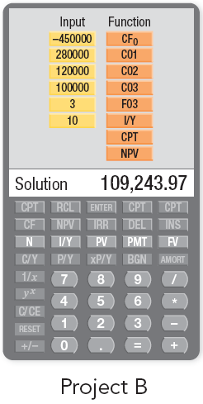
Example 10.5 (3 of 4)
The keystrokes for project B—the mixed stream—appear in the left margin. Because the last three cash inflows for project B are the same (CF₃ = CF₄ = CF₅ = 100,000), after inputting the first of these cash inflows, CF₃, we merely input its frequency, F03 = 3.
The calculated NPVs for projects A and B of $110,710 and $109,244, respectively, agree with the NPVs already cited.

Slide 34
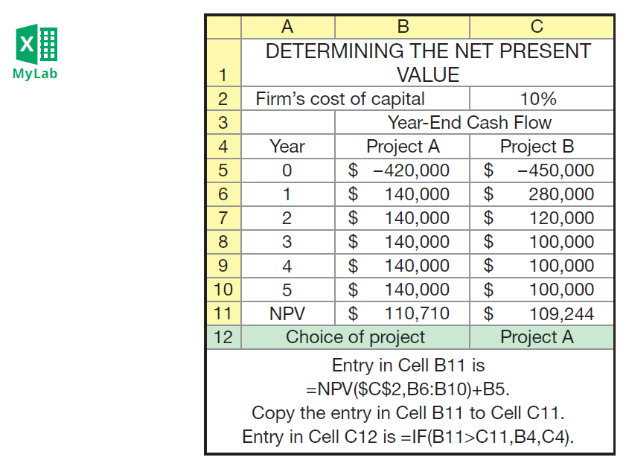
Example 10.5 (4 of 4)
Spreadsheet use The following Excel screenshot illustrates how to calculate the NPVs using a spreadsheet.

Slide 35
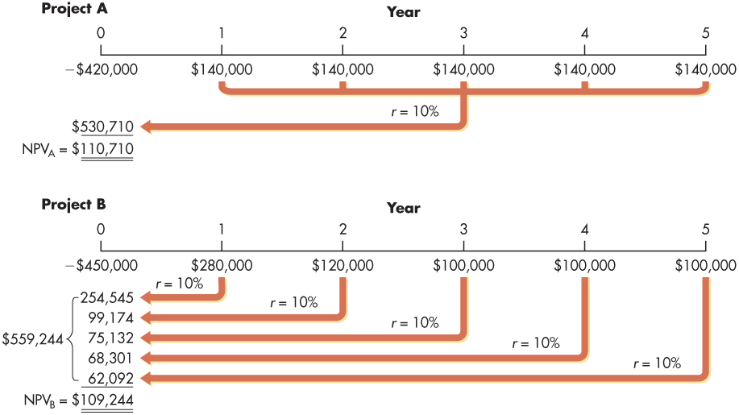
Figure 10.2 Calculation of NPVs for Bennett Company’s Capital Expenditure Alternatives

Slide 36
10.3 Net Present Value (NPV) (4 of 8)
NPV and the Profitability Index
For a project that has an initial cash outflow followed by cash inflows, the profitability index (PI) is simply equal to the present value of cash inflows divided by the absolute value of the initial cash outflow:

Slide 37
10.3 Net Present Value (NPV) (5 of 8)
NPV and the Profitability Index
A PI greater than 1.0 implies that the present value of cash inflows is greater than the (absolute value of the) initial cash outflow, so a profitability index greater than 1.0 corresponds to a net present value greater than 0
In other words, the NPV and PI methods will always come to the same conclusion regarding whether a particular investment is worth doing or not

Slide 38
Example 10.6
We can refer back to Figure 10.2, which shows the present value of cash inflows for projects A and B, to calculate the PI for each of Bennett’s investment options:
PI_{A} = $530,710 ÷ $420,000 = 1.26
PI_{B} = $559,244 ÷ $450,000 = 1.24
According to the profitability index, both projects are acceptable (because PI > 1.0 for both), which shouldn’t be surprising because we already know that both projects have positive NPVs. Furthermore, in this particular case, the NPV rule and the PI both indicate that project A is preferred over project B. It is not always true that the NPV and PI methods will rank projects in exactly the same order. Different rankings can occur when alternative projects require initial outlays that have very different magnitudes.

Slide 39
10.3 Net Present Value (NPV) (6 of 8)
NPV and Economic Value Added
Economic Value Added (EVA), a registered trademark of the consulting firm Stern Stewart & Co., is another close cousin of the NPV method
Whereas the NPV approach calculates the value of an investment over its entire life, the EVA approach gives managers a tool to measure an investment’s performance on a year-by-year basis
The EVA method begins the same way that NPV does: by calculating a project’s net cash flows

Slide 40
10.3 Net Present Value (NPV) (7 of 8)
NPV and Economic Value Added
However, the EVA approach subtracts from those cash flows a charge that is designed to capture the return that the firm’s investors demand on the project
That is, the EVA calculation asks whether a project generates positive cash flows above and beyond what investors demand
If so, the project is worth undertaking

Slide 41
10.3 Net Present Value (NPV) (8 of 8)
NPV and Economic Value Added
The EVA method determines whether a project earns a pure economic profit
Pure Economic Profit
A profit above and beyond the normal competitive rate of return in a line of business

Slide 42
Example 10.7 (1 of 3)
Suppose that a certain project costs $1,000,000 up front, but after that it will generate net cash inflows each year (in perpetuity) of $120,000. To calculate the NPV of this project, we would simply discount the cash flows and add them up. If the firm’s cost of capital is 10%, the project’s NPV is
NPV = −$1,000,000 + ($120,000 ÷ 0.10) = $200,000

Slide 43
Example 10.7 (2 of 3)
To calculate the investment’s economic value added in any particular year, we start with the annual $120,000 cash flow. Next, we assign a charge that accounts for the return that investors demand on the capital invested by the firm in the project. In this case, the firm invested $1,000,000, and investors expect a 10% return. This means that the project’s annual capital charge is $100,000 ($1,000,000 × 10%), and its EVA is $20,000 per year:

Slide 44
Example 10.7 (3 of 3)
In other words, this project earns more than its cost of capital each year, so the project is clearly worth doing. To calculate the EVA for the project over its entire life, we would simply discount the annual EVA figures using the firm’s cost of capital. In this case, the project produces an annual EVA of $20,000 in perpetuity. Discounting at 10% gives a project EVA of $200,000 ($20,000 ÷ 0.10), identical to the NPV. In this example, both the NPV and EVA methods reach the same conclusion, namely, that the project creates $200,000 in value for shareholders. If the cash flows in our example had fluctuated through time rather than remaining fixed at $120,000 per year, an analyst would calculate the investment’s EVA every year and then discount those figures to the present, using the firm’s cost of capital. If the resulting figure is positive, the project generates a positive EVA and is worth doing.

Slide 45
10.4 Internal Rate of Return (IRR) (1 of 3)
Internal Rate of Return (IRR)
The discount rate that equates the NPV of an investment opportunity with $0 (because the present value of cash inflows equals the initial investment); it is the rate of return that the firm will earn if it invests in the project and receives the given cash inflows
Recognizing that projects may have cash inflows or outflows in any time period (including period 0), we can define the IRR more generally as

Slide 46
10.4 Internal Rate of Return (IRR) (2 of 3)
Decision Criteria
If the IRR is greater than the cost of capital, accept the project
If the IRR is less than the cost of capital, reject the project

Slide 47
10.4 Internal Rate of Return (IRR) (3 of 3)
Calculating the IRR
With most financial calculators, you merely punch in all cash flows as if to calculate an NPV and then depress IRR to find the internal rate of return
Spreadsheets also have preprogrammed functions that allow you to calculate a project’s IRR very quickly

Slide 48
Example 10.8 (1 of 4)
We can demonstrate the internal rate of return (IRR) approach by using the Bennett Company data presented in Table 10.1. Algebraically, the IRR for project A is the number that solves this equation:
Again, we are looking for the discount rate that makes the NPV of project A’s cash flows equal to zero. One way to solve this equation is to use a trial-and-error approach, trying different values for the IRR until reaching a solution. Likewise, the IRR for project B is the discount rate that makes the NPV of that project’s cash flows equal zero.

Slide 49
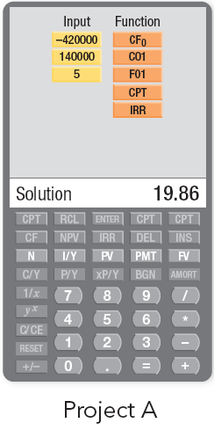
Example 10.8 (2 of 4)
Figure 10.3 uses timelines to depict the framework for finding the IRRs for Bennett’s projects A and B. We can see in the figure that the IRR is the unknown discount rate that causes the NPV to equal $0.
Calculator use To find the IRR using the preprogrammed function in a financial calculator, the keystrokes for each project are the same as those shown on slides 31 and 32 for the NPV calculation, except that you don’t enter a value for I/Y or compute NPV. Instead, once the cash flows have been entered, you push CPT and IRR as shown here.

Slide 50
Example 10.8 (3 of 4)
Comparing the IRRs of projects A and B given in Figure 10.3 to Bennett Company’s 10% cost of capital, we can see that both projects are acceptable because the return on each project is greater than the cost of capital:
IRR_{A} = 19.9% > 10.0%
IRR_{B} = 21.7% > 10.0%
Comparing the two projects’ IRRs, Bennett’s managers rank project B over project A because project B delivers a higher IRR (IRR_{B} = 21.7% > IRR_{A} = 19.9%). If these projects are mutually exclusive, meaning that Bennett can choose one project or the other but not both, the IRR decision technique would recommend project B.

Slide 51
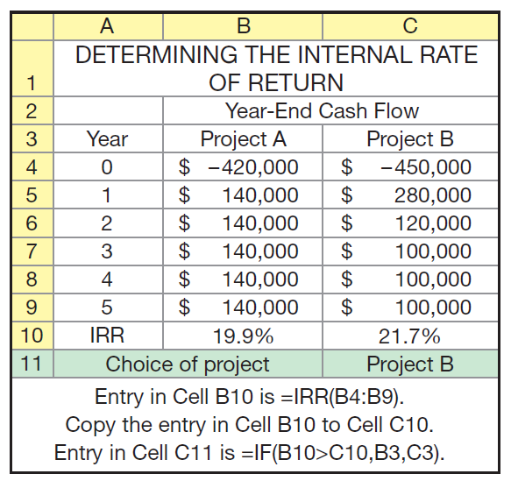
Example 10.8 (4 of 4)
Spreadsheet use The internal rate of return also can be calculated as shown on the following Excel spreadsheet.

Slide 52
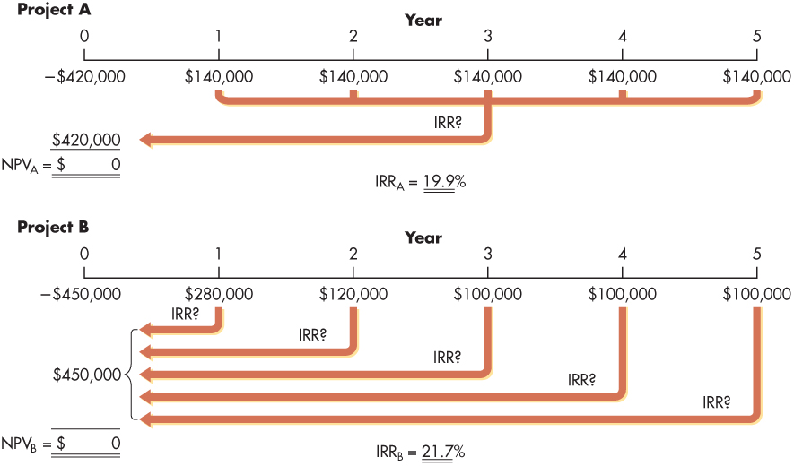
Figure 10.3 Calculation of IRRs for Bennett Company’s Capital Expenditure Alternatives

Slide 53
Personal Finance Example 10.9 (1 of 2)
Tony DiLorenzo is evaluating an investment opportunity. He is comfortable with the investment’s level of risk. On the basis of competing investment opportunities, he believes this investment must earn a minimum compound annual after-tax return of 9% to be acceptable. Tony’s initial investment would be $7,500, and he expects to receive annual after-tax cash flows of $500 per year in each of the first 4 years, followed by $700 per year at the end of years 5 through 8. He plans to sell the investment at the end of year 8 and net $9,000, after taxes.

Slide 54
Personal Finance Example 10.9 (2 of 2)
To calculate the investment’s IRR, Tony first summarizes the after-tax cash flows as shown in the following table:
Year | Cash flow
0 | −$7,500 (Initial investment)
1 | 500
2 | 500
3 | 500
4 | 500
5 | 700
6 | 700
7 | 700
8 | 9,700 ($700 + $9,000)
Substituting the after-tax cash flows for years 0 through 8 into a financial calculator or spreadsheet, he finds the investment’s IRR of 9.54%. Given that the projected IRR of 9.54% exceeds Tony’s required minimum return of 9%, the investment is acceptable.

Slide 55
10.5 Comparing NPV and IRR Techniques (1 of 8)
Net Present Value Profiles
Graph that depicts projects’ NPVs calculated at different discount rates

Slide 56
Example 10.10 (1 of 4)
To prepare net present value profiles for Bennett Company’s two projects, A and B, the first step is to develop a number of “discount rate–net present value” coordinates. Three coordinates are easy to obtain for each project; they are at a discount rate of 0%, at a discount rate of 10% (the cost of capital, r), and the IRR. The net present value at a 0% discount rate is the sum of all the cash inflows minus the initial investment. Using the data in Table 10.1 and assuming a 0% discount rate, we get
For project A:

Slide 57
Example 10.10 (2 of 4)
For project B:
The net present values for projects A and B at the 10% cost of capital are $110,710 and $109,244, respectively (from Figure 10.2). Because the IRR is the discount rate for which net present value equals zero, the IRRs (from Figure 10.3) of 19.9% for project A and 21.7% for project B result in $0 NPVs. Table 10.4 summarizes the three sets of coordinates for each of the projects.

Slide 58
Example 10.10 (3 of 4)
Of course, it is easy to generate more coordinates by simply calculating the NPV for each project at other discount rates. Plotting all of those coordinates results in the net present value profiles for projects A (the blue curve) and B (the red curve) shown in Figure 10.4. The figure reveals three important facts:
The IRR of project B is greater than that of project A, so managers using the IRR method to rank projects will choose B over A if both projects are acceptable.
The NPV of project A is sometimes higher and sometimes lower than that of project B, depending on the discount rate; thus, the NPV method will not consistently rank A above B or vice versa. The NPV ranking will depend on the firm’s cost of capital.
When the cost of capital is approximately 10.7%, projects A and B have identical NPVs.

Slide 59
Example 10.10 (4 of 4)
The cost of capital for Bennett Company is 10%; at that rate, project A has a higher NPV than project B (the blue line is above the red line in Figure 10.4 when the discount rate is 10%). Therefore, the NPV and IRR methods rank the two projects differently. If Bennett’s cost of capital were a little higher, say 12%, the NPV method would rank project B over project A and there would be no conflict in the rankings provided by the NPV and IRR approaches.

Slide 60
Table 10.4 Discount Rate–NPV Coordinates for Projects A and B
Blank | Net present value
Discount rate | Project A | Project B
0% | $280,000 | $250,000
10 | 110,710 | 109,244
19.9 | 0 | —
21.7 | — | 0

Slide 61
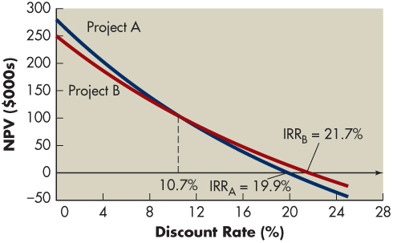
Figure 10.4 NPV Profiles

Slide 62
10.5 Comparing NPV and IRR Techniques (2 of 8)
Conflicting Rankings
Conflicts in the ranking given a project by NPV and IRR, resulting from differences in the magnitude and timing of cash flows
Reinvestment Assumption
One underlying cause of conflicting rankings is different implicit assumptions about the reinvestment of intermediate cash inflows
The NPV calculation implicitly assumes that the firm can reinvest intermediate cash inflows at the cost of capital
The IRR approach, however, assumes that the firm reinvests intermediate cash inflows at a rate equal to the project’s IRR
Intermediate Cash Inflows
Cash inflows received prior to the termination of a project

Slide 63
Example 10.11 (1 of 5)
A project requiring a $170,000 initial investment will provide operating cash inflows of $52,000, $78,000, and $100,000 in each of the next 3 years. The NPV of the project (at the firm’s 10% cost of capital) is $16,867, and its IRR is 15%, so clearly the project is acceptable.

Slide 64
Example 10.11 (2 of 5)
Now let’s see what happens if we assume that the firm reinvests cash flows as they come in. Table 10.5 shows how much the firm can earn by reinvesting each intermediate cash flow at either 10% (the cost of capital) or 15% (the project’s IRR). If we assume that the firm earns 10% on reinvested cash flows, the firm could accumulate $248,720 in 3 years. Now suppose we discount that value back to the present, using the 10% cost of capital. In doing so, we are asking the question, what is the project worth today if it costs $170,000 and the firm can reinvest cash flows at 10%? We have

Slide 65
Example 10.11 (3 of 5)
The project’s NPV calculated this way is $16,867, which matches the number stated at the beginning of this example. This confirms what we said earlier, namely, that the NPV approach assumes that the firm reinvests cash flows at the cost of capital. It is interesting that if the firm invests $170,000 today and 3 years later has accumulated $248,720, then its average annual return over that period is 13.5%, not the 15% figure obtained in the IRR calculation.

Slide 66
Example 10.11 (4 of 5)
Next, assume that the firm reinvests intermediate cash flows at 15%. Table 10.5 shows that the firm can accumulate $258,470 in 3 years by reinvesting cash flows as they arrive. If undertaking this project costs $170,000 and the firm can reinvest cash flows at 15%, what is the project worth today, assuming a 10% cost of capital? Discounting $258,470 back to the present, we obtain

Slide 67
Example 10.11 (5 of 5)
This time the NPV is larger than it was before, and that difference is driven entirely by the 15% reinvestment rate assumption. Table 10.6 summarizes the important lessons from this example. The project’s NPV is $16,867, but if the firm can reinvest cash flows only at the cost of capital, the project effectively earns a 13.5% annual return. The project’s IRR is 15%, but that assumes the firm can reinvest cash flows at 15%. If the firm could do so, the project would be even more valuable than the NPV calculation indicates.

Slide 68
Table 10.5 Reinvestment Rate Comparisons for a Project
Blank | Reinvestment rate
Blank | Blank | Blank | 10% | 15%
Year | Operating cash inflows | Number of years earning interest (t) | Future value | Future value
1 | $ 52,000 | 2 | $ 62,920 | $ 68,770
2 | 78,000 | 1 | 85,800 | 89,700
3 | 100,000 | 0 | 100,000 | 100,000
Blank | Blank | Future value end of year | $248,720 | $258,470
NPV @ 10% = $16,867 IRR = 15% | Blank | Blank | Blank | Blank
Note: Initial investment in this project is $170,000.

Slide 69
Table 10.6 Project Cash Flows after Reinvestment
Blank | Reinvestment rate
Blank | 10% | 15%
Initial investment | −$170,000 | Blank
Year | Operating cash inflows
1 | $ 0 | $ 0
2 | 0 | 0
3 | 248,720 | 258,470
NPV @ 10% | $16,867 | $24,192
IRR | 13.5% | 15.0%

Slide 70
10.5 Comparing NPV and IRR Techniques (3 of 8)
Conflicting Rankings
Timing of the Cash Flow
Another reason the IRR and NPV methods may provide different rankings for investment options has to do with differences in the timing of cash flows
Figure 10.1 shows the upfront investment required by each investment is similar, but after that, the timing of each project’s cash flows is quite different
Because so much of project B’s cash flows arrive early in its life (especially compared to the timing for project A), the NPV of project B will not be particularly sensitive to changes in the discount rate
Project A’s NPV, in contrast, will fluctuate more as the discount rate changes

Slide 71
Table 10.7 Ranking Projects A and B Using IRR and NPV Methods
Method | Project A | Project B
IRR |  | ✓
NPV
if r < 10.7% | ✓
if r > 10.7% |  | ✓

Slide 72
10.5 Comparing NPV and IRR Techniques (4 of 8)
Conflicting Rankings
Magnitude of the Initial Investment
Suppose that someone offered you the following two investment options
You could invest $2 today and receive $3 tomorrow, or you could invest $1,000 today and receive $1,100 tomorrow
The first investment provides a return (an IRR) of 50% in just 1 day, a return that surely would surpass any reasonable hurdle rate
But after making this investment, you’re only better off by $1

Slide 73
10.5 Comparing NPV and IRR Techniques (5 of 8)
Conflicting Rankings
Magnitude of the Initial Investment
On the other hand, the second choice offers a return of 10% in a single day
That’s far less than the first opportunity, but earning 10% in a single day is still a very high return
In addition, if you accept this investment, you will be $100 better off tomorrow than you were today

Slide 74
10.5 Comparing NPV and IRR Techniques (6 of 8)
Which Approach Is Better?
Theoretical View
On a theoretical basis, NPV is the better approach to capital budgeting for several reasons
Most importantly, the NPV measures how much wealth a project creates (or destroys if the NPV is negative) for shareholders

Slide 75
10.5 Comparing NPV and IRR Techniques (7 of 8)
Which Approach Is Better?
Theoretical View
For an investment project, the NPV calculation always provides a single answer, but sometimes the IRR calculation has more than one solution
Multiple IRRs
More than one IRR resulting from a capital budgeting project with a nonconventional cash flow pattern; the maximum number of IRRs for a project is equal to the number of sign changes in its cash flows

Slide 76
10.5 Comparing NPV and IRR Techniques (8 of 8)
Which Approach Is Better?
Practical View
Evidence suggests that despite the theoretical superiority of NPV, financial managers use the IRR approach just as often as the NPV method
The appeal of the IRR technique is due to the general disposition of business people to think in terms of rates of return rather than actual dollar returns

Slide 77
Matter of Fact
Which Methods Do Companies Actually Use?
Researchers surveyed chief financial officers (CFOs) about what methods they used to evaluate capital investment projects. One interesting finding was that many companies use more than one of the approaches we’ve covered in this chapter. The most popular approaches by far were IRR and NPV, used by 76% and 75% (respectively) of the CFOs responding to the survey. These techniques enjoy wider use in larger firms, with the payback approach more common in smaller firms.

Slide 78
Review of Learning Goals (1 of 8)
LG 1
Understand the key elements of the capital budgeting process.
Managers use capital budgeting techniques to make investment decisions that maximize the value of the firm; applied to each project’s cash flows, they indicate which capital expenditures are consistent with the firm’s goal of maximizing owners’ wealth

Slide 79
Review of Learning Goals (2 of 8)
LG 2
Calculate, interpret, and evaluate the payback period.
The payback period is the amount of time required for the firm to recover its initial investment
Shorter payback periods are preferred
The payback period is relatively easy to calculate, has simple intuitive appeal, focuses on a project’s cash flows, and is at least a crude way of adjusting for a project’s risk
However, the payback method does not have a strong connection to the wealth maximization goal; it offers only crude adjustments for the time value of money and for project risk

Slide 80
Review of Learning Goals (3 of 8)
LG 3
Calculate, interpret, and evaluate the net present value (NPV) and economic value added (EVA).
The NPV method measures the wealth generated by a project; positive NPV projects create value, while negative NPV projects destroy value
The rate at which cash flows are discounted in calculating NPV is called the discount rate, required return, cost of capital, or opportunity cost
Projects that earn returns exceeding this rate create value for shareholders

Slide 81
Review of Learning Goals (4 of 8)
LG 3 (Cont.)
Calculate, interpret, and evaluate the net present value (NPV) and economic value added (EVA).
The EVA method begins the same way that NPV does: by calculating a project’s net cash flows
However, the EVA approach subtracts from those cash flows a charge that is designed to capture the return that the firm’s investors demand on the project
That is, the EVA calculation asks whether a project generates positive cash flows above and beyond what investors demand
If so, the project is worth undertaking

Slide 82
Review of Learning Goals (5 of 8)
LG 4
Calculate, interpret, and evaluate the internal rate of return (IRR).
The IRR is the compound annual rate of return that the firm will earn by investing in a project and receiving the projected cash inflows, assuming that the firm can reinvest intermediate cash flows at a rate equal to the project’s IRR
By accepting only those projects with IRRs in excess of the firm’s cost of capital, the firm should enhance its market value and the wealth of its owners
Both NPV and IRR yield the same accept–reject decisions, but they often provide conflicting rankings

Slide 83
Review of Learning Goals (6 of 8)
LG 5
Use net present value profiles to compare NPV and IRR techniques.
A net present value profile is a graph that depicts projects’ NPVs for various discount rates
The NPV profile is prepared by developing a number of “discount rate–net present value” coordinates (including discount rates of 0%, the cost of capital, and the IRR for each project) and then plotting them on the same set of discount rate–NPV axes

Slide 84
Review of Learning Goals (7 of 8)
LG 6
Discuss NPV and IRR in terms of conflicting rankings and the strengths of each approach.
Conflicting rankings of projects frequently emerge from NPV and IRR as a result of differences in the reinvestment rate assumption as well as the magnitude and timing of cash flows
NPV assumes reinvestment of intermediate cash inflows at the more conservative cost of capital; IRR assumes reinvestment at the project’s IRR

Slide 85
Review of Learning Goals (8 of 8)
LG 6 (Cont.)
Discuss NPV and IRR in terms of conflicting rankings and the strengths of each approach.
Theoretically speaking, the NPV approach is superior because it does a better job of ranking projects and because it does not suffer from some of the mathematical quirks that occasionally affect IRR calculations
Even so, many firms use the IRR approach because it has a very intuitive interpretation and is easy for managers to understand and to communicate to others

