Slide 1
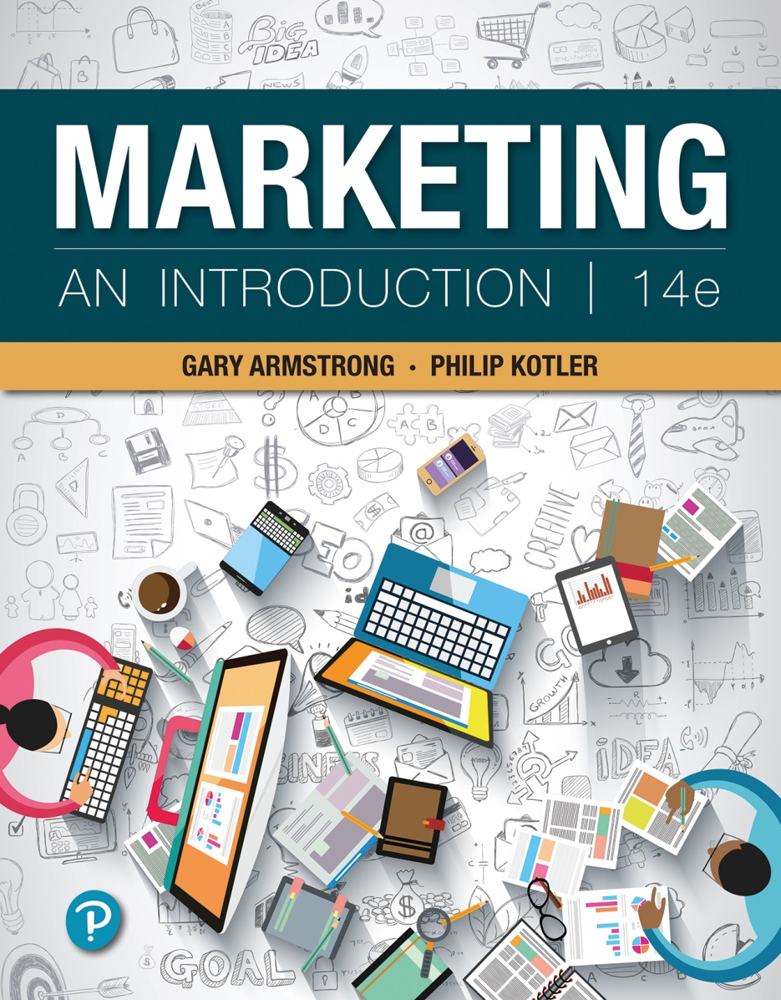
Marketing: An Introduction
Fourteenth Edition
Chapter 11
Deliver the Goods:
Determine the
Distribution Strategy
Notes:
If this PowerPoint presentation contains mathematical equations, you may need to check that your computer has the following installed:
1) MathType Plugin
2) Math Player (free versions available)
3) NVDA Reader (free versions available)

Slide 2
Objectives Outline (1 of 2)
11.1 Explain the role of retailers in the distribution channel and describe the major types of retailers.
11.2 Discuss how retailers are using omni-channel retailing to meet the cross-channel shopping behavior of today’s digitally connected consumers.
11.3 Describe the major retailer marketing decisions.
11.4 Discuss the major trends and developments in retailing.
11.5 Explain the major types of wholesalers and their marketing decisions.
Notes:
This chapter explains the role of retailers in the distribution channel and describes the major types of retailers. It describes the major retailer marketing decisions, discusses the major trends and developments in retailing, and finally, the chapter explains the major types of wholesalers and their marketing decisions.

Slide 3
First Stop: Walmart The World’s Largest Retailer—the World’s Largest Company
“Save money. Live better.” Says Walmart’s CEO, “We’re obsessed with delivering value to customers.”
Notes:
Day in and day out, giant Walmart lives up to its promise: “Save money. Live better.” Its obsession with customer value has made Walmart not only the world’s largest retailer but also the world’s largest company.
Walmart has the lowest cost structure in the industry. Walmart’s low costs result from superior operations management, sophisticated information technology, and tough buying. And Walmart is known for using its massive scale to wring low prices from suppliers.
Despite its incredible success over the past five decades, mighty Walmart faces some weighty challenges ahead. Having grown so big, it is having difficulty maintaining the rapid growth rates of its youth. To keep growing, Walmart has pushed into new, faster-growing product and service lines, including organic foods, store brands, in-store health clinics, and consumer financial services.

Slide 4
Objective Outline 11-1
Explain the role of retailers in the distribution channel and describe the major types of retailers.

Slide 5
Retailing: Connecting Brands with Consumers
Activities involved in selling goods or services directly to consumers for their personal use
Retailer: Business whose sales come primarily from retailing
Notes:
Retailing includes all the activities involved in selling products or services directly to final consumers for their personal, nonbusiness use. Most retailing is done by retailers, businesses whose sales come primarily from retailing.

Slide 6
The Shifting Retailing Model
Shopper marketing: Focusing the entire marketing process toward turning shoppers into buyers as they approach the point of sale
Omni-channel retailing: Creating a seam-less cross-channel buying experience that integrates in-store, online, and mobile shopping
Notes:
Many marketers are now embracing the concept of shopper marketing, focusing the entire marketing process—from product and brand development to logistics, promotion, and merchandising—toward turning shoppers into buyers as they approach the point of sale.
Omni-channel retailing creates a seam-less cross-channel buying experience that integrates in-store, online, and mobile shopping.

Slide 7
Types of Retailers
Retailer classification can be based on
Amount of service offered
Breadth and depth of the product lines
Relative prices charged
Way they are organized
Notes:
The most important types of retail stores are briefly discussed in the forthcoming slides.
They can be classified in terms of several characteristics, including the amount of service they offer, the breadth and depth of their product lines, the relative prices they charge, and how they are organized.

Slide 8
Amount of Service
Self-service retailers
Serve customers who are willing to perform their own locate-compare-select process
Limited-service retailers
Carry more shopping goods about which customers need information
Provide more sales assistance
Full-service retailers
Carry more specialty goods
Assist customers in every phase of the shopping process
Notes:
Different types of customers and products require different amounts of service. To meet these varying service needs, retailers may offer one of three service levels.
Self-service retailers serve customers who are willing to perform their own locate-compare-select process to save time or money. Self-service is the basis of all discount operations and is typically used by retailers selling convenience goods and nationally branded, fast-moving shopping goods.
Limited-service retailers provide more sales assistance because they carry more shopping goods about which customers need information. Their increased operating costs result in higher prices.
Full-service retailers, such as high-end specialty stores and first-class department stores, assist customers in every phase of the shopping process. Full-service stores usually carry more specialty goods for which customers need or want assistance or advice.

Slide 9
Major Store Retailer Types (1 of 2)
Type | Description | Examples
Specialty store | A store that carries a narrow product line with a deep assortment, such as apparel stores, sporting-goods stores, furniture stores, florists, and bookstores. | REI, Sunglass Hut, Sephora, Williams-Sonoma
Department store | A store that carries several product lines—typically clothing, home furnishings, and household goods—with each line operated as a separate department managed by specialist buyers or merchandisers.. | Macy’s, Sears, Neiman Marcus
Supermarket | A relatively large, low-cost, low-margin, high-volume, self-service operation designed to serve the consumer’s total needs for grocery and household products. | Kroger, Publix, Safeway, SuperValu.
Convenience store | A relatively small store located near residential areas, open 24/7, and carrying a limited line of high-turnover convenience products at slightly higher prices. | 7-Eleven, Circle K, Speedway, Sheetz
Superstore | A very large store that meets consumers’ total needs for routinely purchased food and nonfood items. This includes supercenters, combined supermarket and discount stores, and category killers, which carry a deep assortment in a particular category. | Walmart Supercenter, SuperTarget, Meijer (discount stores); Best Buy, Petco, Staples, Bed Bath & Beyond (category killers)
Discount store | A store that carries standard merchandise sold at lower prices with lower margins and higher volumes. | Walmart, Target, Kohl’s
Off-price retailer | A store that sells merchandise bought at less-than-regular wholesale prices and sold at less than retail. These include factory outlets owned and operated by manufacturers; independent off-price retailers owned and run by entrepreneurs or by divisions of larger retail corporations; and warehouse (or wholesale) clubs selling a limited selection of goods at deep discounts to consumers who pay membership fees. | Mikasa (factory outlet); TJ Maxx (independent off-price retailer); Costco, Sam’s Club, BJ’s (warehouse clubs).
Notes:
This table describes the most important types of retail stores.
Specialty stores carry a narrow product line with a deep assortment within that line. Department stores carry a wide variety of product lines, each operated as a separate department managed by specialist buyers or merchandisers. Supermarkets are large, low-cost, low-margin, high-volume, self-service stores that carry a wide variety of grocery and household products. Convenience stores are small stores located near residential areas, that are open long hours seven days a week, and carry a limited line of high-turnover convenience goods. Discount stores sell standard merchandise at lower prices by accepting lower margins and selling at higher volume. Off-price retailers buy less-than-regular wholesale prices and sell at less than retail. An independent off-price retailer is either independently owned and run or is a division of a larger retail corporation. A factory outlet is owned and operated by a manufacturer and normally carries the manufacturer’s surplus, discontinued, or irregular goods. Warehouse clubs sell a limited selection of brand name grocery items, appliances, clothing, and other goods at deep discounts to members who pay annual membership fees. Superstores are much larger than regular supermarkets and offer a large assortment of routinely purchased food products, nonfood items, and services. This includes supercenters, combined supermarket and discount stores, and category killers, which carry a deep assortment of a particular line. Finally, for many retailers, the product line is actually a service. Service retailers in the United States are growing faster than product retailers.

Slide 10
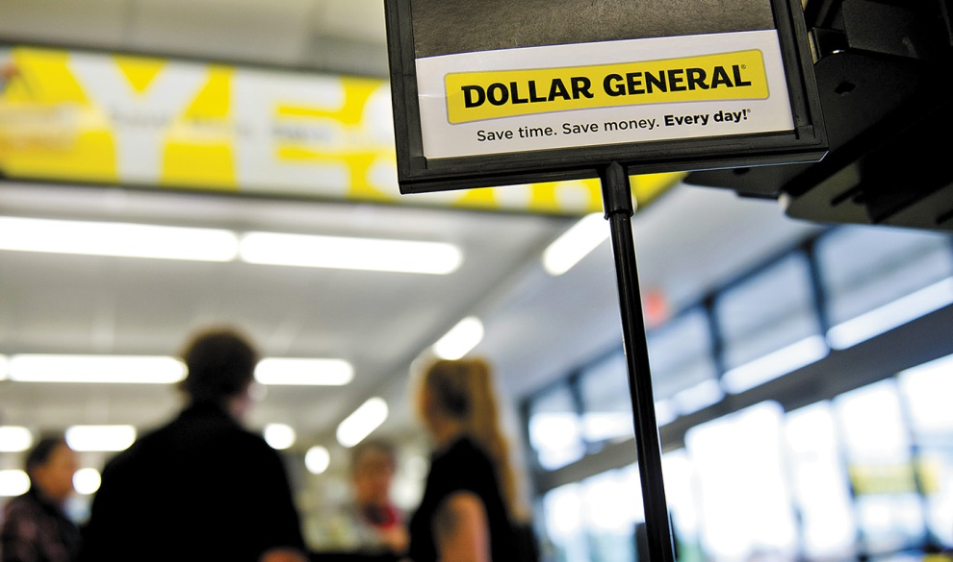
Major Store Retailer Types (2 of 2)
Discounter Dollar General is the nation’s largest small-box discount retailer.
Notes:
Discounter Dollar General, the nation’s largest small-box discount retailer, makes a powerful value promise for the times: “Save time. Save money. Every day.”

Slide 11
Major Types of Retail Organizations
Type | Description | Examples
Corporate chain | Two or more outlets that are commonly owned and controlled. Corporate chains appear in all types of retailing but they are strongest in department stores, discount stores, food stores, drugstores, and restaurants. | Macy’s (department stores), Target (discount stores), Kroger (grocery stores), CVS (drugstores)
Voluntary chain | Wholesaler-sponsored group of independent retailers engaged in group buying and merchandising. | Independent Grocers Alliance (IGA), Western Auto (auto supply), True Value (hardware)
Retailer cooperative | Group of independent retailers who jointly establish a central buying organization and conduct joint promotion efforts. | Associated Grocers (groceries), Ace Hardware (hardware)
Franchise organization | Contractual association between a franchisor (a manufacturer, wholesaler, or service organization) and franchisees (independent businesspeople who buy the right to own and operate one or more units in the franchise system). | McDonald’s, Subway, Pizza Hut, Jiffy Lube, Meineke Mufflers, 7-Eleven
Notes:
This table describes the four major types of retail organizations.
Corporate chains are two or more outlets that are commonly owned and controlled. Their size allows them to buy in large quantities at lower prices and gain promotional economies.
The great success of corporate chains caused many independents to band together in one of two forms of contractual associations. One is the voluntary chain—a wholesaler-sponsored group of independent retailers that engages in group buying and common merchandising. The other type of contractual association is the retailer cooperative—a group of independent retailers that bands together to set up a jointly owned, central wholesale operation and conducts joint merchandising and promotion efforts.
Another form of contractual retail organization is a franchise. It refers to a contractual association between a manufacturer, wholesaler, or service organization (a franchisor) and independent business people (franchisees) who buy the right to own and operate one or more units in the franchise system.

Slide 12
Objective Outline 11-1 Summary
Retailing—selling goods or services directly to final consumers
Shopper marketing—turning shoppers into buyers
Omni-channel retailing—integrates in-store, online, and mobile shopping
Retailers classified by amount of service, product line sold, and relative prices
Corporate and contractual retail organizations
Notes:
Retailing includes all the activities involved in selling goods or services directly to final consumers for their personal, nonbusiness use. Retailers play an important role in connecting brands to consumers in the final phases of the buying process. Shopper marketing involves focusing the entire marketing process on turning shoppers into buyers as they approach the point of sale. These days, shopper marketing and the “point of purchase” go well beyond in-store buying. Today’s buyers are omni-channel consumers who work across multiple channels as they shop. Thus, influencing consumers’ buying decisions calls for omni-channel retailing, creating a seamless cross-channel buying experience that integrates in-store, online, and mobile shopping. Retail stores come in all shapes and sizes, and new retail types keep emerging. Store retailers can be classified by the amount of service they provide (self-service, limited service, or full service), product line sold (specialty stores, department stores, supermarkets, convenience stores, superstores, and service businesses), and relative prices (discount stores and off-price retailers). Today, many retailers are banding together in corporate and contractual retail organizations (corporate chains, voluntary chains, retailer cooperatives, and franchise organizations).

Slide 13
Objective Outline 11-2
Discuss how retailers are using omni-channel retailing to meet the cross-channel shopping behavior of today’s digitally connected consumers.

Slide 14
Omni-Channel Retailing: Blending In-Store, Online, Mobile, and Social Media Channels (1 of 2)
In this age of websites, smartphones, mobile apps, social media, and other things digital—shopping typically involves a dazzling array of channels and platforms.
Omni-channel consumers readily research products and prices online, shopping digitally from home, from work, in stores, or anywhere in between.
The boundaries between in-store and online retailing are rapidly blurring.

Slide 15
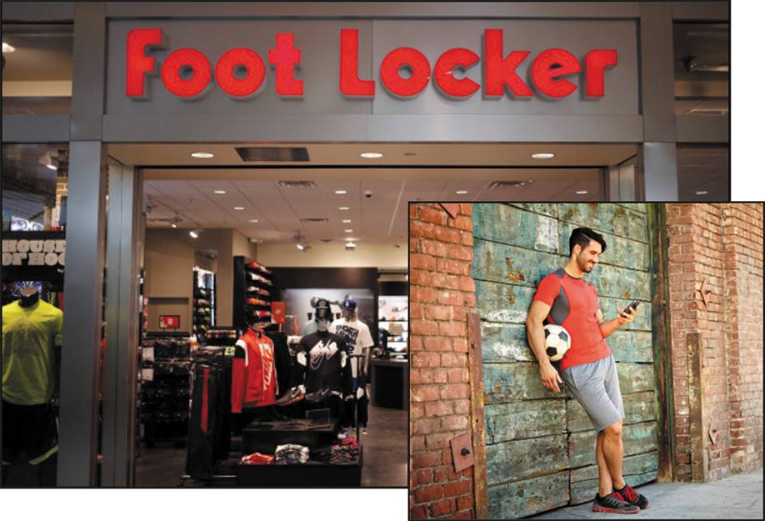
Omni-Channel Retailing: Blending In-Store, Online, Mobile, and Social Media Channels (2 of 2)
Athletic footwear and apparel giant Foot Locker has mastered omni-channel retailing.

Slide 16
Objective Outline 11-3
Describe the major retailer marketing decisions.

Slide 17
Figure 11.1 Retailer Marketing Strategies
Notes:
This figure shows the major marketing decisions retailers face about segmentation and targeting, store differentiation and positioning, and the retail marketing mix.
As with other types of marketers, the aim for retailers is to find the customer value-driven marketing strategy and marketing mix that will let them create value for customers and capture value in return.

Slide 18
Segmentation, Targeting, Differentiation, and Positioning Decisions (1 of 2)
Target markets must be segmented and defined.
Retailers then decide how to differentiate and position themselves in those markets.
Notes:
Retailers must first segment and define their target markets and then decide how they will differentiate and position themselves in these markets. With solid targeting and positioning, a retailer can compete effectively against even the largest and strongest competitors.

Slide 19
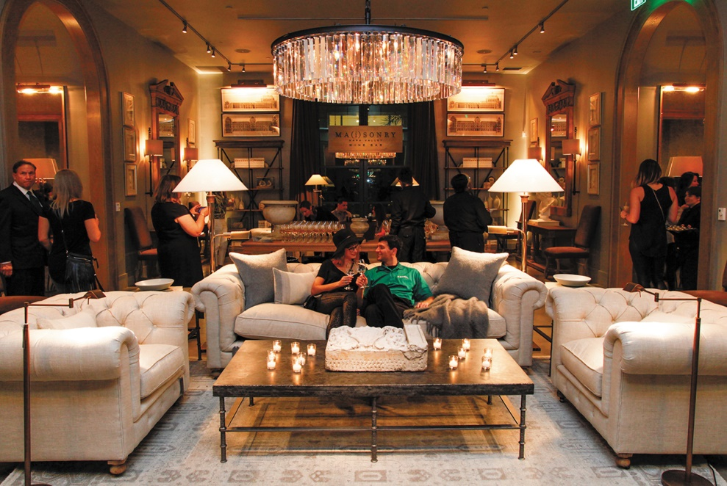
Segmentation, Targeting, Differentiation, and Positioning Decisions (2 of 2)
Furnishings retailer Restoration Hardware has unleashed a new generation of furniture where you don’t just see the furnishings, you experience them.
Notes:
Most retail furniture stores do little more than display their wares in functional fashion. Not so at RH galleries. “We wanted to blur the lines between residential and retail, and to create a sense of place that is more home than store,” says Restoration Hardware’s CEO. The RH Atlanta gallery is a massive 70,000-square-foot, six-story estate on two acres, complete with a 40-foot-tall entry rotunda flanked by a double staircase, gardens, terraces, a 50-foot-long reflecting pool, and a rooftop park. Its rooms and outdoor places serve as showrooms for the goods that Restoration Hardware sells, from glasses to furniture to rugs to items for the garden.

Slide 20
Product Assortment and Services Decision
Retailers must determine three product variables.
Product assortment
Services mix
Store atmosphere
Notes:
Retailers must decide on three major product variables.
The retailer’s product assortment should differentiate it while matching target shoppers’ expectations. One strategy is to offer merchandise that no other competitor carries, such as store brands or national brands for which the retailer holds exclusive rights.
The services mix can also help set one retailer apart from another. For example, some retailers invite customers to ask questions or consult service representatives in person or via phone or keyboard.
The store’s atmosphere is another important element in the retailer’s product arsenal. Retailers want to create a unique store experience, one that suits the target market and moves customers to buy. Many retailers practice experiential retailing.

Slide 21
Price Decision
Price policy must fit the retailers’
Target market and positioning
Product and service assortment
Competition
Economic factors
Retailers practice either
Everyday low pricing (EDLP)
High-low pricing
Notes:
A retailer’s price policy must fit its target market and positioning, product and service assortment, the competition, and economic factors. Most retailers seek either high markups on lower volume or low markups on higher volume.
Retailers such as Walmart, Costco, ALDI, and Family Dollar practice everyday low pricing (EDLP), charging constant, everyday low prices with few sales or discounts. Still other retailers practice high-low pricing, that is, charging higher prices on an everyday basis, coupled with frequent sales and other price promotions, to increase store traffic, create a low-price image, or attract customers who will buy other goods at full prices.

Slide 22
Promotion Decision
Retailers use various combinations of the five promotion tools:
Advertising
Personal selling
Sales promotion
Public relations (PR)
Direct and social media marketing
Notes:
Retailers use various combinations of the five promotion tools—advertising, personal selling, sales promotion, public relations, and direct and social media marketing—to reach consumers.
Advertising may be supported by newspaper inserts and catalogs. Personal selling involves store salespeople greeting customers, meeting their needs, and building relationships. Sales promotions may include in-store demonstrations, displays, sales, and loyalty programs. Public relations (PR) activities, such as new-store openings, special events, newsletters and blogs, store magazines, and public service activities, are also available to retailers.
Most retailers also interact digitally with customers using Web sites and digital catalogs, online ads and video, social media, mobile ads, and apps, blogs, and emails.

Slide 23
Place Decision
Locations should be accessible to the target market in areas that are consistent with the retailer’s positioning.
Shopping center: Group of retail businesses built on a site that is planned, developed, owned, and managed as a unit
Notes:
It’s very important that retailers select locations that are accessible to the target market in areas that are consistent with the retailer’s positioning. Most stores today cluster together to increase their customer pulling power and give consumers the convenience of one-stop shopping.
A shopping center is a group of retail businesses built on a site that is planned, developed, owned, and managed as a unit. The various types of shopping centers are discussed in the following slide.

Slide 24
Types of Shopping Centers
Regional shopping center
Community shopping center
Neighborhood shopping center
Power center
Lifestyle center
Notes:
A regional shopping center, or regional shopping mall, is the largest and most dramatic shopping center. It has from 50 to more than 100 stores, including two or more full-line department stores. A community shopping center contains between 15 and 50 retail stores. It contains a branch of a department store or variety store, a supermarket, specialty stores, professional offices, and sometimes a bank. Neighborhood shopping centers or strip malls contain between 5 and 15 stores. These centers, which are close and convenient for consumers, usually contain a supermarket, perhaps a discount store, and several service stores—dry cleaner, drugstore, hardware store, local restaurant, or other stores. A newer form of shopping center is the power center. Power centers are huge unenclosed shopping centers consisting of a long strip of retail stores, such as Walmart, Home Depot, Costco, and Best Buy. Lifestyle centers are smaller, open-air malls with upscale stores, convenient locations, and nonretail activities, such as a playground, skating rink, hotel, dining establishments, and a movie theater.

Slide 25
Objective Outline 11-3 Summary
Major retailer marketing decisions
Segmentation and targeting
Store differentiation and positioning
Retail marketing mix decisions
Product and services assortment
Price, promotion, and place
Notes:
Retailers are always searching for new marketing strategies to attract and hold customers. They face major marketing decisions about segmentation and targeting, store differentiation and positioning, and the retail marketing mix.
Retailers must first segment and define their target markets and then decide how they will differentiate and position themselves in these markets. Those that try to offer “something for everyone” end up satisfying no market well. By contrast, successful retailers define their target markets well and position themselves strongly.
Guided by strong targeting and positioning, retailers must decide on a retail marketing mix—product and services assortment, price, promotion, and place. Retail stores are much more than simply an assortment of goods. Beyond the products and services they offer, today’s successful retailers carefully orchestrate virtually every aspect of the consumer store experience. A retailer’s price policy must fit its target market and positioning, products and services assortment, and competition. Retailers use various combinations of the five promotion tools—advertising, personal selling, sales promotion, PR, and direct marketing—to reach consumers. Online, mobile, and social media tools are playing an ever-increasing role in helping retailers to engage customers. Finally, it’s very important that retailers select locations that are accessible to the target market in areas that are consistent with the retailer’s positioning.

Slide 26
Objective Outline 11-4
Discuss the major trends and developments in retailing.

Slide 27
Retailing Trends and Developments (1 of 4)
Tighter consumer spending
Impact of the Great Recession on consumers
Changed spending patterns
Impact of the Great Recession on retailers
Cost-cutting, price promotions, bankruptcy
New value pitches in positioning
New retail forms, shortening retail life cycles, and retail convergence
Notes:
Following many years of good economic times for retailers, the Great Recession of 2008–2009 turned many retailers’ fortunes from boom to bust.
Some retailers benefit from a down economy. For example, as consumers cut back and looked for ways to spend less, big discounters such as Costco scooped up new business from bargain-hungry shoppers. For most retailers, however, tighter consumer spending has meant tough times.
New retail forms continue to emerge to meet new situations and consumer needs, but the life cycle of new retail forms is getting shorter. Today’s retail forms appear to be converging. Increasingly, different types of retailers now sell the same products at the same prices to the same consumers. This merging of consumers, products, prices, and retailers is called retail convergence. Such convergence means greater competition for retailers and greater difficulty in differentiating the product assortments of different types of retailers.

Slide 28
Retailing Trends and Developments (2 of 4)
Rise of megaretailers
Offer better merchandise selections, good service, and strong price savings to consumers
Have shifted the balance of power between retailers and producers
Growth of direct, online, mobile, and social media retailing
Availability of a variety of nonstore alternatives
Notes:
The rise of huge mass merchandisers and specialty superstores, the formation of vertical marketing systems, and a rash of retail mergers and acquisitions have created a core of superpower megaretailers. The megaretailers have shifted the balance of power between retailers and producers. With their size and buying power, these giant retailers can offer better merchandise selections, good service, and strong price savings to consumers. As a result, they grow even larger by squeezing out their smaller, weaker competitors.
Most consumers still make a majority of their purchases the old-fashioned way. They go to a store, find what they want, plunk down their cash or credit cards, and bring home the goods. Retailer online sites, mobile apps, and online social media influence a large amount of in-store buying.

Slide 29
Retailing Trends and Developments (3 of 4)
Growing importance of retail technology
Produce better forecasts
Control inventory costs
Interact digitally with suppliers
Send information between stores
Sell to customers within stores
Notes:
Retail technologies have become critically important as competitive tools. Progressive retailers are using advanced information technology and software systems to produce better forecasts, control inventory costs, interact electronically with suppliers, send information between stores, and even sell to customers within stores. They have adopted sophisticated systems for checkout scanning, RFID inventory tracking, merchandise handling, information sharing, and customer interactions.

Slide 30
Retailing Trends and Developments (4 of 4)
Green retailing
Promoting more environmentally responsible products
Launching programs to help customers be more responsible
Working with channel partners to reduce their environmental impact
Global expansion of major retailers
Escaping saturated home markets
Notes:
Today’s retailers are increasingly adopting environmentally sustainable practices. They are greening up their stores and operations, promoting more environmentally responsible products, launching programs to help customers be more responsible, and working with channel partners to reduce their environmental impact. Many large retailers are also joining forces with suppliers and distributors to create more sustainable products, packaging, and distribution systems.
Retailers with unique formats and strong brand positions are increasingly moving into other countries. Many are expanding internationally to escape saturated home markets. International retailing presents challenges as well as opportunities. Retailers can face dramatically different retail environments when crossing countries, continents, and cultures. Hence, when going global, retailers must understand and meet the needs of local markets.

Slide 31
Objective Outline 11-4 Summary
Major trends and developments in retailing
New economic realities---thrift-minded consumers
New retail forms and retail convergence
Rise of mega retailers
Growth of direct, online, mobile, and social media retailing and retail technology
Green retailing and global expansion of major retailers
Notes:
Retailers operate in a harsh and fast-changing environment, which offers threats as well as opportunities. Following years of good economic times, retailers have now adjusted to the new economic realities and more thrift-minded consumers. New retail forms continue to emerge. At the same time, however, different types of retailers are increasingly serving similar customers with the same products and prices (retail convergence), making differentiation more difficult. Other trends in retailing include the rise of megaretailers; the rapid growth of direct, online, mobile, and social media retailing; the growing importance of retail technology; a surge in green retailing; and the global expansion of major retailers.

Slide 32
Objective Outline 11-5
Explain the major types of wholesalers and their marketing decisions.

Slide 33
Wholesaling (1 of 2)
Involves all the activities in selling goods and services to those buying for resale or business use
Wholesaler: A firm engaged primarily in wholesaling activities
Notes:
Wholesaling includes all the activities involved in selling goods and services to those buying for resale or business use. Wholesalers buy mostly from producers and sell mostly to retailers, industrial consumers, and other wholesalers. For example, many of the nation’s largest and most important wholesalers like Grainger are largely unknown to final consumers. But they are very well known and much valued by the business customers they serve.

Slide 34
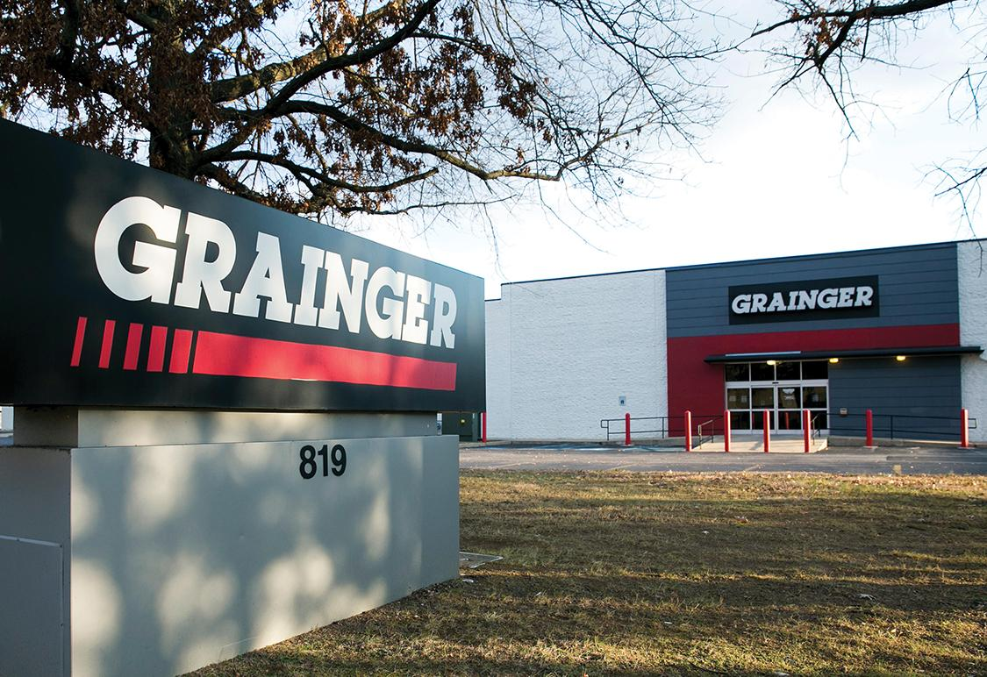
Wholesaling (2 of 2)
Many of the nation’s largest and most important wholesalers—like Grainger—are largely unknown to final consumers.
Notes:
“Grainger may be the biggest market leader you’ve never heard of. It’s a $10 billion business that offers more than 1.6 million maintenance, repair, and operating (MRO) products from 5,000 manufacturers to more than 3.2 million active customers. Through its branch network, service centers, sales reps, catalog, and online and social media sites, Grainger links customers with the supplies they need to keep their facilities running smoothly—everything from light bulbs, cleaners, and display cases to nuts and bolts, motors, valves, power tools, test equipment, and safety supplies. Grainger’s nearly 600 branches, 33 strategically located distribution centers, more than 25,000 employees, and innovative web and mobile sites handle more than 100,000 transactions a day. Grainger’s customers include organizations ranging from factories, garages, and grocers to schools and military bases.”

Slide 35
Channel Functions Performed by Wholesalers
Selling and promoting
Buying and assortment building
Bulk breaking
Warehousing
Transportation
Financing
Risk bearing
Market information
Management services and advice
Notes:
Wholesalers add value by performing one or more channel functions.
Wholesalers’ sales forces help manufacturers reach many small customers at a low cost. They can select items and build assortments needed by their customers, thereby saving much work. Wholesalers can save their customers money by buying in carload lots and breaking bulk. They can also hold inventories, thereby reducing the inventory costs and risks of suppliers and customers. Wholesalers can provide quicker delivery to buyers because they are closer to buyers than are producers. They finance their customers by giving credit, and they finance their suppliers by ordering early and paying bills on time.
Wholesalers absorb risk by taking title and bearing the cost of theft, damage, spoilage, and obsolescence. They give information to suppliers and customers about competitors, new products, and price developments. Wholesalers also help retailers train their salesclerks, improve store layouts and displays, and set up accounting and inventory control systems.

Slide 36
Table 11.3 Major Types of Wholesaler (1 of 3)
Type | Description
Merchant wholesalers | Independently owned businesses that take title to all merchandise handled. There are full-service Wholesalers and limited-service wholesalers.
Full-service wholesalers | Provide a full line of services: carrying stock, maintaining a sales force, offering credit, making deliveries, and providing management assistance. Full-service wholesalers include wholesale merchants and Industrial distributors.
Wholesale merchants | Sell primarily to retailers and provide a full range of services. General merchandise wholesalers carry several merchandise lines, whereas general line wholesalers carry one or two lines in great depth. Specialty wholesalers specialize in carrying only part of a line.
Industrial distributors | Sell to manufacturers rather than to retailers. Provide several services, such as carrying stock, offering credit, and providing delivery. May carry a broad range of merchandise, a general line, or a specialty line.
Limited-service wholesalers | Offer fewer services than full-service wholesalers. Limited-service wholesalers are of several types:
Cash-and-carry wholesalers | Carry a limited line of fast-moving goods and sell to small retailers for cash. Normally do not deliver..
Truck wholesalers (or truck jobbers) | Perform primarily a selling and delivery function. Carry a limited line of semiperishable merchandise (such as milk, bread, snack foods), which is sold for cash as deliveries are made to supermarkets, small groceries, hospitals, restaurants, factory cafeterias, and hotels.
Drop shippers | Do not carry inventory or handle the product. On receiving an order, drop shippers select a manufacturer, who then ships the merchandise directly to the customer. Drop shippers operate in bulk industries, such as coal, lumber, and heavy equipment.
Rack jobbers | Serve grocery and drug retailers, mostly in nonfood items. Rack jobbers send delivery trucks to stores, where the delivery people set up toys, paperbacks, hardware items, health and beauty aids, or other items. Rack Jobbers price the goods, keep them fresh, set up point-of-purchase displays, and keep inventory records.
Producers’ cooperatives | Farmer-owned members that assemble farm produce for sale in local markets. Producers’ cooperatives Often attempt to improve product quality and promote a co-op brand name, such as Sun-Maid raisins, Sunkist oranges, or Diamond nuts.
Mail-order or web wholesalers | Send catalogs to or maintain websites for retail, industrial, and institutional customers featuring jewelry, cosmetics, specialty foods, and other small items. Its primary customers are businesses in small outlying areas.
Notes:
This table summarizes the first type of wholesalers: merchant wholesalers.
Merchant wholesalers are the largest single group of wholesalers, accounting for roughly 50 percent of all wholesaling. They include two broad types: full-service wholesalers and limited-service wholesalers. Full-service wholesalers provide a full set of services, whereas the various limited-service wholesalers offer fewer services to their suppliers and customers.

Slide 37
Table 11.3 Major Types of Wholesaler (2 of 3)
Brokers and agents | Do not take title to goods. The main function is to facilitate buying and selling, for which they earn a commission on the selling price. Generally specialize by product line or customer type.
Brokers | Bring buyers and sellers together and assist in negotiation. Brokers are paid by the party who hired the broker and do not carry inventory, get involved in financing, or assume risk. Examples include food brokers, real estate brokers, insurance brokers, and security brokers.
Agents | Represent either buyers or sellers on a more permanent basis than brokers do. There are four types:
Manufacturers’ agents | Represent two or more manufacturers of complementary lines. Often used in such lines as apparel, furniture, and electrical goods. A manufacturer’s agent is hired by small manufacturers who cannot afford their own field sales forces and by large manufacturers who use agents to open new territories or cover territories that cannot support full-time salespeople.
Selling agents | Have contractual authority to sell a manufacturer’s entire output. The selling agent serves as a sales department and has significant influence over prices, terms, and conditions of sale. Found in product areas such as textiles, industrial machinery and equipment, coal and coke, chemicals, and metals.
Notes:
This table summarizes two other types of wholesalers: brokers and agents.
Brokers differ from merchant wholesalers in two ways. They do not take title to goods, and second, they perform only a few functions. Like merchant wholesalers, they generally specialize by product line or customer type. A broker brings buyers and sellers together and assists in negotiations for which they earn a commission on the selling price.
Agents represent buyers or sellers on a more permanent basis. Manufacturers’ agents (also called manufacturers’ representatives) are the most common type of agent wholesaler. They perform only a few functions and do not take title to goods.

Slide 38
Table 11.3 Major Types of Wholesaler (3 of 3)
Type | Description
Purchasing agents | Generally have a long-term relationship with buyers and make purchases for them, often receiving, inspecting, warehousing, and shipping the merchandise to buyers. Purchasing agents help clients obtain the best goods and prices available.
Commission merchants | Take physical possession of products and negotiate sales. Used most often in agricultural marketing by farmers who do not want to sell their own output. Take a truckload of commodities to a central market, sell it for the best price, deduct a commission and expenses, and remit the balance to the producers.
Manufacturers’ and retailers’ branches and offices | Wholesaling operations conducted by sellers or buyers themselves rather than operating through independent wholesalers. Separate branches and offices can be dedicated to either sales or purchasing.
Sales branches and offices | Set up by manufacturers to improve inventory control, selling, and promotion. Sales branches carry inventory and are found in industries such as lumber and automotive equipment and parts. Sales offices do not carry inventory and are most prominent in the dry goods and notions industries.
Purchasing offices | Perform a role similar to that of brokers or agents but are part of the buyer’s organization. Many retailers set up purchasing offices in major market centers, such as New York and Chicago.
Notes:
Another major type of wholesaling is that done in manufacturers’ and retailers’ branches and offices by sellers or buyers themselves rather than through independent wholesalers.

Slide 39
Figure 11.2 Wholesaler Marketing Strategies
Notes:
As shown in this figure, wholesalers’ marketing decisions include choices of segmentation and targeting, differentiation and positioning, and the marketing mix, which is product and service assortments, price, promotion, and distribution. They can choose a target group by size of customer (for example, large retailers only), type of customer (convenience stores only), the need for service (customers who need credit), or other factors.
Like retailers, wholesalers must decide on product and service assortments, price, promotion, and place. Wholesalers add customer value through the products and services they offer. Price is an important wholesaler decision. Wholesalers usually mark up the cost of goods by a standard percentage. Most wholesalers are not promotion minded. Finally, distribution or location is important. Wholesalers must choose their locations, facilities, and Web locations carefully.

Slide 40
Trends in Wholesaling
Need for greater efficiency
Demands for lower prices
Sorting out suppliers who are not adding value based on cost and quality
Blurring distinction between large retailers and wholesalers
Increased use of technology to contain costs and boost productivity
Notes:
Today’s wholesalers face considerable challenges. The industry remains vulnerable to one of its most enduring trends, the need for ever-greater efficiency. Recent economic conditions have led to demands for even lower prices and the sorting out of suppliers who are not adding value based on cost and quality.
The distinction between large retailers and large wholesalers continues to blur. Many retailers now operate formats such as wholesale clubs and supercenters that perform many wholesale functions. In return, some large wholesalers are setting up their own retailing operations. The increased use of computerized, automated, and Internet-based systems will help wholesalers contain the costs of ordering, shipping, and inventory holding, thus boosting their productivity.

Slide 41
Objective Outline 11-5 Summary
Wholesaling—selling goods or services to those buying for the purpose of resale or business use
Wholesalers fall into three groups:
Merchant wholesalers
Brokers and agents
Manufacturers’ and retailers’ branches and offices
Notes:
Wholesaling includes all the activities involved in selling goods or services to those who are buying for the purpose of resale or business use. Wholesalers fall into three groups. First, merchant wholesalers take possession of the goods. They include full-service wholesalers (wholesale merchants and industrial distributors) and limited-service wholesalers (cash-and-carry wholesalers, truck wholesalers, drop shippers, rack jobbers, producers’ cooperatives, and mail-order wholesalers). Second, brokers and agents do not take possession of the goods but are paid a commission for aiding companies in buying and selling. Finally, manufacturers’ and retailers’ branches and offices are wholesaling operations conducted by non-wholesalers to bypass the wholesalers.
Like retailers, wholesalers must target carefully and position themselves strongly. And, like retailers, wholesalers must decide on product and service assortments, prices, promotion, and place. Progressive wholesalers constantly watch for better ways to meet the changing needs of their suppliers and target customers. They recognize that, in the long run, their only reason for existence comes from adding value, which occurs by increasing the efficiency and effectiveness of the entire marketing channel. As with other types of marketers, the goal is to build value-adding customer relationships.

Slide 42
Objectives Outline (2 of 2)
11.1 Explain the role of retailers in the distribution channel and describe the major types of retailers.
11.2 Discuss how retailers are using omni-channel retailing to meet the cross-channel shopping behavior of today’s digitally connected consumers
11.3 Describe the major retailer marketing decisions.
11.4 Discuss the major trends and developments in retailing.
11.5 Explain the major types of wholesalers and their marketing decisions.
Notes:
This chapter explained the role of retailers in the distribution channel and describes the major types of retailers. It described the major retailer marketing decisions, discussed the major trends and developments in retailing, and finally, the chapter explained the major types of wholesalers and their marketing decisions.

