Slide 1


Slide 2
Chapter 7
Work motivation and job satisfaction

Slide 3
The significance of motivation
‘Why do people do what they do?’
Four characteristics of motivation:
  Motivation is typified as an individual phenomenon.
  Motivation is described, usually, as intentional.
  Motivation is multifaceted.
  The purpose of motivational theories is to predict behaviour.
  Mitchell

Slide 4
Underlying concept of motivation
People’s behaviour is determined by what motivates them. Their performance is a product of both ability level and motivation.
Performance = function (ability × motivation)

Slide 5
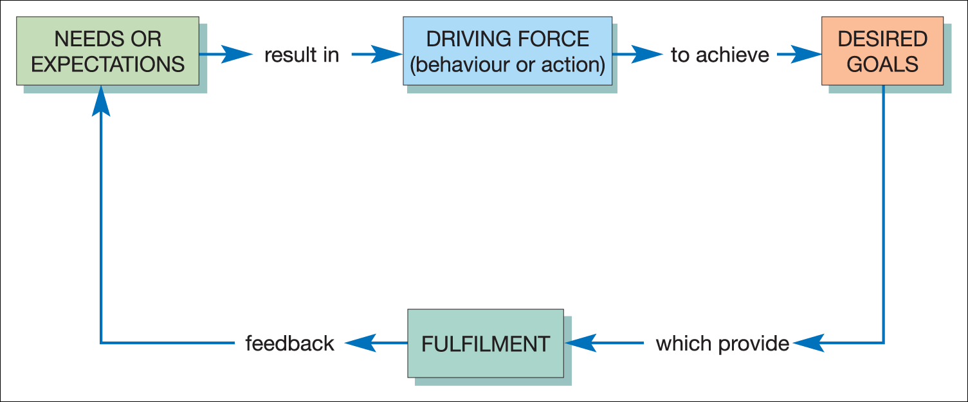
Underlying concept of motivation
Figure 7.1 A simplified illustration of the basic motivational model

Slide 6
Extrinsic and intrinsic motivation
Extrinsic motivation
Related to tangible rewards, e.g. salary, security, promotion and conditions of work
Intrinsic motivation
Related to psychological rewards, e.g. a sense of challenge and achievement and receiving appreciation

Slide 7
Developing a passion for work - critical needs of employees: Blanchard
Meaningful work
Collaboration
Fairness
Autonomy
Recognition
Growth
Connectedness with leaders
Connectedness with colleagues

Slide 8
Threefold classification for motivation at work
Economic rewards
  such as pay, fringe benefits, pension rights and security (instrumental orientation).
Intrinsic satisfaction
  derived from the nature of work itself (personal orientation).
Social relationships
  such as friendships, group working, status and dependency (relational orientation).

Slide 9
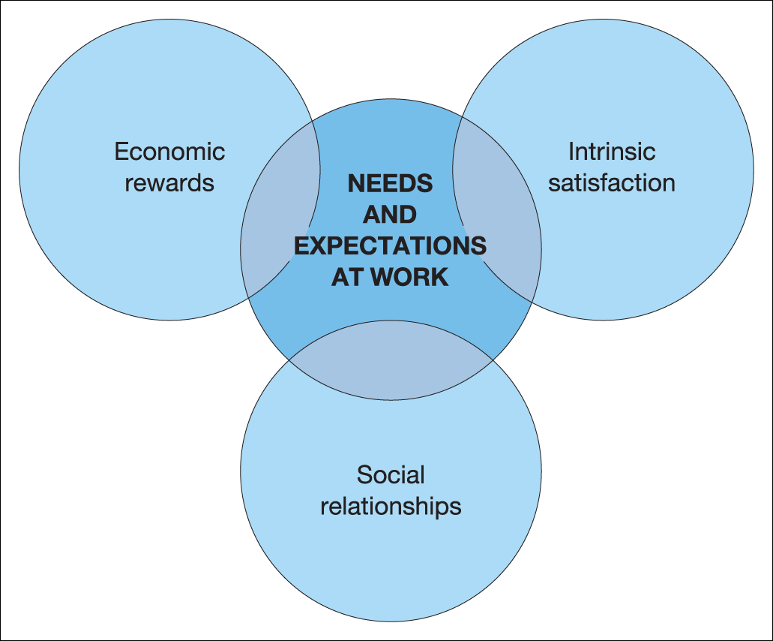
The needs and expectations of people at work
Figure 7.2 Needs and expectations of people at work

Slide 10
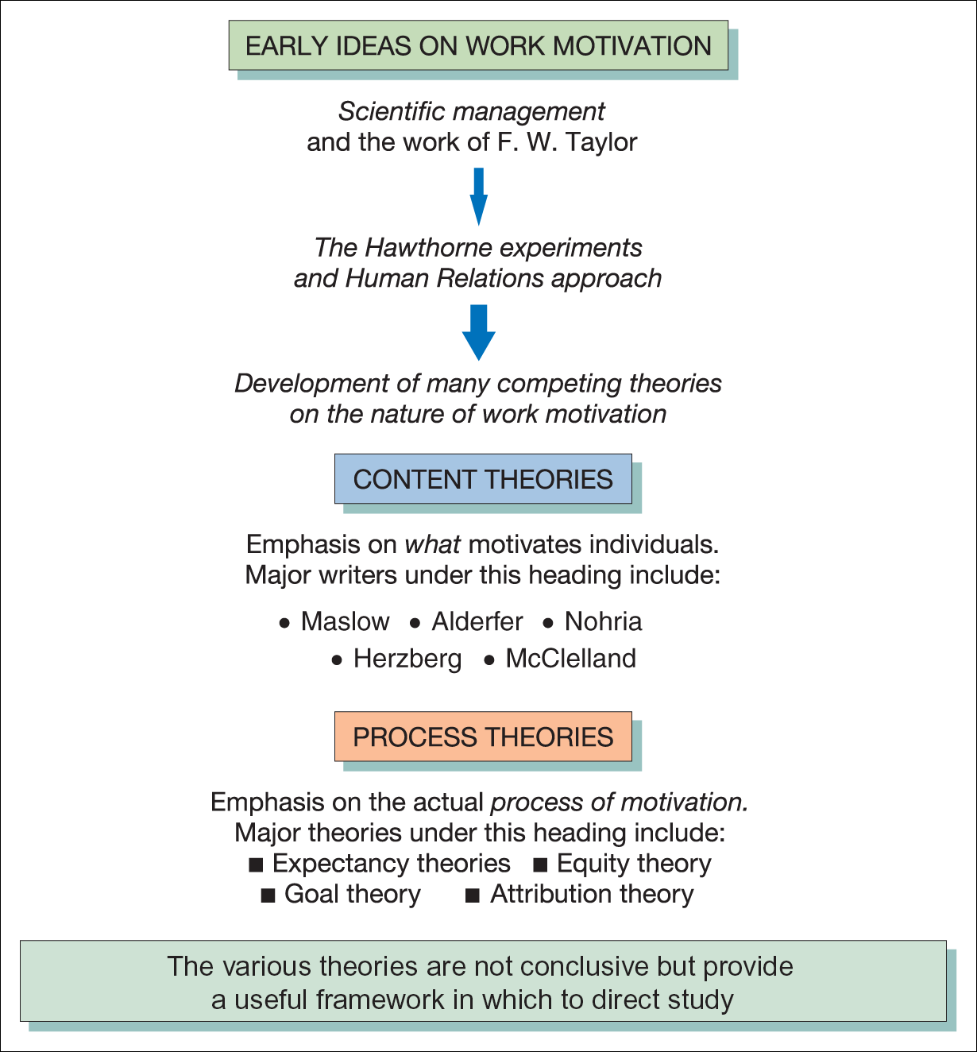
Theories of motivation
Figure 7.3 An overview of the main theories of work motivation

Slide 11
Content and process theories of motivation
Content theories
Main theorists include:
Maslow
Alderfer
Nohria
Herzberg
McClelland
Process theories
Main theorists include:
Vroom, Porter and Lawler
Adams
Locke
Heider and Kelley (see Chapter 6)

Slide 12
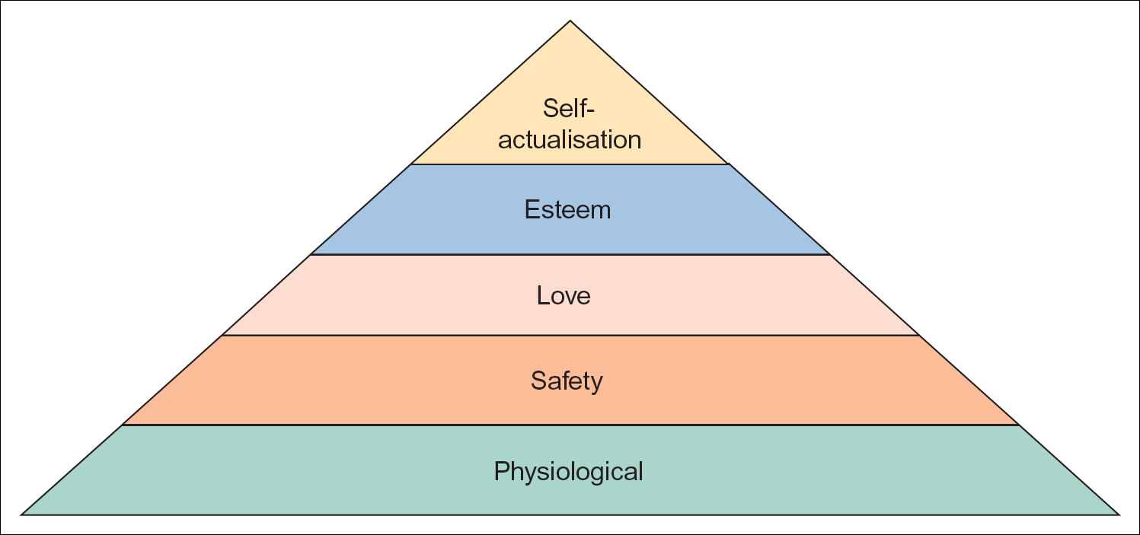
Maslow’s hierarchy of needs
Figure 7.5 Maslow’s hierarchy of needs model

Slide 13
Applying Maslow’s model to the work situation
There are a few problems doing this:
  People do not necessarily satisfy their needs, especially higher level needs, just through work.
  People place different values on the same need.
  Some rewards or outcomes may satisfy more than one need.
  Job satisfaction does not necessarily lead to improved performance.

Slide 14
Alderfer’s modified need hierarchy model
Existence needs are
  concerned with sustaining human existence and survival and covers physiological and safety needs of a material nature.
Relatedness needs are
  concerned with relationships to the social environment and covers love or belonging, affiliation and meaningful interpersonal relationships.
Growth needs are
  concerned with the development of potential and covers self-esteem and self-actualisation.

Slide 15
Nohria’s four-drives model
The drive to acquire – scarce goods and intangibles such as social status
The drive to bond – connections with individuals and groups
The drive to comprehend – satisfy curiosity and master the world around us
The drive to defend – against external threats and to promote justice

Slide 16
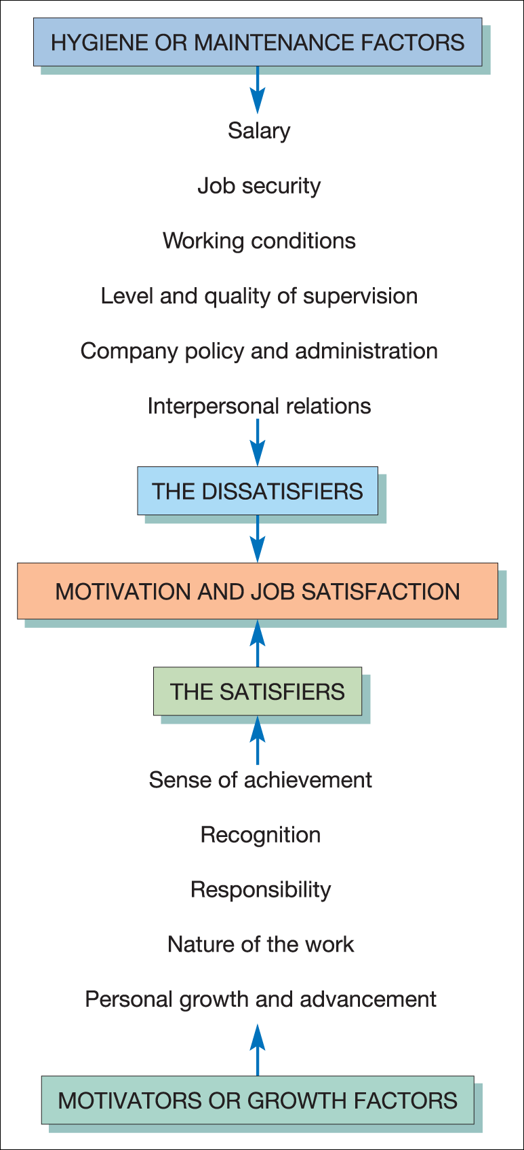
Herzberg’s two-factor theory
Figure 7.6 Representation of Herzberg’s two-factor theory

Slide 17
McClelland’s achievement motivation theory
Use of Thematic Apperception Tests (TAT) in research
Identified four arousal-based and socially developed motives, namely:
  Achievement motive
  Power motive
  Affiliative motive
  Avoidance motive

Slide 18
McClelland and achievement need (n-Ach)
Four characteristics of people with a strong achievement need (n-Ach):
  They prefer moderate task difficulty and goals as an achievement incentive.
  They prefer personal responsibility for performance.
  They have the need for clear and unambiguous feedback on performance.
  They are more innovative.

Slide 19
Process theories of motivation
Process theories include:
Expectancy-based models
  Vroom, Porter and Lawler
Equity theory
  Adams
Goal theory
  Locke
Attribution theory
  Heider and Kelley (see Chapter 6)

Slide 20
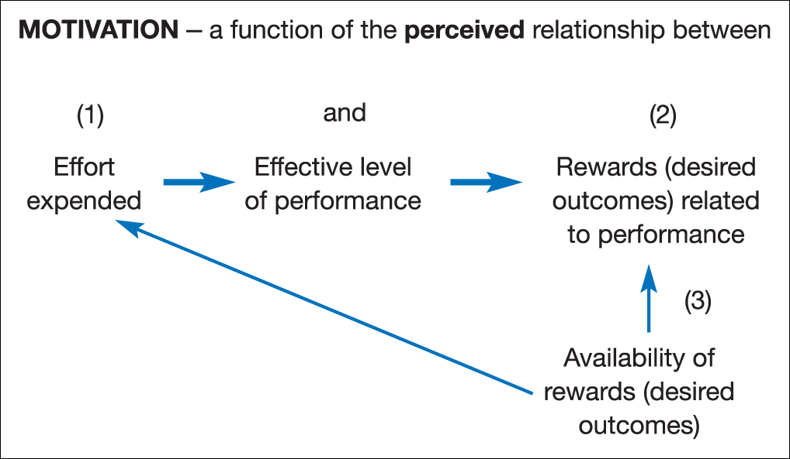
Expectancy theories: the motivational link
Figure 7.7 Expectancy theory: the motivational link

Slide 21
Vroom’s expectancy theory
Based on the idea that people prefer certain outcomes from their behaviour over others and anticipate feelings of satisfaction should the preferred outcome be achieved:
  This feeling of anticipated satisfaction from an outcome is termed valence.
  Instrumentality is the extent to which first-level outcomes lead to second-level outcomes.
  Expectancy is the perception of the probability that the desired satisfaction will be achieved by the chosen behaviour.
  The combination of valence and expectancy determines the strength of individual motivation or motivational force.

Slide 22
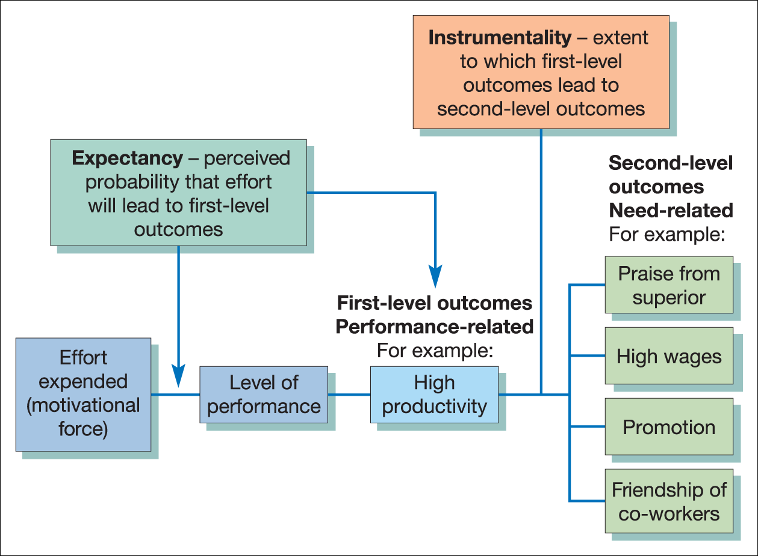
Basic model of expectancy theory
Figure 7.8 Basic model of expectancy theory

Slide 23
Motivational force
Motivation (M) is the sum of the products of the valences of all outcomes (V), multiplied by the strength of expectancies that action will result in the achievement of these outcomes (E).
M = ∑E ∙ V
n

Slide 24
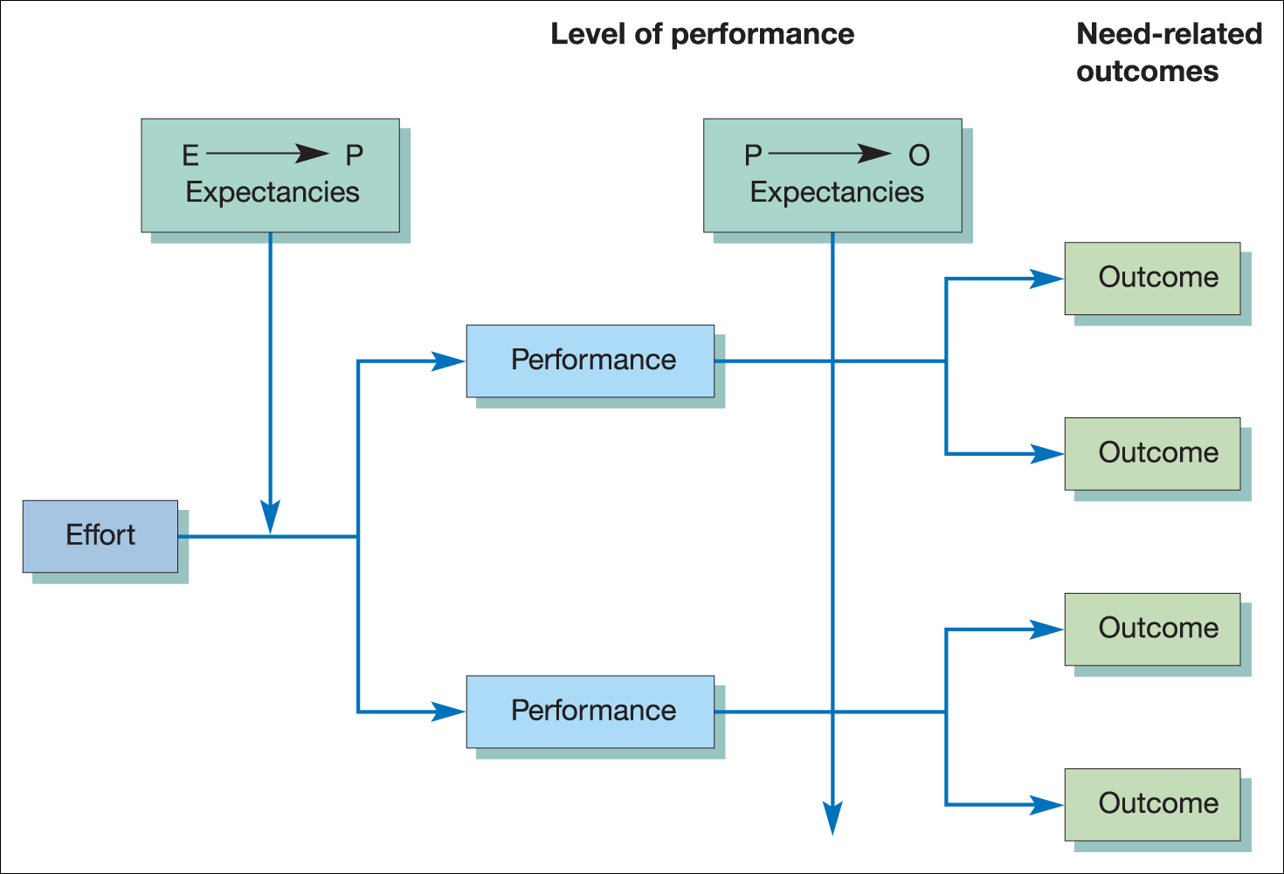
Lawler’s revised expectancy model
Figure 7.9 An illustration of the Lawler expectancy model

Slide 25
Implications of expectancy theories
Managers need to:
  use rewards appropriate in terms of individual performance;
  attempt to establish clear relationships between effort–performance and rewards, as perceived by the individual;
  establish clear procedures for the evaluation of individual levels of performance;
  pay attention to intervening variables;
  minimise undesirable outcomes that may be perceived to result from a high level of performance, e.g. industrial accidents.

Slide 26
Equity theory of motivation: Adams
Equity theory focuses on people’s feelings of how fairly they have been treated in comparison with the treatment received by others
Suggests six broad types of possible behaviour which result from a sense of inequity
  Changes to inputs
  Changes to outcomes
  Cognitive distortion (of inputs and outcomes)
  Leaving the field
  Acting on others
  Changing the object of comparison

Slide 27
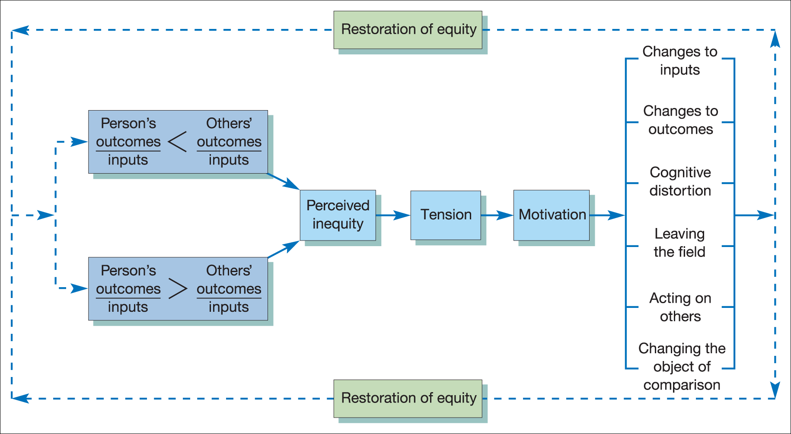
Illustration of Adams’ equity theory
Figure 7.10 An illustration of Adams’ equity theory of motivation

Slide 28
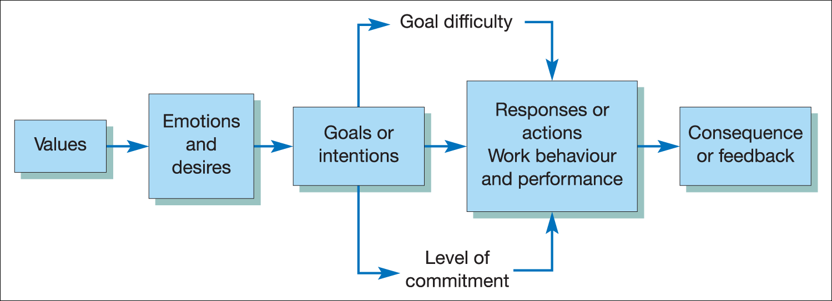
Goal theory: Locke
Figure 7.11 An illustration of Locke’s theory of goal-setting

Slide 29
Implications of goal theory
Practical implications for the manager of goal theory include:
  The need for systematic identification of specific performance goals.
  The need for goals to be challenging but realistic.
  The importance of complete, accurate and timely feedback on results.
  The need for goals to be determined either by a superior or by the individual themselves.

Slide 30
Organisational behaviour modification (OBMod)
Luthans and Kreitner suggest that OBMod ‘represents a merging of behavioral learning theory on the one hand and organizational behavior theory on the other’.
Five steps to learn desired and eliminating undesired behaviours:
  Identify behaviours relevant to desired organisational performance.
  Measure the frequency with which they occur as a baseline.
  Determine antecedents, reinforcements and consequences.
  Develop an intervention strategy for positive change.
  Measure and evaluate the change.

Slide 31
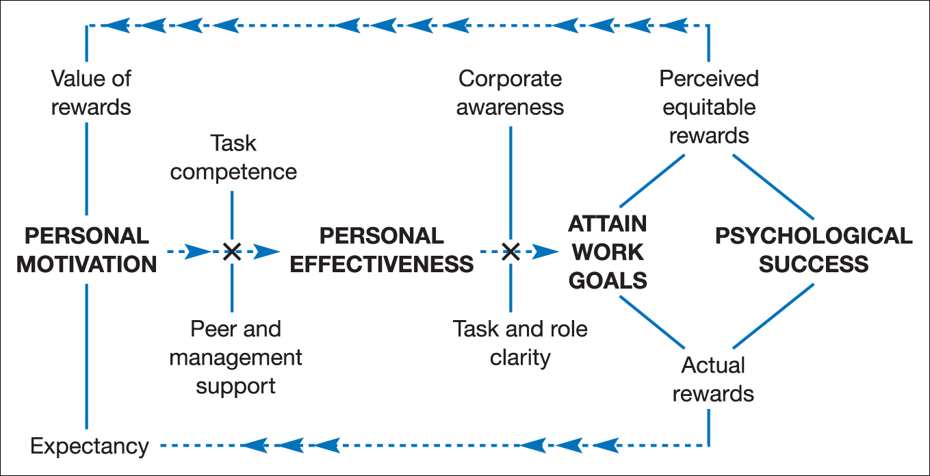
Motivation of knowledge workers
Figure 7.13 Motivating knowledge workers
Source: Tampoe, M. ‘Knowledge Workers: The New Management Challenge’, Professional Manager, Institute of Management, November 1994, p. 13. Reproduced with permission
from Chartered Management Institute.

Slide 32
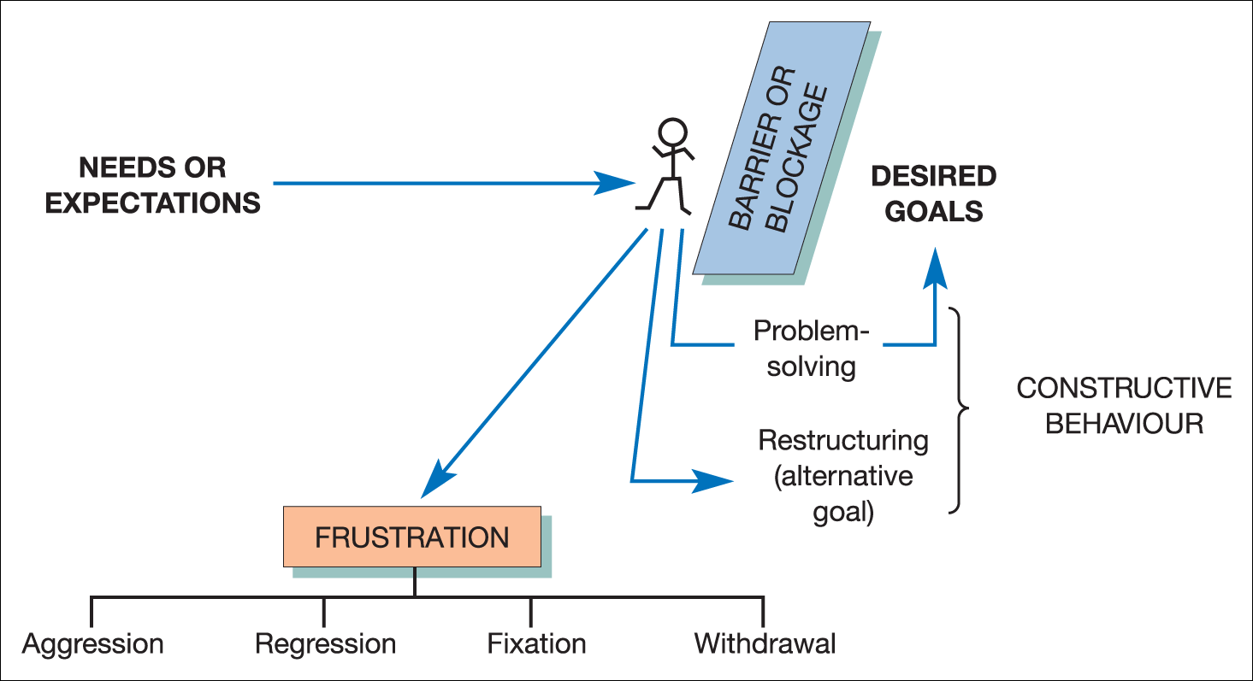
Frustration-induced behaviour
Figure 7.14 A basic model of frustration

Slide 33
Negative responses to frustration
Negative reactions to the blockage of a desired goal can take many forms, including one or a combination of:-
Aggression – a physical or verbal attack
Regression – reverting to childish behaviour
Fixation – persisting in a form of behaviour which has no positive results
Withdrawal – apathy and resignation

Slide 34
Factors influencing individual reactions to frustration
The strength of motivation
The level and potency of need
The degree of attachment to the desired goal
The perceived nature of the barrier or blocking agent
The personality characteristics of the individual

Slide 35
Reducing potential frustration
Effective recruitment, selection and socialisation
Training and development
Job design and work organisation
Equitable HRM policies
Recognition and rewards
Effective communications
Participative styles of management
Attempting to understand the individual’s perception of the situation

Slide 36
Job satisfaction
An attitude or internal state that is associated with the working environment and working experiences.
A key question:
  Does job satisfaction cause good performance or does good performance cause job satisfaction?

Slide 37
Dimensions of job satisfaction
Levels of job satisfaction can be affected by a wide range of variables including:
  Individual factors
  Social factors
  Cultural factors
  Organisational factors
  Environmental factors

Slide 38
Alienation at work
Alienation refers to the detachment of the person from their work role. Marx viewed the division of labour as a means by which workers became estranged from their work.
Blauner identifies four dimensions of
alienation:
  Powerlessness
  Meaninglessness
  Isolation
  Self-estrangement

Slide 39
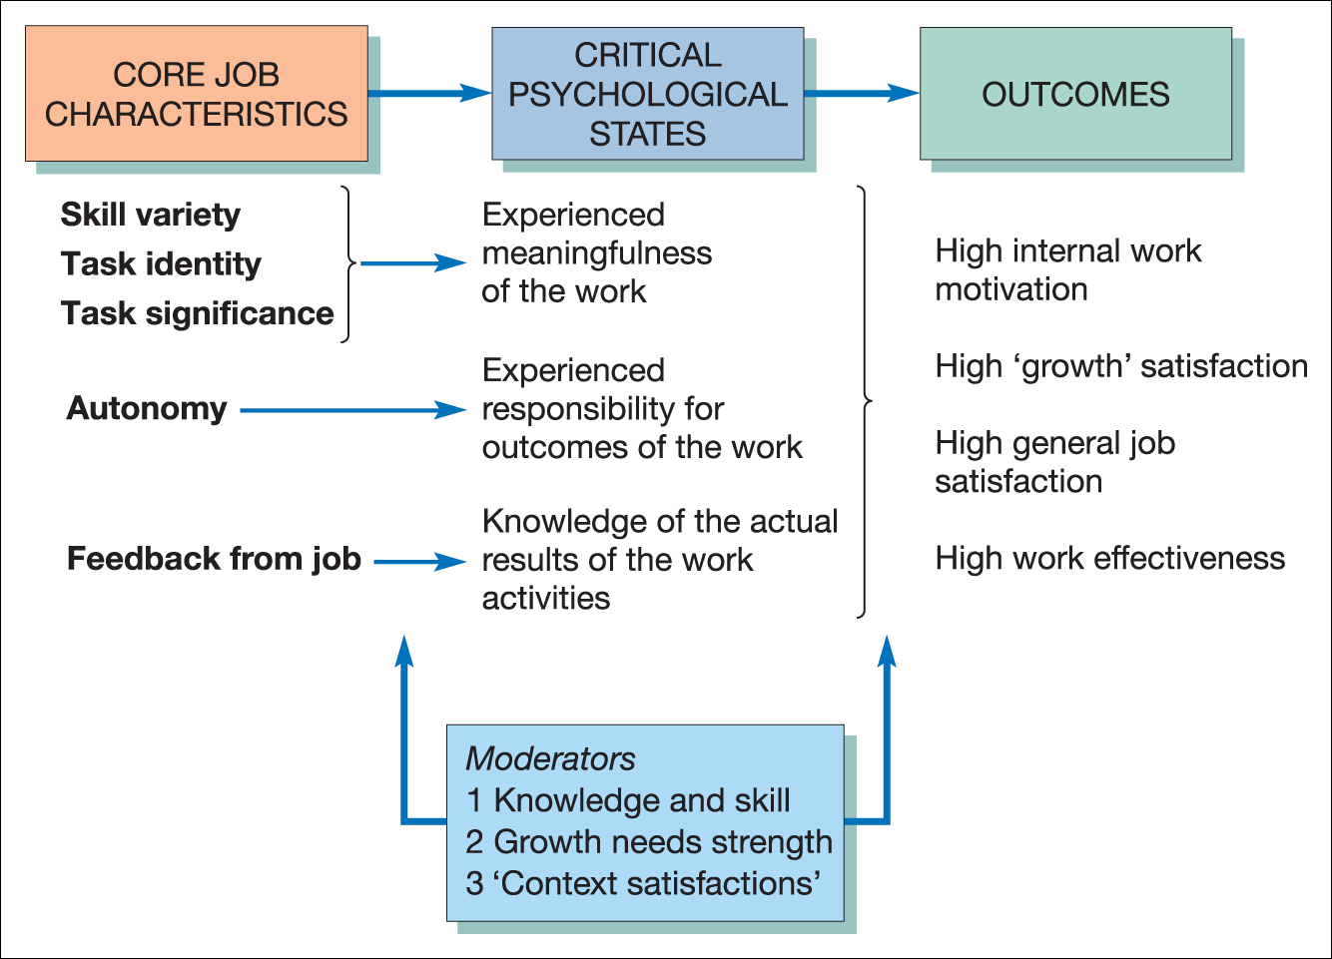
Comprehensive model of job enrichment
Figure 7.15 A job characteristics model of work motivation
Source: Hackman, J. R. and Oldham, G. R. Work Redesign, 1st ed., © 1980, Addison-Wesley Publishing Company, Inc. (1980), Figure 4.6, p. 90. Reproduced with permission from Pearson Education, Inc.

Slide 40
Job enrichment and work motivation
By increasing the skill variety, task identify, task significance, autonomy and feedback processes, job enrichment can create three positive psychological states:
  Experienced meaningfulness of the work
  Experienced responsibility for the outcome
  Knowledge of the actual results
Hackman and Oldham

Slide 41
Motivating potential score
Hackman and Oldham
MPS =
{Skill variety + Task identify + Task significance}
X Autonomy X Feedback
3

Slide 42
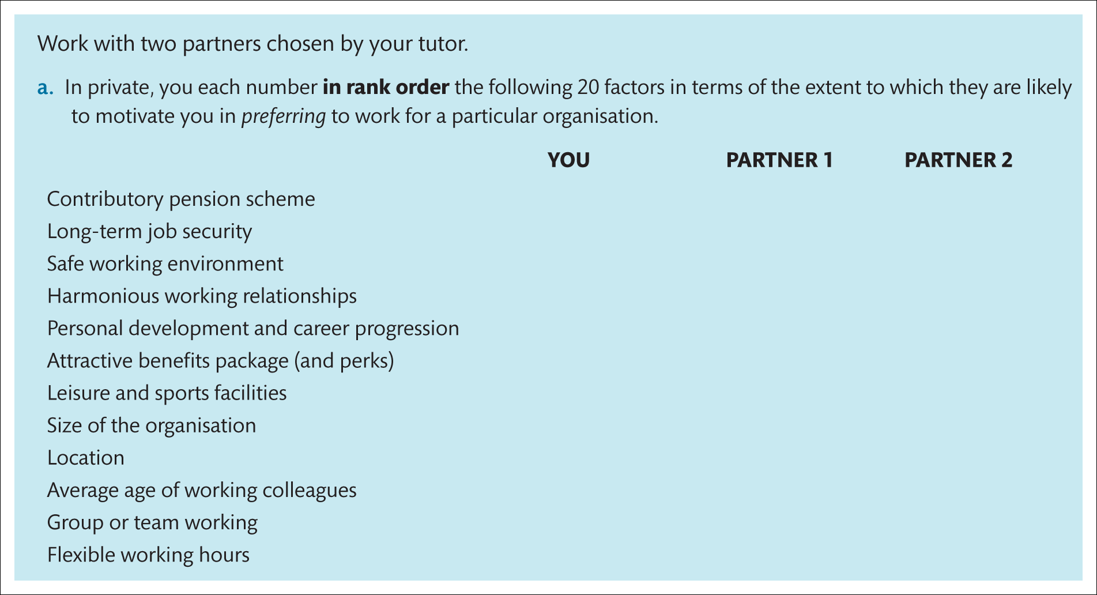
Assignment

Slide 43
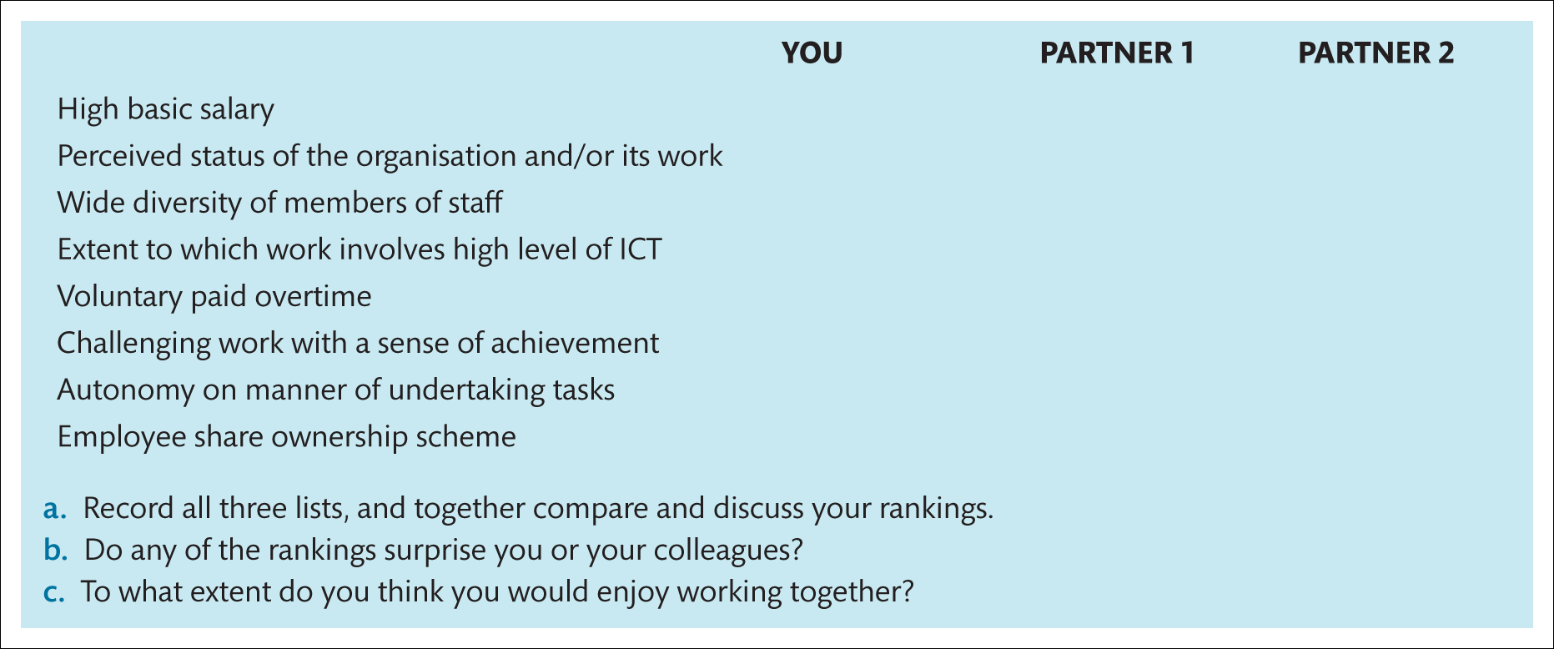
Assignment (Continued)

Slide 44


