Slide 2
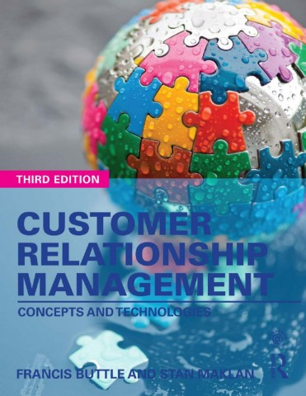

Slide 3
Part 1
Understanding Customer Relationships
Chapter 4
Managing Customer Lifecycle
Customer Retention and Development

Slide 4
Learning Objectives
By the end of this chapter you will be aware of:
What is meant by the terms ‘customer retention’ and ‘customer development’.
The economics of customer retention.
How to select which customers to target for retention.
The distinction between positive and negative customer retention strategies.
Several strategies for improving customer retention performance.
Several strategies for growing customer value.
CRM technologies that facilitate growth in customer value.
Why and how customers are ‘sacked’.

Slide 5
Customer Lifecycle Core Stages
Customer Acquisition
Customer Retention
Customer Development

Slide 6
What is Customer Retention?
Customer retention is the number of customers doing business with a firm at the end of a financial year expressed as percentage of those who were active customers at the beginning of the year.
Important Notes
Retention rate should not always be measured based on one year, but rather, it depends on the customer repurchase cycle.
It is more complex when companies sell a range of products and services each with different repurchase cycle.

Slide 7
Information System Database
Location of customer-related data on the system play a role in measuring customer retention rate.
Product silos - product based information system. Example: Insurance companies.
Channel silos – Buying from different dealers.
Functional silos - Not integrated to a whole-of-customer perspective

Slide 8
Three Measures of Customer Retention
Raw customer retention rate.
The number of customers doing business with a firm at the end of a trading period expressed as a percentage of those who were active customers at the beginning of the period.
Sales-adjusted retention rate.
The value of sales achieved from the retained customers expressed as a percentage of the sales achieved from all customers who were active at the beginning of the period.
Profit-adjusted retention rate.
The profit earned from the retained customers expressed as a percentage of the profit earned from all customers who were active at the beginning of the period.

Slide 9
Managing Customer Retention or Value Retention?
Focus on retaining customers that contribute value.
Focus on retention of share-of-wallet and customer spending.
Manage migration rather than defection - customers may use more than one supplier.
Measurement need to be sensitive to the Sales, Profitability and Value.
The Key is to retain “value-creating” customers.

Slide 10
Economics of Customer Retention
Increasing purchases as tenure grows
Trust and commitment grow in a satisfactory relationship.
Lower customer management costs over time
Customer acquisition cost is higher than relationship maintenance cost over tenure length, specially in B2B as it can be measured.
Customer referrals
Frequent buyers are heavier referrers (WOM advocates)
Premium prices
Satisfied customers are prepared to pay higher prices.

Slide 11
Which Customers to Retain?
Customers with great strategic value:
High CLV
Low retaining cost vs. profits gained
Highly committed customers do not require high retaining cost
Valuable customers may change over time – focus on the 5% that make 50% of the profit
Retention efforts depend on the current value of the customer, the potential for value growth and the cost of relationship maintenance/development

Slide 12
Strategies For Customer Retention
Customer retention strategies vary according to the environment in which the company competes.
Positive Customer Retention Strategies - reward a customer for remaining in a relationship
Negative Customer Retention Strategies –Penalizing their exit from a relationship

Slide 13
Positive Customer Retention Strategies
Customer Delight
Understand the customer - Surprise the customer - Exceed customer expectation
CD = P > E
CD = Customer Delight, P = Perception of performance, E = Expectation
Should Manage expectations or Manage performance
Customer’s expectations: Product quality, Service responsiveness, Price stability, Physical appearance
Online Customer’s expectations: Rapid and accurate order fulfilment, good price, high levels of customer service and website functionality.
Hard to consistently delight the customer because of competition.
CRM is grounded on detailed customer-related knowledge.

Slide 14
Positive Customer Retention Strategies
Kano’s Customer Delight Model
Product quality model:
Basic Qualities the customer routinely expects in the product. (Often unexpressed until the product fails)
Linear Quality. Attributes that the customer wants. Better performance generates better customer satisfaction.
Attractive Quality. Attributes that surprise, delight and excite the customer.
Customers can be delighted in two ways: by enhancing linear qualities beyond expectations and by creating innovative attractive qualities

Slide 15
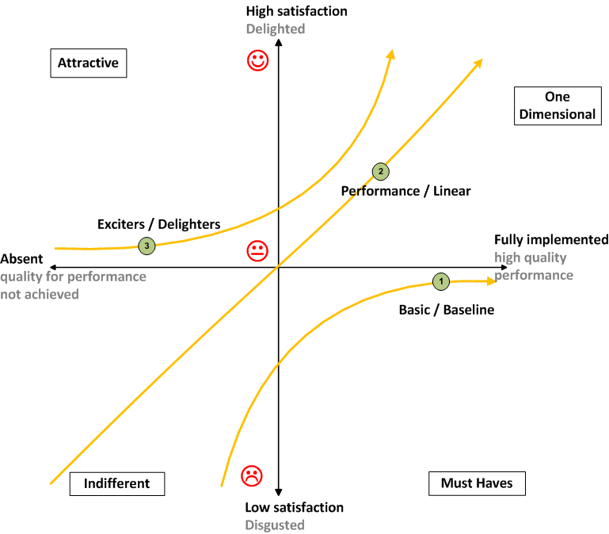
Kano’s Model For Creating Customer Delight

Slide 16
Positive Customer Retention Strategies
Add Customer-Perceived Value 01/02
Additional value as the customers buy and use products and services.
Loyalty schemes:
A loyalty scheme is a customer management programme that offers delayed or immediate incremental rewards to customers for their cumulative patronage.
Customer Clubs:
A customer club is a company-run membership organization that offers a range of value-adding benefits exclusively to members.

Slide 17
Positive Customer Retention Strategies
Add Customer-Perceived Value 01/02
Sales promotions
In pack or on-pack voucher: for future purchases.
Rebate or cash-back: refunds from purchases.
Patronage awards: collecting store receipts to get cash or a gift related to the volumes purchased.
Free premium for continuous purchase: collecting receipts to receive a gift.
Collection schemes: collectible items, like sports stars.
Self-liquidating premium: Collecting receipts and pay money to buy a discounted premium product.

Slide 18
Positive Customer Retention Strategies
Bonding (In B2B)
Bonds between customers and suppliers include interpersonal bonds, technology bonds (as in electronic data interchange – EDI), legal bonds and process bonds.
Social Bonds – linking people of the 2 organizations
Positive interpersonal relationships between people are characterized by high levels of trust and commitment.
Structural Bonds – linking organizations (Ex. Alliance or Joint Venture) When companies and customers commit resources to a relationship. A joint customer–supplier quality team can work on Improving quality compliance, benefiting both companies.
(Financial bonds - Legal bonds - Equity bonds - Knowledge-based bonds - Technological bonds - Process bonds - Values-based bonds - Geographic bonds - Project bonds - Multi-product bonds)

Slide 19
Positive Customer Retention Strategies
Build Customer Engagement
Customer satisfaction is not enough to ensure customer longevity.
Increase levels of customer engagement instead of only focusing on customer satisfaction.
Develop “Customer Relationship Management”.
Engaged customers have greater loyalty to brands (or organizations) and become highly resistant to competitive influence.
Engagement has a multidimensional composition of four elements:
The cognitive and affective elements reflect the experiences and feelings of customers, and
The behavioural and social elements capture brand or organizational participation by consumers, beyond merely buying the firms’ offerings

Slide 20
Building Interactive Relationships With Consumers
Gamification: The use of game-like mechanics in non-game contexts.
Relational attachment: Customers develop emotional tie with an individual person, a work group or the company as a whole. Using ‘my banker’ - ‘my mechanic’ - ‘my builder’.
Values-based attachment: Customers develop emotional attachment when their personal values are aligned with those of the company.

Slide 21
Context Makes a Difference
Context makes a difference to customer retention according to:
Number of competitors
Corporate culture.
Channel configuration
Purchasing practices
Ownership expectations
Ethical concerns

Slide 22
Key Performance Indicators (KPIs) of Customer Retention Programmes
KPIs to measure the impact of the customer retention strategies and tactics:
Raw customer retention rate
Raw customer retention rate in each customer segment
Sales-adjusted retention rate
Sales-adjusted retention rate in each customer segment
Profit-adjusted retention rate
Profit-adjusted retention rate in each customer segment
Cost of customer retention
Share-of-wallet of the retained customers
Customer churn rate per product category, sales region or channel

Slide 23
The Role of Research on Reducing Customer Churn Rate
Research must answer the following questions by contacting former customers:
Why are customers churning?
Are there any lead indicators of impending defection?
What can be done to address the root causes?

Slide 24
Strategies for Customer Development
Cross-selling: (To grow share-of-wallet)
Selling additional products and services to an existing customer.
Up-selling:
Selling higher priced or higher margin products and services to an existing customer.

Slide 25
CRM Technologies to Support Customer Development
Campaign management software
Event-based marketing
Data mining
Customization
Channel integration
Integrated customer communications
Marketing optimization

Slide 26
STRATEGIES FOR TERMINATING CUSTOMER RELATIONSHIPS
Relationships dissolve when one partner no longer views the relationship as worth continuing investment.
Companies terminate the relationship with customers who will never be profitable or who serve no other useful strategic purpose. Such as:
Fraudsters - Persistent late payers - Serial complainants - Capricious customers who change their minds with cost - Switchers who are in constant search for a better deal.

Slide 27
Strategies for Shedding Unprofitable Customers
Make them profitable by raising prices or cutting the cost-to-serve.
Un-bundle the offer – reprice the components and reoffer it to the customer.
Respecify the product - redesign the product so that it no longer appeals to the customer.
Reorganize sales, marketing and service departments so that they no longer focus on segments or customers you no longer wish to retain.
Introduce ABC class service - migrate customers down the service ladder

