Slide 2
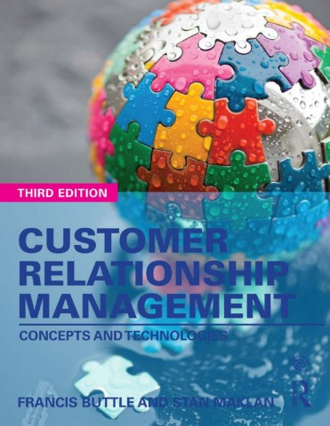

Slide 3
Part 1
Understanding Customer Relationships
Chapter 3
Managing Customer Lifecycle
Customer Acquisition

Slide 4
Learning Objectives
By the end of this chapter you will be aware of:
The meaning of the terms ‘customer lifecycle’ and ‘new customer’.
The strategies that can be used to recruit new customers.
How companies can decide which potential customers to target.
Sources of prospects in both business-to-business and consumer markets.
How to communicate with potential customers.
What offers can be made to attract new customers.
Key performance indicators for customer acquisition strategies.
The operational CRM applications that support customer acquisition.

Slide 5
Customer Lifecycle Core Stages
Customer Acquisition
Customer Retention
Customer Development

Slide 6
Customer Acquisition Plan
Three Main Concerns
Which prospects (potential new customers) will be targeted?
How will these prospects be approached?
What offer will be made?

Slide 7
What is a New Customer?
New to the product category
New existing need / change in customer status
Replacement of an existing solution
Product new uses/applications
New to the company
A lower value customer with a weaker commitment to the current supplier may be a better prospect

Slide 8
Portfolio Purchasing Strategic switching Acquire and retain customers - Share-of-wallet (SOW)
The Conversion Model - Jan Hofmey 01/02
Committed customers:
Entrenched customers - Unlikely to switch
Average customers - May switch in the medium term
Uncommitted customers:
Shallow customers/lower commitment than average – Consider alternatives
Convertible customers - Most likely to defect

Slide 9
Portfolio Purchasing Strategic switching Acquire and retain customers - Share-of-wallet (SOW)
The Conversion Model - Jan Hofmey 02/02
Non-customers are also segmented according to commitment scores into four availability subsets
Open non-customers:
Available non-customers – Ready to switch for alternative offer
Ambivalent non-customers - Attracted to alternative offer and current brand at the same time
Unavailable non-customers:
Weakly unavailable non-customers - Prefer their current brands
Strongly unavailable non-customers - Strong preference for their current brand

Slide 10
Prospecting B2B Environment
Sources of Business-to-Business Leads
Customers’ referrals
Online sources: Search engines — Company websites — Social media
Networking
Promotional activities: Attendee of events - Advertising response enquiries — Publicity — Email campaigning
Directories
Canvassing
Telemarketing

Slide 11
Prospecting B2C Context
Sources of Business-to-Customer Leads 01/02
Advertising
Message: Recall – Comprehension – Credibility - Feelings evoked - Intention-to-buy
Media:
Printed - High involvement products
Exposure (Reach & Frequency) - low involvement prospects
Media efficiency statistics: Response rate - Conversion rate
Sales Promotion
Product free sample - Free trial – Discounts – Coupons - Cash-back - Bonus packs - Banded packs - Free premiums - Cross-promotions – Lotteries – Competitions - Buzz or word-of-mouth (WOM)

Slide 12
Prospecting B2C Context
Sources of Business-to-Customer Leads 02/02
Social media
Engaging & interactive content
Merchandising
Point-of-sale (POS)
Other Tools
Customer’s referral - Consumer exhibitions - Free publicity - Telemarketing - SMS - Email and canvassing - product placement and product integration - Pitching

Slide 13
Key Performance Indicators of Customer Acquisition Programmes
How many customers are acquired?
What is the cost per acquired customer?
What is the value of the acquired customer over the longer term?

Slide 14
Making The Right Offer
Targeting new customers for acquisition requires considering what offer will be made to the target.
The ‘right offer’ might be influenced by the geographic location of the consumer.
Examples:
Special offers, Discounts, Added Value…

Slide 15
Operational CRM Tools That Help Customer Acquisition 01/02
Lead Management
B2B CRM software to manage the selling process
Sub-processes include: lead generation, lead qualification, lead allocation, lead nurturing and lead tracking.
Campaign Management – B2C and B2B
CRM technologies support Designing, Executing and Measuring of the Marketing Campaigns

Slide 16
Operational CRM Tools That Help Customer Acquisition 02/02
Event-based Marketing (EBM)
Provides opportunities to approach prospects at times of higher probability that leads to a sale.
Support from CRM Analytics
Ensures that the right offer is made to the right prospect through the right channel at the right time.

