Slide 1
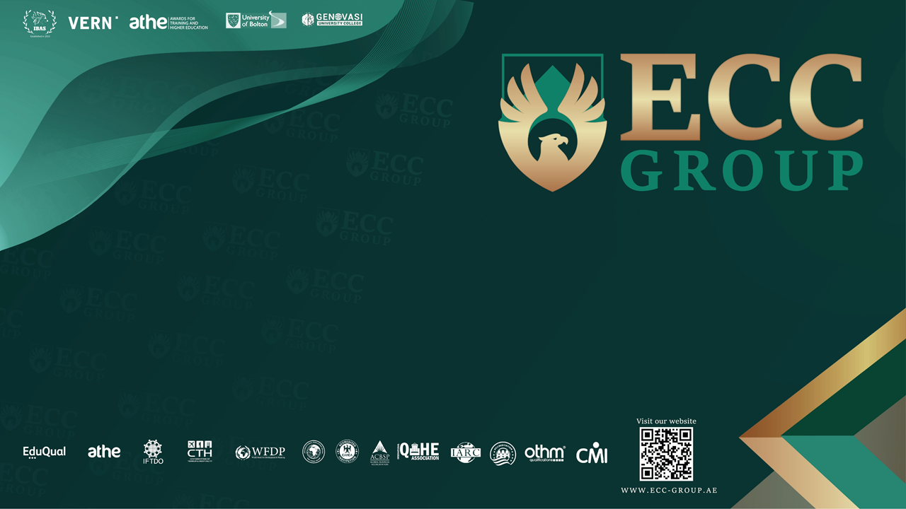

Slide 2
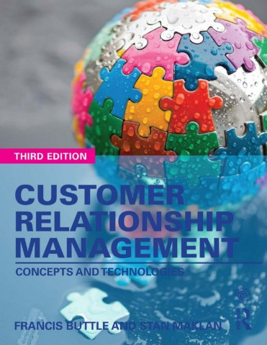

Slide 3
Part 1
Understanding Customer Relationships
Chapter 2
Understanding Relationships

Slide 4
Learning Objectives
By the end of this chapter you will be aware of:
How to recognize a relationship.
Attributes of successful relationships.
The importance of trust and commitment within a relationship.
Why companies and customers are sometimes motivated to establish and maintain relationships with each other, and sometimes not.
The meaning and importance of customer lifetime value.
The five different schools of thought that contribute to our understanding of relationships and relationship management.

Slide 5
What is a Relationship?
Supplier-Customer Relationship
A relationship is composed of a series of interactive episodes between dyadic parties over time.
In modern business
A business-to-business (B2B) Relationships are more complex – It involves many interpersonal relationships formed between people on both sides.

Slide 6
Change Within Relationships
Customer–Supplier Relationship’s Phases
Awareness
Being introduced as a possible exchange partner.
Exploration
Attraction; communication and bargaining; development and exercise of power; development of norms; and the development of expectations.
Expansion
Increasing interdependence. More transactions and trust begins to develop.
Commitment
Increased adaptation and mutually understood roles and goals.
Dissolution
Due to a breach of trust that forces a partner to reconsider the relationship

Slide 7
Attributes of Highly Developed Relationships
Investment in relationship-building has a long-term payoff
Essential Ingredients of a High-Quality Relationship
Trust
Benevolence: A belief that one party acts in the interests of the other.
Honesty: A belief that the other party’s word is reliable or credible.
Competence: A belief that the other party has the necessary expertise to perform as required.
Commitment
Arises from trust, shared values and the belief that partners will be difficult to replace.
Motivates partners to cooperate in order to preserve relationship investments.
Means partners forgo short-term alternatives in favour of more stable, long-term benefits associated with current partners.

Slide 8
Relationship Quality
Investments are made in relationships that are satisfactory.
Other important attributes of highly developed relationship
Relationship satisfaction
Mutual goals
Cooperative norms

Slide 9
Company’s Benefits of Relationship Building
The fundamental Reason is Economic
key strategy’s objectives
Identify, Acquire, Satisfy and Retain Profitable Customers
Key Definitions
Retention Rate Vs. Churn Rate
Tenure: The length of time a customer remains a customer
Customer Lifetime Value (CLV): The present-day value of all net margins earned from a relationship with a customer
Key Benefits
Reduced Marketing Costs
Advertising cost is 20 times more to recruit a new client than to retain an existing client.
Better Customer Insight
As customer tenure lengthens, suppliers are able to develop a better understanding of customer requirements and expectations.

Slide 10
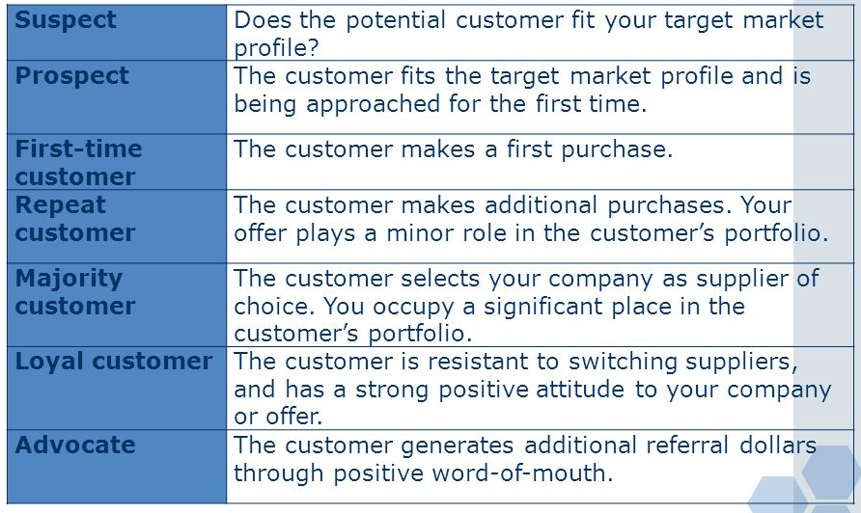
The Customer Journey

Slide 11
Retention Rate (Vs. Churn Rate) and Tenure
Improving customer retention rates has the effect of increasing the size of the customer base.
A larger customer base delivers better business performance.
Customer retention rates rise (or churn rates fall), so does the average tenure of a customer.
Retention Rate = ((E-N)/S) x 100.
E = Number of customers at end of the period.
N = Number of customers acquired during the period.
S = Number of customers at the start of the period.

Slide 12
CUSTOMER LIFETIME VALUE
Customer lifetime value is the present-day value of all net margins earned from a relationship with a customer, customer segment or cohort.
Computation of a meaningful CLV potential estimate requires information about the existing customers:
Forecast customer buying behaviour.
Product and service costs and prices.
The costs of capital (for determining the discount rate)
The costs of acquiring and retaining customers.

Slide 13
Benefits of CLV
The strategic objective is to identify and attract those customers or segments that have the highest CLV potential.
Revenues grow over time, as customers buy more.
Cost-to-serve is lower for existing customers.
Higher prices may be paid by existing customers.
Value-generating referrals made by satisfied customers - Customer Referral Value (CRV).

Slide 14
When Companies Resist Entering A Relationship With Customers
B2B & B2C
Loss of control: Ex. Free consultancy
Exit costs: Ex. Establishing a new production line for certain customer
Resource commitment: Ex. Special research & Development
Opportunity costs: Possibility of causing lost opportunities with other customers

Slide 15
Why Customers Want to Build Relationships with Suppliers?
In B2B
When a relationship can reduce or eliminate a perceived risk
Product complexity: Ex. Networking infrastructure
Product strategic significance. Ex. Supply of essential raw materials for a continuous process manufacturer
Service requirements: Ex. Machine tools
Purchase cost. Ex. Purchase of large pieces of capital equipment
Reciprocity: A financial audit practice may want a close relationship with a management consultancy.

Slide 16
Why Customers Want to Build Relationships with Suppliers?
In B2C
When the relationship delivers more benefits to the customer from acquiring, consuming or using the product or service
Recognition
Personalization
Power
Status
Affiliation

Slide 17
When Customers Do Not Want A Relationship With A Supplier
In B2B
Fear of dependency
Lack of perceived value in the relationship
Lack of confidence in the supplier
Customer lacks relational orientation when one party does not have a relationship orientation
Rapid technological changes

Slide 18
When Customers Do Not Want a Relationship With a Supplier
In B2C
Customers become more involved and emotionally engaged ONLY when products and services are personally important to them

Slide 19
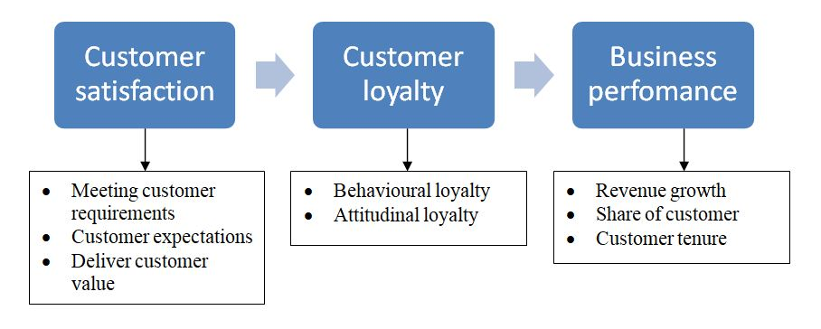
Customer Satisfaction, Loyalty and Business Performance

Slide 20
Customer Satisfaction
Customer satisfaction is the customer’s fulfilment response to a customer experience, or some part thereof.

Slide 21
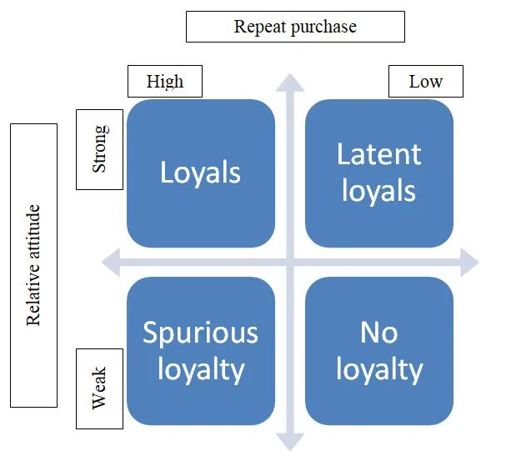
Customer Loyalty
Two-dimensional Model of Customer Loyalty

Slide 22
Business Performance
Balanced scorecard
Key performance indicators (KPI)
Financial
Customer
Process
Learning and growth
People (learning and growth) do things (Process) for customers (Customer) that have effects on business performance (Financial).

Slide 23
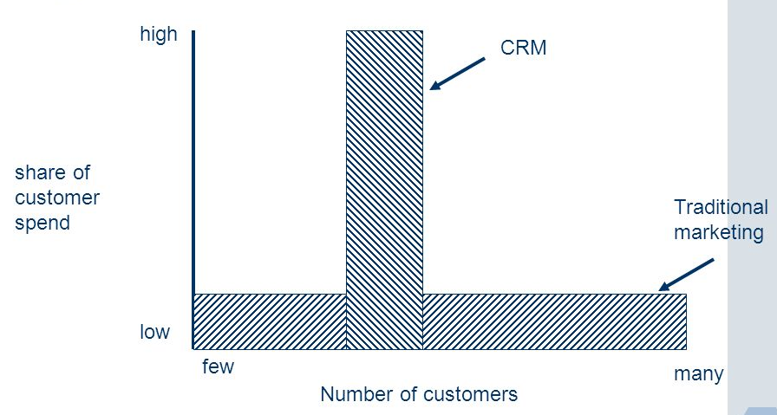
Business Performance Measure of CRM performance
Share of customer spend (share-of-wallet or SOW)
Market share versus share of customer

Slide 24
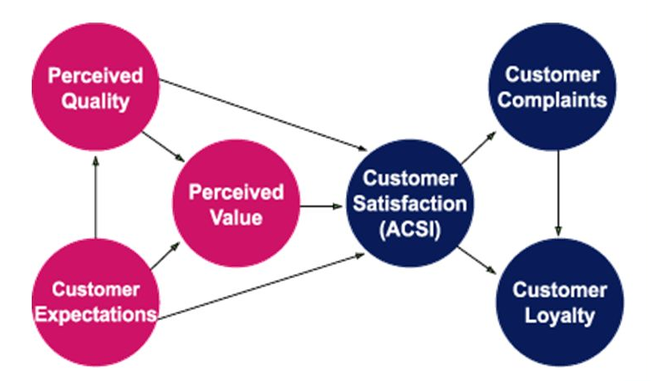
Researching the satisfaction–profit chain
The American Customer Satisfaction Index (ACSI) model

Slide 25
Relationships Management Theories
The Industrial Marketing and Purchasing school
The Nordic school
The Anglo-Australian school
The North American school
The Asian (guanxi) school

Slide 26
The Industrial Marketing and Purchasing (IMP)
Focuses on B2B Relationships
Main Characteristics
Buyers and sellers are both active participants in transactions – Their relationships are frequently long term
Relationships are composed of actor bonds, activity links and resources ties:
Actor bonds are interpersonal contacts between actors in partner firms that result in trust, commitment and adaptation between actors.
Activity links are the commercial, technical, financial, administrative and other connections that are formed between companies in interaction.
Resources are the human, financial, legal, physical, managerial, intellectual and other strengths or weaknesses of an organization.

Slide 27
The Nordic School
Application in B2B and B2C Environments
Focuses on the role of service in supplier–customer relationships
Main Characteristics
Interaction, Dialogue and Value – ‘Triplet of Relationship Marketing’
Relationship marketing: Done by a mutual fulfilment of promises.
The process of identifying and establishing, maintaining, enhancing, Or even terminating relationships with customers and other stakeholders.
Marketing can be defined as ‘interactions, relationships, and networks’.

Slide 28
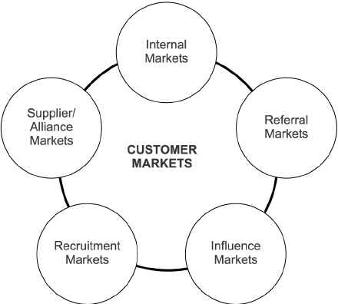
The Anglo-Australian School
Focuses on: customer retention, customer loyalty, customer satisfaction, customer relationship economics and value creation
Main Characteristics
Companies form relationships with customers, and a wide range of other stakeholders including employees, shareholders, suppliers, buyers and governments.
Major finding: Customer satisfaction and customer retention are drivers of shareholder value.
The Six-Markets Model

Slide 29
The North American School
Focuses on the connection between successful inter-firm relationships and excellent business performance
Also focuses on Buyer–Supplier dyads or strategic alliance/joint venture partnerships
Main Characteristics
Relationships reduce transaction costs
Trust and commitment are two very important attributes of successful relationships

Slide 30
The Asian (guanxi) School
Focuses on conducting business and other interpersonal relationships in the Chinese, and broader Asian, context - How Asian societies and economies work
The foundations of guanxi are Buddhist and Confucian teachings regarding the conduct of interpersonal interactions.
Guanxi refers to the informal social bonds and reciprocal obligations between various actors that result from some common social context, for example families, friendships and clan memberships. This is due due to the lack of codified, enforceable contracts such as those found in Western markets.

Slide 31
