Slide 2
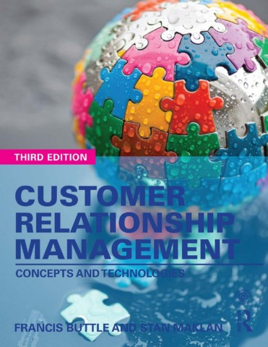

Slide 3
Part VI
Looking To The Future
Chapter 15
The Future

Slide 4
How It Started?
Relationship Marketing (RM)
Promotes the idea that long-term relationships with customers make sound economic sense.
Presented a radical change from a transaction-focused product brand marketing to a customer relationship management.

Slide 5
Today
CRM and e-commerce, and, now m-commerce.
The rise of social media.
Wearable technology and the ‘Internet of Things’ (IoT).
‘Siren Servers’, the largest most comprehensive data repositories.
Candidates for control of data, and hence the economy, include Google, Facebook, Amazon and perhaps big IT services firms such as IBM.
Artificial Intelligence (AI).
Immersive Technology: Virtual Reality (VR), Augmented Reality (AR), Mixed Reality (MR).

Slide 6
The Future
The average citizen provides his/her intellectual property for free, fuelling the profits of the siren servers.
Personal Data Stores (PDS) is a movement for returning that power to the people who generate those data.
CRM vendors are trying to integrate out-of-company data into CRM, so-called ‘social CRM’.

Slide 7
The Future
‘Additive’ or 3D printing is now affordable and feasible for millions.
With 3D printing, customer can co-design a product online and almost immediate manufacture and delivery can happen.
Zero inventory, zero logistics, no cost to manufacture borne by the supplier.

Slide 8
The Future
Senior business leaders for new skills in marketing to make sense of the data being generated in the CRM.
CRM as a set of business practices and a set of technologies will undergo considerable change over the next ten years.

