Slide 2
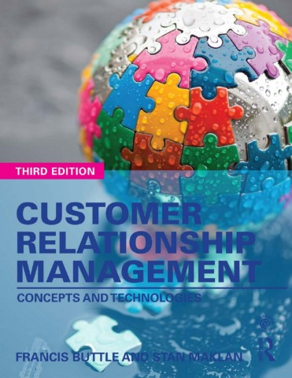

Slide 3
Part V
Realizing The Benefits of CRM
Chapter 13
Planning To Succeed

Slide 4
Learning Objectives
After reading this chapter you will understand how to:
• Generate a business case for CRM aligned both to your strategic
intention and the needs/behaviours of your customers.
• Identify and plan for the immediate operational benefits of CRM.
• Identify and plan for potential future benefits arising from improved operational effectiveness.
• Understand options for organizational structure to implement CRM strategy.

Slide 5
The Logic of The Business Case
How much incremental profit will be generated?
What is the ROI?
What is the risk?

Slide 6
Key Factors for CRM Success
Key Organization’s Capabilities
Excellent brand management
Customer-focused management
Employees
New product development
Organizational responsiveness

Slide 7
Investment in CRM
Investments in technology alone do not improve performance or economic output.

Slide 8
CRM ROI
Improved operational performance.
Duplicate databases are consolidated into a single view of the customer.
Front- and back-office integration is improved thus reducing costs.
Channels are integrated allowing the organization to serve customers anywhere at any time.
Self-service online reduces costs further.
Marketing campaigns are less costly to implement and may generate greater sales through improved customer selection.

Slide 9
Organizing For Benefits
‘strategy before structure’
The acquisition of carefully targeted customers or market segments.
The retention and development of strategically significant customers or market segments.
The continuous development and delivery of competitively superior value propositions and experiences to the selected customers.

Slide 10
Conventional customer management structures
Functional organization structure - Small to medium-sized businesses with narrow product ranges.
Geographic organization structure – International and local, face-to-face sales, service at remote locations.
Product, brand or category organization structure - Wide variety of products with different marketing, sales or service requirements.
Market or customer-based organization structure – Serving different customers or customer groups having different requirements or buying practices.
Matrix organization structure - several different product lines serving several different customer groups.

Slide 11
Network And Virtual Organizations
IT role to provide information to enable network members to:
Sense and respond rapidly to changes in the business environment.
Collaborate to develop and deliver better customer value propositions.
Enhance and share their learning about customers.
Improve their individual and joint cost profiles.

Slide 12
Preferred Characteristics of IT-enabled Organization’s Structure
“A branch-based transaction costs a bank 40 times the cost of an Internet transaction”
A customer interface that is consistent across channels and easy to use whatever the technology or device.
A first point of contact that takes responsibility for resolving the query.
A back-end architecture that enables the contact point to obtain relevant customer and product information immediately.

Slide 13
Person-To-Person Contacts
Controlled contact pattern - a single point of contact: seller-controlled and buyer-controlled.
Coordinated contact pattern - sales representative: seller-coordinated, buyer-coordinated and jointly coordinated.
Stratified contact pattern - individuals and departments on both sides manage their own contacts with their equivalents on the other side.

Slide 14
Reason for a Key Account Management (KAM) Structure 01/02
Concentration of buying power lies in fewer hands – Companies collaborate to secure better inputs.
Globalization - Global companies procure centrally but require goods and services to be provided locally.

Slide 15
Reason for a Key Account Management (KAM) Structure 02/02
Vendor reduction programmes - Customers deal with fewer vendors to enjoy benefits from improved relationships.
More demanding customers - Customers demand that suppliers eliminate non-value adding activities (to be more reliable, to have more responsive customer services, and achieve just-in-time delivery).

Slide 16
Benefits From a Key Account Management (KAM) Structure 01/02
Doing large business with few customers can reduce transaction costs that improves efficiency and effectiveness.
Selling at a relationship level can produce high and beneficial volume, turnover and profit.
Repeat business can be considerably cheaper to win than new business.

Slide 17
Benefits From a Key Account Management (KAM) Structure 02/02
Long-term relationships enable the use of facilitating technologies such as electronic data interchange (EDI) and shared databases.
Familiarity and trust reduce the need for checking and make it easier to do business.

Slide 18
A Model of KAM Development

Slide 19
Bow-tie Structure For Early KAM

Slide 20
Virtual Organization For Synergistic KAM

Slide 21
Team Selling
A more advanced forms of KAM.
May include people from engineering, logistics, research and development, and sales.
Collaborative team selling - two or more partnering organizations can jointly serve the customer.
Partner relationship management systems facilitate availability of information to all partners.

