Slide 2
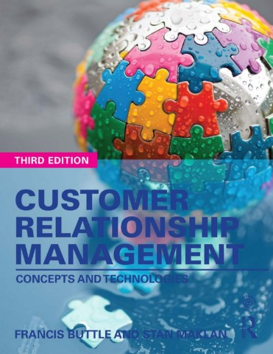

Slide 3
Part IV
Analytical CRM
Chapter 11
Developing and Managing Customer-Related Database

Slide 4
Learning Objectives
By the end of this chapter you will understand:
• The central role of customer-related data in the achievement of CRM outcomes.
• The importance of data quality to CRM performance.
• The issues that need to be considered in developing a customer-related database.
• How data integration contributes to CRM performance.
• The purpose of a data warehouse and data mart.
• The uses of knowledge management systems in CRM.

Slide 5
Databases For All CRM Forms
Strategic CRM uses customer-related data for acquisition, retention and development, and generate insight to develop value propositions.
Operational CRM uses customer-related data in the everyday selling, marketing and customer service operations of the business.
Analytical CRM uses customer-related data to support the marketing, sales and service decisions to enhance the value created for and from customers.

Slide 6
Corporate Customer-Related Data
Companies have a number of customer-related databases.
Databases capture customer-related data from a number of different functional perspectives – sales, marketing, service, logistics and account.
Data might be about individual customers, customer segments or entire market.
It may contain product information, competitor information and regulatory data.

Slide 7
Structured Data
Data stored in a fixed and named field in a record or file are called structured data.
Corporate databases are mostly structured.
Different types of Database:
Hierarchical – Org. chart or family tree like.
Network – Enhancement, but superseded by relational database
Relational – In current CRM application using structured data stored in spread-sheet like format.

Slide 8
Unstructured Data
Data do not fit a pre-defined data model.
Forms of Data:
Textual: emails, PowerPoint, Word doc., SMS, PDFs, spread - sheets, faxes and agent notes on a customer’s service history.
Non-textual: recorded tele - phone calls and other MP3 files, images in JPEG and other formats, video, etc.
Big Data: climate data, mobile phone GPS, etc.

Slide 9
Developing A Customer-Related Database

Slide 10
Data Integration
Single view of the customer

Slide 11
Data Warehousing
Subject-oriented. The warehouse organizes data around the essential subjects of the business – customers and products – rather than around applications such as inventory management or order processing.
Integrated. It is consistent in the way that data from several sources are extracted and transformed. For example, coding conventions are standardized: M = male, F = female.
Time-variant. Data are organized by various time-periods (e.g. months).
Non-volatile. The warehouse’s database is not updated in real time. There is periodic bulk uploading of transactional and other data. This makes the data less subject to momentary change.

Slide 12
Data Transformation

Slide 13
Data Marts
Data mart is a scaled-down version of the data warehouse, customized for use in a particular business function.
Functions can conduct separate analyses and make strategic and tactical decisions.
Typical examples: Marketing and sales.
Data mart projects are less complex projects.
Costs are lower because the volume of data stored is reduced, the number of users is capped and the business focus is more precise.
Technology requirements are less demanding.

Slide 14
Knowledge Management
Knowledge management is the practice of consciously gathering, organizing, storing, interpreting, distributing and judiciously applying knowledge to fulfil the customer management goals and objectives of the organization.

