Slide 1


Slide 2
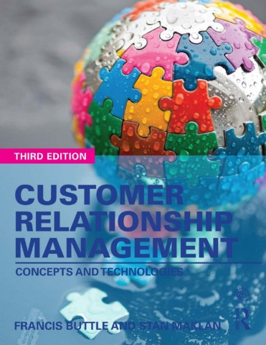

Slide 3
Part III
Operational CRM
Chapter 10
Service Automation

Slide 4
Learning Objectives
By the end of this chapter you will understand:
• What is meant by customer service.
• What is meant by service automation (SA).
• The benefits that SA can deliver to organizations.
• The functionality available within SA software.

Slide 5
Modelling Service Quality
The Nordic Model - Grönroos
Technical, Functional, Reputational
The North America School “SERVQUAL” - ‘Parsu’
Reliability, Assurance, Tangibles, Empathy, Responsiveness

Slide 6
Service Quality Theories
Grönroos model of service quality
Technical
The quality of the outcome of a service performance
Functional
The quality of the performance of a service
Reputational
The quality of the service organization’s image

Slide 7
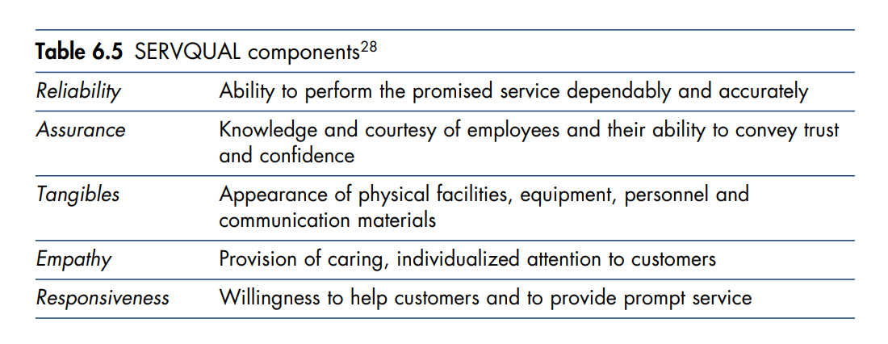
The SERVQUAL Model
‘PARSU”

Slide 8
Common Attributes of Excellent Customer Service
Customer service is pervasive - it is everyone’s responsibility.
Focus on pleasing customers - operations run with minimal product and service defect rates.
Looking for ways to improve.
Customer service lies at the heart of the value proposition - customer service is the main selling point.
Building personal relationships with customers.
Employing the latest technologies - interact with customers, understand customers’ need and want, and track activities and processes that influence customer experience.

Slide 9
Customer Service Excellence Certification
“Customer Service Excellence” - UK licensed certification body – Standard’s Criteria:
Customer insight - the ability to use Customers’ information to improve service delivery.
The culture of the organization - commitment of customer-focused culture across all levels.
Information and access - Putting the customer first to provide effective communications.
Delivery – getting customers’ feedback to improve.
Timeliness and quality of service – speed with quality

Slide 10
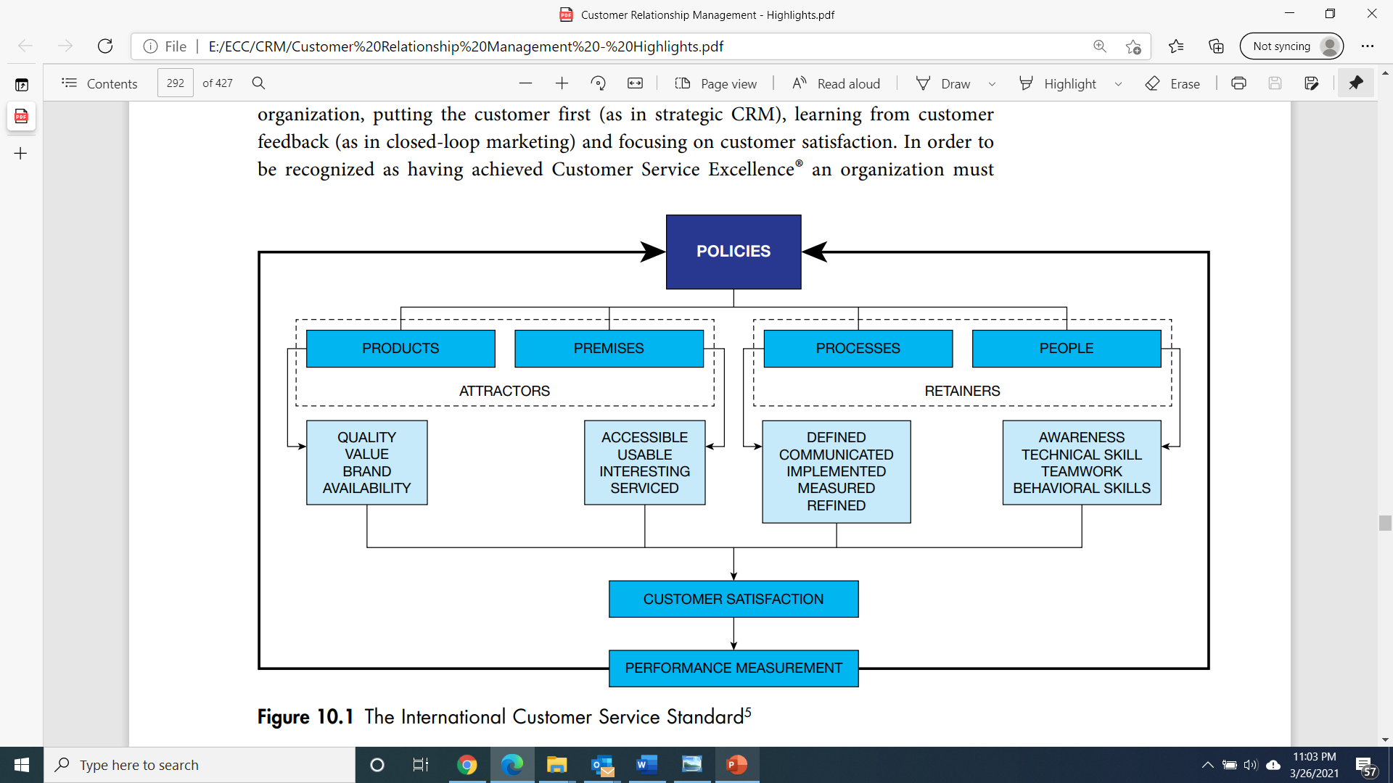
The International Customer Service Standard
5Ps of customer acquisition, retention and satisfaction

Slide 11
What is Service Automation?
Service automation
The application of computerized technologies to support service staff and management in the achievement of their work-related objectives.
Service automation is used in four major contexts
Contact centres
Call centres
Help desk
Field service

Slide 12
Benefits from Service Automation
Enhanced service effectiveness.
Enhanced service efficiency.
Greater service agent productivity.
Better agent work experience.
Improved customer experience.
Improved customer engagement
Improved customer retention.

Slide 13
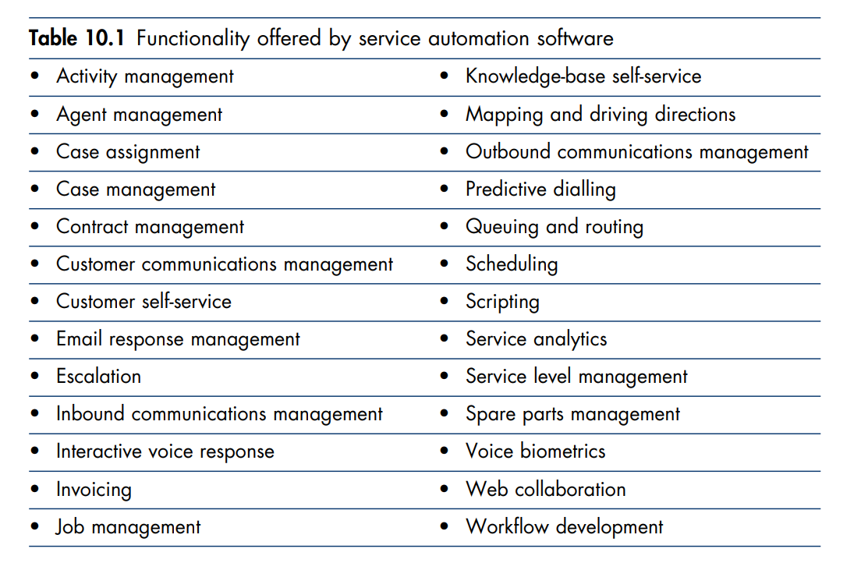
Software Applications For Service

Slide 14
KPI of Contact and Call Centres
Volumes received
Average queuing time
Average handle time (AHT)
Abandon rate
Average speed of answer
Response time
First call (or contact) resolution (FCR)
Self-service issue resolution

Slide 15


