Slide 1


Slide 2



BSc – Bachelor of Science – level 5
Operations Management

Slide 3

Location Planning and Analysis
  The Need for Location Decisions
  The Nature of Location Decisions
  Global Locations
  General Procedure for Making Location Decision
  Service and Retail Locations
  Evaluating Location Alternatives

Slide 4
1-The Need for Location Decisions
Location decisions represent a key part of the strategic planning process of virtually every organization. And, although it might appear that location decisions are one-time problems pertaining to new organizations, existing organizations often have a bigger stake in these kinds of decisions than new organizations. This chapter examines location analysis. It begins with a brief overview of the reasons firms must make location decisions, the nature of these decisions, and a general procedure for developing and evaluating location alternatives.
Existing organizations may need to make location decisions for a variety of reasons. Firms such as banks, fast-food chains, supermarkets, and retail stores view locations as part of marketing strategy, and they look for locations that will help them to expand their markets. Basically, the location decisions in those cases reflect the addition of new locations to an existing system. A similar situation occurs when an organization experiences a growth in demand for its products or services that cannot be satisfied by expansion at an existing location. The addition of a new location to complement an existing system is often a realistic alternative. Some firms face location decisions through depletion of basic inputs. For example, fishing and logging operations are often forced to relocate due to the temporary exhaustion of fish or forests at a given location. Mining and petroleum operations face the same sort of situation, although usually with a longer time horizon. For other firms, a shift in markets causes them to consider relocation, or the costs of doing business at a particular location reach a point where other locations begin to look more attractive.

Slide 5
  2-The Nature of Location Decisions
Location decisions for many types of businesses are made infrequently, but they tend to have a significant impact on the organization. In this section we look at the importance of location decisions, the usual objectives managers have when making location choices, and some of the options that are available to them.
Strategic Importance of Location Decisions
Location decisions are closely tied to an organization’s strategies. For example, a strategy of being a low-cost producer might result in locating where labor or material costs are low, or locating near markets or raw materials to reduce transportation costs. A strategy of increasing profits by increasing market share might result in locating in high-traffic areas, and a strategy that emphasizes convenience for the customer might result in having many locations where customers can transact their business or make purchases (e.g., branch banks, ATMs, service stations, fast-food outlets). Location choices can impact capacity and flexibility. Certain locations may be subject to space constraints that limit future expansion options. Moreover, local restrictions may restrict the types of products or services that can be offered, thus limiting future options for new products or services.
Objectives of Location Decisions
As a general rule, profit-oriented organizations base their decisions on profit potential, whereas nonprofit organizations strive to achieve a balance between cost and the level of customer service they provide. It would seem to follow that all organizations attempt to identify the “best” location available. However, this is not necessarily the case. In many instances, no single location may be significantly better than the others. There may be numerous acceptable locations from which to choose, as shown by the wide variety of locations where successful organizations can be found. Furthermore, the number of possible locations that would have to be examined to find the best location may be too large to make an exhaustive search practical. Consequently, most organizations do not set out with the intention of identifying the one best location; rather, they hope to find a number of acceptable locations from which to choose.

Slide 6
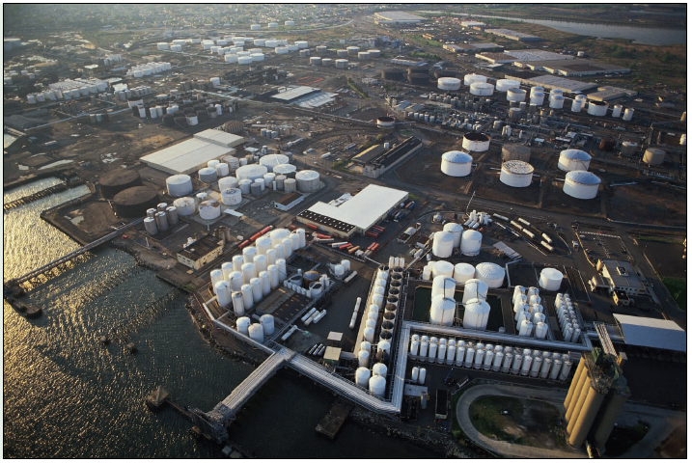
  2-The Nature of Location Decisions

Slide 7
  2-The Nature of Location Decisions
Supply Chain Considerations
Supply chain management must address supply chain configuration. This includes determining the number and location of suppliers, production facilities, warehouses, and distribution centers. The location of these facilities can involve a long-term commitment of resources, so known risks and benefits should be considered carefully. A related issue is whether to have centralized or decentralized distribution. Centralized distribution generally yields scale economies as well as tighter control than decentralized distribution, but it sometimes incurs higher transportation costs. Decentralized distribution tends to be more responsive to local needs. The importance of these decisions is underscored by the fact that they reflect the basic strategy for accessing customer markets, and the decisions will have a significant impact on costs, revenues, and responsiveness.
Location Options
Managers of existing companies generally consider four options in location planning. Expand an existing facility. This option can be attractive if there is adequate room for expansion, especially if the location has desirable features that are not readily available elsewhere. Expansion costs are often less than those of other alternatives. Add new locations while retaining existing ones. This is done in many retail operations. In such cases, it is essential to take into account what the impact will be on the total system. Opening a new store in a shopping mall may simply draw customers who already patronize an existing store in the same chain, rather than expand the market. On the other hand, adding locations can be a defensive strategy designed to maintain a market share or to prevent competitors from entering a market. Shut down at one location and move to another. An organization must weigh the costs of a move and the resulting benefits against the costs and benefits of remaining in an existing location. A shift in markets, exhaustion of raw materials, and the cost of operations often cause firms to consider this option seriously. Do nothing. If a detailed analysis of potential locations fails to uncover benefits that make one of the previous three alternatives attractive, a firm may decide to maintain the status quo, at least for the time being.

Slide 8
  3-Global Locations
Globalization has opened new markets, and it has meant increasing dispersion of manufacturing and service operations around the world. In addition, many companies are outsourcing operations to other companies in foreign locations. In the past, companies tended to operate from a “home base” that was located in a single country. Now, companies are finding strategic and tactical reasons to globalize their operations. As they do, some companies are profiting from their efforts, while others are finding the going tough, and all must contend with issues involved in managing global operations. In this section, we examine some of the reasons for globalization, the benefits, disadvantages, risks, and issues related to managing global operations.
Facilitating Factors
There are a number of factors that have made globalization attractive and feasible for business organizations. Two key factors are trade agreements and technological advances. Trade Agreements. Barriers to international trade such as tariffs and quotas have been reduced or eliminated with trade agreements such as the North American Free Trade Agreement (NAFTA), the General Agreement on Tariffs and Trade (GATT), and the U.S.–China Trade Relations Act. Also, the European Union has dropped many trade barriers, and the World Trade Organization is helping to facilitate free trade. Technology. Technological advances in communication and information sharing have been very helpful. These include faxing capability, e-mail, cell phones, teleconferencing, and the Internet.

Slide 9
  3-Global Locations
Benefits
Companies are discovering a wide range of benefits in globalizing their operations. Here is a list of some of the benefits, although it is important to recognize that not all benefits apply to every situation:
1-Markets. Companies often seek opportunities for expanding markets for their goods and services, as well as better serving existing customers by being more attuned to local needs and having a quicker response time when problems occur.
2-Cost savings. Among the areas for potential cost saving are transportation costs, labor costs, raw material costs, and taxes. High production costs in Germany have contributed to a number of German companies locating some of their production facilities in lower cost countries. Among them are industrial products giant Siemens, AG (a semiconductor plant in Britain), drug makers Bayer, AG (a plant in Texas), and Hoechst, AG (a plant in China), and automakers Mercedes (plants in Spain, France, and Alabama) and BMW (a plant in Spartanburg, South Carolina).
3- Legal and regulatory. There may be more favorable liability and labor laws, and less restrictive environmental and other regulations.
4-Financial. Companies can avoid the impact of currency changes that can occur when goods are produced in one country and sold in other countries. Also, a variety of incentives may be offered by national, regional, or local governments to attract businesses that will create jobs and boost the local economy. For example, state incentives, and workforce and land availability and cost, helped convince Nissan to build a huge assembly plant in Canton, Mississippi, and Mercedes to build an assembly plant in Vance, Alabama. An added benefit came when suppliers for these plants also set up facilities in the region.
5-Other. Globalization may provide new sources of ideas for products and services, new
perspectives on operations, and solutions to problems.

Slide 10
  3-Global Locations
Disadvantages
There are a number of disadvantages of having global operations. These can include the following:
1-Transportation costs. High transportation costs can occur due to poor infrastructure or having to ship over great distances, and the resulting costs can offset savings in labor and materials costs.
2-Security costs. Increased security risks and theft can increase costs. Also, security at international borders can slow shipments to other countries.
3-Unskilled labor. Low labor skills may negatively impact quality and productivity, and the work ethic may differ from that in the home country. Additional employee training may be required.
4-Import restrictions. Some countries place restrictions on the importation of manufactured goods, so having local suppliers avoids those issues.
5-Criticisms. Critics may argue that cost savings are being generated through unfair practices such as using sweatshops, in which employees are paid low wages and made to work in poor conditions; using child labor; and operating in countries that have less stringent environmental requirements.

Slide 11
  3-Global Locations
Risks
1-Political. Political instability and political unrest can create risks for personnel safety and the safety of assets. Moreover, a government might decide to nationalize facilities, taking them over.
2-Terrorism. Terrorism continues to be a threat in many parts of the world, putting personnel and assets at risk and decreasing the willingness of domestic personnel to travel to or work in certain areas.
3-Economic. Economic instability might create inflation or deflation, either of which can negatively impact profitability. Reebok advertisement in the window of Foot Locker in a recently developed Indian shopping mall
4-Legal. Laws and regulations may change, reducing or eliminating what may have been key benefits.
5-Ethical. Corruption and bribery, common in some countries, may be illegal in a company’s home country (e.g., illegal in the United States). This poses a number of issues. One is how to maintain operations without resorting to bribery. Another is how to prevent employees from doing this, especially when they may be of local origin and used to transacting business in this way.
6-Cultural. Cultural differences may be more real than apparent. Walmart discovered that fact when it opened stores in Japan. Although Walmart has thrived in many countries on its reputation for low-cost items, Japanese consumers associated low cost with low quality, so Walmart had to rethink its strategy for the Japanese market.

Slide 12
  4-General Procedure for Making Location Decision
The way an organization approaches location decisions often depends on its size and the nature or scope of its operations. New or small organizations tend to adopt a rather informal approach to location decisions. New firms typically locate in a certain area simply because the owner lives there. Similarly, managers of small firms often want to keep operations in their backyard, so they tend to focus almost exclusively on local alternatives. Large established companies, particularly those that already operate in more than one location, tend to take a more formal approach. Moreover, they usually consider a wider range of geographic locations. The discussion here pertains mainly to a formal approach to location decisions. The general procedure for making location decisions usually consists of the following steps:
1. Decide on the criteria to use for evaluating location alternatives, such as increased revenues or community service.
2. Identify important factors, such as location of markets or raw materials.
3. Develop location alternatives:
  a. Identify a country or countries for location.
  b. Identify the general region for a location.
  c. Identify a small number of community alternatives.
  d. Identify site alternatives among the community alternatives.
4. Evaluate the alternatives and make a selection.

Slide 13
  5-Service and Retail Locations
Service and retail are typically governed by somewhat different considerations than manufacturing organizations in making location decisions. For one thing, nearness to raw materials is usually not a factor, nor is concern about processing requirements. Customer access is sometimes a prime consideration, as it is with banks and supermarkets, but not a consideration in others, such as call centers, catalog sales, and online services. Manufacturers tend to be cost-focused, concerned with labor, energy, and material costs and availability, as well as distribution costs. Service and retail businesses tend to be profit or revenue focused, concerned with demographics such as age, income, and education, population/drawing area, competition, traffic volume/patterns, and customer access/parking. Retail sales and services are usually found near the center of the markets they serve. Examples include fast-food restaurants, service stations, dry cleaners, and supermarkets. Quite often their products and those of their competitors are so similar that they rely on convenience to attract customers. Hence, these businesses seek locations with high population densities or high traffic. The competition/convenience factor is also important in locating banks, hotels and motels, auto repair shops, drugstores, newspaper kiosks, and shopping centers. Similarly, doctors, dentists, lawyers, barbers, and beauticians typically serve clients who reside within a limited area. Retail and service organizations typically place traffic volume and convenience high on the list of important factors. Specific types of retail or service businesses may pay more attention to certain factors due to the nature of their business or their customers. If a business is unique, and has its own drawing power, nearness to competitors may not be a factor. However, retail businesses generally prefer locations that are near other retailers because of the higher traffic volumes and convenience to customers. For example, automobile dealerships often tend to locate near each other, and restaurants and specialty stores often locate in and around malls. When businesses locate near similar businesses it is referred to as clustering. Medical services are often located near hospitals for convenience of patients. Doctors’ offices may be located near hospitals, or grouped in other, centralized areas with other doctors’ offices. Available public transportation is often a consideration. Good transportation and/or parking facilities can be vital to retail establishments. Downtown areas have a competitive disadvantage in attracting shoppers compared to malls because malls offer ample free parking and nearness to residential areas. Customer safety and security can be key factors, particularly in urban settings, for all types of services that involve customers coming to the service location (as opposed, say, to in-home services such as home repair and rug cleaning)

Slide 14
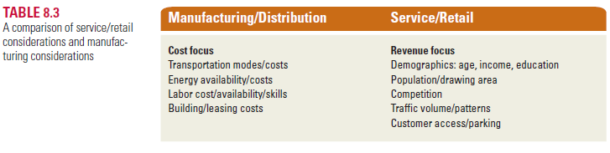
  5-Service and Retail Locations
Many retail firms have multiple outlets (locations). Among the questions that should beconsidered in such cases are the following:
1. How can sales, market share, and profit be optimized for the entire set of locations?
Solutions might include some combination of upgrading facilities, expanding some sites,adding new outlets, and closing or changing the locations of some outlets.
2. What are the potential sales to be realized from each potential solution?
3. Where should outlets be located to maximize market share, sales, and profits without negatively impacting other outlets? This can be a key cause of friction between the operator of a franchise store and the franchising company.
4. What probable effects would there be on market share, sales, and profits if a competitor located nearby?
Table 8.3 briefly compares service/retail site selection criteria with manufacturing criteria. More and more, retailers have to decide if they want to have both an online and a physical presence, or only one, and if so, which. The following reading outlines some considerations.

Slide 15
6-Evaluating Location Alternatives
There are a number of techniques that are helpful in evaluating location alternatives:
1-locational cost-profit-volume analysis : Technique for evaluating location choices in economic terms
2- factor rating : General approach to evaluating locations that includes quantitative and qualitative inputs.
3- the center of gravity method : Method for locating a distribution center that minimizes distribution cost.

Slide 16


