Slide 1

Finance for Managers

Slide 2
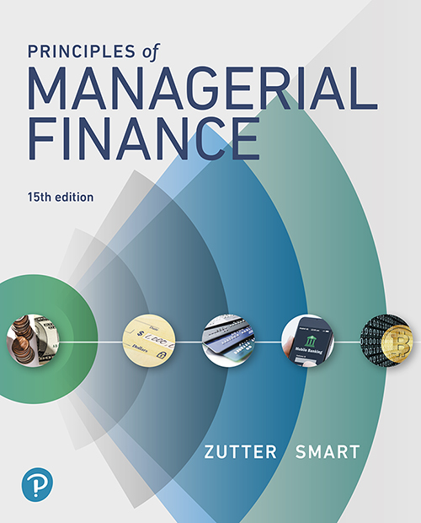
Principles of Managerial Finance
Fifteenth Edition
Chapter 1
The Role of Managerial Finance
Notes:
If this PowerPoint presentation contains mathematical equations, you may need to check that your computer has the following installed:
1) MathType Plugin
2) Math Player (free versions available)
3) NVDA Reader (free versions available)

Slide 3
Learning Goals (1 of 2)
LG 1 Define finance and the managerial finance function.
LG 2 Describe the goal of the firm, and explain why maximizing the value of the firm is an appropriate goal for a business.
LG 3 Identify the primary activities of the financial manager.
LG 4 Explain the key principles that financial managers use when making business decisions.

Slide 4
Learning Goals (2 of 2)
LG 5 Describe the legal forms of business organization.
LG 6 Describe the nature of the principal–agent relationship between the owners and managers of a corporation, and explain how various corporate governance mechanisms attempt to manage agency problems.

Slide 5
1.1 Finance and the Firm (1 of 3)
What Is Finance?
  Finance can be defined as the science and art of managing money
  At the personal level, finance is concerned with individuals’ decisions about:
    how much of their earnings they spend
    how much they save
    how they invest their savings

Slide 6
1.1 Finance and the Firm (2 of 3)
What Is Finance?
  In a business context, finance involves:
    how firms raise money from investors
    how firms invest money in an attempt to earn a profit
    how firms decide whether to reinvest profits in the business or distribute them back to investors
  Managerial finance concerns the duties of the financial manager in a business

Slide 7
1.1 Finance and the Firm (3 of 3)
What Is a Firm?
  A firm is a business organization that sells goods or services
  Firms exist because investors want access to risky investment opportunities

Slide 8
1.1 Finance and the Firm (1 of 7)
What Is the Goal of the Firm?
  Maximize Shareholder Wealth
    The primary goal of managers should be to maximize the wealth of the firm’s owners
    In most instances this is equivalent to maximizing the stock price
  Maximize Profit?
    Does profit maximization lead to the highest possible share price?
    For at least three reasons, the answer is often no:
      Timing
      Cash Flows
      Risk

Slide 9
Example 1.1 (1 of 2)
Nick Dukakis, the financial manager of Neptune Manufacturing, a producer of marine engine components, is choosing between two investments, Rotor and Valve. The following table shows the EPS Dukakis expects each investment to earn over its 3-year life.
Earnings per share (EPS)
Investment | Year 1 | Year 2 | Year 3 | Total for years 1, 2, and 3
Rotor | $1.40 | $1.00 | $0.40 | $2.80
Valve | 0.60 | 1.00 | 1.40 | 3.00

Slide 10
Example 1.1 (2 of 2)
If Dukakis thought he should make decisions to maximize profits, he would recommend that Neptune invest in Valve rather than Rotor because it results in higher total earnings per share over the 3-year period ($3.00 EPS compared with $2.80 EPS).

Slide 11
1.1 Finance and the Firm (2 of 7)
What Is the Goal of the Firm?
  Maximize Stakeholders’ Welfare?
    Some suggest a balanced consideration of the welfare of shareholders and other firm stakeholders
      Stakeholders include employees, suppliers, customers, and even members of the local community where a firm is located

Slide 12
1.1 Finance and the Firm (3 of 7)
What Is the Goal of the Firm?
  Maximize Stakeholders’ Welfare?
    Flaws in neglecting shareholder wealth maximization:
      Maximizing shareholder wealth does not in any way imply that managers should ignore the interests of everyone connected to a firm who is not a shareholder
      To maximize shareholder value, managers must necessarily assess the long-term consequences of their actions
      The stakeholder perspective is intrinsically difficult to implement, and advocates of the idea that managers should consider all stakeholders’ interests along with those of shareholders do not typically indicate how managers should carry it out

Slide 13
1.1 Finance and the Firm (4 of 7)
What Is the Goal of the Firm?
  Maximize Stakeholders’ Welfare?
    Flaws in neglecting shareholder wealth maximization:
      Many people misinterpret the statement that managers should maximize shareholder wealth as implying that managers should take any action, including illegal or unethical actions, that increases the stock price

Slide 14
1.1 Finance and the Firm (5 of 7)
The Role of Business Ethics
  Business ethics are the standards of conduct or moral judgment that apply to persons engaged in commerce
  The goal of such standards is to motivate business and market participants to adhere to both the letter and the spirit of laws and regulations concerned with business and professional practice

Slide 15
1.1 Finance and the Firm (6 of 7)
The Role of Business Ethics
  Ethical Guidelines
    Is the action arbitrary or capricious? Does it unfairly single out an individual or group?
    Does the action violate the moral or legal rights of any individual or group?
    Does the action conform to accepted moral standards?
    Are there alternative courses of action that are less likely to cause actual or potential harm?

Slide 16
1.1 Finance and the Firm (7 of 7)
The Role of Business Ethics
  Ethics and Share Price
    An effective ethics program can enhance corporate value by producing positive benefits
    Ethical behavior is for achieving the firm’s goal of owner wealth maximization

Slide 17
1.2 Managing the Firm (1 of 7)
The Managerial Finance Function
  Financial Managers’ Key Decisions
    Investment Decisions
    Capital Budgeting Decisions
    Financing Decisions
      Capital Structure Decisions
        The money that firms raise to finance their activities
      Working Capital Decisions
        Decisions that refer to the management of a firm’s short-term resources

Slide 18
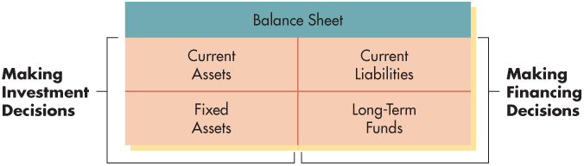
Figure 1.1 Financial Activities

Slide 19
1.2 Managing the Firm (2 of 7)
The Managerial Finance Function
  Principles That Guide Managers’ Decisions
    Time Value of Money
    Tradeoff between Return and Risk
    Cash Is King
    Competitive Financial Markets
    Incentives are Important

Slide 20
1.2 Managing the Firm (3 of 7)
The Managerial Finance Function
  Principal–Agent Problem
    A problem that arises because the owners of a firm and its managers are not the same people and the agent does not act in the interest of the principal

Slide 21
1.2 Managing the Firm (4 of 7)
The Managerial Finance Function
  Organization of the Finance Function
    CEO
      CFO
        Treasurer
        Controller
        Director of Investor Relations
        Director of Internal Audit
        Foreign Exchange Manager

Slide 22
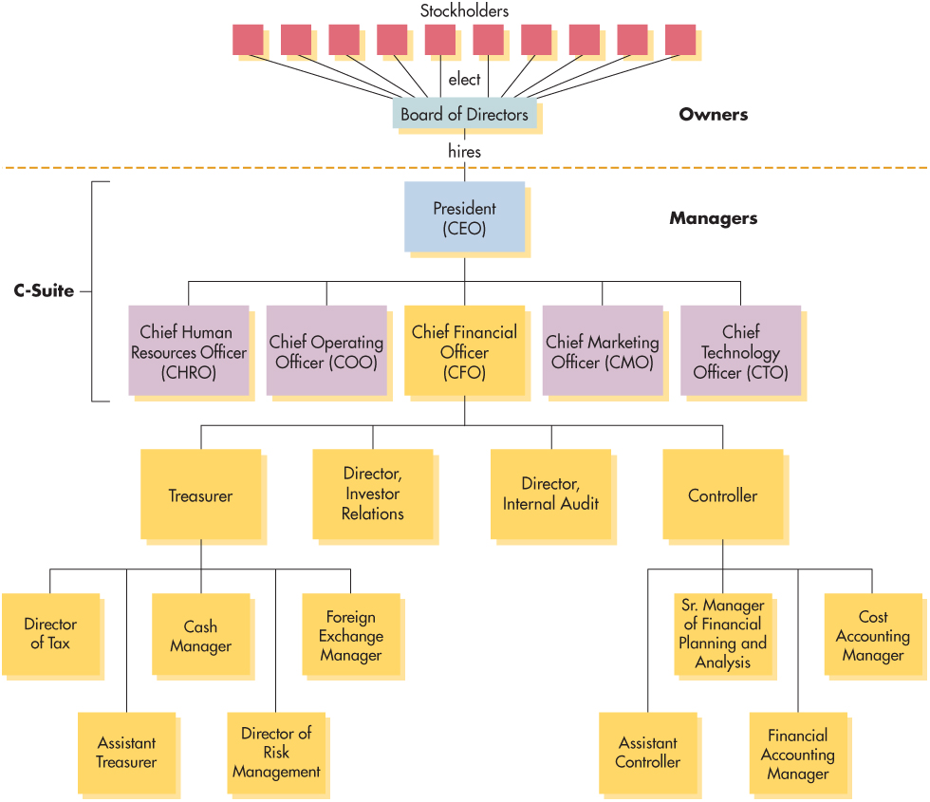
Figure 1.2 Corporate Organization

Slide 23
1.2 Managing the Firm (5 of 7)
The Managerial Finance Function
  Relationship to Economics
    Marginal Cost–Benefit Analysis
      Economic principle that states that financial decisions should be made and actions taken only when the marginal benefits exceed the marginal costs

Slide 24
Example 1.2 (1 of 2)
Jamie Teng is a financial manager for Nord Department Stores, a large chain of upscale stores operating primarily in the western United States. She is currently trying to decide whether to replace one of the firm’s computer servers with a new, more sophisticated one that would both speed processing and handle a larger volume of transactions. The new computer server would require a cash outlay of $8,000, and the old one could be sold to net $2,000. The future benefits from faster processing would be $10,000 in today’s dollars. The benefits over a similar period from the old computer (measured in today’s dollars) would be $3,000.

Slide 25
Example 1.2 (2 of 2)
Applying marginal cost–benefit analysis, Jamie organizes the data as follows:
Benefits with new computer | $10,000
Less: Benefits with old computer | 3,000
(1) Marginal benefits | $ 7,000
Cost of new computer | $ 8,000
Less: Proceeds from sale of old computer | 2,000
(2) Marginal costs | $ 6,000
Net benefit [(1) – (2)] | $ 1,000
Because the marginal benefits of $7,000 exceed the marginal costs of $6,000, Jamie recommends purchasing the new computer to replace the old one. The firm will experience a net benefit of $1,000 as a result of this action.

Slide 26
1.2 Managing the Firm (6 of 7)
The Managerial Finance Function
  Relationship to Accounting
    Emphasis on Cash Flows
      Accrual Basis
        Recognizes revenue at the time of sale and recognizes expenses when they are incurred
      Cash Basis
        Recognizes revenues and expenses only with respect to actual inflows and outflows of cash

Slide 27
Example 1.3 (1 of 2)
Nassau Corporation, a small yacht dealer, sold one yacht for $1,000,000 in the calendar year just ended. Nassau originally purchased the yacht for $800,000. Although the firm paid in full for the yacht during the year, at year’s end it has yet to collect the $1,000,000 from the customer. The accounting view and the financial view of the firm’s performance during the year are given by the following income and cash flow statements, respectively.

Slide 28
Example 1.3 (2 of 2)
Accounting view (accrual basis)
Nassau Corporation income statement for the year ended 12/31
Financial view (cash basis)
Nassau Corporation cash flow statement for the year ended 12/31
Sales revenue | $1,000,000
Less: Costs | 800,000
Net profit | $ 200,000
Cash inflow | $ 0
Less: Cash outflow | 800,000
Net cash flow | −$800,000
In an accounting sense, Nassau Corporation is profitable, but in terms of actual cash flow, it has a problem. Its lack of cash flow resulted from the uncollected accounts receivable of $1,000,000. Without adequate cash inflows to meet its obligations, the firm will not survive, regardless of its level of profits.

Slide 29
Personal Finance Example 1.4 (1 of 2)
Individuals rarely use accrual concepts. Rather, they rely mainly on cash flows to measure their financial outcomes. Generally, individuals plan, monitor, and assess their financial activities using cash flows over a given period, typically a month or a year. Ann Bach projects her cash flows during October 2018 as follows:
Item | Inflow | Outflow
Net pay received | $4,400
Rent | blank | −$1,200
Car payment | blank | −450
Utilities | blank | −300
Groceries | blank | −800
Clothes | blank | −750
Dining out | blank | −650
Gasoline | blank | −260
Interest income | 220 | Blank
Misc. expense | _____ | −425
Totals | $4,620 | −$4,835
Amount

Slide 30
Personal Finance Example 1.4 (2 of 2)
Ann subtracts her total outflows of $4,835 from her total inflows of $4,620 and finds that her net cash flow for October will be – $215. To cover the $215 shortfall, Ann will have to either borrow $215 (putting it on a credit card is a form of borrowing) or withdraw $215 from her savings. Alternatively, she may decide to reduce her outflows in areas of discretionary spending such as clothing purchases, dining out, or those items that make up the $425 of miscellaneous expense.

Slide 31
1.2 Managing the Firm (7 of 7)
The Managerial Finance Function
  Relationship to Accounting
    Decision Making
      Accountants devote most of their attention to the collection and presentation of financial data
      Financial managers evaluate the accounting statements, develop additional data, and make decisions based on their assessment of the associated returns and risks

Slide 32
1.3 Organizational Forms, Taxation, and the Principal–Agent Relationship (1 of 13)
Legal Forms of Business Organizations
  Sole Proprietorships
    Businesses owned by one person and operated for his or her own profit
      Unlimited Liability
        The condition of a sole proprietorship, giving creditors the right to make claims against the owner’s personal assets to recover debts owed by the business

Slide 33
1.3 Organizational Forms, Taxation, and the Principal–Agent Relationship (2 of 13)
Legal Forms of Business Organizations
  Partnerships
    Businesses owned by two or more people and operated for profit
      Articles of Partnership
        The written contract used to formally establish a business partnership

Slide 34
1.3 Organizational Forms, Taxation, and the Principal–Agent Relationship (3 of 13)
Legal Forms of Business Organizations
  Corporations
    Legal business entities with rights and duties similar to those of individuals but with a legal identity distinct from its owners
    Stockholders
      The owners of a corporation, whose ownership, or equity, takes the form of common stock or, less frequently, preferred stock
    Limited Liability
      A legal provision that limits stockholders’ liability for a corporation’s debt to the amount they initially invested in the firm by purchasing stock

Slide 35
1.3 Organizational Forms, Taxation, and the Principal–Agent Relationship (4 of 13)
Legal Forms of Business Organizations
  Corporations
    Stock
      A security that represents an ownership interest in a corporation
    Dividends
      Periodic distributions of cash to the stockholders of a firm
    Board of Directors
      Group elected by the firm’s stockholders and typically responsible for approving strategic goals and plans, setting general policy, guiding corporate affairs, and approving major expenditures

Slide 36
1.3 Organizational Forms, Taxation, and the Principal–Agent Relationship (5 of 13)
Legal Forms of Business Organizations
  Corporations
    President or Chief Executive Officer (CEO)
      Corporate official responsible for managing the firm’s day-to-day operations and carrying out the policies established by the board of directors

Slide 37
Table 1.1 Strengths and Weaknesses of the Common Legal Forms of Business Organization (1 of 2)
 | Sole proprietorship | Partnership | Corporation
Strengths | Owner receives all profits (and sustains all losses) Low organizational costs Income included and taxed on proprietor’s personal tax return Independence Secrecy Ease of dissolution | Can raise more funds than sole proprietorships Borrowing power enhanced by more owners More available brain power and managerial skill Income included and taxed on partner’s personal tax return | Owners have limited liability, which guarantees that they cannot lose more than they invested Can achieve large size via sale of ownership (stock) Ownership (stock) is readily transferable Long life of firm Can hire professional managers Has better access to financing

Slide 38
Table 1.1 Strengths and Weaknesses of the Common Legal Forms of Business Organization (2 of 2)
 | Sole proprietorship | Partnership | Corporation
Weaknesses | Owner has unlimited liability in that total wealth can be taken to satisfy debts Limited fund-raising power tends to inhibit growth Proprietor must be jack-of-all-trades Difficult to give employees long-run career opportunities Lacks continuity when proprietor dies | Owners have unlimited liability and may have to cover debts of other partners Partnership is dissolved when a partner dies Difficult to liquidate or transfer partnership | Taxes are generally higher because corporate income is taxed, and dividends paid to owners are also taxed at a maximum 15% rate More expensive to organize than other business forms Subject to greater government regulation Lacks secrecy because regulations require firms to disclose financial results

Slide 39
Matter of Fact (1 of 2)
Number of Businesses and Income Earned by Type of U.S. Firm
Although sole proprietorships greatly outnumber partnerships and corporations combined, they generate the lowest level of income. In total, sole proprietorships accounted for almost three-quarters of the number of business establishments in operation, but they earned just 10% of all business income. Corporations, on the other hand, accounted for just 17% of the number of businesses, but they earned almost two-thirds of all business income.

Slide 40
Matter of Fact (2 of 2)
blank | Sole proprietorships | Partnerships | Corporations
Number of firms (millions) | 25.3 | 3.4 | 5.8
Percentage of all firms | 73% | 10% | 17%
Percentage of all business income | 10% | 26% | 64%
Source: Overview of Approaches to Corporate Integration, Joint Committee on Taxation, United States Congress, May 17, 2016.

Slide 41
1.3 Organizational Forms, Taxation, and the Principal–Agent Relationship (6 of 13)
Business Organizational Forms and Taxation
Prior to 2018
  Proprietorships and partnerships taxed according to the same progressive rate structure as individual taxpayers
  Corporations taxed according to an alternative, mostly progressive rate structure
Marginal vs. Average Tax Rate
    The marginal tax rate represents the rate at which the next dollar of income is taxed while the average tax rate equals taxes paid divided by taxable income
    The marginal rate does not usually equal the average rate under a progressive tax rate structure
`

Slide 42
1.3 Organizational Forms, Taxation, and the Principal–Agent Relationship (7 of 13)
Business Organizational Forms and Taxation
After 2018 (Tax Cuts and Jobs Act)
  Proprietorships and partnerships still taxed according to a (revised) progressive rate structure
  Corporations taxed at a flat rate of 21%
  Under a flat tax, the marginal and average tax rates are equal
`

Slide 43
1.3 Organizational Forms, Taxation, and the Principal–Agent Relationship (8 of 13)
Legal Forms of Business Organizations
  Business Organizational Forms and Taxation
    Double Taxation
      A situation facing corporations in which income from the business is taxed twice—once at the business level and once at the individual level when cash is distributed to shareholders
    Ordinary Income versus Capital Gains
      Ordinary income is income earned by a business through the sale of goods or services while capital gains is income earned by selling an asset for more than it cost

Slide 44
Table 1.2 2018 Tax Rate Schedule for Single Taxpayer (Tax Rates Faced by Pass-Through Businesses Like Proprietorships and Partnerships)
Tax calculation
Taxable income brackets | Base tax | + | (Marginal rate × amount over bracket lower limit)
$ 0 to $ 9,525 | $ 0 | + | (10% × amount over $ 0)
9,525 to 38,700 | $ 953 | + | (12% × amount over $ 9,525)
38,700 to 82,500 | $ 4,454 | + | (22% × amount over $ 38,700)
82,500 to 157,500 | $ 14,090 | + | (24% × amount over $ 82,500)
157,500 to 200,000 | $ 32,090 | + | (32% × amount over $157,500)
200,000 to 500,000 | $ 45,690 | + | (35% × amount over $200,000)
Over 500,000 | $150,690 | + | (37% × amount over $500,000)
Notes:
Note that in the original printing of Principles of Managerial Finance, Table 1.2 showed the then-current progressive tax rate schedule that was replaced by the Tax Cuts and Jobs Act with a 21% flat rate structure. Newer printings show this version of Table 1.2 with tax rates applicable to partnerships and proprietorships. See the next slide for the original version of Table 1.2.

Slide 45
Pre-2018 Corporate Tax Rate Schedule
Tax calculation
Taxable income brackets | Base tax | + | (Marginal rate × amount over bracket lower limit)
$ 0 to $ 50,000 | $ 0 | + | (15% × amount over $ 0)
50,000 to 75,000 | $ 7,500 | + | (25% × amount over $ 50,000)
75,000 to 100,000 | $ 13,750 | + | (34% × amount over $ 75,000)
100,000 to 335,000 | $ 22,250 | + | (39% × amount over $ 100,000)
335,000 to 10,000,000 | $ 113,900 | + | (34% × amount over $335,000)
10,000,000 to 15,000,000 | $3,400,000 | + | (35% × amount over $10,000,000)
15,000,000 to 18,333,333 | $5,150,000 | + | (38% × amount over $15,000,000)
Over 18,333,333 | $6,416,667 | + | (35% × amount over $18,333,333)
Notes:
This rate structure appeared in versions of Principles of Managerial Finance prior to the passage of the Tax Cuts and Jobs Act. The new corporate tax rate structure is a 21% flat tax.

Slide 46
Example 1.5 (1 of 2)
Dan Webster is the sole proprietor of Webster Manufacturing. This year Webster earned $80,000 before taxes from his business. Assuming that Dan has no other income, the taxes he will owe on his business income (based on 2018 tax law) are as follows:
Total taxes due = (0.10 × $9,525) + [0.12 × ($38,700 − $9,525)]
+ [0.22 × ($80,000 − $38,700)]
= $953 + $3,501 + $9,086
= $13,540

Slide 47
Example 1.5 (2 of 2)
Notice that Webster’s tax liability has two components. The first $4,454 in tax, denoted in Table 1.2 as the base tax, is calculated by multiplying 10% times Webster’s first $9,525 in income and then multiplying 12% times Webster’s next $29,175 in income. The sum of those two calculations is the $4,454 base tax from line 3 in Table 1.2. On top of that, Webster must pay an additional 22% in taxes on income above $38,700.

Slide 48
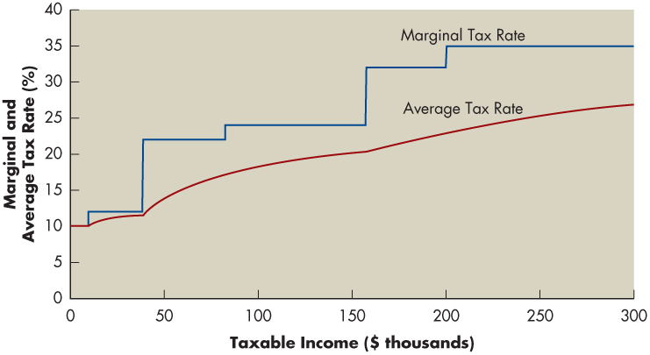
Figure 1.3 Marginal and Average Tax Rates at Different Income Levels for a Single Taxpayer (2018 Tax Rates)
Notes:
Note that for individuals and pass-through businesses like proprietorships and partnerships, the marginal tax rate usually exceeds the average tax rate. This is not true under the post-2018 corporate flat tax, because both the marginal and average tax rates are 21%. In the original printing of Principles of Managerial Finance, Figure 1.3 showed the marginal and average corporate tax rates under pre-2018 law. See next slide for the original version of Figure 1.3

Slide 49
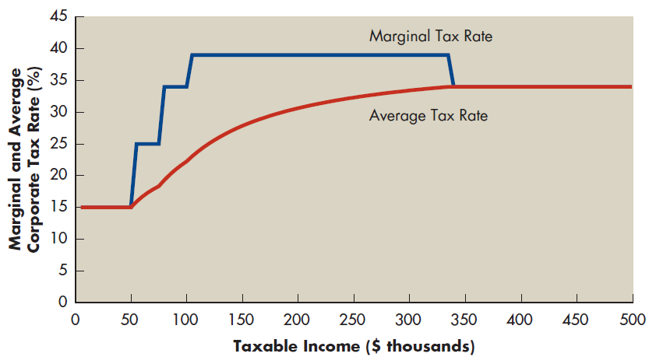
Pre-2018 Marginal and Average Tax Rates at Different Income Levels for a Single Taxpayer

Slide 50
Example 1.6 (1 of 2)
Peter Strong is a partner in Argaiv Software, and from that business he earned taxable income of $300,000. Assuming that this is Peter’s only source of income, from Table 1.2 we can see that based on Peter’s tax bracket, he faces a marginal tax rate of 35%. How much in tax does Peter owe, and what is his average tax rate? Table 1.2 shows a base tax of $45,690 for individuals with income above $200,000 but below $500,000. Here’s where that base tax comes from:
Base tax = (0.10 × $9,525) + (0.12 × $29,175) + (0.22 × $43,800)
+ (0.24 × $75,000) + (0.32 × $42,500)
= $953 + $3,501 + $9,636 + $18,000 + $13,600
= $45,690
Notes:
This example assumes that Argaiv Software is a partnership subject to the 2018 progressive rate structure for individuals and pass-through businesses. Earlier versions of PMF featured Argaiv Software as a corporation subject to the pre-2018 progressive corporate tax.

Slide 51
Example 1.6 (2 of 2)
In other words, based on his first $200,000 in partnership earnings, Peter owes $45,690 in taxes. In addition to that base tax, Peter must pay 35% tax on the last $100,000 that he earns, so his total tax bill is
Total taxes due = $45,690 + (0.35 × $100,000) = $80,690
Given Peter’s total tax bill, we can calculate the average tax rate by dividing taxes due by taxable income, as follows:
Average tax rate = $80,690 ÷ $300,000 = 0.269 = 26.9%
Again we stress that in many cases the marginal tax rate and the average tax rate are not equal, and in such cases, managers should focus on the marginal tax rate when they make decisions about how to invest the firm’s money.

Slide 52
Example 1.7
Suppose that Argaiv Software (from Example 1.6) is organized as a corporation rather than as a partnership, and suppose also that Argaiv paid $300,000 in dividends to shareholders. For individuals, the tax code applies a different marginal rate to dividends than to ordinary income, with the top marginal tax rate on dividends equal to 23.8%. On the $300,000 in corporate taxable income, Argaiv will pay taxes of $63,000 (0.21 × $300,000), and its shareholders could pay as much as $71,400 (0.238 × $300,000) in taxes on the dividends that they receive. Therefore, the total tax burden faced by Argaiv and its shareholders is as high as $134,400, compared to the total tax bill of $80,690 that would be owed if Argaiv were organized as a partnership as in the previous example. The taxes paid on Argaiv dividends by its shareholders could be less than shown here if shareholders are not in the highest individual tax bracket.
Notes:
This example does not appear in Principles of Managerial Finance versions printed prior to the passage of the Tax Cuts and Jobs Act.

Slide 53
1.3 Organizational Forms, Taxation, and the Principal–Agent Relationship (9 of 13)
Legal Forms of Business Organizations
  Business Organizational Forms and Taxation
    Ordinary Income
      Income earned by a business through the sale of goods or services
    Capital Gain
      Income earned by selling an asset for more than its cost
      For corporations, ordinary income and capital gains are treated the same for tax purposes

Slide 54
1.3 Organizational Forms, Taxation, and the Principal–Agent Relationship (10 of 13)
Legal Forms of Business Organizations
  Business Organizational Forms and Taxation
    Interest received by corporations is taxed as ordinary income, while dividends received get a special tax break that moderates the effect of double taxation
    Dividends received by the firm for stock held in other corporations are usually subject to a 50% exclusion for tax purposes
      The dividend exclusion in effect eliminates half of the potential tax liability from dividends received by the second and any subsequent corporations
    In calculating their taxes, corporations can deduct operating expenses, as well as interest expenses they pay to lenders
      The tax deductibility of these expenses reduces their after-tax cost

Slide 55
Example 1.8 (1 of 2)
Two corporations, Debt Co. and No-Debt Co., earned $200,000 before interest and taxes this year. During the year, Debt Co. paid $30,000 in interest. No-Debt Co. had no debt and no interest expense. How do the after-tax earnings of these firms compare?
blank | Debt Co. | No-Debt Co.
Earnings before interest and taxes | $200,000 | $200,000
Less: Interest expense | 30,000 | 0
Earnings before taxes | $170,000 | $200,000
Less: Taxes (21%) | 35,700 | 42,000
Earnings after taxes | $134,300 | $158,000
Difference in earnings after taxes | $23,700
Notes:
This example does not appear in Principles of Managerial Finance versions printed prior to the passage of the Tax Cuts and Jobs Act.

Slide 56
Example 1.8 (2 of 2)
Both firms face a 21% flat tax rate. Debt Co. had $30,000 more interest expense than No-Debt Co., but Debt Co.’s earnings after taxes are only $23,700 less than those of No-Debt Co. This difference is attributable to Debt Co.’s $30,000 interest expense deduction, which provides a tax savings of $6,300 (the tax bill is $35,700 for Debt Co. versus $42,000 for No-Debt Co.). The tax savings can be calculated directly by multiplying the 21% tax rate by the interest expense (0.21 × $30,000 = $6,300). Similarly, the $23,700 after-tax interest expense can be calculated directly by multiplying 1 minus the tax rate by the interest expense [(1 − 0.21) × $30,000 = $23,700].
Notes:
This example does not appear in Principles of Managerial Finance versions printed prior to the passage of the Tax Cuts and Jobs Act.

Slide 57
1.3 Organizational Forms, Taxation, and the Principal–Agent Relationship (11 of 13)
Legal Forms of Business Organizations
  Other Limited Liability Organizations
    Limited partnership (LP)
    S corporation (S corp)
    Limited liability company (LLC)
    Limited liability partnership (LLP)
Agency Problems and Agency Costs
  Agency Costs
    Costs that shareholders bear due to managers’ pursuit of their own interests

Slide 58
1.3 Organizational Forms, Taxation, and the Principal–Agent Relationship (12 of 13)
Corporate Governance
  The rules, processes, and laws by which companies are operated, controlled, and regulated
  Internal Corporate Governance Mechanisms
    Stock Options
      Securities that allow managers to buy shares of stock at a fixed price
    Restricted Stock
      Shares of stock paid out as part of a compensation package that do not fully transfer from the company to the employee until certain conditions are met

Slide 59
1.3 Organizational Forms, Taxation, and the Principal–Agent Relationship (13 of 13)
Corporate Governance
  External Corporate Governance Mechanisms
    Individual versus Institutional Investors
      Activist Investors
        Investors who specialize in influencing management
    The Threat of Takeover
  Government Regulation
    Sarbanes-Oxley Act of 2002
      An act aimed at eliminating corporate disclosure and conflict of interest problems
      Contains provisions concerning corporate financial disclosures and the relationships among corporations, analysts, auditors, attorneys, directors, officers, and shareholders

Slide 60
1.4 Developing Skills for Your Career
Critical Thinking
Communication and Collaboration
Financial Computing Skills

Slide 61
Review of Learning Goals (1 of 8)
LG 1
  Define finance and the managerial finance function.
    Finance is the science and art of how individuals and firms raise, allocate, and invest money. It affects virtually all aspects of business
    Managerial finance is concerned with the duties of the financial manager working in a business. Financial managers administer the financial affairs of all types of businesses: private and public, large and small, profit seeking and not for profit
    They perform such varied tasks as developing a financial plan or budget, extending credit to customers, evaluating proposed large expenditures, and raising money to fund the firm’s operations

Slide 62
Review of Learning Goals (2 of 8)
LG 2
  Describe the goal of the firm, and explain why maximizing the value of the firm is an appropriate goal for a business.
    The goal of the firm is to maximize its value and therefore the wealth of its shareholders. Maximizing the value of the firm means running the business in the interest of those who own it, the shareholders. Because shareholders are paid after other stakeholders, it is also generally necessary to satisfy the interests of other stakeholders to enrich shareholders

Slide 63
Review of Learning Goals (3 of 8)
LG 3
  Identify the primary activities of the financial manager.
    Financial managers are primarily involved in three types of decisions. Investment decisions relate to how a company invests its capital to generate wealth for shareholders. Financing decisions relate to how a company raises the capital it needs to invest. Working capital decisions refer to the day-to-day management of a firm’s short-term resources such as cash, receivables, inventory, and payables

Slide 64
Review of Learning Goals (4 of 8)
LG 4
  Explain the key principles that financial managers use when making business decisions.
    The time value of money means that money is more valuable today than in the future because of the opportunity to earn a return on money that is on hand now. Because a tradeoff exists between risk and return, managers have to consider both factors for any investment they make
    Managers should also focus more on cash flow than on accounting profit. Furthermore, managers need to recognize that market prices reflect information gathered by many different investors, so the price of a company’s stock is an important signal of how the company is doing

Slide 65
Review of Learning Goals (5 of 8)
LG 4 (Cont.)
  Explain the key principles that financial managers use when making business decisions.
    Finally, although managers should act in shareholders’ interest, they do not always do so, which requires various kinds of incentives to be in place so that the interests of managers and shareholders align to the greatest extent possible

Slide 66
Review of Learning Goals (6 of 8)
LG 5
  Describe the legal forms of business organization.
    These are the sole proprietorship, the partnership, and the corporation. The corporation is dominant in the sense that most large companies are corporations, and a corporation’s owners are its stockholders. Stockholders expect to earn a return by receiving dividends or by realizing gains through increases in share price

Slide 67
Review of Learning Goals (7 of 8)
LG 6
  Describe the nature of the principal–agent relationship between the owners and managers of a corporation, and explain how various corporate governance mechanisms attempt to manage agency problems.
    The separation of owners and managers in a corporation gives rise to the classic principal–agent relationship, in which shareholders are the principals and managers are the agents. This arrangement works well when the agent makes decisions in the principal’s best interest, but it can lead to agency problems when the interests of the principal and agent differ

Slide 68
Review of Learning Goals (8 of 8)
LG 6 (Cont.)
  Describe the nature of the principal–agent relationship between the owners and managers of a corporation, and explain how various corporate governance mechanisms attempt to manage agency problems.
    A firm’s corporate governance structure is intended to help ensure that managers act in the best interests of the firm’s shareholders and other stakeholders, and it is usually influenced by both internal and external factors

Slide 69


