Slide 1


Slide 2

Managing Quality: Integrating The Supply Chain
Sixth Edition
Chapter 6
The Voice of the Market
Notes:
If this PowerPoint presentation contains mathematical equations, you may need to check that your computer has the following installed:
1) MathType Plugin
2) Math Player (free versions available)
3) NVDA Reader (free versions available)

Slide 3
Learning Objectives
6.1 Discuss the different types of benchmarking.
6.2 Assess what type of benchmarking is most appropriate for a particular situation.
6.3 Compute single-, multi-, and total factor productivity.
6.4 Understand the ethical issues associated with benchmarking.

Slide 4
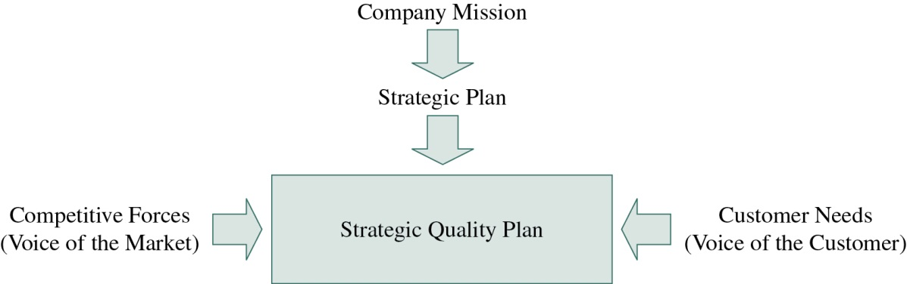
Figure 6-1 Strategic Quality Planning Model
Notes:
Strategy formation results from understanding customers and the marketplace (see Figure 6-1). The marketplace includes immediate customers as well as competitors, the customers of competitors, potential competitors, and potential customers. In every market, advances shape and reshape the markets. Each firm strives to introduce new products, develop innovative processes, and find better ways to satisfy the customer. Customers can be a good sources of information about competitors. This type of data gathering should include both strengths and weaknesses of your competitors. Some customers might be reticent to share this information. However, most customers realize that it is in their best interest to improve the performance of suppliers and will eagerly help. Information from lost customers can also be extremely useful for targeting weaknesses and improving products and services.

Slide 5
Gaining Insights Through Benchmarking (1 of 3)
Benchmark
  An organization recognized for its exemplary operational performance
    Initiator firm
    Target firm
Benchmarking
  The sharing of information between companies so that both can improve
Notes:
There are many benchmarks in the world, including Toyota for processes, Intel for design, Scandinavian Airlines for service, and Honda for rapid product development.
To be a benchmark, a company must be willing to open its doors and allow others to view its operations and tour its facilities. Thus a distinguishing feature of benchmarks is their amazing openness to other firms. Consider Toyota Motor Company. From the 1960s to the 1980s, Toyota developed the world-class production system known as just-in-time, or lean production. This production system resulted in previously unseen levels of productivity, minimal cost, and a source of competitive advantage. Some companies might have put barbed wire and guard dogs around their lean facilities to keep this technology to themselves and maintain their competitive advantage. Instead, Toyota allowed employees such as Taiichi Ohno and Shigeo Shingo to write books explaining the lean concept to the rest of the world. Toyota also allowed thousands of visitors to tour its facilities and learn about the lean system. The company even entered into strategic alliances with chief competitors so that those competitors could learn about lean production.
The initiator firm initiates contact and studies another firm. The target firm is the firm being studied (also called a benchmarking partner).
The first step a benchmarking firm must take is to document current performance. This activity will allow the company to pinpoint its goals and find a company (inside or outside the industry) that already excels at what it is trying to accomplish, study what it does, and gather ideas for improvement. Benchmarking is useful for externally validating an organization’s approach to its business. If the managers in a firm are unsure that they are pursuing a useful plan of action, benchmarking can help them understand how what they are doing stacks up against the masters.

Slide 6
Gaining Insights Through Benchmarking (2 of 3)
Benchmarking is good business because:
  Openness provides an impetus to continual improvement.
  Openness can create a competitive advantage through creating psychological barriers to competition.
Notes:
Two rationales explain why benchmarking is good business. The first originates from Deming’s thought that “the worst thing for a business is a weak competitor.” Therefore, strengthening the competition forces everyone to improve in order to maintain a competitive edge. As such, openness provides an impetus to continual improvement. Another view is that openness can create a competitive advantage through creating psychological barriers to competition.
A manager of a high-technology firm marketing a new product once said, “We do not mind if the others come to see how we produce our product. Once they see what we can do, they will not want to compete against us.” In other words, the large amount of work it would take to establish and develop the systems that a truly outstanding competitor already has in place can be daunting and discouraging to its competitors.

Slide 7
Gaining Insights Through Benchmarking (3 of 3)
Process benchmarking
Financial benchmarking
Performance benchmarking
Product benchmarking
Strategic benchmarking
Functional benchmarking
Notes:
In process benchmarking, the initiator firm focuses its observation and investigation on business processes.
The goal of financial benchmarking is to perform financial analysis and to compare the results in an effort to assess your overall competitiveness.
Performance benchmarking allows initiator firms to assess their competitive position by comparing products and services with those of target firms.
Many firms perform product benchmarking when designing new products or upgrades to current products.
Strategic benchmarking involves observing how others compete.
Another type of benchmarking, referred to as functional benchmarking, happens when a company focuses its benchmarking efforts on a single function to improve the operation of that function.

Slide 8
Purposes of Benchmarking
Learning from success
Borrowing ideas
Best-in-firm
Beating industry standards
Best-in-class
National leadership
Best-in-world
Notes:
There are seven primary purposes for benchmarking. These purposes require different levels of involvement in the benchmarking activities. Time consumption and costs may vary according to the purpose of benchmarking.

Slide 9
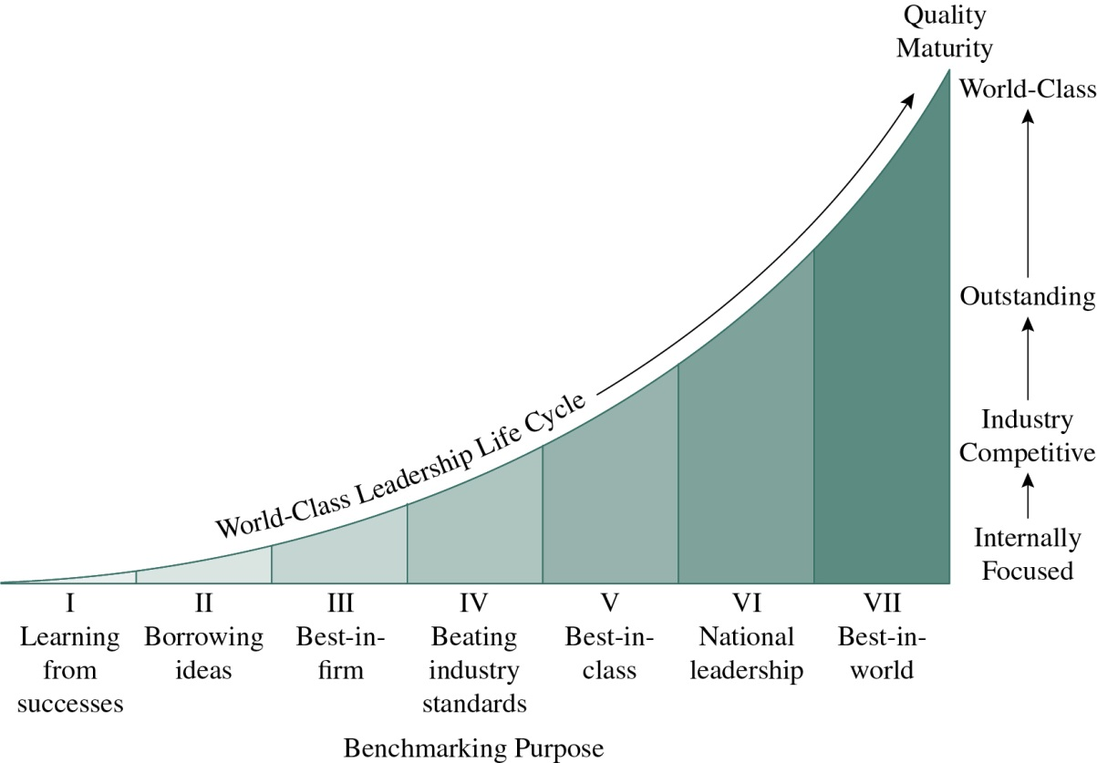
Figure 6-2 Benchmarking Purpose and Quality Maturity
Notes:
The purposes of benchmarking range from basic learning to achieving world-class leadership. The life cycle in Figure 6-2 shows that benchmarking purposes evolve as the firm becomes more mature in its quality journey.

Slide 10
Difficulties in Monitoring and Measuring Performance
Limitations of accounting systems
  Variations in the ways companies compute the measures that affect the results
Focusing too much on results and not causes
Analyzing longitudinal data
Comparisons between U.S. firms and foreign companies
Notes:
Firms often desire to compare financial measures between companies when benchmarking. Although this comparison can be a useful activity, there can be problems. One of the most significant problems stems from limitations of accounting systems. Often, companies have variations in the way they compute their measures that affect the results.
Another caveat for comparing measures between companies is based on the Deming arguments against such things as work measurement and management by objective. To concentrate too much on comparative measures might focus managers on results and not causes. This could result in the unfortunate development of numerical goals that ignore the necessity of improving the system of production.
Because of the possibility of serial correlation of data, even greater care should be taken when analyzing longitudinal (time-series) data. For example, company researchers might want to compare rates of growth for two companies in assets, sales, and other measures. If the data have serial correlation, they might reach the wrong conclusions.
Problems in comparisons are even more pronounced when comparing U.S. firms with foreign companies. The cost accounting conventions and accepted accounting principles can vary greatly between countries. For this reason, it is best not to compare accounting figures with foreign companies. However, if you must, take great care as to how the results of the comparisons are used in formulating policy.

Slide 11
Productivity Measures
Single-factor productivity = output/(a single input)
Multiple-factor productivity = output/(the sum of multiple inputs)
Total-factor productivity = output/(sum of all inputs to production)
Notes:
One remedy for the effects of accounting differences on productivity ratios is to compute total-factor productivity measures.
To understand total-factor productivity measures, we first must understand single-factor productivity measures.
Multiple-factor productivity measures use multiple inputs in their computation. Multiple inputs might include scrap, labor, energy, materials, equipment, and other measures of input. Hayes and Wheelwright suggested that it is better for firms to use multiple-factor productivity measures when making comparisons because these measures are more robust.
Total-factor productivity, although still subject to the “apples and oranges” problems of comparisons, is less sensitive to differences in costing conventions and accounting practices. Notice that if you focused on plant and equipment productivity, the conclusion would be that the competitor is lagging in productivity. Also notice that labor productivity may be a small part of total productivity.

Slide 12
Example 6-1 (1 of 3)
A company has gathered the following financial information for itself and a competing firm. The company wants to compare productivity for the two firms. (All the following numbers are in 000s.)
Blank | Firm A | Competition
Labor | $ 20,000 | $ 15,000
Plant and equipment (P&E) | 100,000 | 145,000
Energy | 5,500 | 10,500
Materials | 220,000 | 190,000
Sales | 425,000 | 500,000
Notes:
Example 6-1 provides an opportunity for students to calculate productivity measures for two firms to use as a comparison.

Slide 13
Example 6-1 (2 of 3)
Labor and other productivity ratios for the two firms are computed as:
  Firm A labor productivity = (sales>labor) = 425,000>20,000 = 21.25
  Competitor labor productivity = (sales>labor) = 500,000>15,000 = 33.33
  Firm A P&E productivity = (sales>P&E) = 425,000>100,000 = 4.25
  Competitor P&E productivity = (sales>P&E) = 500,000>145,000 = 3.45
  Firm A energy productivity = (sales>energy) = 425,000>5,500 = 77.27
  Competitor energy productivity = (sales>energy) = 500,000>10,500 = 47.62
  Firm A materials productivity = (sales>materials) = 425,000>220,000 = 1.93
  Competitor materials productivity = (sales>materials) = 500,000>190,000 = 2.63
Notes:
Calculate the Labor Productivity Measure for Firm A and the Competition for Labor, Plant and Equipment (P&E), Energy, Materials and Sales.

Slide 14
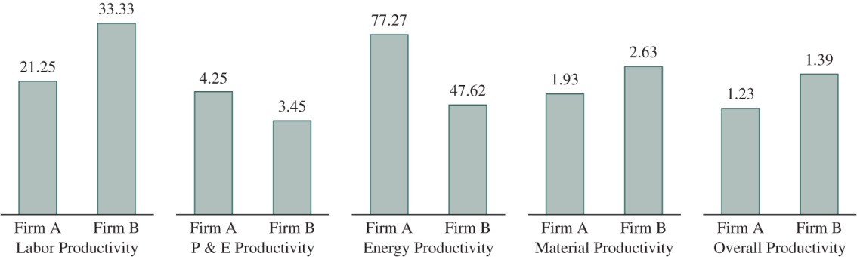
Example 6-1 (3 of 3)
Labor and other productivity ratios for the two firms are computed as:
  Total factor productivity for Firm A = (sales>total of inputs) = 425,000>345,500 = 1.23
  Total factor productivity for the competitor = (sales>total of inputs) = 500,000>360,500 = 1.39
Notes:
Calculate the Total Factor Productivity Measure for Firm A and the Competition. As you can see, the total-factor productivity measure provides a more complete picture of firm productivity.

Slide 15
Commonly Benchmarked Performance Measures
Dependent on key business factors (K B F s):
  Financial ratios
  Productivity ratios
  Customer-related results
  Operating results
  Human resource measures
  Quality measures
  Market share data
  Structural measures
Notes:
Financial ratios such as return on assets (ROA) or return on investments (ROI) are probably the easiest to obtain and compare. For many financial ratios, all that is needed is an income statement of a firm and a balance sheet.
Productivity ratios are useful for measuring the extent to which a firm effectively uses the scarce resources that are available to the firm. As we have previously discussed, they include single-factor, multi-factor, and total-factor productivity measures.
Customer-related results include customer satisfaction, customer dissatisfaction, and comparisons of customer satisfaction relative to competitors. These measures may be in the form of retention, gains, losses, customer-perceived value, competitive awards, competitive customer ratings, and independent organization evaluations. Customer satisfaction measures are important for gauging the effectiveness of quality improvement because they are good indicators of financial performance.
Operating results are important for monitoring and tracking the effectiveness of company operations. They might relate to cycle times, waste-reduction measures, value-added measures, lead times, time from concept to market, setup times, percent reduction in setup times, and myriad other operating results.
Human resources measures provide important insights into how effectively the business is being run. Employee satisfaction is significantly related to business performance in many firms. Therefore, employee satisfaction measures, training expenditures, training hours per year, work system performance, employee effectiveness measures, turnover, safety statistics, absenteeism, and many other data might be important measures for benchmarking.
Quality measures are often compared between firms. They can include conformance-based quality information such as reject rates, capability analysis, performance information, or other measures. These quality measures also can include scrap and rework measures, percentage of defectives, field repairs, costs of quality, and many other metrics.
Market share data are an essential indicator of business success, resulting from the change in competition because of increased global competition. However, market share does not encompass only a single measure. Because markets are segmented, market share includes shares in the different markets served by the firm. Market share comparisons also are made to determine where the initiator firm ranks in the market.
Finally, with the advent of ISO standards and a move to formalized production systems, structural measures often are benchmarked. Structural measures include the objectives, policies, and procedures followed by a firm. They may include safety, production, accounting, financial, engineering, and other types of structural measures that are used in determining competitiveness.

Slide 16
Why Collect All These Measures?
Management by fact
  Dictates that decisions are made based on the sound collection and analysis of data
Performance measures or indicators
  Measureable characteristics of products, services, processes and operations that the company uses to track and improve performance
Notes:
The Malcolm Baldrige criteria are clear about this: data and analysis support a variety of company purposes, such as planning, reviewing company performance, improving operations, and comparing company performance with competitors or with “best practices” benchmarks.
A major consideration in performance improvement involves the creation and use of performance measures or indicators. The measures or indicators should be selected to best represent the factors that lead to improved customer, operational, and financial performance. A comprehensive set of measures or indicators tied to customer and/or company performance requirements represents a clear basis for aligning all activities with the company’s goals. Through the analysis of data from the tracking processes, the measures or indicators may be evaluated and changed to better support such goals.

Slide 17
Key Business Factors (K B F s)
Mission
Vision
Values
Key customer segments
Core capabilities
Culture
Governance
Other facets of a business
Notes:
When benchmarking, it is important to understand your target firm’s key business factors (KBFs) as well as your own.
Key business factors are important attributes of a business that influence its operations and decision making. KBFs are not to be confused with key measures (the metrics that need to be monitored to gauge the health of the business) and critical success factors (factors that help to determine the success of the firm).

Slide 18
Business Process Benchmarking
Based on the concept of 5 w 2 h:
  Who?
  What?
  When?
  Where?
  Why?
  How?
  How much?
Notes:
Business process benchmarking is based on the concept of 5w2h, developed by Alan Robinson.
The 5w2h concept is labeled as such because a business process benchmarking project should result in the answers to seven questions, as shown here.
The 5w2h concept is a good starting point because it focuses the participants in the benchmarking process on the nuts and bolts of what is being done. If the initiator organization can answer the 5w2h questions at the end of a benchmarking process, then information will be in place that could, for instance, help a company improve its customer satisfaction.

Slide 19
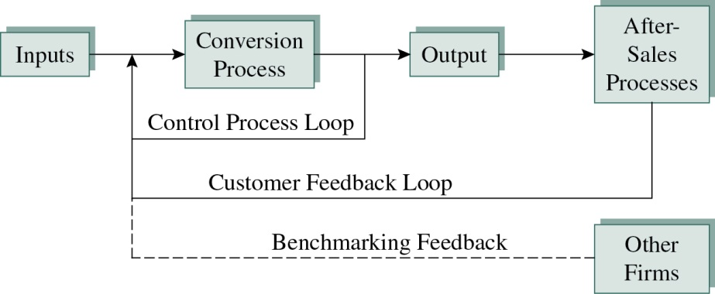
Figure 6-3 Business Process Benchmarking
Notes:
The 5w2h questions should be viewed in the context of a process. Figure 6-3 contains a diagram of a generic process. In a broad sense, inputs include the equipment, people, machines, materials, and design that combine to form a product or service. The inputs are combined in what is known as the conversion process. In the conversion process, we align the inputs together to form the product or service. Conversion processes might include turning sheet steel into chimney pipes or turning wood pulp into paper, or moving materials from point A to point B for a shipping service.
The conversion process results in outputs that are eventually sold to customers. Notice in Figure 6-3 that there are two feedback loops in the process. The first feedback loop results from gathering data from the process. This is known as the control process. As we explained in Chapter 1, the control process involves gathering, analyzing, and using the data to adjust the process. This is often the result of using process control charts. The second feedback loop in the process is the customer feedback loop and results from gathering data from the customers. Using these data, the control process is improved to give the customer greater satisfaction. A third feedback process can be added by gathering information from competitors through benchmarking.

Slide 20
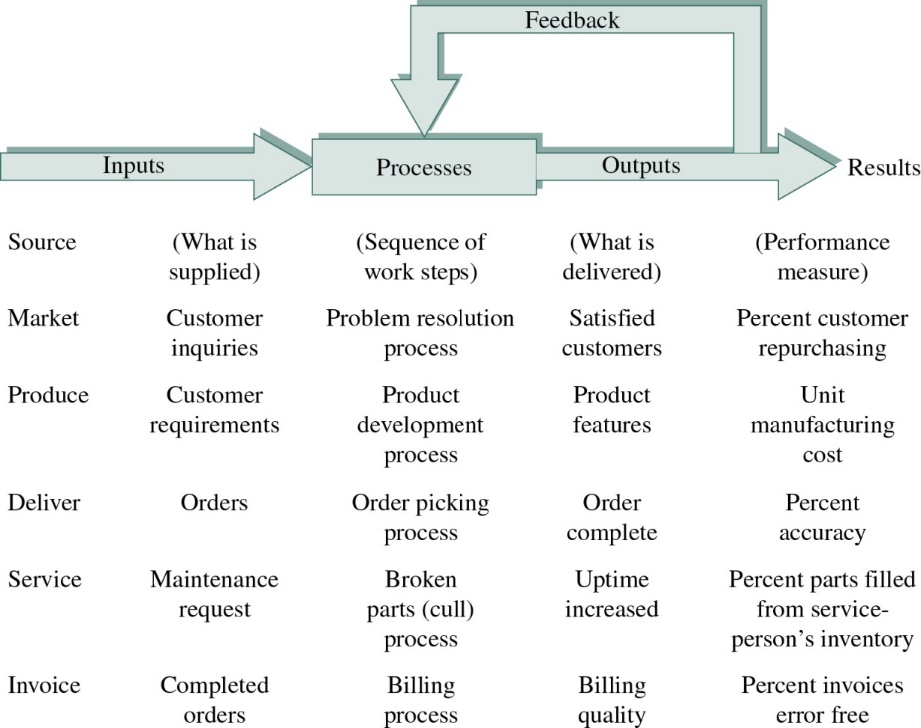
Figure 6-4 Business Process Benchmarking
Process Information
R. Camp, Business Process Benchmarking (Milwaukee, WI: ASQ Quality Press, 1995), p. 26. Reprinted with permission from the Quality Press. © 1995 American Society for Quality.
Notes:
Figure 6-4 shows what to benchmark at each stage. Again, the questions asked are similar to the 5w2h questions posed earlier.

Slide 21
Robert Camp’s Business Process Benchmarking Process (1 of 2)
Decide what to benchmark.
Identify whom to benchmark.
Plan and conduct the investigation.
Determine the current performance gap.
Project future performance levels.
Notes:
We now discuss the benchmarking process developed by Robert Camp. Xerox was an early adopter of benchmarking and has used benchmarking effectively to improve processes. This approach includes a formal 10-step process to benchmarking, also shown in Table 6-3 in your text.
Step 1: Decide what to benchmark. There are innumerable areas for improvement in every company. Obviously, not all of these can be tackled at once. Too many simultaneous changes can result in a confused organization and can actually hurt performance. Therefore, you must prioritize those processes that offer the greatest potential for improvement. To do this, you must have identified your key processes and charted those processes for future analysis.
Step 2: Identify whom to benchmark. This involves identifying those competitors in your industry and those firms outside your industry that have outstanding results and processes for study. Those companies that have developed best practices are prime candidates for benchmarking.
Step 3: Plan and conduct the investigation. To complete this step, identify data to be collected. Next, develop a method with the target firms to determine how the data are to be collected. Once the data are selected, observe the practices of the target firm and document the best practices that are observed.
Step 4: Determine the current performance gap. Once you have collected the data about the processes, a determination is made as to which processes in the initiator company have the greatest performance gap with the target company. Brainstorming can help make this determination. This step helps to prioritize which areas are the first candidates for change and improvement.
Step 5: Project future performance levels. Predict whether the performance gap for the benchmarked processes will narrow or widen in the coming years. If the performance gaps are likely to widen in the future, project how this will affect the company.

Slide 22
Robert Camp’s Business Process Benchmarking Process (2 of 2)
Communicate benchmarking findings and gain acceptance.
Revise performance goals.
Develop action plans.
Implement specific actions and monitor progress.
Recalibrate the benchmarks.
Notes:
Step 6: Communicate benchmarking findings and gain acceptance. This step begins the communication of the benchmarking findings to those who will be affected by the results. This can be done through meetings and written media. Communication keeps the process as open as possible, which minimizes uncertainty and fear.
Step 7: Revise performance goals. After best practices are identified, operational goals are revised. This process establishes measures for evaluating the results of improvements based on benchmarking.
Step 8: Develop action plans. Action plans are the specific steps and objectives for implementation. Assignments to personnel and timetables for implementation are used with a project management approach.
Step 9: Implement specific actions and monitor progress. As implementation proceeds, progress is reported to management and stakeholders.
Step 10: Recalibrate the benchmarks. Continued benchmarking with the best firms helps to identify new best practices. This process “raises the bar” for higher levels of future performance.

Slide 23
Leading and Managing the Benchmarking Effort
Benchmarking is a managed process.
Management must have an understanding of the benchmarking process, the participants involved, and the objectives of the exercise.
Managing the benchmarking process involves establishing, supporting, and sustaining the benchmarking program.
Training is a key to success in all management approaches.
Notes:
Like other quality management efforts, benchmarking is a managed process. Therefore, management must have an understanding of the benchmarking process, the participants involved, and the objectives of the exercise.
Managing the benchmarking process involves establishing, supporting, and sustaining the benchmarking program. To begin the management process, a strategy statement outlining the goals and strategies to be used is developed (see A Closer Look at Quality 6-1). With the strategy statement in place, management sets expectations for performance relating to the benchmarking project. At a minimum, the expectations for benchmarking are that this is an ongoing process that serves as a basis for improvement (not a one-time event) and that specific deliverables are to be identified by management that must be fulfilled.
Other activities for management include providing management awareness training, establishing a benchmarking competency center, developing guidelines for information sharing, and overseeing the development of a visit protocol. Once this benchmarking infrastructure is in place, benchmarking teams are commissioned and trained to perform the benchmarking project.
Training is a key to success in all quality management approaches. This is especially true for benchmarking. Participants must have project management skills and be familiar with benchmarking approaches and protocols. Benchmarking carries with it legal liabilities that should be addressed during the training (see A Closer Look at Quality 6-2). Training should include managerial training, cross-functional benchmarking skills training, team training, and documentation training (flowcharting). Many of these training courses are available from many different consulting organizations. It is best to obtain training from organizations that are experienced with benchmarking. Many companies have established external training arms that can be hired by competing firms.

Slide 24
Baselining and Process Improvement
Process redesign
  A fundamental rethinking and redesign of business processes often accompanied by the automation of business processes
Critical factors to achieving success through process redesign
  Breadth
  Depth
Baselining
  Requires the monitoring of key internal firm performance measures over time to identify trends such as improvement (or decline) to inform managerial decision making
Notes:
Many firms are facing the important decision to redesign and improve business processes to enhance productivity, reduce cost, improve quality, and achieve better customer service.
Process redesign is defined as a fundamental rethinking and redesign of business processes. Such change is often accompanied by the automation of business processes.
Two factors are critical to achieving success through process redesign:
Breadth refers to the impact of the process redesign process to the entire organization.
Depth refers to organizational elements such as responsibilities, measurements, information technology, and skills.
These dichotomous factors imply that business process redesign will result in both localized (such as the affected work areas) and generalized (or organization-wide) performance impacts. However, these impacts are difficult to assess. Therefore, appropriate and effective methodologies are needed to assess the impacts of business process redesign.
Baselining, which has been discussed in other chapters, requires the monitoring of key internal firm performance measures over time to identify trends such as improvement (or decline) to inform managerial decision making.

Slide 25
Problems with Benchmarking
There may be substantial difficulty obtaining cooperation from other firms in your own industry - unless you happen to be a Fortune 500 firm.
The predominance of functional benchmarking with firms in noncompeting industries makes it difficult to benchmark with these firms.
Your efforts will be wasted unless you fully understand your own processes before you benchmark someone else.
Benchmarking is time-consuming and costly.
Notes:
Benchmarking is not a simple activity, and it can be difficult to implement any of these tools and concepts. There are four key problems with benchmarking:
1. Most organizations have much less clout. The thing to remember is reciprocity. To be effective, you must have something to offer the target firm in return for sharing information. For example, a small firm may feel that it has little to offer a larger firm. If the small firm is flexible, the Goliath firm may want to learn how to achieve that flexibility.
2. It takes much ingenuity to identify benchmarks properly from noncompeting firms. This is where the business and industry literature is very helpful in trying to identify benchmarking firms in noncompetitive industries.
3. By using tools such as business process maps, you can identify the exact performance measures and metrics needed from the target firm.
4. A recent benchmarking project between two firms took nearly two years to complete and cost each of the firms more than $250,000. Of course, this was a major benchmarking project; other projects have been completed at lower costs, but some have been much more expensive. Costs of benchmarking include time for planning, travel, documentation, and implementation. By far the largest costs are associated with implementation. The investment is lost if benchmarking data are not used to drive improvement.

Slide 26
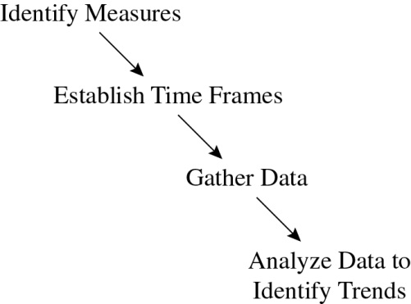
Figure 6-5 Baselining Process
Notes:
The baselining process involves identifying measures, establishing timeframes for future data collection, gathering data, and analyzing data on an ongoing basis to identify performance trends and changes (see Figure 6-5). Because process redesign affects multiple levels in a firm, abrupt organizational changes are reflected in baselining results. If changes are effective in improving the organization, the data collected will reflect this improvement.

Slide 27


