Slide 1


Slide 2
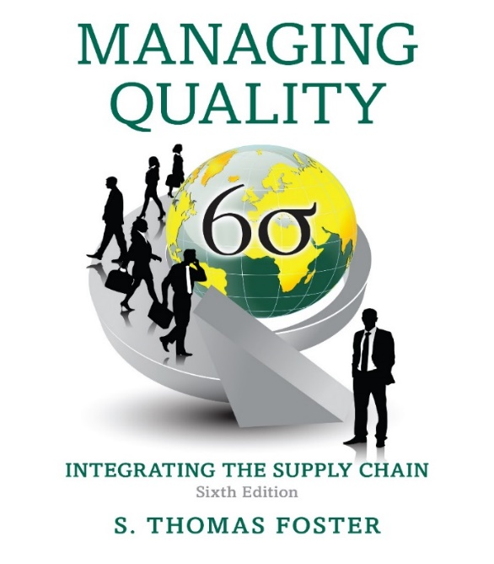
Managing Quality: Integrating The Supply Chain
Chapter 5
Sixth Edition
The Voice of the Customer
Notes:
If this PowerPoint presentation contains mathematical equations, you may need to check that your computer has the following installed:
1) MathType Plugin
2) Math Player (free versions available)
3) NVDA Reader (free versions available)

Slide 3
Learning Objectives
5.1 Discuss the basics of customer relationship management.
5.2 Distinguish how managing quality in services is different from manufacturing.
5.3 Implement gap analysis in a service firm using S E R V Q U A L.
5.4 Develop a customer service survey using specific examples and critical incidents.

Slide 4
The Voice of the Customer
Customer
The receiver of goods or services
Internal customers
Employees receiving goods or services from within the same firm
External customers
The bill-paying receivers of our work
Notes:
Reasons why customers service is important:
• Customers tell twice as many people about bad experiences as good experiences.
• A dissatisfied customer tells 8 to 10 people about the bad experience.
• Seventy percent of upset customers will remain your customer if you resolve the complaint satisfactorily.
• It is easier to get customers to repeat than it is to find new business.
• Service firms rely on repeat customers for 85% to 95% of their business.
• Eighty percent of new product and service ideas come from customer ideas.
• The cost of keeping an existing customer is one-sixth of the cost of attracting a new customer.
Source: Kabodian, A., The Customer Is Always Right. (Cambridge, MA: Harvard University Press, 1996).

Slide 5
Customer-Driven Quality
A proactive approach to satisfying customer needs that is based on gathering data about our customers to learn their needs and preferences, and then providing products and services that satisfy the customers
Many companies implement customer feedback mechanisms incorrectly and are placed in a reactive rather than a proactive mode with their customers.
Notes:
Customer-driven quality is one of the core values of the Malcolm Baldrige Award. A Closer Look at Quality, Figure 5-1 (shown on the next slide), shows that companies have taken differing approaches to handling customer feedback.

Slide 6
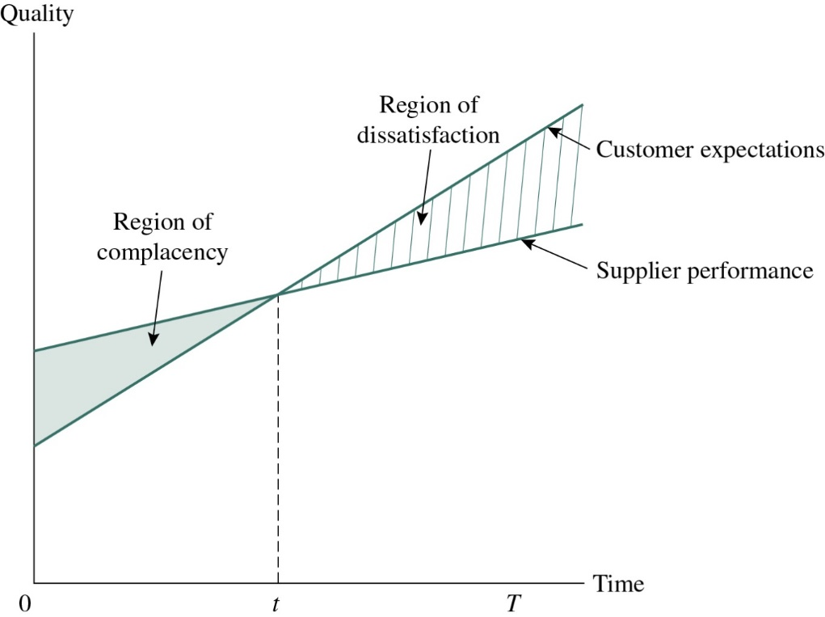
Figure 5-1 The Reactive Customer-Driven Model
S. T. Foster, “The Ups and Downs of Customer-Driven Quality,” Quality Progress (October 1998):70.
© 1998 American Society for Quality. Reprinted with permission.
Notes:
This model shows that a firm’s quality performance is increasing while customers’ expectations also are increasing. Problems occur when customer requirements increase at a faster rate than quality and service improvement. This places a firm in a reactive mode that may signal the need for major process and service redesign.
The RDQ model demonstrates conceptually and graphically the primary pitfalls and dangers of RCDQ. In a sense, manufacturers and service organizations attempting to meet customer expectations are pursuing a moving target. As the supplier’s competitors improve quality, and competition increases, customers demand higher levels of quality and service. The difference between world-class and ordinary suppliers lies in whether suppliers stay ahead of the target or fall behind the target. Although a supplier to a customer might desire to provide high-quality service to the customer, the reactive posture engendered in the RCDQ approach will cause the supplier to fall farther and farther behind the moving target over time.

Slide 7
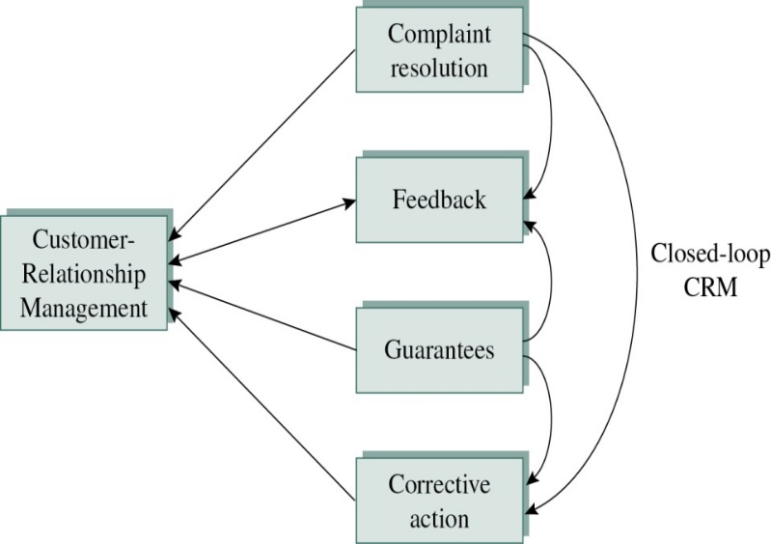
Figure 5-2 Customer-Relationship Management (1 of 3)
Customer-relationship management:
The view of that customer that asserts that he or she is a valued asset to be managed
Notes:
Much of the focus in marketing today is on maintaining the existing customer base that a firm has established. If it is true that 90% of the business for many service firms is in the form of repeat business, the focus of process and system design must be on developing relationships with customers rather than simply providing clean transactions at each stage of the process.
For many firms, the focus on process design includes the aspect of customer-relationship management (CRM). This view of the customer asserts that he or she is a valued asset to be managed. This is relationship management. The tangibles (such as facilities and machinery) meet the intangibles (such as professionalism and empathy) to provide a satisfying experience for the customer.
There are four important design aspects to customer-relationship management that we address here: complaint resolution, feedback, guarantees, and corrective action or recovery (see Figure 5-2). For practical reasons, we distinguish between CRM and customer relationship management systems (CRMS). CRMS are systems used for capturing customer-related data. CRMS are discussed later in the chapter and in these slides.

Slide 8
Customer-Relationship Management (2 of 3)
Complaint resolution
Regulatory complaints
Employee complaints
Customer complaints
Feedback
Feedback to the customer
Feedback to the firm as a basis for process improvement
Notes:
Complaints come in many forms. For our discussion, we focus on three types of complaints that need to be resolved: regulatory complaints, employee complaints, and customer complaints. Because only a small percentage of customers ultimately will complain, they should be taken very seriously. This small percentage of customers may represent a much larger population of dissatisfied customers.
The complaint-resolution process involves the transformation of a negative situation into one in which the complainant is restored to the state existing prior to the occurrence of a problem. The first component of a complaint-resolution process is to compensate people for losses. This may be as small as an easy return policy with no questions asked. The second component to complaint resolution is contrition. The firm should apologize to the customer for the mistakes made and invoke the Macy’s mantra: “The customer is always right.” Third, the complaint-resolution process must be designed to make it easy for complainants to reach resolution to simple complaints. The process associated with resolving complaints is called the complaint-recovery process.
To understand customer behavior, wants, and needs, data about the customer are necessary. Some of these data come directly from the customer. Some customer data are solicited, and other data are provided without solicitation. The customer-feedback loop includes reporting the resolution of the complaint to the customer. Many times, this requires a data-gathering mechanism, such as a computerized information system, to ensure that the customer complaint has been resolved adequately. Feedback to the firm should occur on a consistent basis with a process to monitor changes resulting from the process improvement.

Slide 9
Customer-Relationship Management (3 of 3)
Guarantees
Unconditional
Meaningful
Understandable
Communicable
Painless to invoke
Corrective action
Closed-loop corrective action
Notes:
To be effective, a guarantee should be:
• Unconditional. No “small print.” Inconsistent application can make the guarantee less compelling.
• Meaningful. To be meaningful, customer grievances must be fully addressed. For example, any financial loss must be fully recovered by the complainant.
• Understandable. The customer must be able to understand easily the parameters of the guarantee and how to achieve resolution quickly.
• Communicable. The phrasing of a guarantee should resonate with the customer. “The best quality at the lowest prices—I guarantee it,” is the famous motto at the Men’s Wearhouse. Not only is this a great guarantee but it also is a great marketing line.
• Painless to invoke. The customer must not be inconvenienced too much. Costco has a “no questions asked” return policy that allows customers to return or exchange merchandise with a minimum of hassle. This return policy was an early service linchpin that differentiated its service from other retailers.
Source: Chase, R., Operations and Supply Chain Management (Homewood, IL: Irwin, 2010).
An important aspect of customer-relationship management is corrective action. This means that when a service or product failure occurs, the failure is documented, and the problem is resolved so that it never happens again. Corporate teams or committees should be in place to regularly review complaints and to improve processes so that the problems don’t recur. Referring to Figure 5-2, the corrective action results in gathering complaint and warranty data, and determining the causes of these problems. Often, teams of employees and managers study complaints, do Pareto cost analysis of the complaints, and recommend improvements to the customer service delivery system. Such systems are often referred to as closed-loop corrective action: the loop is in effect closed because a process is in place that ensures this information is used for improvement. This is why complaint and field repair data are so golden.

Slide 10
The “Gaps” Approach to Service Design (1 of 2)
Gap
The differences between desired levels of performance and actual levels of performance
Gap analysis
Formal means for identifying and correcting these gaps
Notes:
Typically, the gap refers to the differences between desired levels of performance and actual levels of performance. This could be something like the difference between the desired conformance level versus the existing conformance level in a manufacturing environment. In services, this is the difference between the expected and the actual level of service provided. A gap is important because once it is identified, it is a candidate for corrective action and process improvement.

Slide 11
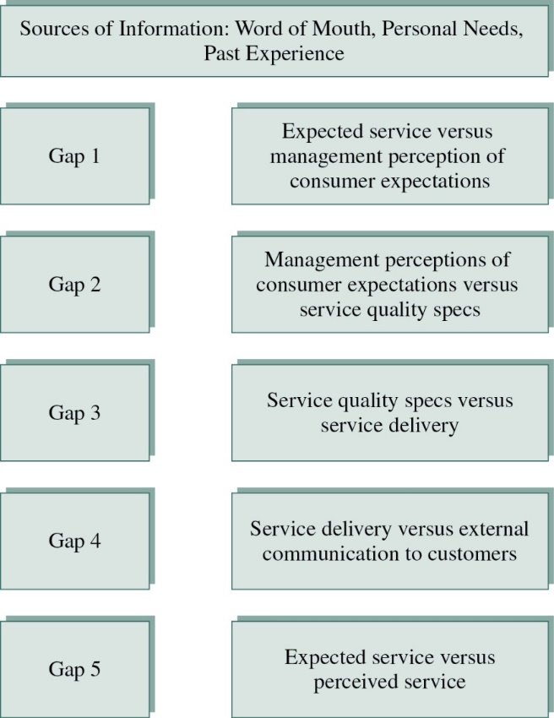
Figure 5-3 The “Gaps” Approach to Service Design
Service quality model gaps
Notes:
One of the differences studied by gap analysis identifies the difference between managerial and customer perceptions of what the customer wants (gap 1). When this gap is large, service providers are likely producing excellent services that no one wants. The other gaps and gap analyses are discussed in depth in Chapter 8.

Slide 12
The “Gaps” Approach to Service Design (2 of 2)
Determinants of Service Quality
Reliability
Responsiveness
Competence
Access
Courtesy
Communication
Credibility
Security
Understanding/knowing the customer
Tangibles
Based on A. Parasuraman, V. Zeithamel, and L. Berry, “SERVQUAL: A Multiple-Item Scale for Measuring Customer Perceptions of Service Quality,” Journal of Retailing (Spring 1988): 12–40.
Notes:
In addition to the gaps model, Parasuraman, Zeithamel, and Berry contributed a number of important concepts to managing service quality. These concepts include 10 determinants of service quality (seen here and in Table 5-1 in your chapter), service quality dimensions discussed in Chapter 1, and a questionnaire to test the hypothesized relationships in Figure 5-3. The survey instrument is called SERVQUAL.

Slide 13
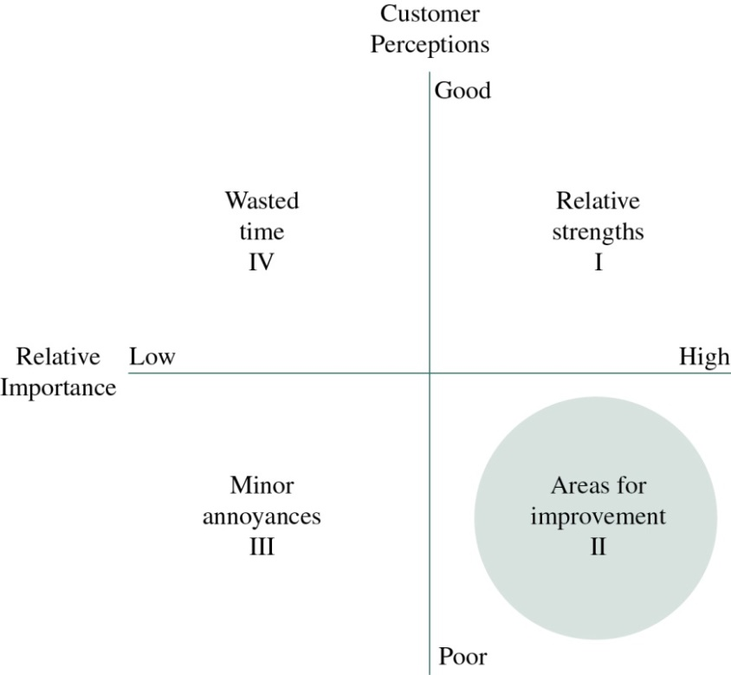
Figure 5-4 The “Gaps” Approach to Service Design
Two-dimensional gaps model
Notes:
Another approach to identifying and measuring gaps in quality service is found in the two-dimensional gaps model shown in Figure 5-4. Surveys using this approach measure customer satisfaction perceptions on the y axis and ratings of relative importance on the x axis. This approach is presented in depth in Chapter 8, but it is presented here in the context of gathering customer data to better understand the customer.

Slide 14
Segmenting Customers and Markets
Segmenting markets:
To distinguish customers or markets according to common characteristics
Notes:
One of the preliminary steps that many analysts overlook is segmenting data. Data about customers can be gathered from a number of sources, such as industry groups, external sources, the Internet, commercially available databases, or questionnaires. The Baldrige criteria emphasize data segmentation of customers and customer markets. The segmentation is simple (e.g., consumer, commercial, or wholesalers). To segment markets means to distinguish customers or markets according to common characteristics. Personal computer markets are segmented into home and business markets. Sometimes segmentation is more complex, involving customer characteristics and demographics, psychographics, or benefits desired.
Table 5-2 shows examples of segments for consumer markets. This segmentation implies that data are gathered separately for each of these segments and analyzed separately. Table 5-3 shows examples of segments for commercial markets. Therefore, you may segment your markets according to consumer markets or commercial markets. You also may segment further within these markets.

Slide 15
Strategic Supply Chain Alliances between Customers and Suppliers
Competitive model
A relationship in which one party attempts to gain advantage over the other
Single sourcing
A process for developing relationships with a few suppliers for long contract terms
Strategic alliances
Suppliers become de facto subsidiaries to their major customers
Notes:
The theory behind the competitive model was that competition among the suppliers drives costs lower and quality higher. However, this theory ignores the costs associated with variability created by using multiple suppliers. This variability can be seen in process industries such as steel production, in which customers use sheet steel raw materials from suppliers. Even though the dimensions and specifications for sheet metal are the same, if different suppliers are used, there will be increased variability in the physical properties of the materials, such as tensile strength. For example, one manufacturer found that by limiting the number of suppliers of sheet steel, it reduced its defects by 40%. This demonstrated that variability in sourced materials was a major cause of defects.
Today, many companies use single sourcing as a way to reduce the number of suppliers. Single sourcing is a process for developing relationships with a few suppliers for long contract terms. Historically, this was the Japanese method of purchasing. Increasingly, single-sourcing arrangements are developing into strategic alliances, in which the suppliers become de facto subsidiaries to their major customers. In these arrangements, not only are suppliers single-source providers but they also integrate information systems and quality systems that allow close interaction at all levels.

Slide 16
Process-Chain-Network (P C N) Tool for Service Design (1 of 4)
Process-chain-network (P C N) diagram
A flowchart that evaluates the interactions between service providers and customers
P C N categories
Direct interaction
Surrogate interaction
Independent processing
Notes:
Flowcharts are graphical diagrams with boxes that represent process steps. The steps are connected by arrows that represent process dependency; an arrow between steps suggests that accomplishing one step is dependent on accomplishing another step.
A PCN diagram categorizes the flowchart steps according to whether they involve interaction between entities such as providers and customers. In PCN diagrams, an entity is either a service provider, customer, or supplier. Entities such as supplier’s suppliers or customer’s customers can also be further up or down the supply chain.

Slide 17
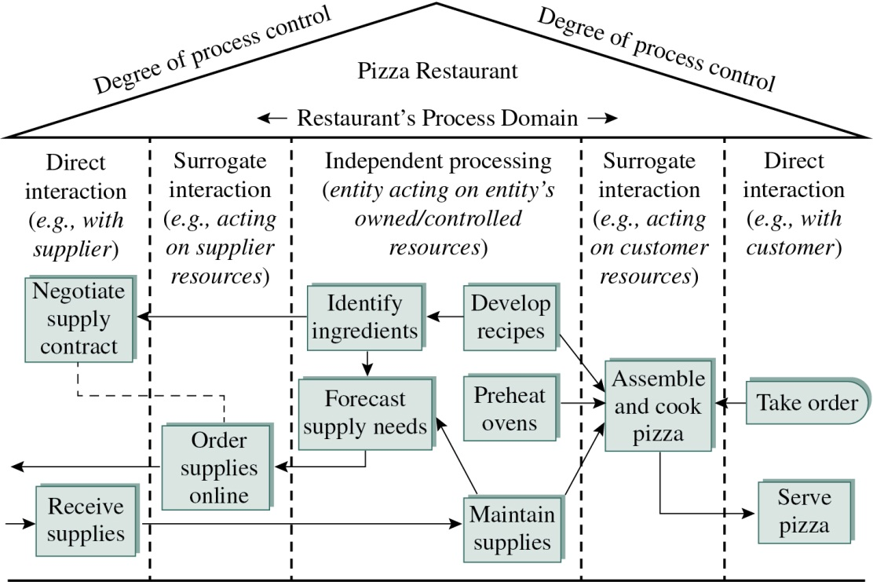
Figure 5-5 Process-Chain-Network (P C N) Tool for Service Design
PCN diagram for a pizza maker
Notes:
Figure 5-5 shows an example of a PCN diagram for a pizza restaurant. The pizza restaurant has a process domain, which is made of process steps that are the responsibility of the given entity (in this case, a pizza restaurant) as well as interactions with customers.
A process domain has three regions:
• The direct interaction region includes process steps that involve the pizza restaurant interacting with another entity, such as a local cheese supplier or a customer.
• The surrogate interaction region includes process steps in which the restaurant is acting on the resources coming from another entity without direct interaction. For example, the restaurant may order napkins online.
• The independent processing region includes process steps that the restaurant performs without interacting with other entities, such as developing recipes and turning on the ovens. PCN diagrams have been used in a variety of situations to improve customer service.

Slide 18
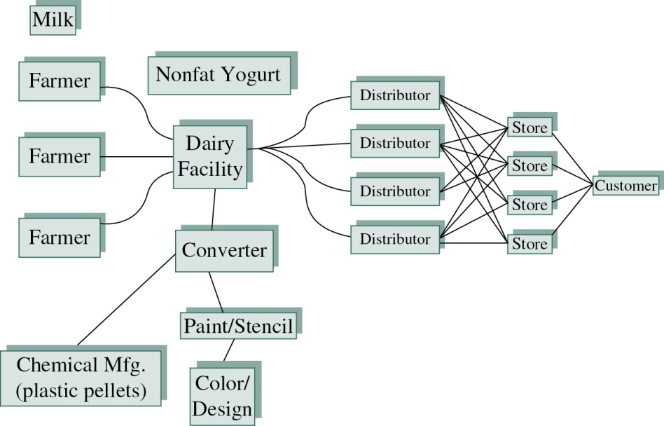
Figure 5-6 The Role of the Customer in the Supply Chain
The goal of supply chain management is customer satisfaction.
Segmenting the supply chain helps to define who is the customer.
Notes:
Figure 5-6 shows a picture of a supply chain for yogurt. Notice that the supply chain consists of several parts. In one, the farmers are providing product to a dairy. On another part of the supply chain, a chemical company provides plastic pellets to a converter who molds the cups. The label maker also provides labels to the converter. Do you suppose that the converter is primarily concerned with the final consumer who buys the yogurt? Likely not. The supply chain can be segmented. The chemical company is primarily focused on the converter. The dairy company schedules shipments to the distributors, and the distributors handle shipments to the store. The dairy works with the distributors and retailers to understand consumer preferences and to provide the flavors desired by the customers.

Slide 19
Communicating Downstream
Customer rationalization
Annuity relationship
Active data gathering
Passive data gathering
Notes:
Customer rationalization results from agreement between marketing and operations as to which customers add the greatest advantage and profits over time. This does not necessarily mean pursuing customers who are currently the most profitable. It could mean pursuing customers who cause the company to improve in ways necessary for continued survival. For example, consulting firms often have to turn away customers desiring services in areas outside the expertise of the company. Customer rationalization ensures that a high-quality product is provided, and the service provider stays within its field of expertise. Also, this allows firms to focus on a smaller number of key customers and to develop an annuity relationship, in which the customer provides a long-term, steady income stream to the provider.
As suppliers focus on satisfying their customers, these customers are recognized as primary sources of information. To better understand the customer, data about the customer must be gathered, analyzed, and used for improvement. The rest of this chapter is concerned with gathering and analyzing customer data so that the data can be used for improvement. There are a variety of means for gathering data from customers. These include active data gathering, such as through focus groups and surveys, and passive data gathering, such as through customer comment cards.

Slide 20
Process-Chain-Network (P C N) Tool for Service Design (2 of 4)
Actively solicited customer feedback
Includes all supplier-initiated contact with customers
Examples: telephone contact, focus groups, surveys
Types of data
Soft data, hard data, and ordinal data
Notes:
Phone contacts, focus groups, and survey results are referred to as soft data. As opposed to soft data, hard data are measurement data such as height, weight, or volume, measured on a continuous scale. Soft data are not continuous and are, at best, ordinal. Ordinal data are ranked so one measure is higher than the next.

Slide 21
Process-Chain-Network (P C N) Tool for Service Design (3 of 4)
Telephone contact:
Convenience survey method
Major issue is bias because major segments of the population of interest are often not available via telephone at certain times
Notes:
Telephone surveys are often used to gather information related to customers. Most often, they are used for surveys or structured interviews. This is a type of convenience survey method. The major problem with telephone surveys is bias. Major segments of the population of interest are often not available via telephone at certain times. This makes random sampling difficult. Also, customers resent being called at inconvenient times. With recent changes in laws, service providers can be asked to remove customers from contact lists if this method is used. In addition, phone surveyors must respect state and federal do-not-call lists. However, it is often helpful to call respondents prior to sending a survey to see whether they are willing to respond to a survey.

Slide 22
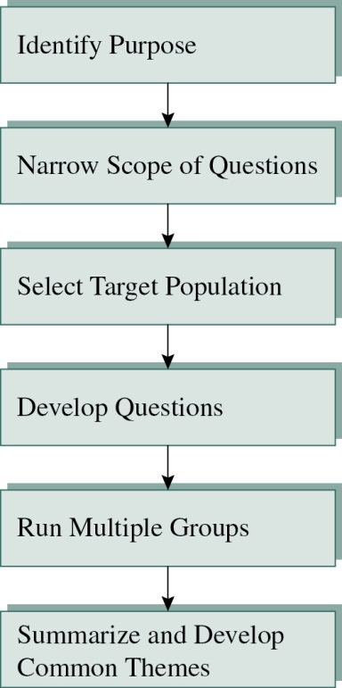
Figure 5-7 Process-Chain-Network (P C N) Tool for Service Design
Focus groups:
Allows a supplier to gather feedback from a group of consumers at one time
Notes:
Focus groups narrowly address a single topic or group of topics, and they draw individuals with similar characteristics or demographics, which limits the discussion to subjects and market segments that are of particular interest to the firm.
Figure 5-7 shows the steps included in performing a focus group session. After identifying the purpose of the focus group, a set of questions is developed that sequences from broad to specific. After the focus group sessions are completed with multiple groups, the notes from the sessions are reviewed to find common themes that become the basis for planning and improvement. Focus groups are often used by business and government agencies to gauge topics or issues that elicit the strongest emotional responses from the subject. Focus groups need to be carefully facilitated so that the objectives of the research are met.

Slide 23
Process-Chain-Network (P C N) Tool for Service Design (4 of 4)
Customer service surveys
Used by marketers and quality professionals to define areas of strength and areas for improvement in quality systems
Four steps to developing a useful survey:
Identifying customer requirements
Developing and validating the instrument
Critical incident approach
Implementing the survey
Analyzing the results
Notes:
The customer service survey is an important tool for determining customer perceptions of customer service and quality, and is used by marketers and quality professionals to define areas of strength and areas for improvement in quality systems. It is disappointing that surveys are sometimes misused, as is shown in A Closer Look at Quality, Figure 5-2. A survey (or instrument) consists of a series of items (or questions) designed to capture perceptions. The number of items is determined by the purpose of the instrument and the willingness of respondents to spend time filling out the survey.
1. Identifying customer requirements. Customer requirements include the dimensions of quality, service, and performance that are necessary to satisfy the customer. Identifying customer requirements initially involves reviewing the purchase orders and contracts established when the relationship with the customer begins. Second, customer needs are reviewed with marketing and production. Third, interviews are conducted with a sampling of customers to determine what to add to the list of customer requirements.
2. Developing and validating the instrument. After dimensions of customer requirements are identified, specific examples are developed to measure the particular dimensions. An alternative means of developing survey items is the critical-incident approach, which involves obtaining information from customers about the process they use to receive goods and services. The critical incidents are aspects of organizational performance with which the customers come in direct contact. These are important for monitoring and measuring process performance as it relates to customer service.
3. Implementing the survey. Reliability and validity are two different but interrelated issues of survey development. We use the traditional target approach to explain this relationship. If the target in Figure 5-11 (shown on the next slide) is the dimension of customer service that you are trying to measure, each arrow mark represents a single response using the survey instrument. If the measure of the dimension ascertains the dimension perfectly, the shot will be right in the center of the target. If you don’t hit the center, you are not perfectly measuring the quality dimension. The more imperfect the measurement, the farther the shot will be from the center of the target
4. Analyzing the results. For business purposes, data analysis generally should be kept simple. Means, histograms or numerical responses, and simple correlations are best for analyzing survey responses. Open-ended questions are analyzed with Pareto analysis using bar charts of the various categories of responses. More extensive data analysis using advanced statistical techniques—such as multiple regression, analysis of variance, or other procedures—should be performed if necessary. Explanations of these statistics can be found in introductory statistics textbooks. However, business experience has shown that simpler analysis is better because simple statistical results are easy to communicate to managers and coworkers.

Slide 24
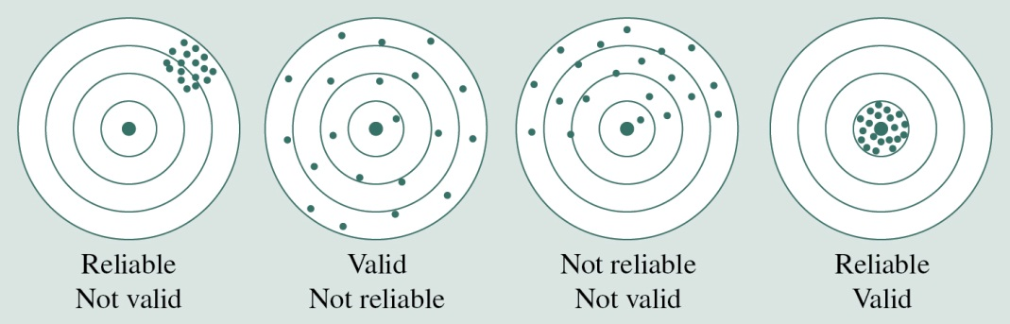
Figure 5-11 Reliability and Validity
Reliability – Consistency of responses; little variability
Validity – Measuring the correct construct; centered
Construct validity, criterion validity, content validity
Notes:
Validity is related to reliability, but a reliable instrument is not guaranteed to be valid.
There are different types of validity; for example, construct validity refers to the use of certain terms and whether terms really measure what it is we want to measure. Criterion validity indicates that your measuring instrument has the capability to predict or agree with constructs external to that which you are measuring. Content validity refers to whether the item really measures what we want to measure.

Slide 25
Passively Solicited Customer-Feedback Approaches
Passively solicited customer feedback:
Customer-initiated contact
Examples: filling out a restaurant complaint card, calling a toll-free complaint line, submitting an inquiry via a company’s website
Notes:
According to research in the area of passive data collection, it was found that passive collections resulted in lower ratings of quality than active collections. It is not clear which approach is more biased. However, it is expected that people who fill out customer response cards based on their own initiative probably have issues they would like resolved.
Customer research card: We are all familiar with customer cards. We see them at many services companies and receive them with products. They are often an inexpensive way to involve the customer in the process. Research shows that respondents to these cards tend to be expressing extreme responses—either very highly pleased or extremely displeased. Response cards provide an opportunity for the service provider to develop a relationship with a customer through properly recovering from an extremely poor service encounter. Companies should have a method for logging, resolving, and tracking complaints. Resolved complaints also should be used for future feedback for systems improvement.
Many companies provide websites and toll-free phone lines for customer complaints, questions, and inquiries. These services are offered by many third parties or can be offered in-house.

Slide 26
Managing Customer Retention and Loyalty
Customer retention
The percentage of customers who return for more service
Will increase by application of service tools and concepts
Customer loyalty
Instilled by offering specialized service not available from competitors
Can be intangible
Notes:
Customer retention is an important indicator that every company should track. For services in which the customers are an input to the process, variability can be reduced by maintaining a stable pool of customers who are familiar with the transaction processes.
Customer loyalty can take many forms, including high customer contact or technology advancements. If a customer and supplier are linked through electronic data interchange (EDI), it is more difficult to switch to an alternative supplier because information systems have to be upgraded to work with new suppliers. This also speeds up data transmission between supplier and customer, reducing cycle times and lead times for delivery of products and services.

Slide 27
Customer-Relationship Management Systems (1 of 2)
Systems created to mine data to improve customer service and retention
Three phases of customer-relationship management:
Acquisition
Retention
Enhancement
Notes:
With business information systems—especially over the Internet and social media—companies are receiving volumes of customer-related data. These data include personal, Internet, process, and customer-preference information. As a result, systems have been created to mine these data to improve customer service and retention.
CRMS technologies are used in customer data acquisition and data-mining efforts. All firms desire profitable customers. Customer self-service and product customization are ways to acquire new customer data. Another means is to provide customer access to information technology (IT) systems for configuring orders or researching information online. Customer retention is enhanced through a variety of activities. Because it costs six times as much to acquire customers, it is cost effective to retain customers. Frequent-flier programs and grocery discount cards are examples of information-based methods for retaining customers. Enhancement involves improving service to the customer through the use of information systems.

Slide 28
Customer-Relationship Management Systems (2 of 2)
Used to monitor customer interactions, preferences, and relationships:
Customer defections
Churn reduction
Clickstream
Knowledge management
Transactional analysis
Notes:
CRMS are used to monitor customer interactions, preferences, and relationships through media such as customer transaction records, call center logs, searches, and website clicks.
The activities monitored include customer defections—customers who do not repeat business in some fixed period of time. This involves determining who are active versus inactive customers.
Personalized service to those who are in danger of becoming inactive is used to achieve churn reduction—that is, reduction of the loss of customers.
For companies such as Amazon.com, clickstream information is kept that demonstrates how a customer navigates the website. This allows tailoring of the website to the preferences of the customer.
Maintaining these types of information is referred to as knowledge management, which involves managing the mountain of information generated by website usage in a way to improve marketing to key customers.
The sales activities are managed specifically to each customer’s preferences. This includes transactional analysis, which consists of customer service policies, sales processes, service process design, and after-sales service. Like many newer technologies such as enterprise resource planning systems, CRMS implementations often result in failure. To implement CRMS properly requires an understanding of your business, customers, competitors, culture, and processes.

Slide 29


