Slide 1
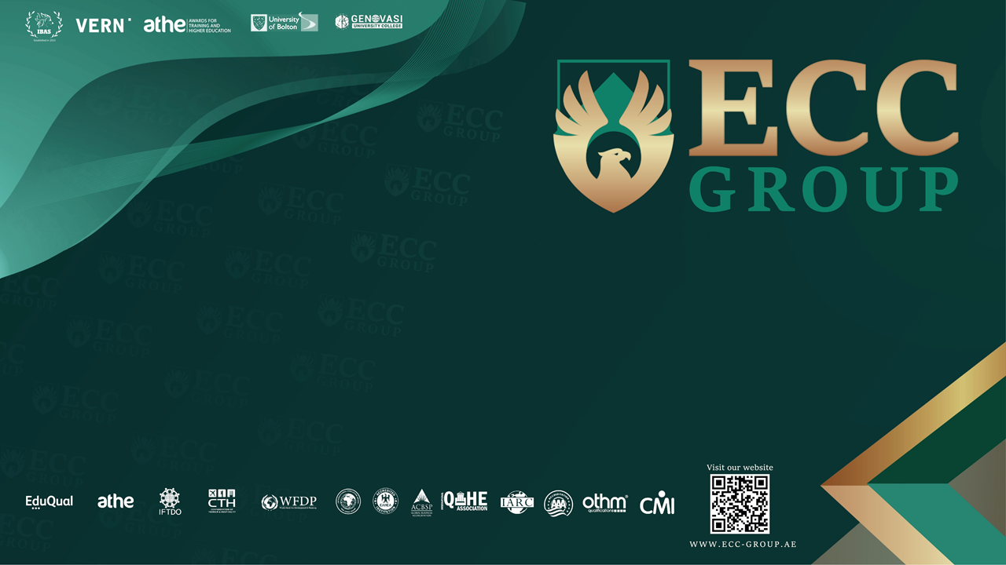

Slide 2
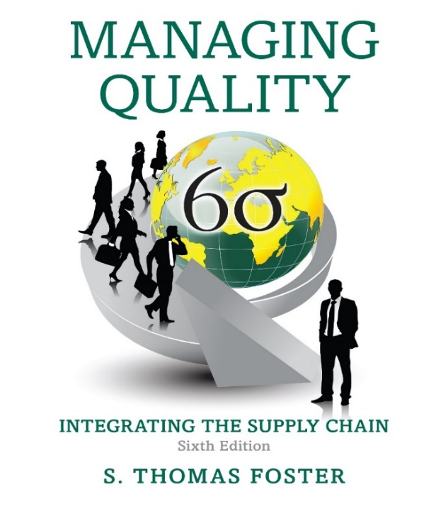
Managing Quality: Integrating The Supply Chain
Chapter 9
Sixth Edition
Managing Supplier Quality in the Supply Chain
Slides in this presentation contains hyperlinks. JAWS users should be able to get the list of links by using INSERT+F7
Notes:
If this PowerPoint presentation contains mathematical equations, you may need to check that your computer has the following installed:
1) MathType Plugin
2) Math Player (free versions available)
3) NVDA Reader (free versions available)

Slide 3
Learning Objectives
9.1 Explain why the concept of the value chain is important for quality management.
9.2 Discuss how quality approaches are used to manage supplier alliances.
9.3 Explain how I S O/T S 16949 is used to improve supplier performance in the auto industry.

Slide 4
The Value Chain (1 of 2)
Value chain
  A tool that disaggregates a firm into its core activities to help reduce costs and identify sources of competitiveness
Value system
  A network of value chains
Value chain activities
  Inbound logistics, operations, outbound logistics, marketing and sales, and service
Notes:
To understand the supply chain, we first discuss the economic concept of the value chain. Michael Porter, the noted economist and author, identified a systematic means for examining all the activities a firm performs and how those activities interact. The value chain is a tool that disaggregates a firm into its core activities to help reduce costs and identify sources of competitiveness. It is part of the value system that consists of a network of value chains. The value chain and core activities that are performed by any company include inbound logistics, operations, outbound logistics, marketing and sales, and service.

Slide 5
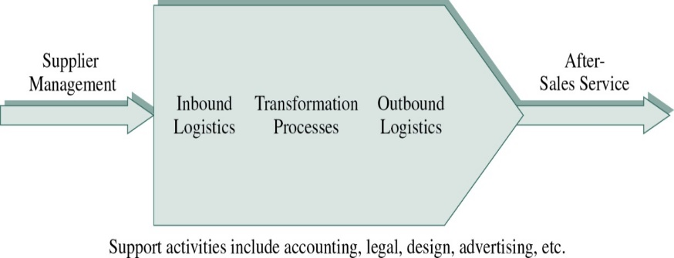
Figure 9-1 Value Chain Activities
Value-chain activities
  Core activities
Non-value-chain activities
  Hidden factory
Based on M. Porter, Competitive Advantage: Creating and Sustaining Superior Performance (New York: Free Press, 1995).
Notes:
Figure 9-1 shows Porter’s value chain. Notice that it is a chain for a single firm; however, the firm’s suppliers also have value chains. The core activities shown in the figure are termed value chain activities because they are the tasks that add value for the customer. If a firm performs these core functions well, the result is high customer satisfaction. Non-value-chain activities typically have costs but no effect on the customer, and are referred to as the hidden factory. The hidden factory contains all the bureaucratic processes that are not part of the core activities in Figure 9-1.

Slide 6
The Value Chain (2 of 2)
The chain of customers:
  This is revealed when you view the step in the chain after you, as your own customer.
  For example, if you work at workstation 4 in a process at the core of the value chain, you will make sure that the work you do is absolutely impeccable before you release it to your “customer” in workstation 5.
Notes:
From a quality perspective, an interesting variation of the value chain is the concept of the chain of customers. Looking at the activities along the value chain sequentially, we see that the links in the value chain are really people performing different functions.
This chain extends from raw materials through supplier firms to the producing firm, with the final link in the chain being the ultimate consumer of the product. The notion is that if each of us along a chain works to satisfy our own customer, the final customer will be very satisfied, and our products and services will be free of defects and mistakes.

Slide 7
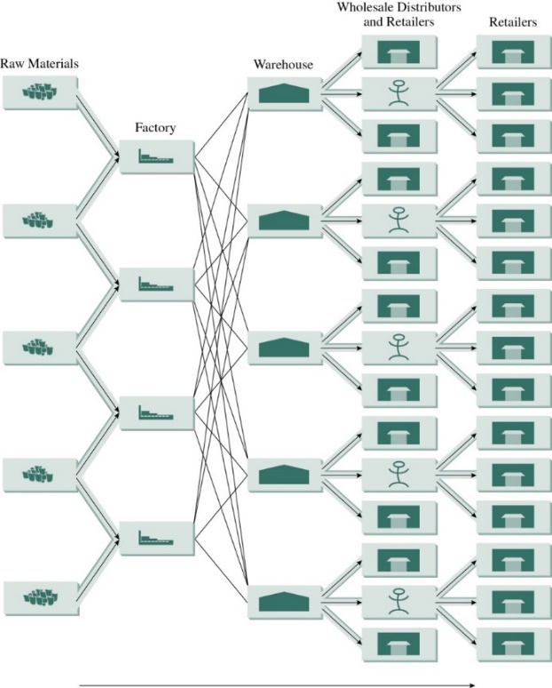
Figure 9-2 The Value Chain
One of the most significant aspects of the value chain is the linkage between a series of suppliers and consumers.
Notes:
The concept of supply-chain management extends the economic concept of the value chain. Figure 9-2 shows a rendering of a supply chain.
Notice that it includes several suppliers, plants, distribution centers, and customer groups. This is a useful extension of the value chain because it provides a more realistic picture of the value chain. Notice that the value chain focuses on activities such as inbound and outbound logistics, which are supply-chain activities. One of the most significant aspects of the value chain is the linkage between a series of suppliers and consumers.
This linkage is especially tenuous because it involves the complex interaction of logistics, systems, and human behavior. These linkages and relationships between suppliers and customers have undergone radical changes in the past decade. Much of this chapter focuses on this linkage.

Slide 8
Supplier Alliances
A big part of quality improvement requires developing and assisting suppliers so they can provide needed products with low levels of defects in a reliable manner, while conforming to requirements.
Treat suppliers as de facto subsidiaries of the customer organization.
Notes:
Managing inbound logistics in the supply chain involves working with suppliers who provide parts, raw materials, components, and services. As we have already discussed, there has been a trend toward developing closer working relationships with fewer suppliers. Given this new approach to suppliers, a big part of quality improvement requires developing and assisting suppliers so they can provide needed products with low levels of defects, in a reliable manner, while conforming to requirements.
Several approaches to improving suppliers result in what are called supplier alliances. Inspired by lean purchasing approaches learned from Japanese industry, supplier–alliance relationships have emerged that treat suppliers as de facto subsidiaries of the customer organization. We say de facto subsidiaries because as information is shared and communications are improved, the relationship begins to resemble a parent/subsidiary instead of separate firms.

Slide 9
Supplier Development Approaches (1 of 3)
Single sourcing
  Narrowing down the list of approved suppliers for a single component to just one supplier
    Electronic data interchange (E D I)
    Vendor-managed inventory (V M I)
Dual sourcing
  The number of approved suppliers is reduced to just a few to reduce the exposure of having a single supplier
Notes:
As shown in Table 9-1 in your text, a number of systems are used to help develop suppliers.
Single sourcing refers to narrowing down the list of approved suppliers for a single component to just one supplier.
Electronic data interchange (EDI) is a system that aids customer and supplier communication by linking together supplier and customer information systems. Customers now are helping suppliers to isolate bottlenecks in the operation, balance production systems, and reduce setup times in an effort to reduce lead times.
Single sourcing has changed the landscape of purchasing. Prior to single sourcing, Xerox used 5,000 suppliers. Since implementing single sourcing, Xerox uses only 300 suppliers. Suppliers were chosen for their current quality practices and their willingness to work with Xerox to implement a quality improvement program. In Britain, dual sourcing, or multisourcing, has been chosen by many major customers, predominantly to avoid unfair pricing and the possibility of the customer’s production being disrupted by suppliers’ labor disputes. Having a limited set of suppliers also reduces shopping around for the best price.
Perhaps the most extreme example of supplier partnering comes from the Bose Corporation. Bose has implemented what it terms JIT II. In this effort, Bose eliminated a large part of its purchasing department and empowered suppliers to write their own purchase orders. In effect, this made the suppliers responsible for managing inventories and keeping inventory costs low. It is now called vendor-managed inventory (VMI).

Slide 10
Supplier Development Approaches (2 of 3)
Supplier evaluation
  A tool used by many firms to differentiate and discriminate between suppliers
Sole-source filters
  External validation of quality programs
  Examples: I S O 9000 and Baldrige Award
Supplier certification or qualification programs
  Lengthy inspections of suppliers that involve long-term visits and evaluations
Notes:
Supplier evaluation is a tool used by many firms to differentiate and discriminate between suppliers. Supplier evaluations are often recorded on report cards in which potential suppliers are rated based on criteria such as quality, technical capability, and ability to meet schedule demands.
Sole-source filters that are used in many companies rely on external validation of quality programs. The external validation comes from outside examiners and registrars that are used in these processes. This gives customers the comfort that outside authorities have given your company a sort of seal of approval.
Two of the most commonly-used filters are the Baldrige criteria and ISO 9000 (Chapter 3). In these cases, companies must show either that they are using the Baldrige criteria to improve or that they have become ISO 9000 registered. The ISO 9000 filter is used commonly in the international community. Many companies perform lengthy inspections of their suppliers that involve long-term visits and evaluations.
These programs are often called supplier certification or qualification programs if the focus is entirely on evaluation.

Slide 11
Supplier Development Approaches (3 of 3)
Supplier development programs
  Helping a supplier to improve by training the supplier over long periods of time
Supplier audit
  A team of auditors visits the supplier and then provides results of the audit to the customer
Alliances
  Treat suppliers as de facto subsidiaries of the customer organization
Notes:
If the focus is on helping the supplier to improve by training the supplier over long periods of time, they are termed supplier development programs.
Another tool used often is the supplier audit. It is similar to supplier certification except that a team of auditors visits the supplier and then provides results of the audit to the customer. The audits are performed to ensure that product quality and procedural objectives are being met. Supplier audits tend not to have the developmental component that is found in supplier development programs.

Slide 12
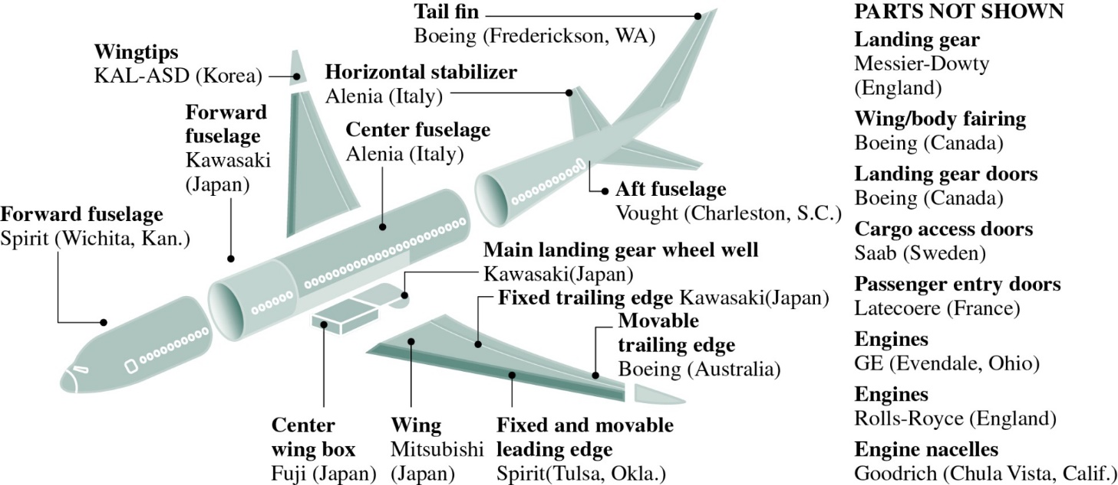
Figure 9-3 Single Sourcing Examples
Boeing 787 Suppliers
Based on www.seattlepi.com/
Notes:
Figure 9-3 shows a picture of Boeing 787 subsystems and suppliers. As you can see, this is a large number of suppliers to manage. There is often no playbook that shows the best way to manage such large networks of suppliers. Boeing has acknowledged these problems and the criticism it has received. Boeing CEO Jim McNerney stated, “In retrospect, our 787 game plan may have been overly ambitious, incorporating too many firsts all at once—in the application of new technologies, in revolutionary design-and-build processes, and in increased global sourcing of engineering and manufacturing content.”

Slide 13
Supplier Development (1 of 3)
Supplier development activities:
  Supplier evaluation
  Supplier training
  Consultation
  Data sharing
  Processes sharing
Notes:
Supplier development has to do with the activities a buyer undertakes to improve the performance of its suppliers. Some of these activities may include supplier evaluation, supplier training, consultation, data sharing, and processes sharing. Although companies such as Toyota and Honeywell have become very good at developing suppliers, recent data suggests that many companies do not have adequate supplier development programs. There is much work left to be done in this area.

Slide 14
Supplier Development (2 of 3)
Steps in the supplier development process:
  Identify critical products and services.
  Identify critical suppliers.
  Form cross-functional teams.
  Meet with supplier top-management.
  Identify key projects.
  Define details of agreement.
  Monitor status and modify strategies.
Notes:
There are seven steps for supplier development.
First, identify critical products and services. This involves identifying strategic products and components (those that are difficult to obtain, have high costs, or are high volume).
Second, identify critical suppliers. They may be suppliers who provide strategic components but do not meet quality or reliability objectives, or suppliers who do not meet schedules.
Third, form cross-functional teams. The buyer forms a cross-functional team to work with the supplier.
Fourth, meet with supplier top management. This meeting is held to discuss details of strategic alignment, performance expectations and measurement,
and processes for improving.
Fifth, identify key projects. These occur when there is agreement about how the supplier needs to improve and where. Projects are selected in the same way Six Sigma projects are selected, by criteria such as impact, ROI, feasibility, and required investments.
Sixth, define details of agreement. This definition involves cost (and benefit sharing), commitments of resources, metrics for improvement, project charters, accountability, and deliverables.
Finally, monitor status and modify strategies. To ensure success, management must actively monitor progress and revise strategies as needed.

Slide 15
Supplier Development (3 of 3)
Supplier awards
  Awards given by companies to outstanding suppliers
Supplier relationship management system (S R M S)
  Spend analytics
  Sourcing execution
  Procurement execution
  Payment
  Supplier scorecarding
  Performance monitoring
Notes:
Many times, companies will provide awards to outstanding suppliers. This provides an opportunity to celebrate supplier performance that is the best of the best. Some of these awards are based on the Baldrige criteria or are decided by a committee within the buyer’s company. An example of a supplier award is the Ford World Excellence Award. Its program includes Gold, Silver, and Recognition level awards.
Elsewhere in this text, we discuss customer relationship management systems (CRMS). For upstream activities, there are similar systems called supplier relationship management systems (SRMS). These systems include spend analytics, sourcing execution, procurement execution, payment, supplier scorecarding, and performance monitoring.

Slide 16
I S O/T S 16949 (1 of 2)
An International Standards Organization (I S O) Technical Specification that aligns existing automotive quality system requirements within the global automotive industry
It specifies the quality system requirements for the design/development production, and, where relevant, installation and servicing of automotive-related products.
Notes:
Now that we have discussed supplier development conceptually, let’s look at a specific example of a supplier development program: ISO/TS 16949. The goal of developing your suppliers is based on the need to provide high quality to the customer. Because variability is anathema to quality, the supplier’s processes must be consistent with those of the customer. In the late 1980s, U.S. automakers developed certification programs for suppliers. The General Motors program was called “Targets for Excellence,” and Ford used a program called “Q1.” With the increase in popularity of ISO 9000, suppliers asked auto companies to adopt a single standard for certifying suppliers.
The result, called QS 9000, provided a common standard for DaimlerChrysler, General Motors, and Ford. This standard has gone through an update and was supplanted by ISO/TS 16949.
The ISO/TS 16949 standard applies only to automotive companies. ISO/TS 16949 was written by the International Automotive Task Force (IATF). The IATF consists of an international group of vehicle makers, including Ford, General Motors, and Chrysler, as well as several automotive trade associations. Representatives and subcommittees of TC 176 also helped to prepare ISO/TS 16949.

Slide 17
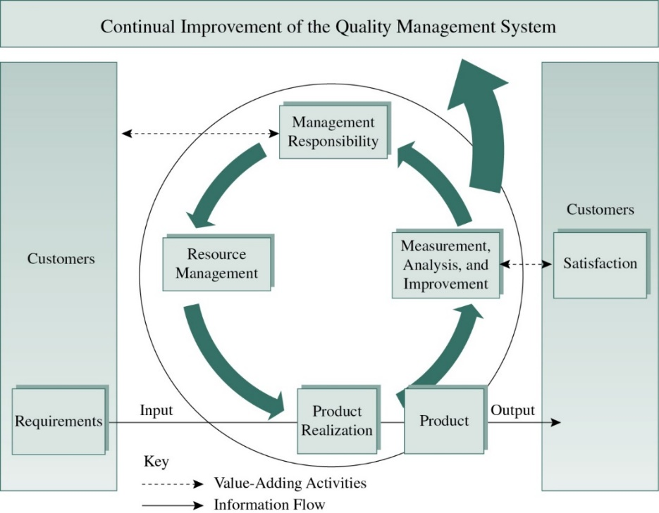
Figure 9-4 I S O/T S 16949
Model of a process-based quality management system
Notes:
We discuss ISO/TS 16949 in more depth later. ISO/TS 16949 is based on the model in Figure 9-4. This model shows that ISO/TS 16949 is closely aligned with ISO 9000 in that it is founded on a systems view of automotive production. This system for continual improvement involves management responsibility; resource management; product realization; and measurement, analysis, and improvement. The sections of ISO/TS 169496 are shown in Table 9-2.

Slide 18
I S O/T S 16949 (2 of 2)
Quality management system
Management responsibility
Resource management
Product realization
Measurement, analysis, and improvement
Notes:
For the quality management system, suppliers must recognize key processes and document these processes. They must establish sequences and linkages for these processes. The organization must determine how effective their operations are; make resources and information available in sufficient quality and quantity to run the business; monitor, measure, and analyze the business to ensure effective operations; and take actions to ensure that the planned results are attained and continual improvements are being made.
Management responsibility – For this section of ISO/TS 16949, the extent to which management is committed to the development and implementation of quality management and continuous improvement is documented. Management is responsible for developing policy, communicating with the organization relative to customer service, establishing quality objectives, conducting managerial reviews, and providing resources. For example, managers with responsibility and authority for corrective actions will need to be informed when products do not meet specifications, and see that corrective action is taken to ameliorate the problems.
Resource management – For management to fulfill its responsibility, it must provide resources. These resources are used to maintain the quality management system and meet customer requirements, including training and development for human resources. Management is required to provide infrastructure such as bricks and mortar, equipment, and support systems. They must be planned and implemented properly; a safe, clean, and adequate work environment is established for worker satisfaction.
Product realization – Products and processes should be adequately planned, including quality objectives for the products. Customer-related processes should be designed so that customer needs are fully considered and regulatory requirements are met. This section considers all aspects of product and process design as well as purchasing, suppliers, control plans, setups, preventive maintenance, traceability, and many other aspects of designing and producing products.
Measurement, analysis, and improvement – For this requirement, the company needs to provide documentation that it can demonstrate product conformity, quality management system conformity, and continual improvement of the quality management system. This requirement includes aspects such as statistical tools, measurement systems, customer satisfaction measurement, internal audits, and other considerations.

Slide 19
Building an Understanding of Supply Chain Quality
Supply chain quality management:
  A systems-based approach to performance improvement that leverages opportunities created by upstream and downstream linkages with suppliers and customers
Notes:
Recent work has been performed in the area of supply chain quality management that is helping us better understand this field. A question remains: As business and engineering schools place more emphasis on supply chain management, what impact will it have on how we approach and teach quality management? Although our understanding is still preliminary, we are beginning to create a body of knowledge in this area.
Supply chain quality management (SCQM) is defined as a systems-based approach to performance improvement that leverages opportunities created by upstream and downstream linkages with suppliers and customers

Slide 20


