Slide 1
Human Resource Management
Chapter 9
Selection methods
and decisions

Slide 2
Selection
‘Selection is the process of choosing which applicant should be appointed to a vacancy. The costs of poor selection choices can be high and include poor performance, additional training, demotivation of others, high levels of absence and so on. Sophisticated selection processes thus form part of a strategic bundle of HR practices which contribute to improved organisational performance’.

Slide 3
Selection criteria
Job fit
This emphasises the requirements of the person specification and identifies a candidate who can conduct that job.
Team/functional fit
This is concerned with how well a candidate will slot into the team or functional area.
Organisational fit
This is concerned with how well an appointee will fit into the culture of the organisation.

Slide 4
Traditional shortlisting
Stage 1: Panel members agree essential criteria for those to be shortlisted.
Stage 2: Selectors individually produce lists of candidates using these criteria.
Stage 3: Selectors reveal their lists and find consensus.
Stage 4: Discussion of candidates preferred by some and not others to reduce disagreement.
Stage 5: Selectors produce a final shortlist by discussion.

Slide 5
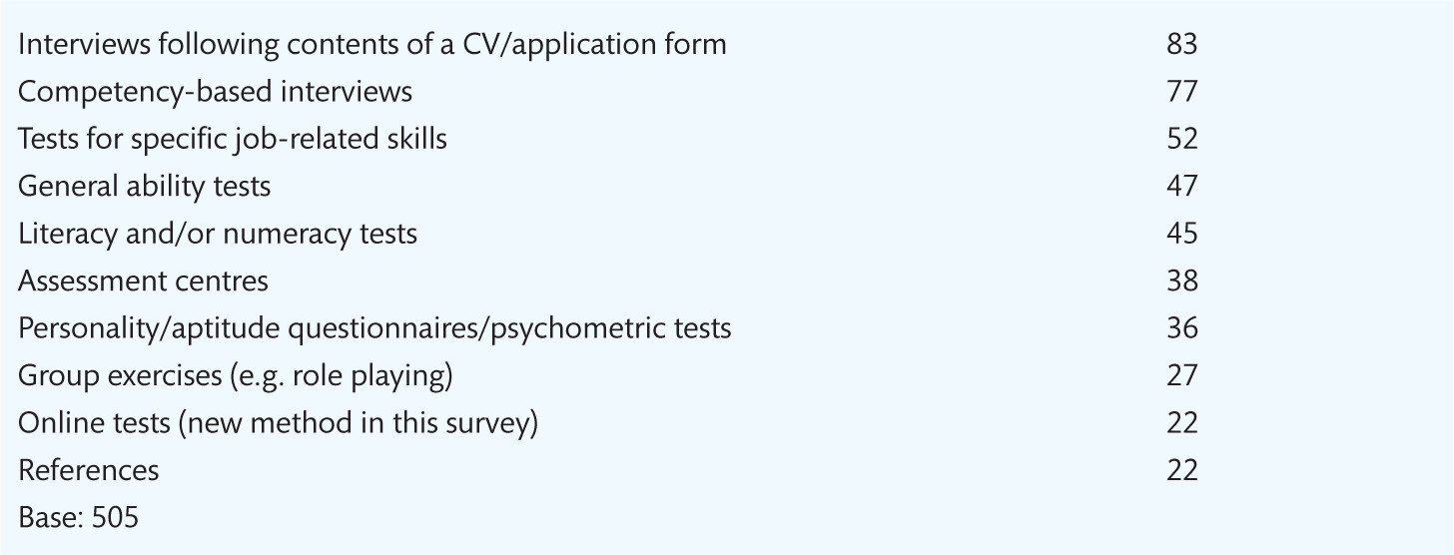
Selection methods
Notes:
Table 9.1 Methods used to select applicants (%)

Slide 6
Selection methods: choice criteria
Selection criteria for the post to be filled
Acceptability and appropriateness of the methods
Abilities of the staff involved in the selection process
Administrative ease
Time factors
Cost
Accuracy.

Slide 7
The ‘classic trio’
Application forms
These give a standardised synopsis of candidates’ career histories
They are easy to compare
They provide useful biodata.
Telephone interviewing
Can be by telephone, online or face-to-face
Have low predictive validity, but are still widely used.
References
Factual checks
Character references.

Slide 8
Advanced methods of selection: testing
Selection tests can take several different forms:
Aptitude tests
General intelligence tests
Special aptitude tests
Attainment tests
Personality tests
Work sampling tests
Online testing.

Slide 9
Validity and reliability
Validity
Reliability
This means that test scores relate to or correlate with subsequent job performance.
Ability tests and work sample tests may have high predictive validity for manual workers.
This means the degree to which the test measures consistently whatever it sets out to measure.
A reliable test will mean that greater weight can be placed on individual scores.
A reliable test is of no value unless it also has high validity.

Slide 10
Group selection methods
Group tasks provide evidence about the candidates’ ability to:
Get on with others
Influence others and the way they do this
Express themselves verbally
Think clearly and logically
Argue from past experience and apply themselves to a new problem
Identify the type of role they play in group situations.

Slide 11
Assessment centres
Assessment centres incorporate multiple selection techniques such as:
Group selection methods
Work simulation exercises
Psychological tests
A variety of interviews
Presentations
They are used to assess a group of broadly similar applicants using competencies and behavioural criteria relevant to the job on offer.

Slide 12
Final selection decision making
These can be used by groups of selectors to reconcile different evaluations of candidates.
Notes:
Table 9.3

Slide 13
General discussion topics
It could be argued that the selection process identifies candidates who are competent in the selection process rather than candidates who are most competent to perform the job on offer. Discuss this in relation to all forms of selection.
‘It is unethical and bad for business to make candidates undergo appraisal at a selection assessment centre without providing detailed feedback and support.’ Discuss.

