Slide 1
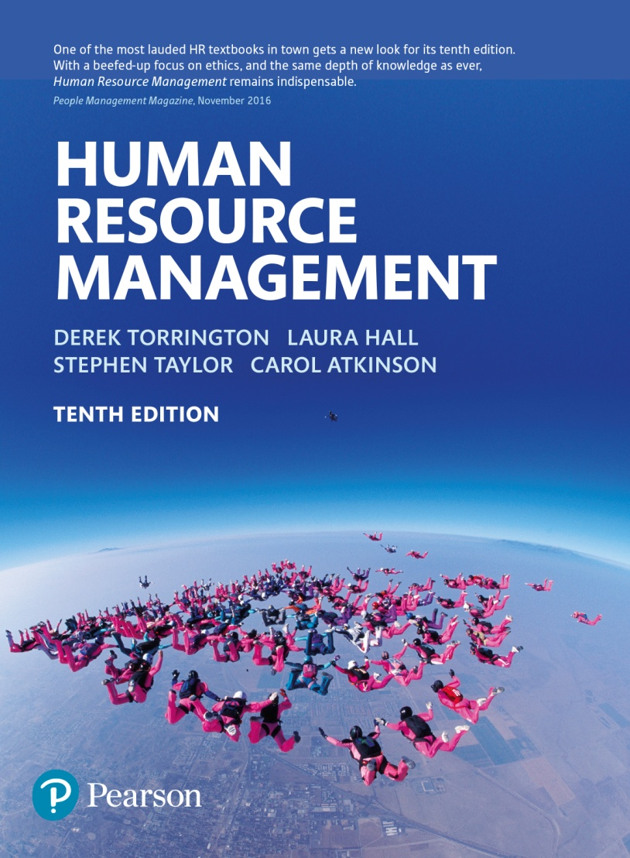
Human Resource Management
Chapter 4
Strategic human resource management

Slide 2
Strategic HRM
‘Human resources are increasingly viewed as a critical, if not the source of, competitive advantage for the business. Thus attention needs to be paid, at a strategic level, to the nature of this resource and its management, as this will impact on the performance of the organisation, however defined’.

Slide 3
HR strategy
‘The intentions of the corporation both explicit and covert, towards the management of its employees, expressed through philosophies, policies and practices’.
Tyson, (1995)

Slide 4
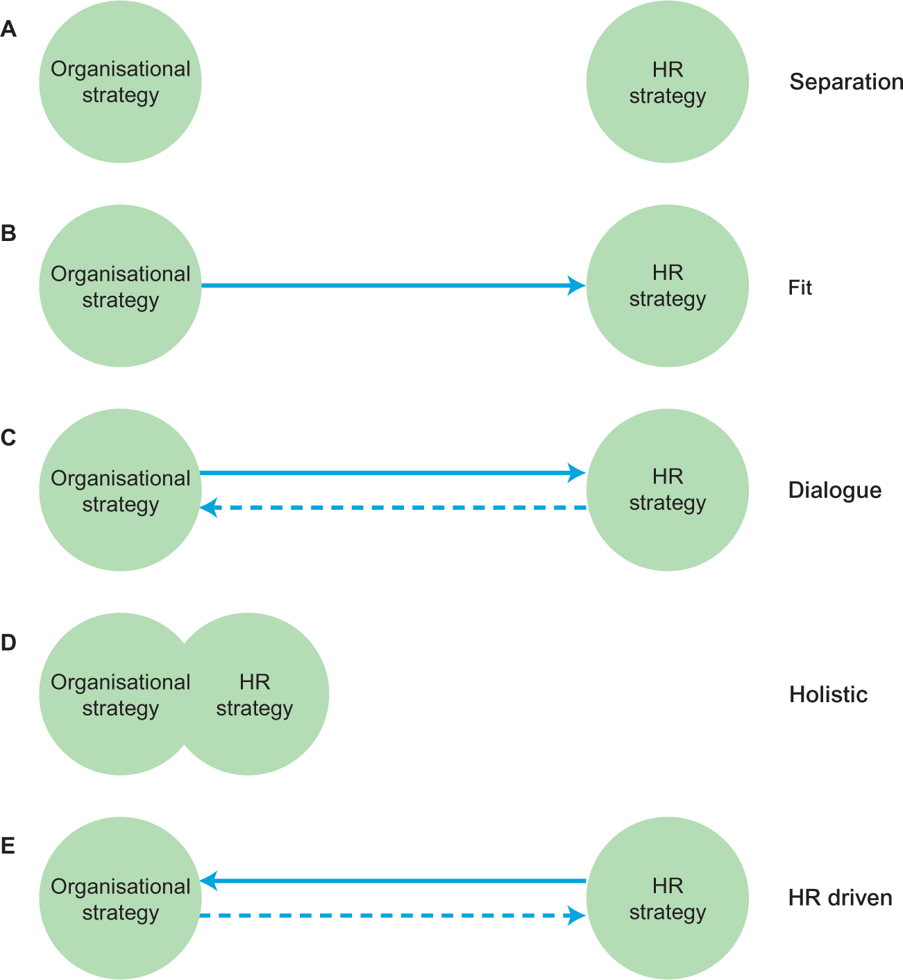
Relationships between organisational strategy and HR strategy
Notes:
Figure 4.1 Potential relationships between organisational strategy and HR strategy

Slide 5
The separation model
No relationship exists between organisational strategy and HR strategy.
There may be neither organisational strategy nor HR strategy at all.
Typical of organisations thirty years ago.
May still typify small organisations.

Slide 6
The fit model
There is recognition of the importance of people to organisational strategy.
Employees are key implementers of strategy.
HR is designed to fit with the business strategy.
Strategy and objectives are ‘cascaded’ down the organisation via management structure.
Assumes high degree of rationality within the organisation.

Slide 7
The dialogue model
Builds on the ‘fit’ model.
Recognises the need for two-way communication and debate.
Not all strategic aims may be feasible.
Alternative ways of achieving aims need to be sought and evaluated.

Slide 8
The integrated/holistic model
People are seen as key to competitive advantage, not simply implementers of strategy.
HR strategy is therefore an end in itself, not simply a means to an end.
The notion of the resource-based firm requires business strategy to encompass HR, and other, strategies.
There is mutual development and integration which aligns both HR and business aims.

Slide 9
The HR-driven model
HR strategy drives other strategies.
People are key to competitive advantage so the organisation needs to build on their strengths.
Supports the idea of the resource-based firm.
Uses the notion of ‘human capital’ which provides the potential for future competitive advantage.

Slide 10
Theoretical perspectives of strategic HRM
Universalist approach
  The ‘one best way’ concept
Fit or contingency approach
  The ‘alignment’ concept
Resource-based approach
  The ‘human capital’ concept

Slide 11
Universalist approach
Derives from the concept of HRM as ‘best practice’.
Bundles of practice when combined are mutually supportive of each other and the business.
There is ‘one best way’ of managing human resources.
It involves a high-commitment (high-involvement, high-performance) model.
It is unitarist and assumes that employees will not question or dispute managerial practice.

Slide 12
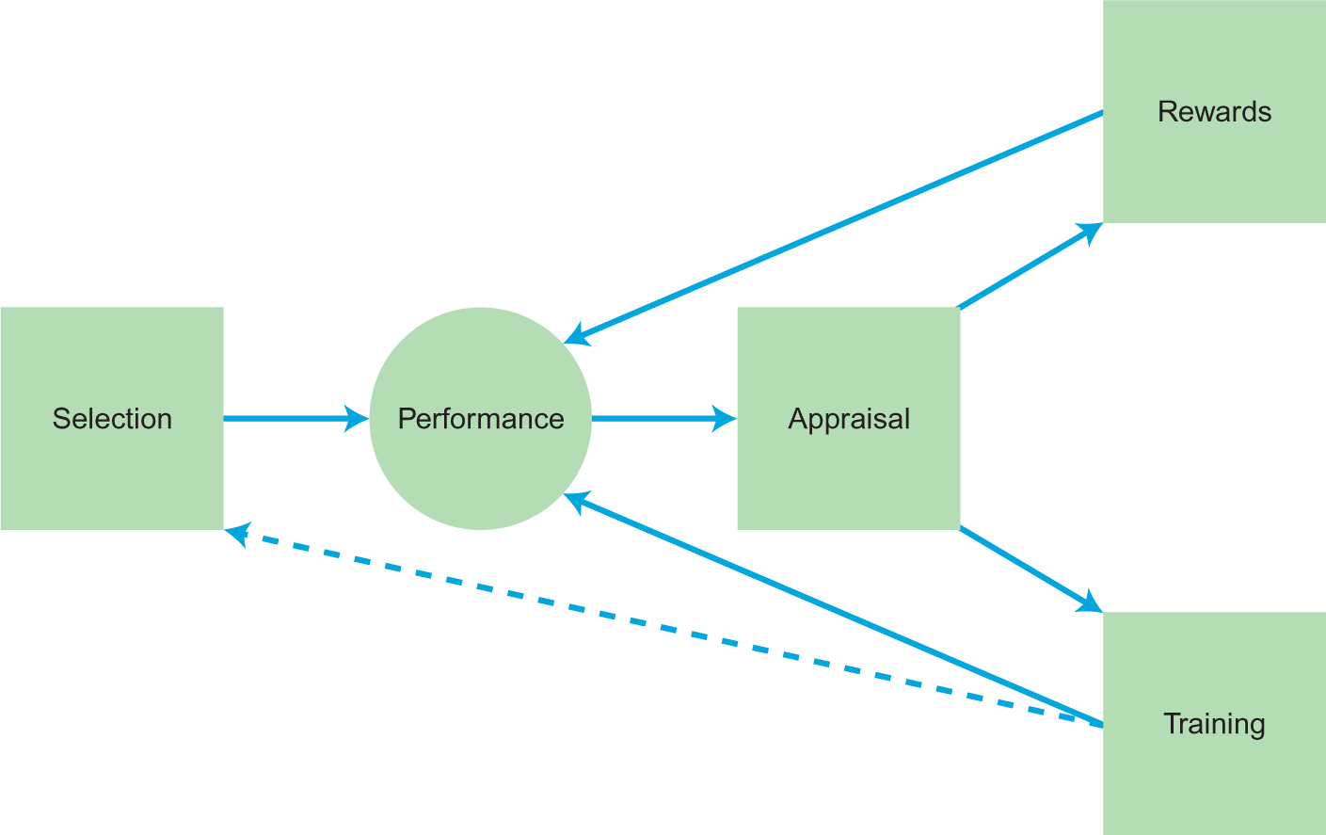
Fit or contingency approach; the HR cycle
Notes:
Figure 4.2 The HR cycle

Slide 13
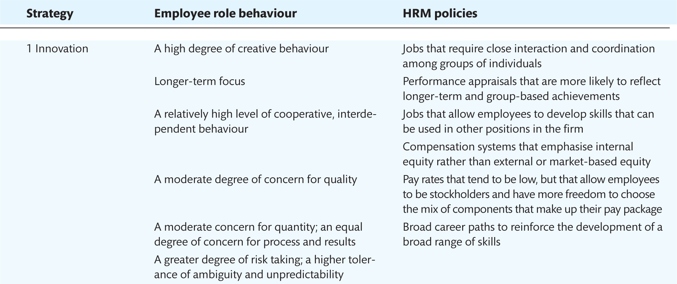
Innovation strategy and HRM fit
Notes:
Table 4.1 Business strategies, and associated employee role behaviour and HRM policies

Slide 14
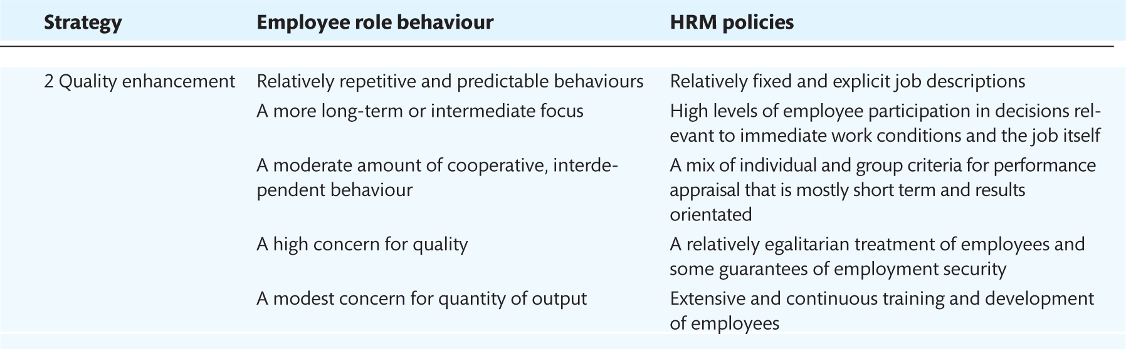
Quality enhancement strategy and HRM fit
Notes:
Table 4.1 Business strategies, and associated employee role behaviour and HRM policies

Slide 15
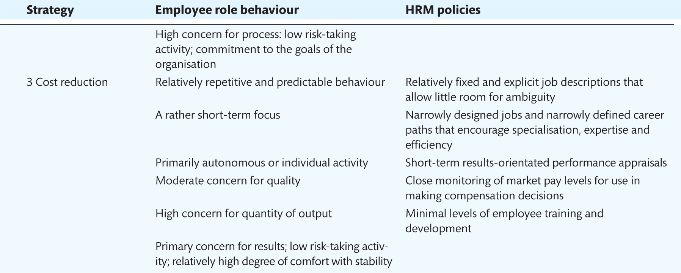
Cost reduction strategy and HRM fit
Notes:
Table 4.1 Business strategies, and associated employee role behaviour and HRM policies

Slide 16
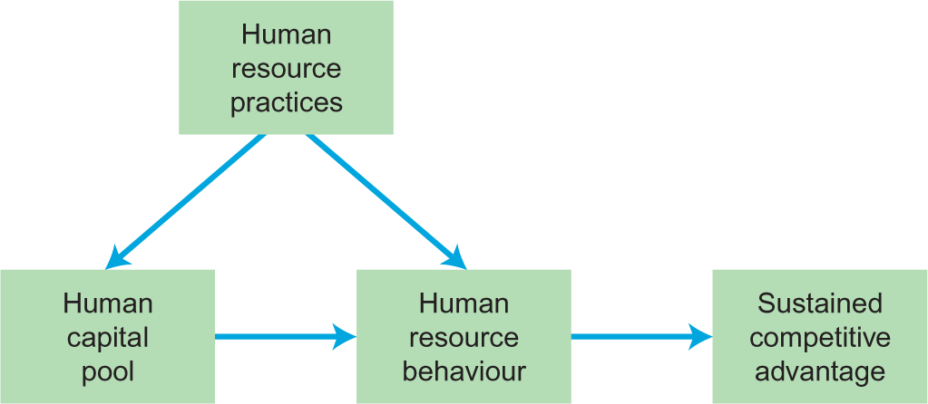
Resource-based approach; human resources as a source of competitive advantage
Notes:
Figure 4.3 A model of human resources as a source of sustained competitive advantage

Slide 17
The HRM practices-performance link; the causal chain
Notes:
Figure 4.4 The people management–performance causal chain

Slide 18
General discussion topics
Is it feasible to link business strategy with the management of people in organisations?
HR strategies can be stimulating to produce and satisfying to display, but how can we make sure that they are implemented?

