Slide 1

Strategic Marketing
Lecture 2

Slide 2


Strategic marketing
Lecture # 2
مساء الخير وأتمنى أن يكون الجميع بخير سنبدأ الساعة 6:10مساء بتوقيت القاهرة مع خالص الشكر د. علي يحيى

Slide 3

Quick recap on previous lecture

Slide 6
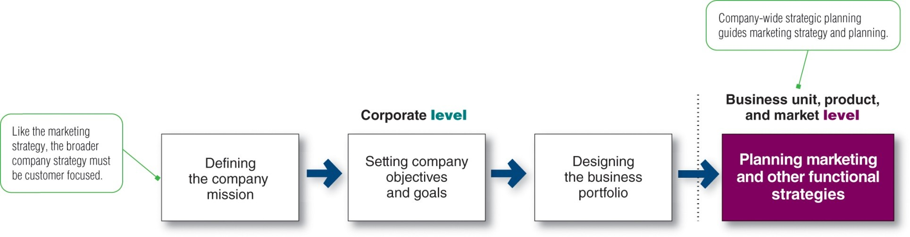
PLANNING MARKETING STRATEGIES
The marketing logic/how the company creates the customer value
Marketing strategy formulation
Where are we now? What is the business doing now, Identification: What is current strategy? Assumptions: What assumptions about the company’s relative position, strengths and weaknesses, competitors and industry trends must be made for the current strategy to be viable?
What is happening in the environment? Industry analysis: What are the key factors influencing competitive success? What are the important industry opportunities and threats? Competitor analysis: What are the capabilities and limitations of existing and potential competitors, and what are their probable future moves? Societal analysis: What important government, social and political factors will present opportunities or threats? what are the firm’s strengths and weaknesses relative to present and future competition?
What should the business be doing? Tests of assumptions and strategy: How do the assumptions embodied in the current strategy compare with the analysis indicated above? How does the strategy meet the tests indicated above? Strategic alternatives: What are the strategic alternatives given the analysis above? (Is the current strategy one of these?) Strategic choice: Which alternative best relates the company’s situation to external opportunities and threats?
Proctor, T., 2014, Strategic Marketing: An Introduction, Routledge
Notes:
Companies must find the game plan for long-run survival and growth that makes the most sense given its specific situation, opportunities, objectives, and resources. This is the focus of strategic planning—the process of developing and maintaining a strategic fit between the organization’s goals, capabilities and its changing marketing opportunities.
Strategic planning sets the stage for the rest of planning in the firm. Companies prepare annual plans, long-range plans, and strategic plans. The annual and long-range plans deal with the company’s current businesses and how to keep them going. In contrast, the strategic plan involves adapting the firm to take advantage of opportunities in its constantly changing environment.

Slide 10
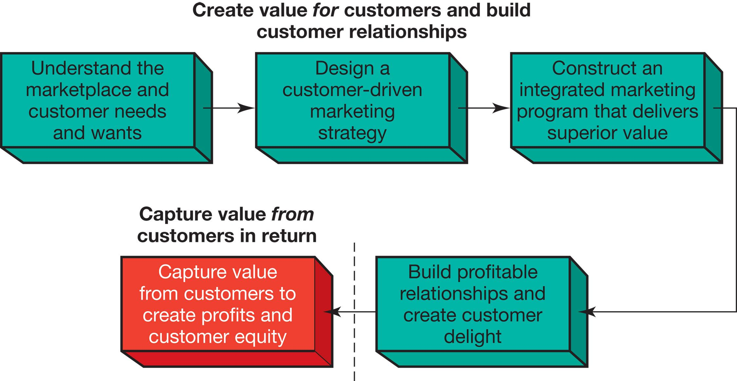
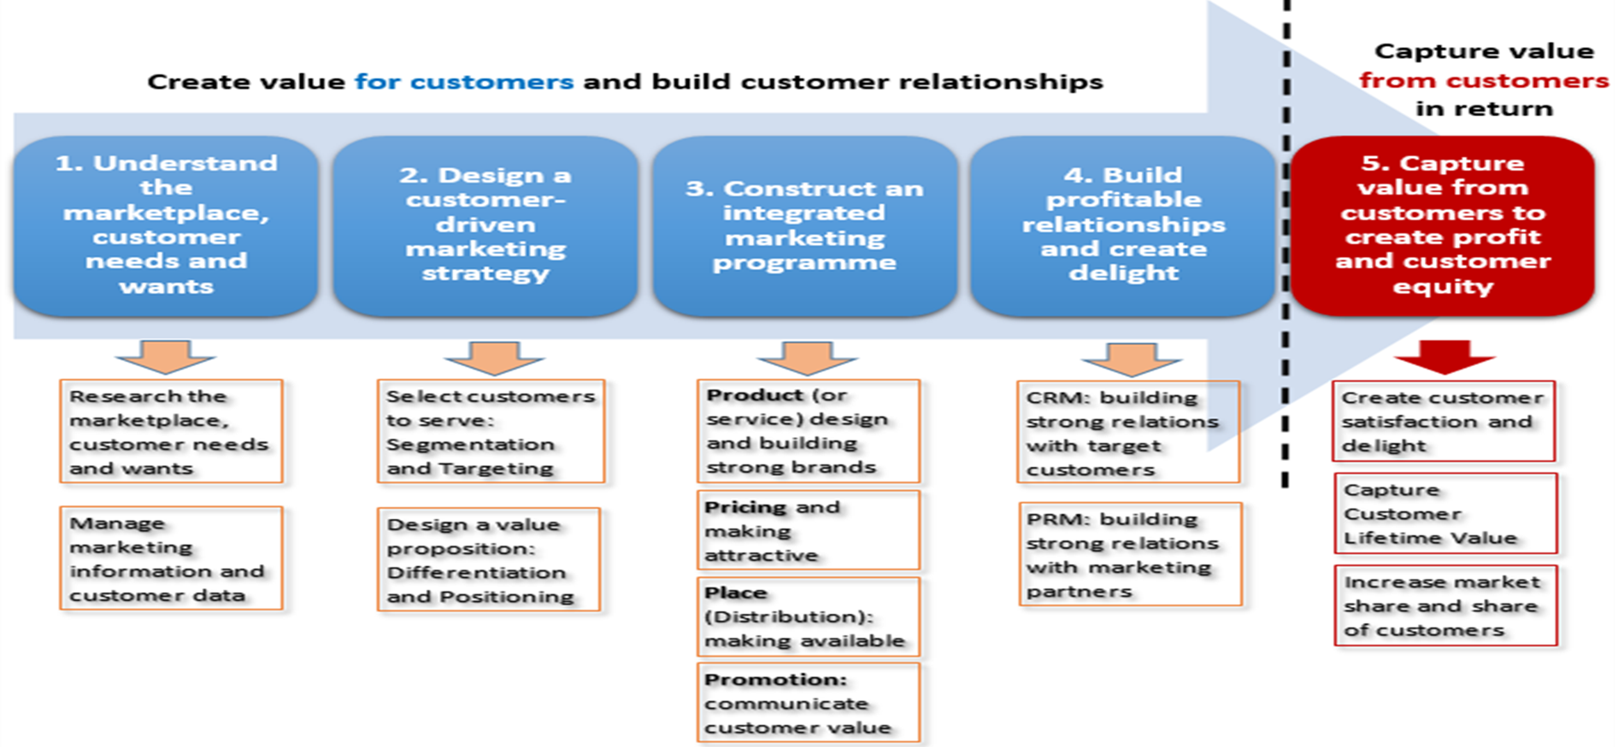
1
2
3
4
- consumer buyer behaviour and consumer markets
- Business Buyer Behaviour and Business Markets
Needs and wants
Marketplace
Market offering
Strategic marketing analysis
Big data and MIS
Grand marketing strategies competitive and growth
STP strategies
Differentiation and branding
CRM tools and systems
CUSTOMER RELATIONSHIP GROUPS
Marketing control
Marketing MIX
4Ps
Notes:
The Marketing Process
In the first four steps, companies work to understand consumers, create customer value, and build strong customer relationships
In the final step, companies reap the rewards of creating superior customer value
By creating value for customers, companies are able capture value from customers in the form of sales, profits, and long-term customer equity

Slide 11
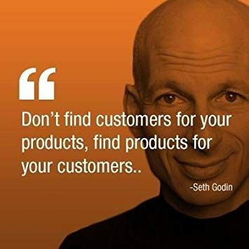

1- Understanding customer needs/wants.
Analyzing customer needs & marketplace
Seth W. Godin is an American author and former dot com business executive.
Godin is the author of many books.
Free Prize Inside was a Forbes Business Book of the Year in 2004
Purple Cow sold over 150,000 copies in more than 23 print runs in its first two years
The Dip was a Business Week and New York Times bestseller.
Customer S’ NEEDS, WANTS, DEMANDS, AND MARKETING OFFERINGS ?

Slide 12
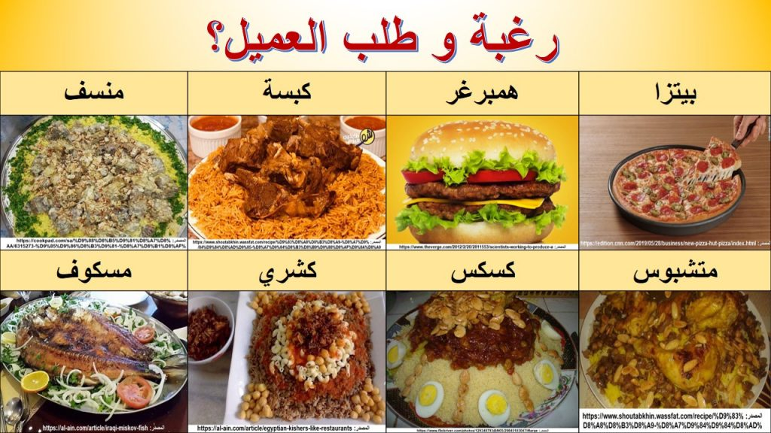

المفاهيم الأساسية للتسويق
Customer S’ NEEDS, WANTS, DEMANDS, AND MARKETING OFFERINGS ?
فهم السوق واحتياجات العملاء ورغباتهم
العملاء يبحثون عن الحلول، وليس عن المنتجات
الاحتياجات: الاحتياجات الإنسانية الأساسية والمتمثلة في الهواء والغذاء والمياه والملبس والمأوى.
الرغبات: هي منتجات محددة قد تشبع الاحتياجات بناء علي مجتمعنا
الطلبات: هي الرغبة لشراء منتجات معينة مع وجود القدرة على الشراء
عروض التسويق: هي منتجات تلبي احتياجات العملاء
كثير من الناس يريدون سيارة مرسيدس. فقط عدد قليل يمكنهم شراء واحدة. يجب على الشركات قياس عدد الأشخاص الذين يريدون منتجهم ، ولكن أيضا عدد الأشخاص الراغبين والقادرين على شرائه.
Notes:
A U.S. consumer needs food but may want a Chicago-style “deep-dish” pizza and a craft beer. A person in Afghanistan needs food but may want rice, lamb, and carrots. Our wants are shaped by our society. Many people want a Mercedes; only a few c
an buy one. Companies must measure not only how many people want their product, but also how many are willing and able to buy it.

Slide 13








CONSUMERS’ NEEDS, WANTS, AND DEMANDS?
Feeling of deprivation
Needs - state of felt deprivation including physical, social, and individual needs i.e hunger
Wants - form that a human need takes as shaped by culture and individual personality i.e. bread
Demands - human wants backed by buying power i.e. money= ordering
Definitive Desire
ability to act
Notes:
As a first step, marketers need to understand customer needs and wants and the marketplace within which they operate.
Needs
A human need is a state of felt deprivation
Included are:
The basic physical needs for food, clothing, warmth, and safety
Social needs for belonging, affection, fun, and relaxation
Esteem needs for prestige, recognition, and fame
Individual needs for knowledge and self-expression
Wants
The form human needs take as they are shaped by culture and individual personality
As a society evolves, the wants of its members expand
Be careful not to confuse wants with needs
For example: a manufacturer of drill bits may think that customers need a drill bit, but what the customers really need is a hole (aka "marketing myopia")
Demands
People have almost unlimited wants, but limited resources
Therefore, wants become demands when backed by buying power

Slide 14
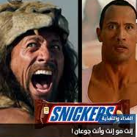



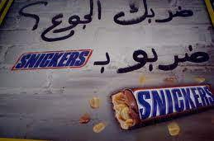
Notes:
As a first step, marketers need to understand customer needs and wants and the marketplace within which they operate.
Needs
A human need is a state of felt deprivation
Included are:
The basic physical needs for food, clothing, warmth, and safety
Social needs for belonging, affection, fun, and relaxation
Esteem needs for prestige, recognition, and fame
Individual needs for knowledge and self-expression
Wants
The form human needs take as they are shaped by culture and individual personality
As a society evolves, the wants of its members expand
Be careful not to confuse wants with needs
For example: a manufacturer of drill bits may think that customers need a drill bit, but what the customers really need is a hole (aka "marketing myopia")
Demands
People have almost unlimited wants, but limited resources
Therefore, wants become demands when backed by buying power

Slide 15


Activity # 1

Slide 16
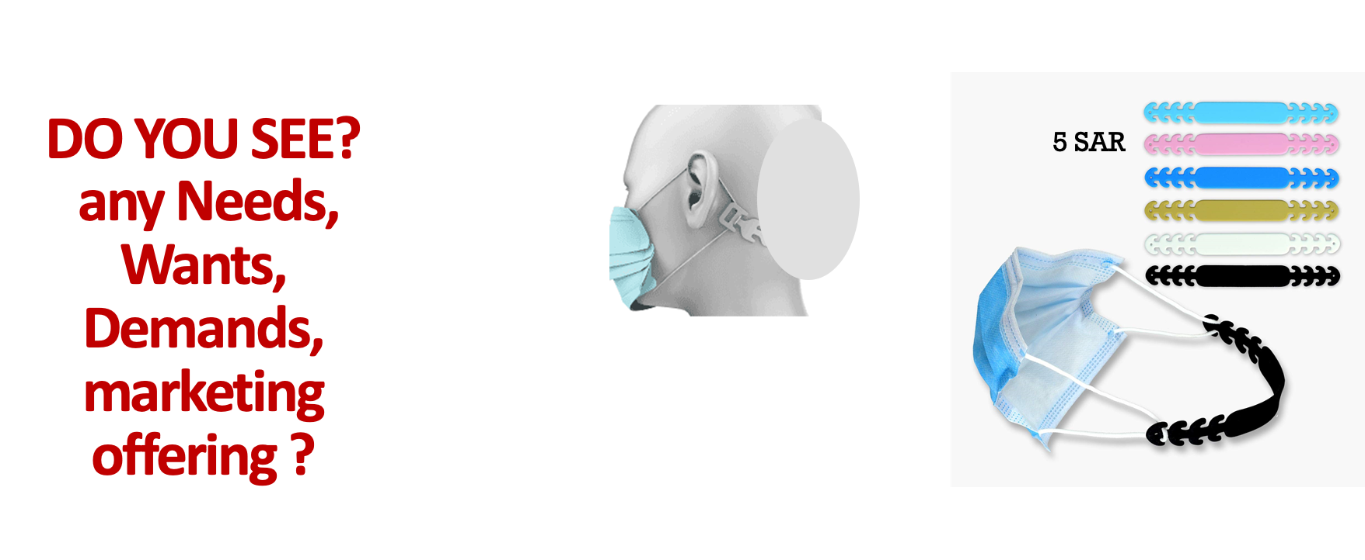

Slide 17
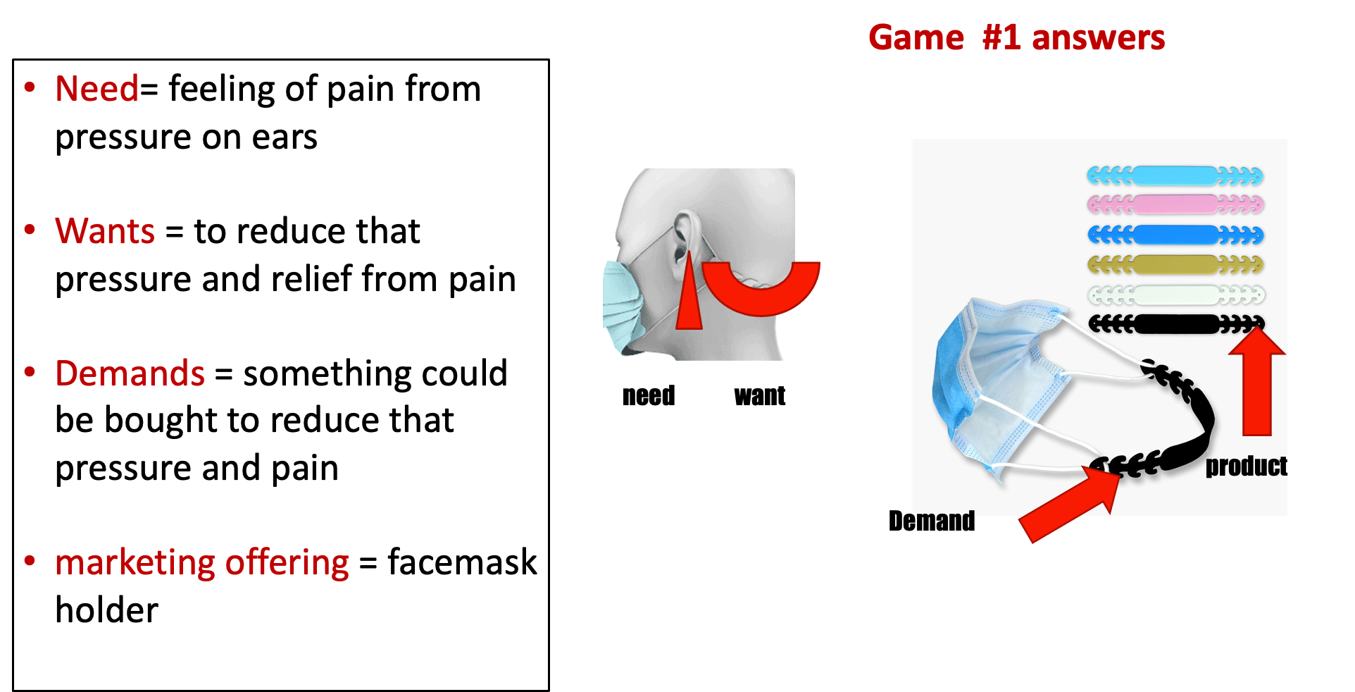
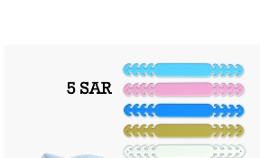

Slide 18
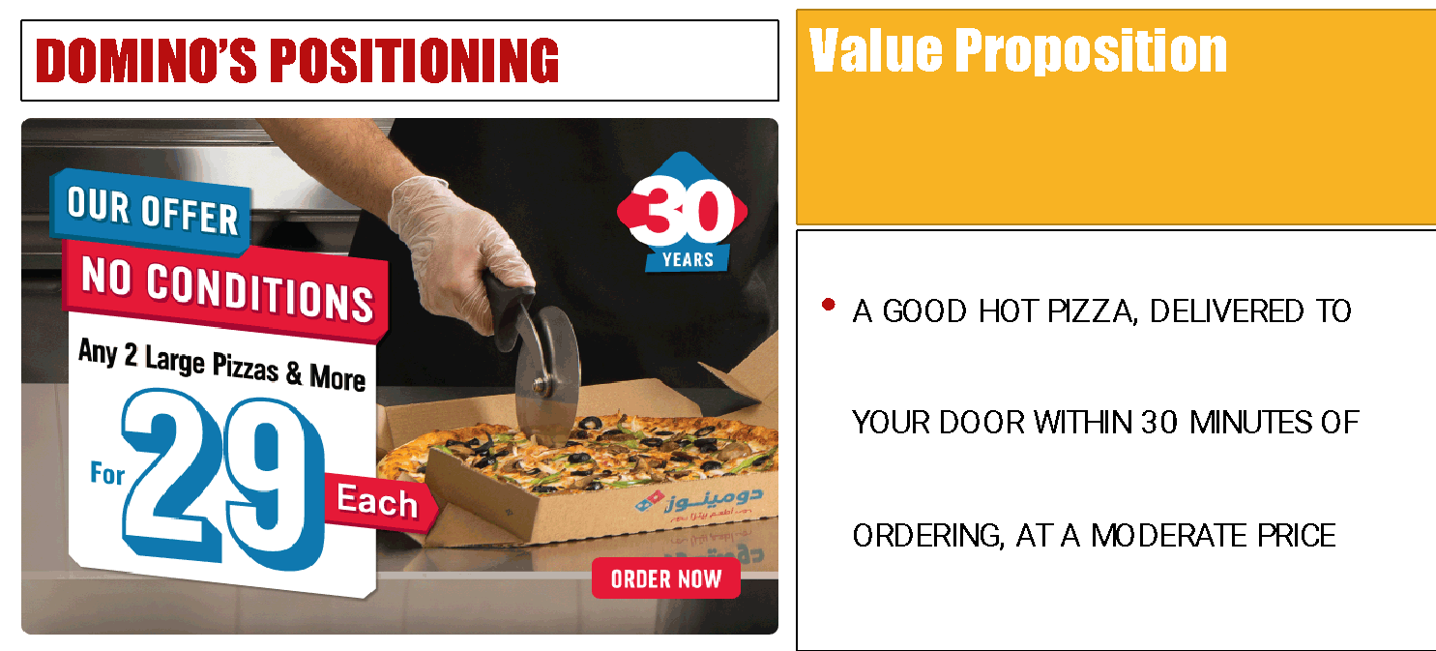
MARKETING OFFERINGS
Product that fulfills Customer needs
products could be goods (commodities) or services could be Events, Persons, Places, Organizations, and or Ideas.
Sometimes customer needs are fulfilled through Hybrid, products combination of tangible goods and intangible services. such as a cell phones, with an internet Services,
The successful marketing offering
consumers are aware of the product and its capabilities
consumers acknowledge that product could solve their need
consumers, see product as the best available solution, proceed to buy it, and become satisfied with the result of the purchase.
Notes:
A market offering includes much more than just physical goods or services. Consumers decide which events to experience, which tourist destinations to visit, which hotels to stay in, and which restaurants to patronize. To the consumer these are all products.

Slide 19
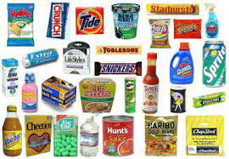
GOODS
Goods is anything tangible that can be offered to a market to satisfy a want or need, and it is accompanied by use, consumption, and ownership.

Slide 20

SERVICES
SERVICE is anything intangible that can be offered to satisfy a want or need and do not result in the ownership.
Examples include:
Hospital
Insurance
Internet
Barber shop

Slide 21
Activity #2

Slide 22
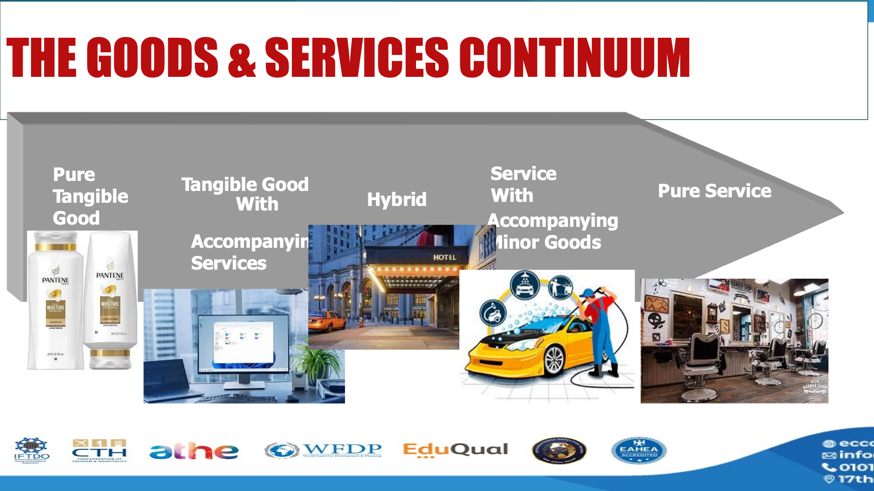

Slide 23






The goods & Services continuum
Pure Tangible Good
Tangible Good
Service With
With
Hybrid
Pure Service
Accompanying Minor Goods
Accompanying
Services

Slide 24
UNDERSTANDING MARKETPLACE

Slide 25

Does the Marketing Offerings are a one-way communication ! exchange? relationship? Where does this happen?
UNDERSTANDING MARKETPLACE.

Slide 26

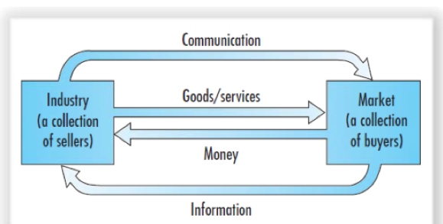
MARKETING IS ALL ABOUT EXCHANGE RELATIONSHIPS WITH TARGET AUDIENCES
Marketing consists of actions taken to create, maintain, and grow desirable relationships with target market .
Exchange is the act of obtaining a desired object by offering something in return.
All the above interactions took place in the marketplace
Notes:
Marketing occurs when people decide to satisfy their needs and wants through exchange relationships. Exchange is the act of obtaining a desired object from someone by offering something in return.
Marketing consists of actions taken to create, maintain, and grow desirable exchange relationships with target audiences involving a product, service, idea, or other object. Companies want to build strong relationships by consistently delivering superior customer value.
In the broadest sense, the marketer tries to bring about a response to some market offering. The response may be more than simply buying or trading products and services. For example, a political candidate wants votes; a church wants membership; an orchestra wants an audience; and a social action group wants idea acceptance.

Slide 27

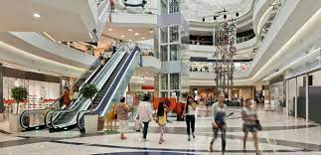

WHAT IS THE MARKETPLACE?
A marketplace is any location, whether in person or online, that facilitates the exchange of goods between buyers and sellers where transactions happen in both directions.

Slide 28

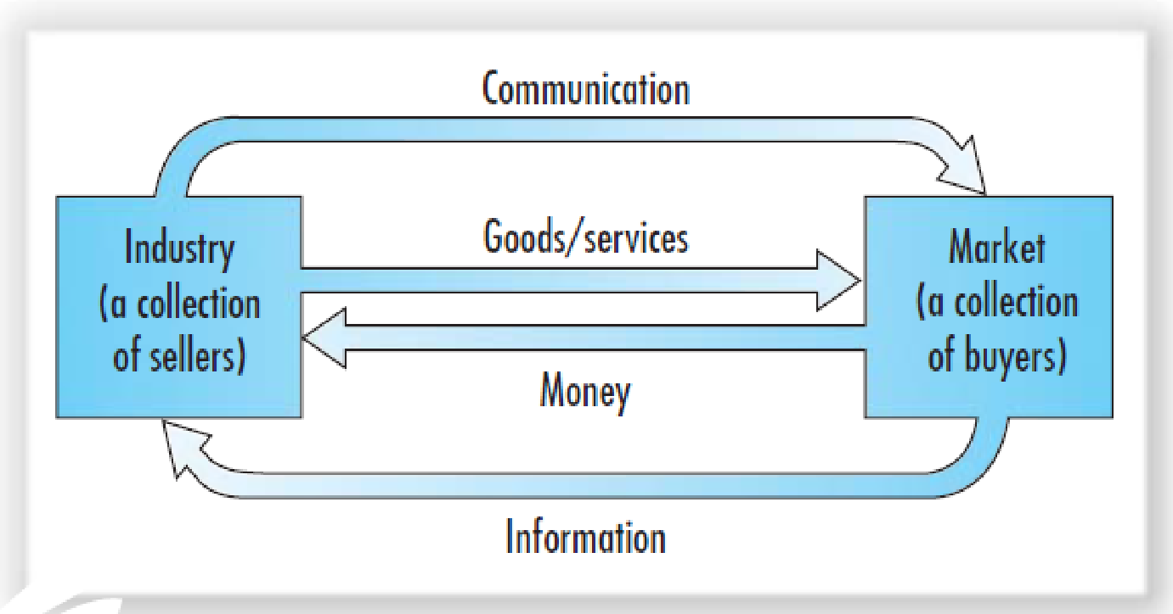
WHAT IS THE MARKETING MICROENVIRONMENT
Intermediaries = Distributors~ subagents ~wholesalers ~Broker
Public = PBULIC RELATION

Slide 29
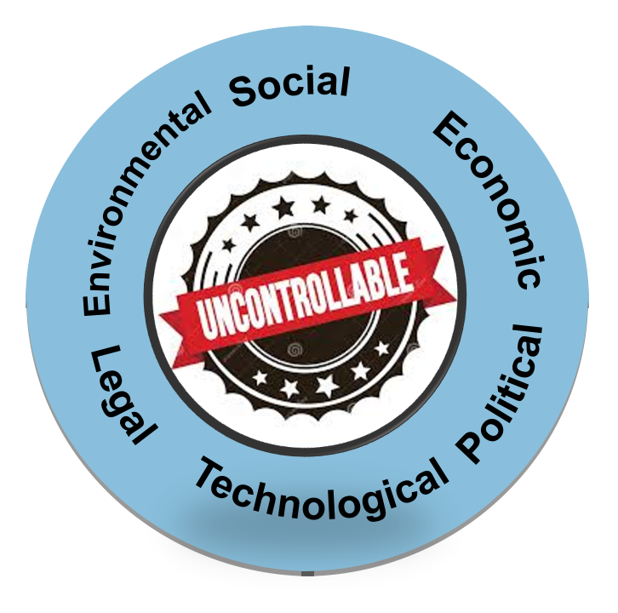
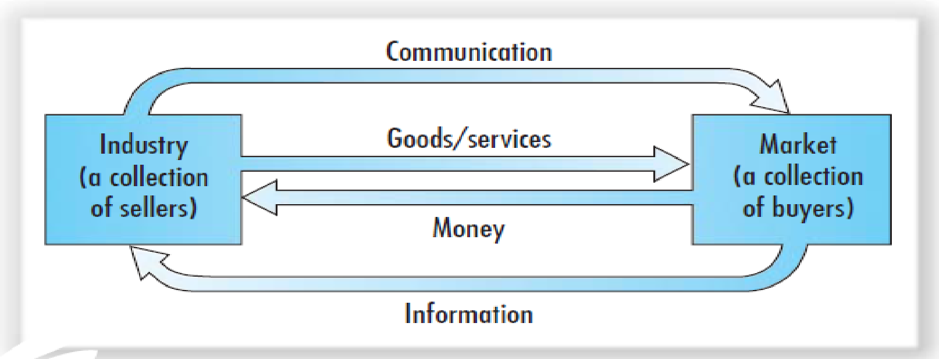
WHAT IS THE MARKETING MACROENVIRONMENT
PESTLE analysis= Macroenvironmental analysis = Political, Economic, Social, Technological, Legal and Environmental

Slide 30
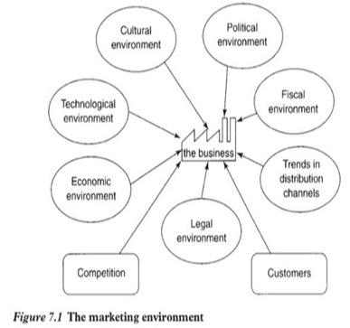
WHAT IS THE MARKETING ENVIRONMENT ?

Slide 31
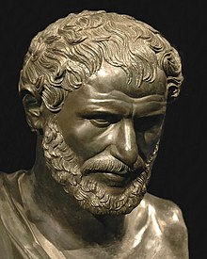
- Firms operate within an unpredictable and dynamic Marketing environment. - This dynamic has an impact on organization, customers, and the exchange and or relationship.
WHY IT IS IMPORTANT TO STUDY THE MARKETING ENVIRONMENT?
The only thing that is constant
is that things will change.
" No man ever steps in the same river twice, for it's not the same river and he's not the same man.
Heraclitus, an ancient Greek, philosopher 535 BC- 475 BC
Notes:
Strategic Marketing is a systematic process that enables organizational to achieving vision mission and goals
Continuous process of assessing , determining the needs and wants of target markets and delivering desired satisfactions more effectively and efficiently than competitors.

Slide 32
Macroenvironment analysis |PESTEL|
Integration of internal and external analyses| SWOT Analysis
Microenvironmental analysis |Porter 5 forces|
Internal Marketing environment |business portfolio analysis |
PLC |product life cycle|
BCG |Growth share matrix|
External Marketing Environment Analysis.
1
Strategic Marketing
Environment Analysis
2
3

Slide 33
Analyzing the Marketing Environment
1.1
External Environment
Microenvironmental analysis
|Porter 5 forces|

Slide 34
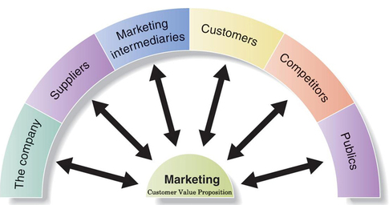
Major Forces in the Company’s Microenvironment
forces that affect marketing management’s ability to build and maintain successful relationships with target customers
Notes:
This figure shows the major actors in the marketer’s microenvironment.
Each of these actors are discussed in greater detail in the following slides.

Slide 35
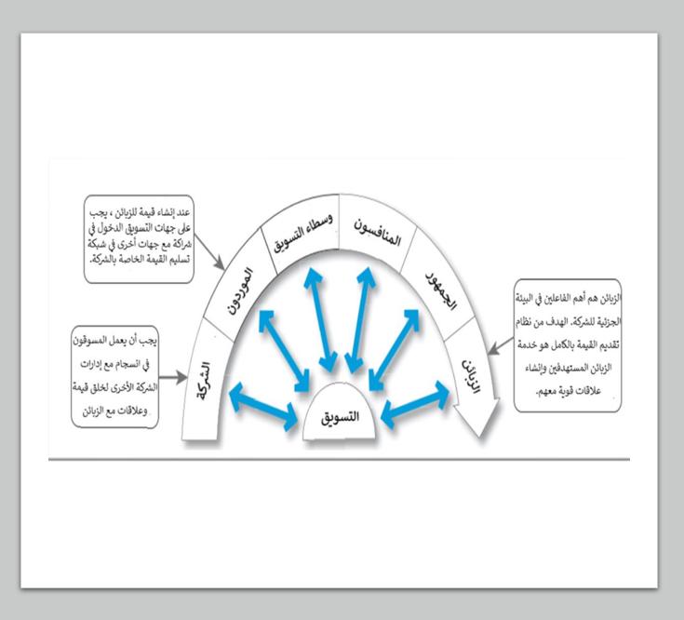
البيئة الجزئية
القوى التي تؤثر على قدرة مهمه إدارة التسويق وعلي قدره المنظمة في بناء علاقات ناجحة مع العملاء المستهدفين والحفاظ عليها
لا يمكن لمديري التسويق القيام بذلك بمفردهم و يتطلب نجاح التسويق بناء علاقات مع أقسام الشركة الأخرى، والمجهزين ، ووسطاء التسويق، والمنافسين، ومختلف الجماهير والزبائن ، والتي تتحد لتشكيل شبكة تسليم القيمة للشركة.

Slide 36
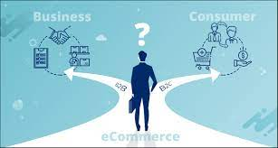

The Customers
Types of customer markets
B2B, or business to business, is a form of business focused on selling products or services to other businesses, like raw materials, industrial products, software that help companies conduct business.
B2C, or business to consumer, is a form of business focused on selling products or services to consumers, such as supermarkets or the Apple store.
Notes:
Consumer markets consist of individuals and households that buy goods and services for personal consumption.
Business markets buy goods and services for further processing or use in their production process.
Reseller markets buy goods and services to resell at a profit.
Government markets consist of government agencies that buy goods and services to produce public services.
International markets consist of buyers in other countries, including consumers, producers, resellers, and governments.

Slide 37
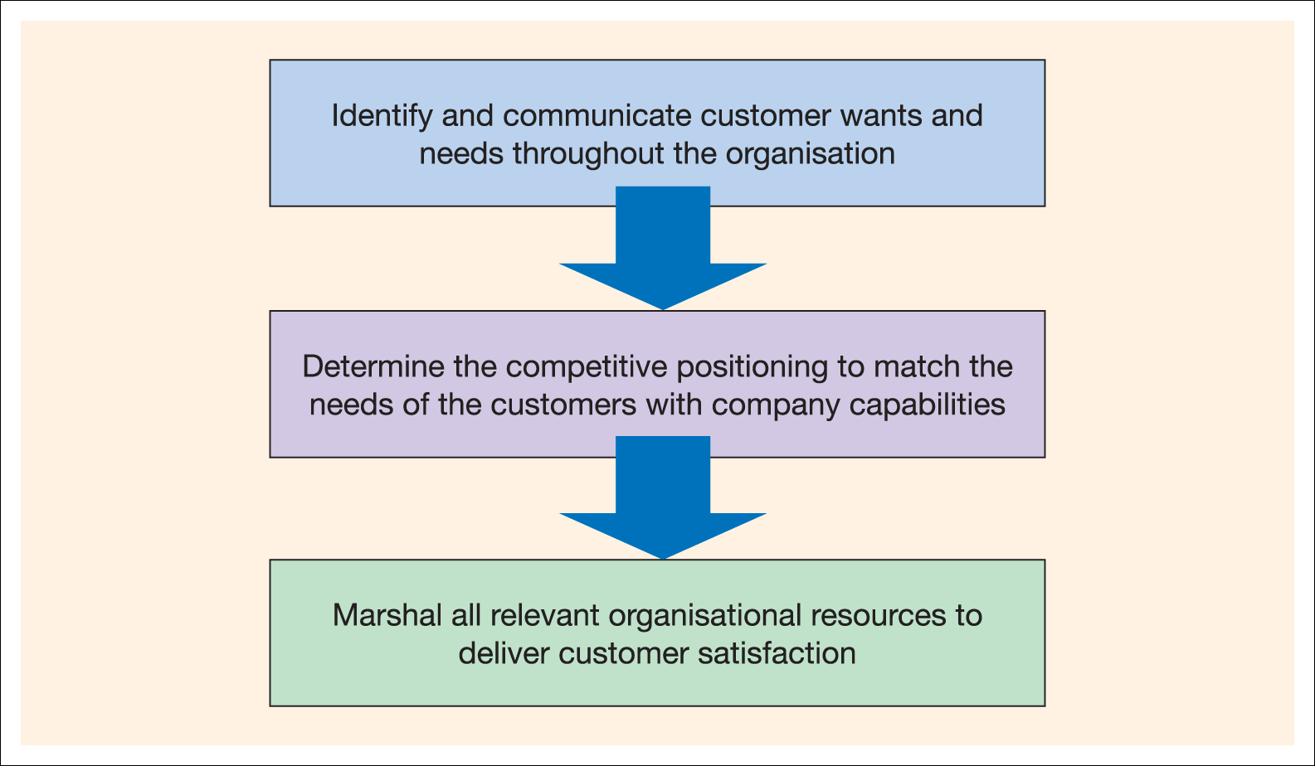
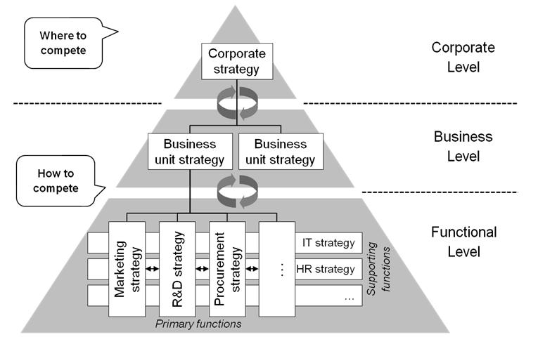
The Company
The Interrelated departments in a company form the internal environment
marketing management takes other company groups into account
With marketing taking the lead, all departments share the responsibility for understanding customer needs and creating customer value
Notes:
In designing marketing plans, marketing management takes other company groups into account—groups such as top management, finance, research and development (R&D), purchasing, operations, human resources, and accounting. All of these interrelated groups form the internal environment.
With marketing taking the lead, all—from manufacturing and finance to legal and human resources—share the responsibility for understanding customer needs and creating customer value.
Departments
Marshal

Slide 38
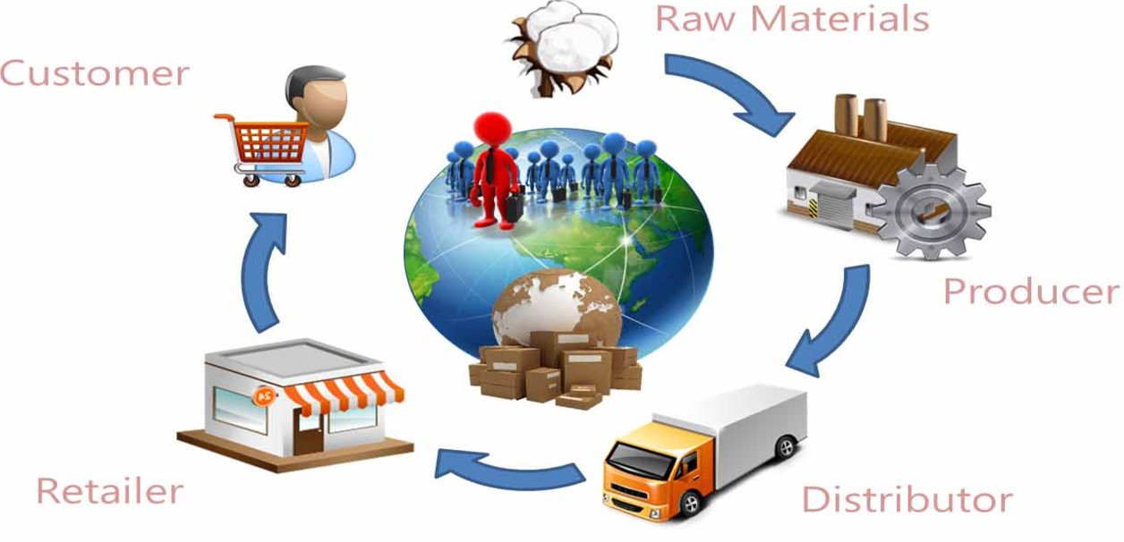
The Suppliers
Suppliers form an important link in the company’s overall customer value delivery network. They provide the resources needed by the company to produce its goods and services.
Supplier problems can seriously affect marketing. Marketing managers must watch supply availability and costs. Supply shortages or delays can cost sales in the short run and damage customer satisfaction in the long run. Rising supply costs may force price increases that can harm the company’s sales vol
Notes:
Suppliers form an important link in the company’s overall customer value delivery network. They provide the resources needed by the company to produce its goods and services.
Supplier problems can seriously affect marketing. Marketing managers must watch supply availability and costs. Supply shortages or delays can cost sales in the short run and damage customer satisfaction in the long run. Rising supply costs may force price increases that can harm the company’s sales volume.

Slide 39

تتمثل مهمة ايكيا في خلق حياة يومية أفضل للعملاء من خلال تقديم مفروشات منزلية عصرية بسيطة وعملية بأسعار مناسبه للغاية بحيث يستطيع غالبيه العملاء تحمل تكاليفها.
ولكي تتمكن ايكيا من بيع
منتجاتها عالميا بمليارات الدولارات، يجب على ايكيا أولا تطوير شبكة قوية وموثوقة من الموردين والشركاء الذين يمكنهم مساعدتها في تصميم وصنع كل هذه المنتجات في المقام الأول
تدرك شركة ايكيا لبيع المفروشات المنزلية أهمية بناء علاقات وثيقة مع شبكتها الواسعة من الموردين
Notes:
IKEA’s mission is to create a better everyday life for customers by offering trendy but simple and practical home furnishings at prices so low that as many people as possible can afford them. But before it can sell the billions of dollars’ worth of products its customers covet, IKEA must first develop a robust and reliable network of supplier–partners who can help it design and make all those products.
ڑتتمثل مهمة ايكيا في خلق حياة يومية أفضل للعملاء من خلال تقديم مفروشات منزلية عصرية ولكنها بسيطة وعملية بأسعار منخفضة للغاية بحيث يستطيع أكبر عدد ممكن من الناس تحمل تكاليفها. ولكن قبل أن تتمكن من بيع منتجات بقيمة مليارات الدولارات يطمح إليها عملاؤها، يجب على ايكيا أولا تطوير شبكة قوية وموثوقة من الموردين والشركاء الذين
يمكنهم مساعدتها في تصميم وصنع كل هذه المنتجات.

Slide 40
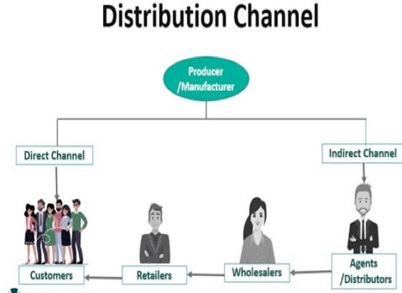
Marketing Intermediaries
Marketing intermediaries help the company to promote, sell, and distribute its products to final buyers.
Resellers wholesalers and retailers.
Marketing services agencies, advertising agencies, media firms
Financial intermediaries; banks, credit companies, insurance companies, and other businesses that help finance transactions or insure against the risks associated with the buying and selling of goods.
Notes:
Resellers are distribution channel firms that help the company find customers or make sales to them. These include wholesalers and retailers.
Physical distribution firms help the company stock and move goods from their points of origin to their destinations.
Marketing services agencies are the marketing research firms, advertising agencies, media firms, and marketing consulting firms that help the company target and promote its products to the right markets.
Financial intermediaries include banks, credit companies, insurance companies, and other businesses that help finance transactions or insure against the risks associated with the buying and selling of goods.

Slide 41
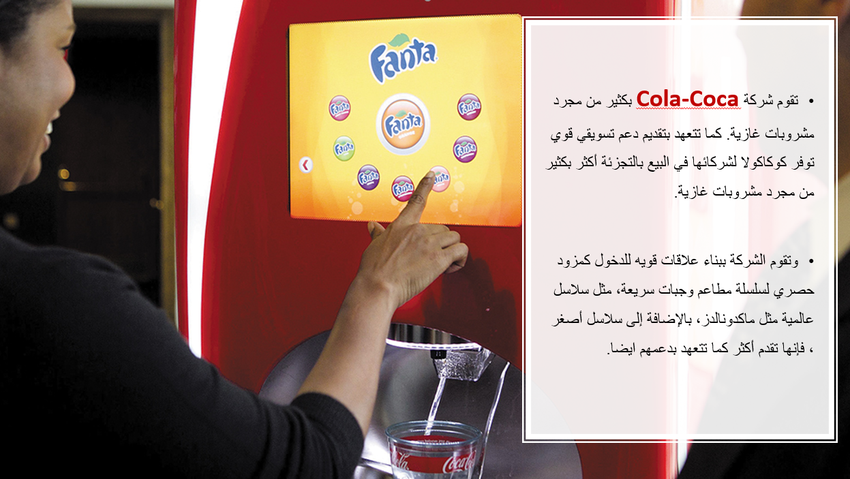
Marketing Intermediaries

Slide 42
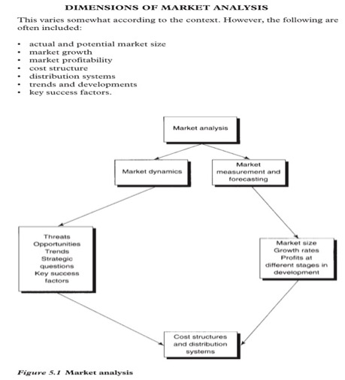
Market analysis
A market forward-looking, aims to anticipate the future via examine the history.
Size
Growth
Tends the direction
prices
Forecast
firm has to constantly review its product market posture and look for STRATEGIC WINDOWS .
Proctor, T., 2014, Strategic Marketing: An Introduction, Routledge

Slide 43
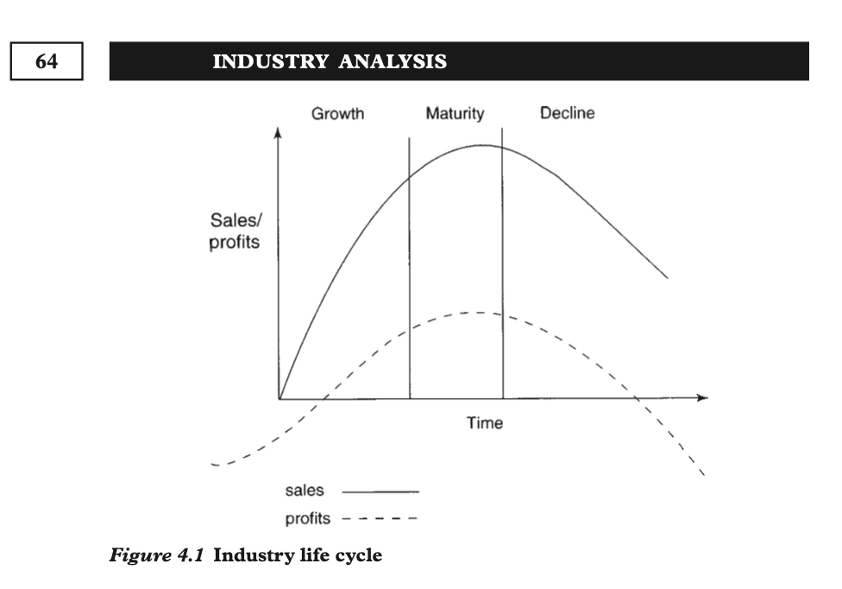
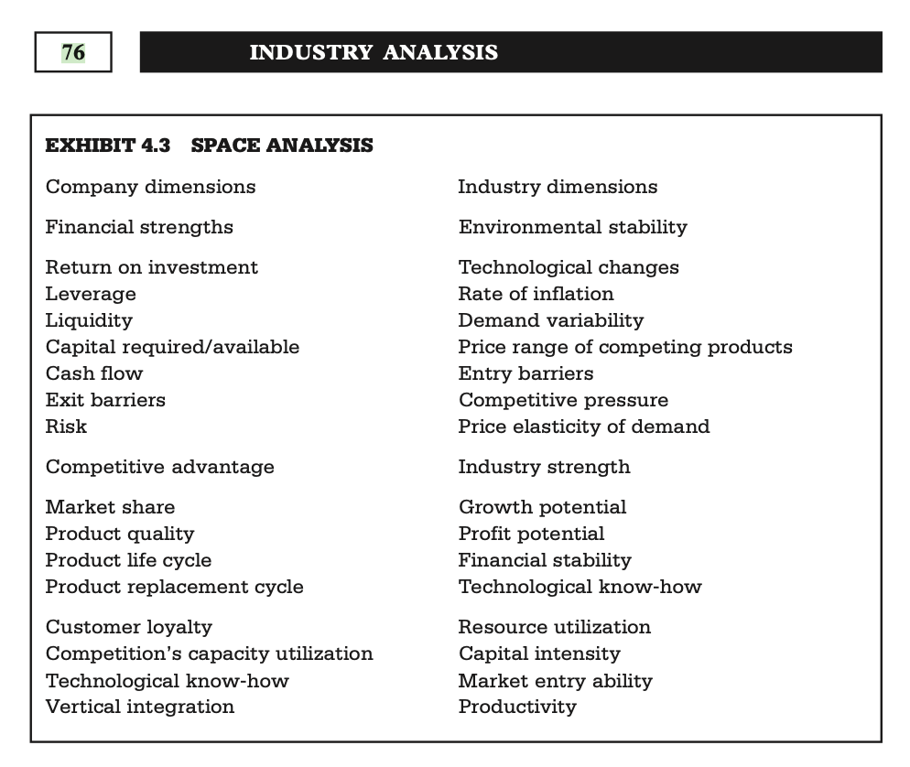
NDUSTRY ANALYSIS
industries, like products have life cycles. As with products, industries progress through their life cycles and as they do so the nature of competition and consumer demand changes and the opening and closure of strategic windows.
Industry dimensions
Demand variability
Growth potential
Profit potential
Price range of competing products
Entry barriers
Price elasticity of demand
Competitive pressure
Proctor, T., 2014, Strategic Marketing: An Introduction, Routledge

Slide 44
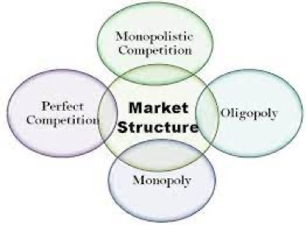
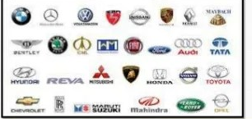

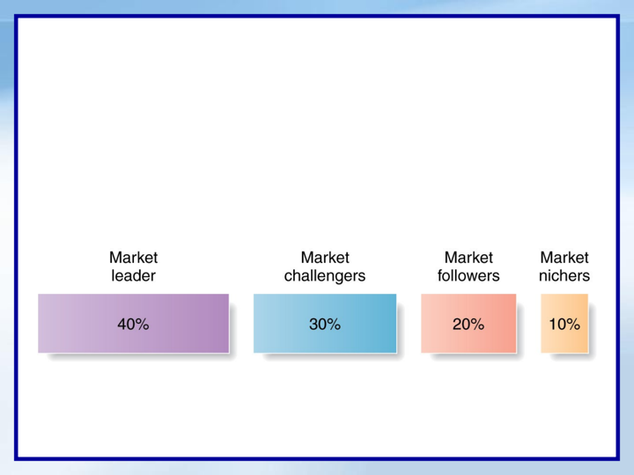
Competitors
One seller, Or a single firm
The marketing concept states that, to be successful, a company must provide greater customer value and satisfaction than its competitors do.
Competitive Analysis, process of identifying key competitors; assessing their strategies, strengths and weaknesses, and and selecting which Competitive Strategy to use to gain strategic advantage against competitors
No single strategy is best for all companies
large number of firms.
Few firms in the market.
Notes:
The marketing concept states that, to be successful, a company must provide greater customer value and satisfaction than its competitors do. Thus, marketers must do more than simply adapt to the needs of target consumers. They also must gain strategic advantage by positioning their offerings strongly against competitors’ offerings in the minds of consumers.
No single competitive marketing strategy is best for all companies. Each firm should consider its own size and industry position compared with those of its competitors. Large firms with dominant positions in an industry can use certain strategies that smaller firms cannot afford. However, small firms can also develop winning strategies.

Slide 45

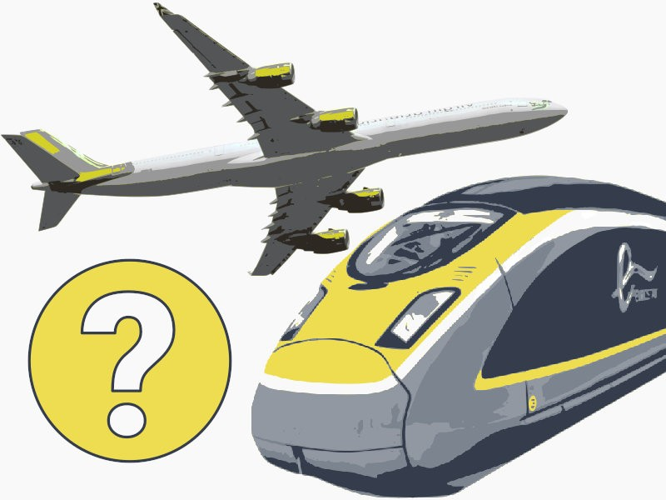


Competitor Analysis
1- Identifying competitors
Similar specific-same product, technology and target market, e.g. Haagen daze vs. Wall’s
Different specific-same need satisfied by different means, e.g. Eurostar vs. British airway
Different general-competing for discretionary spend e.g. holiday vs. new car

Slide 46

Competitor Analysis
Understanding the strategies adopted by competitors. This is more than noting in which markets/segments the competition is operating and their respective market shares and financial performance. In addition, it is important to consider how competition will develop in the future and thus to ascertain the focus of the strategies that competitors are pursuing.
Firms need to monitor competition continually. The main need is for information regarding sales, market share ,profit margin ,return on investment , cash flow and new investment
Understanding competition is central to making marketing plans and strategy. To establish a sustainable competitive advantage in the marketplace , firms regularly compare its products, prices, channels of distribution and promotional methods with those of its competitors , In so it can also identify areas where it can gain a competitive advantage.
Identifying competitors
Assessing competitors Sources of differentiations
Strategy Typologies

Slide 47
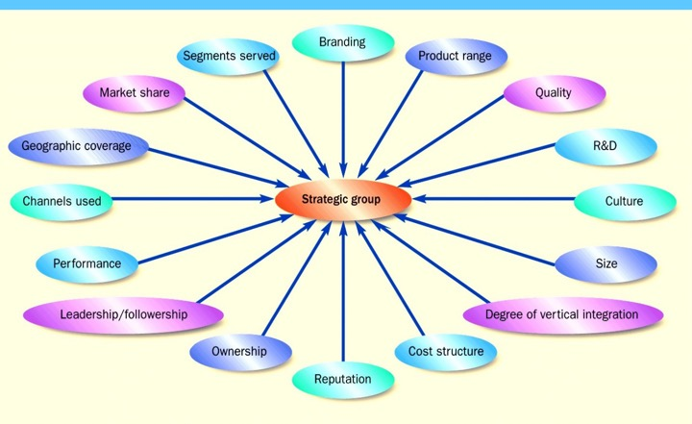
Competitor Analysis
2- Assessing competitors Sources of differentiations
Product – branding, innovation, quality , specification, design, image, patents;
Price – price positions, price-value combinations
Place – intensive, exclusive distributions
Promotion – creativity, spending
Service – strong trust with customer

Slide 48
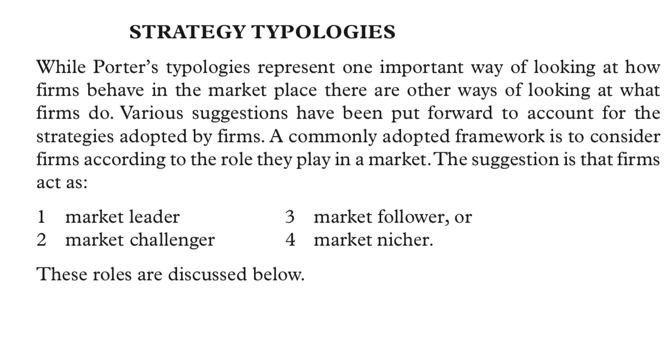
Competitor Analysis Strategy Typologies
Proctor, T., 2014, Strategic Marketing: An Introduction, Routledge , page 107-109

Slide 49

Publics
Publics: any group that has an actual or potential interest in or impact on an organization’s ability to achieve its objectives
Financial
Media
Government
Citizen action
Local
General
Internal
Notes:
Financial publics influence the company’s ability to obtain funds.
Media publics carry news, features, and editorial opinions.
Government publics: Management must take government developments into account.
Citizen-action publics: A company’s marketing decisions may be questioned by consumer organizations, environmental groups, etc.
Local publics include neighborhood residents and community organizations.
General public: The general public’s image of the company affects its buying.
Internal publics include workers, managers, volunteers, and the board of directors.

Slide 50

Porter’s Five Forces
Michael Porter is a famous academic known for his theories on economics, business strategy, and competitive advantages.

Slide 51
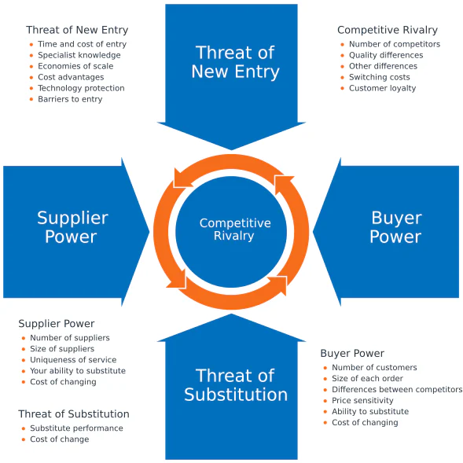
FIVE FORCES ANALYSIS (by Michael Porter)

Slide 52
Activity #3
Practice

Slide 53
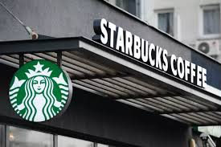
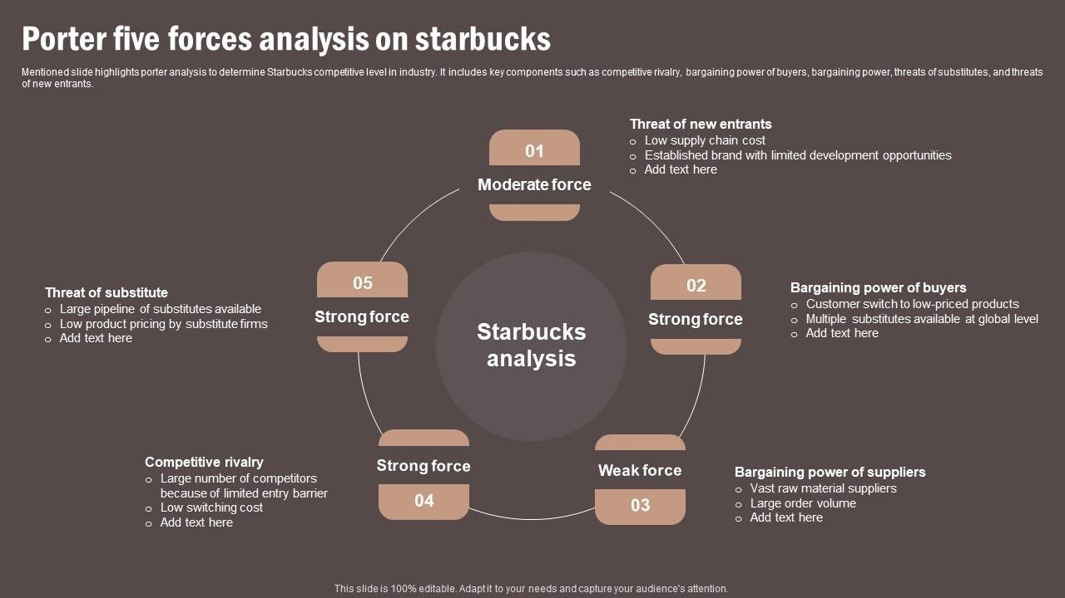
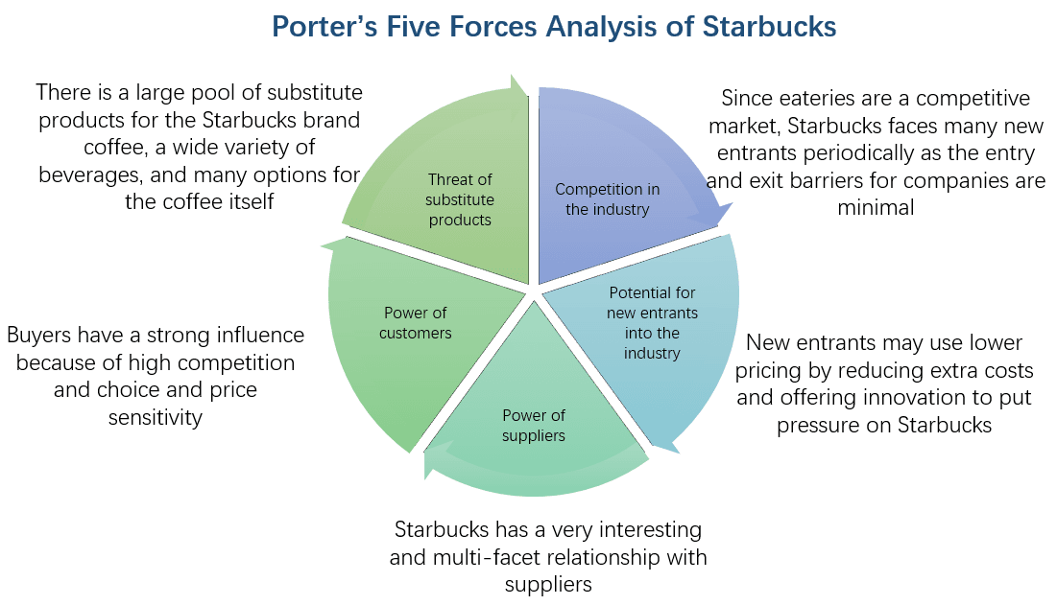
FIVE FORCES ANALYSIS:
1
5
2
4
3

Slide 54
FIVE FORCES ANALYSIS:
1
5
2
4
3

Slide 55

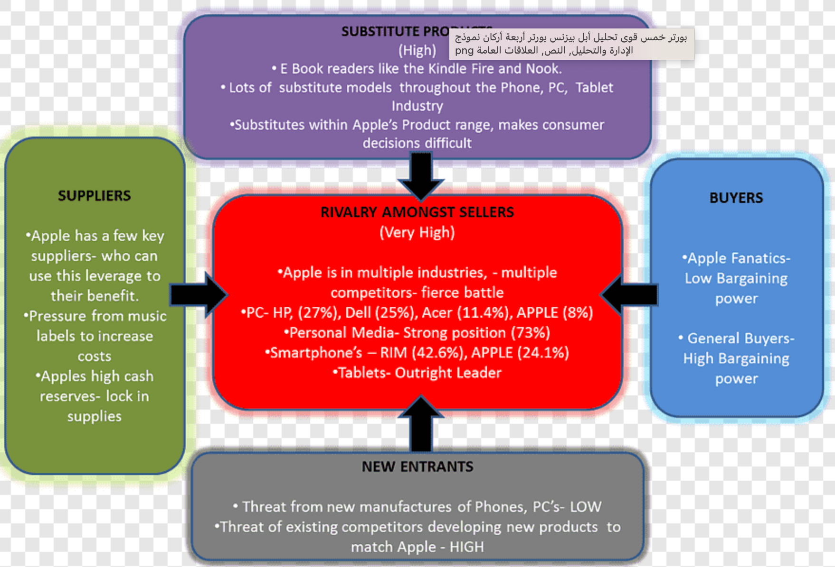
Notes:
Purple substitute
Red completion
Blue pyers
Grey new entrans
Green supplier

Slide 56
Analyzing the Marketing Environment
1.2
Marketing Environment
Macroenvironment analysis
|PESTEL|

Slide 57
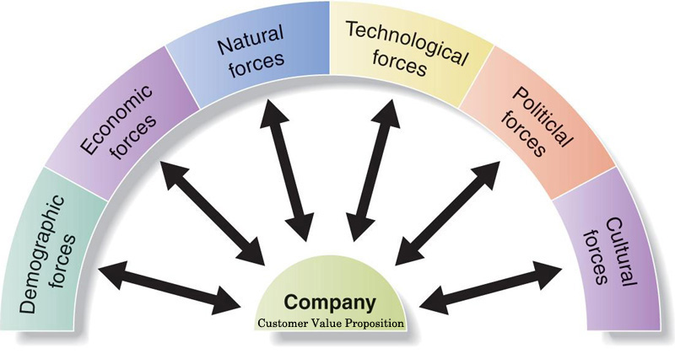
Major Forces in the Company’s Macroenvironment
1.1
Outside forces that affect marketing management’s ability to build and maintain successful relationships with target customers
Notes:
This figure shows the six major forces in the company’s macroenvironment.
Each of these forces are discussed in greater detail in the following slides.

Slide 58
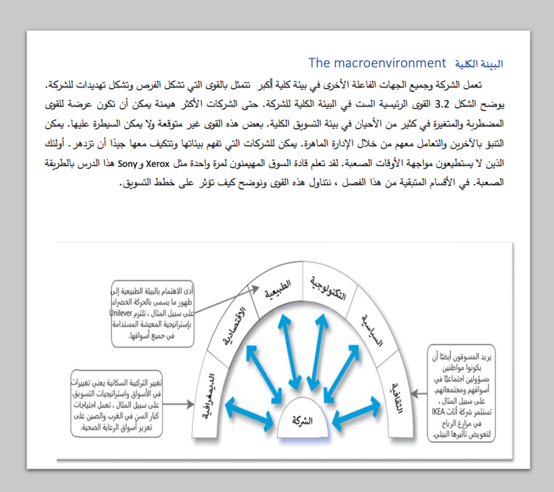
البيئة الكلية
ست قوى رئيسية تتحكم في البيئة الكليه ستؤدي تفاعلاتهم إلى فرص وتهديدات جديدة.
القوى الديموغرافية.
القوى الاقتصادية.
القوى الاجتماعية الثقافية
القوى الطبيعية.
القوى التكنولوجية.
القوى السياسية والقانونية.

Slide 59
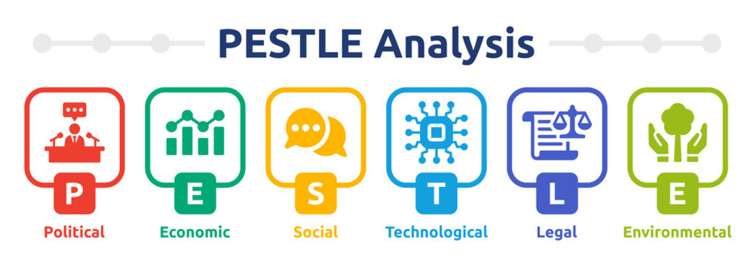
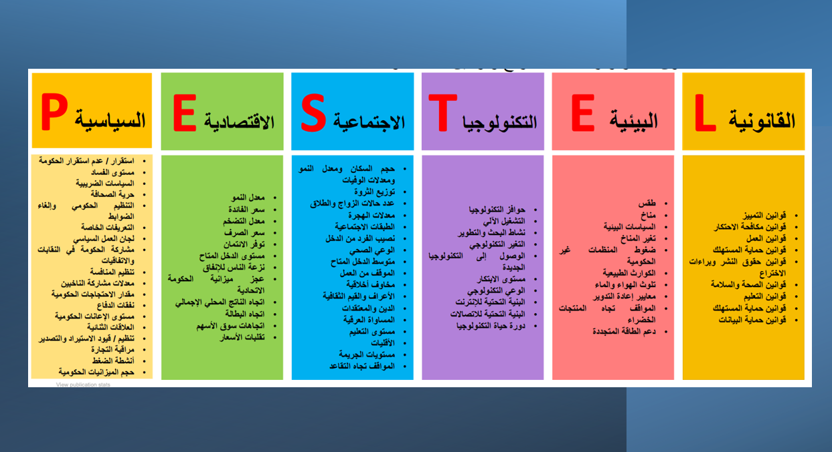
PESTLE - Analysis

Slide 60
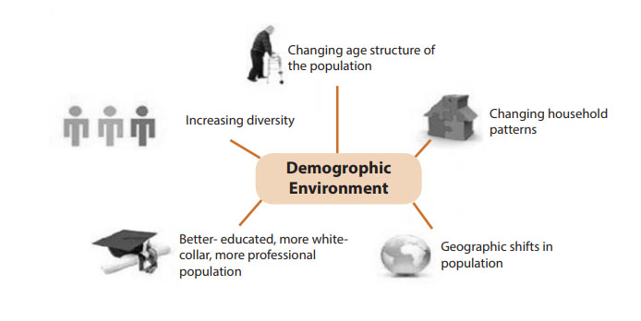
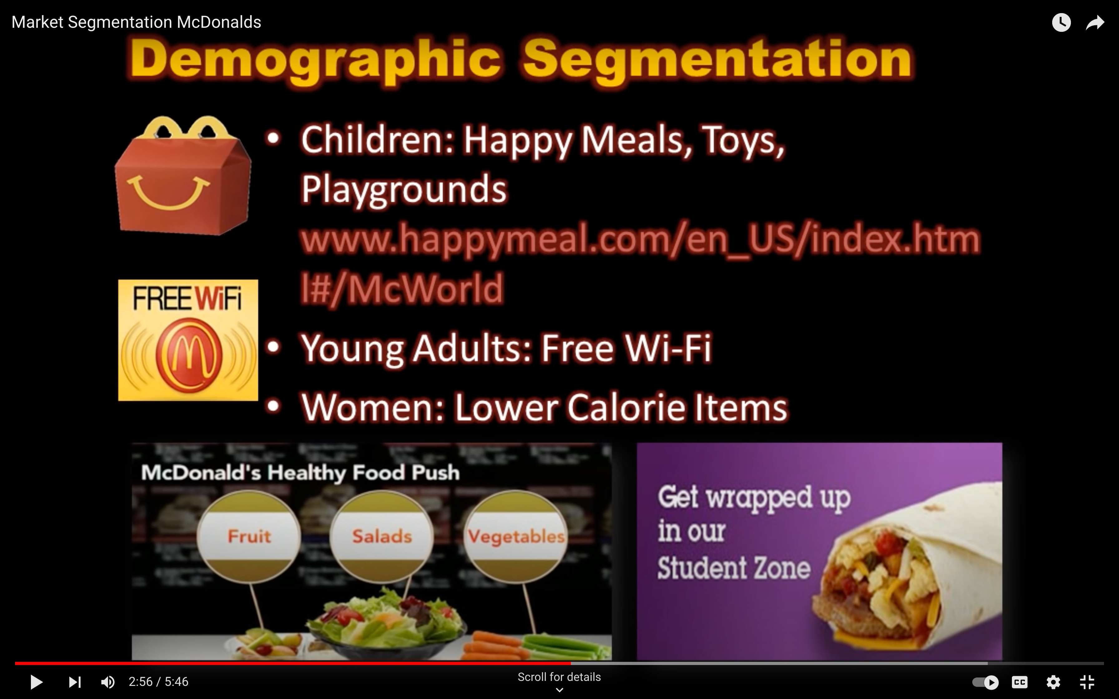
Demographic Forces
Demography is the study of human populations in terms of size, density, location, age, gender, race, occupation, and other statistics.
Marketers analyze:
Changing age and family structures
Geographic population shifts
Educational characteristics
Population diversity
Notes:
Demography is the study of human populations in terms of size, density, location, age, gender, race, occupation, and other statistics. Marketers analyze several important factors that affect the marketing environment.
The first factor is the changing age and family structures. The U.S. population contains several generational groups. These include the Baby Boomers, Generation X, Generation Y or Millennials, and Generation Z. These are discussed in more detail on the next slide.
The second factor is the changing American household. More people are divorcing or separating, choosing not to marry, marrying later, or marrying without intending to have children. Marketers must increasingly consider the special needs of nontraditional households because they are now growing more rapidly than traditional households. Each group has distinctive needs and buying habits.
The third factor is geographic shifts in population. Population shifts interest marketers because people in different regions buy differently. For example, people in the Midwest buy more winter clothing than people in the Southeast.
And the final factor is increasing diversity. Marketers face increasingly diverse marke
ts as their operations become more international in scope. Some major companies also explicitly target gay and lesbian consumers.
https://www.youtube.com/watch?v=XVpZA2bect8

Slide 61
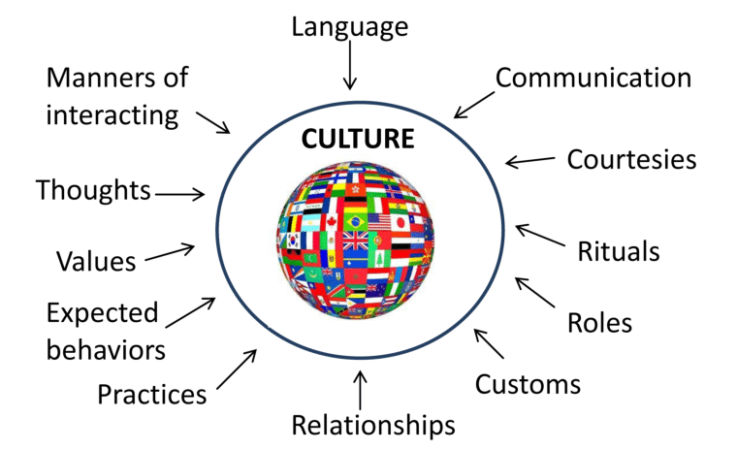
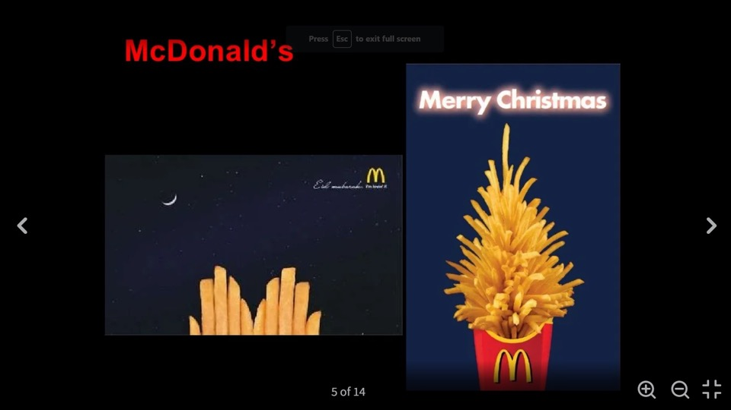
Cultural Forces
SOCIOCULTURAL ELEMENTS
Cultural Forces are the characteristics that can affect marketing decision making
Cultural Forces affect a society’s basic values, perceptions, preferences, and behaviors. shapes basic beliefs and values.
For example, most Americans believe in individual freedom, hard work, getting married, achievement, and success. These beliefs shape more specific attitudes and behaviors found in everyday life.

Slide 62


Economic Forces
Economic factors affect consumer purchasing power and spending
Differences in income distributions well as income levels. Over the past several decades, the rich have grown richer, the middle class has shrunk, and the poor have remained poor.
Consumers are buying less and looking for greater value in the things they do buy.
Marketers should pay attention to income distribution as well as income levels to tailor their marketing offers across a range of markets, from the affluent to the less affluent.
Economic growth
Employment
Disposable income
Interest rate
Inflation
FX
Notes:
The economic environment consists of economic factors that affect consumer purchasing power and spending patterns.
Economic factors can have a dramatic effect on consumer spending and buying behavior. Consumers have now adopted a back-to-basics sensibility in their lifestyles and spending patterns that will likely persist for years to come. They are buying less and looking for greater value in the things they do buy. In turn, value marketing has become the watchword for many marketers. Marketers in all industries are looking for ways to offer today’s frugal buyers greater value.
Marketers should pay attention to income distribution as well as income levels. Over the past several decades, the rich have grown richer, the middle class has shrunk, and the poor have remained poor. This distribution of income has created a tiered market. Many companies aggressively target the affluent, while other firms target those with more modest means. Still other companies tailor their marketing offers across a range of markets, from the affluent to the less affluent.
Disposable income is total personal income minus current income taxes. In national accounts definitions, personal income minus personal current taxes equals disposable personal income.

Slide 63
Technological forces
Emerging Technologies
Copyright and Patents
Production and Distribution
Research and Development
Marketers should adopt the new Digital Technologies and capture new markets and opportunities.
Online marketing
Online retail
Radio-frequency identification (RFID) is technology to track products through various points in the distribution channel.
Notes:
Radio Frequency Identification (RFID) refers to a wireless system comprised of two components: tags and readers. The reader is a device that has one or more antennas that emit radio waves and receive signals back from the RFID tag

Slide 64


Natural Forces
Pollution
Natural resource management
Climate change
environmental sustainability
Marketers should be aware of several trends in the natural environment.
Shortages of raw materials
Increased pollution
Increased government intervention
environmental sustainability. This refers to the effort to create a world economy that the planet can support indefinitely.
Timberland is on a mission to do everything it can to reduce its impact on the planet while at the same time making better outdoor gear
Notes:
The natural environment involves the physical environment and the natural resources that are needed as inputs by marketers or that are affected by marketing activities. Marketers should be aware of several trends in the natural environment.
The first involves growing shortages of raw materials. Firms making products that require scarce resources face large cost increases, even if the materials remain available. The second trend is increased pollution. The third trend is increased government intervention in natural resource management. The governments of different countries vary in their concern and efforts to promote a clean environment.
Today, enlightened companies adopt practices that support environmental sustainability. This refers to the effort to create a world economy that the planet can support indefinitely.

Slide 65
Political Forces
Consumer Protection Laws
Anti-trust Laws
Political Stability
Taxation/Tariffs policy
Foreign Trade policy
Pressure group
The political factors refer to laws, government agencies, and pressure groups that influence, limit, or affect a specific strategic option , organizations and individuals in each country.
For instance, when launching a new product or looking to expand abroad, it is important to recognize political issues that may add cost, time, and effort to the project.

Slide 66
Activity #4

Slide 67

1
2
3
4
5
6
Notes:
https://pestleanalysis.com/examples-of-pestle-analysis/
1-E
2-Tech
3- P
4-Econmuy
5-social
6-ergal

Slide 68


PESTEL Examples

Slide 69


