Slide 1

Strategic marketing
Lecture 6

Slide 2


Strategic marketing
Lecture # 6
مساء الخير وأتمنى أن يكون الجميع بخير
سنبدأ الساعة 6:05مساء بتوقيت القاهرة
مع خالص الشكر
د. علي يحيى

Slide 3

Quick recap on previous lecture

Slide 7
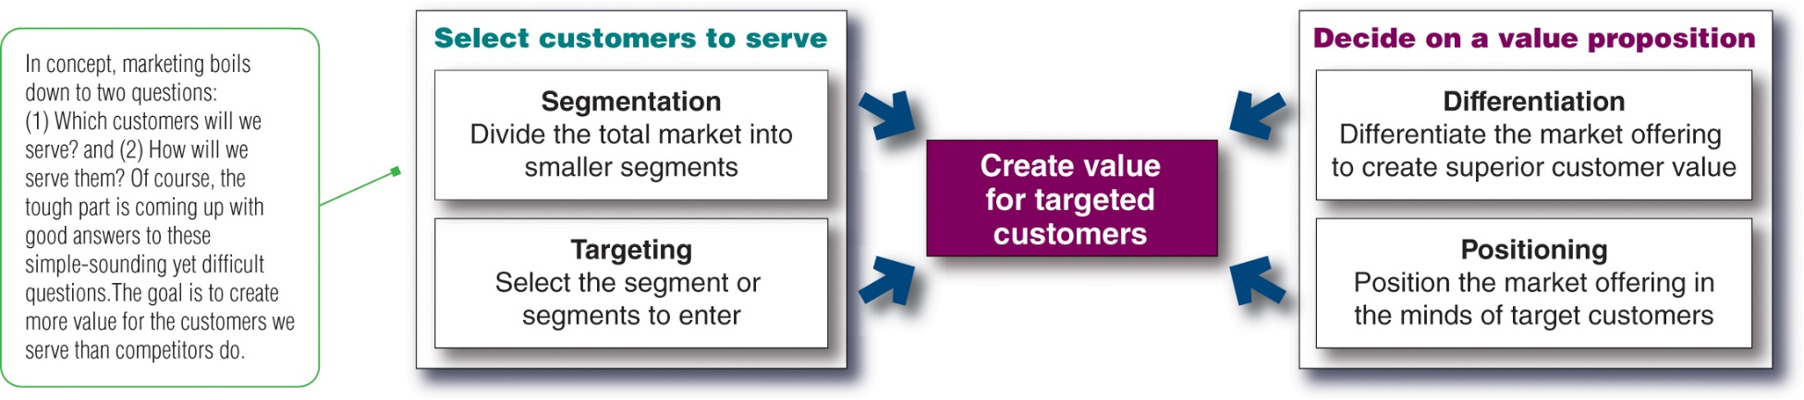
Way in which strategies can contribute to competitive advantage
• Segmentation; targeting and positioning; differentiation &; principles of branding;
Which customers will we serve ? (segmentation and targeting)
How will we create value for them? (differentiation and positioning)
Notes:
This figure shows the four major steps in designing a customer-driven marketing strategy.
In the first two steps, the company selects the customers that it will serve. Market segmentation involves dividing a market into smaller segments of buyers with distinct needs, characteristics, or behaviors that might require separate marketing strategies or mixes. Market targeting (or targeting) consists of evaluating each market segment’s attractiveness and selecting one or more market segments to enter.
In the final two steps, the company decides on a value proposition. Differentiation involves actually differentiating the firm’s market offering to create superior customer value. Positioning consists of arranging for a market offering to occupy a clear, distinctive, and desirable place, relative to competing products in the minds of target consumers.

Slide 9
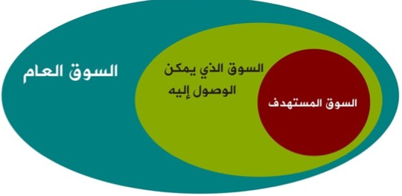
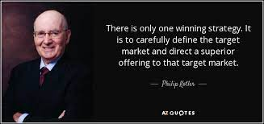
2-Market Targeting
Targeted market
Evaluating the various market segments
Deciding which and how many segments to target
Targeting Strategies

Slide 10
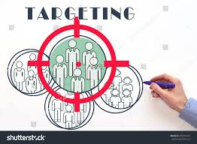

Targeting, A-Evaluating the various segments
Target market segment : Set of buyers sharing common needs or characteristics that the company decides to serve
Five factors govern the attractiveness of a segment (Doyle, 1994):
Segment size
segment growth
profitability of the segment
Current and potential competition
Capabilities of the business.
{Some attractive segments can be dismissed because they do not interconnect with the company’s long-run objectives. Or the company lack the skills and resources needed .
Notes:
Market segmentation reveals the firm’s market segment opportunities. The firm has to evaluate the various segments and decide how many and which segments it can serve best. In evaluating different market segments, a firm must look at three factors.
First, a company wants to select segments that have the right size and growth characteristics.
Second, the company needs to examine major structural factors that affect long-run segment attractiveness like strong and aggressive competitors or if it is easy for new entrants to come into the segment. The existence of actual or potential substitute products, the relative power of buyers, and powerful suppliers also affects segment attractiveness.
Finally, the company must consider its own objectives and resources. Some attractive segments can be dismissed quickly because they do not mesh with the company’s long-run objectives. Or, the company may lack the skills and resources needed to succeed in an attractive segment.
After evaluating different segments, the company must decide which and how many segments it will target. A target market consists of a set of buyers who share common needs or characteristics that the company decides to serve. Market targeting can be carried out at several different levels.
Companies need to consider many factors when choosing a market-targeting strategy. Which strategy is best depending on the company’s resources. When the firm’s resources are limited, concentrated marketing makes the most sense. The best strategy also depends on the degree of product variability. The product’s life-cycle stage also must be considered. When a firm introduces a new product, it may be practical to launch one version only, and undifferentiated marketing or concentrated marketing may make the most sense. In the mature stage of the product life cycle, however, differentiated marketing can be useful.
Another factor is market variability. If most buyers have the same tastes, buy the same amounts, and react the same way to marketing efforts, undifferentiated marketing is appropriate. Finally, competitors’ marketing strategies are important. When competitors use differentiated or concentrated marketing, undifferentiated marketing can be suicidal.
choice of segment(s)
Five factors govern the attractiveness of a segment (Doyle, 1994):
segment size • current and potential competition
segment growth • capabilities of the business.
profitability of the segment

Slide 11
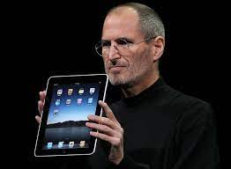
Targeting, B- Deciding which and how many segments to target
Companies consider many factors when choosing a market-targeting strategy.
  Company resources
  product variability
  Product’s life-cycle stage
  Market variability
  Competitors’ marketing strategies
JOBS KILLED 70% OF APPLE’S PRODUCTS
Steve, simple insight was to help people choose a computer using only two questions — are you an everyday consumer or pro? Do you want portable or desktop?
Notes:
Companies need to consider many factors when choosing a market-targeting strategy. Which strategy is best depends on
the company’s resources. When the firm’s resources are limited, concentrated marketing makes the most sense. The best strategy also depends on the degree of
product variability. The product’s life-cycle stage also must be considered. When a firm introduces a new product, it may be practical to launch one version only, and undifferentiated marketing or concentrated marketing may make the most sense. In the mature stage of the product life cycle, however, differentiated marketing can be useful.
market variability. If most buyers have the same tastes, buy the same amounts, and react the same way to marketing efforts, undifferentiated marketing is appropriate. Finally,
competitors’ marketing strategies are important. When competitors use differentiated or concentrated marketing, undifferentiated marketing can be suicidal.

Slide 12
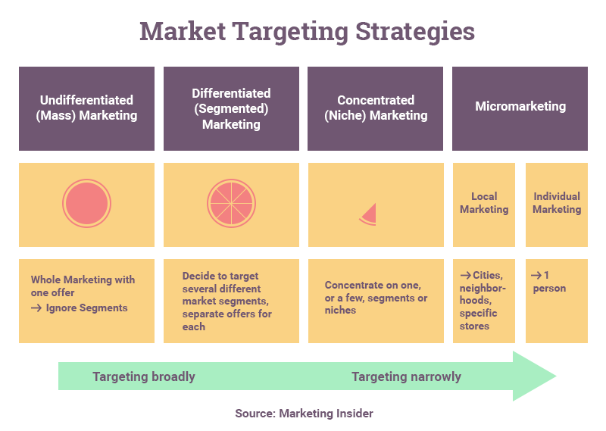
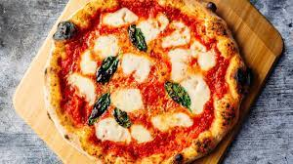
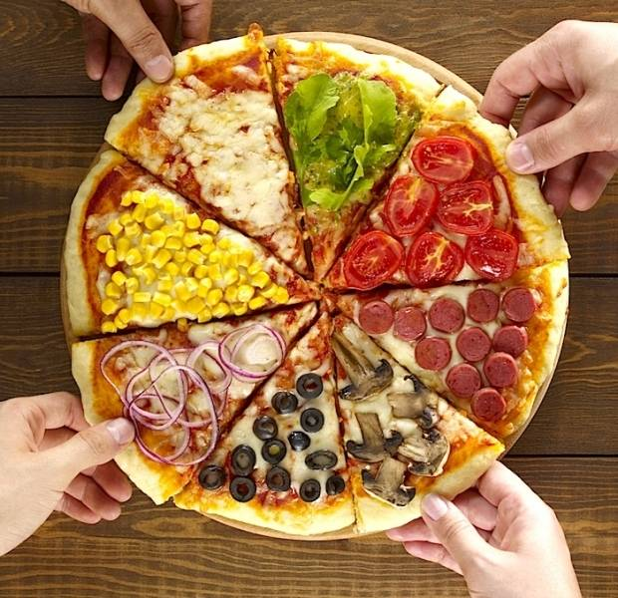
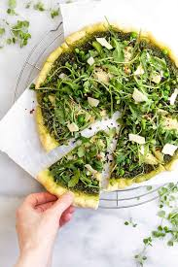
Targeting,
C-Targeting Strategies
Targeting Strategies
  Undifferentiated Marketing {Mass}
  It focuses on what is common in the needs of consumers rather than on differences and provides cost economies however in contemporary marketing It is difficult to develop a product and brand that will satisfy all or even most consumers
  Differentiated Marketing
  company targets several market segments and designs separate offers for each, typically produces more total sales than undifferentiated marketing
  Concentrated Marketing Niche
  companies with limited resources Instead of going for a small share of a large market, the firm pursues a large share of one or a few small markets..
Notes:
After evaluating different segments, the company must decide which and how many segments to serve
Undifferentiated Marketing
Using an undifferentiated marketing strategy, a company ignores market segmentation differences and goes after the entire market with one market offer
It focuses on what is common in the needs of consumers rather than on differences
Undifferentiated marketing provides cost economies
Most contemporary marketers have strong doubts about the strategy in today's competitive environment
It is difficult to develop a product and brand that will satisfy all or even most consumers
Differentiated Marketing
Using a differentiated marketing strategy, a company targets several market segments and designs separate offers for each
Differentiated marketing typically produces more total sales than undifferentiated marketing
Concentrated Marketing
Concentrated marketing, is especially appealing to companies with limited resources
Instead of going for a small share of a large market, the firm pursues a large share of one or a few small markets.
Micromarketing
Differentiated and concentrated marketers tailor their offers and marketing programs to meet the needs of various market segments and niches. At the same time, however, they do not customize their offers to each individual customer.
Micromarketing is the practice of tailoring products and marketing programs to suit the tastes of specific individuals and locations. Rather than seeing a customer in every individual, micromarketers see the individual in every customer.
One form of micro marketing is Local Marketing, which tailoring brands and promotions to the needs and wants of local customer groups-cities, neighborhoods, and specific restaurant/hotel/store locations.

Slide 13
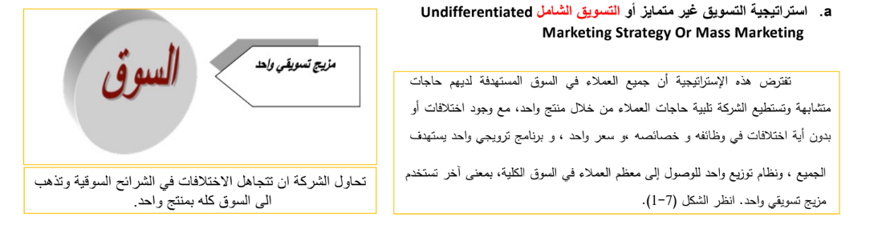

Slide 14
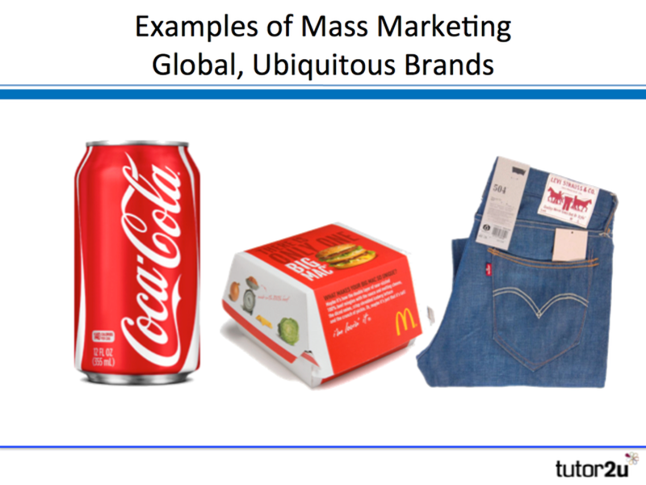
Undifferentiated
Marketing
Appeals to a broad spectrum of people
Efficient due to economies of scale
Effective when most consumers have similar needs
Example: IKEA
Notes:
undifferentiated (or mass marketing) refers to a market-coverage strategy in which a firm decides to ignore market segment differences and go after the whole market with one offer.

Slide 15
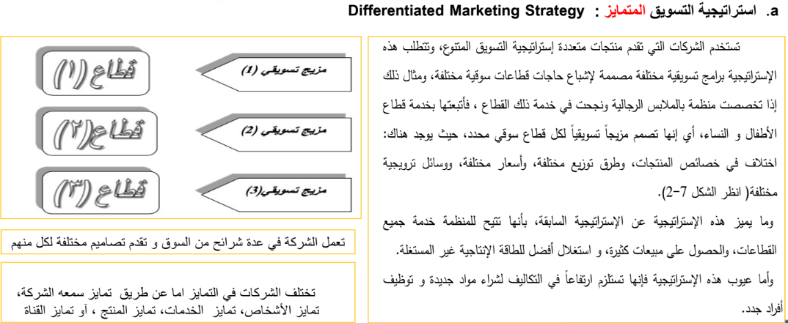
Notes:
There are many statistical techniques for developing market segments. Once the firm has identified its market-segment opportunities, it must decide how many and which ones to target. Marketers are increasingly combining several variables in an effort to identify smaller, better-defined target groups. Thus, a bank may not only identify a group of wealthy retired adults but within that group distinguish several segments depending on current income, assets, savings, and risk preferences. This has led some market researchers to advocate a needs-based market segmentation approach. Roger Best proposed the seven-step approach shown in Table 9.6.

Slide 16
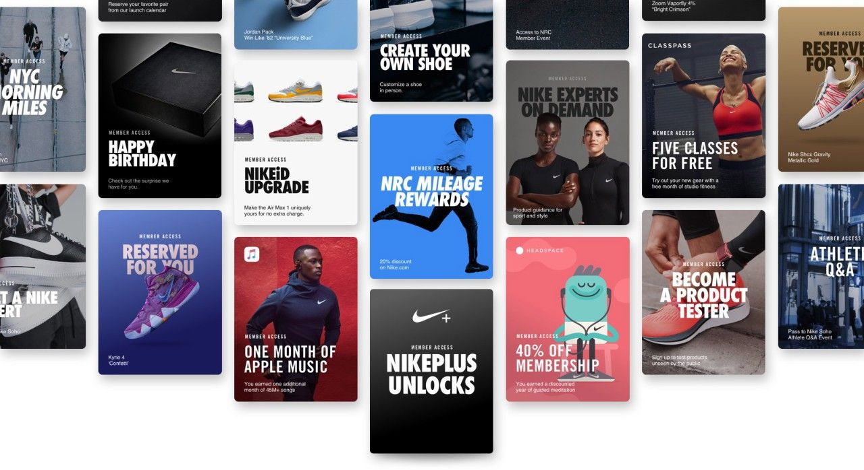
Differentiated Marketing
Develops one or more products for each of several customer groups with different product needs
Appropriate when it is possible to identify one or more segments with distinct needs for different types of products
  Example:
  Nike
  P&G
Nike offers different products for different segments. Not advertising one, single brand ‘trainers. Like most other brands.
Notes:
Differentiated (or segmented marketing) refers to a market-coverage strategy in which a firm decides to target several market segments and designs separate offers for each
Using a differentiated marketing (or segmented marketing) strategy, a firm decides to target several market segments and designs separate offers for each. For example, P&G markets at least six different laundry detergent brands in the United States (Tide, Gain, Cheer, Era, Dreft, and Bold), which compete with each other on supermarket shelves. Thanks to its differentiated approach, P&G is really cleaning up in the $15 billion U.S. laundry detergent market, capturing a 61 percent market share.

Slide 17
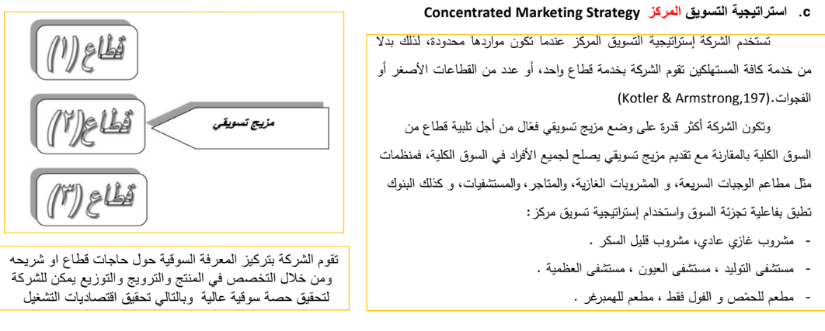
Notes:
There are many statistical techniques for developing market segments. Once the firm has identified its market-segment opportunities, it must decide how many and which ones to target. Marketers are increasingly combining several variables in an effort to identify smaller, better-defined target groups. Thus, a bank may not only identify a group of wealthy retired adults but within that group distinguish several segments depending on current income, assets, savings, and risk preferences. This has led some market researchers to advocate a needs-based market segmentation approach. Roger Best proposed the seven-step approach shown in Table 9.6.

Slide 18
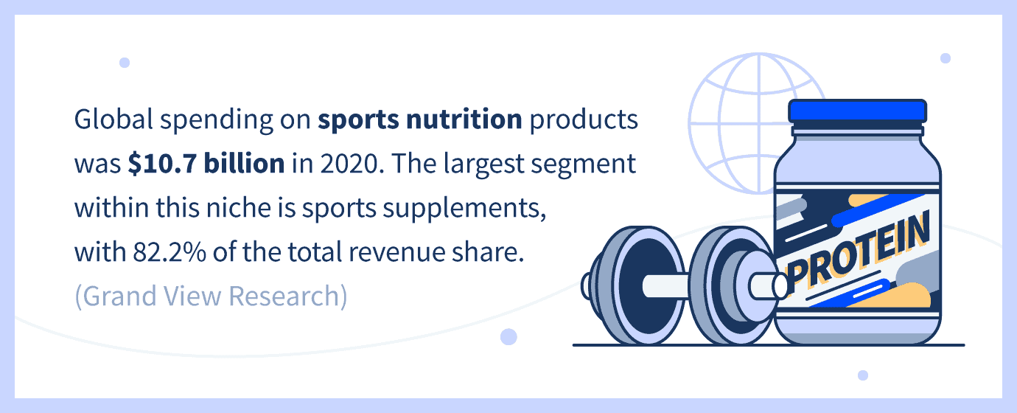

Concentrated
Marketing
focusing efforts on offering one or more products to a single segment
Useful for smaller firms that do not have their sources to serve all markets
Example:
  Rolex – Rolls Royce
Notes:
Concentrated (or niche marketing) refers to a market-coverage strategy in which a firm goes after a large share of one or a few smaller segments or niches.

Slide 19

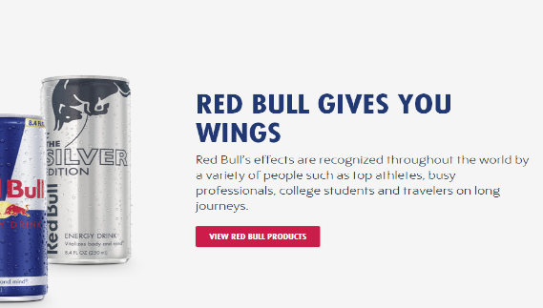
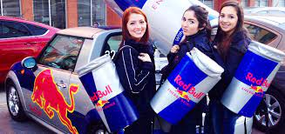
RED BUll
targeting the young,, extreme sport enthusiasts, crowd who are always in need of extra energy.
RED Bull marketed to them directly by sponsoring the events they were most likely to attend.
affiliating itself with everything from skateboarding to rock climbing.
Notes:
Micromarketing is the practice of tailoring products and marketing programs to suit the tastes of specific individuals and locations. Rather than seeing a customer in every individual, micro marketers see the individual in every customer.

Slide 20
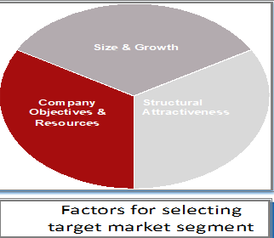
🎯 Targeting,
Target market:
Set of buyers sharing common needs or characteristics that the company decides to serve
Marketers' reveals the firm's market segment opportunities.
  Segment size and growth
  Segment structural attractiveness
  Company objectives and resources

Slide 21

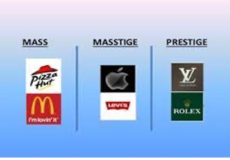
🏷️ Commercial
Mass is a marketing term which denotes products perceived as affordable and targeted to a wide range of customers.
prestige is a contemporary marketing term which denotes products perceived as luxurious.
"Masstige" (a combination of two words: mass + prestige) denotes products that are affordable yet targeted to a wide range of customers known as the "mass affluent." (Or upper middle-class individuals.)

Slide 22
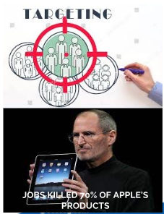
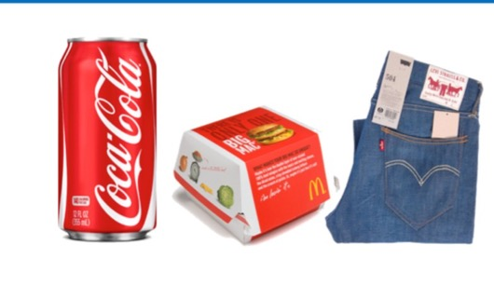
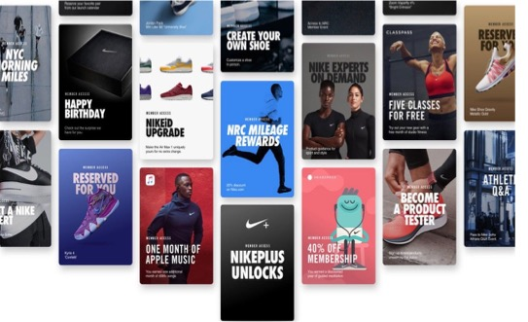
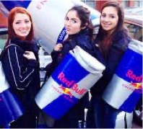
Targeting,
deciding which and how many segments
Marketers decide how many and which segments, to serve Based on the following factors :-
product variability /Product's life-cycle
Market variability
Competitors’ marketing strategies
Company resources

Slide 23
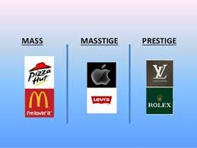
Extra
Commercial
Targeting,
C-Targeting Strategies
Mass is a marketing term which denotes products perceived as affordable and targeted to a wide range of customers.
Prestige is a contemporary marketing term which denotes products perceived as luxurious
Masstige (a combination of two words: and targeted to a wide range of customers known as the “mass affluent Or upper middle-class individuals.)
Notes:
Affluent : a group having a great deal of money; wealthy:
Mass marketing strategy: ering one product/service concept to most of the market, across many market segments.
Single segment strategy: concentrating on a single segment with a product/ service concept. T
Multi-segment strategy: targeting a different product or service concept at each of a number of segments and develop a marketing mix strategy for each of the selected segments

Slide 24


Activity #2
Targeting strategy check

Slide 25
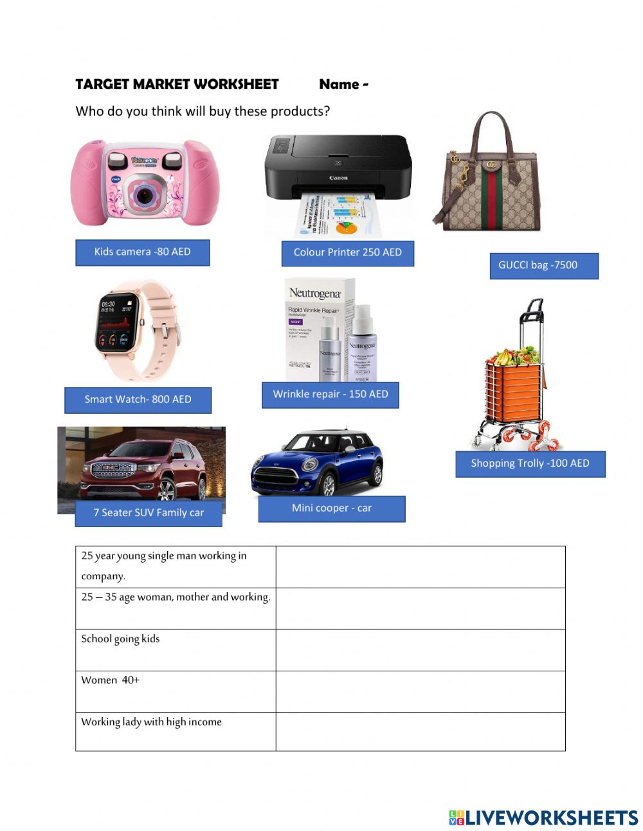

Slide 26
Strategic Marketing Assignment
You have been accepted onto a (FLDP) within a Large organization. The sole representative from the Marketing Department.
The company is currently successful but is going through a period of intense change. There are new competitors entering the market, whilst new technologies are changing both production capabilities and consumer preferences.
Task 1
prepare a presentation with accompanying notes.The content of the presentation and notes should:
• Analyse the relationship between corporate and marketing strategies
• Explain how marketing strategies can contribute to competitive advantage
Extension activities
your presentation you should also evaluate the relationship between strategic intent, strategic assessment, strategic choice and their impact on the formulation of marketing strategy.
Notes:
Future Leaders Development Programme
Analyse Break the subject or complex situations into separate parts and examine each part in detail; identify the main issues and show how the main ideas are related to practice and why they are important; reference to current research or theory may
support the analysis
Explain Make something clear to someone by describing or revealing relevant information in more details
Evaluate Examine strengths and weaknesses, arguments for and against and/or similarities and differences; Judge the evidence from the different perspectives and make avalid conclusion or reasoned judgment; Apply current research or theories to
support the evaluation when applicable

Slide 27
Way in which strategies can contribute to competitive advantage
• Segmentation; targeting and positioning; differentiation &; principles of branding;
Which customers will we serve ? (segmentation and targeting)
How will we create value for them? (differentiation and positioning)
Notes:
This figure shows the four major steps in designing a customer-driven marketing strategy.
In the first two steps, the company selects the customers that it will serve. Market segmentation involves dividing a market into smaller segments of buyers with distinct needs, characteristics, or behaviors that might require separate marketing strategies or mixes. Market targeting (or targeting) consists of evaluating each market segment’s attractiveness and selecting one or more market segments to enter.
In the final two steps, the company decides on a value proposition. Differentiation involves actually differentiating the firm’s market offering to create superior customer value. Positioning consists of arranging for a market offering to occupy a clear, distinctive, and desirable place, relative to competing products in the minds of target consumers.

Slide 28
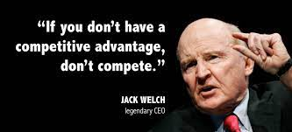
3- Differentiation
Providing customers with something unique, different and distinct from items their competitors may offer in the marketplace.
Notes:
After a company has decided which market segments to enter, it must determine how to differentiate its market offering for each targeted segment and what positions it wants to occupy in those segments. Positioning is arranging for a product to occupy a clear, distinctive, and desirable place relative to competing products in the minds of target consumers.
Effective positioning begins with differentiation. This refers to actually differentiating the market offering to create superior customer value. Once the company has chosen a desired position, it must take strong steps to deliver and communicate that position to target consumers. The company’s entire marketing program should support the chosen positioning strategy.

Slide 29
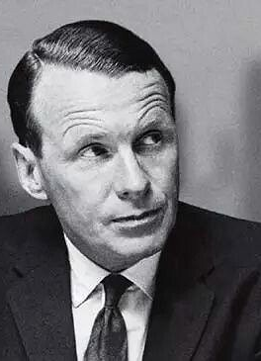
4-Positioning
Positioning is the act of designing the company’s offering and image to occupy a clear, distinctive, and desirable place in the minds of the target market.”
David Ogilvy
David Ogilvy known as the "Father of Advertising". Trained at the Gallup research organization, he attributed the success of his campaigns to meticulous research into consumer habits.

Slide 30
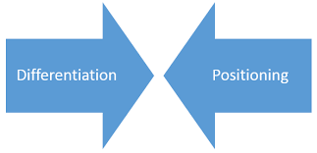

The main objective of Differentiation and Positioning is to increase competitive advantage
  Effective positioning begins with A CLEAR differentiation to occupy a clear, distinctive, and desirable place relative to competing marketing offerings.
  Which creates superior customer value, makes a product unique, helps to stand out from the rest and persuades targeted segment to consider it as a distinct offering.
Differentiation
How to differentiate its market offering versus other products in the market to create superior customer value to the targeted segment
Positioning
  Positioning is arranging for a product to occupy a clear, distinctive, and desirable place relative to competing products in the minds of targeted segment .
Notes:
After a company has decided which market segments to enter, it must determine how to differentiate its market offering for each targeted segment and what positions it wants to occupy in those segments. Positioning is arranging for a product to occupy a clear, distinctive, and desirable place relative to competing products in the minds of target consumers.
Effective positioning begins with differentiation. This refers to actually differentiating the market offering to create superior customer value. Once the company has chosen a desired position, it must take strong steps to deliver and communicate that position to target consumers. The company’s entire marketing program should support the chosen positioning strategy.
The main objective of differentiation strategy is to increase competitive advantage.

Slide 31
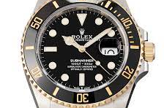


Product position
Is the way a product is defined by consumers on 2 attributes:
  Quality
  Price

Slide 32
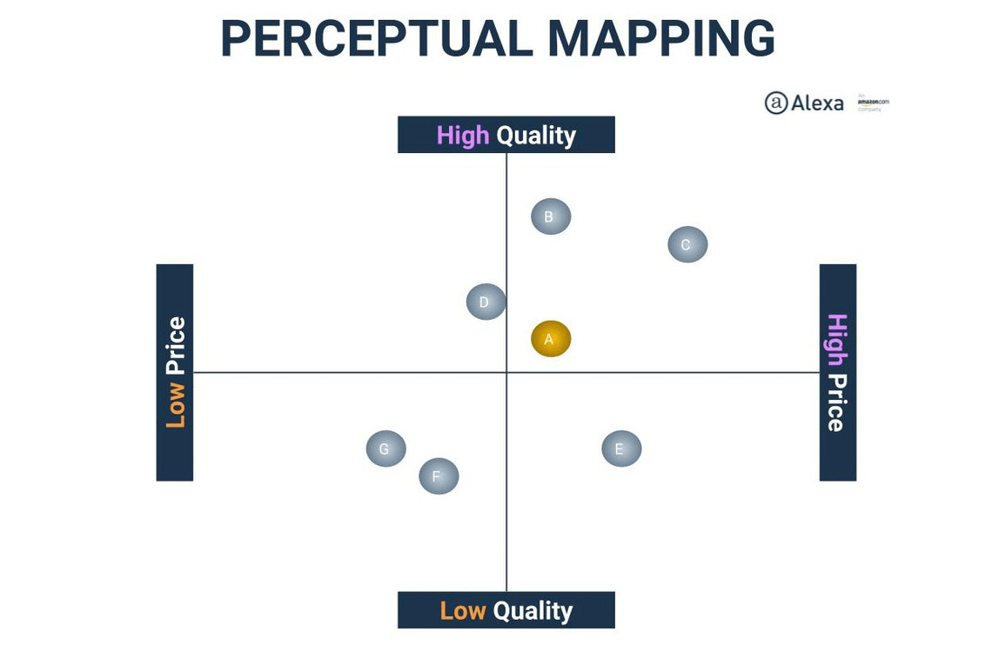
Perceptual Mapping
Perceptual mapping is a visual representation of where a brand, product, or service stands among competitors. It is also known as positional mapping.
generally, consists of two key attributes as a basis (e.g., price and quality)
Marketers chose the attributes want to focus on, then position the brands, products, or services using these attributes.
Notes:
Beyond deciding which segments of the market it will target, the company must decide on a value proposition—how it will create differentiated value for targeted segments and what positions it wants to occupy in those segments. A product position is the way a product is defined by consumers on important attributes—the place the product occupies in consumers’ minds relative to competing products.

Slide 33
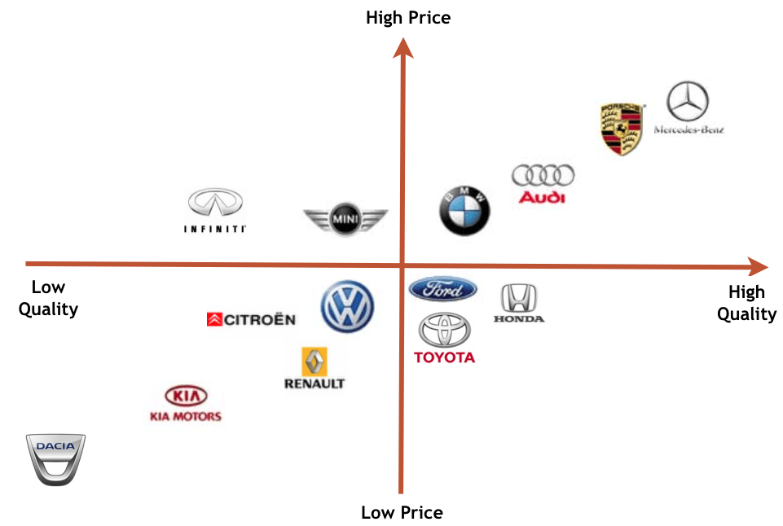

الخريطة ذهنية لموقع المنتجPerceptual mapping
هو تمثيل مرئي للمكان الذي تقف فيه العلامة التجارية أو المنتج أو الخدمة بين المنافسين.
يخطط المسوقون لاستراتيجيات التمايز /التموضع على أبعاد الشراء المهمة التي تعطي تصورات المستهلكين عن علاماتهم التجارية مقابل المنتجات المنافسة.
فولفو (الأمان)، مرسيدس (المكانة الاجتماعية)، BMW (الأداء و الرفاهية )، تويوتا (اقتصادية) لادا الروسية (الصلابة والقوة)، وهكذا..
Notes:
Perceptual mapping is a visual representation of where a brand, product, or service stands among competitors. It is also known as positional mapping.
generally, consists of two key attributes as a basis (e.g., price and quality)
Marketers chose the attributes want to focus on, then position the brands, products, or services using these attributes.
Beyond deciding which segments of the market it will target, the company must decide on a value proposition—how it will create differentiated value for targeted segments and what positions it wants to occupy in those segments. A product position is the way a product is defined by consumers on important attributes—the place the product occupies in consumers’ minds relative to competing products.
Marketers prepare perceptual positioning maps that show consumer perceptions of their brands versus those of competing products on important buying dimensions to plan their differentiation and positioning strategies.
This figure shows a positioning map for the U.S. large luxury SUV market. The position of each circle on the map indicates the brand’s perceived positioning on two dimensions: price and orientation (luxury versus performance). The size of each circle indicates the brand’s relative market share.
شركات بتطور خرايط الصور الذهنية – Positioning maps، واللى فيها بتقارن بين الشركات فى السوق، والمقارنة بتكون على أسس زى الكفاءة – الرفاهية – الامكانيات – الخصائص والمزايا - ... فى مقابل السعر، وغالباً الخريطة بيكون فيها حجم النصيب السوقى لكل شركة فى مقارنة مع الشركات المنافسة، زى ما موجود فى الشكل ده اللى بيقارن الشركات على حسب الفخامة – الكفاءة مع السعر، وحجم الشركة على الخريطة بيدل على النصيب السوقى اللى بتملكه فى
السوق.

Slide 34
Choosing a Differentiation and Positioning Strategy
Identifying which Differences attribute to Promote
1
Identifying Competitive Advantages
2
developing the unique value proposition
3
Developing a Positioning Statement
4
Communicating and Delivering the Chosen Position
5
Notes:
The differentiation and positioning task consists of three steps, which include identifying a set of differentiating competitive advantages on which to build a position, choosing the right competitive advantages, and selecting an overall positioning strategy. The company must then effectively communicate and deliver the chosen position to the market.
The following slides discuss each of these steps in greater detail.

Slide 35

Identifying which Differences to Promote
1
Important. The difference delivers a highly valued benefit to target buyers.
Distinctive. Competitors do not offer the difference, or the company can offer it in a more distinctive way.
Superior. The difference is superior to other ways that customers might obtain the same benefit.
Communicable. The difference is communicable and visible to buyers.
Preemptive. Competitors cannot easily copy the difference.
Affordable. Buyers can afford to pay for the difference.
Profitable. The company can introduce the difference profitably.
Notes:
Each brand difference has the potential to create company costs as well as customer benefits. A difference is worth establishing to the extent that it satisfies the criteria of being important, distinctive, superior, communicable, preemptive, affordable, and profitable.
Important. The difference delivers a highly valued benefit to target buyers.
Distinctive. Competitors do not offer the difference, or the company can offer it in a more distinctive way.
Superior. The difference is superior to other ways that customers might obtain the same benefit.
Communicable. The difference is communicable and visible to buyers.
Preemptive. Competitors cannot easily copy the difference.
Affordable. Buyers can afford to pay for the difference.
Profitable. The company can introduce the difference profitably.

Slide 36



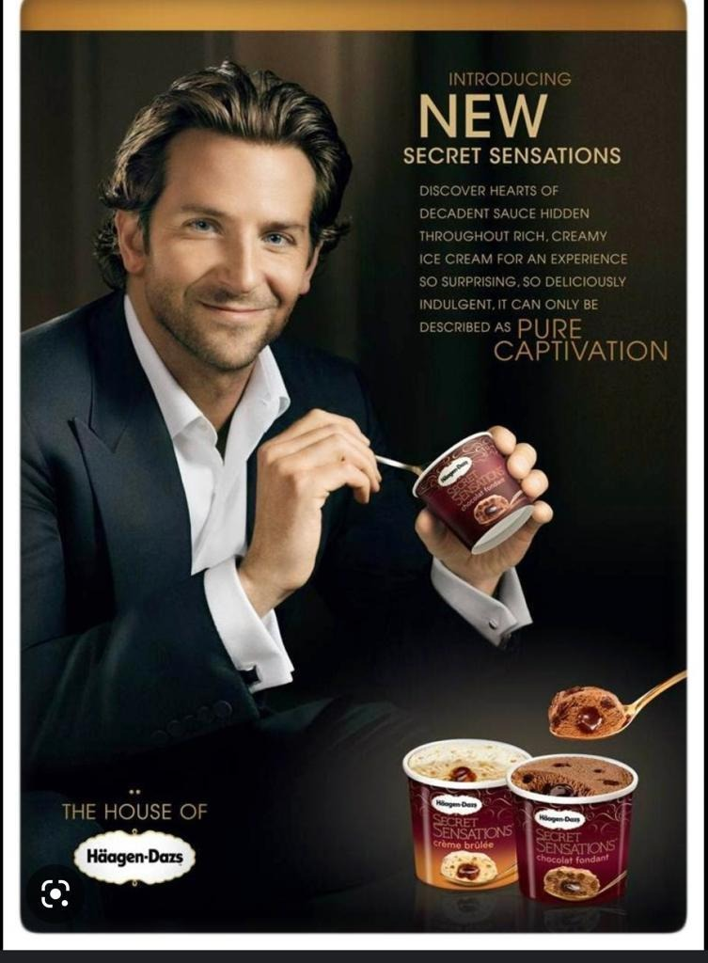


Identifying which Differences to Promote
أحيانا يختار روّاد السوق عرض قيمه يعتمد علي ميزه منافسه موجهه للعميل بكلمات مميزه مثل كلمة (أول)، مثلا كلينكس هي أول مناديل ورقية، و زيروكس هي أول ألة نسخ، و فورد هي أول عربية،
او على أساس كلمات التفضيل الأشهر، اكبر، أصغر، اجمل، اكثر راحة، أكتر امانا اوفر سعرا ،هكذا.....

Slide 37
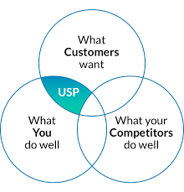
Identifying Competitive Advantages
2
Competitive advantage: An advantage over competitors gained by offering greater customer value for instance:-
  Higher quality
  lower prices
  Uniqueness
Notes:
Competitive advantage refers to an advantage over competitors gained by offering greater customer value, either by having lower prices or providing more benefits that justify higher prices.
To find points of differentiation, marketers must think through the customer’s entire experience with the company’s product or service. Through product differentiation, brands can be differentiated on features, performance, or style and design. Some companies gain services differentiation through speedy, convenient service.
Firms that practice channel differentiation gain competitive advantage through the way they design their channel’s coverage, expertise, and performance. Companies can also gain a strong competitive advantage through people differentiation that is, hiring and training better people than their competitors.
Even when competing offers look the same, buyers may perceive a difference based on company or brand image differentiation. A company or brand image should convey a product’s distinctive benefits and positioning.

Slide 38
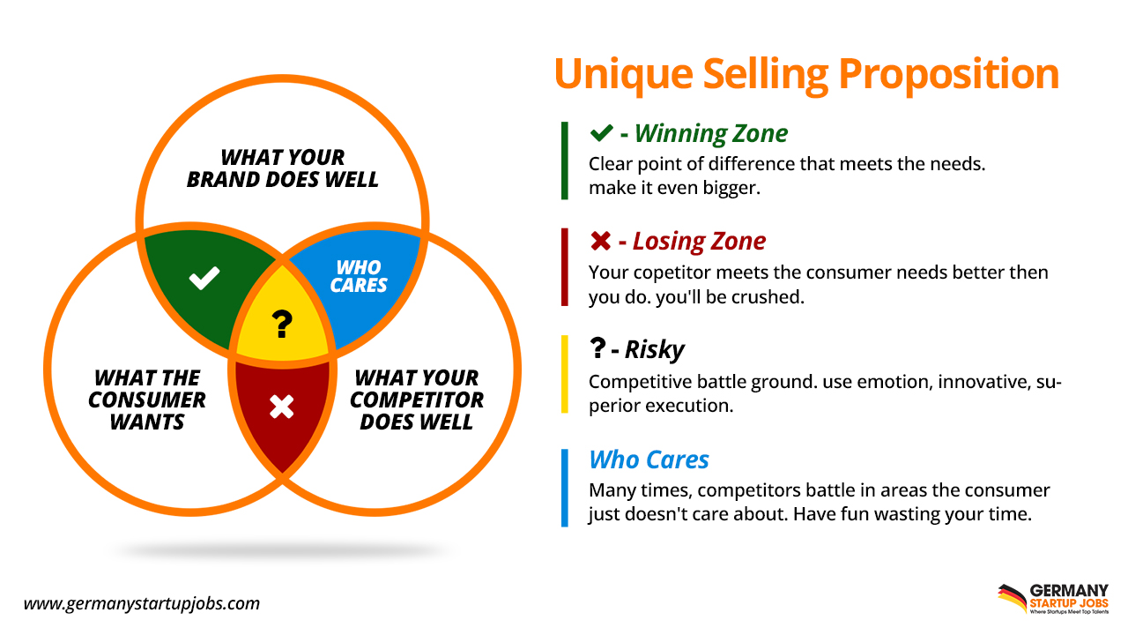
More Understand Competitive Advantages
Extra
Competitive Advantage
unique Selling Proposition
Competitive advantage: refers to an advantage over competitors gained by offering greater customer value, through :
  Providing high quality
  Providing benefits that justify higher prices
  Having lower prices
Notes:
Competitive advantage refers to an advantage over competitors gained by offering greater customer value, either by having lower prices or providing more benefits that justify higher prices.
To find points of differentiation, marketers must think through the customer’s entire experience with the company’s product or service. Through product differentiation, brands can be differentiated on features, performance, or style and design. Some companies gain services differentiation through speedy, convenient service.
Firms that practice channel differentiation gain competitive advantage through the way they design their channel’s coverage, expertise, and performance. Companies can also gain a strong competitive advantage through people differentiation that is, hiring and training better people than their competitors.
Even when competing offers look the same, buyers may perceive a difference based on company or brand image differentiation. A company or brand image should convey a product’s distinctive benefits and positioning.
Identifying Possible Value Differences

Slide 39
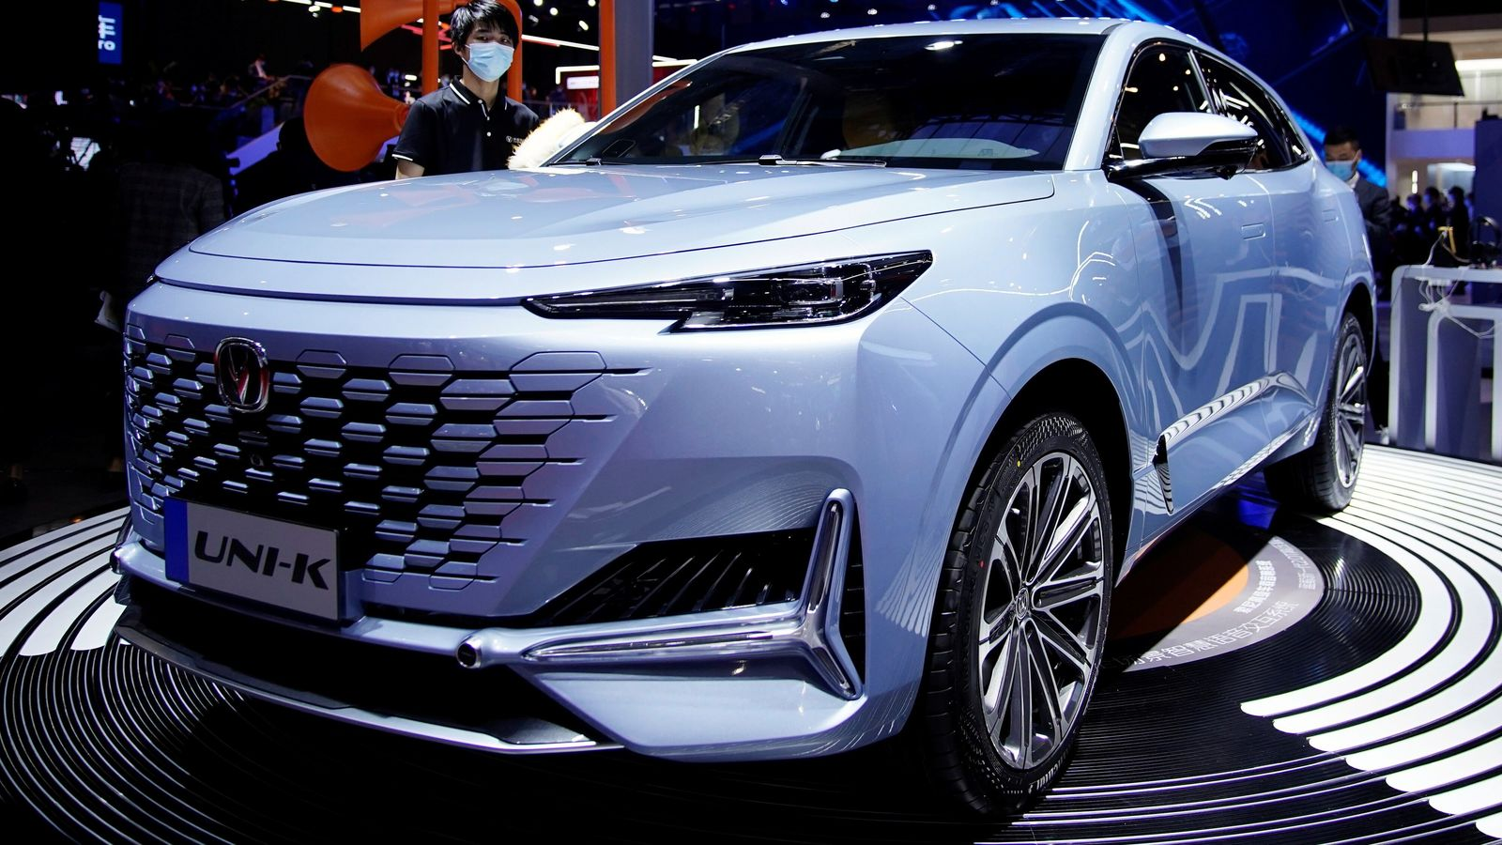
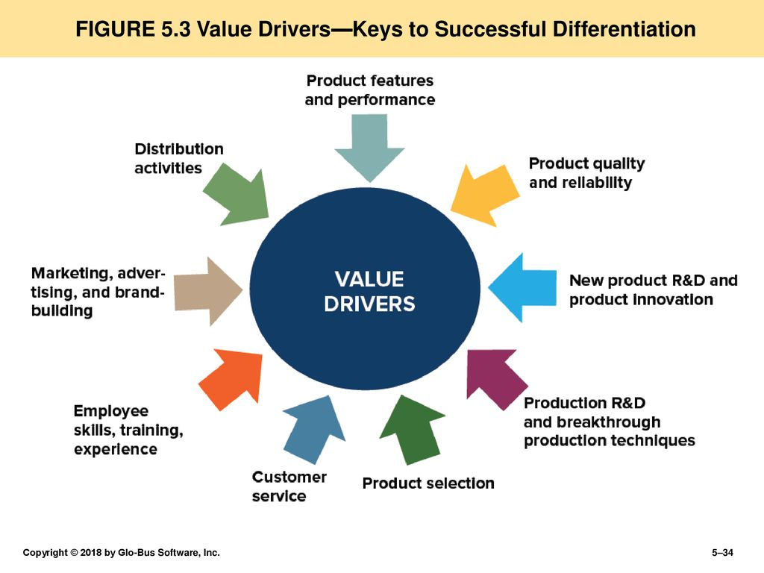
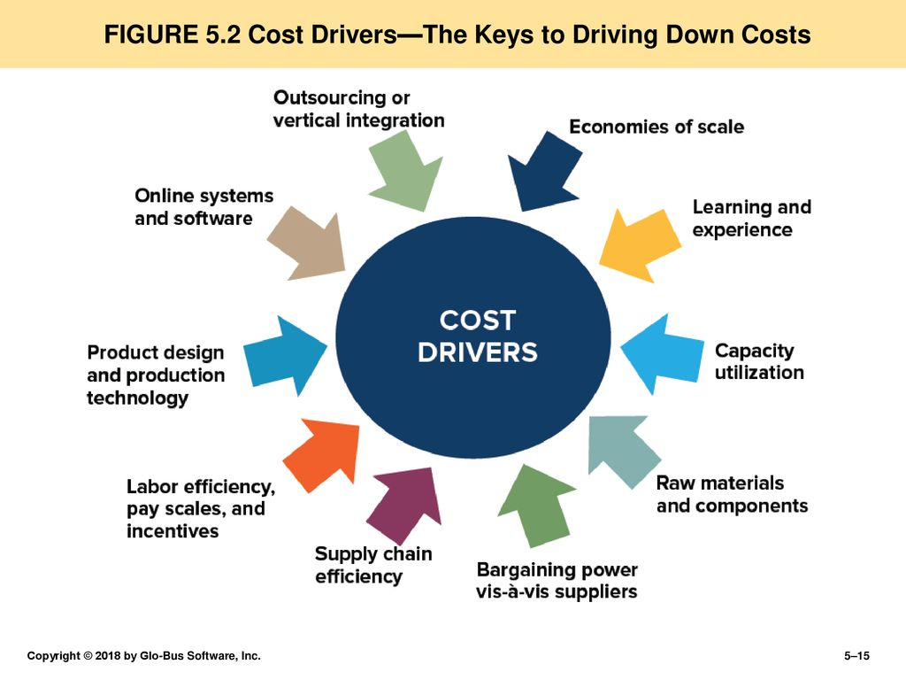
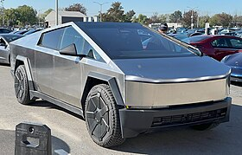
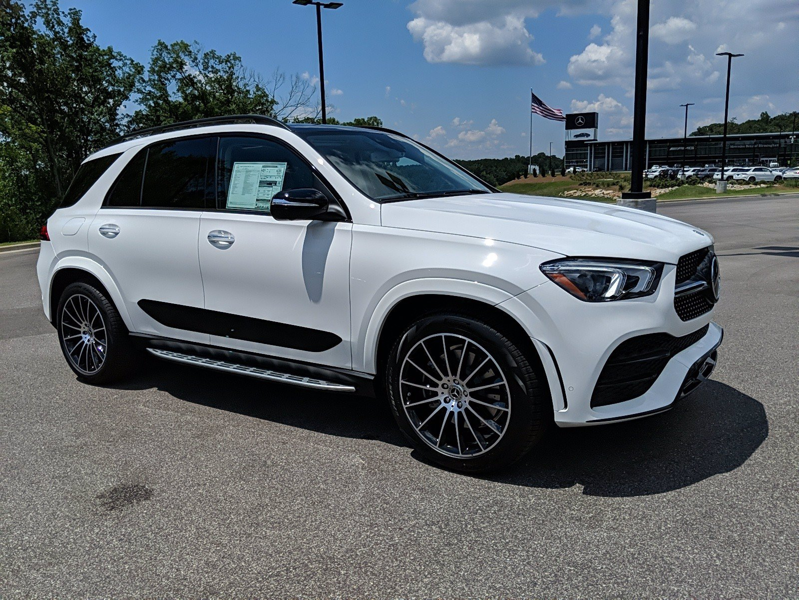
Sources of Competitive Advantages & Customer Value Proposition
1
2
Focus
3
Notes:
Competitive advantage refers to an advantage over competitors gained by offering greater customer value, either by having lower prices or providing more benefits that justify higher prices.
To find points of differentiation, marketers must think through the customer’s entire experience with the company’s product or service. Through product differentiation, brands can be differentiated on features, performance, or style and design. Some companies gain services differentiation through speedy, convenient service.
Firms that practice channel differentiation gain competitive advantage through the way they design their channel’s coverage, expertise, and performance. Companies can also gain a strong competitive advantage through people differentiation that is, hiring and training better people than their competitors.
Even when competing offers look the same, buyers may perceive a difference based on company or brand image differentiation. A company or brand image should convey a product’s distinctive benefits and positioning.
Identifying Possible Value Differences

Slide 40
3
Developing Value Propositions
Notes:
The full positioning of a brand is called the brand’s value proposition. It refers to the full mix of benefits on which a brand is differentiated and positioned.
This figure shows possible value propositions on which a company might position its products. The five blue cells on the top and right represent winning value propositions—differentiation and positioning that give the company a competitive advantage. The purple cells at the lower left, however, represent losing value propositions. The center green cell represents at best a marginal proposition.

Slide 41
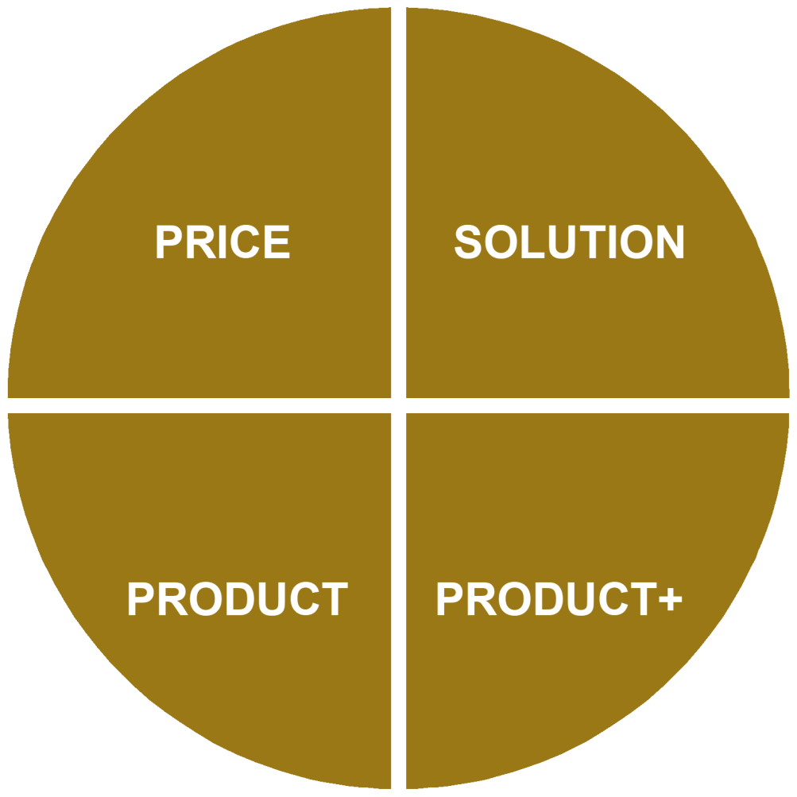
The Customer Value Proposition
Customer: shops for the lowest cost to him, and does not expect “frills”
Company: “We sell what you need at the lowest price, without hassle”.
Customer buys a customized solution to a problem.
Company:”We are experts, we listen to you. Together we will design a solution to your unique problem.”
Customer: is willing to pay extra for products/ services which are distinctive.
Company:”It costs more, but our products/ services are truly distinctive.”
Customer: shops for standard products/ services with some features at a mid-range price
Company: “We offer good products/ services at regular prices”
Note: “Price can be regarded as the lowest
total cost for the customer

Slide 42







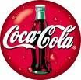
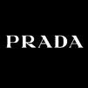

























Examples:
Competitive Advantages & Customer Value Proposition
PRICE
PRODUCT
PRODUCT+
SOLUTION/Logistics
Oilfield services
Management Consulting
Ferretti Group
Luxury yachts
Custom engineering

Slide 43

Activity #6
practice

Slide 44





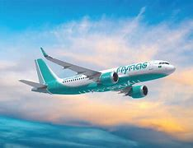

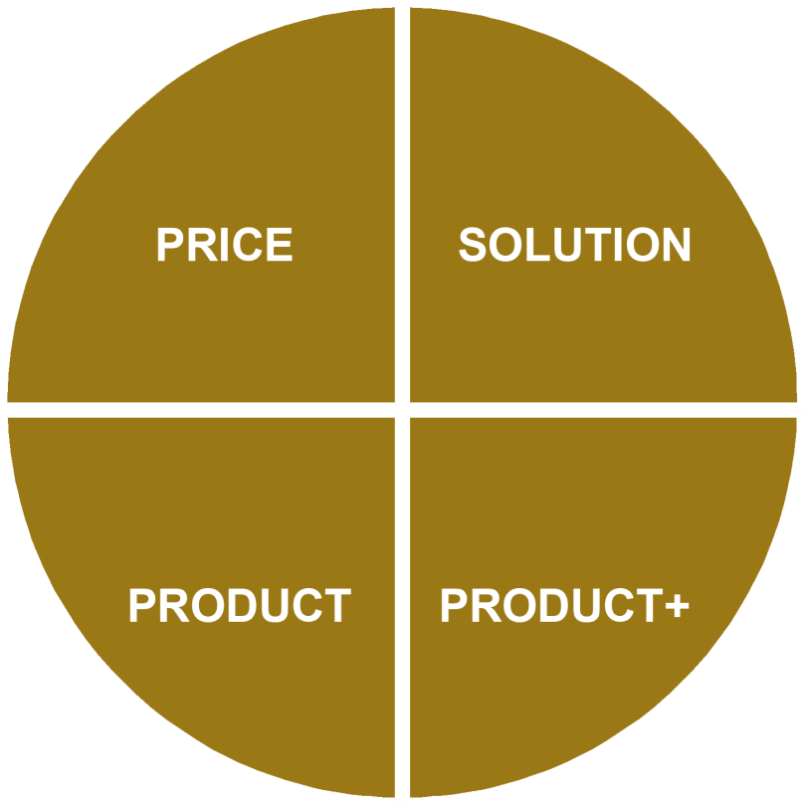


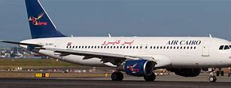




Identify Competitive Advantages & Customer Value Proposition

Slide 45
Identify Competitive Advantages & Customer Value Proposition

Slide 46
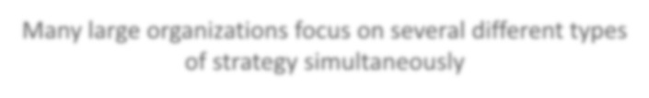




Multi-business enterprise
Many large organizations focus on several different types of strategy simultaneously
And they purposefully differentiate how the different divisions are managed and led (e.g. different KPIs and
reward systems, different sales forces, different customer service operations, different talent management
… different sub-cultures)
PRICE
PRODUCT
PRODUCT+
SOLUTION

Slide 47
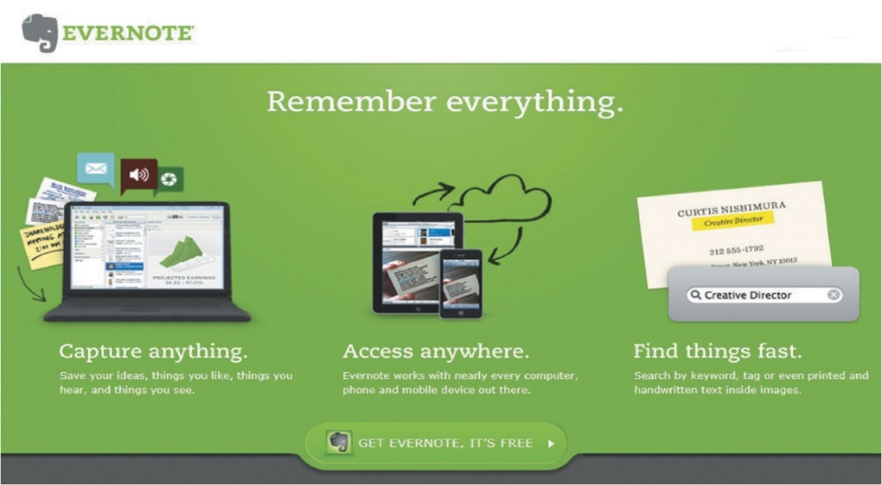
Developing a Positioning Statement
4
Positioning statement: Summarizes company or brand positioning
Format: To (target segment and need) our (brand) is (concept) that (point of difference).
“To busy multitaskers who need help remembering things,
Evernote is a digital content management application that
makes it easy to capture and remember moments and ideas
from your everyday life using your computer, phone, tablet, and the Web.”
Notes:
Placing a brand in a specific category suggests similarities that it might share with other products in the category. But the case for the brand’s superiority is made on its points of difference.
A positioning statement refers to a statement that summarizes a company or brand positioning using this form: To (target segment and need) our (brand) is (concept) that (point of difference).
An example using the popular digital information management application, Evernote, is shown on the next slide.
A positioning statement refers to a statement that summarizes a company or brand positioning using this form: To (target segment and need) our (brand) is (concept) that (point of difference).
Here is an example using the popular digital information management application Evernote: “To busy multitaskers who need help remembering things, Evernote is a digital content management application that makes it easy to capture and remember moments and ideas from your everyday life using your computer, phone, tablet, and the Web.”

Slide 48



Developing a Positioning Statement
4
Uber positions itself as “Everyone’s private driver.”
Sonos does more than just sell speakers; it unleashes “All the
music on earth, in every room of your house, wirelessly.”
Notes:
Car sharing service Uber positions itself as “Everyone’s private driver.” This simple statement provides the backbone for its marketing strategy.

Slide 49
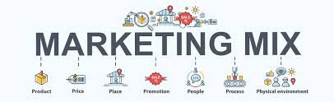
Communicating and Delivering the Chosen Position
5
All the company’s marketing mix efforts must support the positioning strategy.
Maintain the position obtained through consistent performance and communication.
The product’s position should be monitored and adapted over time.
Notes:
Once it has chosen a position, the company must take strong steps to deliver and communicate the desired position to its target consumers. All the company’s marketing mix efforts must support the positioning strategy. Companies often find it easier to come up with a good positioning strategy than to implement it.
Once a company has built the desired position, it must take care to maintain the position through consistent performance and communication.
It must closely monitor and adapt the position over time to match changes in consumer needs and competitors’ strategies. A product’s position should evolve gradually as it adapts to the ever-changing marketing environment.
Many marketers think that companies should aggressively promote only one benefit to the target market. A company should develop a unique selling proposition (USP) for each brand and stick to it. Each brand should pick an attribute and tout itself as “number one” on that attribute. Other marketers think that companies should position themselves on more than one differentiator. Today, in a time when the mass market is fragmenting into many small segments, companies and brands are trying to broaden their positioning strategies to appeal to more segments.

Slide 50
Activity #3
Developing a Positioning Statement

Slide 51
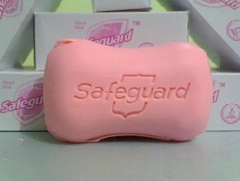
IDETIFY : (target segments and need) our (brand) is (concept) that (point of difference).
for children age range from 5-16 years and to adults’ age range from 24-40 we present Safeguard soap which will provide a 24hrs. Germ protection
as it is the number one antiseptic soap having the highest quality. The only antibacterial soap approved by the FDA.
Safeguard’s positioning

Slide 52
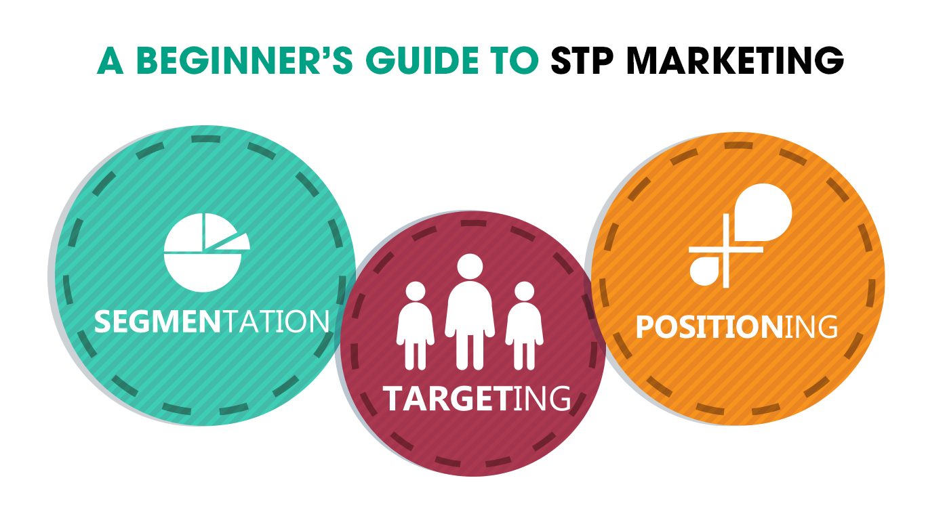
Differentiation
Branding

Slide 53


What are the difference between these 3 bottles ?
1.0$
0.1$
Product
Brands

Slide 54


Slide 55

Brand versus product
“Products are made in the factory but brands are created in the mind”
Leo Burnett was an American advertising executive and the founder of Leo Burnett Company, Inc. He was responsible for creating some of advertising's most well-known characters and campaigns of the 20th
Notes:
https://digitalsynopsis.com/advertising/generic-trademark-product-brand-names/A brand is a name , a term , a symbol or any other unique element of a product.

Slide 56






Summary of Brand vs Product

Slide 57

Brand Equity
Brand equity ,. It's a measure of the brand’s Values as well as its ability to capture consumer preference and loyalty
Brand value is the total financial value of a brand
https://www.forbes.com/the-worlds-most-valuable-brands/#b305959119c0
Notes:
Brands are a key element in a company’s relationships with consumers. Brands represent consumers’ perceptions and feelings about a product and its performance. A powerful brand has high brand equity. Brand equity is the differential effect that knowing the brand name has on customer response to the product and its marketing.
A brand has positive brand equity when consumers react more favorably to it than to a generic or unbranded version of the same product. It has negative brand equity if consumers react less favorably than to an unbranded version.

Slide 58

Major brand strategy decisions Major Brand Strategy Decisions
Brands are powerful assets that must be carefully developed and managed. As this figure suggests, building strong brands involves many challenging decisions
1
2
4
3
Notes:
Brands are powerful assets that must be carefully developed and managed. As this figure suggests, building strong brands involves many challenging decisions.
This figure shows that the major brand strategy decisions involve brand positioning, brand name selection, brand sponsorship, and brand development.

Slide 59

The brand positioning, attributes, benefit, Beliefs and Values
1-
A brand is the company's promise to deliver a benefits, services, and experiences consistently to buyers and must be supported by specific set of features.
Marketers can brand their products through three levels:
Product Features / Attributes,
  At the lowest level they can position the brand on product, However, attributes are the least desirable level for branding.
Product Benefits/ Consumer Rewards
  A brand can be better positioned by associating its name with a desirable benefit
Emotional Benefit. /Beliefs and values
  The strongest brands go beyond attribute or benefit positioning - they are positioned on strong Successful brands engage customers on a deep, emotional level
attributes, benefit, Beliefs and Values Laddering
Notes:
Marketers need to position their brands clearly in target customers' minds
When positioning a brand, the marketer should establish a mission for the brand and a vision of what the brand must be and do
A brand is the company's promise to deliver a specific set of features, benefits, services, and experiences consistently to buyers
The brand promise must be simple and honest
They can position brands at any of three levels:
At the lowest level they can position the brand on product attributes
However, attributes are the least desirable level for brand positioning
Competitors can easily copy attributes
A brand can be better positioned by associating its name with a desirable benefit
The strongest brands go beyond attribute or benefit positioning - they are positioned on strong beliefs and values
Successful brands engage customers on a deep, emotional level

Slide 60


1-
Brand attributes, benefit, Beliefs and Values
Look better

Slide 61





Brand Name, selection and protection
2-
A Brand name is a word used to identify or differentiate a company and its products from the others.
Desirable qualities for a brand name should be
  Based on the product’s benefits and qualities
  Easy to pronounce, recognize, and remember
  Distinctive and extendable
  Easily translated into foreign languages
  Capable of registration and legal protection

Slide 62



Name importance
Chevrolet Nova faced a challenge in Central and South America
In Spanish, No Va, is, simply means No Go -- or this car won’t go! ☺

Slide 63





Brand Sponsorship
3-
National brands Marketed under the manufacturer’s own name
Store brands Created and owned by a reseller of a product or service
Licensing Use names and symbols created by other companies or well-known movie characters or celebrities for a fee
Co-branding Use the established brand names of two different companies on the same product
Notes:
A manufacturer has four sponsorship options:
National brands or manufacturers’ brands are marketed under the manufacturer’s own name. The Samsung Galaxy tablet or Kellogg’s Frosted Flakes are examples of national brands.
An increasing numbers of retailers and wholesalers have created their own store brands or private brands To compete with store brands, national brands must sharpen their value propositions, especially when appealing to today’s more frugal consumers.
Some companies license names or symbols previously created by other manufacturers, the names of well-known celebrities, or characters from popular movies and books. For a fee, licensing any of these can provide an instant and proven brand name. For example, consider the Kodak brand with its familiar red and yellow colors, which has retained its value even after the company went bankrupt and discontinued its consumer products.
Co-branding occurs when two established brand names of different companies are used on the same product. Because each brand dominates in a different category, the combined brands create broader consumer appeal and greater brand equity. For example, Taco Bell and Doritos teamed up to create the Doritos Locos Taco.

Slide 64

4-
Brand Development Strategies
Major strategies to develop and manage brands
Notes:
This figure illustrates the four choices that a company has when it comes to developing brands. It can introduce line extensions, brand extensions, multibrands, or new brands.
Line extensions occur when a company extends existing brand names to new forms, colors, sizes, ingredients, or flavors of an existing product category. A company might introduce line extensions as a low-cost, low-risk way to introduce new products. Or it might want to meet consumer desires for variety, use excess capacity, or command more shelf space from resellers.
A brand extension extends an existing brand name to new or modified products in a new category. It gives a new product instant recognition and faster acceptance. But an extension may also confuse the image of the main brand.
Multibranding offers a way to establish different features that appeal to different customer segments, lock up more reseller shelf space, and capture a larger market share. A major drawback of multibranding is that each brand might obtain only a small market share, and none may be very profitable.
A company might believe that the power of its existing brand name is waning, so a new brand name is needed. Or, it may create a new brand name when it enters a new product category for which none of its current brand names are appropriate. For example, Toyota created the separate Lexus brand aimed at luxury car consumers and the Scion brand, targeted toward Millennial consumers.

Slide 65

Line extensions
extends existing brand names to new forms, colors, sizes, ingredients, or flavors of an existing product category.
A company might introduce line extensions as a low-cost, low-risk way to introduce new prod
Example: Heinz Ketchup different lines extension ……..

Slide 66

Brands extension
Companies extend an existing brand name to new or modified products in a new category.
It gives a new product instant recognition and faster acceptance.
Notes:
A brand extension extends a current brand name to new or modified products in a new category. For example, Google-owned Nest—which began as a maker of stylish, connected, learning thermostats that can be controlled remotely by phone—has extended its line with a host of smart and stylish smart-home products, including a smoke and carbon monoxide
alarm, home monitoring cameras, a home security alarm system, and a video doorbell that lets you know who’s calling.

Slide 67

Multibranding
features that appeal to different customer segments, lock up more reseller shelf space, and capture a larger market share.
Notes:
common Brand Strategies
Brand extension: uses an existing brand name to promote a new or improved product in a company's product lineExample: Ocean Spray extended cranberry juice line by adding CranApple, CranGrape, and CranCherry
Brand licensing: companies allow other organizations to use their brand, brand mark, or trade charactersExample: NFL has licensing arrangements with Pepsi & Visa
Mixed brands: offer a combo of national, private, and generic brands to sell productsExample: Michelin manufactures its own brand of tires as well as sells them at Sears under the Sears brand name.
Co-branding: combines one or more brands in the manufacture of a product or in the delivery of a service Example: Starbucks has an agreement with Barnes & Noble to open coffee shops inside their bookstores
Product Line Decisions • Product Line • Group of products with variations (flavors/types/appeals). • Product Line Stretching • Downward • Upward • Both directions • Product Line Filling • Examples • Ice Tea • Pet Foods
Product Line Stretching - Marriott Marriott offers a full line of hotel brands, each aimed at a different market.
Product Mix Decisions • Product mix: • What combination of products do we carry? • Product mix decisions: •

Slide 68


New brand
new brand name when it enters a new product category for which none of its current brand names are appropriate. For example, Toyota created the separate Lexus brand aimed at luxury car consumers.
Notes:
common Brand Strategies
Brand extension: uses an existing brand name to promote a new or improved product in a company's product lineExample: Ocean Spray extended cranberry juice line by adding CranApple, CranGrape, and CranCherry
Brand licensing: companies allow other organizations to use their brand, brand mark, or trade charactersExample: NFL has licensing arrangements with Pepsi & Visa
Mixed brands: offer a combo of national, private, and generic brands to sell productsExample: Michelin manufactures its own brand of tires as well as sells them at Sears under the Sears brand name.Co-branding: combines one or more brands in the manufacture of a product or in the delivery of a serviceExample: Starbucks has an agreement with Barnes & Noble to open coffee shops inside their bookstores
Product Line Decisions • Product Line • Group of products with variations (flavors/types/appeals). • Product Line Stretching • Downward • Upward • Both directions • Product Line Filling • Examples • Ice Tea • Pet Foods
Product Line Stretching - Marriott Marriott offers a full line of hotel brands, each aimed at a different market.
Product Mix Decisions • Product mix: • What combination of products do we carry? • Product mix decisions: •

Slide 69
Activity #5
What do you see

Slide 70











Slide 71



استراحة ١٥ دقيقه
نعود بعد
الاستراحة الساعة8:12
توقيت القاهرة

Slide 72


