Slide 1

Strategic marketing
Lecture 7

Slide 2


Strategic marketing
Lecture # 7
مساء الخير وأتمنى أن يكون الجميع بخير
سنبدأ الساعة 6:15مساء بتوقيت القاهرة
مع خالص الشكر
د. علي يحيى

Slide 3

Quick recap on previous lecture

Slide 4
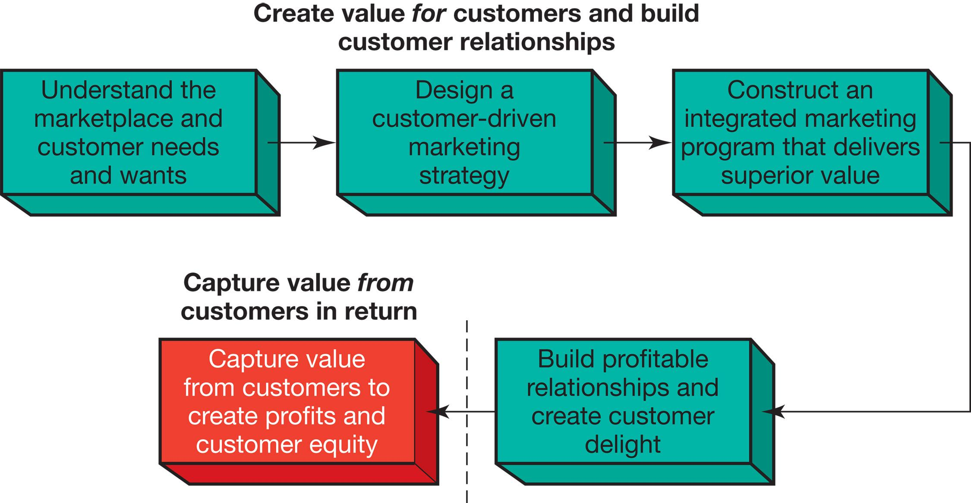
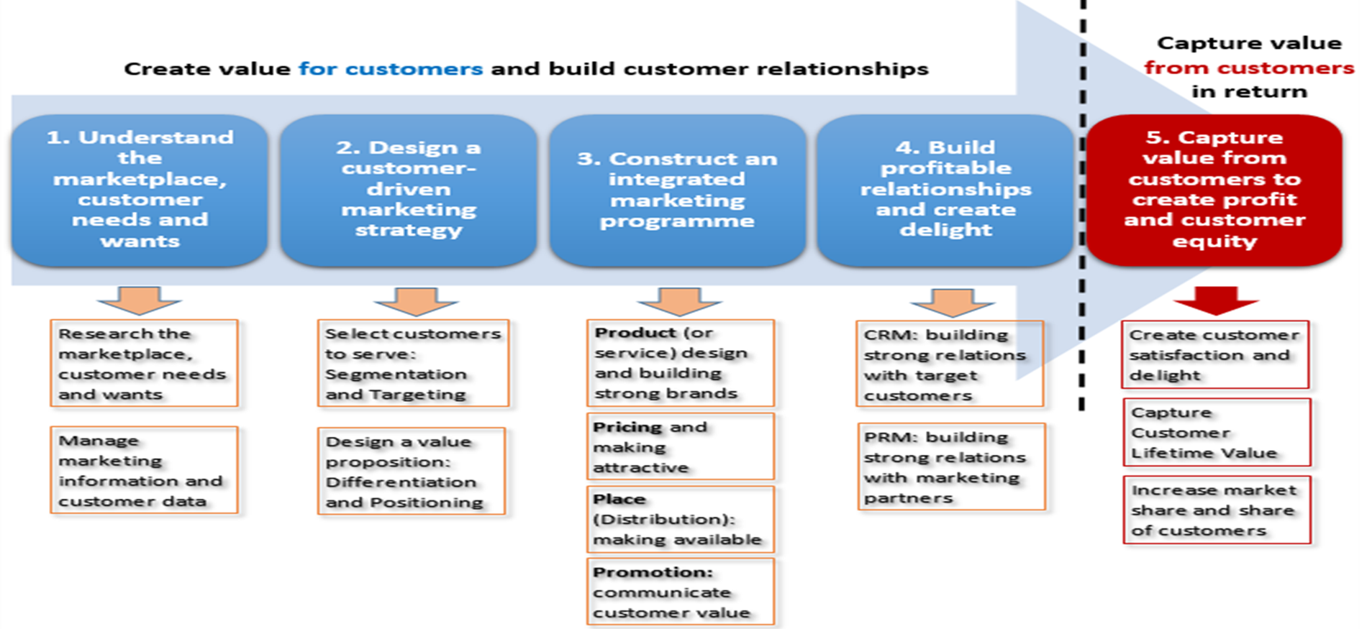
1
2
3
4
- consumer buyer behaviour and consumer markets
- Business Buyer Behaviour and Business Markets
Needs and wants
Marketplace
Market offering
Strategic marketing analysis
Big data and MIS
Grand marketing strategies competitive and growth
STP strategies
Differentiation and branding
CRM tools and systems
CUSTOMER RELATIONSHIP GROUPS
Marketing control
Marketing MIX
4Ps
Notes:
The Marketing Process
In the first four steps, companies work to understand consumers, create customer value, and build strong customer relationships
In the final step, companies reap the rewards of creating superior customer value
By creating value for customers, companies are able capture value from customers in the form of sales, profits, and long-term customer equity

Slide 5
Constructing an Integrated Marketing Mix
Marketing mix = 4 Ps.
Set of tactical marketing tools blended to produce the response to the target market.
Product is the goods/services combination the company offers to the target market.
Price is the amount of money customers must pay to obtain the product.
Place includes the company activities that make the product available to target consumers.
Promotion refers to activities that communicate the merits of the product and persuade target customers to buy it.
Notes:
After deciding on its overall marketing strategy, the company is ready to begin planning the details of the marketing mix, one of the major concepts in modern marketing
The marketing mix consists of everything the firm can do to influence the demand for its product
The many possibilities can be collected into four groups of variables known as the four Ps: product, price, place, and promotion.
Product means the goods-and-services combination the company offers to the target market
Price is the amount of money customers must pay to obtain the product
Place includes company activities that make the product available to target customers
Promotion means activities that communicate the merits of the product and persuade target customers to buy it
However, some critics think that the four Ps may omit or underemphasize certain important activities
The four Ps concept takes the seller's view of the market, not the buyer's view
From the buyer's viewpoint, in this age of customer value and relationships, the four Ps might be better described as the four Cs
Marketers would do well to think through the four Cs first and then build the four Ps on that platform
The marketing mix is the set of tactical marketing tools that the firm blends to produce the response it wants in the target market. This figure shows the four marketing tools, the four Ps.
Product is the goods-and-services combination the company offers to the target market.
Price is the amount of money customers must pay to obtain the product.
Place includes the company activities that make the product available to target consumers.
Promotion refers to activities that communicate the merits of the product and persuade target customers to buy it.
An effective marketing program blends the marketing mix elements into an integrated marketing program designed to achieve the company’s marketing objectives by delivering value to consumers.

Slide 6
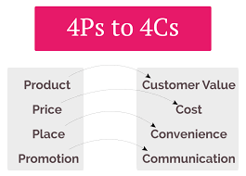
Constructing an Integrated Marketing Mix
Customer value is buying value added and solutions to problems
Customer cost, total costs of obtaining, using, and disposing of a product
Customer Convenience, Customer will make purchases depending on where, when, and how it is Convenient for them
Customer want two-way and regular communication also relationships with businesses
Notes:
After deciding on its overall marketing strategy, the company is ready to begin planning the details of the marketing mix, one of the major concepts in modern marketing
The marketing mix consists of everything the firm can do to influence the demand for its product
The many possibilities can be collected into four groups of variables known as the four Ps: product, price, place, and promotion.
Product means the goods-and-services combination the company offers to the target market
Price is the amount of money customers must pay to obtain the product
Place includes company activities that make the product available to target customers
Promotion means activities that communicate the merits of the product and persuade target customers to buy it
However, some critics think that the four Ps may omit or underemphasize certain important activities
The four Ps concept takes the seller's view of the market, not the buyer's view
From the buyer's viewpoint, in this age of customer value and relationships, the four Ps might be better described as the four Cs
Marketers would do well to think through the four Cs first and then build the four Ps on that platform

Slide 7
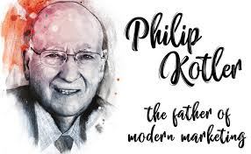
1st P-Products
  Goods & Services
Philip Kotler: “A product is anything that can be offered to a market for attention, acquisitions, use or consumption that might satisfy a want or need. It includes physical objectives, services, persons, places, organizations and ideas”.

Slide 9

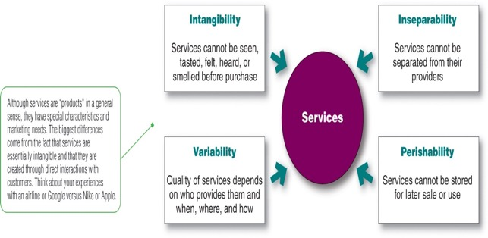



Service Characteristics cont.
Notes:
This figure depicts the four special service characteristics a company must consider when designing marketing programs: intangibility, inseparability, variability, and perishability.
Service intangibility means that services cannot be seen, tasted, felt, heard, or smelled before they are bought. To reduce uncertainty, buyers look for signals of service quality. They draw conclusions about quality from the place, people, price, equipment, and communications that they can see.
Service inseparability means that services cannot be separated from their providers, whether the providers are people or machines. Customer coproduction makes provider–customer interaction a special feature of services marketing. Both the provider and the customer affect the service outcome.
Service variability means that the quality of services depends on who provides them as well as when, where, and how they are provided. For example, within a Marriott hotel, one registration-counter employee may be cheerful and efficient, whereas another standing just a few feet away may be grumpy and slow.
Service perishability means that services cannot be stored for later sale or use. Some doctors charge patients for missed appointments because the service value existed only at that point and disappeared when the patient did not show up.

Slide 10
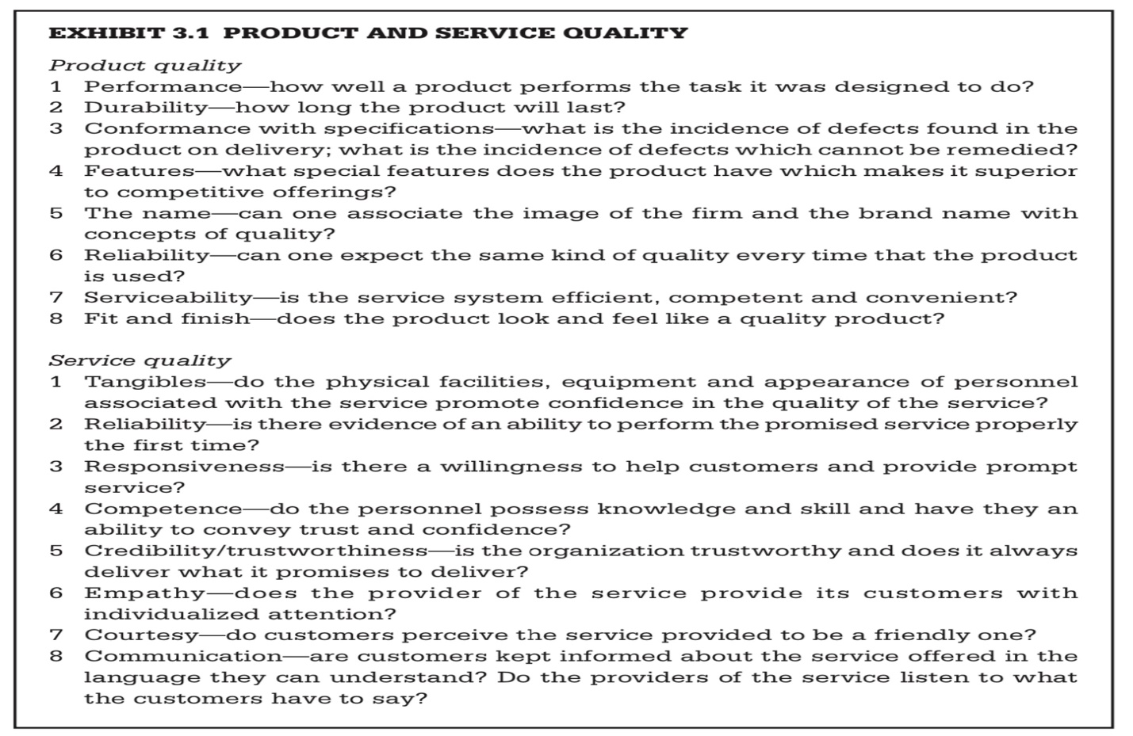
PRODUCT AND SERVICE QUALITY
Proctor, T., 2014, Strategic Marketing: An Introduction, Routledge,

Slide 11

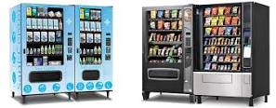
Service companies major marketing tasks :
Managing service differentiation
The act of distinguishing company's offering from competitors' offerings and Delivering consistently higher quality than the competitors in ways that meaningful to consumers.
Managing service differentiation, quality, and productivity
  Developing a differentiated offer, delivery, and image.
  Training current employees or hiring new ones
  Harnessing the power of technology
Notes:
Service companies face three major marketing tasks: They want to increase their service differentiation, service quality, and service productivity.
In these days of intense price competition, service marketers often complain about the difficulty of differentiating their services from those of competitors. The solution to price competition is to develop a differentiated offer, delivery, and image. For example, Dick’s Sporting Goods’ customers can sample shoes on Dick’s indoor footwear track, test golf clubs with an on-site golf swing analyzer and putting green, shoot bows in its archery range, and receive personalized fitness product guidance from an in-store team of fitness trainers.
A service firm can differentiate itself by delivering consistently higher quality than its competitors provide. Service providers need to identify what target customers expect in regard to service quality. As hard as they may try, even the best companies will have an occasional late delivery, burned steak, or grumpy employee. However, good service recovery can turn angry customers into loyal ones.
With their costs rising rapidly, service firms are under great pressure to increase service productivity. They can do so in several ways. They can train current employees better or hire new ones who will work harder or more skillfully. Or they can increase the quantity of their service by giving up some quality. Finally, a service provider can harness the power of technology.
However, companies must avoid pushing productivity so hard that doing so reduces quality. For example, many airlines in their attempts to improve productivity, have mangled customer service.

Slide 12
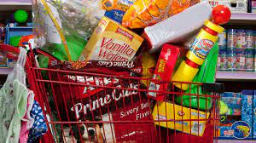

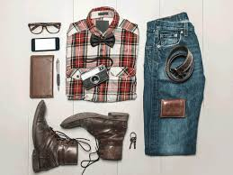





Types of consumer products
Unsought Products
consumers don’t think about
such products,
Convenience Products
Buy frequently & immediately
Low priced
Shopping Products
Buy less frequently
Higher price
Specialty Products
Special purchase efforts
High price

Slide 13
Product decisions
Product and Service decisions
Product Line decisions
Product Mix decisions
Individual Product decisions
Line stretching
Line filling
width
length
depth
consistency
product attributes
Branding
Packaging
Labels
product support services
1
2
3

Slide 14
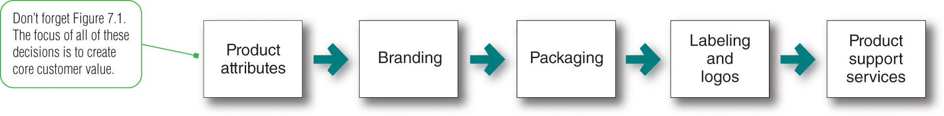
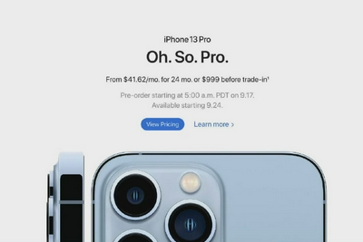
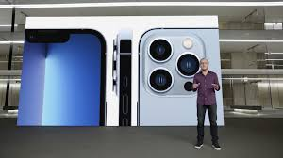
Individual Product decisions
1
A product varying features that add customer value is through distinctive product style and design.
Branding an important part of a product and can add value Consumers view a brand reflects product quality and consistency.
Packaging involves designing the container or wrapper for a product. packages must attract buyers & communicating brand positioning.
Labels help to identify and describe the product or brand as well as promote the brand, support its positioning and engage customers.
Product support services is to survey customers periodically. Once the company has assessed the quality of various support services, it can take steps to fix problems and add new services that will both delight customers and yield profits.
Notes:
This figure shows the important strategies in the development and marketing of individual products and services.
Developing a product or service involves defining the benefits that it will offer. The characteristics of a product or service that bear on its ability to satisfy stated or implied customer needs is known as product quality, one of the marketer’s major positioning tools. Total quality management (TQM) is an approach in which all of the company’s people are involved in constantly improving the quality of products, services, and business processes. A product can be offered with varying features. Another way to add customer value is through distinctive product style and design.
A brand is a name, term, sign, symbol, or design or a combination of these that identifies the maker or seller of a product or service. Consumers view a brand as an important part of a product, and branding can add value to a consumer’s purchase. Brand names help consumers identify products that might benefit them. Brands also say something about product quality and consistency.
Packaging involves designing the container or wrapper for a product. Increased competition means that packages must now perform many sales tasks—from attracting buyers to communicating brand positioning to closing the sale.
Labels help to identify and describe the product or brand as well as promote the brand, support its positioning and engage customers.
The first step in designing product support services is to survey customers periodically. Once the company has assessed the quality of various support services, it can take steps to fix problems and add new services that will both delight customers and yield profits to the company.

Slide 15
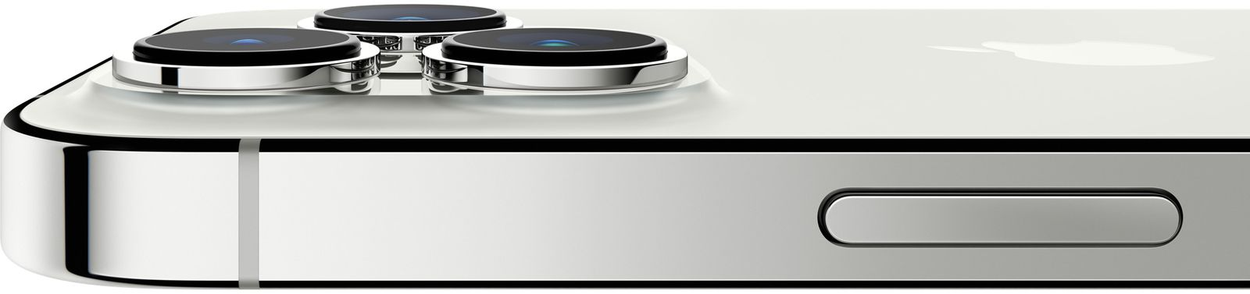
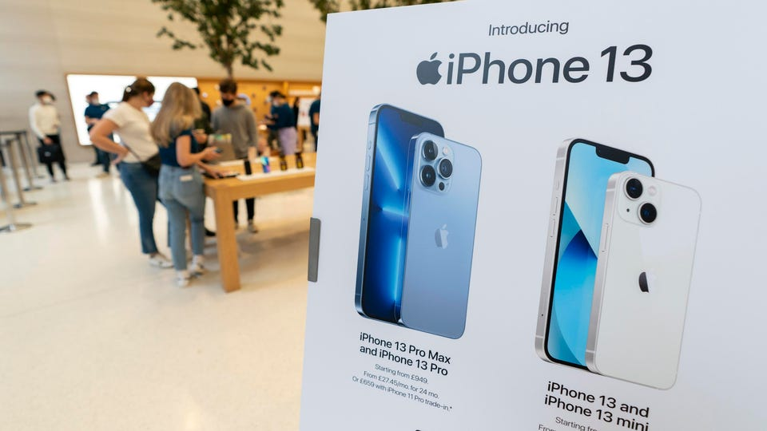
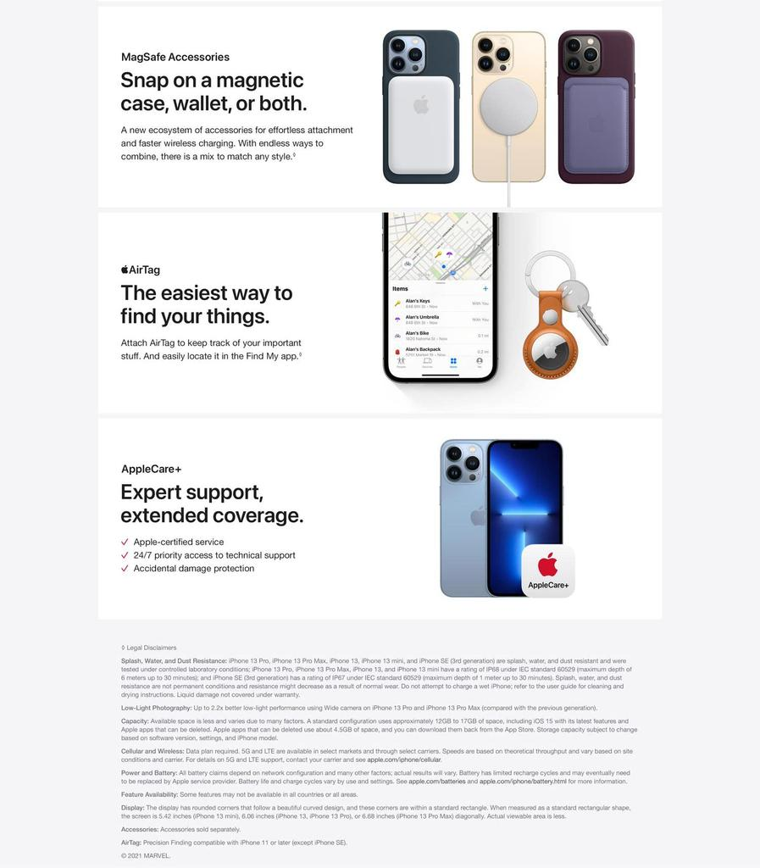
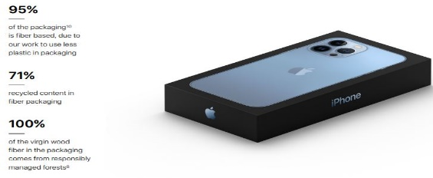

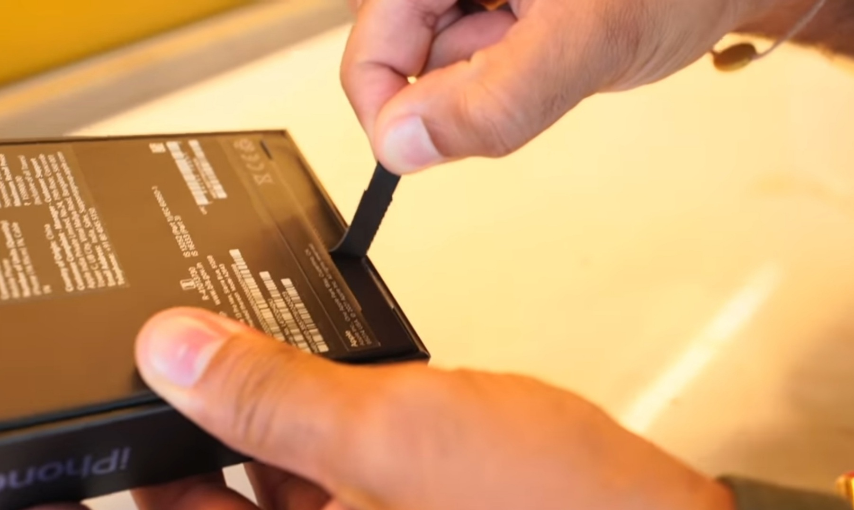
Individual Product decisions
Apple's Pro iPhones with updated cameras, new colors, smaller notches, ProMotion display, 1TB max storage, and faster A15 chip.
tamper-proof in iPhone 13 box, packaging contents are intact during shipping, and make sure consumers get a new iPhone13 box package that has not been opened or tampered with before.
TECH FIX” column in the New York Times. “The truth is that it is the smartphones peaked a few years ago,”
https://support.apple.com/en-sa/iphone
Notes:
This figure shows the important strategies in the development and marketing of individual products and services.
Developing a product or service involves defining the benefits that it will offer. The characteristics of a product or service that bear on its ability to satisfy stated or implied customer needs is known as product quality, one of the marketer’s major positioning tools. Total quality management (TQM) is an approach in which all of the company’s people are involved in constantly improving the quality of products, services, and business processes. A product can be offered with varying features. Another way to add customer value is through distinctive product style and design.
A brand is a name, term, sign, symbol, or design or a combination of these that identifies the maker or seller of a product or service. Consumers view a brand as an important part of a product, and branding can add value to a consumer’s purchase. Brand names help consumers identify products that might benefit them. Brands also say something about product quality and consistency.
Packaging involves designing the container or wrapper for a product. Increased competition means that packages must now perform many sales tasks—from attracting buyers to communicating brand positioning to closing the sale.
Labels help to identify and describe the product or brand as well as promote the brand, support its positioning and engage customers.
The first step in designing product support services is to survey customers periodically. Once the company has assessed the quality of various support services, it can take steps to fix problems and add new services that will both delight customers and yield profits to the company.

Slide 16
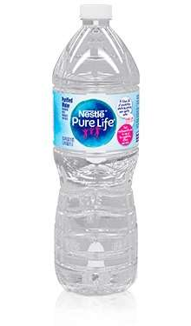
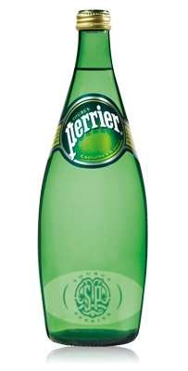
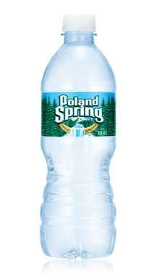
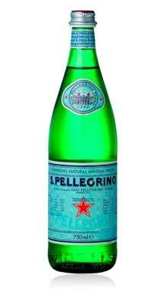

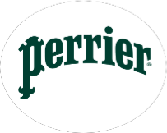
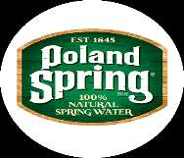
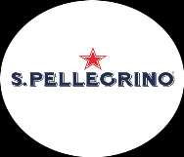
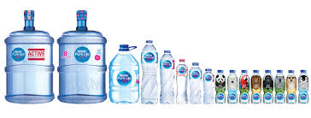
Product line decisions
5
Nestle BOTTLED WATER SBU
2
Product line is closely related products that:
  Have similar functions and customer groups
  Are sold through similar outlets
  EX, Nestle BOTTLED WATER product line.
Product line LENGTH is the number of items in the product line.
  EX, 4 lines is the length of Nestle BOTTLED WATER product line.
Product line DEPTH is Number of versions each product line as , flavor, taste,
  EX, 16 is the depth of a Nestle BOTTLED WATER product line.
PRODUCT LENGTH
4 product lines

Slide 17


Product line decisions
2
product line decisions are two
Product line filling adding more items within the present range of the line
Product line stretching company lengthens its product line beyond its current range The company can stretch its line downward, upward, or both ways.
Notes:
product line is a group of products that are closely related because they function in a similar manner, are sold to the same customer groups, are marketed through the same types of outlets, or fall within given price ranges. For example, Nike produces several lines of athletic shoes and apparel.
The major product line decision involves product line length, which is the number of items in the product line. A company can expand its product line in two ways: line filling and line stretching.
Line filling involves adding more items within the present range of the line. There are several reasons for product line filling. These reasons include reaching for extra profits, satisfying dealers, using excess capacity, being the leading full-line company, and plugging holes to keep out competitors.
Line stretching occurs when a company lengthens its product line beyond its current range. The company can stretch its line downward, upward, or both ways. A reason for downward product line stretching is to plug a market hole that would attract a potential competitor. The reason for upward product line stretching is to add prestige to the current product.

Slide 18
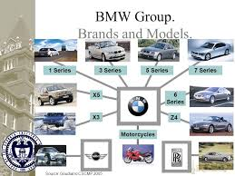
BMW -Product line decisions
2
BMW founded in 1917 Built engines for military aircraft.
Over the years, Through skillful line stretching and filling, BMW Group has transformed itself from a single-brand, five-model automaker into a powerhouse with three brands, 14 “Series,” and dozens of distinct models.
The company has expanded downward with its MINI Cooper line and upward with Rolls-Royce.
BMW now has brands and lines that successfully appeal to the rich, the super-rich, and the hope-to-be-rich.
Notes:
A product line is a group of products that are closely related because they function in a similar manner, are sold to the same customer groups, are marketed through the same types of outlets, or fall within given price ranges. For example, Nike produces several lines of athletic shoes and apparel.
The major product line decision involves product line length, which is the number of items in the product line. A company can expand its product line in two ways: line filling and line stretching.
Line filling involves adding more items within the present range of the line. There are several reasons for product line filling. These reasons include reaching for extra profits, satisfying dealers, using excess capacity, being the leading full-line company, and plugging holes to keep out competitors.
Line stretching occurs when a company lengthens its product line beyond its current range. The company can stretch its line downward, upward, or both ways. A reason for downward product line stretching is to plug a market hole that would attract a potential competitor. The reason for upward product line stretching is to add prestige to the current product.
Over the years, BMW Group has transformed itself from a single-brand, five-model automaker into a powerhouse with three brands, 14 “Series,” and dozens of distinct models. The company has expanded downward with its MINI Cooper line and upward with Rolls-Royce.

Slide 19
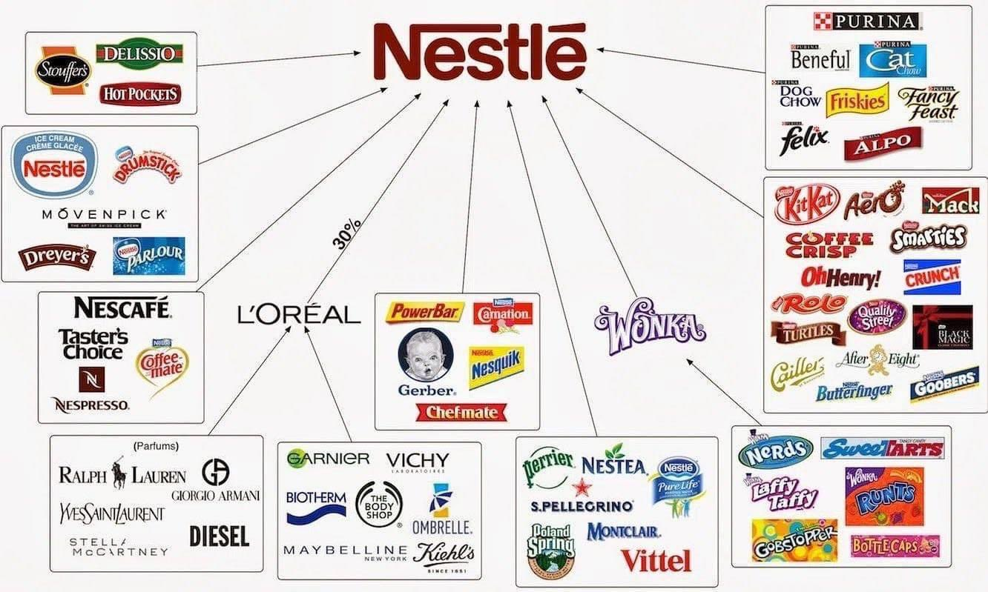
Product Mix decisions
3
Width; Number of different product lines
Length; Total number of items a in the product lines
Depth; Number of versions each product line as , flavor, taste, etc.
Consistency how closely the product lines are related from end user. perspectives, production requirements, and distribution channels,
Nestle’s most product lines are consistent as they are consumer goods that go through the same distribution channels.
Notes:
PRODUCT MIX
Except in the case of very small firms, it is rare to find a firm offering a single product or service. It is much more common to find firms offering a mix of products or services.
The product mix has:
width—quantity of lines the firm carries, e.g. radios,TVs, videorecorders, etc.
length—quantity of items in the product mix, e.g. three kinds of radio and four kinds of TV
depth—number of variants of each product offered in the line, e.g clock radios, car radios, pocket radios, etc.
consistency—how closely related the various product lines are in terms of the use to which they are put, e.g. all electrical leisure/entertainment goods.
The above provides a basis for defining the company’s product strategy since the company can increase its business in four ways.
1 Newlinescanbeaddedtowidentheproductmix,e.g.amanufacturerof radios could introduce a line of cassette players.
2 The length of existing product lines can be increased by introducing additional items, e.g. the radio manufacturer may introduce larger or smaller radios than are currently being offered.
3 Newproductvariantscanbeaddedtodeepentheproductmix,e.g.the radio manufacturer can add new models which are the same size as existing items but which have different features.
4 Productconsistencycanbemademoreorlessdependinguponwhether a firm wants to acquire a strong reputation in a few or many different areas.

Slide 20

Product Mix decisions
.3
company can increase its business in four ways.
add new product lines.
widening its product mix.
lengthen its existing product lines to become a more full-line company. It can add more versions of each product and thus deepen its product mix.
More product line consistency
Notes:
product line is a group of products that are closely related because they function in a similar manner, are sold to the same customer groups, are marketed through the same types of outlets, or fall within given price ranges. For example, Nike produces several lines of athletic shoes and apparel.
The major product line decision involves product line length, which is the number of items in the product line. A company can expand its product line in two ways: line filling and line stretching.
Line filling involves adding more items within the present range of the line. There are several reasons for product line filling. These reasons include reaching for extra profits, satisfying dealers, using excess capacity, being the leading full-line company, and plugging holes to keep out competitors.
Line stretching occurs when a company lengthens its product line beyond its current range. The company can stretch its line downward, upward, or both ways. A reason for downward product line stretching is to plug a market hole that would attract a potential competitor. The reason for upward product line stretching is to add prestige to the current product.

Slide 21
Product Mix decisions examples
5.3
Colgate is a $15.2 billion consumer products company that makes and markets a full product mix consisting of dozens of familiar lines and brands. Colgate divides its overall product mix into four major lines and Each product line consists of many items:
Oral care,
Personal care,
Home care,
Pet nutrition.
Notes:
A company’s product mix has four important dimensions: width, length, depth, and consistency.
The mix width refers to the number of different product lines the company carries. Product mix length refers to the total number of items a company carries within its product lines. Product mix depth refers to the number of versions offered for each product in the line. Finally, the consistency of the product mix refers to how closely related the various product lines are in end use, production requirements, distribution channels, or some other aspect.
A company can increase its business in four ways. It can add new product lines, widening its product mix. The company can lengthen its existing product lines to become a more full-line company. It can add more versions of each product and thus deepen its product mix. Finally, the company can pursue more product line consistency or less depending on whether it wants to have a strong reputation in a single field or in several fields. Finally, a company can pursue more product line consistency—or less—depending on whether it wants to have a strong reputation in a single field or in several fields.
Colgate is a $15.2 billion consumer products company that makes and markets a full product mix consisting of dozens of familiar lines and brands. Colgate divides its overall product mix into four major lines: oral care, personal care, home care, and pet nutrition. Each product line consists of many brands and item.
Colgate full product mix

Slide 22

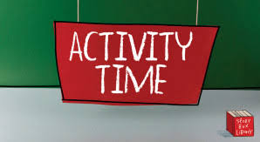
Activity 3
Practice on product line decisions

Slide 23
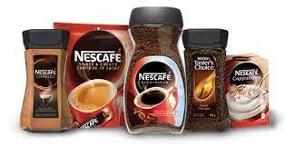
Match numbers and letters with the right Answers
Length; Total number of items a in the product lines
Width; Number of different product lines
Consistency how closely the product lines are related from end user. perspectives, production requirements, and distribution channels,
Depth; Number of versions each product line as , flavor, taste, etc.
B
C
D
A
Notes:
product line is a group of products that are closely related because they function in a similar manner, are sold to the same customer groups, are marketed through the same types of outlets, or fall within given price ranges. For example, Nike produces several lines of athletic shoes and apparel.
The major product line decision involves product line length, which is the number of items in the product line. A company can expand its product line in two ways: line filling and line stretching.
Line filling involves adding more items within the present range of the line. There are several reasons for product line filling. These reasons include reaching for extra profits, satisfying dealers, using excess capacity, being the leading full-line company, and plugging holes to keep out competitors.
Line stretching occurs when a company lengthens its product line beyond its current range. The company can stretch its line downward, upward, or both ways. A reason for downward product line stretching is to plug a market hole that would attract a potential competitor. The reason for upward product line stretching is to add prestige to the current product.

Slide 24
Match numbers and letters with the right Answers
B
Length; Total number of items a in the product lines
Width; Number of different product lines
Consistency how closely the product lines are related from end user. perspectives, production requirements, and distribution channels,
Depth; Number of versions each product line as , flavor, taste, etc.
A
D
B
C
D
C
A-
Notes:
product line is a group of products that are closely related because they function in a similar manner, are sold to the same customer groups, are marketed through the same types of outlets, or fall within given price ranges. For example, Nike produces several lines of athletic shoes and apparel.
The major product line decision involves product line length, which is the number of items in the product line. A company can expand its product line in two ways: line filling and line stretching.
Line filling involves adding more items within the present range of the line. There are several reasons for product line filling. These reasons include reaching for extra profits, satisfying dealers, using excess capacity, being the leading full-line company, and plugging holes to keep out competitors.
Line stretching occurs when a company lengthens its product line beyond its current range. The company can stretch its line downward, upward, or both ways. A reason for downward product line stretching is to plug a market hole that would attract a potential competitor. The reason for upward product line stretching is to add prestige to the current product.

Slide 25

Let us continue understanding;
  How to create value for customers?
  Marketing mix
  2nd P-Price

Slide 26
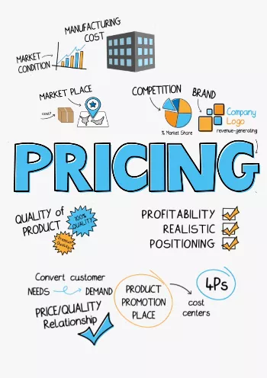
Pricing

Slide 27
2nd P-Price
C
Factors affecting Pricing Strategies
A
MAJOR PRICING STRATEGIES:
Cost-based pricing.
customer value–based pricing.
competition-based pricing
D
New Product Pricing Strategies
B
PRODUCT MIX PRICING STRATEGIES
Product line pricing
Optional-product pricing
Captive-product pricing
By-product pricing
Product bundle pricing
E
PRICE ADJUSTMENT STRATEGIES
Discount and allowance pricing
Segmented pricing
Psychological pricing
Promotional pricing
Dynamic pricing
International pricing
Notes:
Price is the amount of money charged for a product or a service. It is the sum of all the values that customers give up to gain the benefits of having or using a product or service. Price is one of the most important elements that determines a firm’s market share and profitability. Price is the only element in the marketing mix that produces revenue; all other elements represent costs.

Slide 28
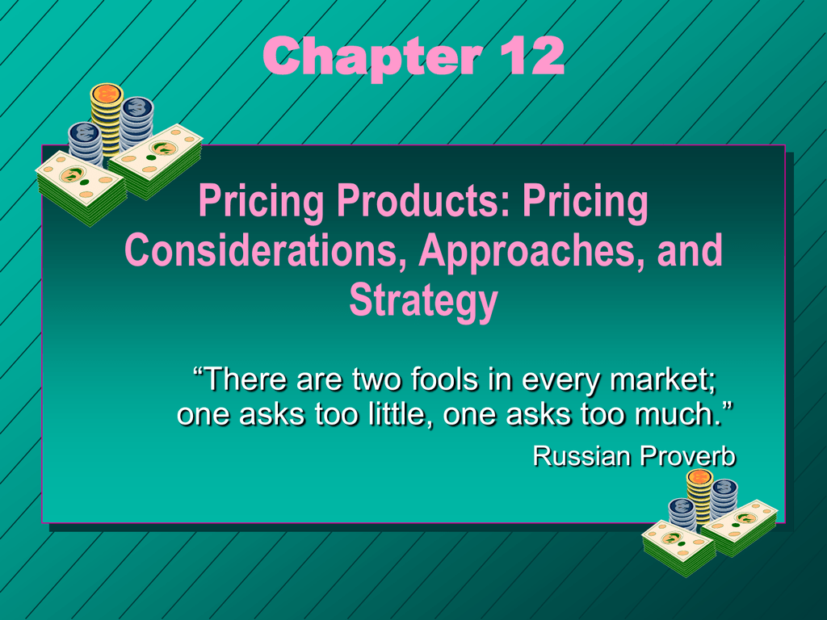
2nd P-Price
Amount of money charged for a product or service
The sum of the values that consumers exchange for the benefits of having or using
Determines a firm’s revenue, market share and profitability
Notes:
Price is the amount of money charged for a product or a service. It is the sum of all the values that customers give up to gain the benefits of having or using a product or service. Price is one of the most important elements that determines a firm’s market share and profitability. Price is the only element in the marketing mix that produces revenue; all other elements represent costs.

Slide 29
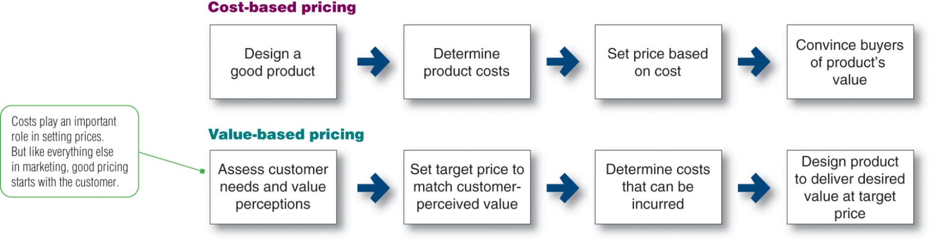
MAJOR PRICING STRATEGIES
A -
1
2
3
Market and Competition-Based Pricing
Notes:
This figure compares value-based pricing with cost-based pricing. Although costs are an important consideration in setting prices, cost-based pricing is often product driven. The company designs what it considers to be a good product, adds up the costs of making the product, and sets a price that covers costs plus a target profit. Value-based pricing reverses this process. The company first assesses customer needs and value perceptions. It then sets its target price based on customer perceptions of value.

Slide 30
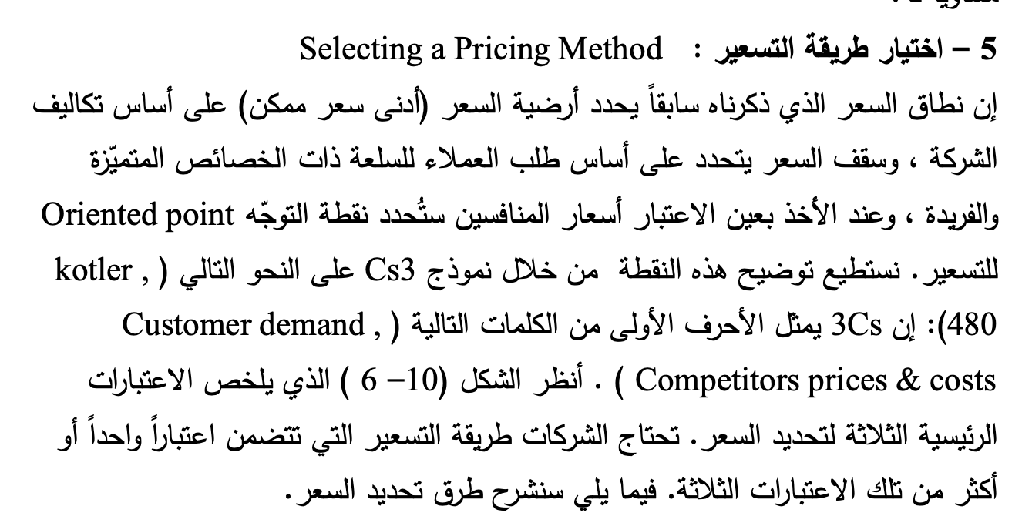
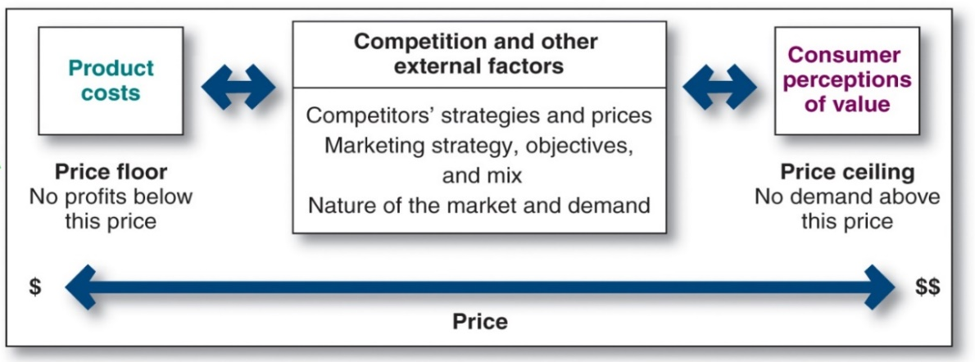
A -
إستراتيجيات التسعير نموذج [ Cs3]
3 major pricing strategies:
Cost-based pricing.
customer value–based pricing.
competition-based pricing.
Notes:
إذا أدرك العملاء أن سعر المنتج أكبر من قيمته ، فلن يشتروا المنتج. إذا قامت الشركة بتسعير المنتج بأقل من تكاليفها ، فستعاني الأرباح. بين النقيضين ، فإن استراتيجية التسعير الصحيحة هي تلك التي تقدم قيمة للعميل وأرباحا للشركة.

Slide 31
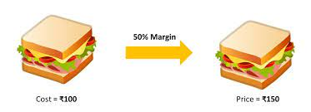
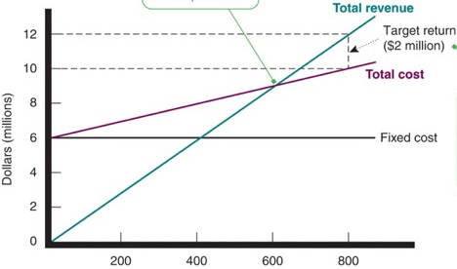
Types of Cost-Based Pricing
1
Cost-Based Pricing
Cost-plus pricing (markup pricing)
Adding a standard markup to the cost of the product
Break-even
Another cost-oriented pricing Break-even pricing (target return pricing)
Setting price to break even on the costs of making and marketing a product, or setting price to make a target return.
Notes:
The simplest pricing method is cost-plus pricing (or markup pricing)—adding a standard markup to the cost of the product. Markup pricing remains popular for many reasons. First, sellers are more certain about costs than about demand. By tying the price to cost, sellers simplify pricing. Second, when all firms in the industry use this pricing method, prices tend to be similar and price competition is minimized.
Another cost-oriented pricing approach is break-even pricing, or a variation called target return pricing. The firm tries to determine the price at which it will break even or make the target return it is seeking. Target return pricing uses the concept of a break-even chart, which shows the total cost and total revenue expected at different sales volume levels.

Slide 32
Value-Based Pricing
2
Customer value-based pricing by using buyers’ perceptions of value as the key to pricing .
A buyers’ perceptions of value rather than on the seller’s cost
Types of value-based pricing:
  Value-added pricing MORE For MORE, offers value-added features and services to differentiate a company’s offers and then charging higher prices.
  Good-value pricing, MORE For SAME just the right combination of quality good/ service at a fair price. more quality for a same price or same quality for less price.
Apple differentiates company’s offers and quality then charging higher prices above competitors
Notes:
Customer value-based pricing uses buyers’ perceptions of value as the key to pricing. Price is considered along with all other marketing mix variables before the marketing program is set. The company first assesses customer needs and value perceptions. It then sets its target price based on customer perceptions of value. There are two types of value-based pricing: good-value pricing and value-added pricing.
Good-value pricing offers just the right combination of quality and good service at a fair price. This pricing method involves introducing less expensive versions of established, brand name products or new lower-price lines. It also involves redesigning existing brands to offer more quality for a given price or the same quality for less.
Value-added pricing involves attaching value-ded features and services to differentiate a company’s offers and then charging higher prices. For example, even as frugal economical consumer spending habits linger, some movie theater
]
hains are adding amenities and charging more rather than cutting services to maintain lower admission prices.

Slide 33

Market and Competition-Based Pricing
3
Market and Competition-Based Pricing
Pricing is handled differently in each types of Markets competition
  Pure competition
  Monopolistic competition
  Oligopolistic competition
  Pure monopoly
Prices based on assessing competitors’ pricing strategies:
  How does the company’s market offering compare in terms of customer value?
  How strong are current competitors?
the customer pays an $80,000 price premium for the Caterpillar bulldozer, it’s getting $150,000 in added value over the product’s lifetime in the form of superior reliability and durability, lower lifetime operating costs, superior service, and a longer parts warranty.
Notes:
Competition-based pricing involves setting prices based on competitors’ strategies, costs, prices, and market offerings. In assessing competitors’ pricing strategies, the company should ask several questions. First, how does the company’s market offering compare with competitors’ offerings in terms of customer value? Next, how strong are current competitors and what are their current pricing strategies?

Slide 34

Activity #2

Slide 35
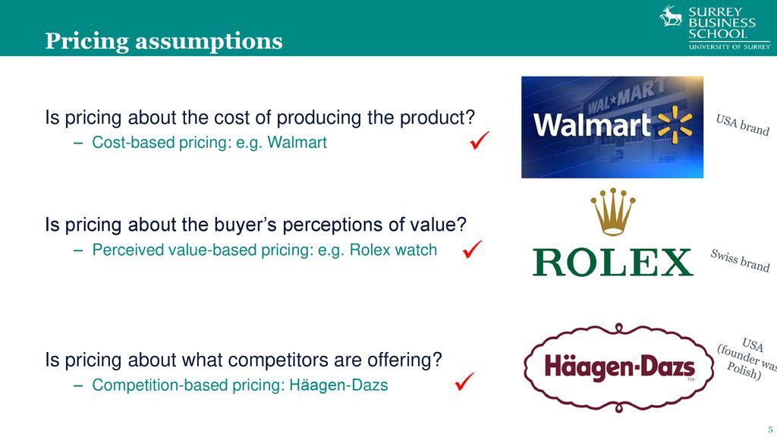
Value-Based Pricing versus Cost-Based Pricing
What is the PRICING STRATEGIES >

Slide 36
Value-Based Pricing versus Cost-Based Pricing

Slide 37
Product Mix Pricing Strategies
B -
Pricing Situation | Description
Product line pricing | Setting prices across an entire product line
Optional-product pricing | Pricing optional or accessory products sold with the main product
Captive-product pricing | Pricing products that must be used with the main product
By-product pricing | Pricing low-value by-products to get rid of or make money on them
Product bundle pricing | Pricing bundles of products sold together
Notes:
This slide summarizes the five product mix pricing strategies.
Product line pricing refers to determining the price steps to set between various products in a product line based on cost differences between the products,
customer evaluations of different features, and competitors’ prices.
Optional-product pricing refers to the pricing of optional or accessory products along with a main product.
Captive-product pricing refers to setting a price for products that must be used along with a main product, such as blades for a razor and games for a video-game console.
By-product pricing refers to setting a price for by-products in order to make the main product’s price more competitive.
Product bundle pricing refers to combining several products and offering the bundle at a reduced price.

Slide 38
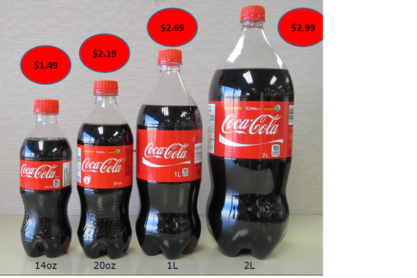
Product line pricing
SETTING PRICES ACROSS AN ENTIRE PRODUCT LINE
It considers the
cost differences between products in the line,
customer evaluation of their features,
competitors’ prices
Example : Car model that has different model types that change with performance and quality

Slide 39
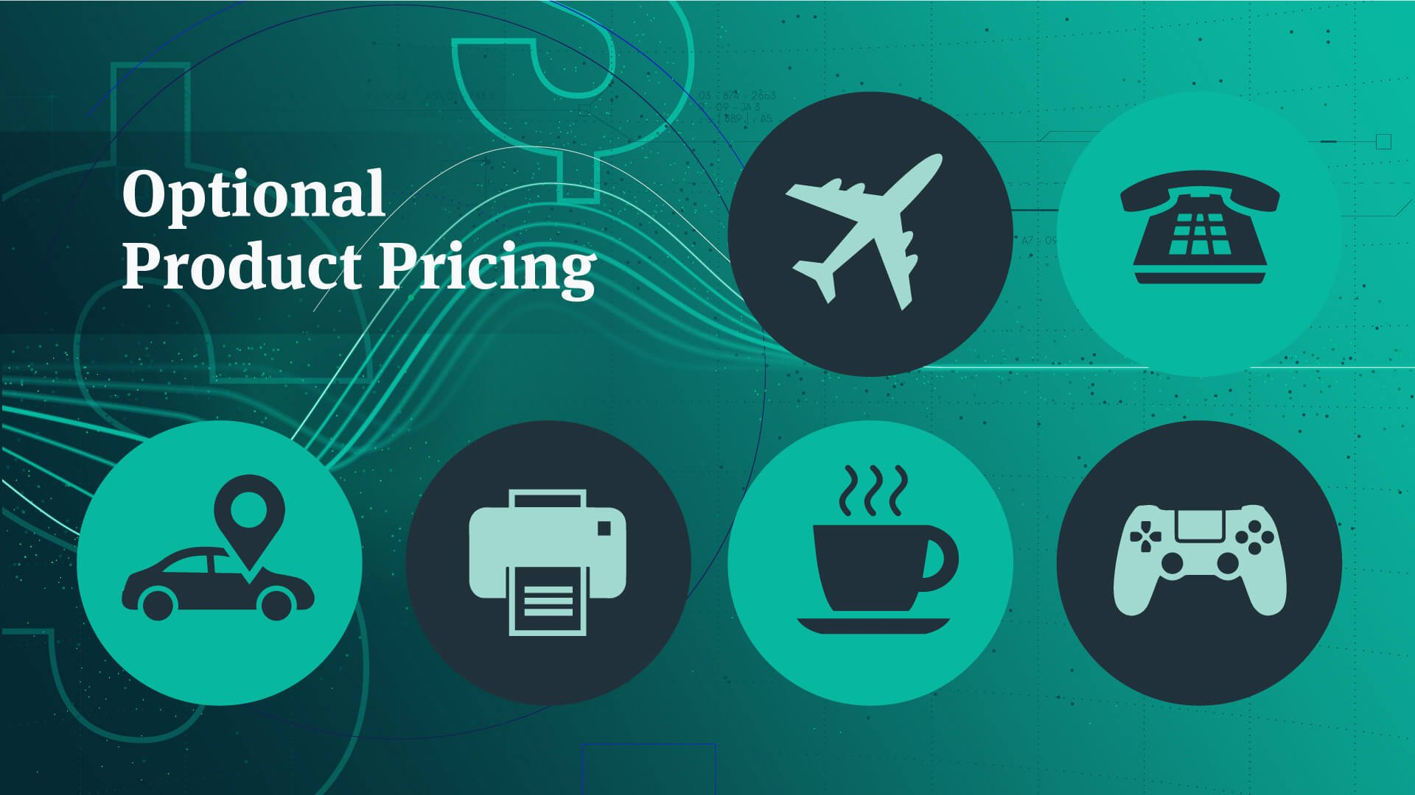
Optional-product pricing
OPTIONAL PRODUCT pricing is the pricing of optional or accessory products along with a main product. In many cases, you can buy optional or accessory products along with the main product.
For instance, when you order your new car, you may choose to order a navigation system or an advanced Entertainment system. However, for the company, pricing these options is not easy. They must decide carefully which items to include in the base price and which to offer as options.

Slide 40
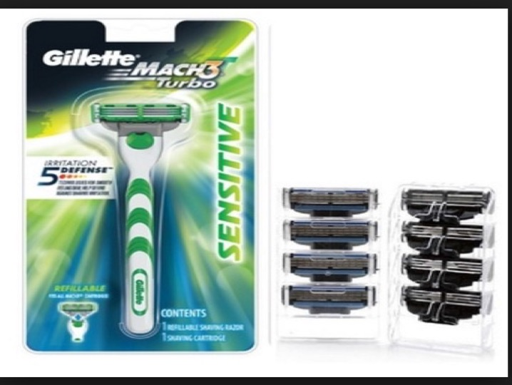
Captive-product pricing
CAPTIVE-PRODUCT PRICING—main products less than other ancillary products.
Gillette has long sold razor handles at low prices and made its money on higher-price, higher margin replacement blade cartridges
Notes:
Captive products can account for a substantial portion of a brand’s sales and profits. For example, Gillette has long sold razor handles at low prices and made its money on higher-price, higher-margin replacement blade cartridges. “The razor business is all about the blades,” says an analyst. “Get consumers hooked on your razor, and they buy the highly profitable refill blades forever.” Last year, Gillette sold well over half a billion dollars’ worth of refill blades at prices ranging up to a hefty $5 per cartridge.
Gillette has lost market share in recent years as price-fatigued customers have shifted to lower-priced private-label upstarts such as Dollar Shave Club and Harry’s. To compete, it was recently forced to slash cartridge prices across the board by 15 to 20 percent.

Slide 41
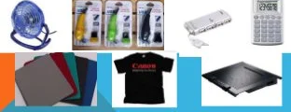
By-product pricing
BY-PRODUCT PRICING
low-value by-products to get rid of or make money on them

Slide 42
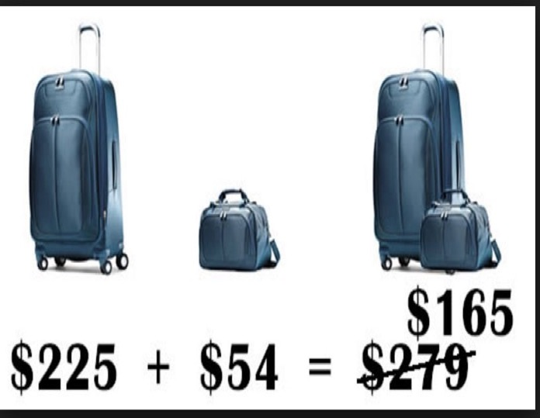
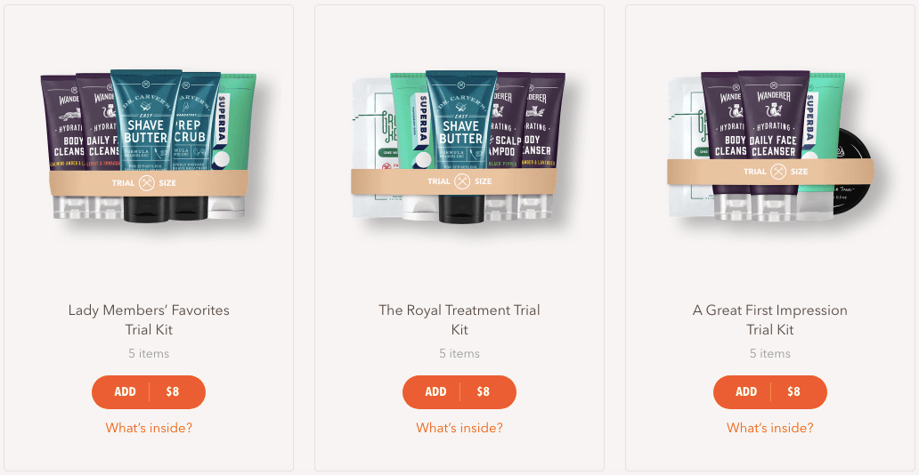
Product bundle pricing
PRODUCT-BUNDLE PRICING is a marketing strategy that combines two or more products to sell them at a lower price than if the same products were sold individually. less costly when purchased together
The bundle pricing technique is popular in retail and eCommerce as it offers more value for the price. It can also help build customer loyalty and boost product sale

Slide 43

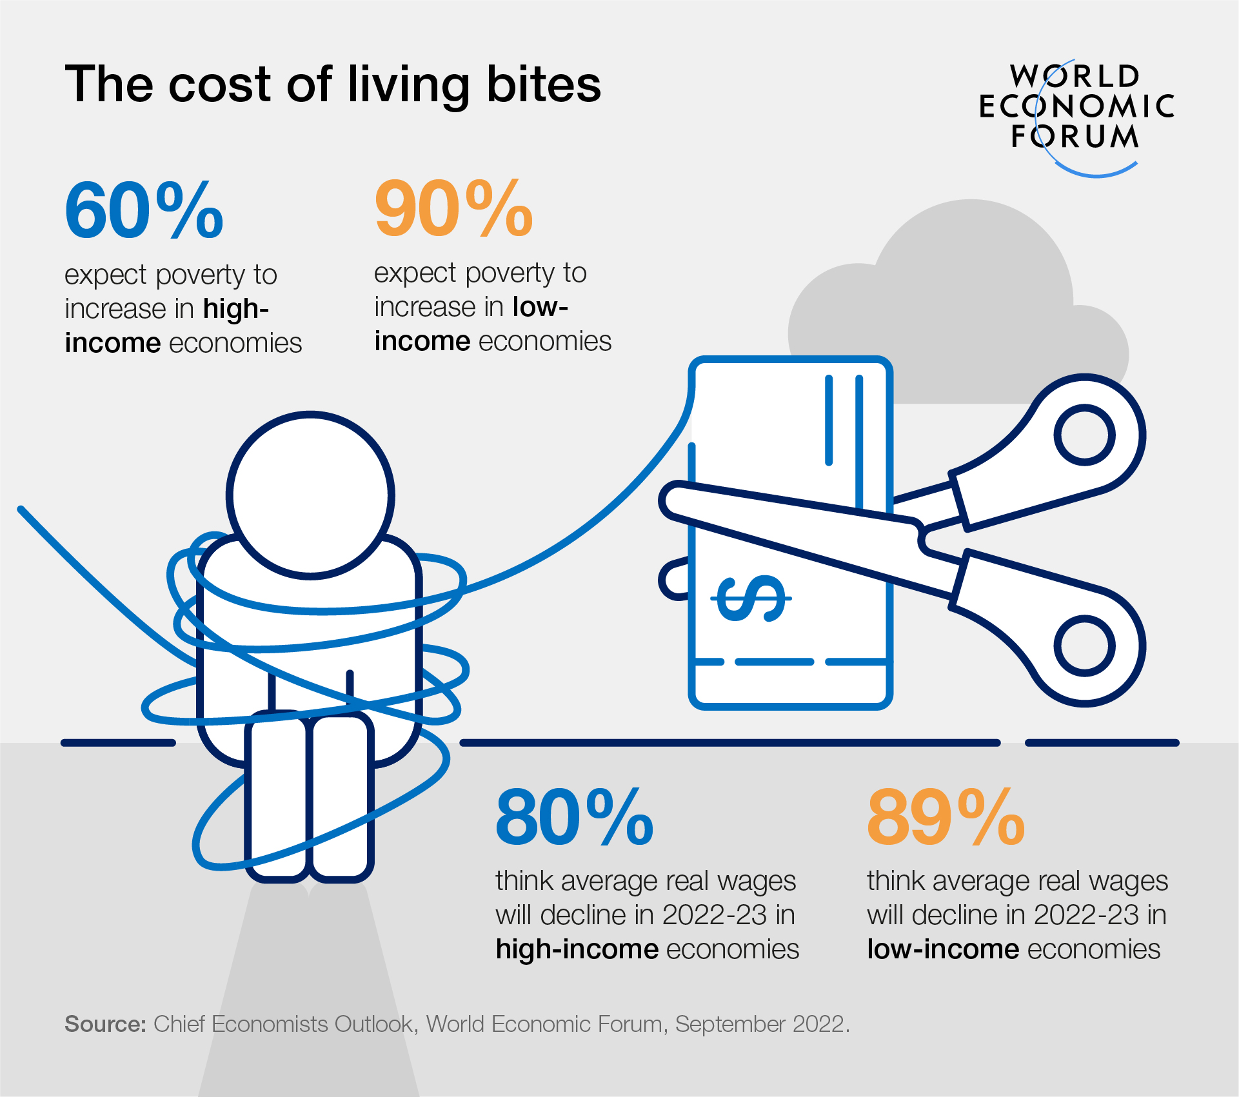

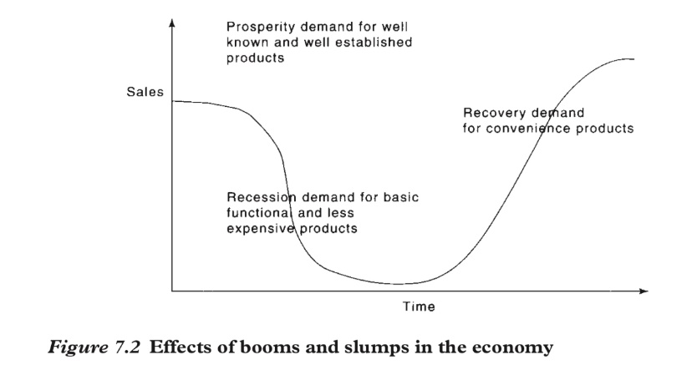
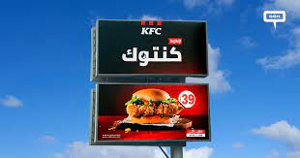
Economy
C -
External Considerations Affecting Price strategies
Factors impacting pricing strategies
Boom or recession
Inflation
Interest rates
Responses to the frugality of post recession consumers
Cut prices and offer discounts
Develop more affordable items
Redefine value propositions
Notes:
Economic conditions can have a strong impact on the firm’s pricing strategies. Factors such as a boom or recession, inflation, and interest rates affect pricing strategies. In the aftermath of the recent Great Recession, many consumers have rethought the price-value equation. As a result, many marketers have increased their emphasis on value-for-the-money pricing strategies.
The most obvious response to the new economic realities is to cut prices and offer discounts. Lower prices make products more affordable and help spur short-term sales. However, such price cuts can have undesirable long-term consequences. Once a company cuts prices, it’s difficult to raise them again when the economy recovers.
Rather than cutting prices, many companies have instead developed “price tiers,” adding both more affordable lines and premium lines. Other companies are holding prices but redefining the “value” in their value propositions.

Slide 44
Price Demand elasticity
C -
External Considerations Affecting Price strategies
Demand
Elasticity = (% change in demanded / %change in price)
  > 1 Elastic,
  <1 Inelastic
Measure of the sensitivity of demand to changes in price
  Inelastic demand: Demand hardly changes with a small change in price.
  Elastic demand: Demand changes greatly with a small change in price.
Notes:
Price elasticity refers to the measure of the sensitivity of demand to changes in price. If demand hardly changes with a small change in price, we say demand is inelastic. If demand changes greatly, we say the demand is elastic.
Each price the company might charge will lead to a different level of demand. This figure shows the relationship between the price charged and the resulting demand level. The demand curve shows the number of units the market will buy in a given time period at different prices that might be charged. In a normal case, demand and price are inversely related—that is, the higher the price, the lower the demand. Thus, the company would sell less if it raised its price from P1 to P2. In short, consumers with limited budgets probably will buy less of something if its price is too high. Understanding a brand’s price-demand curve is crucial to good pricing strategies. Most companies try to measure their demand curves by estimating demand at different prices. The type of market makes a difference in demand curves.

Slide 45
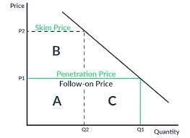
New Product Pricing Strategies (1 of 2)
D-
setting prices for the first time, there are two broad strategies. market-skimming pricing and market-penetration pricing.
Market-skimming pricing (price skimming)
Setting a high price to skim maximum revenues from the segments willing to pay the high price
Company makes fewer but more profitable sales
Market-penetration pricing
Setting a low price to attract many buyers and a large market share
Notes:
Companies bringing out a new product face the challenge of setting prices for the first time. They can choose between two broad strategies. These are market-skimming pricing and market-penetration pricing.
Market-skimming pricing or price skimming refers to setting a high price for a new product to skim maximum revenues, layer by layer, from the segments willing to pay the high price. The company makes fewer but more profitable sales. This strategy works only under certain conditions. First, the product’s quality and image must support its higher price, and enough buyers must want the product at that price. Second, the costs of producing a smaller volume cannot be so high that they cancel the advantage of charging more. Finally, competitors should not be able to enter the market easily and undercut the high price.
Market-penetration pricing refers to setting a low price for a new product in order to attract a large number of buyers and a large market share. The high sales volume results in falling costs, allowing companies to cut their prices even further. Several conditions must be met for this low-price strategy to work. First, the market must be highly price sensitive so that a low price produces more market growth. Second, production and distribution costs must decrease as sales volume increases. Finally, the low price must help keep out the competition, and the penetration pricer must maintain its low-price position. Otherwise, the price advantage may be only temporary.

Slide 46
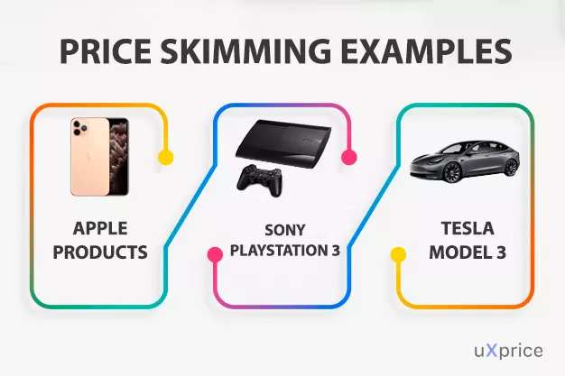
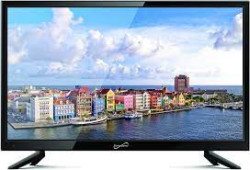
SKIMMING PRICING
D-
New Product Pricing Strategies (2 of 2)
strategy involving the use of a high price Commonly used as a market entry price for distinctive goods or services with little or no initial competition.
PENETRATION PRICING
Under this strategy, The purpose of Penetration pricing is to capture maximum market share.
it is used after skimming price reach. To a stagnant sales pattern or used from the beginning a low in order to reach a mass market immediately.

Slide 47
Activity 2
What do you see

Slide 48
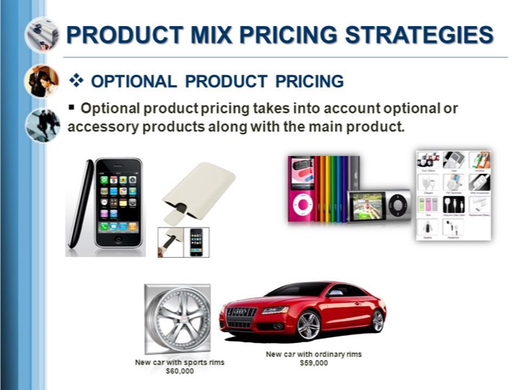







supply and demand elasticity
Value pricing
Product line pricing
Optional-product pricing
Captive-product pricing
By-product pricing
Product bundle pricing
competition based pricing example
Cost based pricing

Slide 49
Price Adjustment Strategies
E-
 | Strategy | Description
1 | Discount and allowance pricing | Reducing prices to reward customer responses such as volume purchases, paying early, or promoting the product
2 | Segmented pricing | Adjusting prices to allow for differences in customers, products, or locations
3 | Psychological pricing | Adjusting prices for psychological effect
4 | Promotional pricing | Temporarily reducing prices to spur short-run sales
5 | Dynamic pricing | Adjusting prices continually to meet the characteristics and needs of individual customers and situations
6 | International pricing | Adjusting prices for international markets
Notes:
Each of these strategies are discussed in greater detail in the following slides.

Slide 50


Discount and Allowance Pricing strategy:
Most companies adjust their basic price to reward customers for certain responses, such as paying bills early, volume purchases, and off-season buying.
Price Adjustment Strategies (1 of 6)
Discount—a straight reduction in price on purchases during a stated period of time or of larger quantities as Cash, quantity, functional, and seasonal discounts
Allowance—Promotional allowances are payments or price reductions that reward to customers, For example, price reductions given for turning in an old item when buying a new one.
Notes:
Most companies adjust their basic price to reward customers for certain responses, such as paying bills early, volume purchases, and off-season buying. These price adjustments—called discounts and allowances—can take many forms.
A discount is a straight reduction in price on purchases during a stated period of time or of larger quantities. One form of discount is a cash discount, a price reduction to buyers who pay their bills promptly. A quantity discount is a price reduction to buyers who buy large volumes. A seller offers a functional discount, also called a trade discount, to trade-channel members who perform certain functions, such as selling, storing, and record keeping. A seasonal discount is a price reduction to buyers who buy merchandise or services out of season.
An allowance is promotional money paid by manufacturers to retailers in return for an agreement to feature the manufacturer’s products in some way. For example, trade-in allowances are price reductions given for turning in an old item when buying a new one. Promotional allowances are payments or price reductions that reward dealers for participating in advertising and sales-support programs.

Slide 51
Segmented Pricing, the company sells a product or service at two or more prices, even though the difference in prices is not based on differences in costs. Segmented pricing takes several forms.
Price Adjustment Strategies (2 of 6 )
Forms of segmented pricing:
  Customer-segment pricing
  Product form pricing
  Location-based pricing
  Time-based pricing
Notes:
In segmented pricing, the company sells a product or service at two or more prices, even though the difference in prices is not based on differences in costs. Segmented pricing takes several forms.
With customer-segment pricing, different customers pay different prices for the same product or service. Museums and movie theaters, for example, may charge a lower admission for students and senior citizens.
With product form pricing, different versions of the product are priced differently, but not according to differences in their costs. Examples include a round-trip economy seat on a flight versus a more expensive business class seat and different prices for seats in a theater based on their location.
Location-based pricing involves a company charging different prices for different locations, even though the cost of offering each location is the same.
Time-based pricing occurs when a firm varies its price by the season, the month, the day, and even the hour. For example, movie theaters charge matinee pricing during the daytime, and resorts give weekend and seasonal discounts.
For segmented pricing to be an effective strategy, certain conditions must exist. The market must be able to be segmented, and segments must show different degrees of demand. The costs of segmenting and reaching the market cannot exceed the extra revenue obtained from the price difference. Segmented pricing should also be legal.

Slide 52

Psychological Pricing
Considers the psychology of prices and not the economics.
Price Adjustment Strategies (3 of 6)
  instead of pricing a product at $ 1020, you discount it and price it at $ 999. This 21 $ reduction will give much more turnover because people will judge the product being priced at 900 $ and not 1000 $.
Notes:
Psychological pricing refers to pricing that considers the psychology of prices and not simply the economics. The price is used to say something about the product.
Another aspect of psychological pricing is reference prices, which are the prices that buyers carry in their minds and refer to when looking at a given product. The reference price might be formed by noting current prices, remembering past prices, or assessing the buying situation. Sellers can influence or use these consumers’ reference prices when setting price.
Odd-Even pricing technique prices products at an odd number which is slightly less that a rounded off even number.
instead of pricing a product at $ 1020, you discount it and price it at $ 999. This 21 $ reduction will give much more turnover because people will judge the product being priced at 900 $ and not 1000 $.

Slide 53


Promotional Pricing,
Temporarily pricing products below the list price to increase short-run sales
Price Adjustment Strategies (4 of 6)
Forms of promotional pricing:
  Buy one, get one free BOGOF. Consumers are offered a second item for free when they purchase the first one.
  Discounting This when the price of a product or service is lowered
  Seasonal sales This is a strategy that lowers prices for a certain time of the year.
  flash sales last at least a day, and frequently for more than that, are over much quicker
Notes:
With promotional pricing, companies will temporarily price their products below list price to create buying excitement and urgency. Promotional pricing takes several forms. A seller may simply offer discounts from normal prices to increase sales and reduce inventories. Sellers also use special-event pricing in certain seasons to draw more customers. Limited-time offers, such as online flash sales, can create buying urgency and make buyers feel lucky to have gotten in on the deal. Manufacturers sometimes offer cash rebates to consumers who buy the product from dealers within a specified time. Some manufacturers offer low-interest financing, longer warranties, or free maintenance to reduce the consumer’s price.
Promotional pricing, however, can have adverse effects. Used too frequently, price promotions can create “deal-prone” customers who wait until brands go on sale before buying them. In addition, constantly reduced prices can erode a brand’s value in the eyes of customers. Marketers sometimes become addicted to promotional pricing, especially in tight economic times. They use price promotions as a quick fix instead of sweating through the difficult process of developing effective longer-term strategies for building their brands.
promotional pricing is when companies have a sale concept when they changed prices
Buy one, get one free BOGOF. Consumers are offered a second item for free when they purchase the first one.
Discounting This when the price of a product or service is lowered
Seasonal sales This is a strategy that lowers prices for a certain time of the year.
flash sales last at least a day, and frequently for more than that, are over much quicker. Reduced prices for only 2-3 hours are common. Flash sales can create a great sense of urgency.

Slide 54
Dynamic Pricing,
Refers to adjusting prices continually to meet the characteristics and needs of individual customers and situation and It is especially prevalent online
Price Adjustment Strategies (5 of 6)
The Dynamic Pricing, goes both ways, and consumers often benefit from online and dynamic pricing. Thanks to the Internet, consumers can get instant product and price comparisons from thousands of vendors at price comparison sites.
Notes:
Dynamic pricing refers to adjusting prices continually to meet the characteristics and needs of individual customers and situations. It is especially prevalent online, where the Internet seems to be taking us back to a new age of fluid pricing. Such pricing offers many advantages for marketers. These days, online offers and prices might well be based on what specific customers search for and buy, how much they pay for other purchases, and whether they might be willing and able to spend more.
Dynamic pricing is legal as long as companies do not discriminate based on age, gender, location, or other similar characteristics. The practice of online pricing, however, goes both ways, and consumers often benefit from online and dynamic pricing. Thanks to the Internet, consumers can get instant product and price comparisons from thousands of vendors at price comparison sites. For example, the RedLaser mobile app lets customers scan barcodes or QR codes while shopping in stores. It then searches online and at nearby stores to provide thousands of reviews and comparison prices.

Slide 55


International Pricing,
Companies that market their products internationally must decide what prices to charge in different countries.
Price Adjustment Strategies (6 of 6 )
Price strategies of international companies
  Set a uniform worldwide price
  Adjust prices to reflect local market conditions and cost considerations
Prices charged depend on many factors
  Economic conditions
  Competitive situations
  Laws and regulations
  Nature of the wholesaling and retailing system
  Consumer perceptions and preferences
  Company’s marketing objectives
  Costs of selling in another country
many companies are shifting their sights to include a new target—the so-called “bottom of the pyramid,” the vast untapped market consisting of the world’s poorest consumers.
Notes:
Companies that market their products internationally must decide what prices to charge in different countries. In some cases, a company can set a uniform worldwide price. The price that a company should charge in a specific country depends on many factors, including economic conditions, competitive situations, laws and regulations, and the nature of the wholesaling and retailing system. Consumer perceptions and preferences also may vary from country to country, calling for different prices. Or the company may have different marketing objectives in various world markets, which require changes in pricing strategy. Costs play an important role in setting international prices. Travelers abroad are often surprised to find that goods that are relatively inexpensive at home may carry outrageously higher price tags in other countries.
Price has become a key element in the international marketing strategies of companies attempting to enter emerging markets. Typically, entering such markets has meant targeting the exploding middle classes in developing countries. As the weakened global economy has slowed growth in both domestic and emerging markets, many companies are shifting their sights to include a new target—the so-called “bottom of the pyramid,” the vast untapped market consisting of the world’s poorest consumers.

Slide 56

extra

Slide 57

Initiating Price Changes
Reasons for price cuts:
  Excess capacity
  Falling demand
  Attempt to dominate the market
Reasons for price increases:
  Cost inflation
  Over-demand
Notes:
Several situations may lead a firm to consider cutting its price. One such circumstance is excess capacity. Another is falling demand in the face of strong price competition or a weakened economy. A company may also cut prices in a drive to dominate the market through lower costs. Either the company starts with lower costs than its competitors, or it cuts prices in the hope of gaining market share that will further cut costs through larger volume.
A successful price increase can greatly improve profits. A major factor in price increases is cost inflation. Rising costs squeeze profit margins and lead companies to pass cost increases along to customers. Another factor leading to price increases is over-demand, however, when raising prices, the company must avoid being perceived as a price gouger.

Slide 58
Activity 3
How to respond from your marketing understanding to the price change

Slide 59

Responding to Competitor Price Changes
Notes:
This figure shows the ways a company might assess and respond to a competitor’s price cut.
If a company learns that a competitor’s price cut that is likely to harm company sales and profits, it might make any of the following four responses:
Reduce its price to match the competitor’s price.
Maintain its price but raise the perceived value of its offer.
Improve quality and increase price, moving its brand into a higher price–value position.
Launch a low-price fighter brand—adding a lower-price item to the line or creating a separate lower-price brand.

Slide 60
Responding to Competitor Price Changes
Notes:
This figure shows the ways a company might assess and respond to a competitor’s price cut.
If a company learns that a competitor’s price cut that is likely to harm company sales and profits, it might make any of the following four responses:
Reduce its price to match the competitor’s price.
Maintain its price but raise the perceived value of its offer.
Improve quality and increase price, moving its brand into a higher price–value position.
Launch a low-price fighter brand—adding a lower-price item to the line or creating a separate lower-price brand.

Slide 61
Activity 4
Case study

Slide 62


Starbucks 2008 economic challenges
2008 financial crunch economic downturn in US.
consumers have lost jobs and lost value in their homes.
Starbucks struggled to attract and retain customers who followed claims of low-cost competitors
Starbucks quarterly profit fell 77%
McDonald's Corp was the best winner
Through Market research Starbucks got complains from consumers about bad aftertaste
2009 Starbucks launch Ads 2009 Starbucks launch Ads Without specifically mentioning rivals like McDonald's Corp that
Urge Consumers Not to Switch to Cheaper Coffee ” to reassert the quality of their product and reassure consumers that it was worth the extra cost.
Starbucks consumers not to trade down to less expensive coffee.
"Beware of a cheaper cup of coffee. It comes with a price."
Another says, "Starbucks or nothing. Because compromise leaves a really bad aftertaste. https://www.wsj.com/articles/SB124112408062074463

Slide 63
International Pricing
Price decisions of international companies
Set a uniform worldwide price
Adjust prices to reflect local market conditions and cost considerations
Prices charged depend on many factors
Economic conditions
Competitive situations
Laws and regulations
Nature of the wholesaling and retailing system
Consumer perceptions and preferences
Company’s marketing objectives
Costs of selling in another country
Notes:
Companies that market their products internationally must decide what prices to charge in different countries. In some cases, a company can set a uniform worldwide price. The price that a company should charge in a specific country depends on many factors, including economic conditions, competitive situations, laws and regulations, and the nature of the wholesaling and retailing system. Consumer perceptions and preferences also may vary from country to country, calling for different prices. Or the company may have different marketing objectives in various world markets, which require changes in pricing strategy. Costs play an important role in setting international prices. Travelers abroad are often surprised to find that goods that are relatively inexpensive at home may carry outrageously higher price tags in other countries.
Price has become a key element in the international marketing strategies of companies attempting to enter emerging markets. Typically, entering such markets has meant targeting the exploding middle classes in developing countries. As the weakened global economy has slowed growth in both domestic and emerging markets, many companies are shifting their sights to include a new target—the so-called “bottom of the pyramid,” the vast untapped market consisting of the world’s poorest consumers.

Slide 64
Initiating Price Changes
Reasons for price cuts:
  Excess capacity
  Falling demand
  Attempt to dominate the market
Reasons for price increases:
  Cost inflation
  Over-demand
Notes:
Several situations may lead a firm to consider cutting its price. One such circumstance is excess capacity. Another is falling demand in the face of strong price competition or a weakened economy. A company may also cut prices in a drive to dominate the market through lower costs. Either the company starts with lower costs than its competitors, or it cuts prices in the hope of gaining market share that will further cut costs through larger volume.
A successful price increase can greatly improve profits. A major factor in price increases is cost inflation. Rising costs squeeze profit margins and lead companies to pass cost increases along to customers. Another factor leading to price increases is over-demand, however, when raising prices, the company must avoid being perceived as a price gouger.

Slide 65
Reactions to Price Changes
Buyer’s perspective
Price increase:
  Product is more exclusive or better made.
  Company is being greedy.
Price cut:
  Brand wants to get a better deal on an exclusive product.
  Product’s quality has been reduced.
  Company’s image has tarnished.
Competitor’s perspective
Price cut:
  Company is trying to grab a larger market share.
  Company is doing poorly and trying to boost its sales.
  Company wants the whole industry to cut prices to increase total demand.
Notes:
Customers do not always interpret price changes in a straightforward way. A price increase, which would normally lower sales, may have some positive meanings for buyers. For example, what would you think if Rolex raised the price of its latest watch model? On the one hand, you might think that the watch is even more exclusive or better made. On the other hand, you might think that Rolex is simply being greedy by charging what the traffic will bear.
Similarly, consumers may view a price cut in several ways. For example, what would you think if Rolex were to suddenly cut its prices? You might think that you are getting a better deal on an exclusive product. More likely, however, you’d think that quality had been reduced, and the brand’s luxury image might be tarnished.
A firm considering a price change must worry about the reactions of its competitors as well as those of its customers. The competitor can interpret a company price cut in many ways. It might think the company is trying to grab a larger market share or that it’s doing poorly and trying to boost its sales. Or it might think that the company wants the whole industry to cut prices to increase total demand.

Slide 66

Public Policy Issues in Pricing
Notes:
This figure shows the major public policy issues in pricing. These include potentially damaging pricing practices within a given level of the channel (price-fixing and predatory pricing) and across levels of the channel (retail price maintenance, discriminatory pricing, and deceptive pricing).
For pricing within channel levels, federal legislation on price-fixing states that sellers must set prices without talking to competitors. Price-fixing is illegal, and the companies found guilty of these practices can receive heavy fines. Sellers are also prohibited from using predatory pricing. Predatory pricing means selling below cost with the intention of punishing a competitor or gaining higher long-run profits by putting competitors out of business. This protects small sellers from larger ones that might sell items below cost temporarily or in a specific locale to drive them out of business.
For pricing across channel levels, the Robinson-Patman Act seeks to prevent unfair price discrimination by ensuring that sellers offer the same price terms to customers at a given level of trade. Laws also prohibit retail or resale price maintenance, that is, a manufacturer cannot require dealers to charge a specified retail price for its product. Deceptive pricing occurs when a seller states prices or price savings that mislead consumers or are not actually available to consumers. This might involve bogus reference or comparison prices, as when a retailer sets artificially high regular prices and then announces “sale” prices close to its previous everyday prices.

Slide 67


