Slide 1
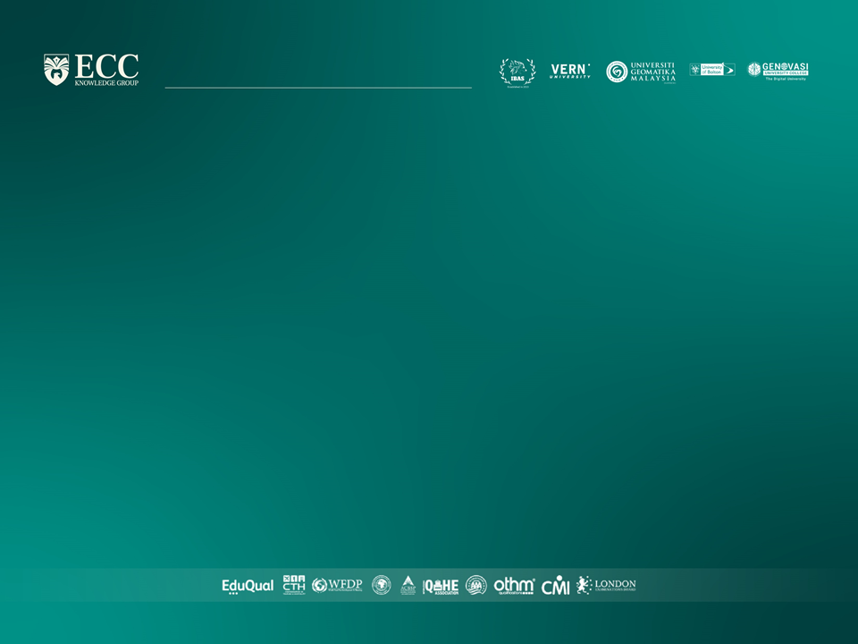
Strategic Marketing
Lecture 9

Slide 2


Strategic marketing
Lecture # 9
مساء الخير وأتمنى أن يكون الجميع بخير
سنبدأ الساعة 6:15مساء بتوقيت القاهرة
مع خالص الشكر
د. علي يحيى

Slide 3

Quick recap on previous lecture

Slide 5
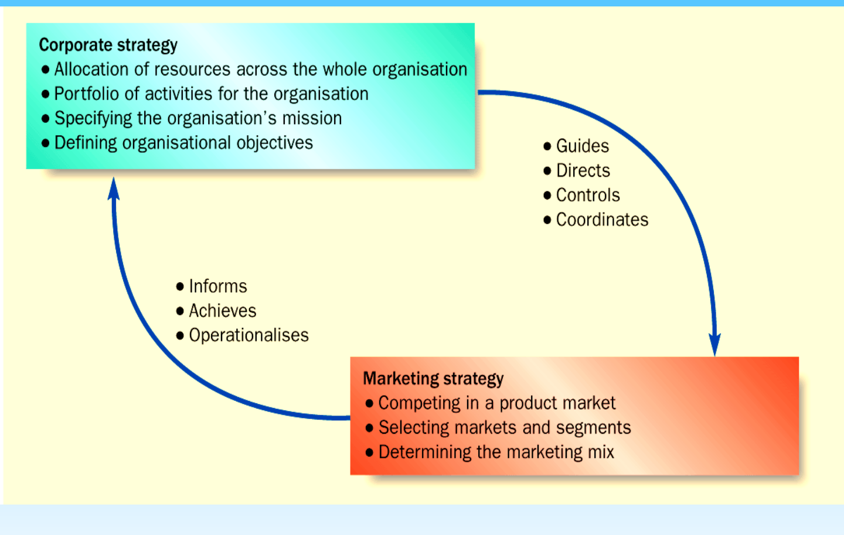
Interaction between marketing and corporate strategy
Notes:
Allocation of resources
within an organisation to
achieve the business
direction and scope
specified within
corporate objectives.
• Helps to control and
co-ordinate the different
areas of the
organisation

Slide 6
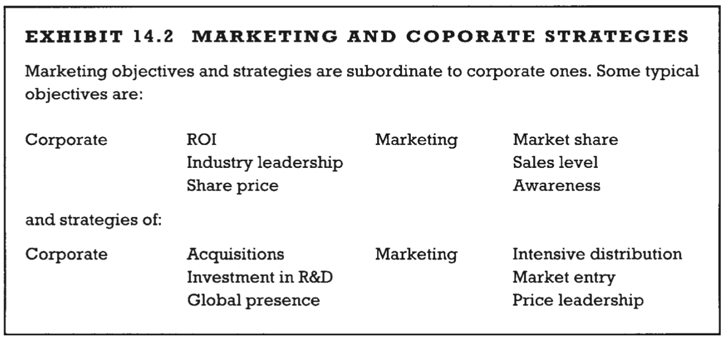
Marketing and corporate strategies examples
Proctor, T., 2014, Strategic Marketing: An Introduction, Routledge

Slide 7
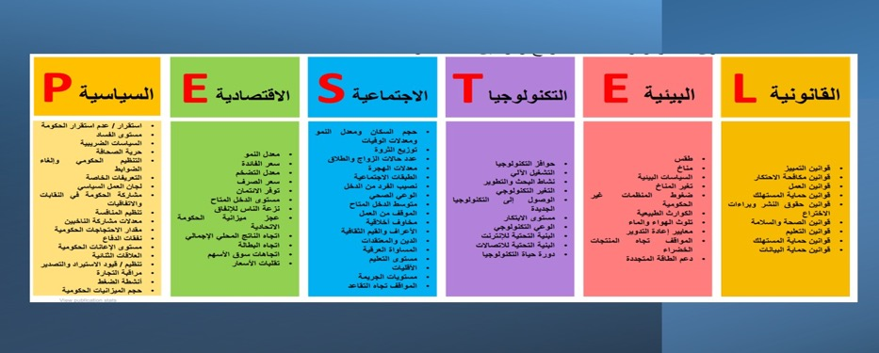

Slide 13
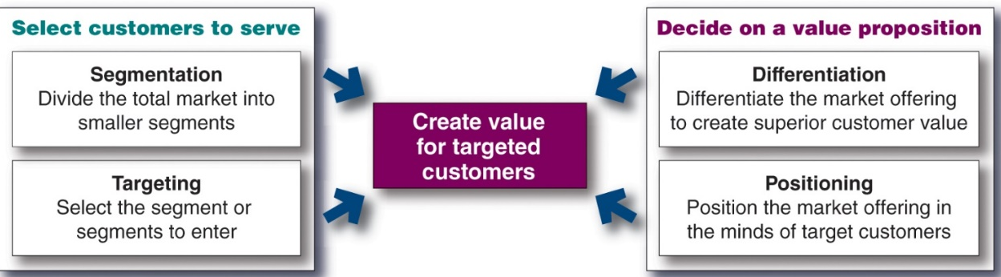
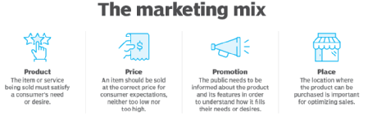
S.T.P.
(Where to play ) Which customers will we serve ? (segmentation and targeting)
(How to win ) how will we create value for them?
(differentiation and positioning)
Which products and services levels ?
Which price ,?
how to distribute?
How to Communicate with customers ?
Marketing Mix

Slide 14
Notes:
Market segmentation reveals the firm’s market segment opportunities. The firm has to evaluate the various segments and decide how many and which segments it can serve best. In evaluating different market segments, a firm must look at three factors.
First, a company wants to select segments that have the right size and growth characteristics.
Second, the company needs to examine major structural factors that affect long-run segment attractiveness like strong and aggressive competitors or if it is easy for new entrants to come into the segment. The existence of actual or potential substitute products, the relative power of buyers, and powerful suppliers also affects segment attractiveness.
Finally, the company must consider its own objectives and resources. Some attractive segments can be dismissed quickly because they do not mesh with the company’s long-run objectives. Or, the company may lack the skills and resources needed to succeed in an attractive segment.
After evaluating different segments, the company must decide which and how many segments it will target. A target market consists of a set of buyers who share common needs or characteristics that the company decides to serve. Market targeting can be carried out at several different levels.
Companies need to consider many factors when choosing a market-targeting strategy. Which strategy is best depending on the company’s resources. When the firm’s resources are limited, concentrated marketing makes the most sense. The best strategy also depends on the degree of product variability. The product’s life-cycle stage also must be considered. When a firm introduces a new product, it may be practical to launch one version only, and undifferentiated marketing or concentrated marketing may make the most sense. In the mature stage of the product life cycle, however, differentiated marketing can be useful.
Another factor is market variability. If most buyers have the same tastes, buy the same amounts, and react the same way to marketing efforts, undifferentiated marketing is appropriate. Finally, competitors’ marketing strategies are important. When competitors use differentiated or concentrated marketing, undifferentiated marketing can be suicidal.
choice of segment(s)
Five factors govern the attractiveness of a segment (Doyle, 1994):
segment size • current and potential competition
segment growth • capabilities of the business.
profitability of the segment

Slide 15
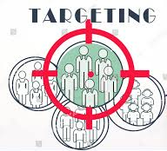
Notes:
Market segmentation reveals the firm’s market segment opportunities. The firm has to evaluate the various segments and decide how many and which segments it can serve best. In evaluating different market segments, a firm must look at three factors.
First, a company wants to select segments that have the right size and growth characteristics.
Second, the company needs to examine major structural factors that affect long-run segment attractiveness like strong and aggressive competitors or if it is easy for new entrants to come into the segment. The existence of actual or potential substitute products, the relative power of buyers, and powerful suppliers also affects segment attractiveness.
Finally, the company must consider its own objectives and resources. Some attractive segments can be dismissed quickly because they do not mesh with the company’s long-run objectives. Or, the company may lack the skills and resources needed to succeed in an attractive segment.
After evaluating different segments, the company must decide which and how many segments it will target. A target market consists of a set of buyers who share common needs or characteristics that the company decides to serve. Market targeting can be carried out at several different levels.
Companies need to consider many factors when choosing a market-targeting strategy. Which strategy is best depending on the company’s resources. When the firm’s resources are limited, concentrated marketing makes the most sense. The best strategy also depends on the degree of product variability. The product’s life-cycle stage also must be considered. When a firm introduces a new product, it may be practical to launch one version only, and undifferentiated marketing or concentrated marketing may make the most sense. In the mature stage of the product life cycle, however, differentiated marketing can be useful.
Another factor is market variability. If most buyers have the same tastes, buy the same amounts, and react the same way to marketing efforts, undifferentiated marketing is appropriate. Finally, competitors’ marketing strategies are important. When competitors use differentiated or concentrated marketing, undifferentiated marketing can be suicidal.
choice of segment(s)
Five factors govern the attractiveness of a segment (Doyle, 1994):
segment size • current and potential competition
segment growth • capabilities of the business.
profitability of the segment

Slide 16
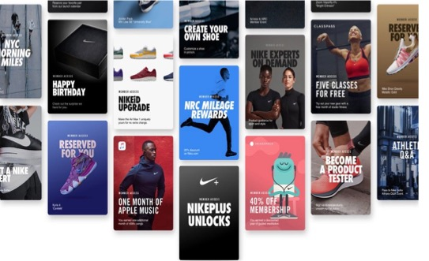
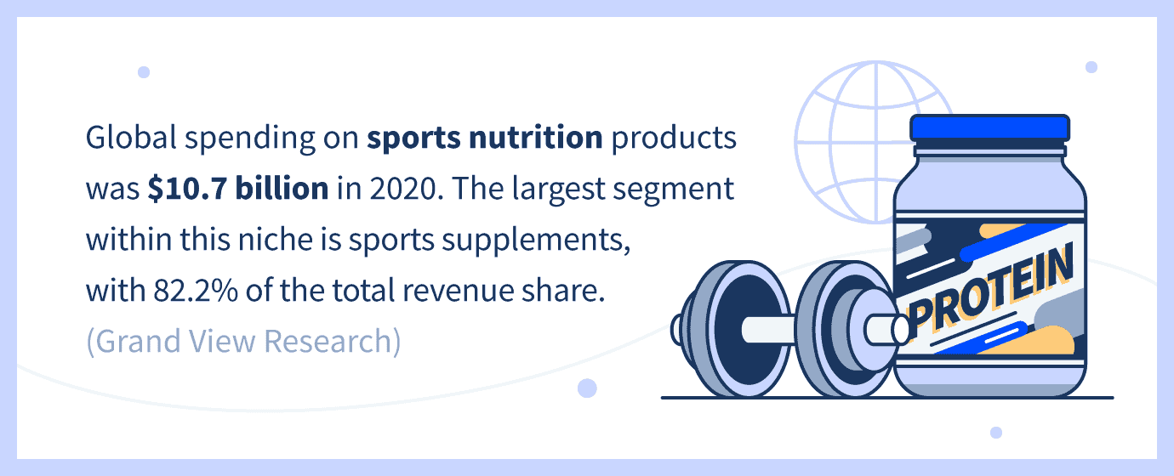
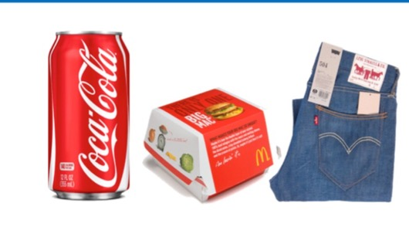

Notes:
Market segmentation reveals the firm’s market segment opportunities. The firm has to evaluate the various segments and decide how many and which segments it can serve best. In evaluating different market segments, a firm must look at three factors.
First, a company wants to select segments that have the right size and growth characteristics.
Second, the company needs to examine major structural factors that affect long-run segment attractiveness like strong and aggressive competitors or if it is easy for new entrants to come into the segment. The existence of actual or potential substitute products, the relative power of buyers, and powerful suppliers also affects segment attractiveness.
Finally, the company must consider its own objectives and resources. Some attractive segments can be dismissed quickly because they do not mesh with the company’s long-run objectives. Or, the company may lack the skills and resources needed to succeed in an attractive segment.
After evaluating different segments, the company must decide which and how many segments it will target. A target market consists of a set of buyers who share common needs or characteristics that the company decides to serve. Market targeting can be carried out at several different levels.
Companies need to consider many factors when choosing a market-targeting strategy. Which strategy is best depending on the company’s resources. When the firm’s resources are limited, concentrated marketing makes the most sense. The best strategy also depends on the degree of product variability. The product’s life-cycle stage also must be considered. When a firm introduces a new product, it may be practical to launch one version only, and undifferentiated marketing or concentrated marketing may make the most sense. In the mature stage of the product life cycle, however, differentiated marketing can be useful.
Another factor is market variability. If most buyers have the same tastes, buy the same amounts, and react the same way to marketing efforts, undifferentiated marketing is appropriate. Finally, competitors’ marketing strategies are important. When competitors use differentiated or concentrated marketing, undifferentiated marketing can be suicidal.
choice of segment(s)
Five factors govern the attractiveness of a segment (Doyle, 1994):
segment size • current and potential competition
segment growth • capabilities of the business.
profitability of the segment

Slide 17
Notes:
Market segmentation reveals the firm’s market segment opportunities. The firm has to evaluate the various segments and decide how many and which segments it can serve best. In evaluating different market segments, a firm must look at three factors.
First, a company wants to select segments that have the right size and growth characteristics.
Second, the company needs to examine major structural factors that affect long-run segment attractiveness like strong and aggressive competitors or if it is easy for new entrants to come into the segment. The existence of actual or potential substitute products, the relative power of buyers, and powerful suppliers also affects segment attractiveness.
Finally, the company must consider its own objectives and resources. Some attractive segments can be dismissed quickly because they do not mesh with the company’s long-run objectives. Or, the company may lack the skills and resources needed to succeed in an attractive segment.
After evaluating different segments, the company must decide which and how many segments it will target. A target market consists of a set of buyers who share common needs or characteristics that the company decides to serve. Market targeting can be carried out at several different levels.
Companies need to consider many factors when choosing a market-targeting strategy. Which strategy is best depending on the company’s resources. When the firm’s resources are limited, concentrated marketing makes the most sense. The best strategy also depends on the degree of product variability. The product’s life-cycle stage also must be considered. When a firm introduces a new product, it may be practical to launch one version only, and undifferentiated marketing or concentrated marketing may make the most sense. In the mature stage of the product life cycle, however, differentiated marketing can be useful.
Another factor is market variability. If most buyers have the same tastes, buy the same amounts, and react the same way to marketing efforts, undifferentiated marketing is appropriate. Finally, competitors’ marketing strategies are important. When competitors use differentiated or concentrated marketing, undifferentiated marketing can be suicidal.
choice of segment(s)
Five factors govern the attractiveness of a segment (Doyle, 1994):
segment size • current and potential competition
segment growth • capabilities of the business.
profitability of the segment

Slide 18
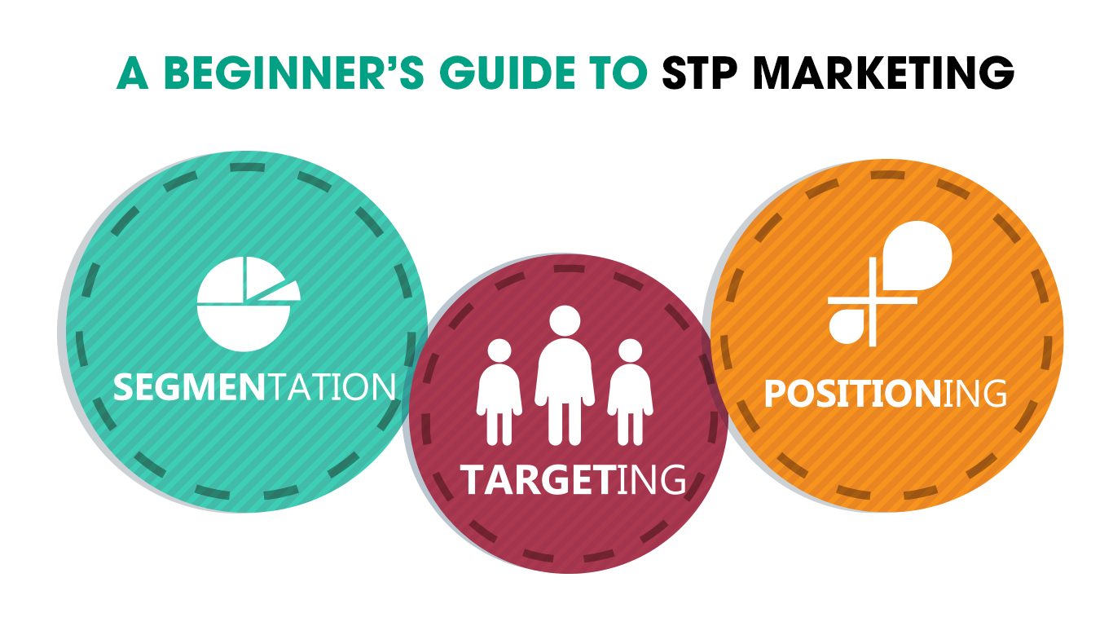
Differentiation
Branding
Branding

Slide 19
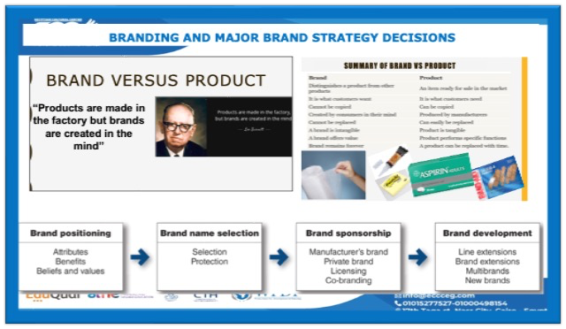
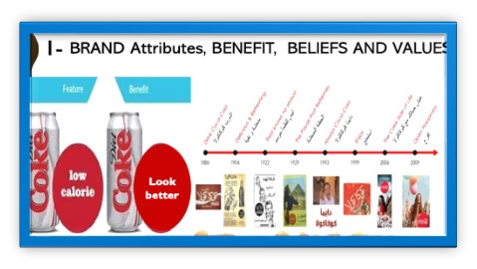
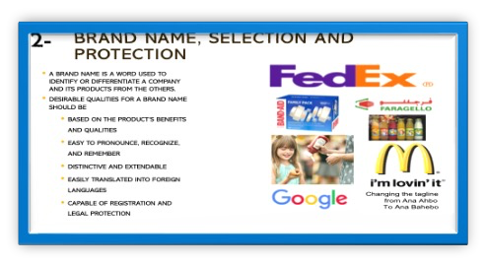
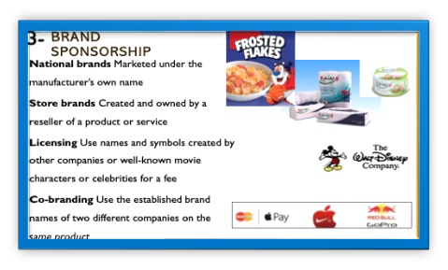
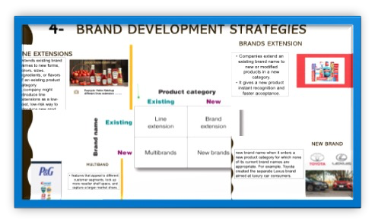

Slide 20
S.T.P.
(Where to play ) Which customers will we serve ? (segmentation and targeting)
(How to win ) how will we create value for them?
(differentiation and positioning)
Which products and services levels ?
Which price ,?
how to distribute?
How to Communicate with customers ?
Marketing Mix

Slide 21
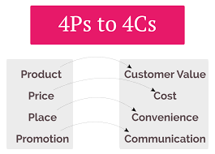
Constructing an Integrated Marketing Mix
Customer value is buying value added and solutions to problems
Customer cost, total costs of obtaining, using, and disposing of a product
Customer Convenience, Customer will make purchases depending on where, when, and how it is Convenient for them
Customer want two-way and regular communication also relationships with businesses
Notes:
After deciding on its overall marketing strategy, the company is ready to begin planning the details of the marketing mix, one of the major concepts in modern marketing
The marketing mix consists of everything the firm can do to influence the demand for its product
The many possibilities can be collected into four groups of variables known as the four Ps: product, price, place, and promotion.
Product means the goods-and-services combination the company offers to the target market
Price is the amount of money customers must pay to obtain the product
Place includes company activities that make the product available to target customers
Promotion means activities that communicate the merits of the product and persuade target customers to buy it
However, some critics think that the four Ps may omit or underemphasize certain important activities
The four Ps concept takes the seller's view of the market, not the buyer's view
From the buyer's viewpoint, in this age of customer value and relationships, the four Ps might be better described as the four Cs
Marketers would do well to think through the four Cs first and then build the four Ps on that platform

Slide 22
1st P- Product

Slide 23
2nd P-Price
C
Factors affecting Pricing Strategies
A
MAJOR PRICING STRATEGIES:
Cost-based pricing.
customer value–based pricing.
competition-based pricing
D
New Product Pricing Strategies
E
PRICE ADJUSTMENT STRATEGIES
Discount and allowance pricing
Segmented pricing
Psychological pricing
Promotional pricing
Dynamic pricing
International pricing
B
PRODUCT MIX PRICING STRATEGIES
Product line pricing
Optional-product pricing
Captive-product pricing
By-product pricing
Product bundle pricing
Other pricing strategies Decoy, Popcorn Pricing strategy
Initiating Price Changes
Responding to Competitor Price Changes

Slide 24
3rd P-Place (distribution /marketing channels)

Slide 25

Group support

Slide 26
Strategic Marketing Assignment
You have been accepted onto a (FLDP) within a Large organization. The sole representative from the Marketing Department.
The company is currently successful but is going through a period of intense change. There are new competitors entering the market, whilst new technologies are changing both production capabilities and consumer preferences.
Task 1
prepare a presentation with accompanying notes.The content of the presentation and notes should:
• Analyse the relationship between corporate and marketing strategies
• Explain how marketing strategies can contribute to competitive advantage
Extension activities
your presentation you should also evaluate the relationship between strategic intent, strategic assessment, strategic choice and their impact on the
formulation of marketing strategy.
Task 2
prepare a handout to be used by future participants in the
FLDP. on Strategic Marketing; Your contribution to the handout should:
• Evaluate the role of marketing research and its relationship to consumer behavior (include the different types of consumers, their behavior in B2B and B2C markets and factors underpinning customer loyalty)
• Evaluate the role of relationship marketing in customer behavior analysis
Extension activities
you must also analyze the influences on, and the psychology of, consumer behavior.
Task 3
You are required to develop a
realistic and workable marketing plan and strategy for a named organization. The choice of organization is important to ensure successful completion of this task.
For the selected and named organisation you must:
• Analyze the key considerations in creating a marketing strategy
• Explain how the marketing strategy should address competitive forces
• Develop a strategic marketing plan for your named organization using an appropriate
format (include KPIs that will support monitoring)
• Develop a risk register and associated contingency plans
Notes:
Future Leaders Development Programme

Slide 27


Slide 28


