Slide 1

Strategic Marketing
Lecture 10

Slide 2


Strategic marketing
Lecture # 10
مساء الخير وأتمنى أن يكون الجميع بخير
سنبدأ الساعة 6:30مساء بتوقيت القاهرة
مع خالص الشكر
د. علي يحيى

Slide 3

Quick recap on previous lecture

Slide 5
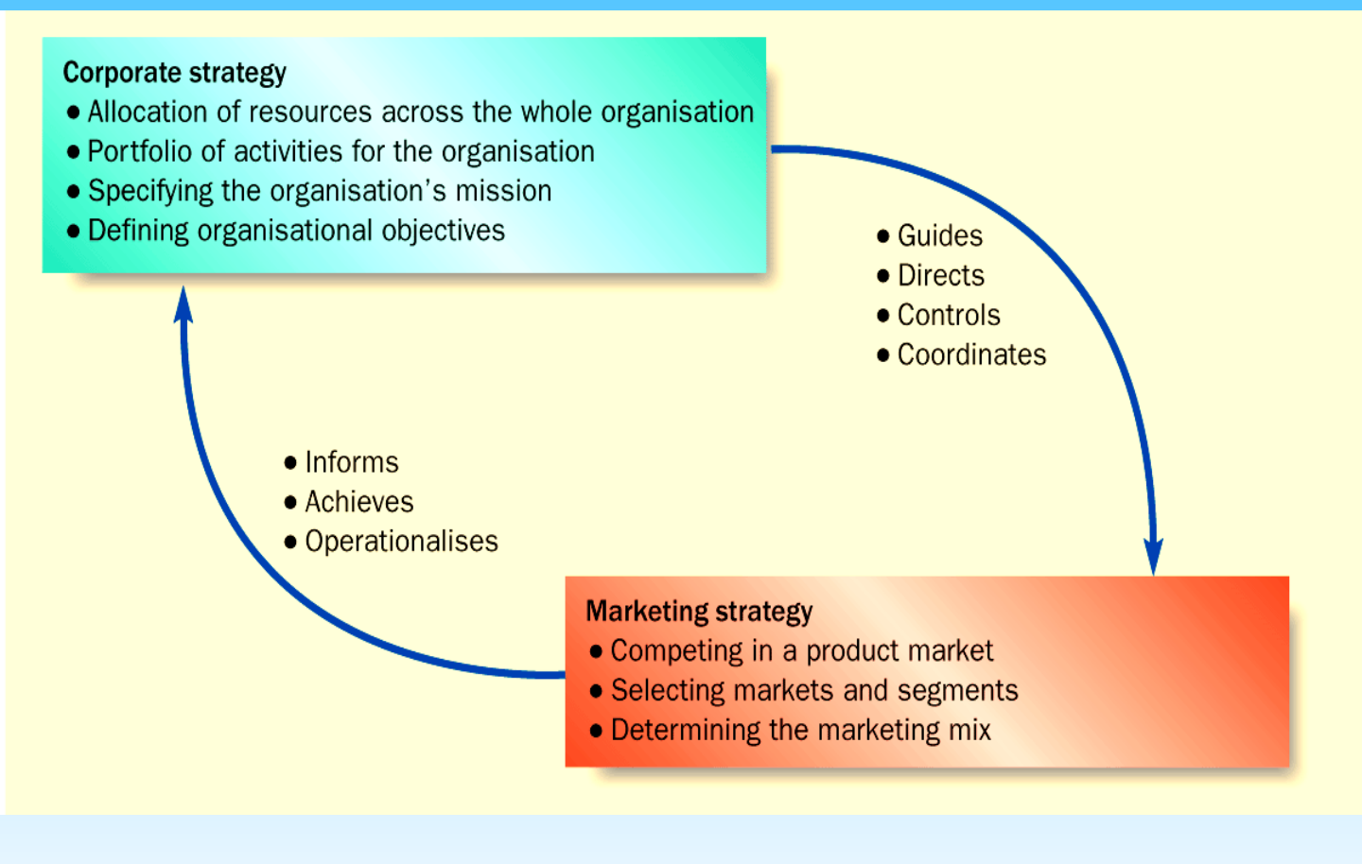
Interaction between marketing and corporate strategy
Notes:
Allocation of resources
within an organisation to
achieve the business
direction and scope
specified within
corporate objectives.
• Helps to control and
co-ordinate the different
areas of the
organisation

Slide 6
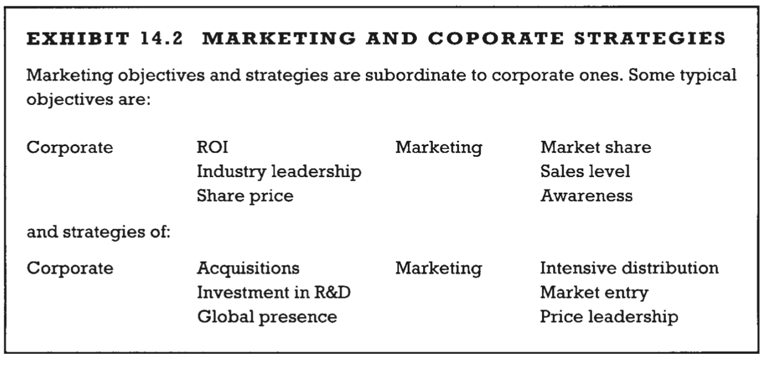
Marketing and corporate strategies examples
Proctor, T., 2014, Strategic Marketing: An Introduction, Routledge

Slide 7
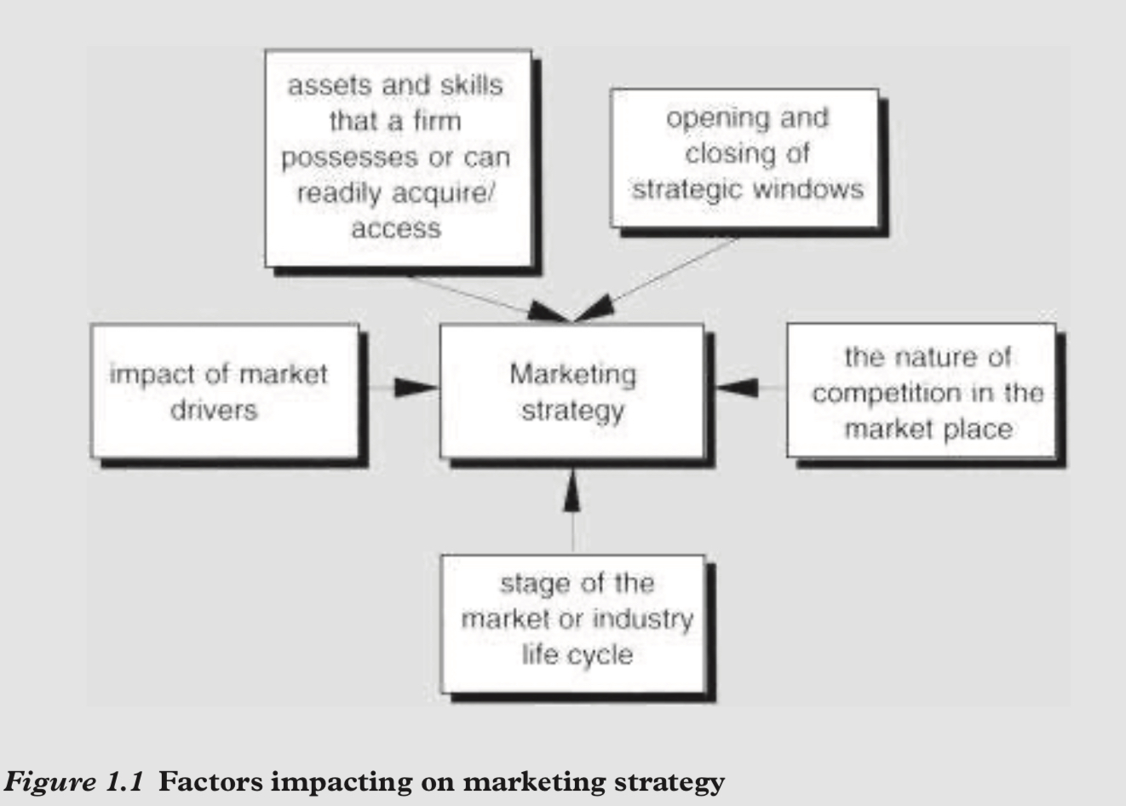
PROCESS FOR FORMULATING A COMPETITIVE STRATEGY
The process consists of three steps:
Factors impacting on marketing strategy
Where are we now? What is the business doing now, Identification: What is current strategy? Assumptions: What assumptions about the company’s relative position, strengths and weaknesses, competitors and industry trends must be made for the current strategy to be viable?
What is happening in the environment? Industry analysis: What are the key factors influencing competitive success? What are the important industry opportunities and threats? Competitor analysis: What are the capabilities and limitations of existing and potential competitors, and what are their probable future moves? Societal analysis: What important government, social and political factors will present opportunities or threats?, what are the firm’s strengths and weaknesses relative to present and future competition?
What should the business be doing? Tests of assumptions and strategy: How do the assumptions embodied in the current strategy compare with the analysis indicated above? How does the strategy meet the tests indicated above? Strategic alternatives: What are the strategic alternatives given the analysis above? (Is the current strategy one of these?) Strategic choice: Which alternative best relates the company’s situation to external opportunities and threats?
Proctor, T., 2014, Strategic Marketing: An Introduction, Routledge, page 2
Proctor, T., 2014, Strategic Marketing: An Introduction, Routledge, page 14
Notes:
at the heart of marketing strategy, which has to take into account the following factors:
1 the opening and closing of strategic windows
2 the impact of market drivers
3 the natureofcompetitioninthemarketplace
4 thestageofthemarketorindustrylifecycle.
5 theassetsandskillsthatafirmpossessesorcanreadilyacquire/access.
Cognisance of all five of these factors is essential if effective long-term marketing strategies are to be evolved which will lead to a firm securing a strategic competitive advantage in industries or product markets. We will introduce these various ideas below.

Slide 9


Slide 14
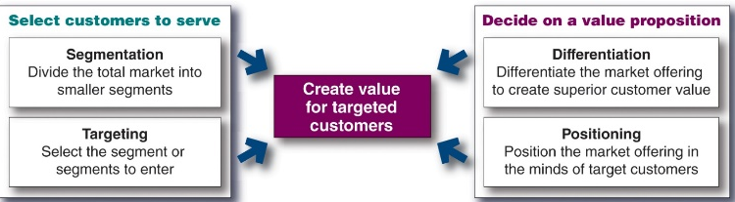

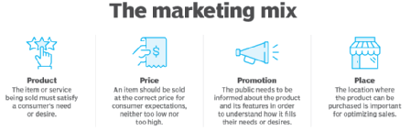
Corporate strategic planning
Marketing strategies formulation
S.T.P+D.&B.
(Where to play ) Which customers will we serve ? (segmentation and targeting)
(How to win ) how will we create value for them?
(differentiation and positioning)
Which products and services levels ?
Which price ,?
how to distribute?
How to Communicate with customers ?
Marketing Mix

Slide 15
Notes:
Market segmentation reveals the firm’s market segment opportunities. The firm has to evaluate the various segments and decide how many and which segments it can serve best. In evaluating different market segments, a firm must look at three factors.
First, a company wants to select segments that have the right size and growth characteristics.
Second, the company needs to examine major structural factors that affect long-run segment attractiveness like strong and aggressive competitors or if it is easy for new entrants to come into the segment. The existence of actual or potential substitute products, the relative power of buyers, and powerful suppliers also affects segment attractiveness.
Finally, the company must consider its own objectives and resources. Some attractive segments can be dismissed quickly because they do not mesh with the company’s long-run objectives. Or, the company may lack the skills and resources needed to succeed in an attractive segment.
After evaluating different segments, the company must decide which and how many segments it will target. A target market consists of a set of buyers who share common needs or characteristics that the company decides to serve. Market targeting can be carried out at several different levels.
Companies need to consider many factors when choosing a market-targeting strategy. Which strategy is best depending on the company’s resources. When the firm’s resources are limited, concentrated marketing makes the most sense. The best strategy also depends on the degree of product variability. The product’s life-cycle stage also must be considered. When a firm introduces a new product, it may be practical to launch one version only, and undifferentiated marketing or concentrated marketing may make the most sense. In the mature stage of the product life cycle, however, differentiated marketing can be useful.
Another factor is market variability. If most buyers have the same tastes, buy the same amounts, and react the same way to marketing efforts, undifferentiated marketing is appropriate. Finally, competitors’ marketing strategies are important. When competitors use differentiated or concentrated marketing, undifferentiated marketing can be suicidal.
choice of segment(s)
Five factors govern the attractiveness of a segment (Doyle, 1994):
segment size • current and potential competition
segment growth • capabilities of the business.
profitability of the segment

Slide 16
Notes:
Market segmentation reveals the firm’s market segment opportunities. The firm has to evaluate the various segments and decide how many and which segments it can serve best. In evaluating different market segments, a firm must look at three factors.
First, a company wants to select segments that have the right size and growth characteristics.
Second, the company needs to examine major structural factors that affect long-run segment attractiveness like strong and aggressive competitors or if it is easy for new entrants to come into the segment. The existence of actual or potential substitute products, the relative power of buyers, and powerful suppliers also affects segment attractiveness.
Finally, the company must consider its own objectives and resources. Some attractive segments can be dismissed quickly because they do not mesh with the company’s long-run objectives. Or, the company may lack the skills and resources needed to succeed in an attractive segment.
After evaluating different segments, the company must decide which and how many segments it will target. A target market consists of a set of buyers who share common needs or characteristics that the company decides to serve. Market targeting can be carried out at several different levels.
Companies need to consider many factors when choosing a market-targeting strategy. Which strategy is best depending on the company’s resources. When the firm’s resources are limited, concentrated marketing makes the most sense. The best strategy also depends on the degree of product variability. The product’s life-cycle stage also must be considered. When a firm introduces a new product, it may be practical to launch one version only, and undifferentiated marketing or concentrated marketing may make the most sense. In the mature stage of the product life cycle, however, differentiated marketing can be useful.
Another factor is market variability. If most buyers have the same tastes, buy the same amounts, and react the same way to marketing efforts, undifferentiated marketing is appropriate. Finally, competitors’ marketing strategies are important. When competitors use differentiated or concentrated marketing, undifferentiated marketing can be suicidal.
choice of segment(s)
Five factors govern the attractiveness of a segment (Doyle, 1994):
segment size • current and potential competition
segment growth • capabilities of the business.
profitability of the segment

Slide 17
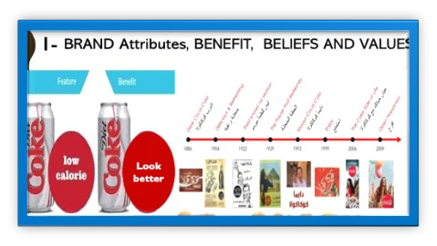
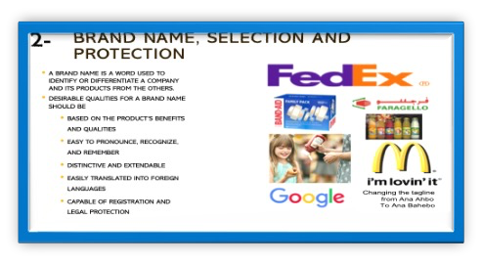
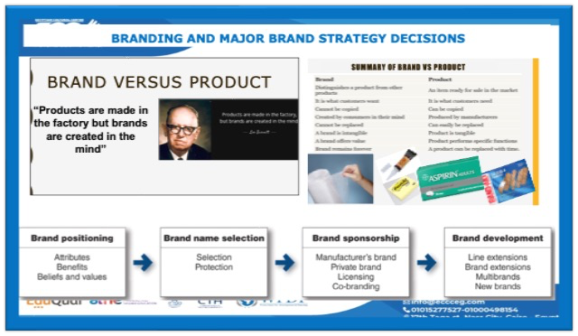
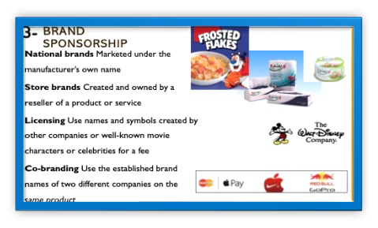
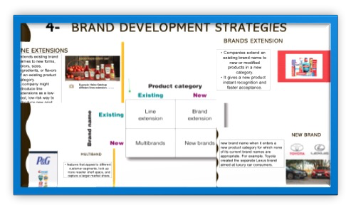

Slide 18
Corporate strategic planning
Marketing strategies formulation
S.T.P+D.&B.
(Where to play ) Which customers will we serve ? (segmentation and targeting)
(How to win ) how will we create value for them?
(differentiation and positioning)
Which products and services levels ?
Which price ,?
how to distribute?
How to Communicate with customers ?
Marketing Mix

Slide 20
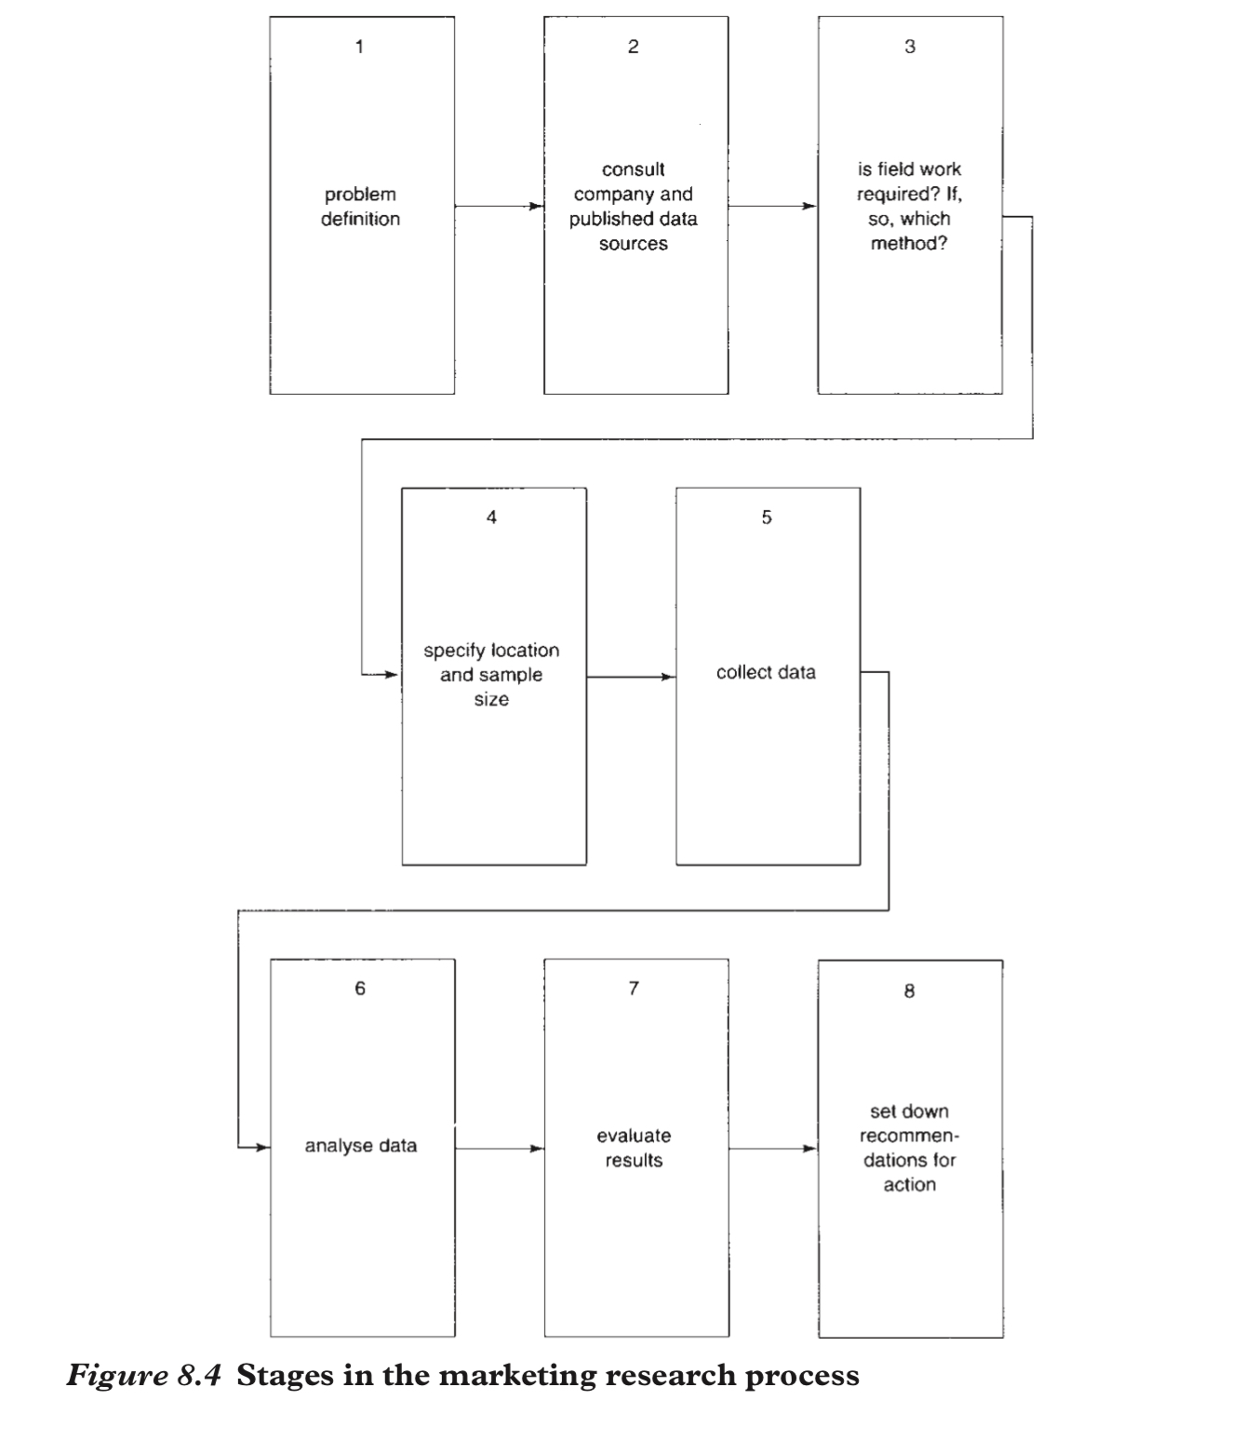
Marketing research stages

Slide 21
1st P- Product

Slide 22
2nd P-Price
C
Factors affecting Pricing Strategies
A
MAJOR PRICING STRATEGIES:
Cost-based pricing.
customer value–based pricing.
competition-based pricing
D
New Product Pricing Strategies
E
PRICE ADJUSTMENT STRATEGIES
Discount and allowance pricing
Segmented pricing
Psychological pricing
Promotional pricing
Dynamic pricing
International pricing
B
PRODUCT MIX PRICING STRATEGIES
Product line pricing
Optional-product pricing
Captive-product pricing
By-product pricing
Product bundle pricing
Other pricing strategies Decoy, Popcorn Pricing strategy
Initiating Price Changes
Responding to Competitor Price Changes

Slide 23
3rd P-Place (distribution /marketing channels)

Slide 24
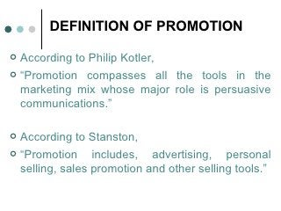
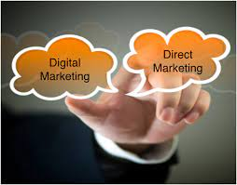
4th P- promotion (promotion MIX/tools)
5

Slide 25

Group support

Slide 26
Strategic Marketing Assignment
You have been accepted onto a (FLDP) within a Large organization. The sole representative from the Marketing Department.
The company is currently successful but is going through a period of intense change. There are new competitors entering the market, whilst new technologies are changing both production capabilities and consumer preferences.
Task 1
prepare a presentation with accompanying notes.The content of the presentation and notes should:
• Analyse the relationship between corporate and marketing strategies
• Explain how marketing strategies can contribute to competitive advantage
Extension activities
your presentation you should also evaluate the relationship between strategic intent, strategic assessment, strategic choice and their impact on the
formulation of marketing strategy.
Task 2
prepare a handout to be used by future participants in the
FLDP. on Strategic Marketing; Your contribution to the handout should:
• Evaluate the role of marketing research and its relationship to consumer behavior (include the different types of consumers, their behavior in B2B and B2C markets and factors underpinning customer loyalty)
• Evaluate the role of relationship marketing in customer behavior analysis
Extension activities
you must also analyze the influences on, and the psychology of, consumer behavior.
Task 3
You are required to develop a
realistic and workable marketing plan and strategy for a named organization. The choice of organization is important to ensure successful completion of this task.
For the selected and named organisation you must:
• Analyze the key considerations in creating a marketing strategy
• Explain how the marketing strategy should address competitive forces
• Develop a strategic marketing plan for your named organization using an appropriate
format (include KPIs that will support monitoring)
• Develop a risk register and associated contingency plans
Notes:
Future Leaders Development Programme

Slide 27


Slide 28
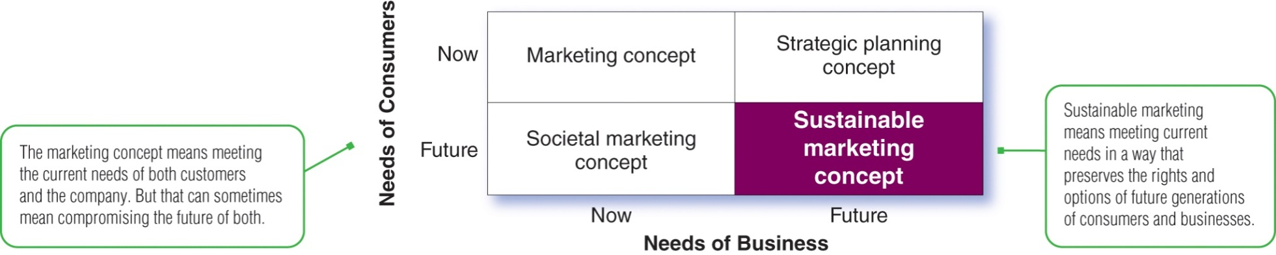
Sustainable Marketing
Notes:
This figure compares the sustainable marketing concept with other marketing concepts.
The marketing concept recognizes that organizations thrive from day to day by determining the current needs and wants of target customers and fulfilling those needs and wants more effectively and efficiently than competitors do. It focuses on meeting the company’s short-term sales, growth, and profit needs by engaging customers and giving customers what they want now.
The societal marketing concept considers the future welfare of consumers.
The strategic planning concept considers future company needs.
The sustainable marketing concept calls for socially and environmentally responsible actions that meet both the immediate and future needs of customers and the company.

Slide 29
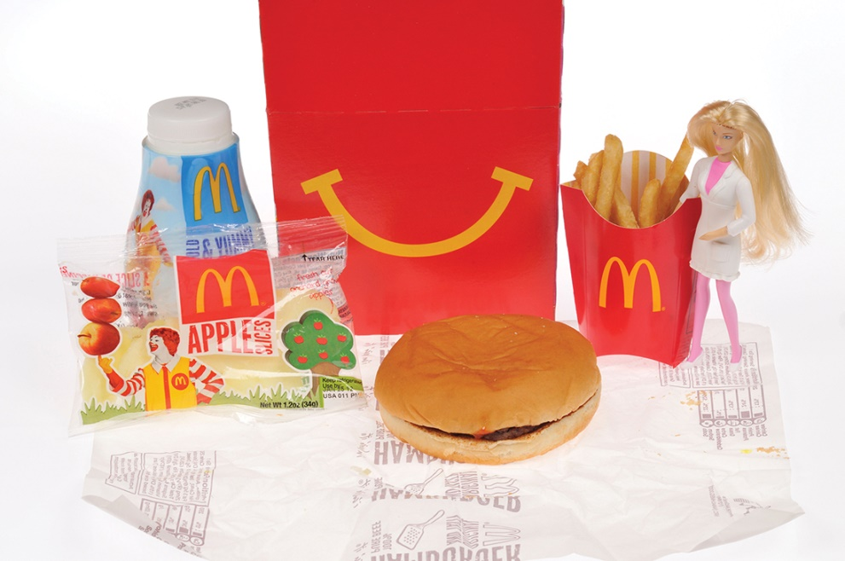
Sustainable Marketing
McDonald’s sustainability initiatives also address environmental
issues
Notes:
Sustainability: McDonald’s has responded to sustainability challenges with a more sustainable strategy of diversifying into salads, fruits, grilled chicken, low-fat milk, and other healthy fare, including Happy Meals offering more balanced meals with simpler ingredients. The company has also sponsored major education campaigns to help consumers better understand the keys to living balanced, active lifestyles.
McDonald’s sustainability initiatives also address environmental issues. It calls for food-supply sustainability, reduced and environmentally sustainable packaging, reuse and recycling, and more responsible store designs. For example, McDonald’s has made the commitment to source all packaging from renewable or certified resources and make recycling an option at all locations by 2025.

Slide 30
Social Criticisms of Marketing
Impact on Individual Consumers
Impact on Society as a Whole
Impact on Other Businesses
Notes:
Marketing receives much criticism. Social critics claim that certain marketing practices hurt individual consumers, society as a whole, and other business firms.

Slide 31
Marketing’s Impact on Individual Consumers (1 of 2)
High prices
Deceptive practices
High-pressure selling
Shoddy, harmful, or unsafe products
Planned and perceived obsolescence
Poor service to disadvantaged consumers
Notes:
Many critics charge that the American marketing system causes prices to be higher than they would be under more sensible systems. Critics point to three factors: high costs of distribution, high advertising and promotion costs, and excessive markups.
Deceptive pricing includes practices such as falsely advertising prices from a phony high retail list price. Deceptive promotion includes practices such as misrepresenting the product’s features. Deceptive packaging involves exaggerating package contents in misleading terms. Deceptive practices led to the Wheeler-Lea Act, which gave the Federal Trade Commission (FTC) power to regulate unfair or deceptive acts or practices.
Salespeople are sometimes accused of high-pressure selling that persuades people to buy goods they had no thought of buying. Too often, products and services are not made well or do not perform well. Also, many products deliver little benefit, or may even be harmful.
Critics also have charged that some companies practice planned obsolescence, causing their products to become obsolete before they need replacement. Other companies are charged with perceived obsolescence, that is, continually changing consumer concepts to encourage more and earlier buying. Critics also accuse major chain retailers of redlining, drawing a red line around disadvantaged neighborhoods and avoiding placing stores there.

Slide 32
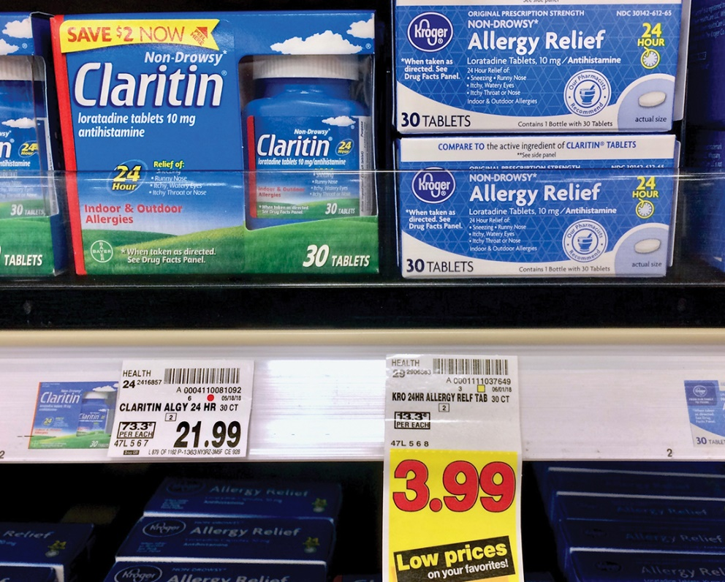
Marketing’s Impact on Individual Consumers (2 of 2)
A heavily promoted national brand sells for much more than a virtually identical non-branded or store-branded product.
Notes:
A heavily promoted national brand sells for much more than a virtually identical store-branded product. Critics charge that much of this promotion and packaging adds only psychological, not functional, value. Marketers respond that although advertising adds to product costs, it also adds value by informing potential buyers of the availability and merits of a brand.

Slide 33
Marketing’s Impact on Society as a Whole (1 of 2)
False Wants and Too Much Materialism
Too Few Social Goods
Cultural Pollution
Notes:
Critics do not view the interest in material things as a natural state of mind but rather as a matter of false wants created by marketing. Marketers, they claim, stimulate people’s desires for goods and create materialistic models of the good life. In this view, marketing’s purpose is to promote consumption, and the inevitable outcome of successful marketing is unsustainable overconsumption. Many observers predict a new age of more sensible consumption. As a result, instead of encouraging today’s more sensible consumers to overspend their means, most marketers are working to help them find greater value with less.
Business has been accused of overselling private goods at the expense of public goods. As private goods increase, they require more public services that are usually not forthcoming. A way must be found to restore a balance between private and public goods. One option is to make producers bear the full social costs of their operations. A second option is to make consumers pay the social costs. For example, many cities around the world are now charging congestion tolls in an effort to reduce traffic congestion.
Critics charge the marketing system with creating cultural pollution. Marketers answer the charges of commercial noise with these arguments. First, they hope that their ads primarily reach the target audience. Second, because of ads, many television, radio, online, and social media sites are free to users. Thus, to hold consumer attention, advertisers are making their ads more entertaining and informative.

Slide 34

Marketing’s Impact on Society as a Whole (2 of 2)
REI closes its stores on Black Friday and encourages customers to #OptOutside.
Notes:
Materialism: Some marketers are urging “conscious consumption.” REI closes its stores on Black Friday and encourages customers to #OptOutside.

Slide 35
Marketing’s Impact on Other Businesses
Acquisitions of competitors
Marketing practices that create barriers to entry
Unfair competitive marketing practices
Notes:
Critics charge that a firm’s marketing practices can harm other companies and reduce competition through acquisitions of competitors, marketing practices that create barriers to entry, and unfair competitive marketing practices. Firms are harmed and competition is reduced when companies expand by acquiring competitors rather than by developing their own new products. Acquisitions have caused concern that vigorous young competitors will be absorbed, thereby reducing competition. In some cases, acquisitions can be good for society. The acquiring company may gain economies of scale that lead to lower costs and lower prices. In addition, a well-managed company may take over a poorly managed company and improve its efficiency.
Some marketing practices bar new companies from entering an industry. Large marketing companies can use patents and heavy promotion spending or tie up suppliers or dealers to keep out or drive out competitors. Those concerned with antitrust regulation recognize that some barriers are the natural result of the economic advantages of doing business on a large scale. Existing and new laws can challenge other barriers.
Some firms have used unfair competitive marketing practices with the intention of hurting or destroying other firms. They may set their prices below costs, threaten to cut off business with suppliers, discourage the buying of a competitor’s products, or use their size and market dominance to unfairly damage rivals.

Slide 36
Sustainable Marketing Principles (1 of 2)
Consumer-oriented marketing
Viewing and organizing a company’s marketing activities from the consumer’s point of view
Customer value marketing
Putting most of a company’s resources into customer value-building marketing investments
Innovative marketing
Seeking real product and marketing improvements
Notes:
Under the sustainable marketing concept, a company’s marketing should support the best long-run performance of the marketing system. It should be guided by five sustainable marketing principles, which are consumer-oriented marketing, customer value marketing, innovative marketing, sense-of-mission marketing, and societal marketing.
Consumer-oriented marketing means that the company should view and organize its marketing activities from the consumer’s point of view. It should work hard to sense, serve, and satisfy the needs of a defined group of customers, both now and in the future.
According to the principle of customer value marketing, the company should put most of its resources into customer value-building marketing investments. By creating value for consumers, the company can capture value from consumers in return.
The principle of innovative marketing requires that the company continuously seek real product and marketing improvements.

Slide 37
Sustainable Marketing Principles (2 of 2)
Sense-of-mission marketing
Defining a company’s mission in broad social terms
Societal marketing
Making marketing decisions by considering
  Consumers’ wants
  Company’s requirements
  Consumers’ long-run interests
  Society’s long-run interests
Notes:
Sense-of-mission marketing means that the company should define its mission in broad social terms rather than narrow product terms. Brands linked with broader missions can serve the best long-run interests of both the brand and consumers.
By following the principles of societal marketing, a company makes marketing decisions by considering consumers’ wants, the company’s requirements, consumers’ long-run interests, and society’s long-run interests.

Slide 38
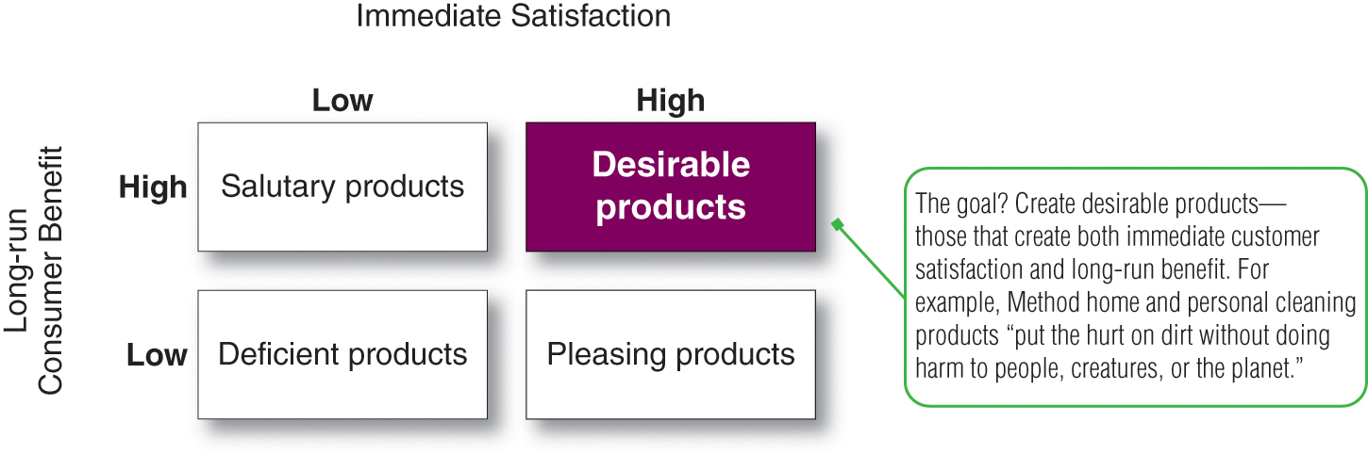
Societal Classification of Products
Notes:
This figure shows how products can be classified according to their degree of immediate consumer satisfaction and long-run consumer benefit.
Deficient products, such as bad-tasting and ineffective medicine, have neither immediate appeal nor long-run benefits.
Pleasing products give high immediate satisfaction but may hurt consumers in the long run. Examples include cigarettes and junk food.
Salutary products have low immediate appeal but may benefit consumers in the long run. Bicycle helmets or some insurance products are examples.
Desirable products give both high immediate satisfaction and high long-run benefits, such as a tasty and nutritious breakfast food.
Companies should try to turn all of their products into desirable products. The challenge posed by pleasing products is that they sell very well but may end up hurting the consumer. The product opportunity, therefore, is to add long-run benefits without reducing the product’s pleasing qualities. The challenge posed by salutary products is to add some pleasing qualities so that they will become more desirable in consumers’ minds.

Slide 39
Marketing Ethics (1 of 2)
Corporate marketing ethics policies should be developed by firms as guidelines for handling various issues and dilemmas.
  Distributor relations
  Advertising standards
  Customer service
  Pricing
  Product development
  General ethical standards
Notes:
The sustainable marketing goals of long-term consumer and business welfare can be achieved only through ethical marketing conduct.
Not all managers have fine moral sensitivity and hence companies need to develop corporate marketing ethics policies—broad guidelines that everyone in the organization must follow. These policies should cover distributor relations, advertising standards, customer service, pricing, product development, and general ethical standards.

Slide 40
Marketing Ethics (2 of 2)
Principles are needed to guide companies and marketing managers on issues of ethics and social responsibility.
  The free market and the legal system should decide such issues.
  Responsibility is in the hands of individual companies and managers.
Addressing ethics helps build strong customer relationships based on honesty and trust.
Notes:
Managers need a set of principles that will help them figure out the moral importance of each situation and decide how far they can go in good conscience. One philosophy is that the free market and the legal system should decide such issues. Under this principle, companies and their managers are not responsible for making moral judgments. Companies can, in good conscience, do whatever the market and legal systems allow.
A second philosophy puts responsibility not on the system but in the hands of individual companies and managers. This more enlightened philosophy suggests that a company should have a social conscience. Companies and managers should apply high standards of ethics and morality when making corporate decisions, regardless of what the system allows.
Dealing with issues of ethics and social responsibility, in an open and forthright way, helps to build and maintain strong customer relationships based on honesty and trust. As with environmentalism, the issue of ethics presents special challenges for international marketers. Business standards and practices vary a great deal from one country to the next.

Slide 41
Ethical Norms Suggested by the American Marketing Association
Do no harm
Foster trust in the marketing system
Embrace ethical values
Notes:
The American Marketing Association, an international association of marketing managers and scholars, developed a code of ethics that calls on marketers to adopt the following ethical norms. The first norm, which is to do no harm, means consciously avoiding harmful actions or omissions by embodying high ethical standards and adhering to all applicable laws and regulations in the choices we make. The second norm, which is to foster trust in the marketing system, means striving for good faith and fair dealing so as to contribute toward the efficacy of the exchange process, and avoiding deception in product design, pricing, communication, and delivery or distribution. The third norm is to embrace ethical values. This means building relationships and enhancing consumer confidence in the integrity of marketing by affirming core values such as, honesty, responsibility, fairness, respect, transparency, and citizenship.
Companies are also developing programs to teach managers about important ethical issues and help them find the proper responses. They hold ethics workshops and seminars and create ethics committees.

Slide 42
The Sustainable Company
Sustainable companies create value for customers through socially, environmentally, and ethically responsible actions.
Sustainable marketing provides the context in which companies can build profitable customer relationships.
Notes:
Sustainable companies are those that create value for customers through socially, environmentally, and ethically responsible actions. Sustainable marketing goes beyond caring for the needs and wants of today’s customers. It means pursuing the mission of a triple bottom line which is people, planet, and profits.
Sustainable marketing provides the context in which companies can build profitable customer relationships by creating value for customers in order to capture value from customers in return, now and in the future.

Slide 43


