Slide 1

Strategic marketing
Lecture 8

Slide 2
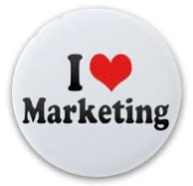

Strategic marketing
Lecture # 8
مساء الخير وأتمنى أن يكون الجميع بخير
سنبدأ الساعة 6:15مساء بتوقيت القاهرة
مع خالص الشكر
د. علي يحيى

Slide 3
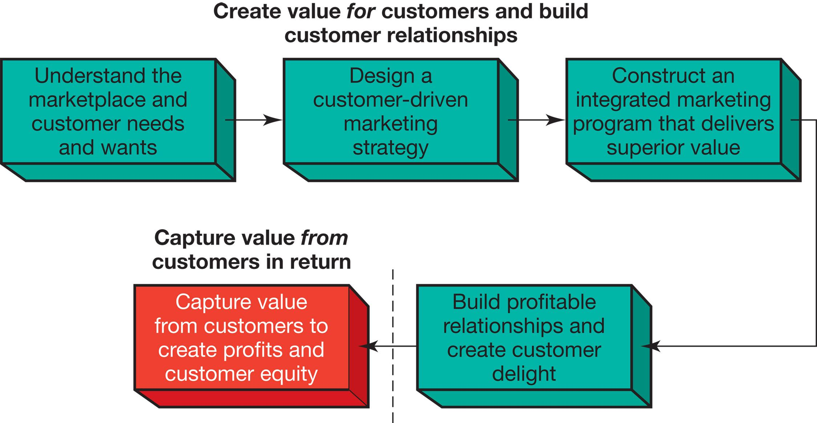
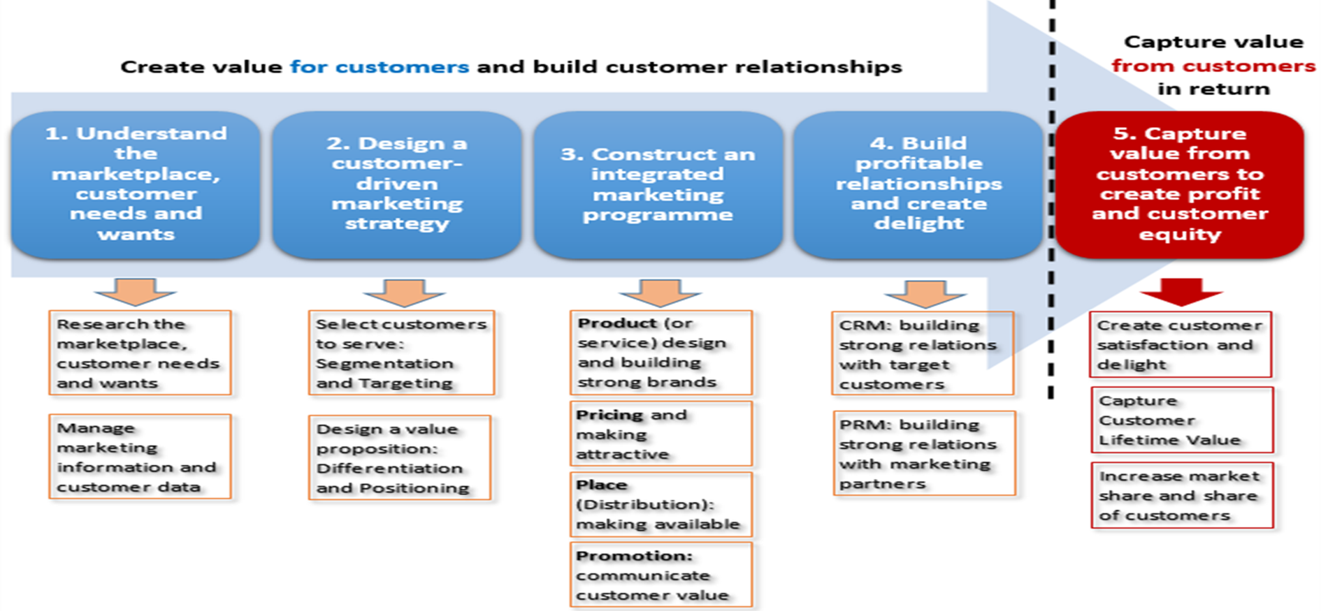
1
2
3
4
- consumer buyer behaviour and consumer markets
- Business Buyer Behaviour and Business Markets
Needs and wants
Marketplace
Market offering
Strategic marketing analysis
Big data and MIS
Grand marketing strategies competitive and growth
STP strategies
Differentiation and branding
CRM tools and systems
CUSTOMER RELATIONSHIP GROUPS
Marketing control
Marketing MIX
4Ps
Notes:
The Marketing Process
In the first four steps, companies work to understand consumers, create customer value, and build strong customer relationships
In the final step, companies reap the rewards of creating superior customer value
By creating value for customers, companies are able capture value from customers in the form of sales, profits, and long-term customer equity

Slide 4
1st P- Product

Slide 5
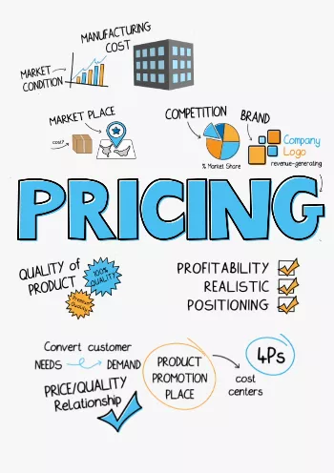
2nd P-Price
C
Factors affecting Pricing Strategies
A
MAJOR PRICING STRATEGIES:
Cost-based pricing.
customer value–based pricing.
competition-based pricing
D
New Product Pricing Strategies
B
PRODUCT MIX PRICING STRATEGIES
Product line pricing
Optional-product pricing
Captive-product pricing
By-product pricing
Product bundle pricing
E
PRICE ADJUSTMENT STRATEGIES
Discount and allowance pricing
Segmented pricing
Psychological pricing
Promotional pricing
Dynamic pricing
International pricing
Notes:
Price is the amount of money charged for a product or a service. It is the sum of all the values that customers give up to gain the benefits of having or using a product or service. Price is one of the most important elements that determines a firm’s market share and profitability. Price is the only element in the marketing mix that produces revenue; all other elements represent costs.

Slide 6

Let us continue understanding;
  How to create value for customers?
  Marketing mix
  3rd P-Place (Distribution - Marketing channels )

Slide 7
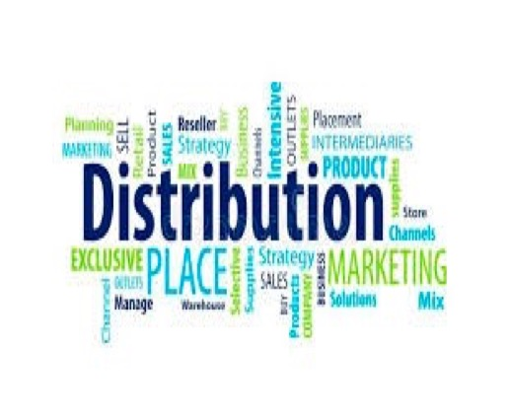
3RD P Place or distribution

Slide 8
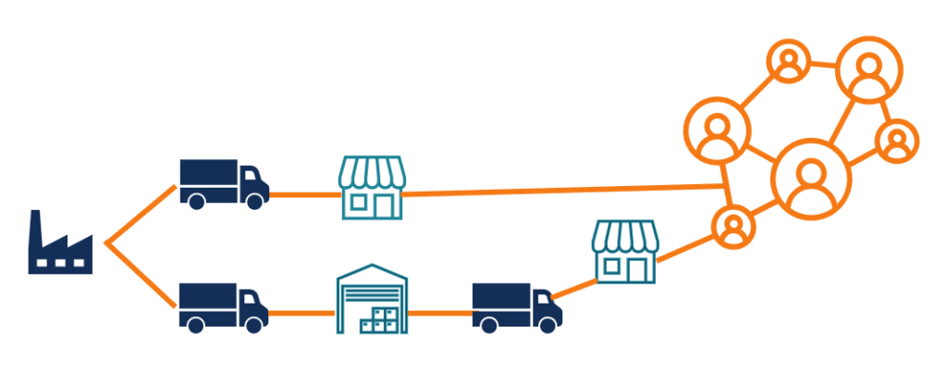
3-distribution
What is DISTRIBUTION?
What is the direct and indirect channels?
What is the Multi Channel Distribution System?
What is the VMS Vertical marketing system (Vertical marketing Channel)?
What are the key Channel strategies?
What is the Disintermediation?

Slide 9

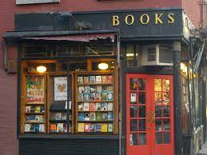
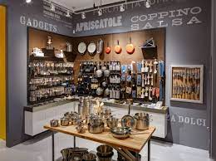
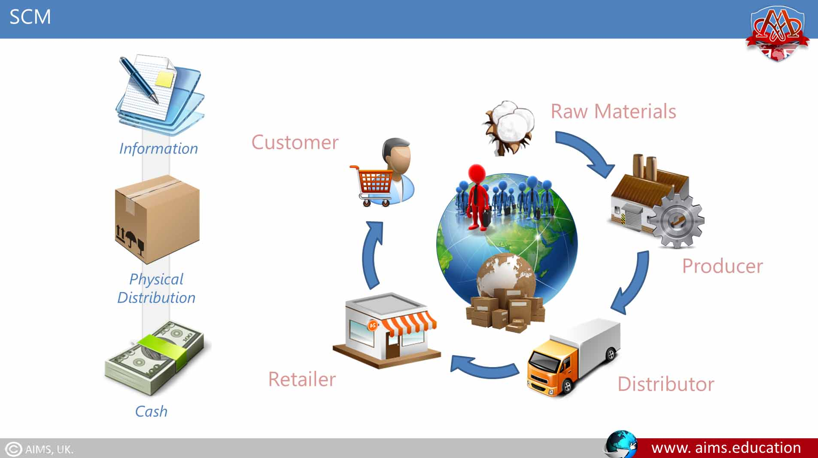
3RD Place
“Distribution”
1
DISTRIBUTION
where the company sells its products so that they're easily available to the target market.
DISTRIBUTION / Marketing Channel,
A set of interdependent organizations that ease the transfer of ownership as products move from producer to business user or consumer.
  cookbook publisher can place their products in a
    bookstore to reach customers who are looking for books,
    also, in a kitchenware store to reach customers interested in cooking.
Supply chain,
All the chain starting from suppliers, the company, resellers, till the final consumers

Slide 10
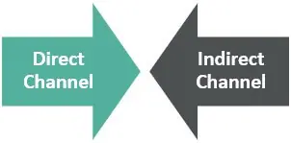
direct and indirect MARKETING/distribution channels
2
DIRECT distribution, manufacturers Lack of Utilizing one distributor requires three contacts to reach out to consumers.
INDIRECT distribution manufacturers working through one distributor, which contacts the three customers. Lack of Utilizing one distributor requires only three contacts and reduces the amount of work that must be done by both producers and consumers using intermediaries can provide economies
The companies directly deal with customers without having any intermediaries involved.
The companies depend on intermediaries to reaching the consumers
Notes:
A distribution channel is how you distribute your products to the consumer while a. There are two different distribution channels

Slide 11
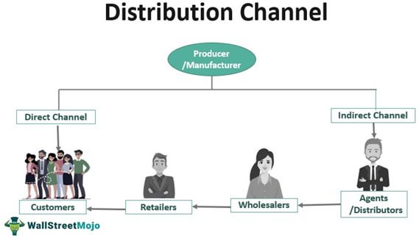
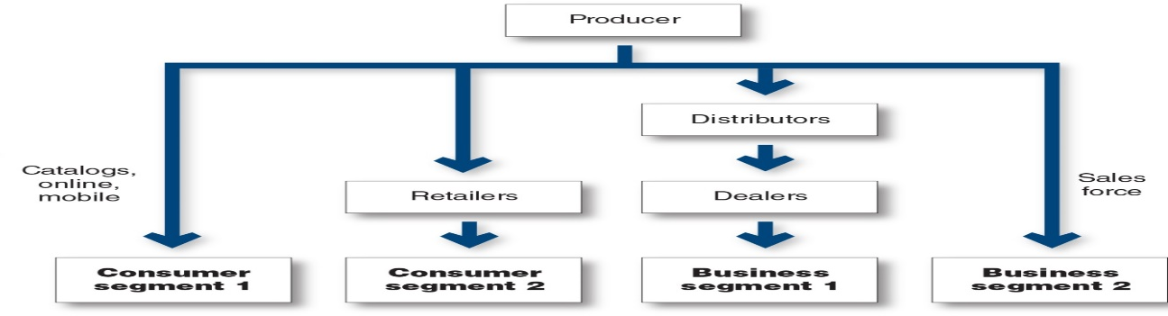
Multi Channel Distribution System
3
These days, almost every large company and many small ones distribute through multiple channels
manufacturer sell to Distributors, Wholesalers , Retailers at profit and/or commission
Besides, might be able to sell direct to customers through online or stores.
Notes:
In the figure, the producer sells directly to consumer segment 1 using catalogs, online, and mobile channels and reaches consumer segment 2 through retailers. It sells indirectly to business segment 1 through distributors and dealers and to business segment 2 through its own sales force. These days, almost every large company and many small ones distribute through multiple channels.
Distributor they do purchase the products from manufacturer and sell to Wholesalers , Retailers or customers at profit and/or commission
Wholesalers: sell to retailers
Retailers :sell directly to consumers
Agents : they do not purchase the products, but they earn commission

Slide 12
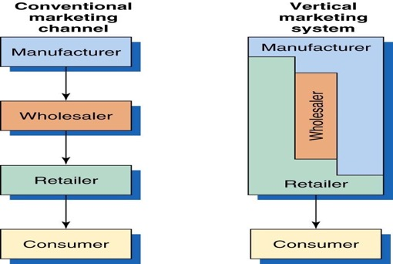
Conventional Vs. Vertical Distribution Channel
4
A CONVENTIONAL DISTRIBUTION CHANNEL
No channel member has much control over the other members, and no formal means exists for assigning roles and resolving channel conflict.
Channel conflict: Disagreements among marketing channel members on goals, roles, and rewards.
Vertical marketing system (VMS)
consists of producers, wholesalers, and retailers acting as a unified system. contracts put much power that they must all cooperate
Notes:
.

Slide 13
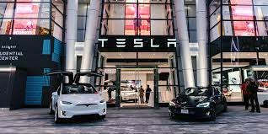
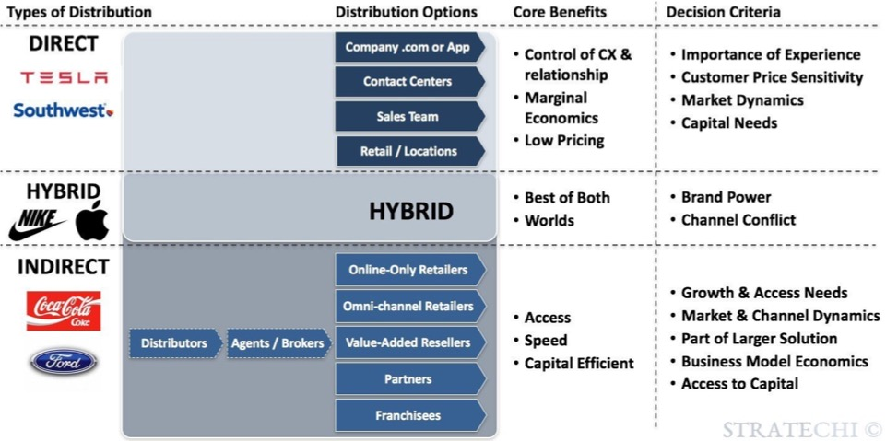
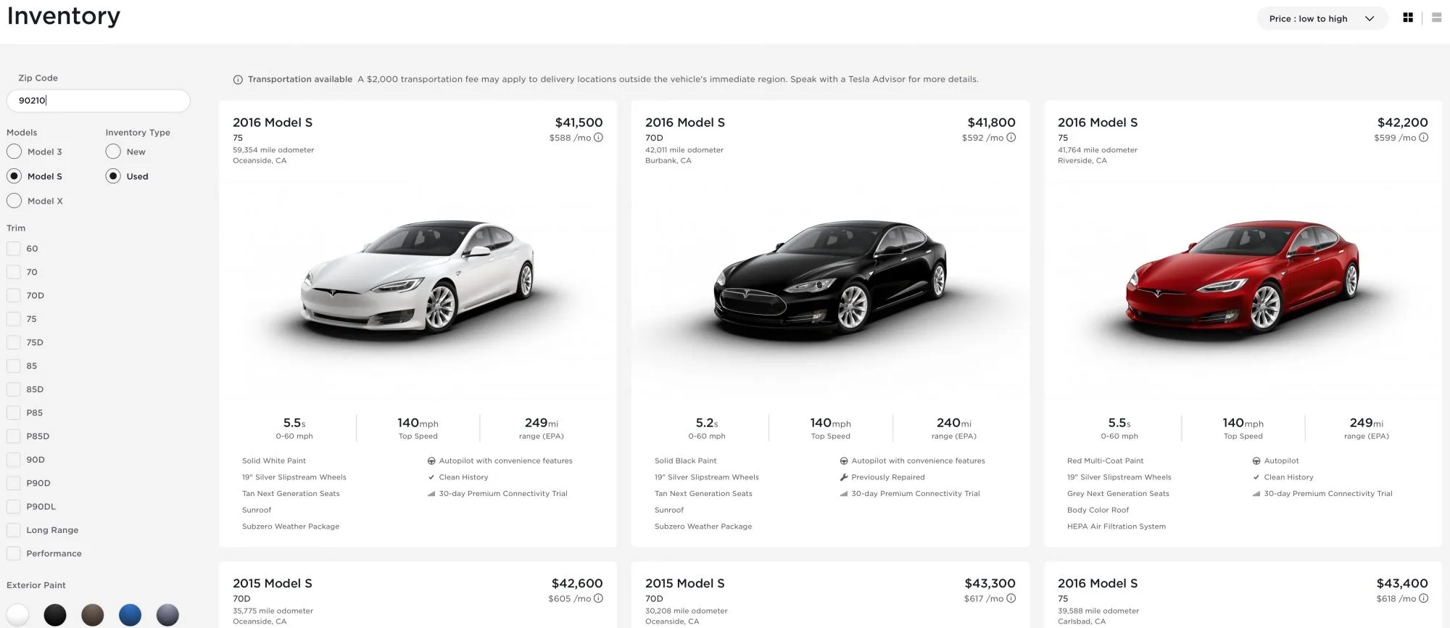
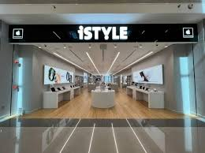

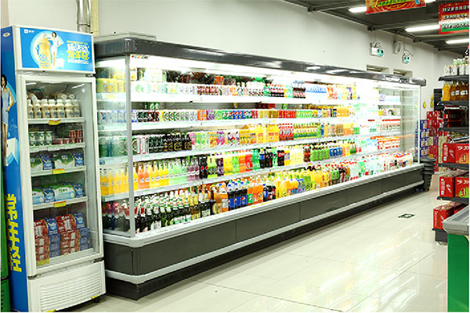
Distribution Channel examples
Notes:
esla sells most of their new cars through orders on the internet. You can go to their site and con

Slide 14
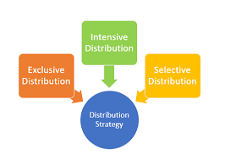
Channel strategies
5
its the channel alternatives in terms of the types of intermediaries, the number of intermediaries, and the responsibilities of each channel member.
There are THREE BASIC TYPES of place strategy
Intensive
Selective
Exclusive
Major Channel strategies

Slide 15
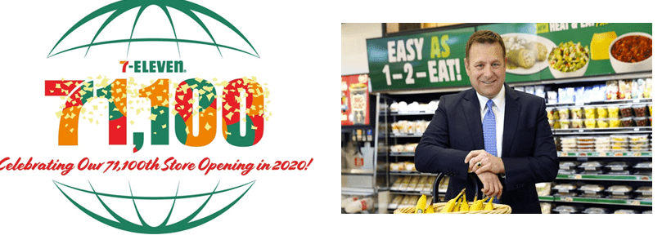


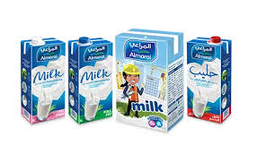
Intensive Distribution strategy
5
Intensive: An intensive place strategy is when a company places its product in as many stores as possible.
Convenience products as Candy companies often use this strategy, as they place their products in supermarkets, movie theaters, convenience stores and airports.
Notes:
7 Eleven opened its 71,100th retail store in the world and crossed a very important milestone on July 13, 2020. This store was inaugurated in Seoul, South Korea. This brand has licensed stores and/or franchises all over the world.

Slide 16
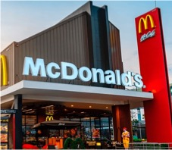
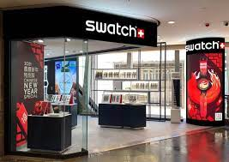

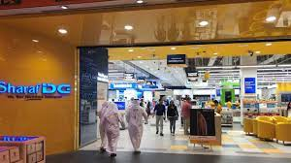
Selective Distribution strategy
5
Selective: A selective place strategy is when a company places its product in only a few stores. For example, Shopping products companies that manufacture appliances often use this strategy.

Slide 17
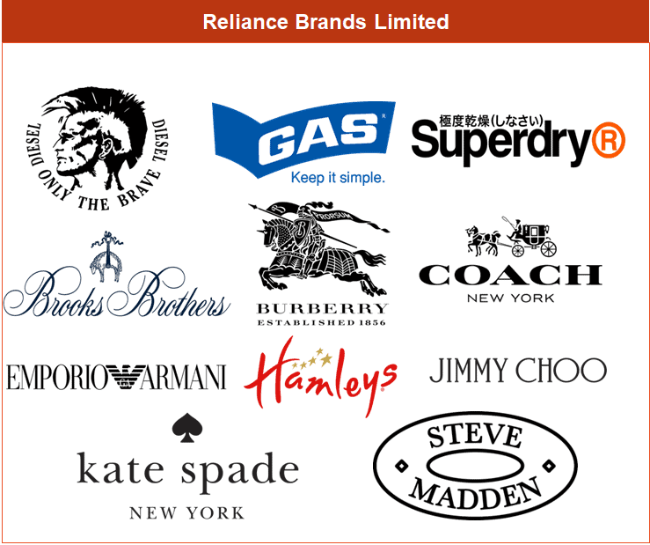

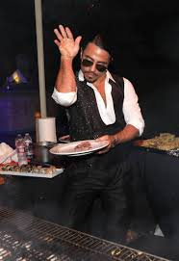
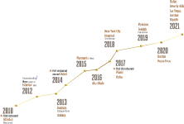
Exclusive Distribution strategy
5
Exclusive: An exclusive place strategy is when a company places its product in very limited places . This is usually for luxurious brands and specialty products, such as cars.

Slide 18
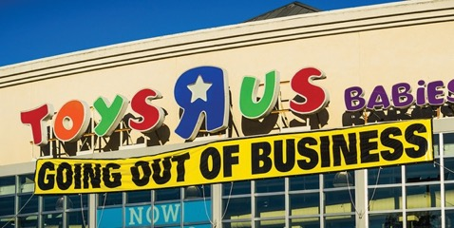
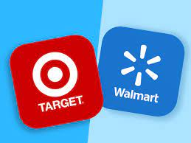
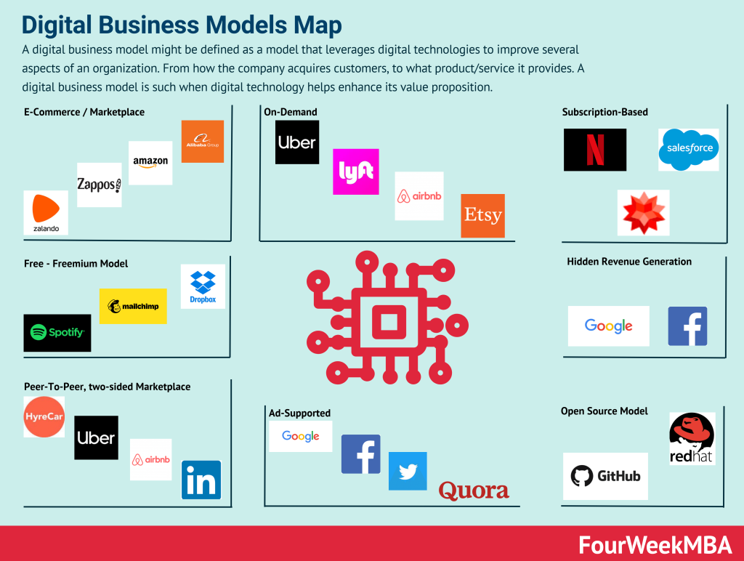
Disintermediation
6
Occurs when product or service producers cut out marketing channel intermediaries or when radically new types of channel intermediaries displace traditional ones
Toys “R” Us failed to adapt to major shifts in toy market sales, first toward big discounters such as Walmart and Target and then toward online merchants like Amazon.
Toy “R” Us recently closed operations and shuttered its stores.
Notes:
Changes in technology and the explosive growth of direct and online marketing are having a profound impact on the nature and design of marketing channels. One major trend is toward disintermediation, which refers to the cutting out of marketing channel intermediaries by product or service producers, or the displacement of traditional resellers by radical new types of intermediaries.

Slide 19

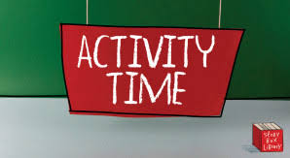
Activity 2
What do you see in the pictures based on distribution understanding

Slide 20
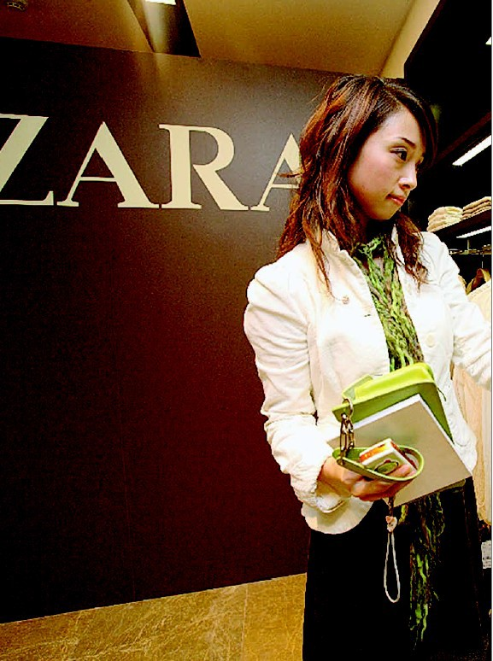
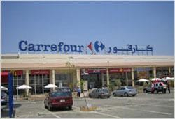

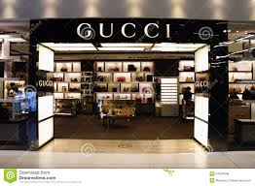

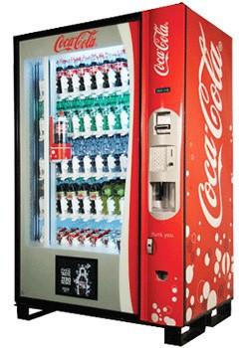
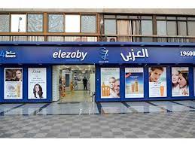
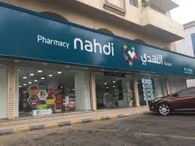
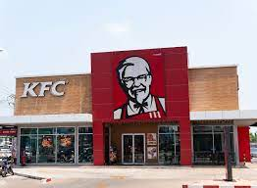

Slide 21
Let us continue understanding;
  How to create value for customers?
  Marketing mix
  3rd P-Place (Distribution - Marketing channels )

Slide 22
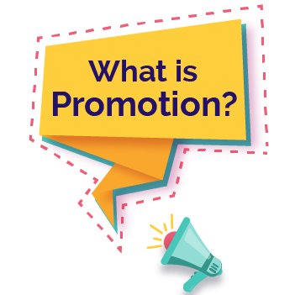
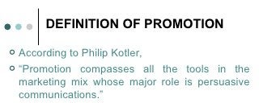
4th P Promotion

Slide 23
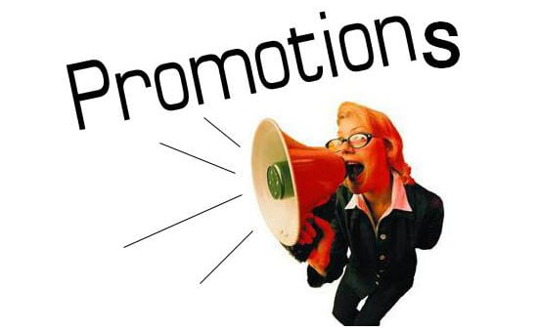
What are the five promotion tools (promotion MIX) ?
What does it mean by Integrated promotion MIX?
which Promotion Strategy Push or Pull?
What are the Major Advertising Decisions?
What are the key Consumer Sales Promotion Tools?
What are the Major Pros & cons in personal Selling?
What are the Public relations Examples?
What is Direct and digital marketing? Offline Marketing Vs. Online Marketing and Key digital marketing channels ?

Slide 24
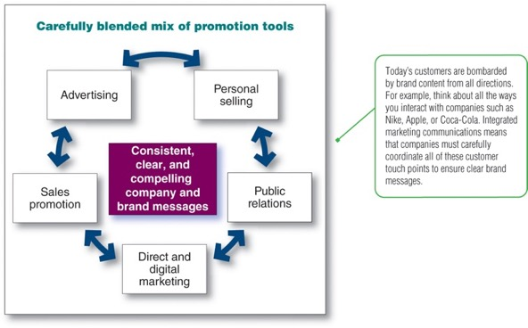
Promotion mix
A mix of different marketing approaches that marketers develop to deliver a clear, consistent, and compelling message about the organization and its brands to the target market segment
It should be carefully integrating and coordinating the company’s many communications channels
The marketer’s task is to decide :
  What is the right promotion mix for a particular product/brand?
  Which promotion strategy to use ?

Slide 25
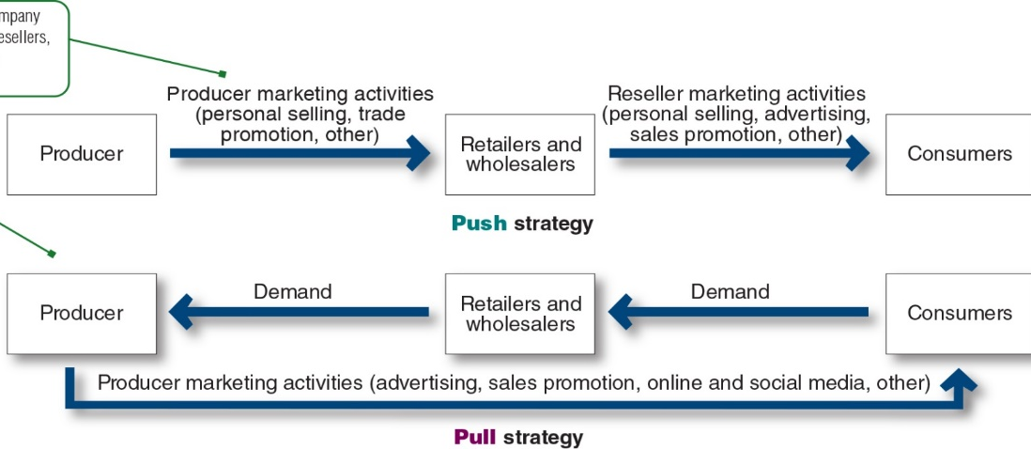
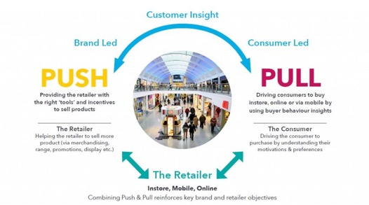
Push versus Pull Promotion Strategy
A push strategy refers to a promotion strategy that calls for using the sales force and trade promotion to push the product through channels. The producer promotes the product to channel members that in turn promote it to final consumers.
A pull strategy refers to a promotion strategy that calls for spending a lot on consumer advertising and promotion to induce final consumers to buy the product, creating a demand vacuum that pulls the product through the channel
Notes:
This figure contrasts the two basic promotion mix strategies: push promotion versus pull promotion. The relative emphasis given to the specific promotion tools differs for push and pull strategies.
A push strategy refers to a promotion strategy that calls for using the sales force and trade promotion to push the product through channels. The producer promotes the product to channel members that in turn promote it to final consumers.
A pull strategy refers to a promotion strategy that calls for spending a lot on consumer advertising and promotion to induce final consumers to buy the product, creating a demand vacuum that pulls the product through the channel.
Business-to-consumer companies pull more, putting more of their funds into advertising, followed by sales promotion, personal selling, and then public relations. Business-to-business marketers tend to push more, putting more of their funds into personal selling, followed by sales promotion, advertising, and public relations.

Slide 26
Promotion mix
A mix of different marketing approaches that marketers develop to deliver a clear, consistent, and compelling message about the organization and its brands to the target market segment
It should be carefully integrating and coordinating the company’s many communications channels
The marketer’s task is to decide :
  What is the right promotion mix for a particular product/brand?
  Which promotion strategy to use ?

Slide 27
Push versus Pull Promotion Strategy
A push strategy refers to a promotion strategy that calls for using the sales force and trade promotion to push the product through channels. The producer promotes the product to channel members that in turn promote it to final consumers.
A pull strategy refers to a promotion strategy that calls for spending a lot on consumer advertising and promotion to induce final consumers to buy the product, creating a demand vacuum that pulls the product through the channel
Notes:
This figure contrasts the two basic promotion mix strategies: push promotion versus pull promotion. The relative emphasis given to the specific promotion tools differs for push and pull strategies.
A push strategy refers to a promotion strategy that calls for using the sales force and trade promotion to push the product through channels. The producer promotes the product to channel members that in turn promote it to final consumers.
A pull strategy refers to a promotion strategy that calls for spending a lot on consumer advertising and promotion to induce final consumers to buy the product, creating a demand vacuum that pulls the product through the channel.
Business-to-consumer companies pull more, putting more of their funds into advertising, followed by sales promotion, personal selling, and then public relations. Business-to-business marketers tend to push more, putting more of their funds into personal selling, followed by sales promotion, advertising, and public relations.

Slide 28
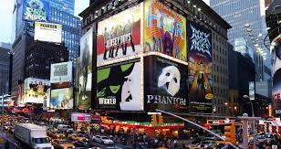
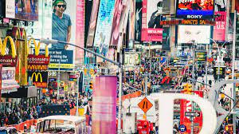
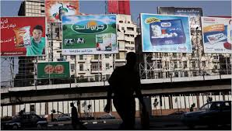
Promotional Tool
1
Advertising
It is the concept of communicating a message about products and services to a customer so that the customer can understand the offering along with its features, uniqueness, price, offer, benefits and value to get convinced about making a purchase
Examples, paid presentations and promotion in print ads, radio, television, billboard, direct mail, brochures and catalogs, signs, in-store displays, posters, mobile apps, motion pictures, web pages, banner ads, emails.

Slide 29
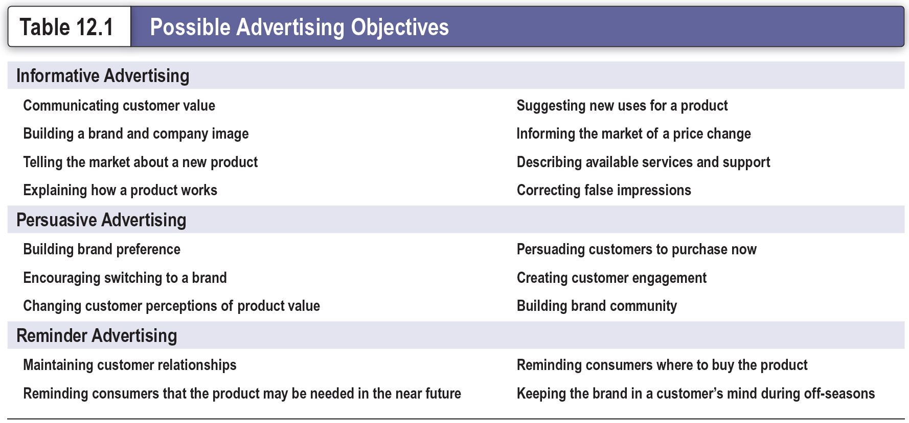
Possible Advertising Objectives
Notes:
An advertising objective is a specific communication task to be accomplished with a specific target audience during a specific period of time. Advertising objectives can be classified by their primary purpose which is, to inform, persuade, or remind. This table lists the examples of each of these specific objectives.
Informative advertising is used heavily when introducing a new product category. Persuasive advertising becomes more important as competition increases. And, reminder advertising is important for mature products; it helps to maintain customer relationships and keep consumers thinking about the product.

Slide 30
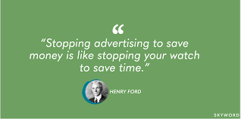

Slide 31
Major Advertising Decisions
Promotional Tool
تحديد الأهداف الإعلانية، للإعلان مهمه محددة يجب إنجازها مع جمهور مستهدف محدد خلال فترة محددة. الاخبارInformative (عند تقديم فئة منتج جديد) .الاقناع Persuasive (ويقوم بالمقارنة مع المنافسين) والتذكير Reminder في المنتجات الناضجة.
وضع الميزانية الإعلانية، تـوضع ميزانيات باستخدامـ طرق بسيطة مثل كل ما يمكن ان تتحمله الشركة، نسبه من المبيعات، حسب المنافسين و حسب الأهداف و المهام
وضع استراتيجية إعلانية، أي قرارات صياغه لرسائل إعلانية. وتحديد نوع الوسيلة (صحف مجلات راديو تليفزيون لوحات)
تقييم الحملات الإعلانية.. صافي العائد على الاستثمار الإعلاني مقسوما على تكاليف الاستثمار الإعلاني
Notes:
This figure shows the four important decisions made by marketing management when developing an advertising program. These decisions include setting advertising objectives, setting the advertising budget, developing advertising strategy, that is, message decisions and media decisions, and evaluating advertising campaigns.

Slide 32
Profiles of Major Media Types (1 of 2)
Medium | Advantages | Limitations
Television | Good mass-marketing coverage; low cost per exposure; combines sight, sound, and motion; appealing to the senses | High absolute costs; high clutter; fleeting exposure; less audience selectivity
Digital, mobile, and social media | High selectivity; low cost; immediacy; engagement Capabilities | Potentially low impact; high audience control of content and exposure
Newspapers | Flexibility; timeliness; good local market coverage; broad acceptability; high believability | Short life; poor reproduction quality; small pass-along audience.
Direct mail | High audience selectivity; flexibility; no ad competition within the same medium; allows personalization | Relatively high cost per exposure; “junk mail” image.
Notes:
This table lists the advantages and limitations of the major media types: television, digital, mobile, and social media, newspapers, direct mail, magazines, radio, and outdoor.

Slide 33
Profiles of Major Media Types (2 of 2)
Medium | Advantages | Limitations
Magazines | High geographic and demographic selectivity; credibility and prestige; high-quality reproduction; long life and good pass-along readership | Long ad purchase lead time; high cost; no guarantee of position
Radio | Good local acceptance; high geographic and demographic selectivity; low cost. | Audio only; fleeting exposure; low attention (“the half-heard” medium); fragmented audiences
Outdoor | Flexibility; high repeat exposure; low cost; good positional selectivity | Little audience selectivity; creative limitations
Notes:
This table lists the advantages and limitations of the major media types: television, digital, mobile, and social media, newspapers, direct mail, magazines, radio, and outdoor.

Slide 34
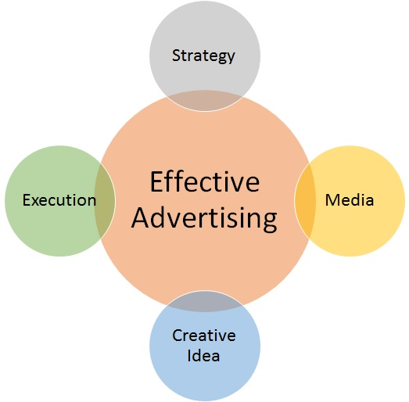
Evaluating Advertising Effectiveness and Return on Advertising Investment
ROI : Net return on advertising investment divided by the costs of the advertising investment
Advertisers should regularly evaluate
  Communication effects
  Sales and profit effects
Advertising media selection : Vehicles through which advertising messages are delivered to their intended audiences
Steps in advertising media selection:
Determining reach, frequency, impact and engagement
Choosing among major media types
Selecting specific media vehicles
Choosing media timing
Advertising objective is a specific communication task to be accomplished with a specific target audience during a specific period.
can be classified by their primary purpose
Informative advertising, inform, is used heavily when introducing a new product category
Persuasive advertising, persuade, becomes more important as competition increases
reminder advertising , remind. In mature products; it helps to maintain customer relationships and keep consumers thinking about the product.
Evaluating advertising campaigns

Slide 35


Promotional Tool
AIDA model in advertising
Extra
Words mean power, once the right words are used, they would enlighten minds, move hearts, and open wallets
AIDA, A communications model which used by advertising companies for communication on a 4 stages
structure your communication with a different level of stages and objectives where each stages might engage consumers differently and probably could take an action with the last stage
Notes:
with a different level of objectives where each stages might engage consumers differently and probably could take an action with the last stage
and then get your audience to follow specific stages in your communication that leads to them taking an action.

Slide 36



Promotional Tool
Sales Promotion
2
Sales promotion tools refers to the short-term incentives to encourage purchases, IMPROVE, market share for a product or service
Examples include samples, coupons, sweepstakes, contests, rebates, tie-ins, premiums

Slide 37
Consumer Promotion Tools (1 of 2)
Tools | Description
Samples | Offers of a trial amount of a product Most effective and expensive
Coupons | Certificates that save buyers money when they purchase specified products
Rebates (cash refunds) | Price reduction occurs after the purchase Customer sends proof of purchase to the manufacturer, which then refunds part of the purchase price by mail
Price packs (cents-off deals) | Offers consumers savings off the regular price of a product
Premiums | Goods offered either free or at low cost as an incentive to buy a product
Notes:
Consumer promotions include a wide range of tools. This table shows the customer promotion tools of samples, coupons, rebates, price packs, and premiums.
Samples are offers of a trial amount of a product. Sampling is the most effective, but most expensive way to introduce a new product or create new excitement for an existing one.
Coupons are certificates that save buyers money when they purchase specified products.
Rebates, or cash refunds, are like coupons except that the price reduction occurs after the purchase rather than at the retail outlet. The customer sends a proof of purchase to the manufacturer, which then refunds part of the purchase price by mail.
Price packs, also called cents-off deals, offer consumers savings off the regular price of a product. The producer marks the reduced prices directly on the label or package.
Premiums are goods offered either free or at low cost as an incentive to buy a product.

Slide 38
Consumer Promotion Tools (2 of 2)
Tools | Description
Advertising specialties | Useful articles imprinted with an advertiser’s name, logo, or message that are given as gifts to consumers
Point-of-purchase (POP) promotions | Displays and demonstrations that take place at the point of sale
Contests, sweepstakes, and games | Give consumers the chance to win something
Event marketing (or event sponsorships) | Creating a brand-marketing event or serving as a sole or participating sponsor of events created by others
Notes:
This table shows the customer promotion tools of advertising specialties, point-of-purchase promotions, contests, sweepstakes, games, and event marketing.
Advertising specialties, also called promotional products, are useful articles imprinted with an advertiser’s name, logo, or message that are given as gifts to consumers.
Point-of-purchase (POP) promotions include displays and demonstrations that take place at the point of sale.
Contests, sweepstakes, and games give consumers the chance to win something, such as cash, trips, or goods, by luck or through extra effort.
Marketers promote brands through event marketing or event sponsorships. Firms can create their own brand-marketing events or serve as sole or participating sponsors of events created by others.

Slide 39

Promotional Tool
Personal selling
3
It is personal promotional tool in which there is a face-to-face contact between a company representative and a customers.
the process of helping and persuading one or more prospects to purchase a good or service or to act on any idea using an oral presentation, often in a face-to-face manner or by telephone.
Examples include sales presentations, sales meetings, sales training and incentive programs for intermediary salespeople, samples, and telemarketing.

Slide 40
Personal Selling (1 of 2)
Personal presentations by a sales force to engage customers, make sales, and build customer relationships
Salesperson: Represents a company to customers by performing the following activities:
  Prospecting and communicating
  Selling and servicing
  Gathering information and building relationships
Notes:
Personal selling involves personal presentations by the firm’s sales force for the purpose of engaging customers, making sales, and building customer relationships.
Most salespeople are well-educated and well-trained professionals who add value for customers and maintain long-term customer relationships. They listen to their customers, assess customer needs, and organize the company’s efforts to solve customer problems.
A salesperson is an individual who represents a company to customers by performing one or more activities: prospecting, communicating, selling, servicing, information gathering, and relationship building.

Slide 41

The Role of the Sales Force
Links the company with its customers
Coordinates marketing and sales
Notes:
The sales force serves as a critical link between a company and its customers. They represent the company to customers. At the same time, salespeople represent customers to the company. Salesperson-owned loyalty lends even more importance to the salesperson’s customer-relationship-building abilities. Strong relationships with the salesperson will result in strong relationships with the company and its products. Poor salesperson relationships will probably result in poor company and product relationships.
A company can take several actions to help bring its marketing and sales functions closer together. At the most basic level, it can increase communications between the two groups by arranging joint meetings and spelling out communications channels. A company can also create joint objectives and reward systems. Finally, it can appoint a high-level marketing executive to oversee both marketing and sales.

Slide 42

Steps in the Selling Process
Notes:
Figure 13.3 shows seven steps in the selling process.
The first step in the selling process is prospecting and qualifying—identifying qualified potential customers. They want to call on those who are most likely to appreciate and respond to the company’s value proposition—those the company can serve well and profitably.
Preapproach refers to a salesperson learning as much as possible about a prospective customer before making a sales call. During the approach step, the salesperson should know how to meet and greet the buyer and get the relationship off to a good start.
During the presentation and demonstration step of the selling process, the salesperson tells the “value story” to the buyer, demonstrating how the company’s offer solves the customer’s problems. In handling objections, the salesperson should use a positive approach, seek out hidden objections, ask the buyer to clarify any objections, take objections as opportunities to provide more information, and turn the objections into reasons for buying.
Closing refers to a salesperson asking the customer for an order. And finally, follow-up refers to a salesperson following up after the sale to ensure customer satisfaction and repeat business.

Slide 43

Promotional Tool
Major Pros & cons in personal Selling

Slide 44

Promotional Tool
Public relations
4
The planned and sustained effort to establish and maintain goodwill and mutual understanding between an organization and its publics
This includes free publicity as well as paid efforts.

Slide 45
Role and Impact of PR
Strong impact on public awareness at a lower cost than advertising
Power to engage consumers and make them part of the brand’s story
Limited and scattered use
Powerful brand-building tool
Notes:
Public relations can have a strong impact on public awareness at a much lower cost than advertising. When using public relations, the company pays for a staff to develop and circulate information and manage events. Public relations has the power to engage consumers and make them a part of the brand story and its telling.
Despite its potential strengths, public relations has limited and scattered use. This situation is changing, however. Although public relations still captures only a small portion of the overall marketing budgets of most firms, PR can be a powerful brand-building tool. PR should work hand in hand with advertising, within an integrated marketing communications program, to help build customer engagement and relationships.

Slide 46
Major Public Relations Tools
News
Special events
Written materials
Audiovisual materials
Corporate identity materials
Public service activities
Notes:
Public relations uses several tools.
PR professionals find or create favorable news about the company and its products or people.
Another PR tool is special events, like news conferences and speeches, brand tours, and grand openings, laser light shows, multimedia presentations, or educational programs designed to reach and interest target publics.
PR also involves the preparation of written materials like annual reports, brochures, and company newsletters and magazines to reach and influence target markets.
Audiovisual materials, such as DVDs and online videos, are also being used increasingly as communication tools.
Corporate identity materials can also help create a corporate identity that the public immediately recognizes. Logos, stationery, brochures, signs, business forms, business cards, buildings, uniforms, and company cars and trucks all become marketing tools when they are attractive, distinctive, and memorable.
Finally, companies can improve public goodwill by contributing money and time to public service activities.

Slide 47
Functions of Public Relations (PR) Departments
Press relations or press agency
Product publicity
Public affairs
Lobbying
Investor relations
Development
Notes:
PR departments may perform any or all of the following functions:
Press relations or press agency—Creating and placing newsworthy information in the news media to attract attention to a person, product, or service.
Product publicity—Publicizing specific products.
Public affairs—Building and maintaining national or local community relationships.
Lobbying—Building and maintaining relationships with legislators and government officials to influence legislation and regulation.
Investor relations—Maintaining relationships with shareholders and others in the financial community.
Development—Working with donors or members of nonprofit organizations to gain financial or volunteer support.

Slide 48



Public relations Examples
Promotional Tool
Examples It can be accomplished by planting a significant news story indirectly in the media or presenting it favorably through press releases or corporate anniversary parties.
  It could be advertised in newspaper, magazine articles, TVs and radio presentations.
  It could be a Corporate social responsibility, charitable contributions, speech, Sponsorship and Exhibitions.
  Word of mouth is also a type of publicity, Videos, “celebrity store openings”, social media influencers, or bloggers promotions today.
  Website

Slide 49

Promotional Tool
Direct and digital marketing
5

Slide 50

Promotional Tool
Direct and digital marketing
Offline Marketing Vs. Online Marketing
5
Offline traditional Marketing refers to creating brand awareness / promotion through traditional marketing channels .
These strategies do not involve the direct use of the Internet.
This includes television and radio ads, direct mail, print publications, outdoor advertising, joining trade shows and festivals, promotional gifts, and even word-of-mouth.
Online {digital} marketing refers to creating brand awareness / promotion through online marketing channels.
These strategies do involve the direct use of the Internet.
Digital marketing utilizes the Internet, its tools like social media, e-ads, e-mail and other applications to increase brand awareness.

Slide 51

Promotional Tool
Offline Marketing Vs. Online Marketing
Offline marketing {traditional marketing} is the process of promotion through offline channels like print ads, telemarketing etc.
Online {digital} marketing is promotion through online channels like social media, ads, e-mail.
Each marketing strategy has its own pros and cons. Considering both is more effective and efficient for business.

Slide 52

Direct Marketing and Indirect Marketing
Promotional Tool

Slide 53
Promotional Tool
Key digital marketing channels
Website Website marketing is the process of creation, promoting of companies' website on the Internet. includes on online listings, allowing customers in the conversation, and sharing valuable content.
SEO search engine optimization the process of getting quality traffic from free, or organic, via optimizing your website titles, description and loading speed, building relevant backlinks and or
(SEM) search engine marketing” the process of gaining paid search traffic (PPC) Pay-per-click is a model of advertising where marketers pay a fee every time people click on their ad.
Social media marketing refers to the process of using social media platforms to attract traffic and attention, increase exposure and build meaningful relationships with your customers,
Online banner advertisements, advertising which uses the Internet to promote products and services at any types of display advertising (including web banner advertising), and mobile advertising.
email marketing the use of email for promoting one’s products or services,
Content marketing creating and distributing content (video blogging, and others ). The content should be valuable, relevant, and consistent. to drive a profitable customer action.
Mobile marketing instant messengers are the latest communication trend. There are 1.5 billion people globally using WhatsApp on a monthly basis, followed by Facebook Messenger and WeChat This type of digital marketing exploded over the last couple of years.
Notes:
It is more measurable. You can easily see the real-time results and measure the return on investment (ROI) of online marketing activities using online tools. You can see how many impressions, follows, likes, views, shares, and even purchases.
Online listening
Provides valuable insights into what consumers are saying or feeling about a brand
Behavioral targeting
Uses online consumer tracking data to target advertisements and marketing offers to specific consumers
Social targeting
Mines individual online social connections and conversations from social networking sites

Slide 54
Integrated marketing mix

Slide 55






Promotional Tool
Key digital marketing channels

Slide 56

Activity 3
Marketing MIX check !

Slide 57
GAME 2
Digital Marketing check !

Slide 58



SEO/SEM
Online advertising
Omni channel marketing
Content marketing

Slide 59
SEO/SEM
Online advertising
Omni channel marketing
Content marketing

Slide 60

Promotional Tool
Summary
1
2
3
4
5
Notes:
the five promotion tools—advertising, personal selling, sales promotion, public relations, and direct and social media marketing—to reach consumers.
Advertising may be supported by newspaper inserts and catalogs.
Personal selling involves store salespeople greeting customers, meeting their needs, and building relationships.
Sales promotions may include in-store demonstrations, displays, sales, and loyalty programs.
Public relations (PR) activities, such as new-store openings, special events, newsletters and blogs, store magazines, and public service activities, are also available to retailers.
direct and social media marketing—to reach consumers. Most retailers also interact digitally with customers using Web sites and digital catalogs, online ads and video, social media, mobile ads, an

Slide 61


Slide 62

New Marketing Communications Model (2 of 3)
Adidas now uses only digital channels to engage its younger consumers.
Notes:
For example, adidas has now abandoned TV altogether and uses only digital channels to reach younger consumers. “It’s clear that the younger consumer engages with us predominantly
over the mobile device,” says adidas’s CEO. In the new marketing communications world, rather than using old approaches that interrupt customers and force-feed them mass messages, new media formats let marketers reach smaller communities of consumers in more engaging ways.

Slide 63
Nature of the Promotion Tools (1 of 2)
Promotion tool | Description
Advertising | Reaches masses of buyers at a low cost per exposure Builds a long-term image for a product Can trigger quick sales Has a public nature and is viewed as legitimate Very expressive Impersonal and lacks the direct persuasiveness of salespeople
Personal selling | Personal interaction between two or more people Allows all kinds of customer relationships to spring up Buyer feels a greater need to listen and respond Most expensive promotion tool
Notes:
Each promotion tool has unique characteristics and costs.
Advertising can reach masses of geographically dispersed buyers at a low cost per exposure, and it enables the seller to repeat a message many times. Because of advertising’s public nature, consumers tend to view advertised products as more legitimate. Advertising is also very expressive. On the one hand, advertising can be used to build up a long-term image for a product. On the other hand, advertising can trigger quick sales. Advertising also has some shortcomings. Although it reaches many people quickly, advertising is impersonal and lacks the direct persuasiveness of company salespeople.
Personal selling involves personal interaction between two or more people, so each person can observe the other’s needs and characteristics and make quick adjustments. Personal selling also allows all kinds of customer relationships to spring up, ranging from matter-of-fact selling relationships to personal friendships. Personal selling is also the company’s most expensive promotion tool.

Slide 64
Nature of the Promotion Tools (2 of 2)
Promotion tool | Description
Sales promotion | Wide assortment of tools with unique qualities Attracts attention and offers incentives to purchase Used to dramatize product offers and boost sales Invites and rewards quick response but has short-lived effects
Public relations | Very believable to readers Can dramatize a company or product Reaches many prospects Effective and economical when well thought out
Direct and digital marketing | More targeted and interactive Immediate and personalized
Notes:
Sales promotion includes a wide assortment of tools like coupons, contests, discounts, premiums, and others, all of which have many unique qualities. They attract consumer attention, offer strong incentives to purchase, and can be used to dramatize product offers and boost sagging sales. Sales promotions invite and reward quick response. However, sales promotion effects are often short lived.
Public relations (PR) involves news stories, features, sponsorships, and events that seem more real and believable to readers than ads. PR can also reach many prospects who avoid salespeople and advertisements. It can dramatize a company or product. A well-thought-out public relations campaign used with other promotion mix elements can be very effective and economical.
The many forms of direct and digital marketing—from direct mail, catalogs, and telephone marketing to online, mobile, and social media—all share some distinctive characteristics. Direct marketing is more targeted: It’s usually directed to a specific customer or customer community. Direct marketing is immediate and personalized. Direct marketing is interactive. Thus, direct and digital marketing are well suited to highly targeted marketing efforts, creating customer engagement, and building one-to-one customer relationships.

Slide 65
1
2
3
4
- consumer buyer behaviour and consumer markets
- Business Buyer Behaviour and Business Markets
Needs and wants
Marketplace
Market offering
Strategic marketing analysis
Big data and MIS
Grand marketing strategies competitive and growth
STP strategies
Differentiation and branding
CRM tools and systems
CUSTOMER RELATIONSHIP GROUPS
Marketing control
Marketing MIX
4Ps
Notes:
The Marketing Process
In the first four steps, companies work to understand consumers, create customer value, and build strong customer relationships
In the final step, companies reap the rewards of creating superior customer value
By creating value for customers, companies are able capture value from customers in the form of sales, profits, and long-term customer equity

Slide 66

CUSTOMER RELATIONSHIP MANAGEMENT
WHAT IS THE CUSTOMER RELATIONSHIP MANAGEMENT?
HOW FIRMS BUILD AND MAINTAIN PROFITABLE CUSTOMER RELATIONSHIPS?
CHARACTERISTICS OF A MARKETING RELATIONSHIP & PARTNERING WITH OTHERS IN THE MARKETING SYSTEM TO CREATE CUSTOMER VALUE
WHAT ARE THE CRM TOOLS AND SYSTEMS?

Slide 67
1- WHAT IS THE CUSTOMER RELATIONSHIP MANAGEMENT
- رضا العملاء Customer Satisfaction,
هو حكم العميل على الأداء الملموس للمنتج بالمقارنة مع توقعاته
  إذا كان الأداء أقل من التوقعات يشعر العميل بخيبة أمل
  إذا كان الأداء يطابق التوقعات ، فإن العميل راض
  . إذا تجاوز الأداء التوقعات ، فإن العميل سعيد
-الارتباط مع العميل
  العملاء هم محرك تحقيق الدخل والارباح للعلامات التجارية وتتأثر قيمة العلامه التجارية بمدى اهتمام العميل ومشاركته النشطة من خلال قنوات التواصل
- إدارة علاقات العملاء Customer relationship management (CRM)
  دور إدارة علاقات العملاء هو كسب العملاء والاحتفاظ بيهم وإعادة البيع لهم إنتاج حقوق ملكية عالية للعملاء.
-القيم الدائمة للعملاء.CLV customer liftimevalue
قيمه كل ما يمكن للعميل الوفي (المخلص) شراءه علي مدارعمر العميل
Customer relationship management (CRM) is perhaps the most important concept of modern marketing. In the broadest sense, CRM is the overall process of building and maintaining profitable customer relationships by delivering superior customer value and satisfaction. It deals with all aspects of acquiring, engaging, and growing customers.
The key to building lasting customer relationships is to create superior customer value and satisfaction. Satisfied customers are more likely to be loyal customers and give the company a larger share of their business.
  Customer Value. Attracting and retaining customers can be a difficult task. Customers often face a bewildering array of products and services from which to choose. A customer buys from the firm that offers the highest customer-perceived value—the customer's evaluation of the difference between all the benefits and all the costs of a market offering relative to those of competing offers.

Slide 68


2-BUILD AND MAINTAIN PROFITABLE CUSTOMER RELATIONSHIPS
Customer Satisfaction, it Depends on the product's perceived performance relative to a buyer's expectations
  If the product's performance fails to meet expectation , the customer is dissatisfied.
  If performance is meeting expectations, the customer is satisfied.
  If performance exceeds expectations, the customer is highly satisfied or delighted.
Satisfied customers buy again and spread positive word of mouth.
Dissatisfied customers switch to competitors and might have negative word of mouth.
Notes:
Customer relationship management (CRM) is perhaps the most important concept of modern marketing. In the broadest sense, CRM is the overall process of building and maintaining profitable customer relationships by delivering superior customer value and satisfaction. It deals with all aspects of acquiring, engaging, and growing customers.
The key to building lasting customer relationships is to create superior customer value and satisfaction. Satisfied customers are more likely to be loyal customers and give the company a larger share of their business.
Customer Value. Attracting and retaining customers can be a difficult task. Customers often face a bewildering array of products and services from which to choose. A customer buys from the firm that offers the highest customer-perceived value—the customer's evaluation of the difference between all the benefits and all the costs of a market offering relative to those of competing offers.
Customer Satisfaction. Depends on the product's perceived performance relative to a buyer's expectations. If the product's performance fails short of expectations, the customer is dissatisfied. If performance matches expectations, the customer is satisfied. If performance exceeds expectations, the customer is highly satisfied or delighted.

Slide 69

3- RELATIONSHIP MARKETING
Relationship marketers are concerned for the welfare of their customers and want to meet, or preferably exceed, customers’ expectations, producing satisfaction or delight.
Marketers do this by co-operating with partners, for long-term expected benefits.
Relationship marketing requires an organization-wide commitment to provide high-quality service by maintaining a relationship, trust and confidence that one partner has in the other’s reliability and integrity.
Notes:
R
Service Quality
Customer satisfaction
Relationship strength
Relationship longevity
Customer relationship profitability
Figure 13.2 The ladder leading to customer relationship profitability

Slide 70


Partnering with Value chain to create customer value
The Value chain is composed of the company, its suppliers, its distributors, who are able to improve the performance of the entire system in delivering customer value.
For example, Ford’s performance against Toyota depends on the quality of Ford’s overall value chain versus Toyota’s. Even if Ford makes the best cars, it might lose in the marketplace if Toyota’s dealer network provides a more customer-satisfying sales and service experience.
Notes:
The value chain: These True Value ads recognize that everyone in the organization—from marketing research analyst, Jeff Alvarez to operations manager, Tom Statham—must contribute to helping the chain’s customers handle their home improvement projects. They form the foundation for the brand’s “Behind Every Project Is a True Value” positioning.
True Value and “Start Right. Start Here” are registered trademarks of True Value Company. The print ads and images are copyrighted works of authorship of True Value Company.
True Value’s ability to help you “Start Right. Start Here” depends on purchasing’s skill in developing the needed suppliers and buying from them at low cost. True Value’s information technology people must provide fast and accurate information about which products are selling in each store. Their operations people must provide effective, low-cost merchandise handling and delivery.

Slide 71




4 -CUSTOMER RELATIONSHIP TOOLS
  Marketers use specific marketing tools to develop stronger bonds with customers: as the most common Frequency marketing programs, that reward customers who buy frequently or in large amounts.
  Loyalty rewards programs, that offer special benefits for customers who buy frequently.
  Club marketing programs that offer members special benefits and create member communities.
Notes:
Figure 1.5 classifies customers into one of four relationship groups, according to their potential profitability and projected loyalty. Each of the four customer relationship groups requires a different relationship management strategy.
Loyal customers spend more and stay around longer. The value of the entire stream of purchases a customer makes over a lifetime of patronage is significant.
Customer defections can be costly. Losing a customer means losing more than a single sale. It means losing that customer’s lifetime value.
For example, the average customer at Stew Leonard’s supermarket spends about $100 a week, shops 50 weeks a year, and remains in the area for about 10 years. If this customer has an unhappy experience and switches to another supermarket, Stew Leonard’s has lost $50,000 in lifetime revenue.
The loss can be much greater if the disappointed customer shares the bad experience with other customers and causes them to defect. In fact, a company can lose money on a specific transaction but still benefit greatly from a long-term relationship. This means that companies must aim high in building customer relationships.
The company will not gain anything by investing time and resources in developing relationships with strangers.
For butterflies, the company should create satisfying and profitable transactions, capturing as much of their business as possible in the short time during which they buy from the company. Efforts to convert butterflies into loyal customers are rarely successful.
True friends are loyal and have the potential to generate good profit for the company. The firm should make continuous relationship investments to delight these customers and nurture, retain, and grow them.
Barnacles are highly loyal but not very profitable. There is a limited fit between their needs and the company’s offerings. The company may be able to improve the profitability of barnacles by selling them more, raising their fees, or reducing service to them. However, if they cannot be made profitable, they should be fired.

Slide 72

4-CUSTOMER RELATIONSHIP SYSTEMS
CRM system manages and analyzes customer data and interactions to improve customer service, aid in retention and drive sales growth.
CRM e-system examples
Salesforce
HubSpot.
Dynamics.
EngageBay.
Salesflare.
Zoho.
BIG Contacts.
Pipedrive.
While Netflixers are busy watching N company’s bulging database contains every viewing detail for each individual subscriber applying artificial intelligence (AI), to get areal-time data on what shows they watch, at what times, on what devices, at what locations, even when they hit the pause, rewind, or fast-forward buttons during programs.
Notes:
Netflix tracks and parses member data on tens of millions of searches, ratings, and “plays.” The company’s bulging database contains every viewing detail for each individual subscriber—real-time data on what shows they watch, at what times, on what devices, at what locations, even when they hit the pause, rewind, or fast-forward buttons during programs.
Such analytics employ artificial intelligence (AI), technology by which machines think and learn in a way that looks and feels human but with a lot more analytical capacity.
Using this rich base of big data, Netflix builds detailed individual subscriber profiles and then uses these profiles to tailor each customer’s viewing experience and make personalized recommendations.

Slide 73
MANAGING PLAN

Slide 74
MANAGING PLAN
THE MARKETING PLAN
The final step for marketer is developing the marketing plan so that objectives which have been identified and decided upon can be systematically pursued.
The plan will vary from organization to organization and situation to situation. However, the composition of the overall marketing plan as follows :
The executive summary
The current marketing situation
Opportunity and issue analysis
Objectives
marketing strategy
Plan of action
budget and profits and losses
Controls & contingency plans
Notes:
• A product mix plan
This indicates product deletions, product modifications and product additions, when they are to occur, and the volume, turnover and profit objectives, broken down by product groups and even product items. Products may be grouped together and each grouping should have its own set of objectives.
• A sales plan
The sales plan specifies desired servicing levels for existing accounts together with targets relating to the obtaining of new accounts. Targets are broken down by area and by individual representative.
• An advertising plan
Where advertising is deemed important there should be an advertising plan. This plan should specify the timing, nature and amount of advertising to use by media. It should also include information appertaining to communications objectives, such as increasing the level of interest in a brand or achieving penetration of new users for each main brand.
• The sales promotion plan
This is assembled in a similar fashion to the advertising plan.
Other sub-plans could include physical distribution, market research and research and development, pricing and even regional plans.

Slide 75

MARKETING PLAN Example

Slide 76

Post implementation
Marketers have Have to make sure that what has been implemented actually works for more than just a couple of days and does not fall down because of some oversight.
By continuous follow up and monitoring marketers could Forecasting what is likely to happen in each business sector in the immediate and longer-term future abs if there is a gap between what the firm wants to achieve in terms of revenues and profit and what it is likely to achieve on the basis of its existing activities and performance .
Gap analysis
Gap analysis is the process that companies use to compare their current performance with their desired, expected performance. by Forecasting what is likely to happen in each business sector in the immediate and longer-term future is important.
Marketers have to predict when the changes are likely to occur and what impacts these will have on its sales and profitability.
This analysis is used to determine whether a company is meeting expectations and using its resources effectively
Notes:
The next step is to project earnings from existing business over the time-scale of the forecasts and to make comparisons with the required objectives.

Slide 77

Contingency plan
The contingency response plan outlines the responses and actions to be implemented if or when a risk occurs (Heimann 2000).
Triggers are defined as the cues to execute contingency risk plans. , track and define the risk triggers to develop the risk contingency responses. As different triggers occur in the environment, the reserves can be used.
Both opportunities and risks should be planned for within contingency plans (Heimann 2000).
This includes any event which poses a risk or a threat to the project – defined as a negative risk. Whereas any event which offers an opportunity for the project is defined as a positive risk.
Across both these events, the response planning is in place to ensure that the most is made out of any opportunity and to provide a strategy to respond to and overcome risks.
Steps for creating the contingency plan:
Identify specific events which could trigger the implementation of the contingency plan.
Document the roles and responsibilities, timeframes or processes, where the plan occurs and how it will be implemented.
Outline guidelines to report and communicate processes.
Document how stakeholders will be engaged, who will send the information, how frequently, and how soon after risks occur the communication needs to be shared.Monitor and report the contingency plan, ensuring it is up-to-date with all potential risks.

Slide 78

Risk mitigation plans
The risk mitigation plan outlines actions to be taken in advance of a risk occurring or pre-emptively in response to a risk trigger occurring (Becker 2004).
Risk identification: potential risks are identified and their relationships are defined.
Risk analysis and evaluation: the likelihoods and consequences of risks are assessed. Consequences can include budget, schedule, technical, performance impacts and functionality.
Risk prioritisation: all identified risks are prioritised and ranked by the most critical to the least.
Risk mitigation planning, implementation, and monitoring and controlling: risks that have been analysed and ranked as high or medium criticality have mitigation planning conducted.
Risk tracking: throughout the project, the risks are identified and added to the registe
Figure 5. Risk mitigation plan process, by Carmen Reaiche, Samantha Papavasiliou and Frank Anglani, licensed under CC BY (Attribution) 4
Notes:
Contingency plan
There are 6 primary components of a contingency plan:
Triggers: the ‘things’ that happen which require the implementation of the plan.
Response plan: outlines what will be done in response to the trigger.
Stakeholder engagement: sharing the risk occurrence and the implementation of the plan with key or primary stakeholders.
Timeframes: consideration of how soon after the trigger or the risk a response action will be taken.
Likelihood: how likely it is it that the risk will occur.
Consequence: the level of consequence or effect of the risk occurring.

Slide 79
There are numerous factors which need to be considered as part of risk mitigation and contingency plans (Becker 2004), including:
Risk Mitigation Plan | Risk Contingency Plan
Actions identified to respond to a potential risk occurring, a risk trigger occurring and/or regardless of risk occurrence. | Actions are planned and conditions are monitored for those that could trigger a risk. Actions are taken when warning signs are identified.
Time and money are spent in advance for a specific risk condition. | Time and money are not spent in advance, but money is set aside to use when or as needed.
Risk mitigation occurs outside risk thresholds. Applying a mitigation plan can reduce the risk likelihood and consequence. | Contingency plan does not change the likelihood or consequence of risk – the aim is to control the consequence for a risk event that could occur.
Used as the initial level of defence for high exposure risks. | Used as a fallback plan for high exposure risks.
In specific situations a proactive action plan is required to reduce the likelihood and consequence of risks. The plan is about supporting the contingency plan. | The contingency reserve is documented in the project management plan to support the budget and/or schedule risk.
https://jcu.pressbooks.pub
Table 15. Risk mitigation versus risk contingency plans

Slide 80

MARKETING CONTROL
Marketing Control
Measuring and evaluating the results of marketing strategies and plans and Taking corrective action where needed to ensure that the objectives are achieved.
  Operating control ensures that the company achieves its sales, profits, and other goals set out in its annual plan. It also involves determining the profitability of different products, territories, markets, and channels ,Marketing should monitor :
    Evaluate the Return on Investment
    Changes in company’s Sales +/- vs competitors
    Customer reach and feedback
    Product availability
    Channels performance
  Strategic control involves looking at whether the company’s basic strategies are well matched to its opportunities. Compare Your Strategy to Competitors
Notes:
Market implementation is the process of turning marketing strategies and plans into marketing actions to accomplish strategic marketing objectives. Whereas marketing planning addresses the what and why of marketing activities, implementation addresses the who, where, when, and how.
Marketing control refers to measuring and evaluating the results of marketing strategies and plans and taking corrective action to ensure that the objectives are achieved. This may require changing the action programs or even changing the goals.
Operating control ensures that the company achieves the sales, profits, and other goals set out in its annual plan. It also involves determining the profitability of different products, territories, markets, and channels.
Strategic control involves looking at whether the company’s basic strategies are well matched to its opportunities.
Managing the marketing process requires the four marketing management functions as illustrated in this figure.
They include analysis, planning, implementation, and control.
The company first develops company-wide strategic plans and then translates them into marketing and other plans for each division, product, and brand.
Through implementation, the company turns the plans into actions.
Control consists of measuring and evaluating the results of marketing activities and taking corrective action where needed.
Finally, marketing analysis provides the information and evaluations needed for all the other marketing activities.

Slide 81

Measuring Marketing Return on Investment (ROI)
Marketing return on investment or marketing ROI is the net return from a marketing investment divided by the costs of the marketing investment. It measures the profits generated by investments in marketing activities.
Marketing investments should result in
  Improved customer value and satisfaction.
  increases customer attraction and retention.
  Increases individual customer lifetime values
  Increases firm’s overall customer equity.
This figure views marketing expenditures as investments that produce returns in the form of more profitable customer relationships.
Notes:
Marketing return on investment or marketing ROI is the net return from a marketing investment divided by the costs of the marketing investment. It measures the profits generated by investments in marketing activities.
Companies can assess marketing ROI in terms of standard marketing performance measures, such as brand awareness, sales, or market share. Such measures can be assembled through marketing dashboards, which are sets of marketing performance measures in a single display used to monitor strategic marketing performance.
Increasingly, marketers also use customer-centered measures of marketing impact, such as customer acquisition, customer engagement, customer retention, customer lifetime value, and customer equity. These measures capture not only current
This figure views marketing expenditures as investments that produce returns in the form of more profitable customer relationships.
Marketing investments result in improved customer value and satisfaction, which in turn increases customer attraction and retention.
This increases individual customer lifetime values and the firm’s overall customer equity.
Increased customer equity, in relation to the cost of the marketing investments, determines return on marketing investment.
marketing performance, but also future performance, resulting from stronger customer relationships.

Slide 82


MARKETING MONITORING SYSTEMS
Marketing DASHBOARDS | SCORECARD
MARKETING DASHBOARDS, or Marketing Scorecard
  a data-driven marketing analysis tool that allows teams to track and improve their marketing activities over time by aligning operations with company strategy
  A single display used to monitor strategic marketing performance and standard marketing performance measures, such as brand awareness, sales, or market share.
Notes:
Marketing return on investment or marketing ROI is the net return from a marketing investment divided by the costs of the marketing investment. It measures the profits generated by investments in marketing activities.
Companies can assess marketing ROI in terms of standard marketing performance measures, such as brand awareness, sales, or market share. Such measures can be assembled through marketing dashboards, which are sets of marketing performance measures in a single display used to monitor strategic marketing performance.
Increasingly, marketers also use customer-centered measures of marketing impact, such as customer acquisition, customer engagement, customer retention, customer lifetime value, and customer equity. These measures capture not only current
This figure views marketing expenditures as investments that produce returns in the form of more profitable customer relationships.
Marketing investments result in improved customer value and satisfaction, which in turn increases customer attraction and retention.
This increases individual customer lifetime values and the firm’s overall customer equity.
Increased customer equity, in relation to the cost of the marketing investments, determines return on marketing investment.
marketing performance, but also future performance, resulting from stronger customer relationships.

Slide 83


Slide 84


Slide 85



استراحة ١٥ دقيقه
نعود بعد
الاستراحة الساعة8:20 توقيت القاهرة

Slide 86


