Slide 1

Strategic Marketing
Lecture 3

Slide 2
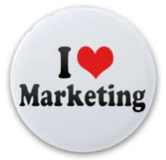

Strategic marketing
Lecture # 3
مساء الخير وأتمنى أن يكون الجميع بخير سنبدأ الساعة 6:10مساء بتوقيت القاهرة مع خالص الشكر د. علي يحيى

Slide 3
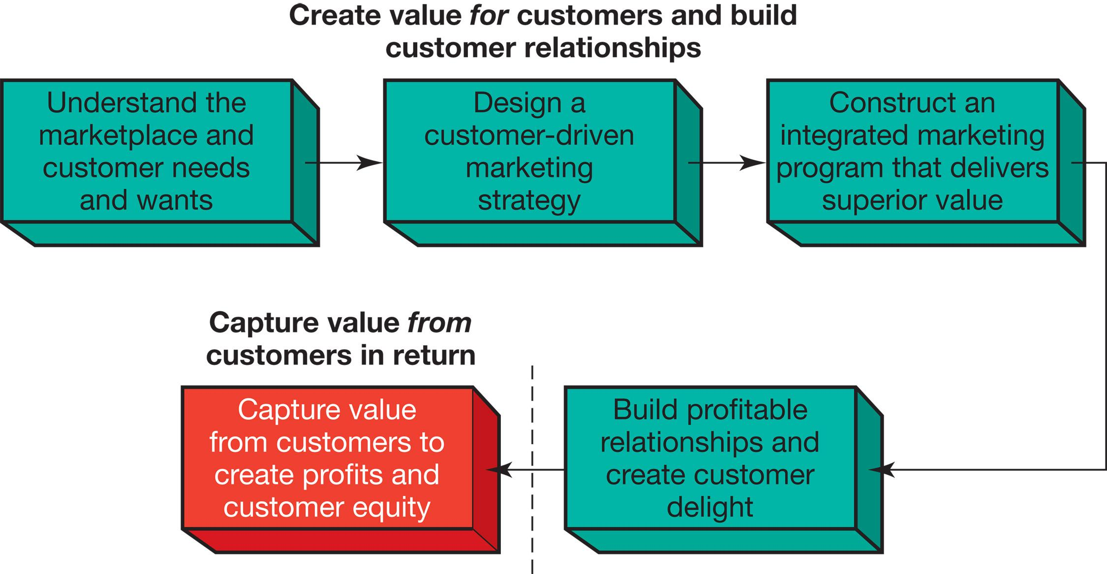
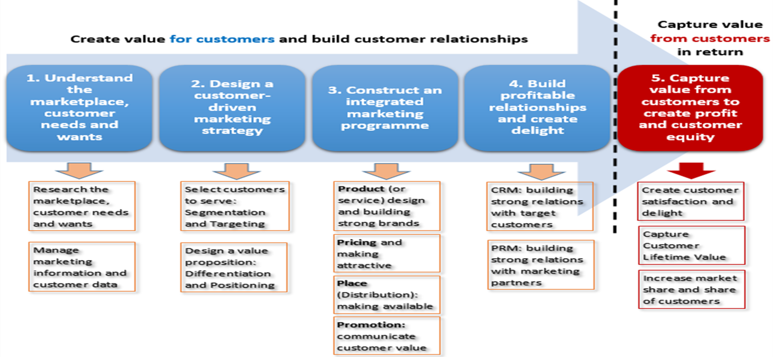
Marketing as a Process of Designing, Communicating and Delivering Value
1
2
3
4
5
- consumer buyer behaviour and consumer markets
- Business Buyer Behaviour and Business Markets
Needs and wants
Marketplace
Market offering
Strategic marketing analysis
Big data and MIS
Marketing research
Grand marketing strategies competitive and growth
STP strategies
Differentiation and branding
CRM tools and systems
CUSTOMER RELATIONSHIP GROUPS
Marketing control
Marketing MIX
4Ps
Marketing An Introduction FOURTEENTH EDITION
Gary Armstrong Philip Kotler
Notes:
The Marketing Process
In the first four steps, companies work to understand consumers, create customer value, and build strong customer relationships
In the final step, companies reap the rewards of creating superior customer value
By creating value for customers, companies are able capture value from customers in the form of sales, profits, and long-term customer equity

Slide 5
Marketing as a Process of Designing, Communicating and Delivering Value
1
2
3
4
5
- consumer buyer behaviour and consumer markets
- Business Buyer Behaviour and Business Markets
Needs and wants
Marketplace
Market offering
Strategic marketing analysis
Big data and MIS
Grand marketing strategies competitive and growth
STP strategies
Differentiation and branding
CRM tools and systems
CUSTOMER RELATIONSHIP GROUPS
Marketing control
Marketing MIX
4Ps
Marketing An Introduction FOURTEENTH EDITION
Gary Armstrong Philip Kotler
Notes:
The Marketing Process
In the first four steps, companies work to understand consumers, create customer value, and build strong customer relationships
In the final step, companies reap the rewards of creating superior customer value
By creating value for customers, companies are able capture value from customers in the form of sales, profits, and long-term customer equity

Slide 8
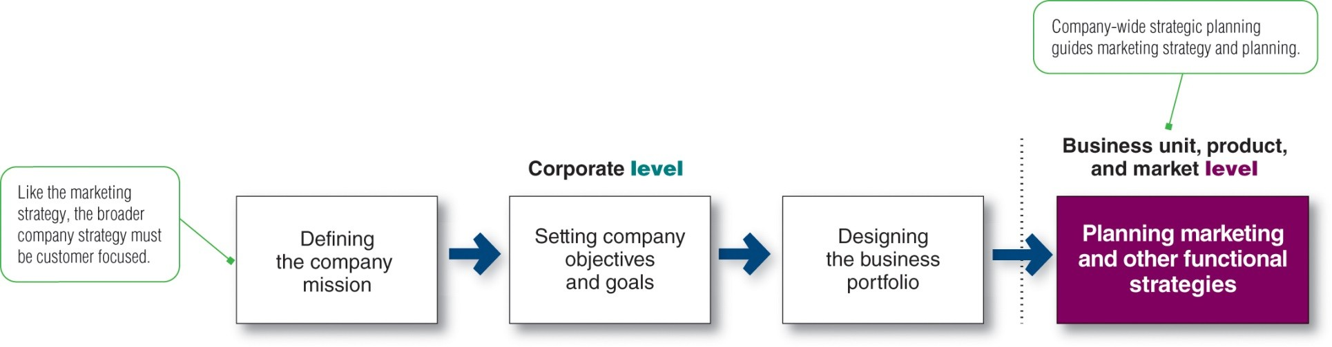
PLANNING MARKETING STRATEGIES
The marketing logic/how the company creates the customer value
Marketing strategy formulation
Where are we now? What is the business doing now, Identification: What is current strategy? Assumptions: What assumptions about the company’s relative position, strengths and weaknesses, competitors and industry trends must be made for the current strategy to be viable?
What is happening in the environment? Industry analysis: What are the key factors influencing competitive success? What are the important industry opportunities and threats? Competitor analysis: What are the capabilities and limitations of existing and potential competitors, and what are their probable future moves? Societal analysis: What important government, social and political factors will present opportunities or threats? what are the firm’s strengths and weaknesses relative to present and future competition?
What should the business be doing? Tests of assumptions and strategy: How do the assumptions embodied in the current strategy compare with the analysis indicated above? How does the strategy meet the tests indicated above? Strategic alternatives: What are the strategic alternatives given the analysis above? (Is the current strategy one of these?) Strategic choice: Which alternative best relates the company’s situation to external opportunities and threats?
Proctor, T., 2014, Strategic Marketing: An Introduction, Routledge
Notes:
Companies must find the game plan for long-run survival and growth that makes the most sense given its specific situation, opportunities, objectives, and resources. This is the focus of strategic planning—the process of developing and maintaining a strategic fit between the organization’s goals, capabilities and its changing marketing opportunities.
Strategic planning sets the stage for the rest of planning in the firm. Companies prepare annual plans, long-range plans, and strategic plans. The annual and long-range plans deal with the company’s current businesses and how to keep them going. In contrast, the strategic plan involves adapting the firm to take advantage of opportunities in its constantly changing environment.

Slide 9


Slide 10
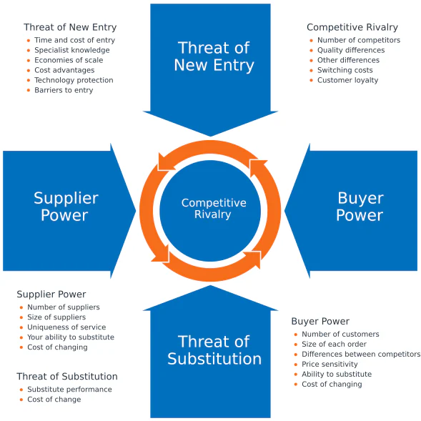


Slide 11
Macroenvironment analysis |PESTEL|
SWOT Analysis |integration of internal and external analyses|
Microenvironmental analysis |Porter 5 forces|
Analyzing Business enterprise
Analyzing Portfolio |internal environmental analysis|
PLC |product life cycle|
BCG |Growth share matrix|
GE/ analysis
Marketing Environment |external environmental analysis|.
1
STRATEGIC ENVIRONMENTAL ANALYSIS
≈≈
2
3

Slide 12
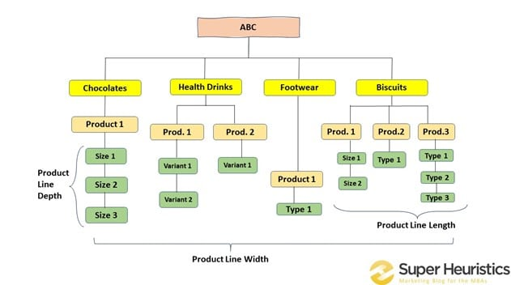
Analyzing Business Portfolio
Business Portfolio is a Collection of businesses and products that make up the company
Analyzing Business portfolios is identifying the key businesses that make up the company, called strategic business units (SBUs), a company division, a product line within a division, or sometimes a single product or brand.
Then the company assesses ts various SBUs and decides how much support each deserves in the future.
At last it must shape the future portfolio by developing strategies for growth and downsizing.
There are many models , the major ones are
PLC |product life cycle|
BCG |Growth share matrix|
GE/ McKinsey analysis
Biscuits
chocolates
3
3
ABC
7
Notes:
A business portfolio is a collection of businesses and products that make up the company. The best business portfolio is the one that best fits the company’s strengths and weaknesses to opportunities in the environment.
Business portfolio planning involves two steps. First, the company must analyze its current business portfolio and determine which businesses should receive more, less, or no investment. Second, it must shape the future portfolio by developing strategies for growth and downsizing.
The major activity in strategic planning is business portfolio analysis, which is the process by which management evaluates the products and businesses that make up the company.
.
The purpose of strategic planning is to find ways in which the company can best use its strengths to take advantage of attractive opportunities in the environment. For this reason, most standard portfolio analysis methods evaluate SBUs on two important dimensions: the attractiveness of the SBU’s market or industry and the strength of the SBU’s position in that market or industry.

Slide 13
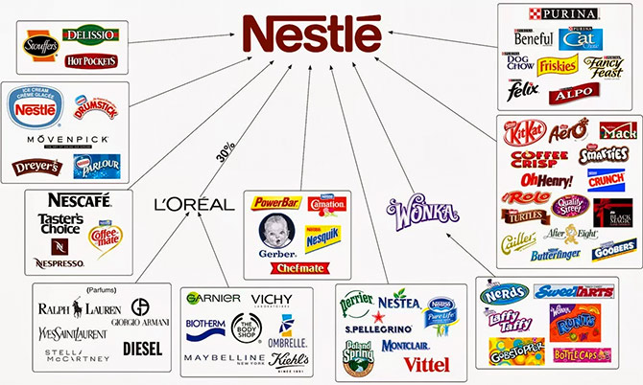

Slide 14
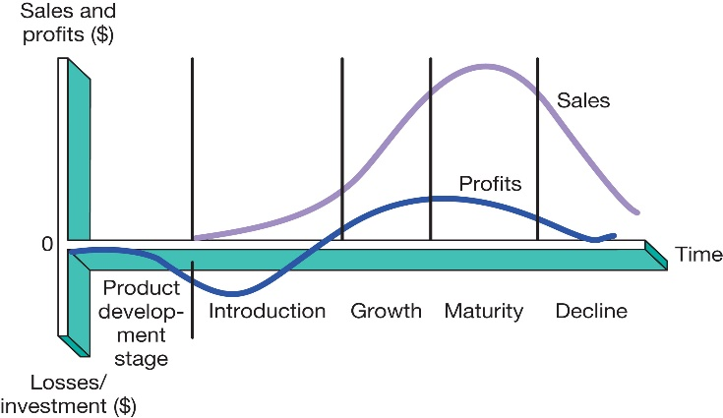
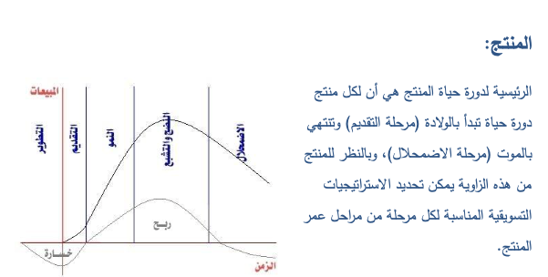
PLC-Product life cycle
2.1
Product development
Begins when the company finds and develops a new product idea
During product development, sales are zero and the company's investment costs add up
Introduction
A period of slow sales growth as the product is being introduced into the market
Profits are nonexistent at this stage because of the heavy expenses of product introduction
Growth
A period of rapid market acceptance and increasing profits
Maturity
A period of slowdown in sales growth because the product has achieved acceptance by most of its potential buyers
Although sales are still high, profits level off or decline because of increased marketing outlays to defend the product against competition
Decline
The period when sales fall off quickly and profits drop

Slide 15
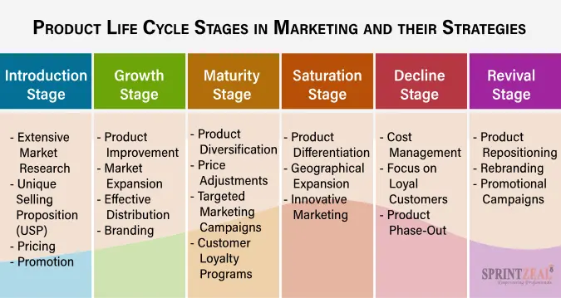
PLC-Product life cycle. Management and strategies
2.1

Slide 16
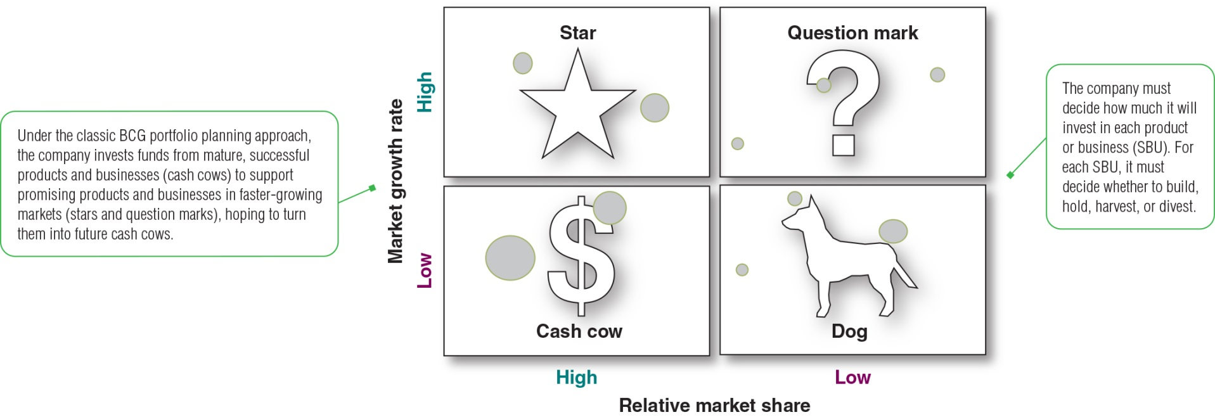
Growth-Share Matrix |BCG Matrix|
2.2
The best-known portfolio-planning method was developed by the Boston Consulting Group (BCG), a leading management consulting firm.
This BCG Growth-Share matrix shows the classification of company’s SBUs. Market growth rate provides a measure of market attractiveness. Relative market share serves as a measure of company strength in the market.
The Growth-Share Matrix defines four types of Products/ SBUs:
Stars are high-growth, high-share businesses or products.
Cash cows are low-growth, high-share businesses or products.
Question marks, are low-share business units in high-growth markets.
Dogs are low-growth, low-share businesses and products.
Notes:
The best-known portfolio-planning method was developed by the Boston Consulting Group (BCG), a leading management consulting firm. This BCG Growth-Share matrix shows the classification of company’s SBUs. Market growth rate provides a measure of market attractiveness. Relative market share serves as a measure of company strength in the market.
The Growth-Share Matrix defines four types of SBUs:
Stars are high-growth, high-share businesses or products.
Cash cows are low-growth, high-share businesses or products.
Question marks, are low-share business units in high-growth markets.
Dogs are low-growth, low-share businesses and products.
The 10 circles in this growth-share matrix would represent a company’s 10 current SBUs. The company must decide how much it will invest in each product or business SBU. It must decide whether to build, hold, harvest or divest.

Slide 17
Benefits of a BCG matrix:
portfolio Analysis: analyze product portfolio by categorizing products into four quadrants based on their market growth rate and relative market share. This segmentation offers a clear overview of each product’s performance and potential.
Resource Allocation: aids in effective resource allocation. It helps businesses prioritize investments, allocate budgets, and align resources with strategic goals.
Decision-Making Support: The BCG Matrix simplifies complex data and presents it visually, making it easier for decision-makers in strategic decision-making by providing a structured framework.
Strategic Direction: With insights from the BCG Matrix, companies can identify growth drivers (Stars) and steady revenue generators (Cash Cows) within their portfolio. This enables the alignment of strategic priorities with business objectives.
Market Positioning: The BCG Matrix helps identify products with growth potential (Question Marks) and those that may require divestment or repositioning (Dogs). This enables businesses to seize new opportunities and optimize their market positioning..

Slide 18
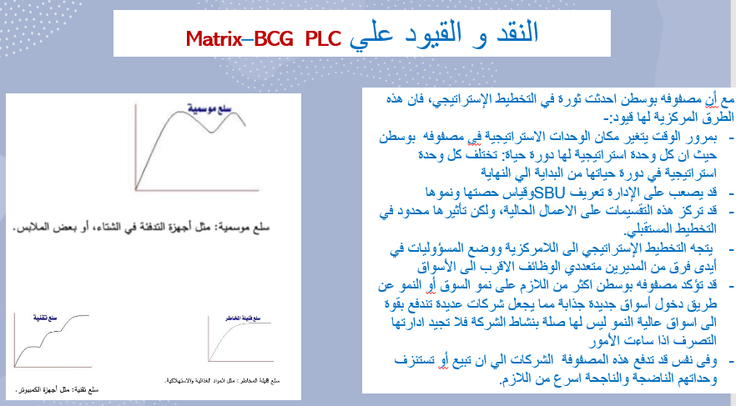
Criticism / Limitations of the Product Life Cycle
The product life cycle concept is that it in no way predicts the length of each phase, nor can it be used to forecast sales with any accuracy.
Another is that the model can be self-fulfilling: if a marketer decides that a product is approaching its Decline phase, and so stops actively marketing it, the product's sales will almost inevitably decline. This might not have happened had it been managed as if it was still in its Maturity phase.
Furthermore, it's possible that by improving a product aggressively on an ongoing basis, growth can continue for a long time. Just think of the market for smartphones, computers and tablets: successful manufacturers continue to launch new and better products year after year.

Slide 19
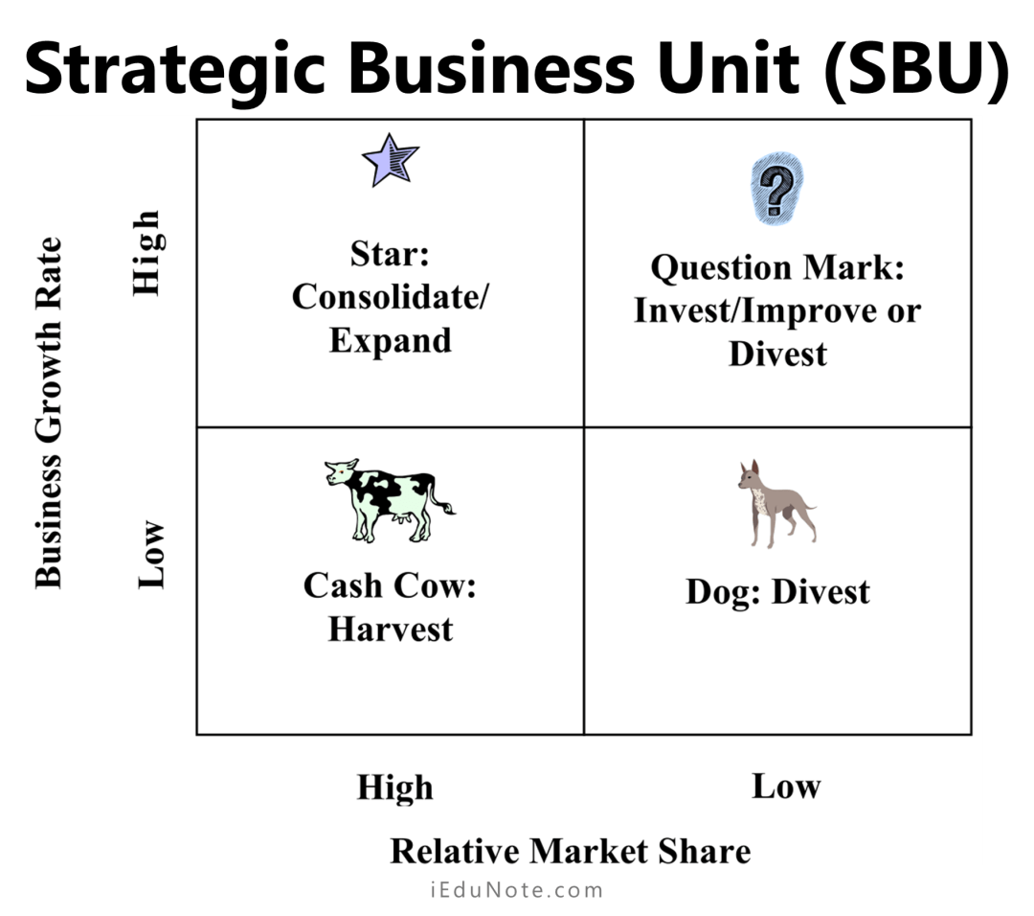
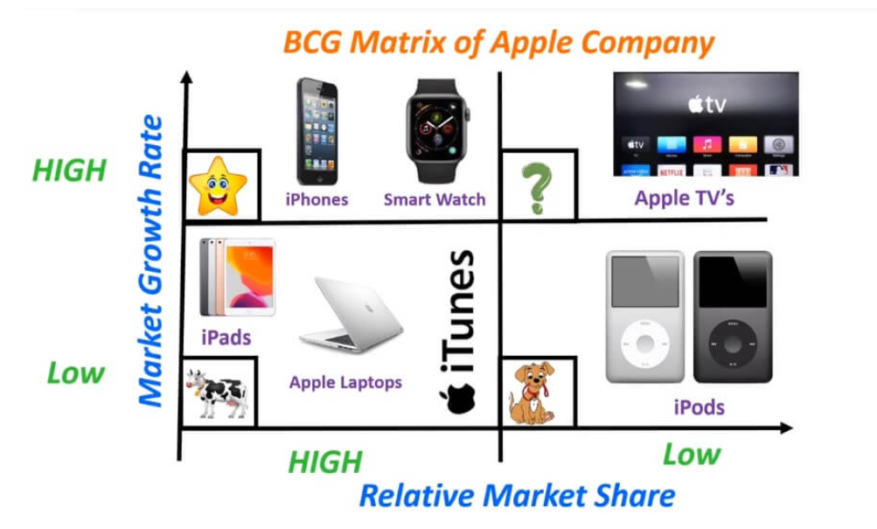
BCG Matrix strategies & Example

Slide 20
Limitations of a BCG matrix:
Oversimplification: categorizing products into only four quadrants based on market growth rate and relative market share, the model overlooks the complexities and market environment. does not account for non-market factors, such as social, environmental, and ethical considerations
Incomplete Analysis: ignoring other crucial variables, such as competition, customer preferences.
Historical Focus: The BCG Matrix relies heavily on historical data, analyzing a product’s past performance rather than providing insights into its future potential. Lack of industry/ Market Dynamics: does not account for the pace at which markets evolve or how quickly a product’s position may change. In dynamic industries, the model’s static analysis may lead to inaccurate strategic recommendations.
Ignores Synergy: The BCG Matrix evaluates products in isolation, disregarding potential synergies and interdependencies among products within a company’s portfolio. A product considered a “dog” alone may add value when combined with other offerings.
Not Suitable for Diverse Businesses: The BCG Matrix is most effective for businesses with a single core market. Companies with diverse product lines or operating in multiple industries may find it challenging to use the matrix effectively.

Slide 21
BCG Matrix Example

Slide 22


Activity #2

Slide 23
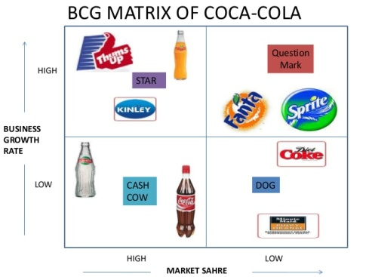

Slide 25
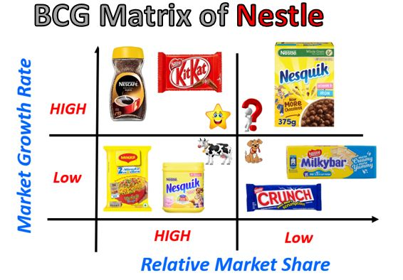

Slide 26
Macroenvironment analysis |PESTEL|
SWOT Analysis |integration of internal and external analyses|
Microenvironmental analysis |Porter 5 forces|
business portfolio analysis |internal environmental analysis|
PLC |product life cycle|
BCG |Growth share matrix|
Marketing Environment |external environmental analysis|.
1
Strategic environmental analysis
2
3

Slide 27
Figure 5. The SWOT Framework for Assessing a Company’s Market Position
inferior
superior

Slide 28
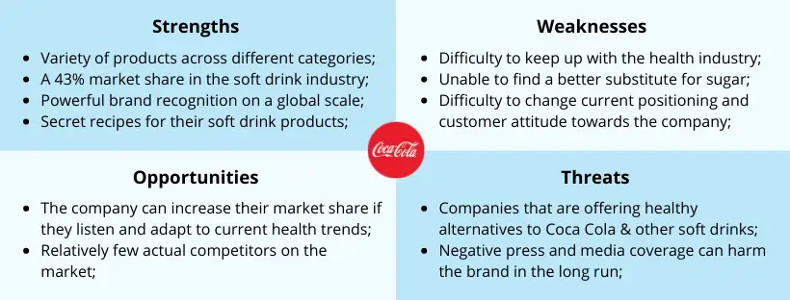
SWOT Analysis
Strengths Unique resources, competencies, capabilities superior to competition AND relevant to consumers NOT a long list, but the most customer-relevant and competitively distinct
Internal Focus

Slide 29

SWOT Analysis
Weaknesses Resources, capabilities, competencies, inferior to competition Based on understanding customer needs/ requirements and distinctive competencies

Slide 30

SWOT Analysis
Opportunities Summarizes favorable trends or developments that lead to higher sales, profits or new business opportunities Describe external situation, not desired action/strategy

Slide 31
SWOT Analysis
Threats Summarizes unfavorable trends or developments that threaten sales, profits or limits new business opportunities Recognize threats to avoid or limit impact

Slide 32
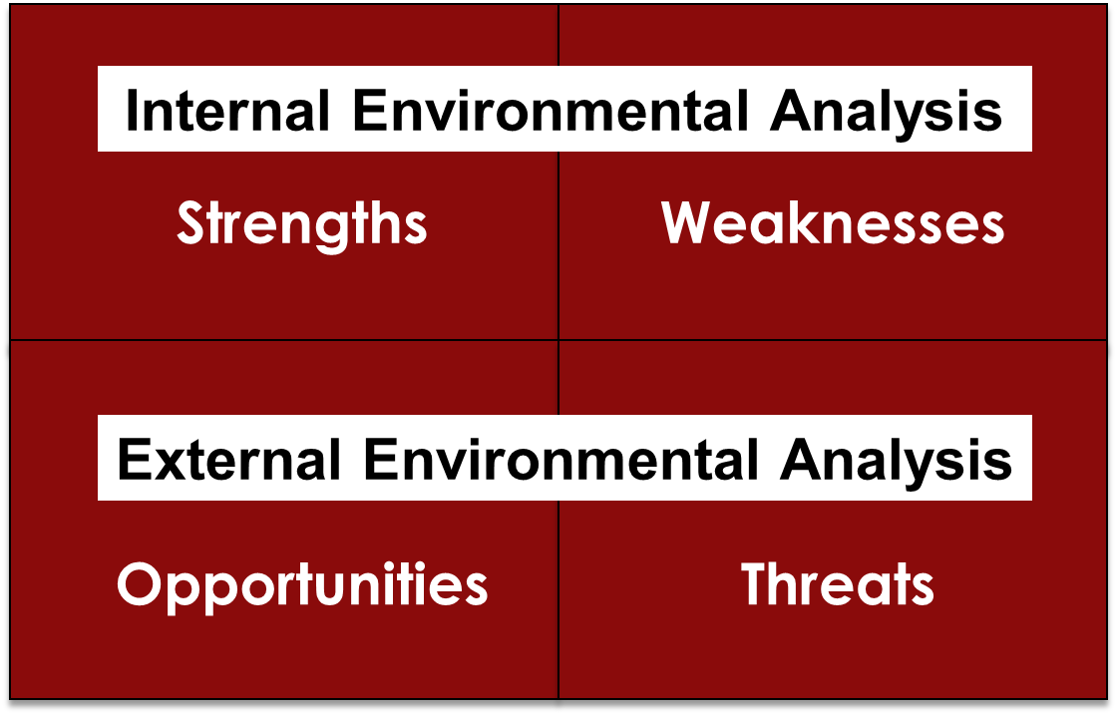
SWOT Analysis
Notes:
SWOT analysis evaluates the company's overall strengths (S), weaknesses (W), opportunities (0), and threats (T)
Strengths
Internal capabilities, resources, and positive situational factors that may help the company to serve its customers and achieve its objectives
Weaknesses
Internal limitations and negative situational factors that may interfere with the company's performance
Opportunities
Favorable factors or trends in the external environment that the company may be able to exploit to its advantage
Threats
Unfavorable external factors or trends that may present challenges to performance.
Internal Environmental Analysis (Strengths and Weaknesses Analysis)
Each business needs to evaluate its strengths and weaknesses periodically
Management or an outside consultant reviews the business's marketing, financial, manufacturing, and organizational competencies
External Environmental Analysis (Opportunity and Threat Analysis)
The business manager now knows the parts of the environment to monitor if the business is to achieve its goals
Macroenvironmental forces
Demographic-economic
Technological
Political-legal
Social-cultural
Microenvironmental forces
Customers
Competitors
Distribution channels
Supplies

Slide 33
Activity #4 SOWT practice

Slide 34
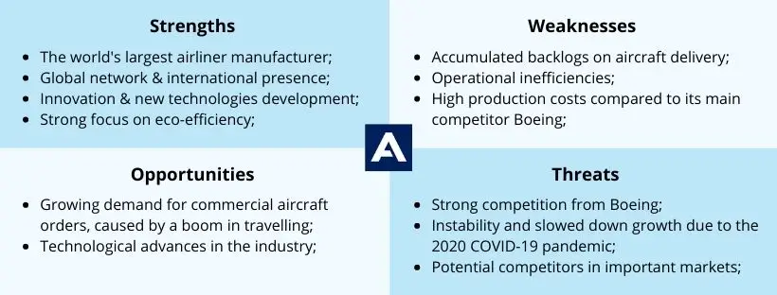

AIRBUS SWOT

Slide 35
AIRBUS SWOT

Slide 36
Marketing as a Process of Designing, Communicating and Delivering Value
1
2
3
4
5
- consumer buyer behaviour and consumer markets
- Business Buyer Behaviour and Business Markets
Needs and wants
Marketplace
Market offering
Strategic marketing analysis
Big data and MIS
Marketing research
Grand marketing strategies competitive and growth
STP strategies
Differentiation and branding
CRM tools and systems
CUSTOMER RELATIONSHIP GROUPS
Marketing control
Marketing MIX
4Ps
Marketing An Introduction FOURTEENTH EDITION
Gary Armstrong Philip Kotler
Notes:
The Marketing Process
In the first four steps, companies work to understand consumers, create customer value, and build strong customer relationships
In the final step, companies reap the rewards of creating superior customer value
By creating value for customers, companies are able capture value from customers in the form of sales, profits, and long-term customer equity

Slide 37
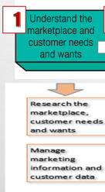
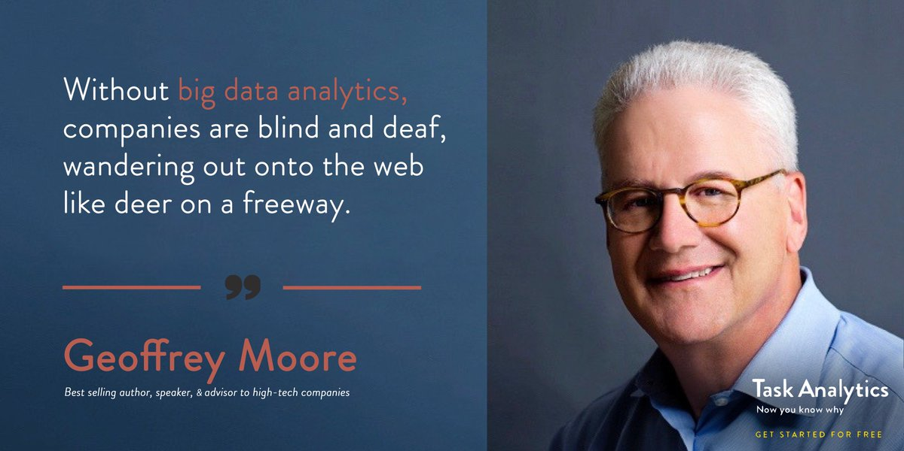
1- Understanding customer needs/wants.
Geoffrey Moore is an American organizational theorist, management consultant and author, known for his work Crossing the Chasm: Marketing and Selling High-Tech Products to Mainstream

Slide 38
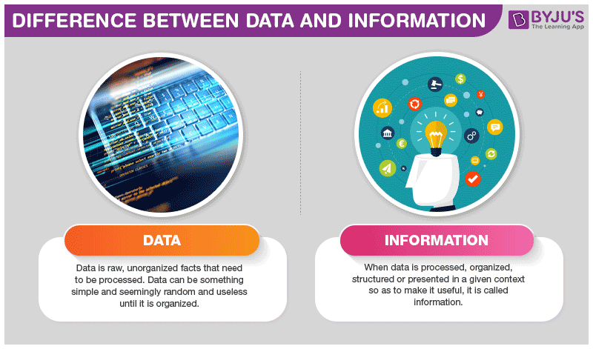
Managing Marketing Information
Information is generated by Big Data could help marketers in decision making
Right information, in the right form, at the right time help Marketer to create customer value, engagement and stronger customer relationships.
For example, Coca-Cola or Apple monitors online discussions about its brand in Tweets, blogs, social media posts, and other sources, to gain valuable information about
Customer insights about the current and future products
Market insights
Notes:
Most marketing managers are overloaded with data and often overwhelmed by it. Marketers don’t need more information; they need better information. And they need to make better use of the information they already have.
The real value of marketing res
Big data presents marketers with both big opportunities and big challenges. Companies that effectively tap this glut of big data can gain rich, timely customer insights.
Far from lacking information, most marketing managers are overloaded with data. Accessing and sifting through so much data is a daunting task. For example, when a large consumer brand such as Coca-Cola or Apple monitors online discussions about its brand in Tweets, blogs, social media posts, and other sources, it might take in a stunning 6 million public conversations a day, more than 2 billion a year arch and marketing information lies in how it is used—in the customer insights that it provides.

Slide 39

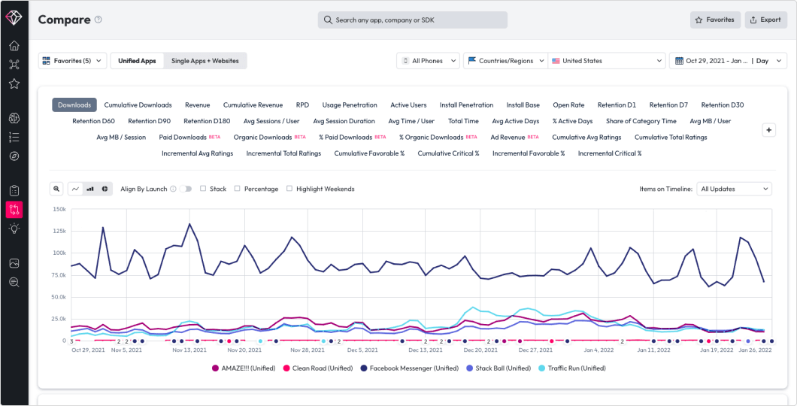
Big data
Big data refers to the huge data sets generated by sophisticated information generation, collection, storage, and analysis technologies. .
An average of 6 million public conversations a day, more than 2 billion a year arch and marketing information lies in how it is used and in the customer insights that it provides.
Analyzing the wealth of data about customers as Browsing history, purchase. patterns, returns, campaign response patterns etc.
Companies that effectively tap this glut of big data can gain rich, timely customer insights
The 1st Unified Data AI Company to combine consumer and market data with the power of artificial intelligence to fuel insights.
Notes:
Most marketing managers are overloaded with data and often overwhelmed by it. Marketers don’t need more information; they need better information. And they need to make better use of the information they already have.
The real value of marketing res
Big data presents marketers with both big opportunities and big challenges. Companies that effectively tap this glut of big data can gain rich, timely customer insights.
Far from lacking information, most marketing managers are overloaded with data. Accessing and sifting through so much data is a daunting task. For example, when a large consumer brand such as Coca-Cola or Apple monitors online discussions about its brand in Tweets, blogs, social media posts, and other sources, it might take in a stunning 6 million public conversations a day, more than 2 billion a year arch and marketing information lies in how it is used—in the customer insights that it provides.

Slide 40



Customer and Market insights.
It is important to understand Customer needs, but it is crucial to understand CUSTOMER AND MARKET INSIGHTS .
It is an interpretation of consumer and market trends through having a deep understanding customers, needs, behaviors and preferences
Marketers can communicate with customers in a highly personalized way provide them with added value that leads to long-term relationships.
It has Became the basis for creating customer value, engagement, and relationships.
Notes:
Most marketing managers are overloaded with data and often overwhelmed by it. Marketers don’t need more information; they need better information. And they need to make better use of the information they already have.
The real value of marketing res
Big data presents marketers with both big opportunities and big challenges. Companies that effectively tap this glut of big data can gain rich, timely customer insights.
Far from lacking information, most marketing managers are overloaded with data. Accessing and sifting through so much data is a daunting task. For example, when a large consumer brand such as Coca-Cola or Apple monitors online discussions about its brand in Tweets, blogs, social media posts, and other sources, it might take in a stunning 6 million public conversations a day, more than 2 billion a year arch and marketing information lies in how it is used—in the customer insights that it provides.

Slide 41
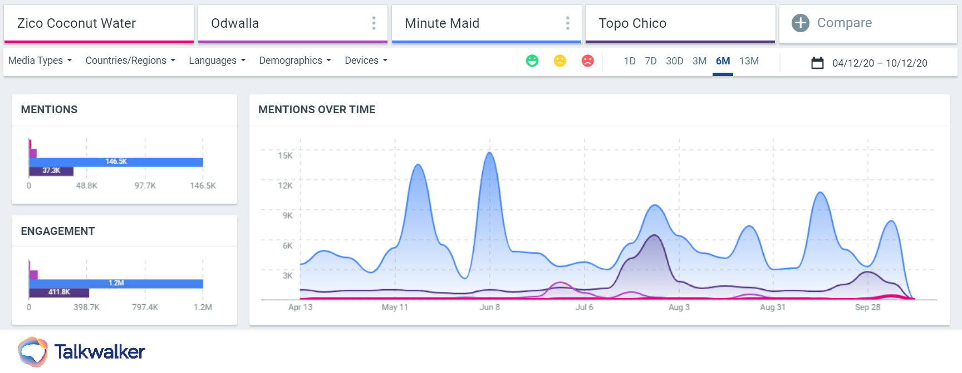
Successful companies took decisions Customer and Market insights.
Coca-Cola a result of revenue, but with social listening tools, announced it would be removing Zico, its coconut water product, just as they did with Odwalla, as they had not grown over a three-year period. By sacrificing these beverages, This decision is often the brand has decided to bet on more successful ranges like Minute Maid and Topo Chico.
Notes:
| Identify what’s holding you back
One simple fact of the consumer goods industry is that businesses have to quickly identify and cut underperforming products in order to survive. analyzing a product line can provide early indicators as to which products should be taken off the shelves and which products consumers are coming back for.

Slide 42
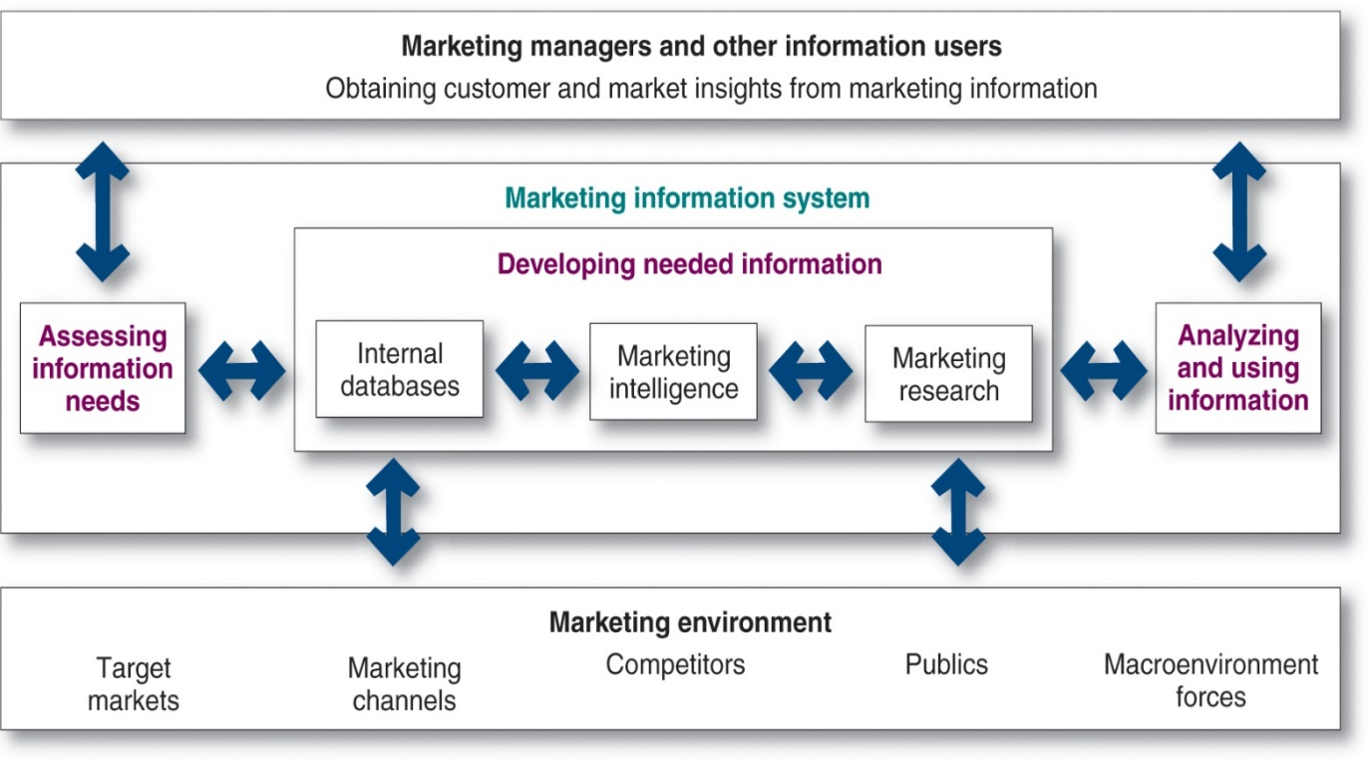
The Marketing Information System (MIS)
It is essential for companies to design effective marketing information systems that consists of people , systems , and procedures to
Assess information needs
Develop the needed information
Help decision makers with the right
information, in the right form, at the right time to help them to create customer value, engagement and stronger customer relationships.
Notes:
This figure shows that the MIS begins and ends with information users.
The information users are marketing managers, internal and external partners, and others who need marketing information. Marketers start by assessing user information needs. Next, they develop needed information using internal company databases, marketing intelligence activities, and marketing research. Finally, the MIS helps users to analyze and use the information to develop customer insights, make marketing decisions, and manage customer engagement and relationships.

Slide 43

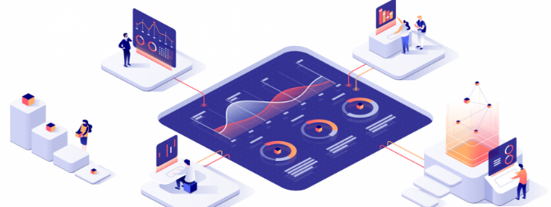
Internal Databases
IMS - developing needed information
1
Internal databases are collections of consumer and market information obtained within the company from
Company Record
Point-of-Sale
Employees' feedback
Pros :
Data can be accessed more quickly and cheaply than other information sources,
Cons :
Data also ages quickly; keeping the database current requires a major effort.
Data may be incomplete or in the wrong form for making marketing decisions
Notes:
Internal databases usually can be accessed more quickly and cheaply than other information sources, but they also present some problems. Because internal information is often collected for other purposes, it may be incomplete or in the wrong form for making marketing decisions. Data also ages quickly; keeping the database current requires a major effort. Finally, managing and mining the mountains of information that a large company produces requires highly sophisticated equipment and techniques.

Slide 44

Amazon is very successful in using personalized marketing
Examples of using Internal Databases
Amazon’s recommendation algorithm consistently makes headlines for its strategic approach to personalized marketing
Cleverly encouraging impulse buying by highlighting key tastes and products to match, it’s a tactic that pays off.
The company reported a 29% sales increase to $12.83 billion during its second fiscal quarter, up from $9.9 billion during the same time the previous year.

Slide 45
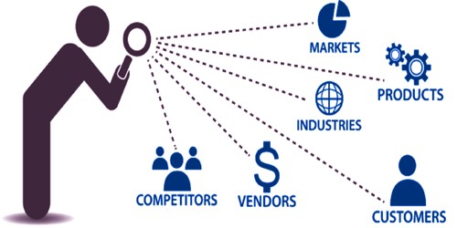
Competitive Marketing Intelligence
IMS - developing needed information
2
Systematic monitoring, collection, and analysis of information about consumers, competitors, and developments in the marketing environment
Offers insights about consumer opinions and their association with the brand
Provides early warnings of competitor strategies and potential competitive strengths and weaknesses
Techniques
Observing consumers first-hand
Quizzing the company’s own employees
Benchmarking competitors’ products
Monitoring social media buzz
Mystery shopping
Notes:
The goal of competitive marketing intelligence is to improve strategic decision making by understanding the consumer environment, assessing and tracking competitors’ actions, and providing early warnings of opportunities and threats.
Good marketing intelligence can help marketers gain insights into how consumers talk about and engage with their brands. Many companies send out teams of trained observers to mix and mingle personally with customers as they use and talk about the company’s products. Other companies, like MasterCard, have set up sophisticated digital command centers that routinely monitor brand-related online consumer and marketplace activity.
Companies can monitor competitors’ Web sites and use the Internet to search specific competitor names, events, or trends and see what turns up. Tracking consumer conversations about competing brands is often as revealing as tracking conversations about the company’s own brands.
Companies can obtain important intelligence information from suppliers, resellers, and key customers. Intelligence seekers can pour through any of the thousands of online databases. For example, the U.S. Security and Exchange Commission’s database provides a huge stockpile of financial information on public competitors, and the U.S. Patent Office and Trademark database reveals patents that competitors have filed.
Some intelligence gathering techniques may involve questionable ethics. With all the legitimate intelligence sources now available, a company does not need to break the law or accepted codes of ethics to get good intelligence.

Slide 46

The Marketing Research
IMS - developing needed information
3
Systematic design, collection, analysis, and reporting of data relevant to a specific marketing situation facing an organization
تعريف أبحاث التسويق من الجمعية الأمريكية للتسويق :AMAانها الأداة التي تربط المُسوقين باللعملاء وذلك من خلال جمع المعلومات التي تساعد المسوقين في اكتشاف فرص آوحلول مشاكل تسويقيه. كما يمكن استخدام هذه الأبحاث في تقييم الإجراءات المتبعة في عملية التسويق، ومراقبة الأداء بها وتحسينها.
Notes:
Companies use marketing research in a wide variety of situations. For example, marketing research gives marketers insights into customer motivations, purchase behavior, and satisfaction. It can help them to assess market potential and market share or measure the effectiveness of pricing, product, distribution, and promotion activities.

Slide 47

The need for Marketing Research
To Forecast future trends & anticipate future customer need
To have an always update on the vast changes :
Changes in technology
Changes in consumer tastes
Changes in Market demand
Changes in the product ranges of competitors
Changes in economic conditions
Changes Distribution channels
To Reduce the risk of new product business failure
To Forecast future trends & anticipate future customer need
To have an always update on the vast changes :
Changes in technology
Changes in consumer tastes
Changes in Market demand
Changes in the product ranges of competitors
Changes in economic conditions
Changes Distribution channels
To Reduce the risk of new product business failure:

Slide 48

Marketing Research Approaches
List Of Top Market Research Companies
Nielsen.
IQVIA.
Kantar.
Gartner.
IPSOS.
GfK.
IRI.
Dynata.
Companies might Use their own research departments
Companies might Purchase data collected by outside firms
Companies might Hire outside research specialists
تجاوز الإنفاق على أبحاث التسويق 70 مليار دولار على مستوى العالم في عام 2022 ، وفقا ل ، ESOMAR وهي المنظمة العالمية التي تتولى تحديد أسس وإجراءات إعداد بحوث التسويق ودراسات السوق، حيث أصدرت “الكود المهني لبحوث التسويق.

Slide 49

Case study # 1

Slide 50

THE NEED FOR MARKETING RESEARCH
في احدي المدن الأمريكية حاولت ماكدونالدز مضاعفه مبيعات الفترة الصباحية و لم تنجح أي طريقه من طرقهم المعروفة كالعروض ومهاره البائعين وغيره .يا تري ماذا فعلت ماكدونالدز

Slide 51
حاولت ماكدونالدز تزود مبيعات الفترة الصباحية في احدي المدن الأمريكية و لم تنجح أي طريقه من طرقهم المعروفة كالعروض ومهاره البائعين.
.ماكدونالدز طلبوا من Harvard Business School يساعدوهم،
هارفارد قامت بعمل بحث ثانوي ( بحث مكتبي ) بتحليل المبيعات ووجدوا أن عينة كبيرة من مبيعات الفترة الصباحية بتكون من مبيعات الميلك شيك.
هارفارد كملت بعمل بحث آولي (بحث في السوق) وعملت مقابلات مع العملاء وسألوا العملاء خلال الدراسة كالاتي
"لماذا تشتري الميلك شيك في الصباح الباكر جدا "،
فالعملاء قالوا لهم أن مشوار الشغل طويل وممل جدا، ومحتاجين حاجة تسليهم على الطريق وتشبعهم لحد ما يفطروا.
وكان السؤال الثاني، طب لو ما اشتريت ميلك شيك ممكن تشتري إيه؟
فالعملاء قالوا ومحتاجين حاجه سهل يمسكوها وهم في السيارة
وكان السؤال الثالث هل ممكن احد الاختيارات الأتية سندوتشات (فالعملاء قالوا صعبة في التناول للسائق)
هل ممكن دونات أو قهوة (فالعملاء قالوا ممكن خطر جد وقد ونصل الشغل ببقع)
وكان السؤال الرابع ايه البديل فالعملاء ردوا ممكن حاجات جافه مثل بسكوت اوشوكولاتة سنيكرز مثلا (بس بتخلص بسرعة).
وكان السؤال الاخير ايه التحسينات المطلوبة . هل ممكن تخليه أكبر حجما، يزودوا الشوكولاتة، يعملوا منتج السكر فيه قليل، يخلوه خفيف أكتر، تقيل أكتر، يعملوه صحيا و تزود فيه قطعة فاكهة زاي وكمان اخدت اقتراحات بتنفيذ الطلب والدفع أسرع حتي لا تتعطل الموظفين علي أوقات الدوام،
وهنا فقط استطاعت ماكدونالدز فهم المشكلة و فهم حلها و ما هو احتياج العملاء ، وقدرت تزود مبيعاته ٧ اضعاف
Notes:
من معلومات لم مقابلات مع العملاء تسألهم عن إيه اللي ممكن يشجعهم يشتروا زيادة. هل يزودوا الشوكولاتة، يعملوا منتج السكر فيه قليل، يخلوه خفيف أكتر، تقيل أكتر، يعملوه صحيعنبتكون في الصباح الباكر جدا"الميلك شيك" أوقات الشراءتتراوح بينالناس بيشتروا المنتج ليهماهي

Slide 52
THE NEED FOR MARKETING RESEARCH

Slide 53
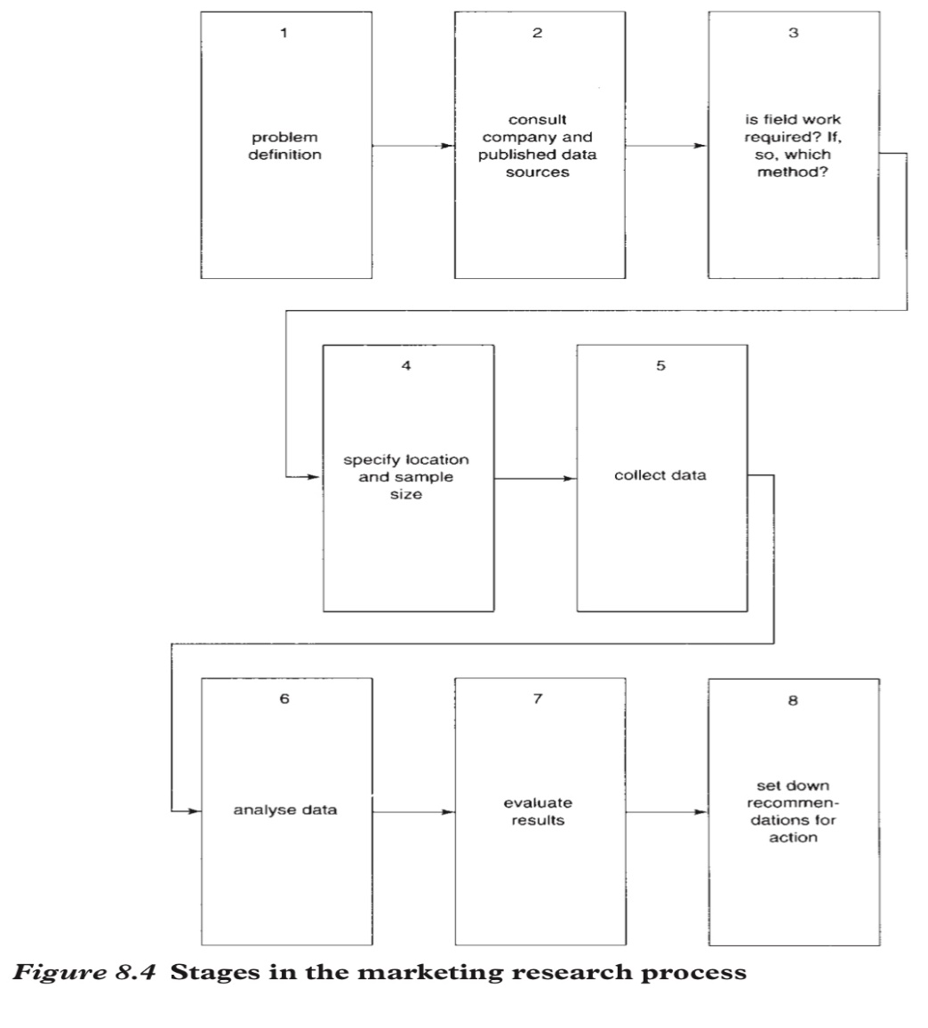
The Marketing Research stages
Expanded Marketing research Process
Define the problem/ Define research objectives
Check secondary data secondary research desk research
Check the need for primary data /primary research field research/ which methods ?
Construct sample/ location
Collect data
Analysis of data
Evaluate results
Recommendation for actions.
Proctor, T., 2014, Strategic Marketing: An Introduction, Routledge
Notes:
Marketing research follows a process that has four steps: defining the problem and research objectives; developing the research plan; implementing the research plan; and interpreting and reporting the findings. Each of these stages is discussed in detail in the following slides.
Marketing managers and researchers must work together closely to define the problem and agree on research objectives. The manager best understands the decision for which information is needed, whereas the researcher best understands marketing research and how to obtain the information. Defining the problem and research objectives is often the hardest step in the research process.
After the problem has been defined carefully, the manager and the researcher must set the research objectives.
Managers often start with exploratory research and later follow with descriptive or causal research. The statement of the problem and research objectives guides the entire research process. The manager and the researcher should put the statement in writing to be certain that they agree on the purpose and expected results of the research.

Slide 54
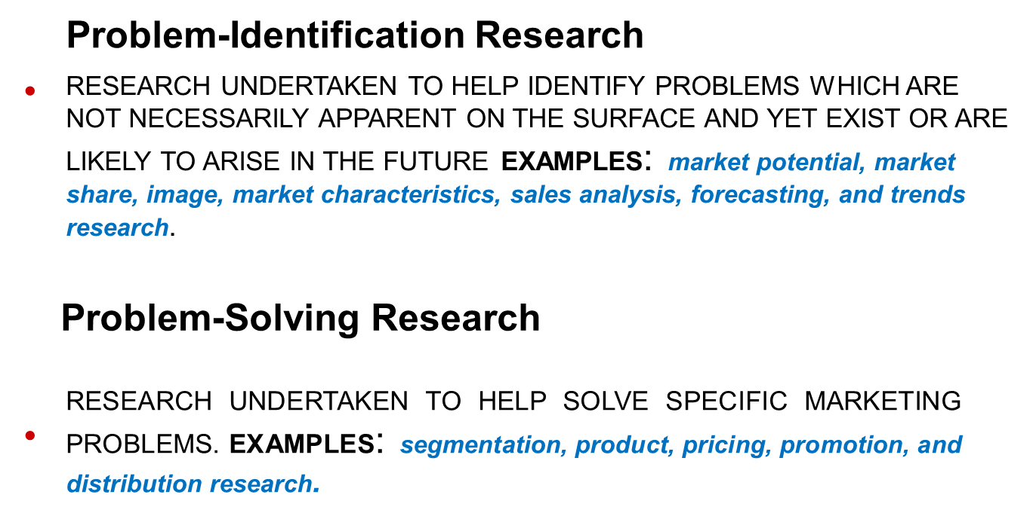

1- Define the Research Problem
Notes:
Expanded Marketing research Process
Define the problem/ Define research objectives
Check secondary data secondary research desk research
Check the need for primary data /primary research field research
Construct sample/ location
Collect data
Analysis of data
Evaluate results
Recommendation for actions.

Slide 55
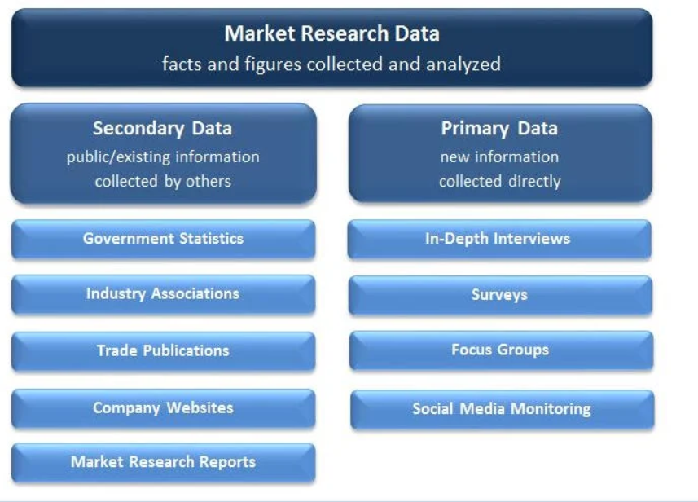
Check secondary data secondary research desk research1/3
Notes:
Researchers usually start by gathering secondary data. The company’s internal database provides a good starting point. Companies can buy secondary data from outside firms that supply high-quality data to suit a wide variety of marketing information needs.
The company can also utilize the wide assortment of external information sources. Using commercial online databases, marketing researchers can conduct their own searches of secondary data sources. Internet search engines can also help in locating relevant secondary information sources. However, they can also be very frustrating and inefficient.

Slide 56
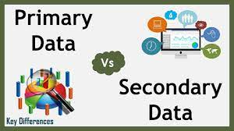
2- Check secondary data secondary research desk research,
3/3
Advantages
Low cost
Obtained quickly
Cannot collect otherwise
Disadvantages
Potentially Irrelevant
Inaccurate
Dated
Biased
Notes:
Secondary data can usually be obtained more quickly and at a lower cost than primary data. Also, secondary sources can sometimes provide data an individual company cannot collect on its own, like data that is not available directly or would be too expensive to collect. For example, it would be too expensive for Red Bull’s marketers to conduct a continuing retail store audit to find out about the market shares, prices, and displays of competitors’ brands.
However, secondary data can also present problems. Researchers can rarely obtain all the data they need from secondary sources. For example, Chipotle will not find existing information regarding consumer reactions about new drive-thru service that it has not yet installed. Even when data can be found, the information might not be very usable.
The researcher must evaluate secondary information carefully to make certain it is relevant, accurate, up-to-date, and impartial.

Slide 57
2- Check secondary data secondary research desk research 2/3
Information that already exists
Collected for another purpose
Sources:
Company’s internal database
Purchased from outside suppliers
Commercial online databases
Internet search engines
Sources: of Secondary Data
Notes:
Researchers usually start by gathering secondary data. The company’s internal database provides a good starting point. Companies can buy secondary data from outside firms that supply high-quality data to suit a wide variety of marketing information needs.
The company can also utilize the wide assortment of external information sources. Using commercial online databases, marketing researchers can conduct their own searches of secondary data sources. Internet search engines can also help in locating relevant secondary information sources. However, they can also be very frustrating and inefficient.

Slide 58
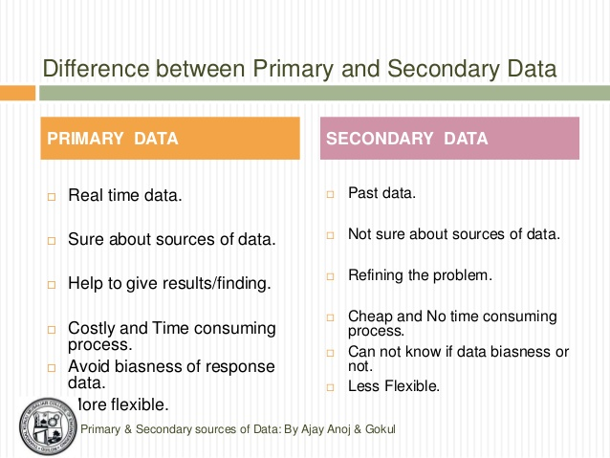
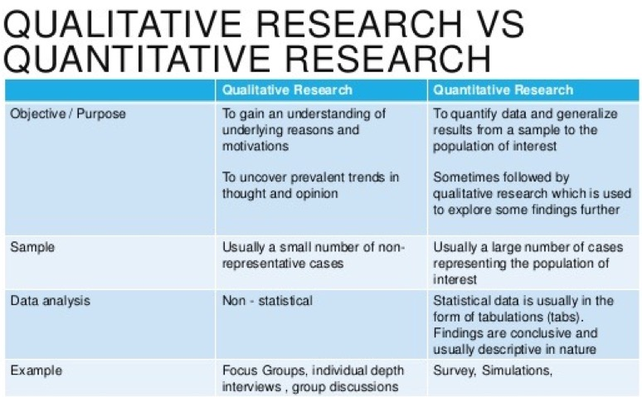
3- Check the need for primary data /primary research field research/ which methods 1/2
Notes:
This table shows that designing a plan for primary data collection calls for a number of decisions on research approaches, contact methods, the sampling plan, and research instruments. The following slides discuss each of these decisions in detail.
Increasingly, researchers are collecting primary data through online marketing research. The Internet is especially well suited to quantitative research. Advantages of Internet-based surveys are speed and low costs. Researchers can quickly and easily distribute surveys to thousands of respondents and responses can be almost instantaneous. Internet-based surveys also tend to be more interactive and engaging, easier to complete, and less intrusive.
A primary qualitative Internet-based research approach is online focus groups. For example, FocusVision’s InterVu service lets focus group participants at remote locations see, hear, and react to each other in real-time, face-to-face discussions.
Both quantitative and qualitative Internet-based research have some drawbacks. One major problem is controlling who’s in the online sample. To overcome such sample and context problems, many online research firms use opt-in communities and respondent panels. Alternatively, many companies are now developing their own custom social networks and using them to gain customer inputs and insights.

Slide 59
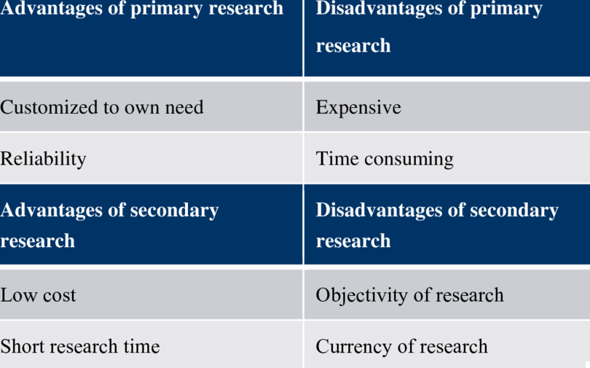
Secondary /primary Research Advantages and Disadvantages
Notes:
Secondary data can usually be obtained more quickly and at a lower cost than primary data. Also, secondary sources can sometimes provide data an individual company cannot collect on its own, like data that is not available directly or would be too expensive to collect. For example, it would be too expensive for Red Bull’s marketers to conduct a continuing retail store audit to find out about the market shares, prices, and displays of competitors’ brands.
However, secondary data can also present problems. Researchers can rarely obtain all the data they need from secondary sources. For example, Chipotle will not find existing information regarding consumer reactions about new drive-thru service that it has not yet installed. Even when data can be found, the information might not be very usable.
The researcher must evaluate secondary information carefully to make certain it is relevant, accurate, up-to-date, and impartial.

Slide 60
3- Check the need for primary data /primary research field research/ which methods 2/2
Experimental research
Selecting matched groups of subjects, giving them different treatments, controlling related factors, and checking for differences in group responses
Observational research
Gathering primary data by observing relevant people, actions, and situations
Survey research
Asking people questions about their knowledge, attitudes, preferences, and buying behaviors
Mail questionnaires are used to collect large amounts of information at a low cost per respondent
Interviewing research methods include;
Individual interviewing
Group interviewing
F-F or Telephone interviewing
Notes:
Observational and ethnographic research yield the kinds of details that don’t emerge from traditional research questionnaires or focus groups. For instance, Fisher-Price has established an observation lab in which it can observe the reactions children have to new toys.
A wide range of companies now use ethnographic research. For example, Coors insights teams frequent bars and other locations in a top-secret, small-town location—they call it the “Outpost”—within a day’s drive of Chicago. The researchers use the town as a real-life lab.
Survey research is the approach best suited for gathering descriptive information. The major advantage of survey research is its flexibility. Surveys addressing almost any marketing question or decision can be conducted by phone or mail, in person, or online. The disadvantages of survey research are that people may be unwilling to respond to unknown interviewers or answer questions about topics they consider private.
Whereas observation is best suited for exploratory research and surveys for descriptive research, experimental research is best suited for gathering causal information. Experimental research tries to explain cause-and-effect relationships. For example, before adding a new sandwich to its menu, McDonald’s might use experiments to test the effects on sales of two different prices it might charge.
questionnaires can be used to collect large amounts of information at a low cost per respondent. Respondents may give more honest answers to more personal questions on a mail questionnaire than to an unknown interviewer. However, mail questionnaires are not very flexible.
Telephone interviewing is one of the best methods for gathering information quickly, and it provides greater flexibility than mail questionnaires. Interviewers can explain difficult questions and, depending on the answers they receive, skip some questions or probe on others. However, the method introduces interviewer bias, which is the way interviewers talk, how they ask questions, and other differences that may affect respondents’ answers.
Personal interviewing takes two forms: individual interviewing and group interviewing. Individual interviewing involves talking with people in their homes or offices, on the street, or in shopping malls. Such interviewing is flexible. Group interviewing consists of inviting 6 to 10 people to meet with a trained moderator to talk about a product, service, or organization. Group interviewing is also referred to as focus group interviewing.
Some companies use immersion groups, which are small groups of consumers who interact directly and informally with product designers without a focus group moderator present. For example, The Mom Complex uses “Mom Immersion Sessions” to help brand marketers understand and connect directly with their “mom customers” on important brand issues

Slide 61
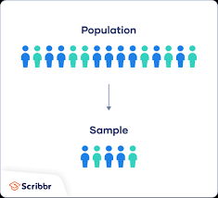
4- Construct sample/ location
A sample is a segment of the population selected to represent the population.
Decisions required for sampling design:
Sampling unit - People to be studied
Sample size - Number of people to be studied
Sampling procedure - Methods of choosing the people to be studied fall under two basic categories:
probability samples
nonprobability samples
Notes:
Marketing researchers usually draw conclusions about large groups of consumers by studying a small sample of the total consumer population. The sample should be representative of the population so that the researcher can make accurate estimates. Designing the sample requires three decisions. First, who is to be studied (unit)? Second, how many people should be included (size)? Finally, how should the people in the sample be chosen (procedure)?

Slide 62
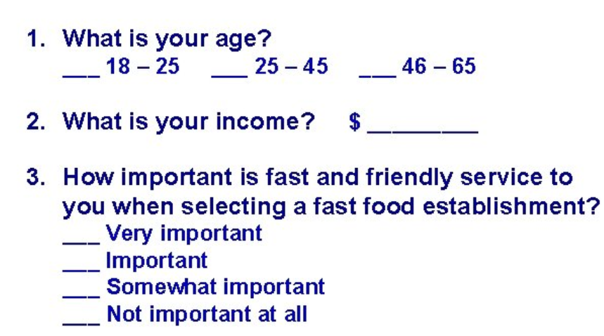
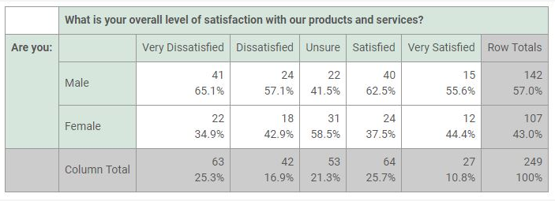
5-Data collection
The researcher next puts the marketing research plan into action by collecting the data through an instrument
Research Instruments could be a Questionnaires that either administered in person F-F, by phone, by e-mail, or online
Closed-ended questions
Open-ended question
Likert scale
Mechanical instruments include
People meters
Checkout scanners
Notes:
The researcher next puts the marketing research plan into action. This involves collecting, processing, and analyzing the information. Data collection can be carried out by the company’s marketing research staff or outside firms. Researchers make sure that the plan is implemented correctly and must guard against problems with data collection techniques and technologies, data quality, and timeliness.
Researchers must also process and analyze the collected data to isolate important information and insights. They need to check data for accuracy and comple
In collecting primary data, marketing researchers have a choice of two main research instruments: questionnaires and mechanical instruments.
A questionnaire is by far the most common instrument used for research. Closed-ended questions include all the possible answers, and subjects make choices among them. Open-ended questions allow respondents to answer in their own words. Open-ended questions are especially useful in exploratory research, when the researcher is trying to find out what people think but is not measuring how many people think in a certain way. Closed-ended questions, on the other hand, provide answers that are easier to interpret and tabulate. Researchers should use care in the wording and ordering of questions.
Mechanical instruments are used to monitor consumer behavior. For example, Time Warner’s MediaLab uses high-tech observation to capture the changing ways that today’s viewers are using and reacting to television and Web content.
Some researchers are applying neuromarketing, which involves measuring brain activity to learn how consumers feel and respond. For example, PepsiCo’s Frito-Lay worked with Nielsen’s NeuroFocus to assess consumer motivations underlying the success of its Cheetos snack brand.
teness and code it for analysis. The researchers then tabulate the results and compute statistical measures.

Slide 63
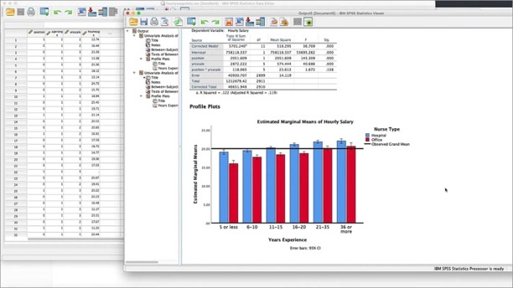
6-Analysing the data
Compute statistical measures
SPSS is the dominant used software statistical package.
Tabulate results
Notes:
The researcher next puts the marketing research plan into action. This involves collecting, processing, and analyzing the information. Data collection can be carried out by the company’s marketing research staff or outside firms. Researchers make sure that the plan is implemented correctly and must guard against problems with data collection techniques and technologies, data quality, and timeliness.
Researchers must also process and analyze the collected data to isolate important information and insights. They need to check data for accuracy and comple
In collecting primary data, marketing researchers have a choice of two main research instruments: questionnaires and mechanical instruments.
A questionnaire is by far the most common instrument used for research. Closed-ended questions include all the possible answers, and subjects make choices among them. Open-ended questions allow respondents to answer in their own words. Open-ended questions are especially useful in exploratory research, when the researcher is trying to find out what people think but is not measuring how many people think in a certain way. Closed-ended questions, on the other hand, provide answers that are easier to interpret and tabulate. Researchers should use care in the wording and ordering of questions.
Mechanical instruments are used to monitor consumer behavior. For example, Time Warner’s MediaLab uses high-tech observation to capture the changing ways that today’s viewers are using and reacting to television and Web content.
Some researchers are applying neuromarketing, which involves measuring brain activity to learn how consumers feel and respond. For example, PepsiCo’s Frito-Lay worked with Nielsen’s NeuroFocus to assess consumer motivations underlying the success of its Cheetos snack brand.
teness and code it for analysis. The researchers then tabulate the results and compute statistical measures.

Slide 64
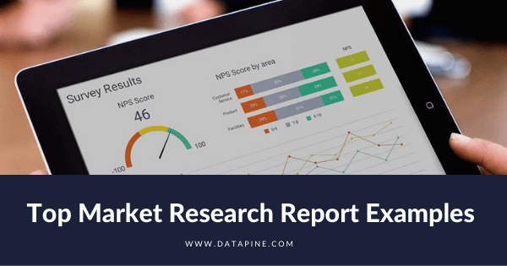
7-Evaluate the results.
Responsibilities of the market researcher:
Interpret the findings
Draw conclusions
Report findings to management
Responsibilities of marketing managers and researchers:
Work together closely when interpreting research results
Share responsibility for the research process and resulting decisions,
A solicited feedback from internal /external stakeholders, such as Key clients, managers, or colleagues.
They could rate your report on various criteria, such as relevance, clarity, accuracy, and impact
They might provide comments and suggestions on how to improve your report, or what additional information they would like to see.
Notes:
The market researcher must interpret the findings, draw conclusions, and report them to management. The researcher should present important findings and insights that are useful in the major decisions faced by management.
The best research means little if the manager blindly accepts faulty interpretations from the researcher. In many cases, findings can be interpreted in different ways, and discussions between researchers and managers will help point to the best interpretations. Thus, managers and researchers must work together closely when interpreting research results, and both must share responsibility for the research process and resulting decisions.

Slide 65
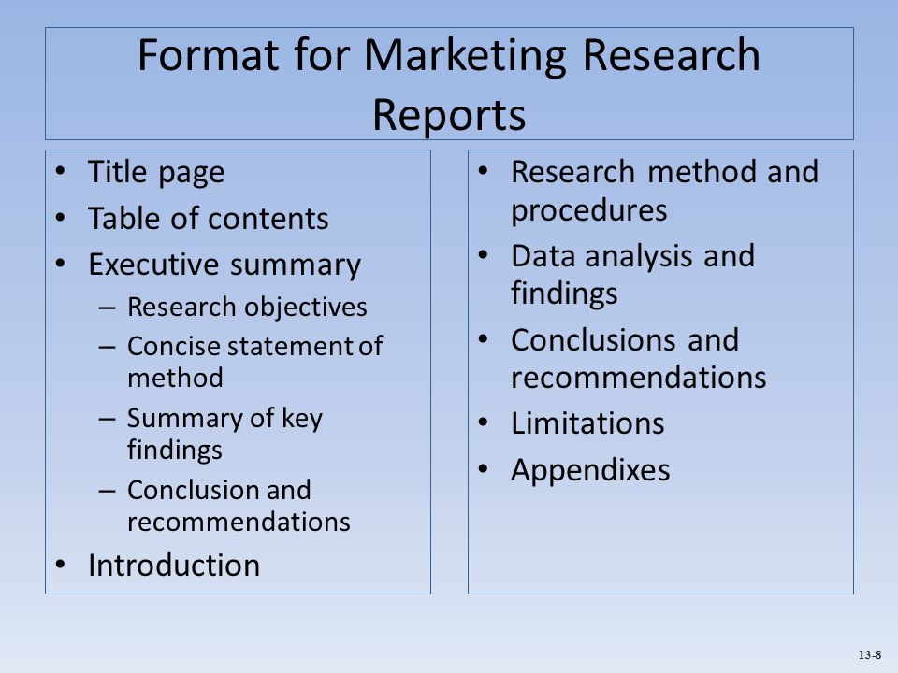
8- Recommendation for actions. and Reporting
Responsibilities of the market manager
Distributing the market research finding and recommendations must be available for decision making.
Escalating Non-routine information for special situations.
Getting consensus on action plan .
Taking plan into actions
Monitor progress
Notes:
The market researcher must interpret the findings, draw conclusions, and report them to management. The researcher should present important findings and insights that are useful in the major decisions faced by management.
The best research means little if the manager blindly accepts faulty interpretations from the researcher. In many cases, findings can be interpreted in different ways, and discussions between researchers and managers will help point to the best interpretations. Thus, managers and researchers must work together closely when interpreting research results, and both must share responsibility for the research process and resulting decisions.

Slide 66
Case study # 1

Slide 67


Slide 68



https://mr.okhtein.com Designed in Egypt, sourced from the world's finest materials, and crafted by artisans. Shop now our latest bags, sunglasses, and small leather goods.

Slide 69


