Slide 1

Strategic marketing

Slide 2
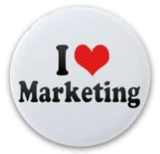
Strategic marketing
Lecture 9

Slide 3
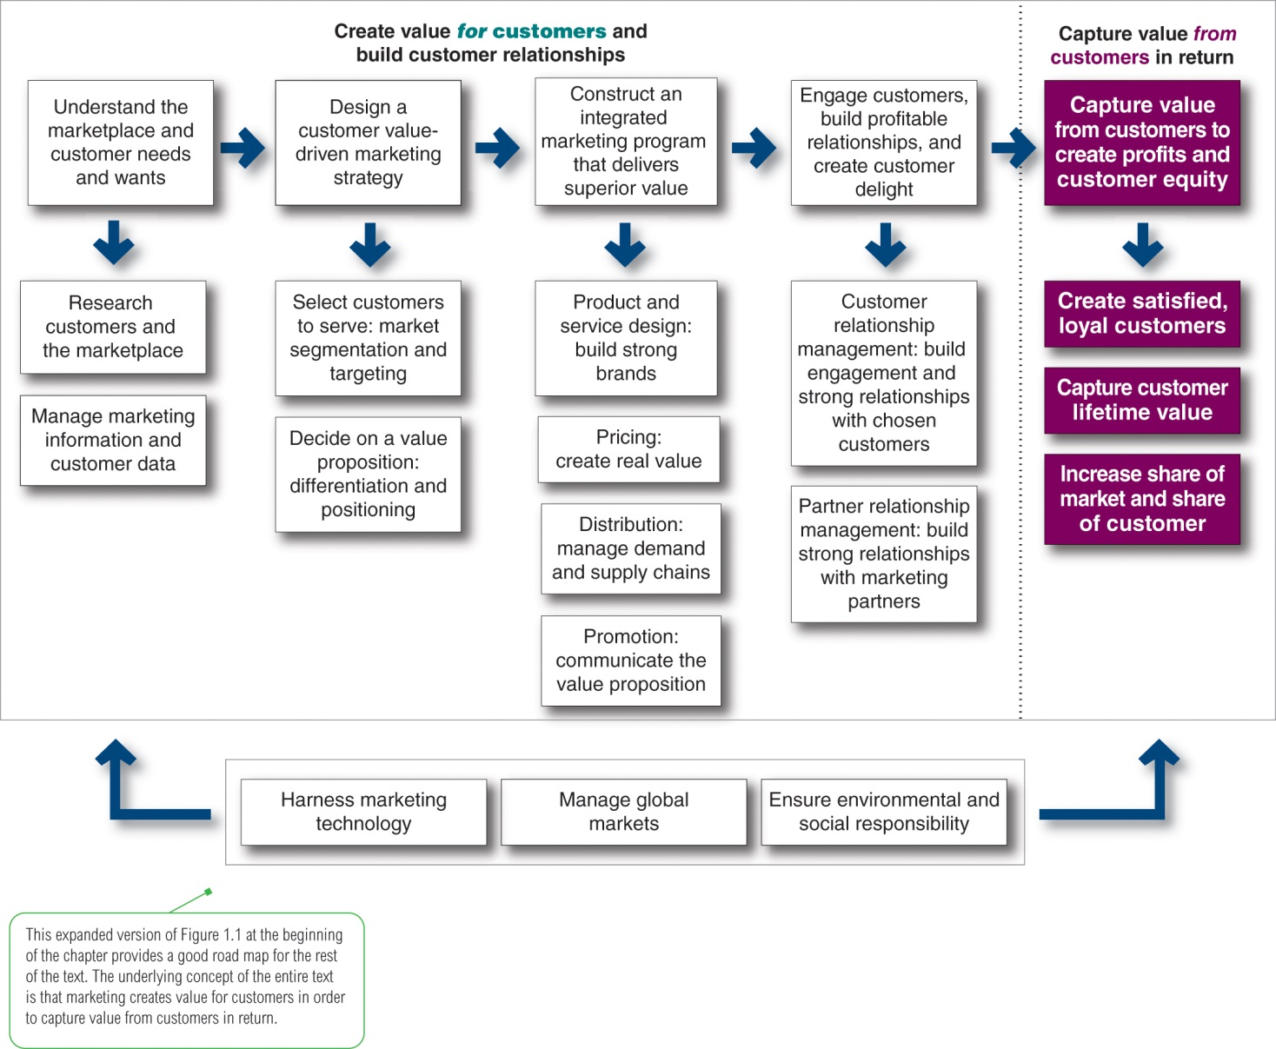
Step 3
Construct an integrated marketing program that delivers superior value
1
2
3
4
5
Notes:
Company-wide strategic planning guides marketing strategy and planning. Like the marketing strategy, the broader company strategy must be customer focused.
This figure illustrates the steps in strategic planning. At the corporate level, the company starts the strategic planning process by defining its overall purpose and mission. The mission is turned into detailed supporting objectives that guide the entire company. Then, headquarters decides what portfolio of businesses and products is best for the company and how much support to give each one.
In turn, each business and product develops detailed marketing and other departmental plans that support the company-wide plan. Thus, marketing planning occurs at the business-unit, product, and market levels. It supports company strategic planning
Strategic planning sets the stage for the rest of planning in the firm. Companies prepare annual plans, long-range plans, and strategic plans. The annual and long-range plans deal with the company’s current businesses and how to keep them going. In contrast, the strategic plan involves adapting the firm to take advantage of opportunities in its constantly changing environment.
with more detailed plans for specific marketing opportunities.

Slide 4
1st P- Product

Slide 5
2nd P-Price
Other pricing strategies Competitive {Going-Rate Pricing} ,Loss leader Pricing, EDLP {Every day low price} ,Popcorn Pricing strategy
Initiating Price Changes
Responding to Competitor Price Changes

Slide 6
3rd P-Place (channels)

Slide 7
4th P- promotion (communication MIX)

Slide 8

Let us continue understanding;
  How to build and maintain profitable customer relationships {CRM}
  How to refers to measure and evaluate the results of marketing strategies Marketing control
  How to build a marketing plan

Slide 9
Engage customer build profitable relationships.
Step 4&5
1
2
3
4
5
∂∂∂∂
∂∂∂∂
∂∂∂∂
Notes:
Company-wide strategic planning guides marketing strategy and planning. Like the marketing strategy, the broader company strategy must be customer focused.
This figure illustrates the steps in strategic planning. At the corporate level, the company starts the strategic planning process by defining its overall purpose and mission. The mission is turned into detailed supporting objectives that guide the entire company. Then, headquarters decides what portfolio of businesses and products is best for the company and how much support to give each one.
In turn, each business and product develops detailed marketing and other departmental plans that support the company-wide plan. Thus, marketing planning occurs at the business-unit, product, and market levels. It supports company strategic planning
Strategic planning sets the stage for the rest of planning in the firm. Companies prepare annual plans, long-range plans, and strategic plans. The annual and long-range plans deal with the company’s current businesses and how to keep them going. In contrast, the strategic plan involves adapting the firm to take advantage of opportunities in its constantly changing environment.
with more detailed plans for specific marketing opportunities.

Slide 10
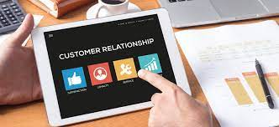
CUSTOMER RELATIONSHIP MANAGEMENT
WHAT IS THE CUSTOMER RELATIONSHIP MANAGEMENT?
HOW FIRMS BUILD AND MAINTAIN PROFITABLE CUSTOMER RELATIONSHIPS?
WHAT ARE THE CUSTOMER LIFETIME VALUE AND RELATIONSHIP GROUPS?
WHAT ARE THE CRM TOOLS AND SYSTEMS?

Slide 11
CUSTOMER RELATIONSHIP MANAGEMENT
Customer relationship management (CRM) , the most important concept of modern marketing and simply it is the overall process of building and maintaining profitable customer relationships by delivering superior customer value and satisfaction.
Customer expectations, buyer’s expectations about the market offering by based on market information, the opinions of friends and previous buying experiences.
Customer Value. (customer-perceived value), the customer's evaluation of the difference between all the benefits and all the costs of a market offering relative to those of competing offers.
Customer Satisfaction, it Depends on the product's perceived performance relative to a buyer's expectations
Customer Satisfaction
Customer Value
Customer Expectations
CRM IS ALL ABOUT HOW MARKETERS SET THE RIGHT LEVEL OF EXPECTATIONS
Notes:
Customer relationship management (CRM) is perhaps the most important concept of modern marketing. In the broadest sense, CRM is the overall process of building and maintaining profitable customer relationships by delivering superior customer value and satisfaction. It deals with all aspects of acquiring, engaging, and growing customers.
The key to building lasting customer relationships is to create superior customer value and satisfaction. Satisfied customers are more likely to be loyal customers and give the company a larger share of their business.
Customer Value. Attracting and retaining customers can be a difficult task. Customers often face a bewildering array of products and services from which to choose. A customer buys from the firm that offers the highest customer-perceived value—the customer's evaluation of the difference between all the benefits and all the costs of a market offering relative to those of competing offers.
Customer Satisfaction. Depends on the product's perceived performance relative to a buyer's expectations. If the product's performance fails short of expectations, the customer is dissatisfied. If performance matches expectations, the customer is satisfied. If performance exceeds expectations, the customer is highly satisfied or delighted.

Slide 12
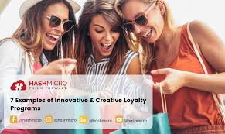

BUILDING & MARINATING PROFITABLE CUSTOMER RELATIONSHIPS
The key to building lasting customer relationships is to deliver superior customer value and satisfaction through setting the right level of expectations.
  If the product's performance fails to meet expectation , the customer is dissatisfied.
  If performance is meeting expectations, the customer is satisfied.
  If performance exceeds expectations, the customer is highly satisfied or delighted.
Satisfied customers buy again
Dissatisfied customers switch to competitors
Notes:
Customer relationship management (CRM) is perhaps the most important concept of modern marketing. In the broadest sense, CRM is the overall process of building and maintaining profitable customer relationships by delivering superior customer value and satisfaction. It deals with all aspects of acquiring, engaging, and growing customers.
The key to building lasting customer relationships is to create superior customer value and satisfaction. Satisfied customers are more likely to be loyal customers and give the company a larger share of their business.
Customer Value. Attracting and retaining customers can be a difficult task. Customers often face a bewildering array of products and services from which to choose. A customer buys from the firm that offers the highest customer-perceived value—the customer's evaluation of the difference between all the benefits and all the costs of a market offering relative to those of competing offers.
Customer Satisfaction. Depends on the product's perceived performance relative to a buyer's expectations. If the product's performance fails short of expectations, the customer is dissatisfied. If performance matches expectations, the customer is satisfied. If performance exceeds expectations, the customer is highly satisfied or delighted.

Slide 13
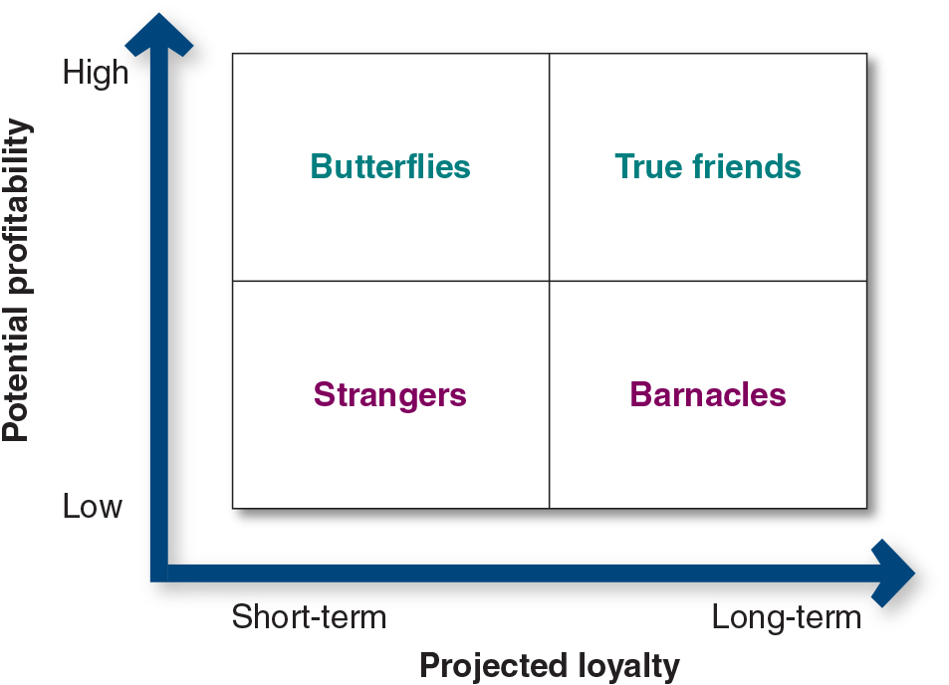
CUSTOMER LIFETIME VALUE AND RELATIONSHIP GROUPS
Customer lifetime value at x supermarket for a customer who spends about $100 a week, shops 50 weeks a year, and remains in the area for about 10 year, is s $50,000.
Customer lifetime value is the value of the entire stream of purchases a customer makes over a lifetime of business .
Customers relationship groups, as per the Figure classified into one of four according to their potential profitability and projected loyalty:
  True friends. The firm should make continuous relationship investments to delight these customers and nurture, retain, and grow them.
  Butterflies, the company should create satisfying and profitable transactions, capturing as much of their business as possible in the short time during which they buy from the company.
  Barnacles are highly loyal but not very profitable. There is a limited fit between their needs and the company’s offerings. The company may be able to improve the profitability of barnacles by selling them more, raising their fees, or reducing service to them.
  Strangers, Companies will not gain anything by investing time and resources in developing relationships with them.
Notes:
Figure 1.5 classifies customers into one of four relationship groups, according to their potential profitability and projected loyalty. Each of the four customer relationship groups requires a different relationship management strategy.
Loyal customers spend more and stay around longer. The value of the entire stream of purchases a customer makes over a lifetime of patronage is significant.
Customer defections can be costly. Losing a customer means losing more than a single sale. It means losing that customer’s lifetime value.
For example, the average customer at Stew Leonard’s supermarket spends about $100 a week, shops 50 weeks a year, and remains in the area for about 10 years. If this customer has an unhappy experience and switches to another supermarket, Stew Leonard’s has lost $50,000 in lifetime revenue.
The loss can be much greater if the disappointed customer shares the bad experience with other customers and causes them to defect. In fact, a company can lose money on a specific transaction but still benefit greatly from a long-term relationship. This means that companies must aim high in building customer relationships.
The company will not gain anything by investing time and resources in developing relationships with strangers.
For butterflies, the company should create satisfying and profitable transactions, capturing as much of their business as possible in the short time during which they buy from the company. Efforts to convert butterflies into loyal customers are rarely successful.
True friends are loyal and have the potential to generate good profit for the company. The firm should make continuous relationship investments to delight these customers and nurture, retain, and grow them.
Barnacles are highly loyal but not very profitable. There is a limited fit between their needs and the company’s offerings. The company may be able to improve the profitability of barnacles by selling them more, raising their fees, or reducing service to them. However, if they cannot be made profitable, they should be fired.

Slide 14
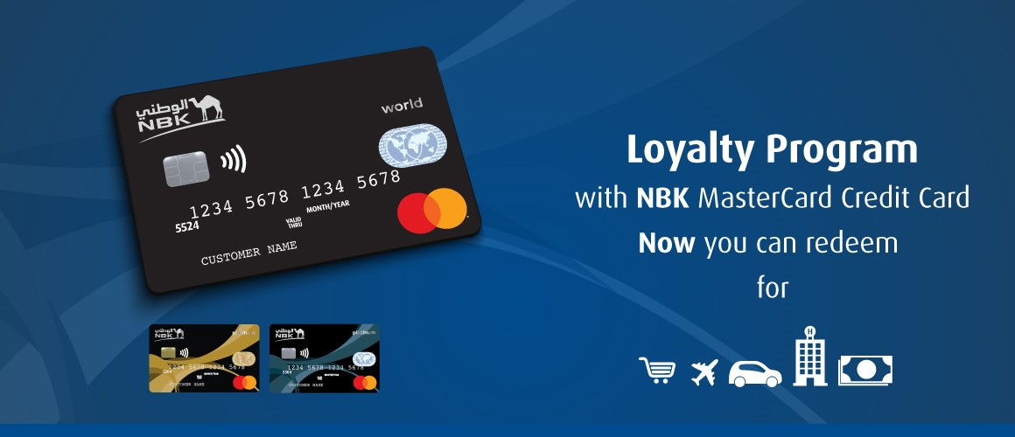
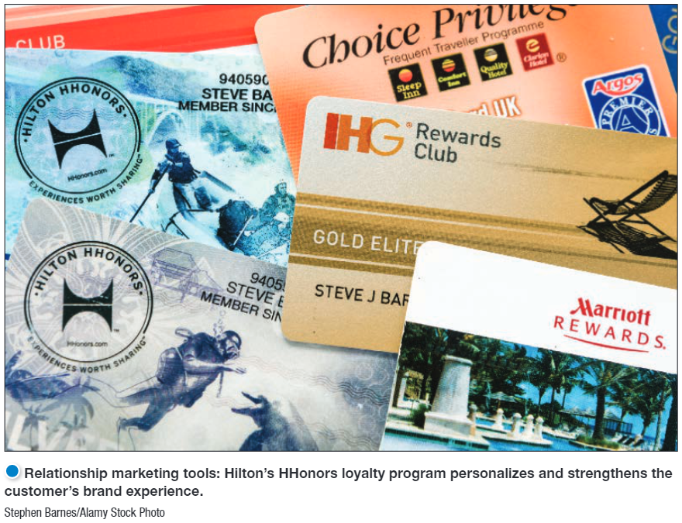

CUSTOMER RELATIONSHIP TOOLS
  Marketers use specific marketing tools to develop stronger bonds with customers: as the most common Frequency marketing programs, that reward customers who buy frequently or in large amounts.
  Loyalty rewards programs, that offer special benefits for customers who buy frequently.
  Club marketing programs that offer members special benefits and create member communities.
Notes:
Figure 1.5 classifies customers into one of four relationship groups, according to their potential profitability and projected loyalty. Each of the four customer relationship groups requires a different relationship management strategy.
Loyal customers spend more and stay around longer. The value of the entire stream of purchases a customer makes over a lifetime of patronage is significant.
Customer defections can be costly. Losing a customer means losing more than a single sale. It means losing that customer’s lifetime value.
For example, the average customer at Stew Leonard’s supermarket spends about $100 a week, shops 50 weeks a year, and remains in the area for about 10 years. If this customer has an unhappy experience and switches to another supermarket, Stew Leonard’s has lost $50,000 in lifetime revenue.
The loss can be much greater if the disappointed customer shares the bad experience with other customers and causes them to defect. In fact, a company can lose money on a specific transaction but still benefit greatly from a long-term relationship. This means that companies must aim high in building customer relationships.
The company will not gain anything by investing time and resources in developing relationships with strangers.
For butterflies, the company should create satisfying and profitable transactions, capturing as much of their business as possible in the short time during which they buy from the company. Efforts to convert butterflies into loyal customers are rarely successful.
True friends are loyal and have the potential to generate good profit for the company. The firm should make continuous relationship investments to delight these customers and nurture, retain, and grow them.
Barnacles are highly loyal but not very profitable. There is a limited fit between their needs and the company’s offerings. The company may be able to improve the profitability of barnacles by selling them more, raising their fees, or reducing service to them. However, if they cannot be made profitable, they should be fired.

Slide 15

CUSTOMER RELATIONSHIP SYSTEMS
CRM system manages and analyzes customer data and interactions to improve customer service, aid in retention and drive sales growth.
CRM examples
Salesforce.
HubSpot.
Dynamics.
EngageBay.
Salesflare.
Zoho.
BIG Contacts.
Pipedrive.
While Netflixers are busy watching N company’s bulging database contains every viewing detail for each individual subscriber applying artificial intelligence (AI), to get areal-time data on what shows they watch, at what times, on what devices, at what locations, even when they hit the pause, rewind, or fast-forward buttons during programs.
Notes:
Netflix tracks and parses member data on tens of millions of searches, ratings, and “plays.” The company’s bulging database contains every viewing detail for each individual subscriber—real-time data on what shows they watch, at what times, on what devices, at what locations, even when they hit the pause, rewind, or fast-forward buttons during programs.
Such analytics employ artificial intelligence (AI), technology by which machines think and learn in a way that looks and feels human but with a lot more analytical capacity.
Using this rich base of big data, Netflix builds detailed individual subscriber profiles and then uses these profiles to tailor each customer’s viewing experience and make personalized recommendations.

Slide 16
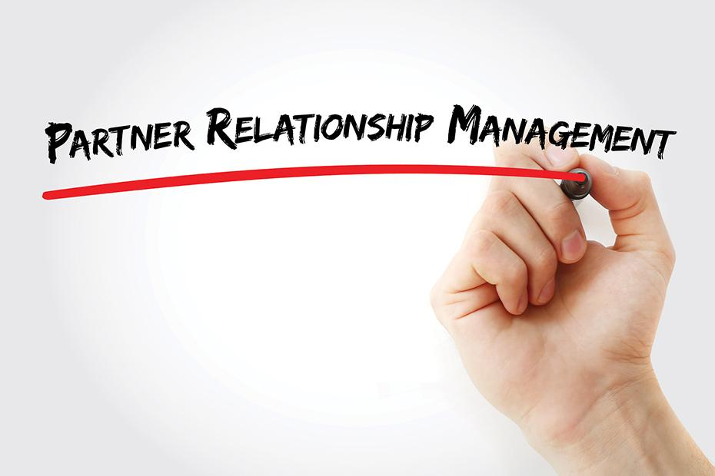

PARTNERING WITH OTHERS IN THE MARKETING SYSTEM TO CREATE CUSTOMER VALUE
Value delivery network is composed of the company, its suppliers, its distributors, and its customers
Marketers should assess value chains
  Internal departments, ensure all the departments are customer-focused and develop a smooth functioning value chain
  External: suppliers, distributors and customers to ensure that all partners improve the performance of the entire system in delivering customer value.
For example, Ford’s performance against Toyota depends on the quality of Ford’s overall value delivery network versus Toyota’s. Even if Ford makes the best cars, it might lose in the marketplace if Toyota’s dealer network provides a more customer-satisfying sales and service experience.
Notes:
The value chain: These True Value ads recognize that everyone in the organization—from marketing research analyst, Jeff Alvarez to operations manager, Tom Statham—must contribute to helping the chain’s customers handle their home improvement projects. They form the foundation for the brand’s “Behind Every Project Is a True Value” positioning.
True Value and “Start Right. Start Here” are registered trademarks of True Value Company. The print ads and images are copyrighted works of authorship of True Value Company.
True Value’s ability to help you “Start Right. Start Here” depends on purchasing’s skill in developing the needed suppliers and buying from them at low cost. True Value’s information technology people must provide fast and accurate information about which products are selling in each store. Their operations people must provide effective, low-cost merchandise handling and delivery.

Slide 17
BUILD AND MAINTAIN PROFITABLE CUSTOMER RELATIONSHIPS
The key to building lasting customer relationships is to deliver superior customer value and satisfaction through setting the right level of expectations,
  If the product's performance fails to meet expectation , the customer is dissatisfied.
  If performance is meeting expectations, the customer is satisfied.
  If performance exceeds expectations, the customer is highly satisfied or delighted.
Satisfied customers buy again
Dissatisfied customers switch to competitors
Notes:
Customer relationship management (CRM) is perhaps the most important concept of modern marketing. In the broadest sense, CRM is the overall process of building and maintaining profitable customer relationships by delivering superior customer value and satisfaction. It deals with all aspects of acquiring, engaging, and growing customers.
The key to building lasting customer relationships is to create superior customer value and satisfaction. Satisfied customers are more likely to be loyal customers and give the company a larger share of their business.
Customer Value. Attracting and retaining customers can be a difficult task. Customers often face a bewildering array of products and services from which to choose. A customer buys from the firm that offers the highest customer-perceived value—the customer's evaluation of the difference between all the benefits and all the costs of a market offering relative to those of competing offers.
Customer Satisfaction. Depends on the product's perceived performance relative to a buyer's expectations. If the product's performance fails short of expectations, the customer is dissatisfied. If performance matches expectations, the customer is satisfied. If performance exceeds expectations, the customer is highly satisfied or delighted.

Slide 18
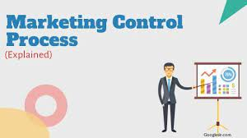
MANAGING MARKETING
&
Marketing control

Slide 19
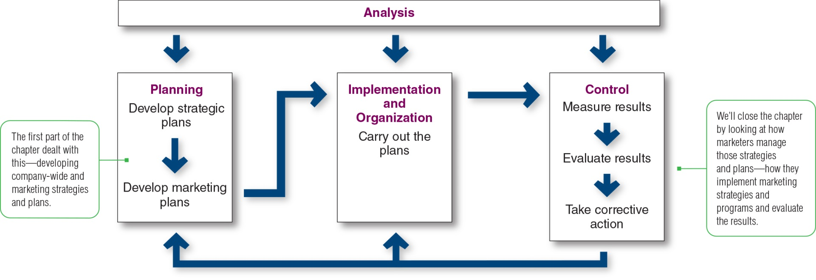
MANAGING MARKETING:
ANALYSIS, PLANNING, IMPLEMENTATION, AND CONTROL
Managing the marketing process requires the four marketing management functions as illustrated in the figure; analysis, planning, implementation, and control.
  Marketing analysis provides the information and evaluations needed for all the other marketing activities.
  Marketing Planning develops company-wide strategic plans and then translates them into marketing and other plans for each division, product, and brand.
  Marketing implementation, the company turns the plans into actions. Addresses the who, where, when, and how of the marketing activities
  Marketing Control consists of measuring and evaluating the results of marketing activities and taking corrective action where needed.
Notes:
Market implementation is the process of turning marketing strategies and plans into marketing actions to accomplish strategic marketing objectives. Whereas marketing planning addresses the what and why of marketing activities, implementation addresses the who, where, when, and how.
Marketing control refers to measuring and evaluating the results of marketing strategies and plans and taking corrective action to ensure that the objectives are achieved. This may require changing the action programs or even changing the goals.
Operating control ensures that the company achieves the sales, profits, and other goals set out in its annual plan. It also involves determining the profitability of different products, territories, markets, and channels.
Strategic control involves looking at whether the company’s basic strategies are well matched to its opportunities.
Managing the marketing process requires the four marketing management functions as illustrated in this figure.
They include analysis, planning, implementation, and control.
The company first develops company-wide strategic plans and then translates them into marketing and other plans for each division, product, and brand.
Through implementation, the company turns the plans into actions.
Control consists of measuring and evaluating the results of marketing activities and taking corrective action where needed.
Finally, marketing analysis provides the information and evaluations needed for all the other marketing activities.

Slide 20
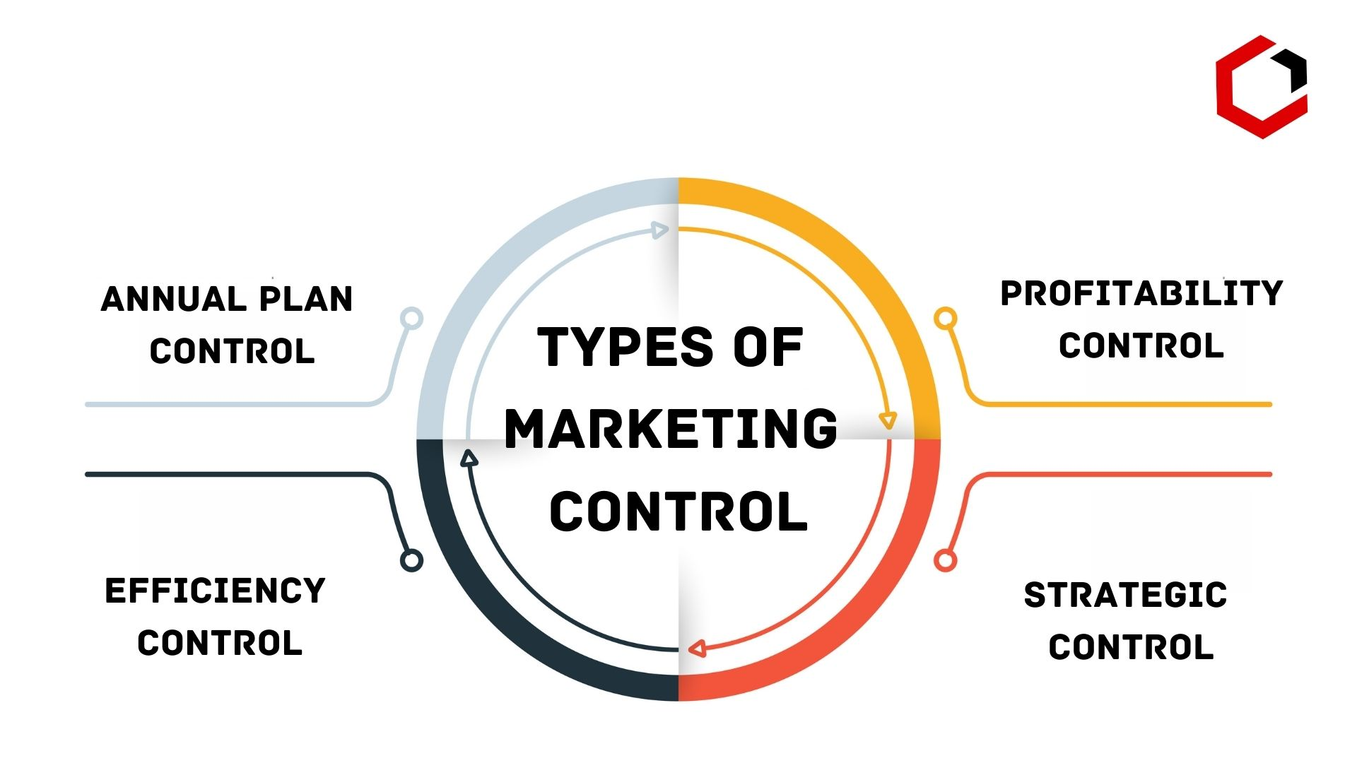
MARKETING CONTROL
Marketing Control
Measuring and evaluating the results of marketing strategies and plans and Taking corrective action where needed to ensure that the objectives are achieved.
  Operating control ensures that the company achieves its sales, profits, and other goals set out in its annual plan. It also involves determining the profitability of different products, territories, markets, and channels ,Marketing should monitor :
    Evaluate the Return on Investment
    Changes in company’s Sales +/- vs competitors
    Customer reach and feedback
    Product availability
    Channels performance
  Strategic control involves looking at whether the company’s basic strategies are well matched to its opportunities. Compare Your Strategy to Competitors
Notes:
Market implementation is the process of turning marketing strategies and plans into marketing actions to accomplish strategic marketing objectives. Whereas marketing planning addresses the what and why of marketing activities, implementation addresses the who, where, when, and how.
Marketing control refers to measuring and evaluating the results of marketing strategies and plans and taking corrective action to ensure that the objectives are achieved. This may require changing the action programs or even changing the goals.
Operating control ensures that the company achieves the sales, profits, and other goals set out in its annual plan. It also involves determining the profitability of different products, territories, markets, and channels.
Strategic control involves looking at whether the company’s basic strategies are well matched to its opportunities.
Managing the marketing process requires the four marketing management functions as illustrated in this figure.
They include analysis, planning, implementation, and control.
The company first develops company-wide strategic plans and then translates them into marketing and other plans for each division, product, and brand.
Through implementation, the company turns the plans into actions.
Control consists of measuring and evaluating the results of marketing activities and taking corrective action where needed.
Finally, marketing analysis provides the information and evaluations needed for all the other marketing activities.

Slide 21
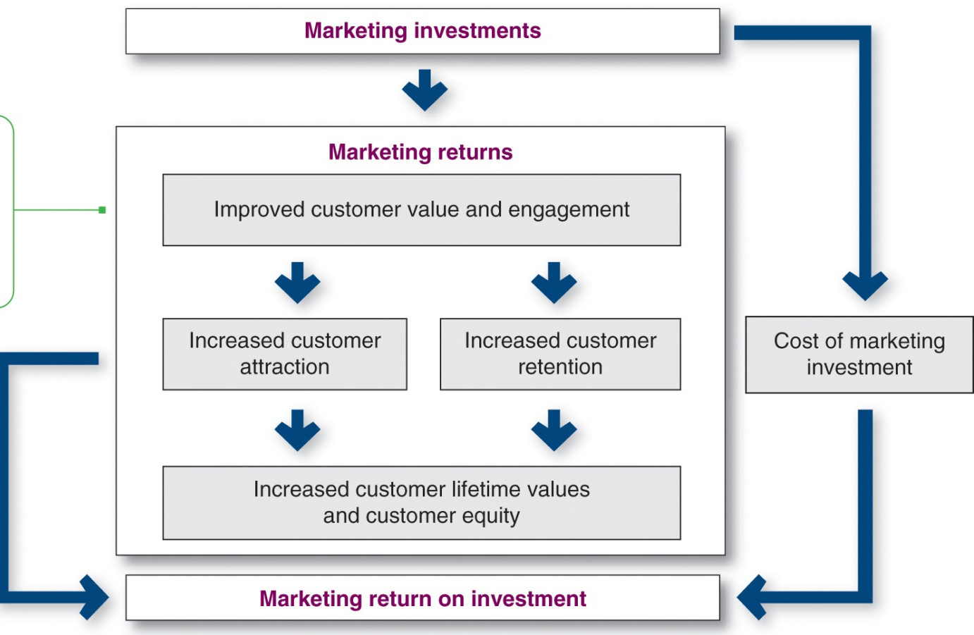
Measuring Marketing Return on Investment (ROI)
Marketing return on investment or marketing ROI is the net return from a marketing investment divided by the costs of the marketing investment. It measures the profits generated by investments in marketing activities.
Marketing investments should result in
  Improved customer value and satisfaction.
  increases customer attraction and retention.
  Increases individual customer lifetime values
  Increases firm’s overall customer equity.
This figure views marketing expenditures as investments that produce returns in the form of more profitable customer relationships.
Notes:
Marketing return on investment or marketing ROI is the net return from a marketing investment divided by the costs of the marketing investment. It measures the profits generated by investments in marketing activities.
Companies can assess marketing ROI in terms of standard marketing performance measures, such as brand awareness, sales, or market share. Such measures can be assembled through marketing dashboards, which are sets of marketing performance measures in a single display used to monitor strategic marketing performance.
Increasingly, marketers also use customer-centered measures of marketing impact, such as customer acquisition, customer engagement, customer retention, customer lifetime value, and customer equity. These measures capture not only current
This figure views marketing expenditures as investments that produce returns in the form of more profitable customer relationships.
Marketing investments result in improved customer value and satisfaction, which in turn increases customer attraction and retention.
This increases individual customer lifetime values and the firm’s overall customer equity.
Increased customer equity, in relation to the cost of the marketing investments, determines return on marketing investment.
marketing performance, but also future performance, resulting from stronger customer relationships.

Slide 22
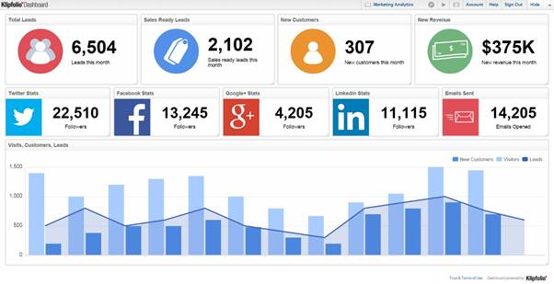
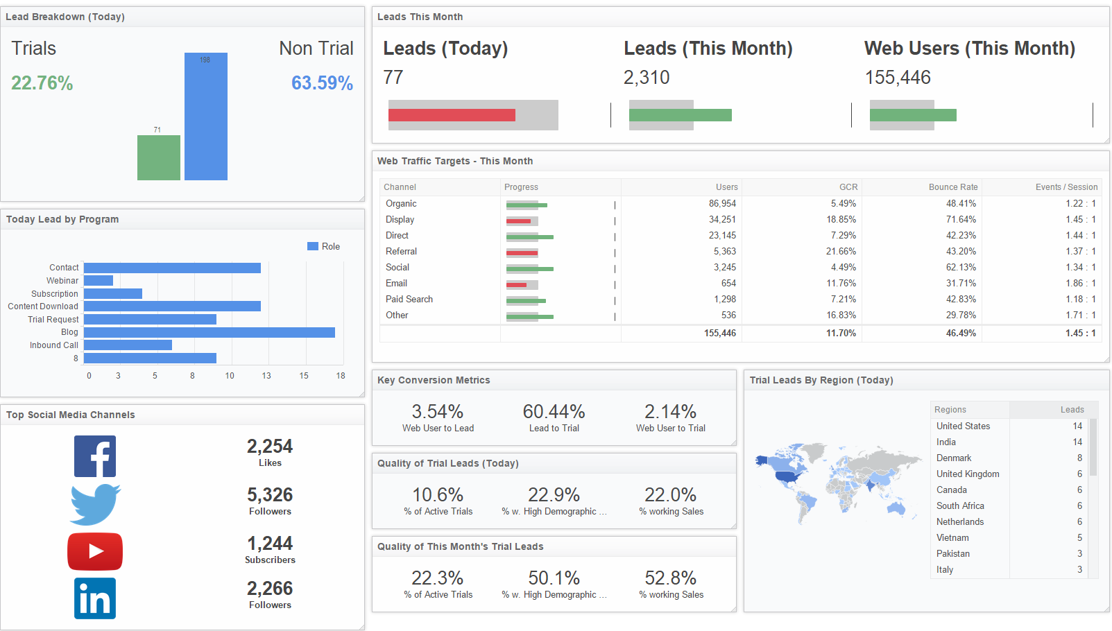
MARKETING MONITORING SYSTEMS
Marketing DASHBOARDS | SCORECARD
MARKETING DASHBOARDS, or Marketing Scorecard
  a data-driven marketing analysis tool that allows teams to track and improve their marketing activities over time by aligning operations with company strategy
  A single display used to monitor strategic marketing performance and standard marketing performance measures, such as brand awareness, sales, or market share.
Notes:
Marketing return on investment or marketing ROI is the net return from a marketing investment divided by the costs of the marketing investment. It measures the profits generated by investments in marketing activities.
Companies can assess marketing ROI in terms of standard marketing performance measures, such as brand awareness, sales, or market share. Such measures can be assembled through marketing dashboards, which are sets of marketing performance measures in a single display used to monitor strategic marketing performance.
Increasingly, marketers also use customer-centered measures of marketing impact, such as customer acquisition, customer engagement, customer retention, customer lifetime value, and customer equity. These measures capture not only current
This figure views marketing expenditures as investments that produce returns in the form of more profitable customer relationships.
Marketing investments result in improved customer value and satisfaction, which in turn increases customer attraction and retention.
This increases individual customer lifetime values and the firm’s overall customer equity.
Increased customer equity, in relation to the cost of the marketing investments, determines return on marketing investment.
marketing performance, but also future performance, resulting from stronger customer relationships.

Slide 23
MARKETING PLAN

Slide 24
CONTENTS OF A MARKETING PLAN (1 OF 2)
Section | Purpose
Executive summary | Brief summary of the main goals and recommendations
Corporate Mission and objectives | Description of Corporate Mission and corporate strategy for achieving them
Current marketing Situation | Gives the market description and the product, competition, and distribution
Threats and opportunities analysis | a detailed SWOT analysis Helps management to anticipate important positive or negative developments
Objectives & issues | States and discusses marketing objectives and marketing strategy for achieving them.
Notes:
Marketing planning involves choosing marketing strategies that will help the company attain its overall strategic objectives.
The plan begins with an executive summary that quickly reviews major assessments, goals, and recommendations. The main section of the plan presents a detailed SWOT analysis of the current marketing situation, as well as, potential threats and opportunities. The plan next states major objectives for the brand and outlines the specifics of a marketing strategy for achieving them.

Slide 25
CONTENTS OF A MARKETING PLAN (2 OF 2)
Section | Purpose
Marketing strategy | Outlines the broad marketing logic and the specifics of target markets, positioning, marketing expenditure levels, and strategies for each marketing mix element
Action programs | Spells out how marketing strategies will be turned into specific action programs
Budgets | Details a supporting marketing budget that is a projected profit-and-loss statement
Controls | Outlines the controls that will be used to monitor progress, allow management to review implementation results, and spot products that are not meeting their goals
Notes:
Marketing planning involves choosing marketing strategies that will help the company attain its overall strategic objectives.
The plan begins with an executive summary that quickly reviews major assessments, goals, and recommendations. The main section of the plan presents a detailed SWOT analysis of the current marketing situation, as well as, potential threats and opportunities. The plan next states major objectives for the brand and outlines the specifics of a marketing strategy for achieving them.

Slide 26
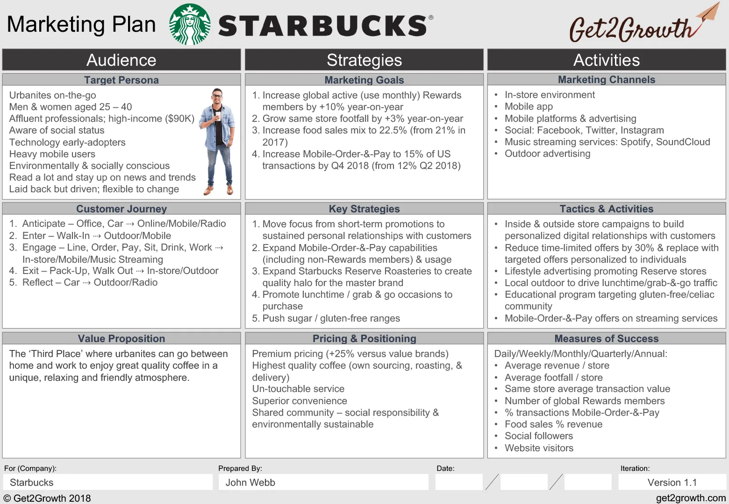
MARKETING PLAN Example

Slide 27
Let us continue understanding;
  CONSUMER BUYER BEHAVIOR AND CONSUMER MARKETS B2C Business-to-consumer B2C,
  BUSINESS BUYER BEHAVIOR and business markets Business-to-business (B-to-B) marketers B2B

Slide 28
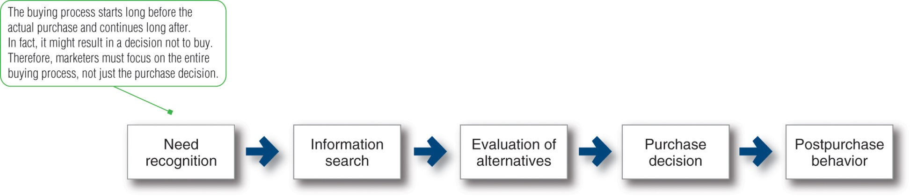
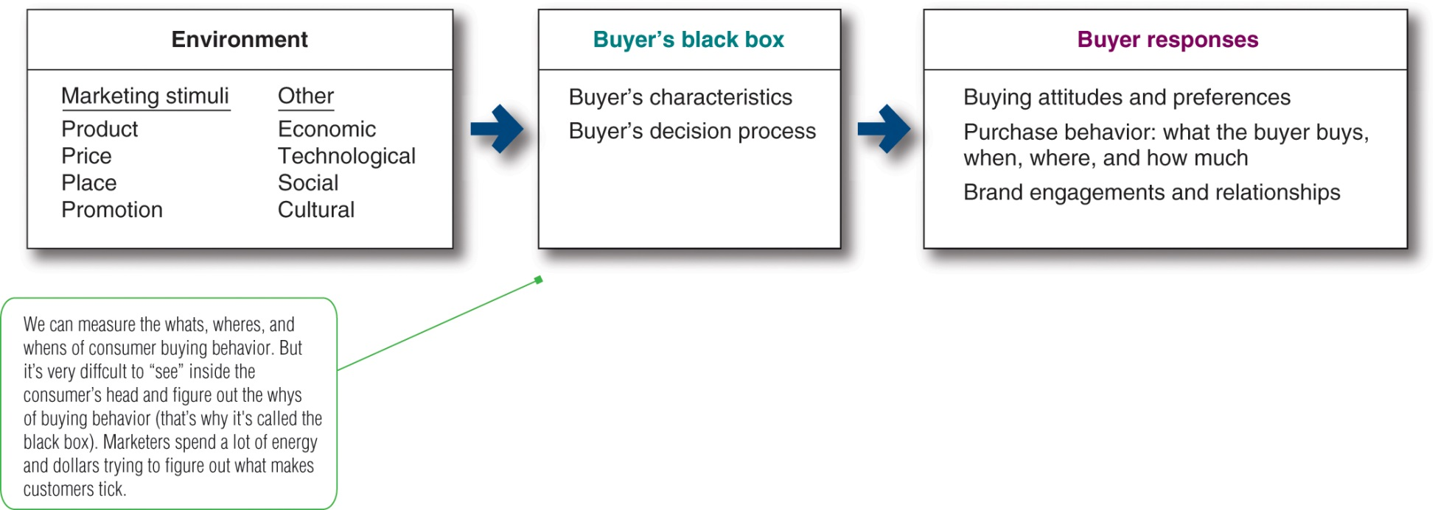
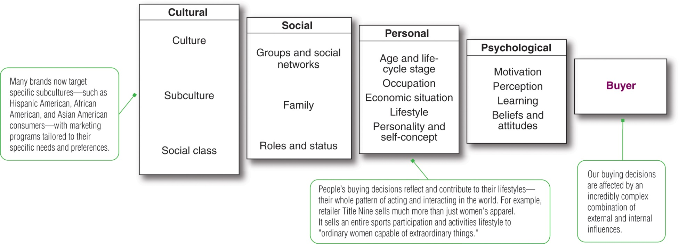
What is CONSUMER BUYER BEHAVIOR AND CONSUMER MARKETS
Buyer Decision Process
Model of Buyer Behavior
Factors Influencing Consumer Behavior
Consumer buyer behavior refers to the buying behavior of final consumers who are the individuals and households that buy goods and services for personal consumption. All of these final consumers combine to make up the consumer market.
1
2
3
1
2
3
4
Notes:
Consumer buyer behavior refers to the buying behavior of final consumers who are the individuals and households that buy goods and services for personal consumption. All of these final consumers combine to make up the consumer market.

Slide 29
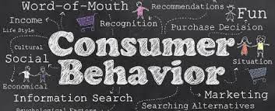
UNDERSTANDING CONSUMER BUYER BEHAVIOR AND CONSUMER MARKETS
Consumer buyer behavior
  Consumer Buying behavior are the actions taken by a consumer to purchase & use products & services
  Behavioral sciences help explain WHY & HOW choices are made
  Organizations use this knowledge to provide value to consumers, and to influence their choices.
Consumer market
  Where Organizations sell their products to the individuals and households that buy or acquire goods and services for personal consumption
Notes:
Consumer buyer behavior refers to the buying behavior of final consumers who are the individuals and households that buy goods and services for personal consumption. All of these final consumers combine to make up the consumer market.

Slide 30
Buyer Decision Process
1
need recognition.
  The need triggered by internal or external stimuli, when one of the person’s normal needs rises to a level high enough to become a drive.
information search.
  Consumers obtain information from several sources like personal, commercial, public, and experiential sources.
evaluation of alternatives
  consumers process information to choose among alternative brands.
purchase decision.
  factors can come between the purchase intention and the purchase decision
Postpurchase behavior.
  Determining if the consumer is satisfied or dissatisfied with the purchase lies in the relationship between the consumer’s expectations and the performance.
Notes:
This figure shows that the buyer decision process consists of five stages.
The first stage is need recognition. The need can be triggered by internal stimuli when one of the person’s normal needs rises to a level high enough to become a drive. A need can also be triggered by external stimuli.
The second stage is information search. Consumers can obtain information from several sources like personal, commercial, public, and experiential sources.
The third stage is the evaluation of alternatives, that is, how consumers process information to choose among alternative brands.
The fourth stage is the purchase decision. Two factors can come between the purchase intention and the purchase decision: the attitudes of others and unexpected situational factors.
The last stage is postpurchase behavior. Determining if the consumer is satisfied or dissatisfied with the purchase lies in the relationship between the consumer’s expectations and the product’s perceived performance. However, all major purchases result in cognitive dissonance, or discomfort caused by postpurchase conflict.

Slide 31


Need Recognition
1.1
The consumer has an unsatisfied need by internal stimuli or triggered by external stimuli& and the customer demands for a solution.
Notes:
The need can be triggered by internal stimuli when one of the person’s normal needs rises to a level high enough to become a drive. A need can also be triggered by external stimuli

Slide 32

Information Search
1.2
Consumers can obtain information from several sources like personal, commercial, public, and experiential sources
The consumer considers all possible alternatives by asking relatives, pharmacist, doctor or internet search.
Notes:
The second stage is information search. Consumers can obtain information from several sources like personal, commercial, public, and experiential sources.

Slide 33
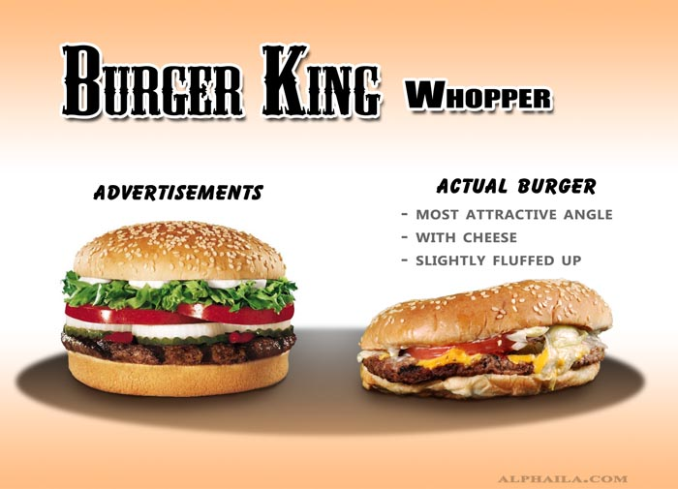
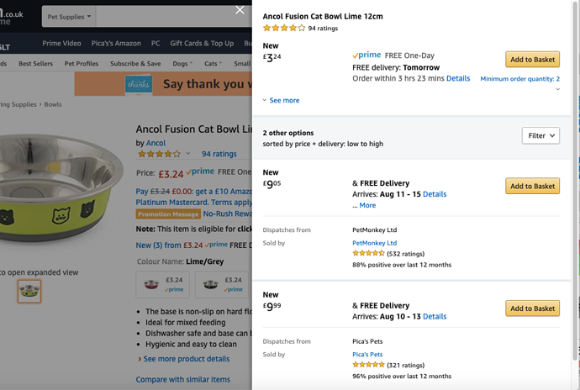
Evaluation of alternatives
1.3
The consumer assesses all reasonable marketing offerings /choices based on previous experience, available promotion or consultation
Notes:
The third stage is the evaluation of alternatives, that is, how consumers process information to choose among alternative brands.

Slide 34
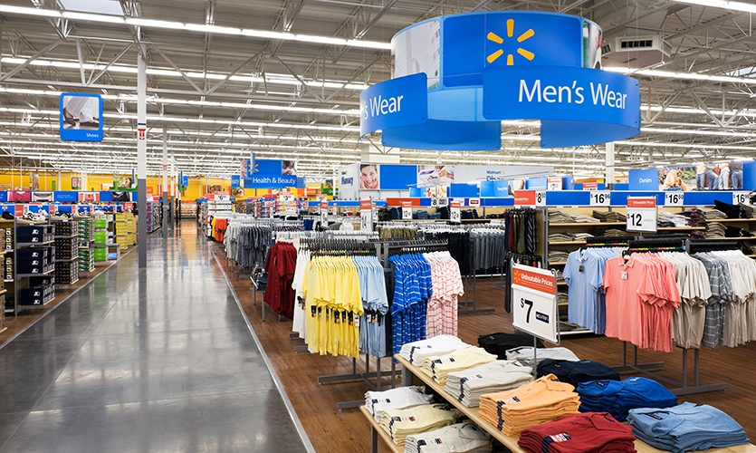
Purchase Decision
1.4
Merchandising Influences
Between 25% to 30% of the planned purchase decisions are switched inside the retail.
Notes:
Two factors can come between the purchase intention and the purchase decision: the attitudes of others and unexpected situational factors.

Slide 35
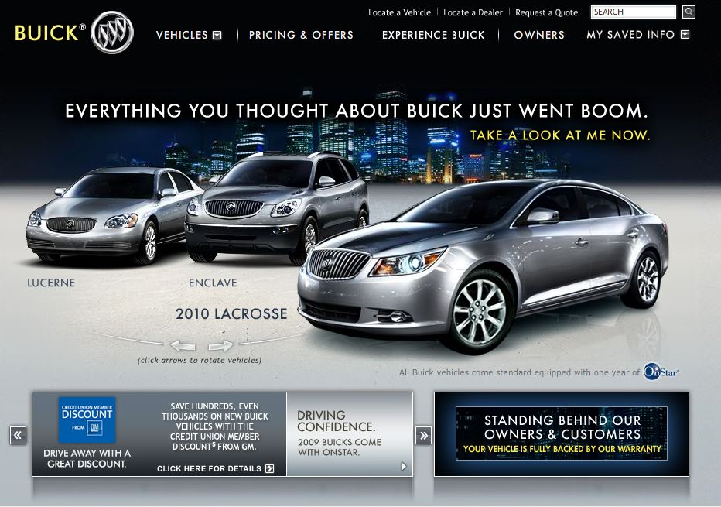
Post purchase behavior
1.5
Cognitive Dissonance= feeling of post-purchase psychological tension or anxiety
Companies follow up with phone calls or ads to reinforce or confirm buyer’s good decision, e.g. “Aren’t you really glad you bought a Buick?”
Notes:
Consumers alleviate cognitive dissonance by seeking affirmation ask friends to applaud choice read ads of rejected brands to confirm why they were not chosen

Slide 36
The Model of Buyer Behavior
2
Black box’ - refers to a device or system that can be viewed only in terms of its input, output, and transfer characteristics, without understanding its internal workings. Philip Kotler
Notes:
This figure shows that marketing and other stimuli enter the consumer’s “black box” and produce certain responses. Marketers must figure out what is in the buyer’s black box. The whats, wheres, and whens of consumer buying behavior can be measured. But it’s very difficult to figure out the whys of buying behavior (that’s why it’s called the black box). Marketers spend a lot of time and money trying to figure out what makes customers tick.

Slide 37
The Model of Buyer Behavior
2
Black box’ - refers to a device or system that can be viewed only in terms of its input, output, and transfer characteristics, without understanding its internal workings. Philip Kotler
Notes:
This figure shows that marketing and other stimuli enter the consumer’s “black box” and produce certain responses. Marketers must figure out what is in the buyer’s black box. The whats, wheres, and whens of consumer buying behavior can be measured. But it’s very difficult to figure out the whys of buying behavior (that’s why it’s called the black box). Marketers spend a lot of time and money trying to figure out what makes customers tick.

Slide 38
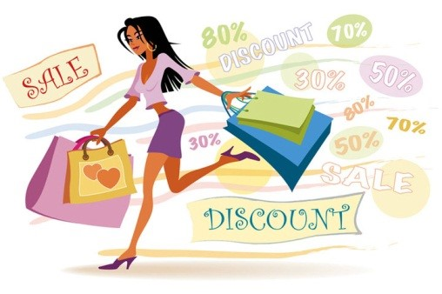
Factors Influencing Consumer Behavior
3
1
2
3
4
Many levels of factors affect our buying behavior from broad cultural and social influences on motivations, beliefs, and attitudes.
marketers cannot control such factors, but they must take them into account.
Notes:
Consumer purchases are influenced strongly by cultural, social, personal, and psychological characteristics, as shown in this figure. For the most part, marketers cannot control such factors, but they must take them into account. The following slides will discuss these characteristics in more detail.

Slide 39
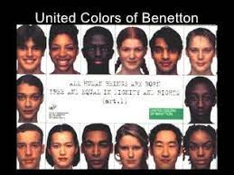
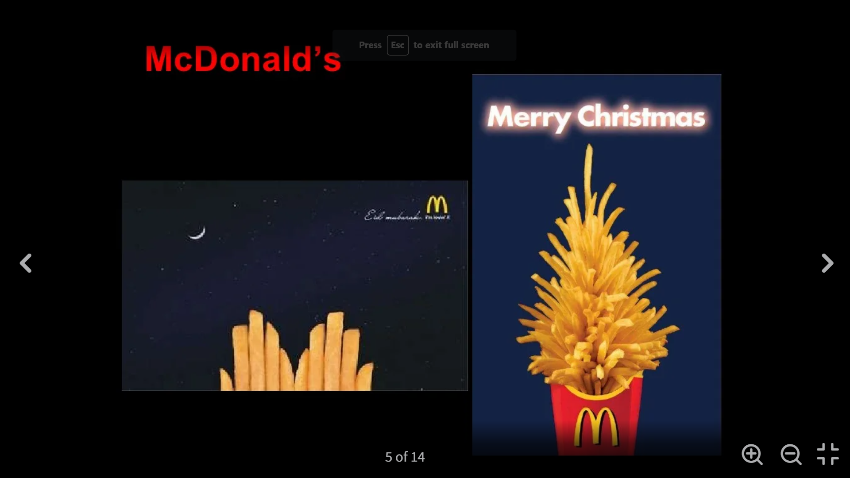
Cultural Factors
3.1
Culture
Set of basic values, perceptions, wants, and behaviors learned by an individual from family and other important institutions
Subculture
Group of people with shared value systems based on common life experiences and situations
A successful Marketing strategy should integrate cultural and cross-cultural perspectives within a brand’s marketing
Notes:
Culture is the most basic cause of a person’s wants and behavior. Culture is the set of basic values, perceptions, wants, and behaviors learned by a member of society from family and other important institutions.
A subculture is a group of people with shared value systems based on common life experiences and situations.
A total market strategy integrates ethnic themes and cross-cultural perspectives within a brand’s mainstream marketing, appealing to consumer similarities across subcultures rather than differences.
A social class is the relatively permanent and ordered divisions in a society whose members share similar values, interests, and behaviors. It is measured as a combination of occupation, income, education, wealth, and other variables.

Slide 40
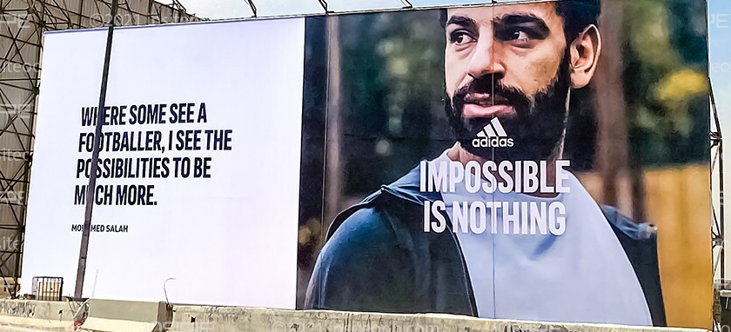

Social Factors
3.2
Groups membership groups. Reference groups An aspirational group is one to which the individual wishes to belong.
Word-of-mouth influence the impact of the personal words and recommendations of trusted friends, associates, and other consumers
Opinion leaders as influential or leading adopters. serve as brand ambassadors who spread the word about a company’s products.
Online social networks online communities where people socialize or exchange information
Family Marketers are interested in the roles and influence of the husband, wife, and children on the purchase of different products and services.
Roles and status People usually choose products appropriate to their roles and status.
Notes:
A consumer’s behavior is also influenced by social factors.
Groups that have a direct influence and to which a person belongs are called membership groups. Reference groups serve as direct or indirect points of comparison or reference in forming a person’s attitudes or behavior. An aspirational group is one to which the individual wishes to belong.
Word-of-mouth influence refers to the impact of the personal words and recommendations of trusted friends, associates, and other consumers on buying behavior. Rather than leaving it to chance, marketers can help to create positive conversations about their brands.
An opinion leader is a person within a reference group who, because of special skills, knowledge, personality, or other characteristics, exerts social influence on others. Opinion leaders are also referred to as influentials or leading adopters. Buzz marketing involves enlisting or even creating opinion leaders to serve as brand ambassadors who spread the word about a company’s products.
Online social networks are online communities where people socialize or exchange information and opinions.
Family members can strongly influence buyer behavior. Marketers are interested in the roles and influence of the husband, wife, and children on the purchase of different products and services.
A person’s position in each group can be defined in terms of both role and status. People usually choose products appropriate to their roles and status.

Slide 41

Personal Factors
3.3
Personality and self-concept, unique psychological characteristics that distinguish a person or group
Occupation. A person’s occupation affects the goods and services bought.
Economic situation affect his or her store and product choices trends in spending, personal income, savings, and interest rates.
Lifestyle AIO dimensions - activities, interests & opinions
Brand personality: MINI markets to personality segments of people who are “adventurous, individualistic, open-minded, creative, tech-savvy, and young at heart”—anything but “normal”—just like the car.
Notes:
A buyer’s decisions also are influenced by personal characteristics of the buyer. A person’s occupation affects the goods and services bought. Marketers try to identify the occupational groups that have an above-average interest in their products and services. A company can specialize in making products needed by a given occupational group.
Tastes in food, clothes, furniture, and recreation are often age related. Buying is also shaped by the stage of the family life cycle. One of the leading life-stage segmentation systems is the Nielsen PRIZM Lifestage Groups system. PRIZM classifies every American household into one of 66 distinct life-stage segments, which are organized into 11 major life-stage groups.
A person’s economic situation will affect his or her store and product choices. Marketers watch trends in spending, personal income, savings, and interest rates.
Lifestyle is a person’s pattern of living as expressed in his or her psychographics. It involves measuring consumers’ major AIO dimensions - activities, interests, and opinions. The lifestyle concept can help marketers understand changing consumer values and how they affect buyer behavior.
Personality refers to the unique psychological characteristics that distinguish a person or group. It can be useful in analyzing consumer behavior for certain product or brand choices. A person’s self-concept is also made use of by marketers. The idea is that people’s possessions contribute to and reflect their identities.

Slide 42
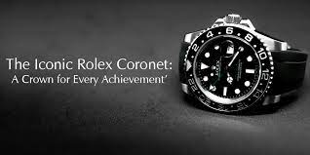
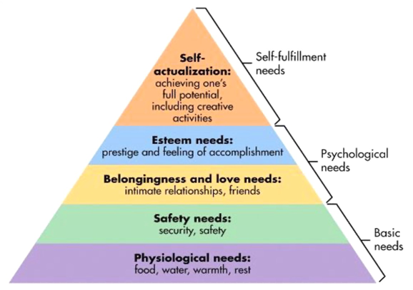
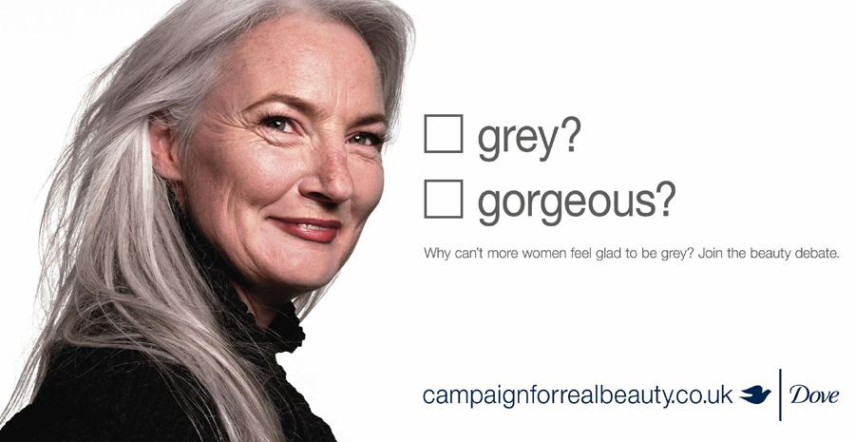


Maslow’s Hierarchy of Needs
Maslow’s answer is that human needs are arranged in a hierarchy, from the most pressing at the bottom to the least pressing at the top. They include physiological needs, safety needs, social needs, esteem needs, and self-actualization needs.
Notes:
Abraham Maslow sought to explain why people are driven by particular needs at particular times. Why does one person spend a lot of time and energy on personal safety and another on gaining the esteem of others? Maslow’s answer is that human needs are arranged in a hierarchy, from the most pressing at the bottom to the least pressing at the top. They include physiological needs, safety needs, social needs, esteem needs, and self-actualization needs.

Slide 43
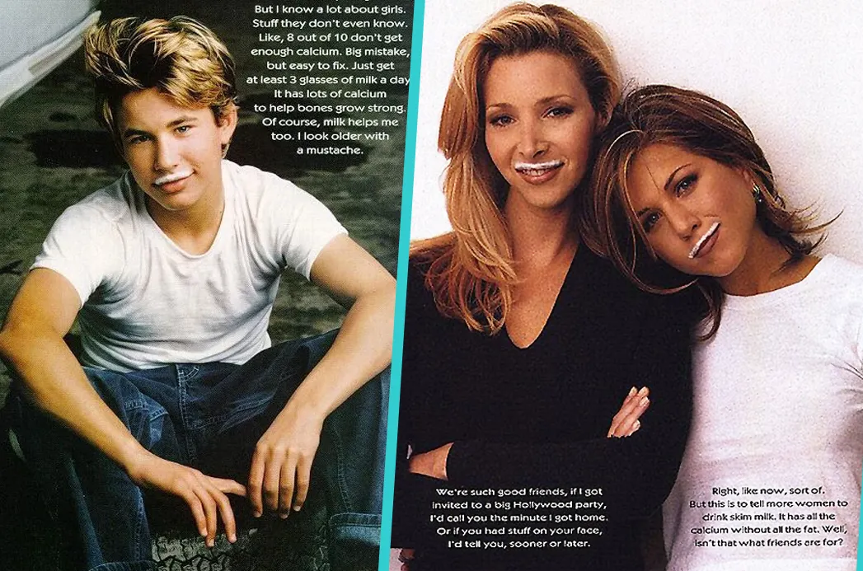
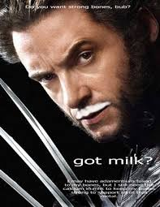
Psychological Factors
3.4
Motivation (drive) is a need that is sufficiently pressing to direct a person to seek satisfaction
Perception process by which people select, organize, and interpret information to form a meaningful picture of the world.
Learning describes changes in an individual’s behavior arising from experience.
Beliefs descriptive thought that a person holds about something
Attitudes put people into a frame of mind of liking or disliking things, of moving toward or away from them.
1994, milk consumption had been in decline for 20 years. The general public perception was that milk was unhealthy, outdated, just for kids, or good only for dunking cookies.
The national Fluid Milk Processors Education Program (MilkPEP) launched its ad campaign featuring celebrities with milk mustaches, and the tag line “Got Milk?”The campaign has been wildly popular + very successful, and is still running.
Notes:
A motive (or drive) is a need that is sufficiently pressing to direct a person to seek satisfaction. Many companies employ teams of psychologists, anthropologists, and other social scientists to carry out motivation research.
Perception is the process by which people select, organize, and interpret information to form a meaningful picture of the world. Selective distortion describes the tendency of people to interpret information in a way that will support what they already believe. Selective retention means that consumers are likely to remember good points made about a brand they favor and forget good points made about competing brands. Some consumers worry that they will be affected by marketing messages without even knowing it—through subliminal advertising.
Learning describes changes in an individual’s behavior arising from experience. The practical significance of learning theory for marketers is that they can build up demand for a product by associating it with strong drives by using motivating cues and providing positive reinforcement.
A belief is a descriptive thought that a person holds about something. Marketers are interested in the beliefs that people formulate about specific products and services because these beliefs make up product and brand images that affect buying behavior. Attitudes put people into a frame of mind of liking or disliking things, of moving toward or away from them.

Slide 44
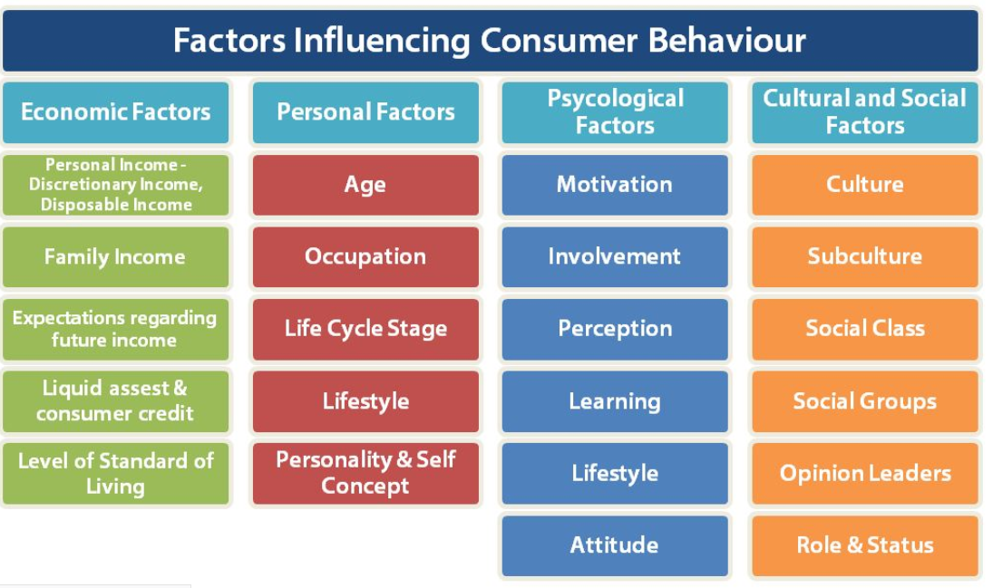
Summary for Factors Influencing Consumer Behavior

Slide 45
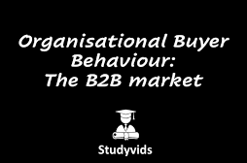
Understanding Business Buyer Behavior and Business Markets
Business buyer behavior
  Buying behavior of the organizations that buy goods and services for use in the production of other products and services that are sold, rented, or supplied to others.
Business market Business-to-business (B-to-B)
  Where Organizations sell their products or services to businesses instead of marketing them to consumers
  like businesses that sell to final buyers, they must engage business customers and build profitable relationships with them by creating superior customer value.
Notes:
Business buyer behavior refers to the buying behavior of the organizations that buy goods and services for use in the production of other products and services that are sold, rented, or supplied to others.
Business-to-business (B-to-B) marketers must do their best to understand business markets and business buyer behavior. Then, like businesses that sell to final buyers, they must engage business customers and build profitable relationships with them by creating superior customer value.
The business buying process is the decision process by which business buyers determine which products and services their organizations need to purchase and then find, evaluate, and choose among alternative suppliers and brands.

Slide 46

Business Buyer Behavior and Business Markets
Business Market Characteristics
Business Buyer Decisions & Process
Business Buyer Behavior Model
Major Influences on Business Buying Behavior
Segmenting Business Markets
E-Procurement and Online Purchasing
Business-to-Business Digital and Social Media Marketing
Business Buying situation
1
2
3
4
5
6
7
8
Notes:
Business buyer behavior refers to the buying behavior of the organizations that buy goods and services for use in the production of other products and services that are sold, rented, or supplied to others.
Business-to-business (B-to-B) marketers must do their best to understand business markets and business buyer behavior. Then, like businesses that sell to final buyers, they must engage business customers and build profitable relationships with them by creating superior customer value.
The business buying process is the decision process by which business buyers determine which products and services their organizations need to purchase and then find, evaluate, and choose among alternative suppliers and brands.

Slide 47

Business Markets characteristics(1/2)
1
1.1 Business markets Structure and Demand
The business market is huge and involves more dollars and items than do consumer markets.
  The business marketer normally deals with fewer but larger buyers.
  Business buyers are Geographical concentrated
  Business markets demand are inelastic and more fluctuating demand.
Business markets differ from consumer markets in terms of market structure and demand, the nature of the buying unit, and the types of decisions and the decision process involved.
Notes:
The business market is huge and involves more dollars and items than do consumer markets. Business markets differ from consumer markets in terms of market structure and demand, the nature of the buying unit, and the types of decisions and the decision process involved.

Slide 48
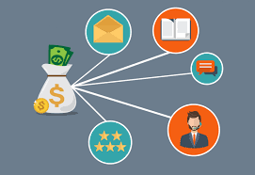
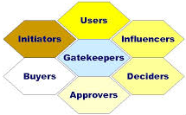
Business Market Characteristics
(2/2)
1
1.2 Business markets buying unit
Buying unit / Center
The decision-making unit of a buying organization and it Includes all individuals and departments that participate in the decision making
  Actual users of the product or service
  People who make the buying decision
  People and units influencing the buying decision
  People who do the actual buying
  Individuals and units controlling the buying information
Nature of the business market buying unit
  The buying center is not a fixed and formally identified unit within the buying organization.
  It is a set of buying roles assumed by different people for different purchases
  More decision participants
  More professional purchasing effort
  companies must have well-trained marketers and salespeople to deal with these well-trained buyers
Notes:
The business marketer normally deals with far fewer but far larger buyers than the consumer marketer does. Even in large business markets, a few buyers often account for most of the purchasing. Further, business demand is derived demand. It ultimately derives from the demand for consumer goods. Finally, many business markets have inelastic and more fluctuating demand. The total demand for many business products is not much affected by price changes, especially in the short run.
The buying center consists of all the individuals and units that play a role in the purchase decision-making process. This group includes the actual users of the product or service, those who make the buying decision, those who influence the buying decision, those who do the actual buying, and those who control buying information.
Buying center: All the individuals and units that play a role in the purchase decision-making process
Actual users of the product or service
People who make the buying decision
People and units influencing the buying decision
People who do the actual buying
Individuals and units controlling the buying information
The buying center is not a fixed and formally identified unit within the buying organization. It is a set of buying roles assumed by different people for different purchases. Within the organization, the size and makeup of the buying center will vary for different products and for different buying situations.

Slide 49
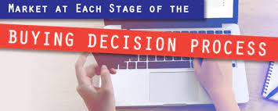
Business Market buying
Decisions & the Decision Process (1/2)
2
Types of Decisions and the Decision Process
More complex buying decisions
more formalized buying process.
Buyer and seller more dependent on each other
long-term relationships.
Systematic development of networks of supplier-partners to ensure a dependable supply of products and materials.
Notes:
The business marketer normally deals with far fewer but far larger buyers than the consumer marketer does. Even in large business markets, a few buyers often account for most of the purchasing. Further, business demand is derived demand. It ultimately derives from the demand for consumer goods. Finally, many business markets have inelastic and more fluctuating demand. The total demand for many business products is not much affected by price changes, especially in the short run.

Slide 50
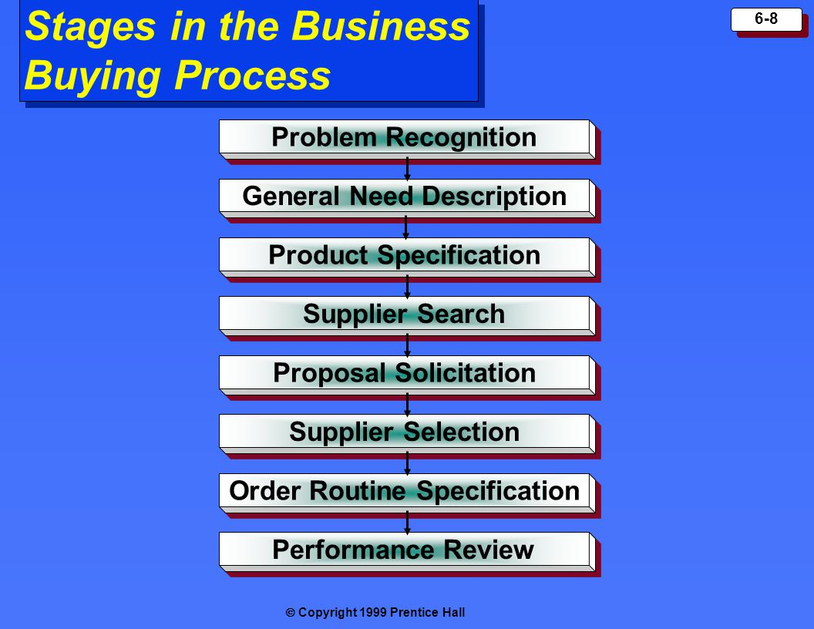
Business Market buying
Decisions & the Decision Process (2/2)
2
Business Market buying Decision Process
problem recognition. Problem recognition can result from internal or external stimuli.
general need description that describes the characteristics and quantity of the needed items or solutions.
product specifications it develops the item’s technical, a value analysis engineering team. to cost reduction in which components are studied carefully to determine if they can be redesigned, standardized, or made by less costly methods of production.
supplier search to find the best vendors.
proposal solicitation stage, the buyer invites qualified suppliers to submit proposals.
supplier selection, reviews the proposals and selects a supplier or suppliers. During the buyer will consider many supplier attributes and their relative importance. n
order-routine specification. It includes the final order with the chosen supplier or suppliers. Many large buyers now practice vendor-managed inventory.
Supplier performance review, in which the buyer reviews the supplier performance. The seller’s job is to monitor the same factors used by the buyer to make sure that the seller is giving the expected satisfaction.
Notes:
Figure 5.8 lists the eight stages of the business buying process. The buying process begins with problem recognition. Problem recognition can result from internal or external stimuli. Having recognized a need, the buyer next prepares a general need description that describes the characteristics and quantity of the needed items or solutions. Once the buying organization has defined the need, it develops the item’s technical product specifications, often with the help of a value analysis engineering team. Product value analysis is an approach to cost reduction in which components are studied carefully to determine if they can be redesigned, standardized, or made by less costly methods of production.
In the next buying process step, the buyer conducts a supplier search to find the best vendors. In the proposal solicitation stage, the buyer invites qualified suppliers to submit proposals. The buyer next reviews the proposals and selects a supplier or suppliers. During supplier selection, the buyer will consider many supplier attributes and their relative importance. The buyer now prepares an order-routine specification. It includes the final order with the chosen supplier or suppliers. Many large buyers now practice vendor-managed inventory, in which they turn over ordering and inventory responsibilities to their suppliers. The final stage of the business buying process is the supplier performance review, in which the buyer reviews the supplier performance. The seller’s job is to monitor the same factors used by the buyer to make sure that the seller is giving the expected satisfaction.

Slide 51
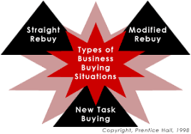
Business Market Buying Situations (1/2)
3
Types of Buying Situations
Straight rebuy, Buyer routinely reorders something without any modifications
Modified rebuy, Buyer wants to modify product specifications, prices, terms, or suppliers
New task, Buyer purchases a product or service for the first time
  Systems selling, (or solutions selling)
  Buying a packaged solution to a problem from a single seller
  Avoids the separate decisions involved in a complex buying situation
Notes:
There are three major types of buying situations: straight rebuy, modified rebuy, and a new task situation.
In a straight rebuy, the buyer reorders something without any modifications. It is usually handled on a routine basis by the purchasing department. In a modified rebuy, the buyer wants to modify product specifications, prices, terms, or suppliers.
A company buying a product or service for the first time faces a new task situation. The marketer not only tries to reach as many key buying influences as possible, but also provides help and information. The buyer makes the fewest decisions in the straight rebuy and the most in the new task situation.
Systems selling (or solutions selling) refers to buying a packaged solution to a problem from a single seller, thus avoiding all the separate decisions involved in a complex buying situation.

Slide 52
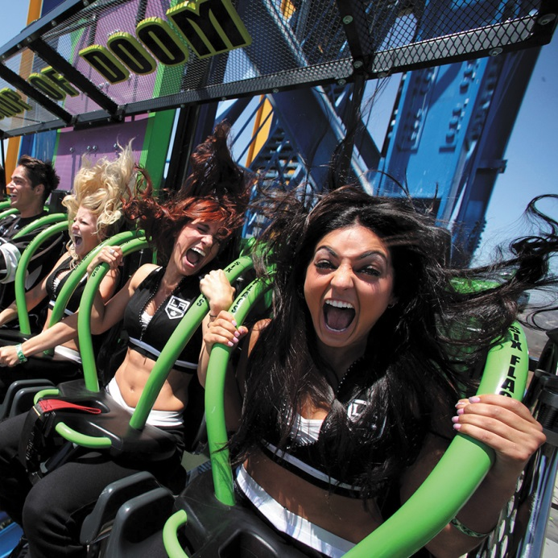


Business Market Buying Situations (2/2)
3
Solutions selling examples
IBM works with Six Flags to provide a complete solution.
Delivering a fun effective management of thousands of park assets across its 19 regional theme parks. IBM works hand in hand with Six Flags to provide not just software but a complete solution.
Notes:
Delivering a fun and safe experience for Six Flags guests requires careful and effective management of thousands of park assets across its 19 regional theme parks. IBM works hand in hand with Six Flags to provide not just software but a complete solution.

Slide 53
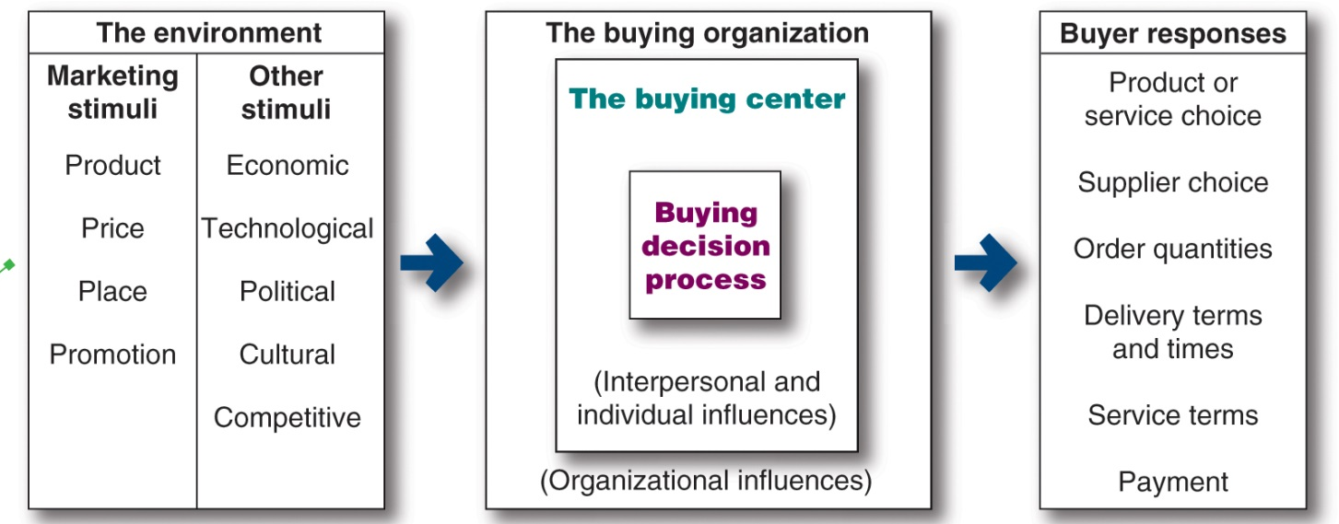
Business Buyer Behavior Model
4

Slide 54
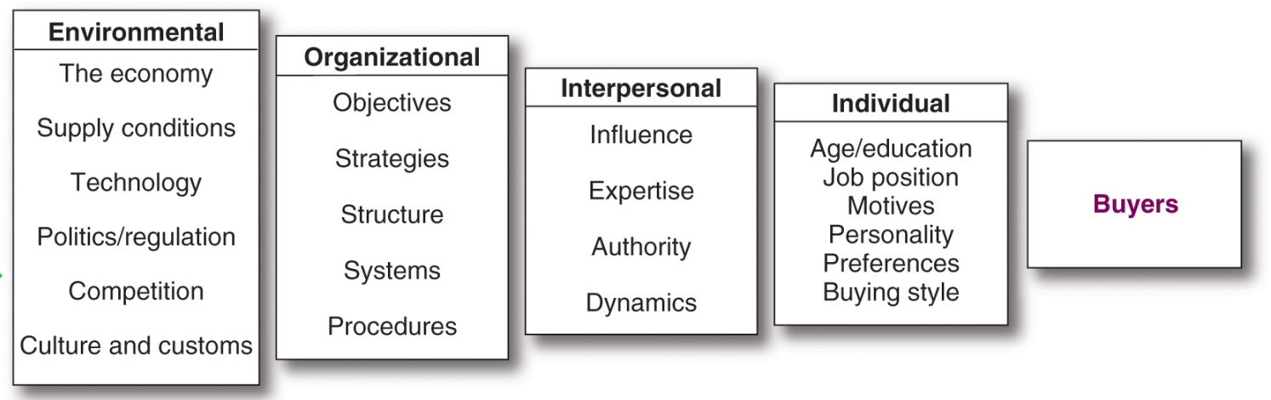
Major Influences on Business Buying Behavior
5
Notes:
Figure 5.7 illustrates that business buying behavior is influenced by a complex combination of environmental, organizational, interpersonal, and individual factors.

Slide 55
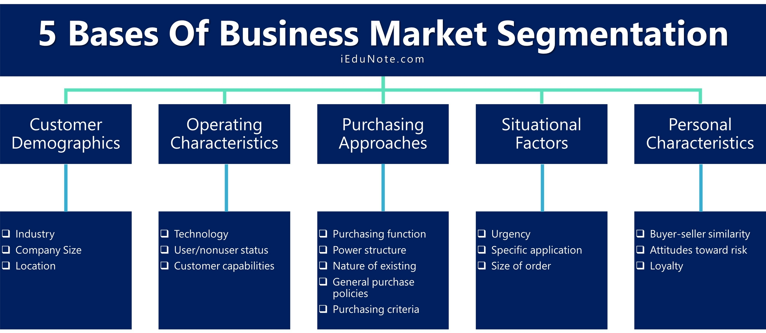
Segmenting Business Markets
6
Consumer and business markets use many of the same variables for segmentation.
Variables used by business marketers for segmentation include
  Demographically (industry, company size),
  Operating characteristics
  Purchasing approaches
  Situational factors
  Personal characteristics
Notes:
Consumer and business marketers use many of the same variables to segment their markets. Business buyers can be segmented geographically, demographically (industry, company size), or by benefits sought, user status, usage rate, and loyalty status. Yet, business marketers also use some additional variables, such as customer operating characteristics, purchasing approaches, situational factors, and personal characteristics.

Slide 56
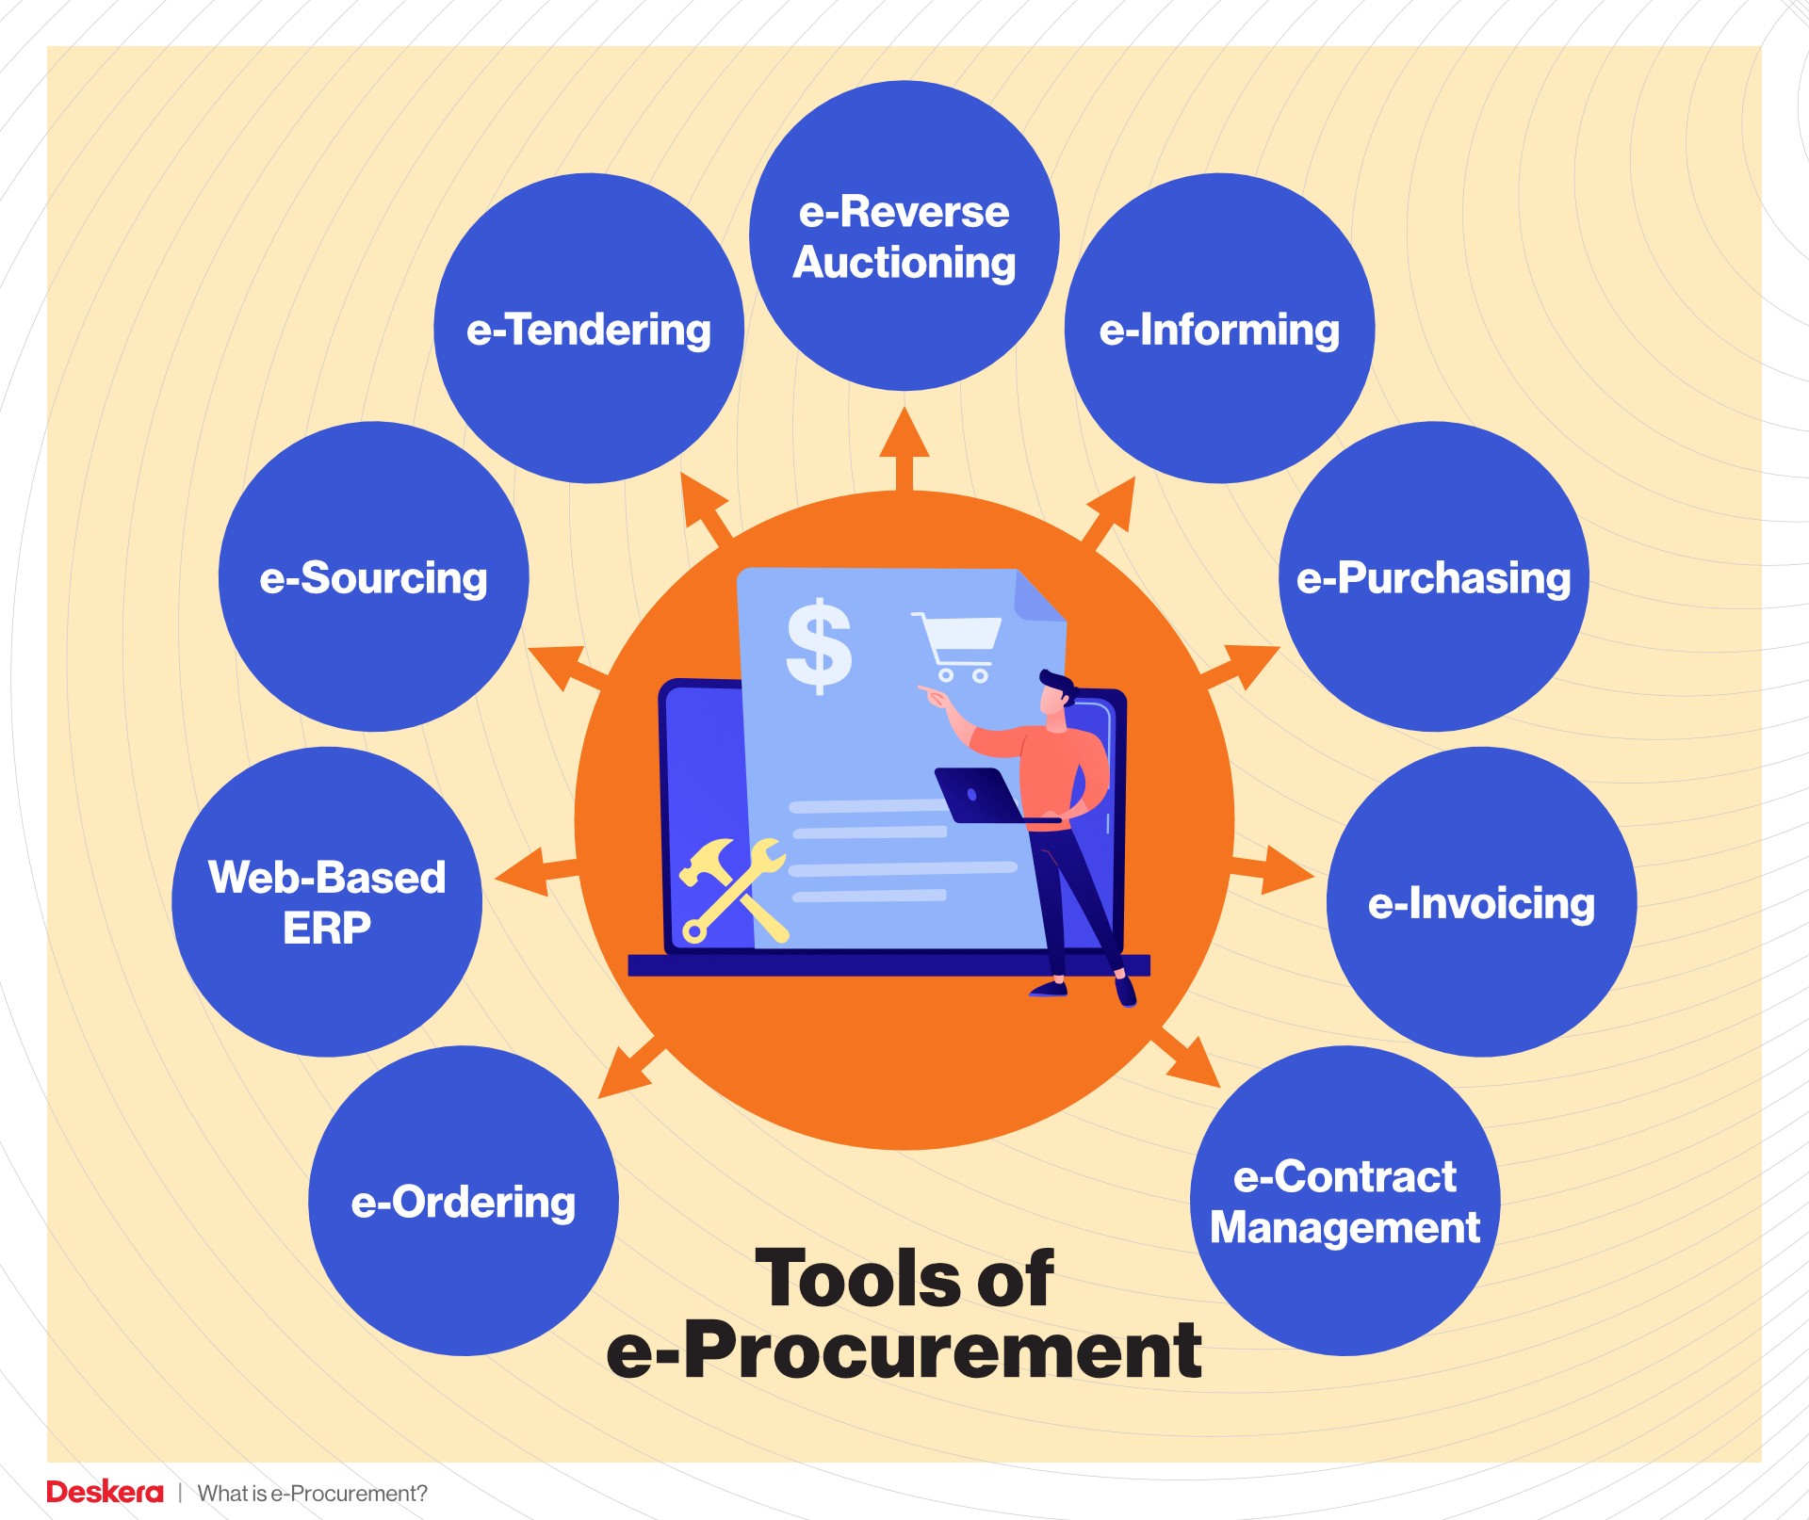
E-Procurement and Online Purchasing (1/2)
7
Purchasing through electronic connections between buyers and sellers—usually online
E-procurement occurs through
  Reverse auctions
  Online trading exchanges
  Company buying sites
  Extranet links with key suppliers
Notes:
Advances in information technology have dramatically affected the face of the B-to-B buying process. Online purchasing, often called e-procurement, refers to purchasing through electronic connections between buyers and sellers—usually online.
Companies can do e-procurement in any of several ways. They can conduct reverse auctions, in which they put their purchasing requests online and invite suppliers to bid for the business. They can engage in online trading exchanges, through which companies work collectively to facilitate the trading process. Companies also can conduct e-procurement by setting up their own company buying sites. Companies can also create extranet links with key suppliers.

Slide 57
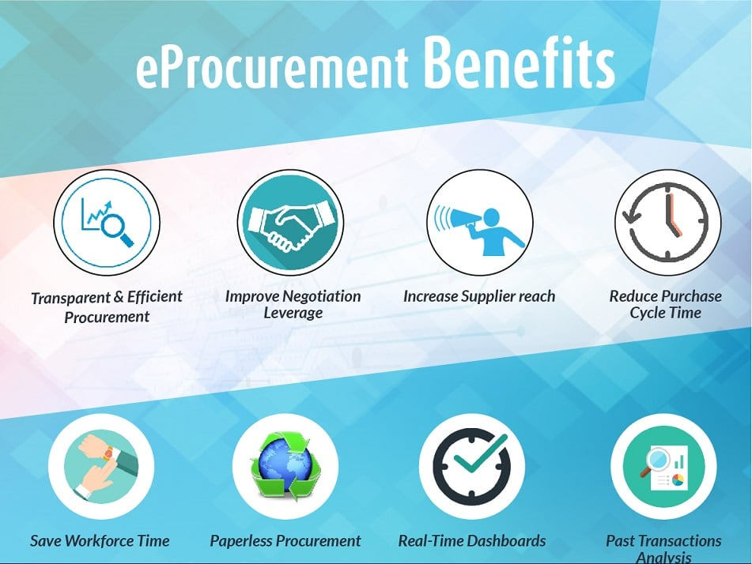
Benefits and Problems of
E-Procurement
E-Procurement and Online Purchasing (2/2)
7
Benefits
  Cuts transaction costs
  Results in efficient purchasing for both buyers and suppliers
  Reduces the time between order and delivery
  Helps an organization keep better track of all purchases
  Frees buyers from a lot of paperwork
Problems
  Can affect the customer-supplier relationship
  Pits suppliers against one another
Notes:
Business-to-business e-procurement yields many benefits. First, it shaves transaction costs and results in more efficient purchasing for both buyers and suppliers. E-procurement reduces the time between order and delivery, and eliminates the paperwork associated with traditional requisition and ordering procedures. It helps an organization keep better track of all purchases. Finally, e-procurement frees purchasing people from a lot of drudgery and paperwork.
However, the rapidly expanding use of e-procurement also presents some problems. At the same time that the Internet makes it possible for suppliers and customers to share business data and even collaborate on product design, it can also erode decades-old customer-supplier relationships. Buyers now use the power of the Internet to pit suppliers against one another and search out better deals, products, and turnaround times on a purchase-by-purchase basis.

Slide 58
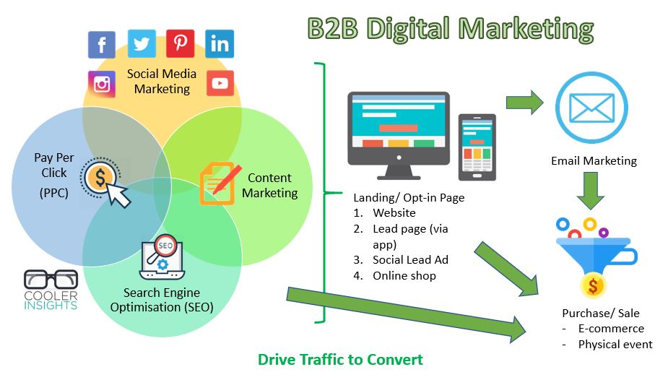
Business-to-Business Digital and Social Media Marketing
8
B-to-B marketers are now using a wide range of digital and social media marketing approaches.
Compared with traditional media and sales approaches, digital and social media can create greater customer engagement and interaction.
Notes:
B-to-B marketers are now using a wide range of digital and social media marketing approaches—from Web sites, blogs, mobile apps, e-newsletters, and proprietary online networks to mainstream social media such as Facebook, LinkedIn, YouTube, Google+, and Twitter—to engage customers and manage customer relationships anywhere, any time.
Compared with traditional media and sales approaches, digital and social media can create greater customer engagement and interaction. B-to-B marketers know that they aren’t really targeting businesses, they are targeting individuals in those businesses who affect buying decisions. Today’s business buyers are always connected via their digital devices—whether it’s PCs, tablets, or smartphones.

Slide 59
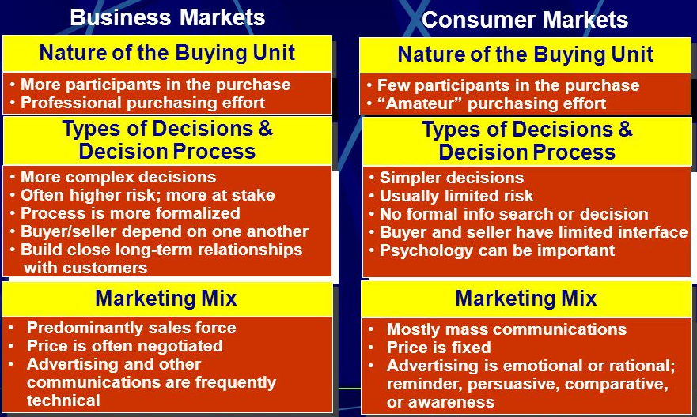
Summary of
Consumer and Business Buyer Behavior

Slide 60


Slide 61


Slide 62


Slide 63


