Slide 1
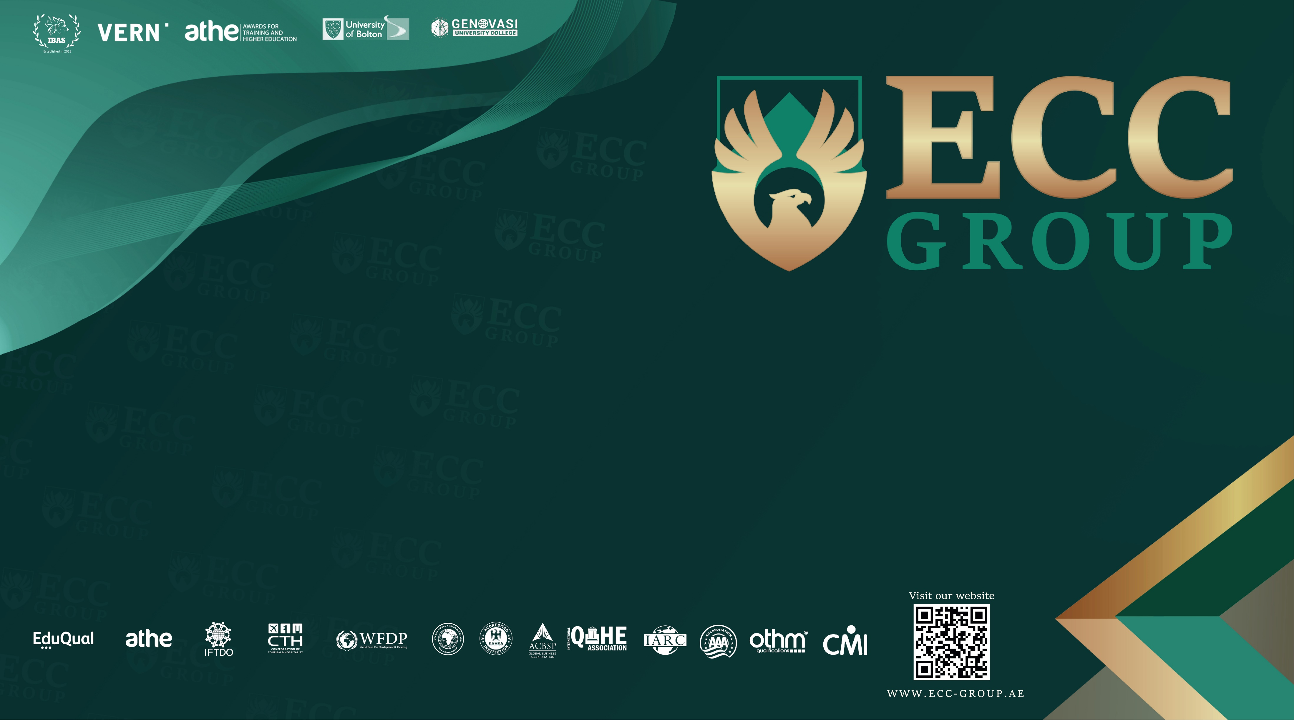
Strategic marketing

Slide 2
Lecture
8

Slide 3
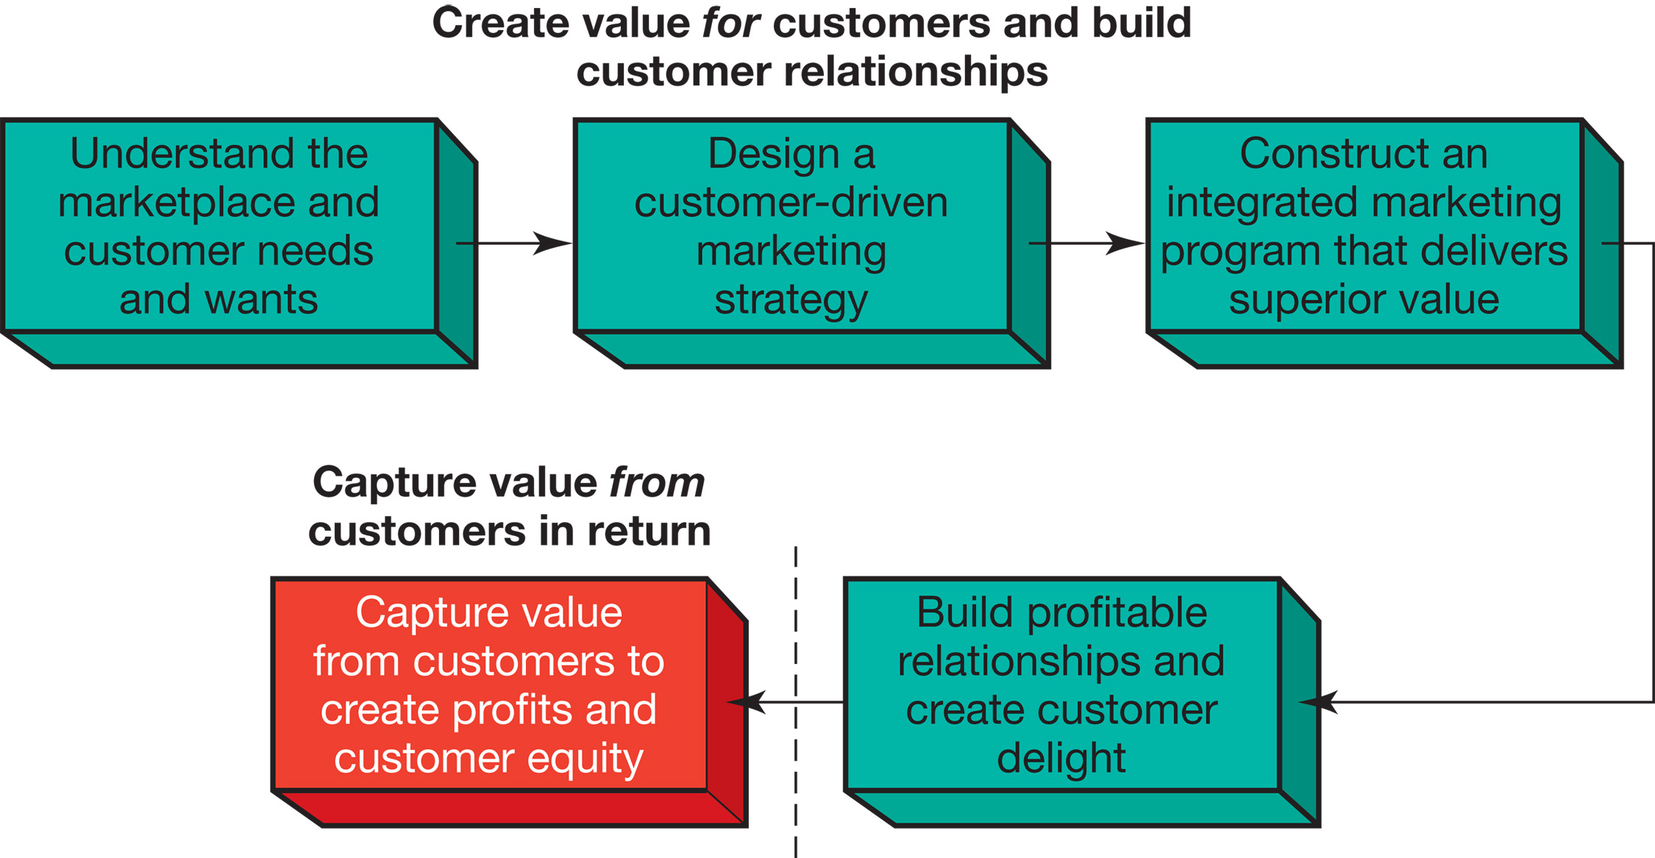
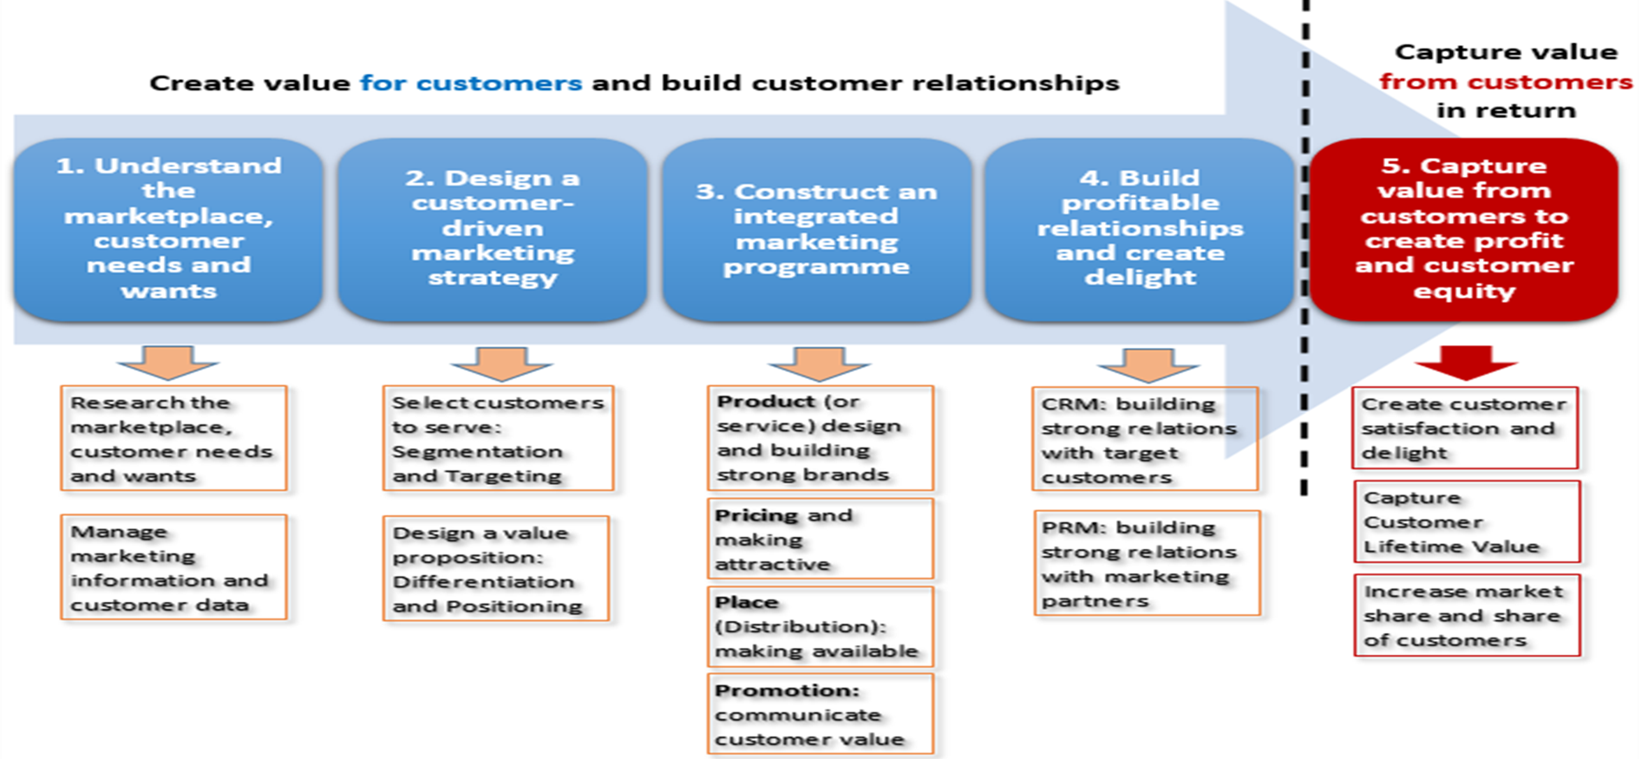
the marketing process, revision .
1
2
3
4
- consumer buyer behaviour and consumer markets
- Business Buyer Behaviour and Business Markets
Needs and wants
Marketplace
Market offering
Strategic marketing analysis
Big data and MIS
Grand marketing strategies competitive and growth
STP strategies
Differentiation and branding
Marketing MIX
4Ps
CRM tools and systems
CUSTOMER RELATIONSHIP GROUPS
Marketing control
Notes:
The Marketing Process
In the first four steps, companies work to understand consumers, create customer value, and build strong customer relationships
In the final step, companies reap the rewards of creating superior customer value
By creating value for customers, companies are able capture value from customers in the form of sales, profits, and long-term customer equity

Slide 4
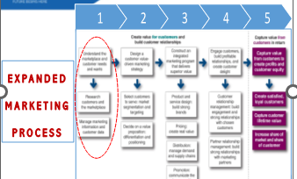

Slide 6
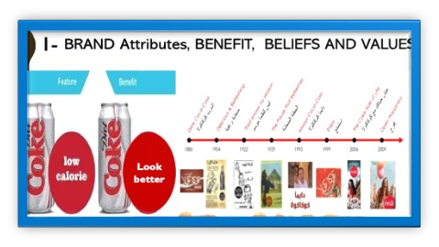
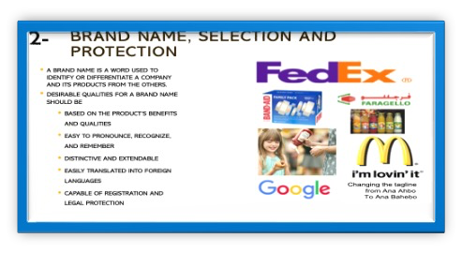
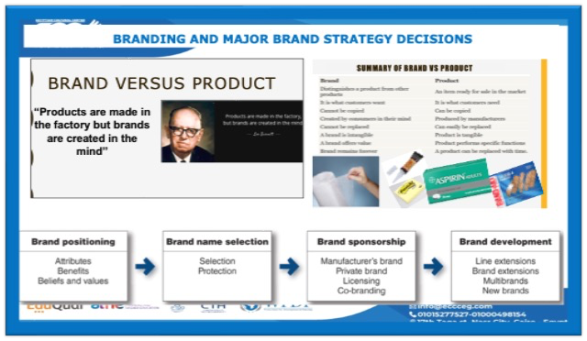
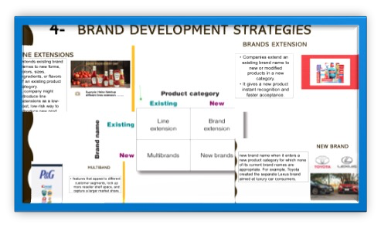
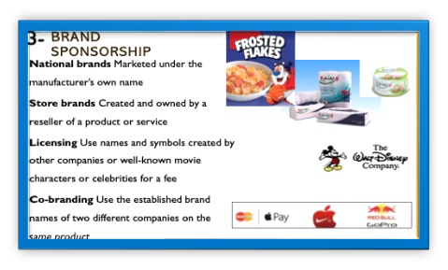

Slide 8
1st P- Product

Slide 9
PRICE ADJUSTMENT STRATEGIES
Other pricing strategies
Initiating Price Changes
Responding to Competitor Price Changes
Public Policy Issues in Pricing

Slide 10

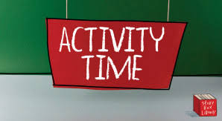
Activity #1
MCQs

Slide 11

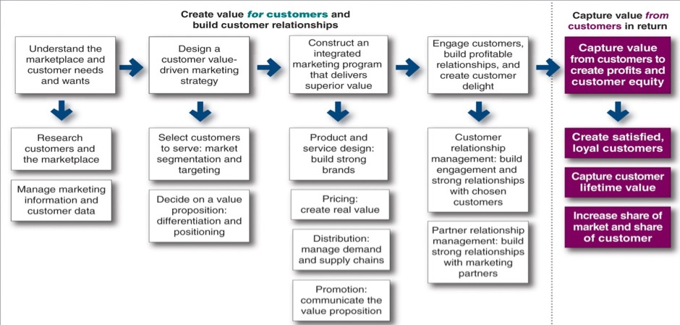
Step 3
Let us continue understanding;
  How to create value for customers through an integrated Marketing Programs
  Marketing mix {4Ps}

Slide 12
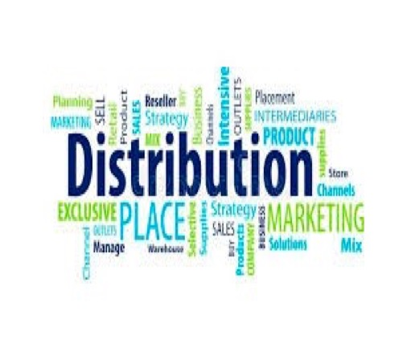
3RD P Place or distribution

Slide 13
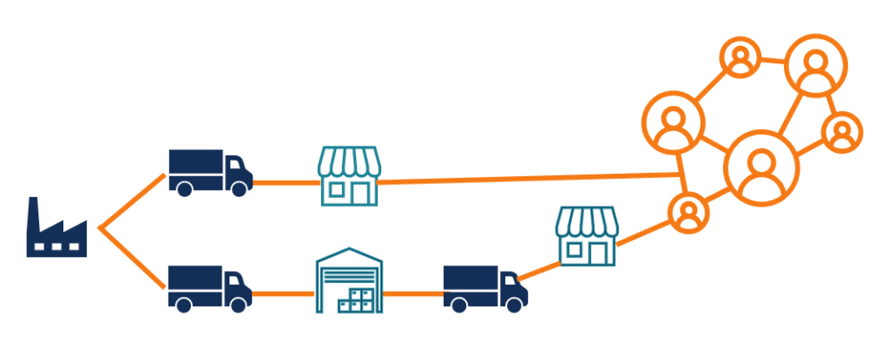
3-distribution
What is DISTRIBUTION?
What is difference between Marketing Channel & Supply chain management?
What is the direct and indirect channels?
What is the Multi Channel Distribution System?
What is the VMS Vertical marketing system (Vertical marketing Channel)?
What are the key Channel strategies?
What is the Disintermediation?

Slide 14
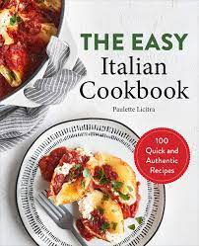
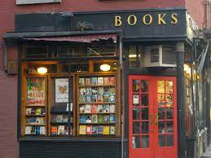
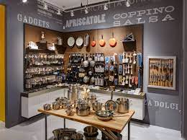
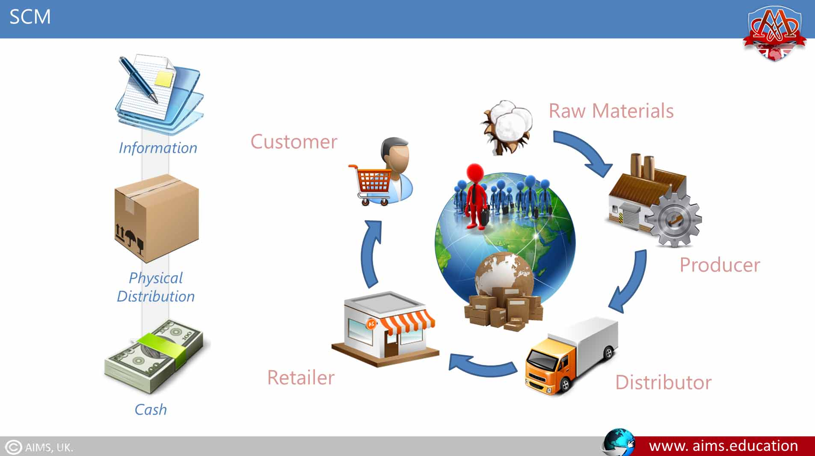
3RD Place
“Distribution”
DISTRIBUTION
where the company sells its products so that they're easily available to the target market.
DISTRIBUTION / Marketing Channel,
A set of interdependent organizations that ease the transfer of ownership as products move from producer to business user or consumer.
  cookbook publisher can place their products in a
    bookstore to reach customers who are looking for books,
    also, in a kitchenware store to reach customers interested in cooking.
Supply chain,
All the chain starting from suppliers, the company, resellers, till the final consumers

Slide 15
Marketing Channel & Supply chain management
Marketing Channel management
involves managing organizations that ease the transfer of products from producer to consumer.
Supply chain management
involves managing upstream and downstream value-added flows of materials, final goods, and related information among suppliers, the company, resellers, and final consumers
The logistics manager’s task is to coordinate the activities of suppliers, purchasing agents, marketers, channel members, and customers.
Notes:
This figure illustrates supply chain management, which involves managing upstream and downstream value-added flows of materials, final goods, and related information among suppliers, the company, resellers, and final consumers.
Marketing logistics involves the entirety of supply chain management. The logistics manager’s task is to coordinate the activities of suppliers, purchasing agents, marketers, channel members, and customers. These activities include forecasting, information systems, purchasing, production planning, order processing, inventory, warehousing, and transportation planning.

Slide 16
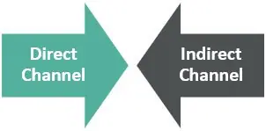
direct and indirect MARKETING/distribution channels
DIRECT distribution, manufacturers Lack of Utilizing one distributor requires three contacts to reach out to consumers.
INDIRECT distribution manufacturers working through one distributor, which contacts the three customers. Lack of Utilizing one distributor requires only three contacts and reduces the amount of work that must be done by both producers and consumers using intermediaries can provide economies
The companies directly deal with customers without having any intermediaries involved.
The companies depend on intermediaries to reaching the consumers
Notes:
A distribution channel is how you distribute your products to the consumer while a. There are two different distribution channels

Slide 17
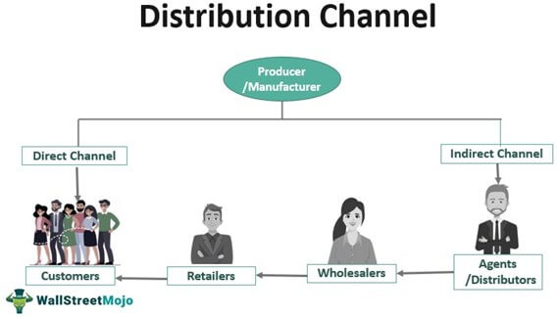
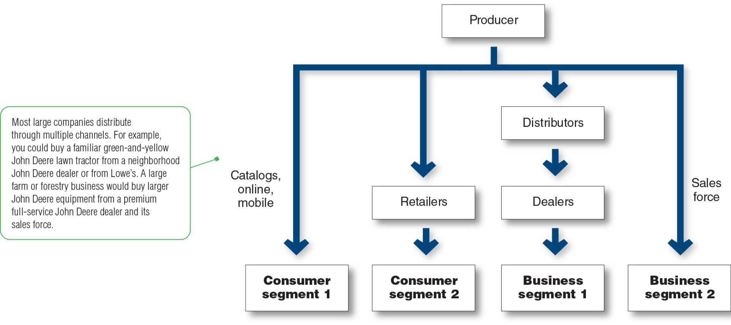
Multi Channel Distribution System
These days, almost every large company and many small ones distribute through multiple channels
manufacturer sell to Distributors, Wholesalers , Retailers at profit and/or commission
Besides, might be able to sell direct to customers through online or stores.
Notes:
In the figure, the producer sells directly to consumer segment 1 using catalogs, online, and mobile channels and reaches consumer segment 2 through retailers. It sells indirectly to business segment 1 through distributors and dealers and to business segment 2 through its own sales force. These days, almost every large company and many small ones distribute through multiple channels.
Distributor they do purchase the products from manufacturer and sell to Wholesalers , Retailers or customers at profit and/or commission
Wholesalers: sell to retailers
Retailers :sell directly to consumers
Agents : they do not purchase the products, but they earn commission

Slide 18
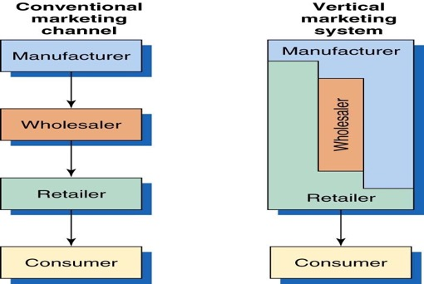
Conventional Vs. Vertical Distribution Channel
A CONVENTIONAL DISTRIBUTION CHANNEL
No channel member has much control over the other members, and no formal means exists for assigning roles and resolving channel conflict.
Channel conflict: Disagreements among marketing channel members on goals, roles, and rewards.
Vertical marketing system (VMS)
consists of producers, wholesalers, and retailers acting as a unified system. contracts put much power that they must all cooperate
Notes:
.

Slide 19
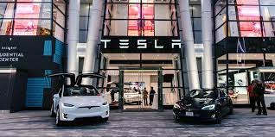
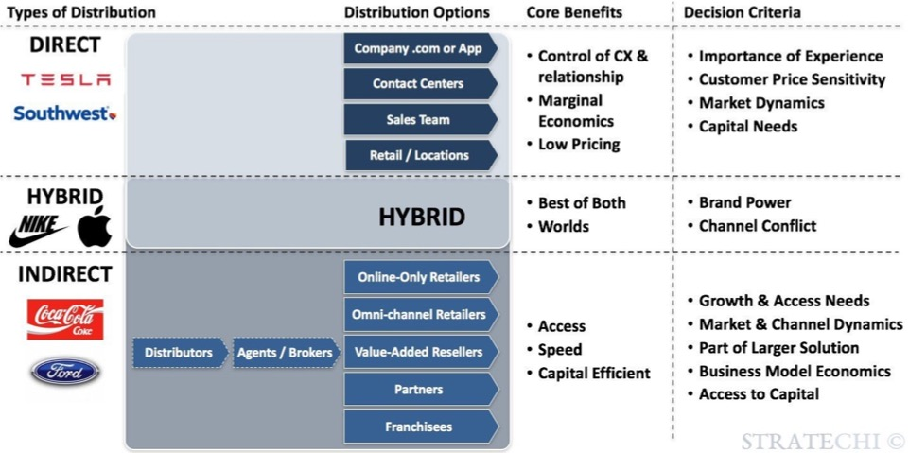
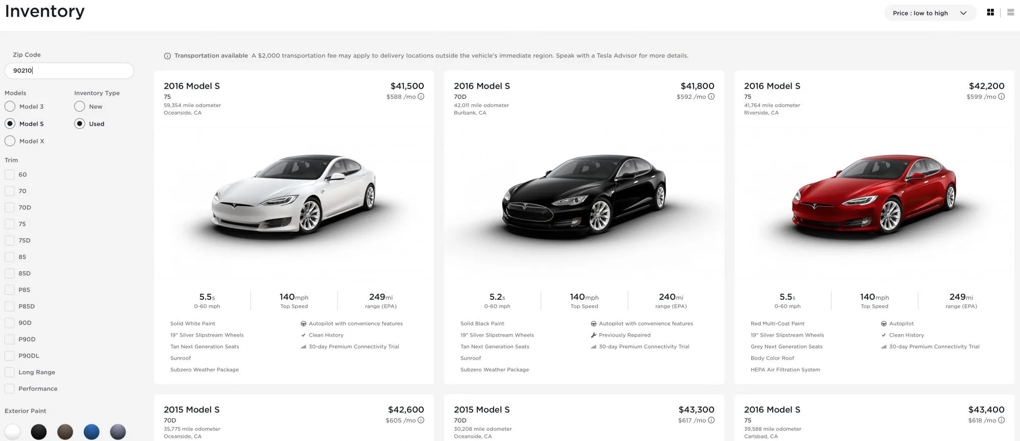
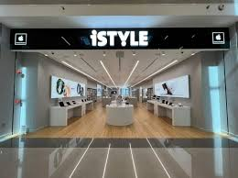
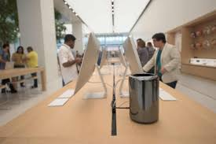
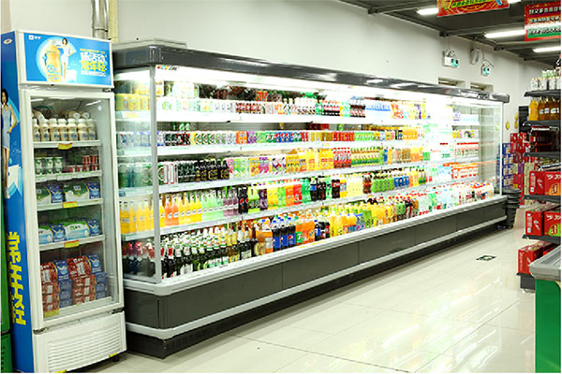
Distribution Channel examples
Notes:
esla sells most of their new cars through orders on the internet. You can go to their site and con

Slide 20
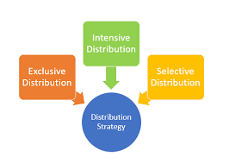
Channel strategies
its the channel alternatives in terms of the types of intermediaries, the number of intermediaries, and the responsibilities of each channel member.
There are THREE BASIC TYPES of place strategy
Intensive
Selective
Exclusive
Major Channel strategies

Slide 21
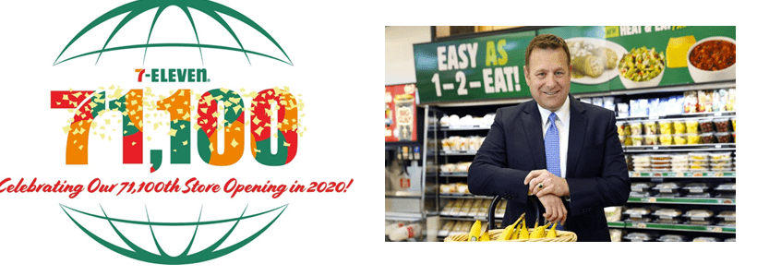

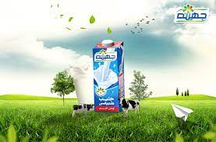
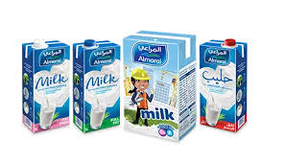
Intensive Distribution strategy
Intensive: An intensive place strategy is when a company places its product in as many stores as possible.
Convenience products as Candy companies often use this strategy, as they place their products in supermarkets, movie theaters, convenience stores and airports.
Notes:
7 Eleven opened its 71,100th retail store in the world and crossed a very important milestone on July 13, 2020. This store was inaugurated in Seoul, South Korea. This brand has licensed stores and/or franchises all over the world.

Slide 22
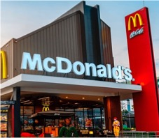
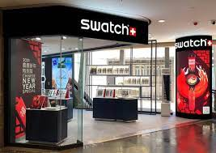
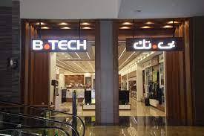
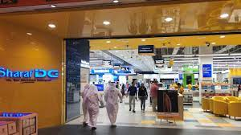
Selective Distribution strategy
Selective: A selective place strategy is when a company places its product in only a few stores. For example, Shopping products companies that manufacture appliances often use this strategy.

Slide 23
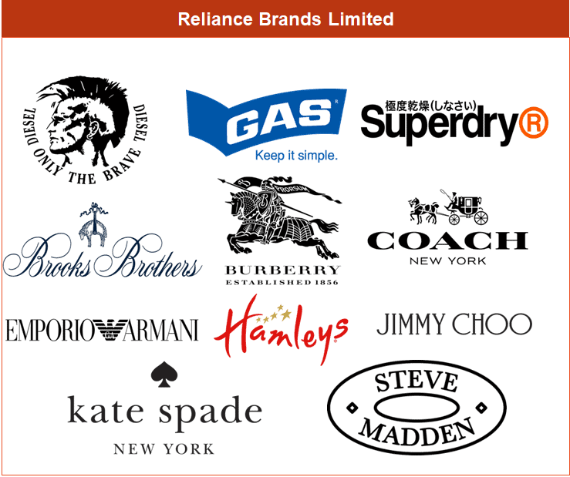
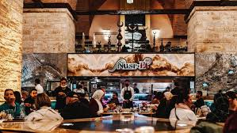
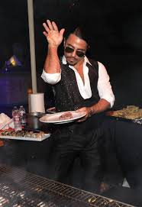
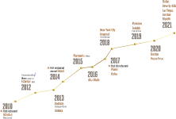
Exclusive Distribution strategy
Exclusive: An exclusive place strategy is when a company places its product in very limited places . This is usually for luxurious brands and specialty products, such as cars.

Slide 24
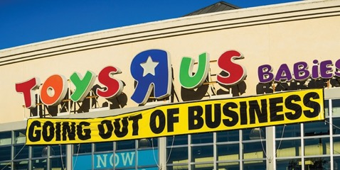
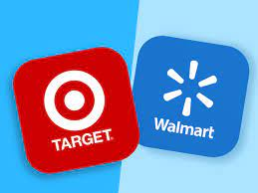
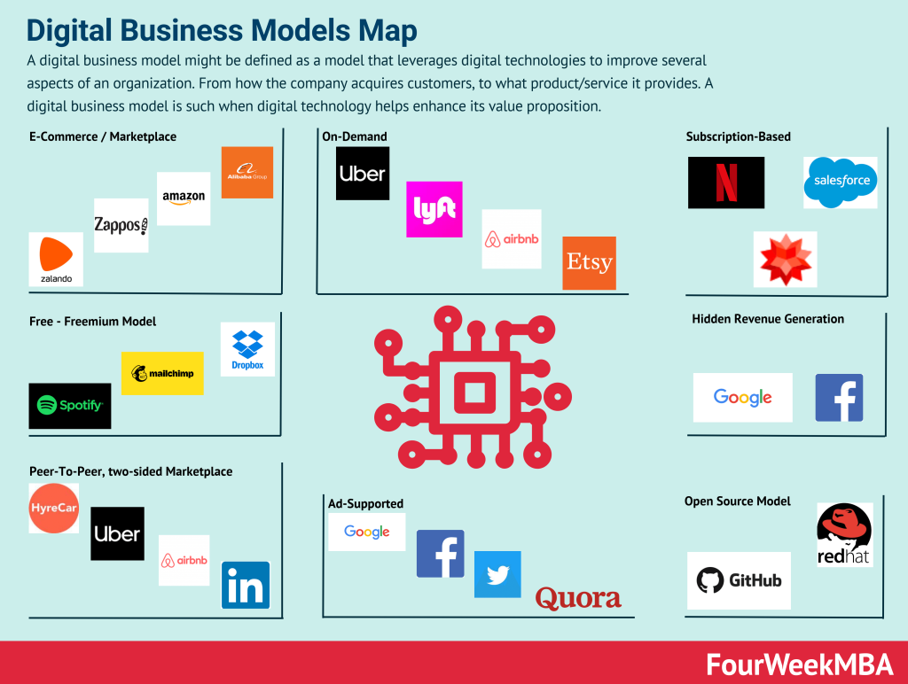
Disintermediation
Occurs when product or service producers cut out marketing channel intermediaries or when radically new types of channel intermediaries displace traditional ones
Toys “R” Us failed to adapt to major shifts in toy market sales, first toward big discounters such as Walmart and Target and then toward online merchants like Amazon.
Toy “R” Us recently closed operations and shuttered its stores.
Notes:
Changes in technology and the explosive growth of direct and online marketing are having a profound impact on the nature and design of marketing channels. One major trend is toward disintermediation, which refers to the cutting out of marketing channel intermediaries by product or service producers, or the displacement of traditional resellers by radical new types of intermediaries.

Slide 25
Activity 2
What do you see in the pictures based on distribution understanding

Slide 26
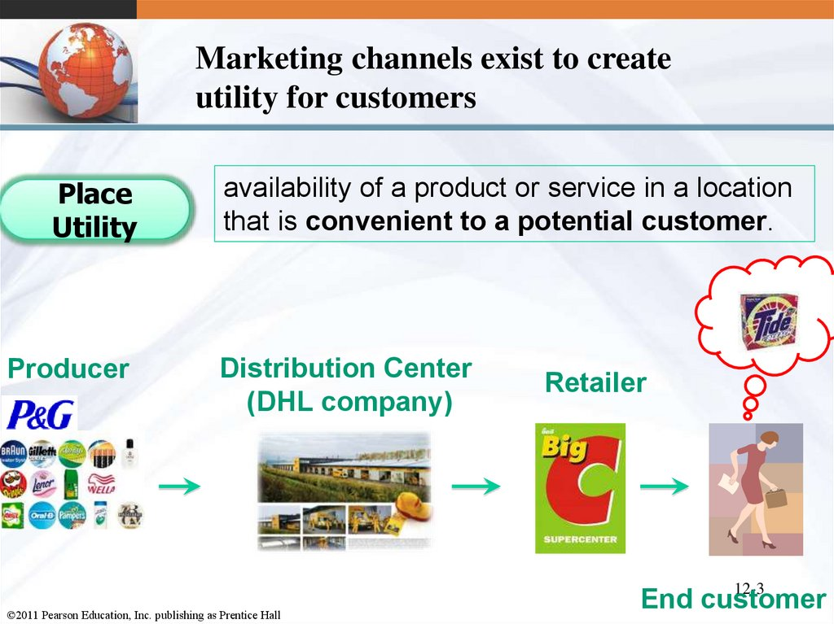
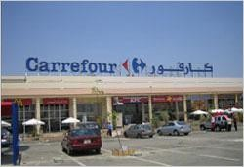
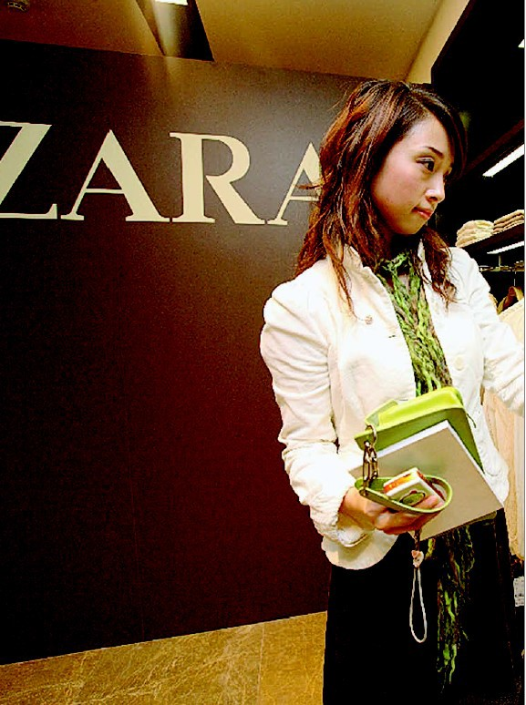

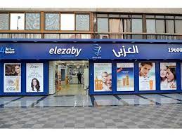
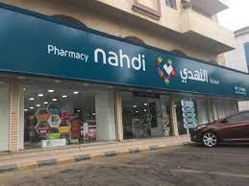
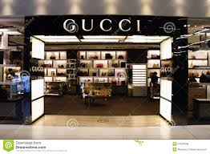
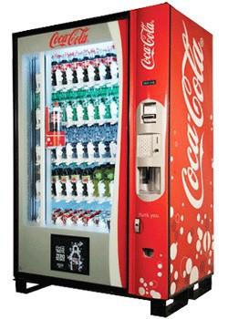
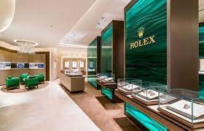



Slide 27


4th P Promotion

Slide 28

What are the five promotion tools (promotion MIX) ?
What des it mean by Integrated promotion MIX?
which Promotion Strategy Push or Pull?
What are the Major Advertising Decisions?
What are the key Consumer Sales Promotion Tools?
What are the Major Pros & cons in personal Selling?
What are the Public relations Examples?
What is Direct and digital marketing? Offline Marketing Vs. Online Marketing and Key digital marketing channels ?

Slide 29

Promotion tools/ MIX
Promotion tools/ MIX
is a mix of different marketing approaches that marketers develop to deliver a clear, consistent, and compelling message about the organization and its brands to the target market segment.

Slide 30

Integrated promotion tools
mix
A carefully integrating and coordinating the company’s many communications channels to deliver a clear, consistent, and compelling message about the organization and its brands
The marketer’s task is to decide :
  What is the right promotion mix for a particular product/brand?
  Which promotion strategy to use ?

Slide 31


Push versus Pull Promotion Strategy
A push strategy refers to a promotion strategy that calls for using the sales force and trade promotion to push the product through channels. The producer promotes the product to channel members that in turn promote it to final consumers.
A pull strategy refers to a promotion strategy that calls for spending a lot on consumer advertising and promotion to induce final consumers to buy the product, creating a demand vacuum that pulls the product through the channel
Notes:
This figure contrasts the two basic promotion mix strategies: push promotion versus pull promotion. The relative emphasis given to the specific promotion tools differs for push and pull strategies.
A push strategy refers to a promotion strategy that calls for using the sales force and trade promotion to push the product through channels. The producer promotes the product to channel members that in turn promote it to final consumers.
A pull strategy refers to a promotion strategy that calls for spending a lot on consumer advertising and promotion to induce final consumers to buy the product, creating a demand vacuum that pulls the product through the channel.
Business-to-consumer companies pull more, putting more of their funds into advertising, followed by sales promotion, personal selling, and then public relations. Business-to-business marketers tend to push more, putting more of their funds into personal selling, followed by sales promotion, advertising, and public relations.

Slide 32



1
Advertising
It is the concept of communicating a message about products and services to a customer so that the customer can understand the offering along with its features, uniqueness, price, offer, benefits and value to get convinced about making a purchase
Examples, paid presentations and promotion in print ads, radio, television, billboard, direct mail, brochures and catalogs, signs, in-store displays, posters, mobile apps, motion pictures, web pages, banner ads, emails.

Slide 33


Slide 34
Major Advertising Decisions
Notes:
This figure shows the four important decisions made by marketing management when developing an advertising program. These decisions include setting advertising objectives, setting the advertising budget, developing advertising strategy, that is, message decisions and media decisions, and evaluating advertising campaigns.

Slide 35

Evaluating Advertising Effectiveness and Return on Advertising Investment
ROI : Net return on advertising investment divided by the costs of the advertising investment
Advertisers should regularly evaluate
  Communication effects
  Sales and profit effects
Advertising media selection : Vehicles through which advertising messages are delivered to their intended audiences
Steps in advertising media selection:
Determining reach, frequency, impact and engagement
Choosing among major media types
Selecting specific media vehicles
Choosing media timing
Advertising objective is a specific communication task to be accomplished with a specific target audience during a specific period.
can be classified by their primary purpose
Evaluating advertising campaigns
Informative advertising, inform, is used heavily when introducing a new product category
Persuasive advertising, persuade, becomes more important as competition increases
reminder advertising , remind. In mature products; it helps to maintain customer relationships and keep consumers thinking about the product.

Slide 36


AIDA model in advertising
Extra
A communications model which used by advertising companies for communication on a 4 stages
Words mean power, once the right words are used, they would enlighten minds, move hearts, and open wallets.
AIDA, structure your communication with a different level of stages and objectives where each stages might engage consumers differently and probably could take an action with the last stage.
Notes:
with a different level of objectives where each stages might engage consumers differently and probably could take an action with the last stage
and then get your audience to follow specific stages in your communication that leads to them taking an action.

Slide 37


Sales Promotion
2
Sales promotion tools refers to the short-term incentives to encourage purchases, IMPROVE, market share for a product or service
Examples include samples, coupons, sweepstakes, contests, rebates, tie-ins, premiums

Slide 38

Extra
Consumer Sales Promotion Tools

Slide 39

Personal selling
3
It is personal promotional tool in which there is a face-to-face contact between a company representative and a customers.
the process of helping and persuading one or more prospects to purchase a good or service or to act on any idea using an oral presentation, often in a face-to-face manner or by telephone.
Examples include sales presentations, sales meetings, sales training and incentive programs for intermediary salespeople, samples, and telemarketing.

Slide 40

Major Pros & cons in personal Selling

Slide 41

Public relations
4
The planned and sustained effort to establish and maintain goodwill and mutual understanding between an organization and its publics
This includes free publicity as well as paid efforts.

Slide 42



Public relations Examples
Examples It can be accomplished by planting a significant news story indirectly in the media or presenting it favorably through press releases or corporate anniversary parties.
  It could be advertised in newspaper, magazine articles, TVs and radio presentations.
  It could be a Corporate social responsibility, charitable contributions, speech, Sponsorship and Exhibitions.
  Word of mouth is also a type of publicity, Videos, “celebrity store openings”, social media influencers, or bloggers promotions today.
  Website

Slide 43

Public relations Vs Advertising
Extra

Slide 44

Direct and digital marketing
5

Slide 45

Direct and digital marketing
Offline Marketing Vs. Online Marketing
5
Offline traditional Marketing refers to creating brand awareness / promotion through traditional marketing channels .
These strategies do not involve the direct use of the Internet.
This includes television and radio ads, direct mail, print publications, outdoor advertising, joining trade shows and festivals, promotional gifts, and even word-of-mouth.
Online {digital} marketing refers to creating brand awareness / promotion through online marketing channels.
These strategies do involve the direct use of the Internet.
Digital marketing utilizes the Internet, its tools like social media, e-ads, e-mail and other applications to increase brand awareness.

Slide 46
Key digital marketing channels
Website Website marketing is the process of creation, promoting of companies' website on the Internet. includes on online listings, allowing customers in the conversation, and sharing valuable content.
SEO search engine optimization the process of getting quality traffic from free, or organic, via optimizing your website titles, description and loading speed, building relevant backlinks and or
(SEM) search engine marketing” the process of gaining paid search traffic (PPC) Pay-per-click is a model of advertising where marketers pay a fee every time people click on their ad.
Social media marketing refers to the process of using social media platforms to attract traffic and attention, increase exposure and build meaningful relationships with your customers,
Online banner advertisements, advertising which uses the Internet to promote products and services at any types of display advertising (including web banner advertising), and mobile advertising.
email marketing the use of email for promoting one’s products or services,
Content marketing creating and distributing content (video blogging, and others ). The content should be valuable, relevant, and consistent. to drive a profitable customer action.
Mobile marketing instant messengers are the latest communication trend. There are 1.5 billion people globally using WhatsApp on a monthly basis, followed by Facebook Messenger and WeChat This type of digital marketing exploded over the last couple of years.
Notes:
It is more measurable. You can easily see the real-time results and measure the return on investment (ROI) of online marketing activities using online tools. You can see how many impressions, follows, likes, views, shares, and even purchases.
Online listening
Provides valuable insights into what consumers are saying or feeling about a brand
Behavioral targeting
Uses online consumer tracking data to target advertisements and marketing offers to specific consumers
Social targeting
Mines individual online social connections and conversations from social networking sites

Slide 47







Slide 48

Offline Marketing Vs. Online Marketing
Offline marketing {traditional marketing} is the process of promotion through offline channels like print ads, telemarketing etc.
Online {digital} marketing is promotion through online channels like social media, ads, e-mail.
Each marketing strategy has its own pros and cons. Considering both is more effective and efficient for business.

Slide 49

Direct Marketing and Indirect Marketing

Slide 50
Integrated marketing mix

Slide 51

1
2
3
4
5
Notes:
the five promotion tools—advertising, personal selling, sales promotion, public relations, and direct and social media marketing—to reach consumers.
Advertising may be supported by newspaper inserts and catalogs.
Personal selling involves store salespeople greeting customers, meeting their needs, and building relationships.
Sales promotions may include in-store demonstrations, displays, sales, and loyalty programs.
Public relations (PR) activities, such as new-store openings, special events, newsletters and blogs, store magazines, and public service activities, are also available to retailers.
direct and social media marketing—to reach consumers. Most retailers also interact digitally with customers using Web sites and digital catalogs, online ads and video, social media, mobile ads, an

Slide 52


Slide 53


Slide 54

Activity 3
Marketing MIX check !

Slide 55
GAME 2
Digital Marketing check !

Slide 56



SEO/SEM
Online advertising
Omni channel marketing
Content marketing

Slide 57
SEO/SEM
Online advertising
Omni channel marketing
Content marketing

Slide 58



