Slide 1

Strategic marketing

Slide 2

Lecture
7

Slide 3

Quick recap on previous lectures

Slide 6
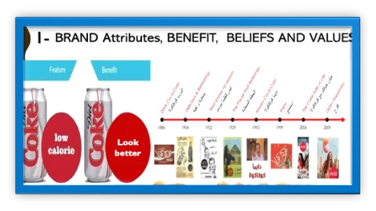
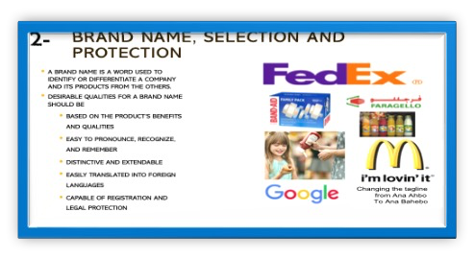
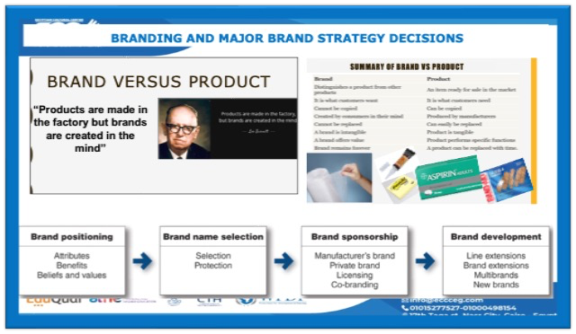
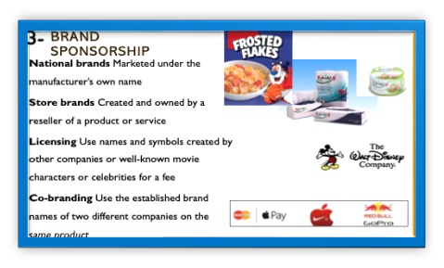
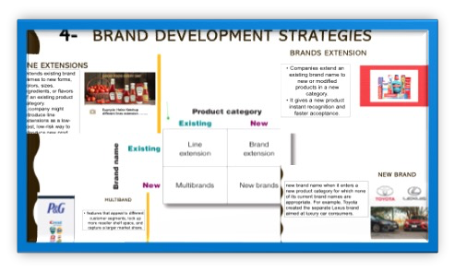

Slide 8


Activity #1
MCQs

Slide 9

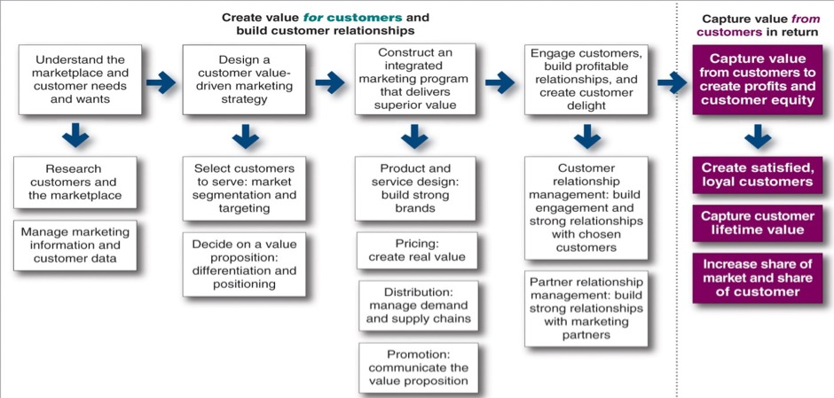
Step 3
Let us continue understanding;
  How to create value for customers through an integrated Marketing Programs
  Marketing mix {4Ps}

Slide 10
2nd P-Price
PRICE ADJUSTMENT STRATEGIES
Discount and allowance pricing
Segmented pricing
Psychological pricing
Promotional pricing
Geographical pricing
Dynamic pricing
International pricing
MAJOR PRICING STRATEGIES:
Cost-based pricing.
customer value–based pricing.
competition-based pricing
PRODUCT MIX PRICING STRATEGIES
Product line pricing
Optional-product pricing
Captive-product pricing
By-product pricing
Product bundle pricing
Other pricing strategies
Initiating Price Changes
Responding to Competitor Price Changes
Public Policy Issues in Pricing
Notes:
Price is the amount of money charged for a product or a service. It is the sum of all the values that customers give up to gain the benefits of having or using a product or service. Price is one of the most important elements that determines a firm’s market share and profitability. Price is the only element in the marketing mix that produces revenue; all other elements represent costs.

Slide 11
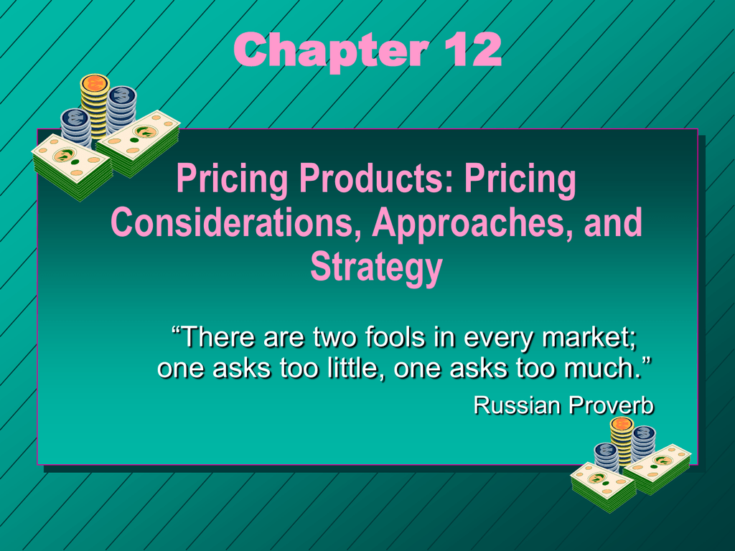
2nd P-Price
Amount of money charged for a product or service
The sum of the values that consumers exchange for the benefits of having or using
Determines a firm’s revenue, market share and profitability
Notes:
Price is the amount of money charged for a product or a service. It is the sum of all the values that customers give up to gain the benefits of having or using a product or service. Price is one of the most important elements that determines a firm’s market share and profitability. Price is the only element in the marketing mix that produces revenue; all other elements represent costs.

Slide 12
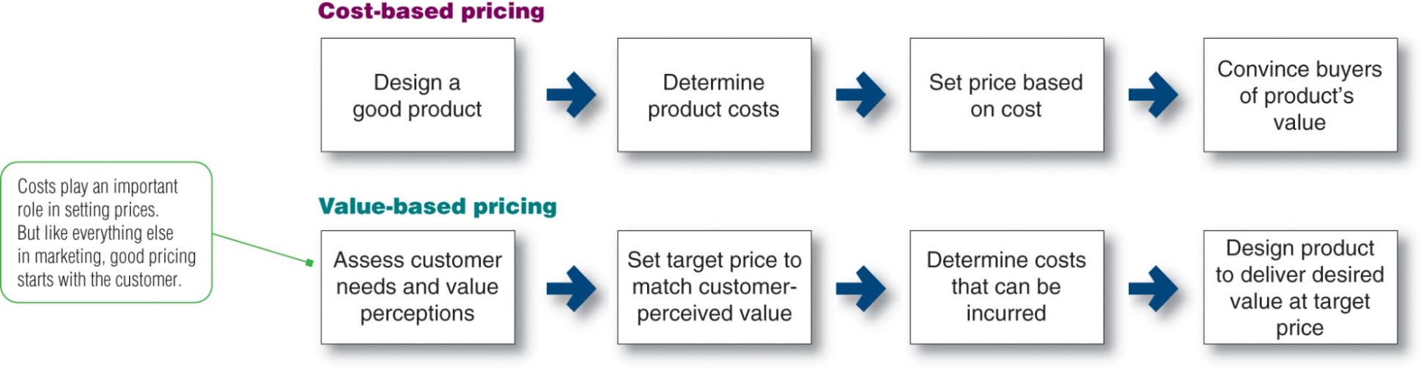
Value-Based Pricing versus Cost-Based Pricing
1
2
3
Market and Competition-Based Pricing
Notes:
This figure compares value-based pricing with cost-based pricing. Although costs are an important consideration in setting prices, cost-based pricing is often product driven. The company designs what it considers to be a good product, adds up the costs of making the product, and sets a price that covers costs plus a target profit. Value-based pricing reverses this process. The company first assesses customer needs and value perceptions. It then sets its target price based on customer perceptions of value.

Slide 13
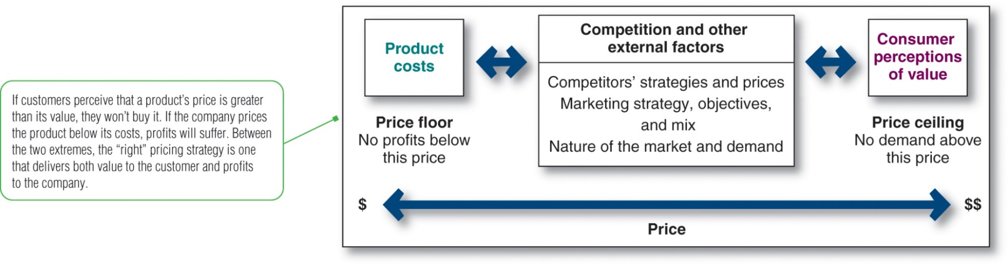
MAJOR PRICING STRATEGIES
3 major pricing strategies:
Cost-based pricing.
customer value–based pricing.
competition-based pricing.
If customers perceive that a product’s price is greater than its value, they won’t buy the product.
If the company prices the product below its costs, profits will suffer.
Between the two extremes, the right pricing strategy is the one that delivers both value to the customer and profits to the company.
Notes:
Cost based pricing
After calculating the total production costs, a target profit margin is levied on it.
Example – If the production cost of a pen is $100 and the target profit margin is 10%, then the price of pen would be 100 + 10% of 100 = $110.
Some of the other cost-based methods are cost plus, markup, break even, target & marginal cost strategy.
2. Demand based pricing
This strategy is used when their price is determined by customer demand.
Example- price of hotels & hospitality increases during the festive season owing to high demand.
Some of the demand-based strategies are price skimming & price penetration.
3. Competition based pricing
The prices in this type of method are decided by what the competition is offering. The different types of pricing strategies include discount, premium & going rate methods.
4. Target Pricing
Total investments are determined and a target rate of return is applied to it to attain the desired return on investment.
Example – If the investments in the production of cups are $100 and the target rate of return is 5%, then the price of the cups will be 100 + 5% of 100 = $105.
5. Value based pricing
The price is calculated based on the value being provided to the customers.
Example – If a personal coaching for 10 days in a particular subject is equivalent to attending a coaching class consisting of 20 students for 20 days, then the person would be willing to even pay the fee that he pays for the coaching classes for his personal tuitions. This is assuming that the coaching class charges higher fee than the personal coaching.
6. Psychological pricing
This is based on the psychological impact that the price would produce on the customers.
Example – These days we see a lot of products are priced at an amount less than some round figure (say $199 instead of $200

Slide 14
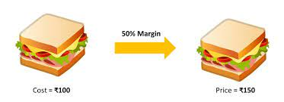
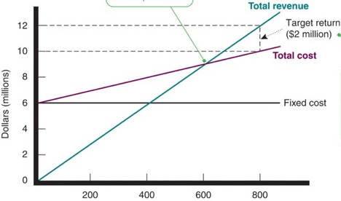
Types of Cost-Based Pricing
1
Cost-Based Pricing
Cost-plus pricing (markup pricing)
Adding a standard markup to the cost of the product
Break-even
Break-even pricing (target return pricing)
Setting price to break even on the costs of making and marketing a product, or setting price to make a target return.
Notes:
The simplest pricing method is cost-plus pricing (or markup pricing)—adding a standard markup to the cost of the product. Markup pricing remains popular for many reasons. First, sellers are more certain about costs than about demand. By tying the price to cost, sellers simplify pricing. Second, when all firms in the industry use this pricing method, prices tend to be similar and price competition is minimized.
Another cost-oriented pricing approach is break-even pricing, or a variation called target return pricing. The firm tries to determine the price at which it will break even or make the target return it is seeking. Target return pricing uses the concept of a break-even chart, which shows the total cost and total revenue expected at different sales volume levels.

Slide 15
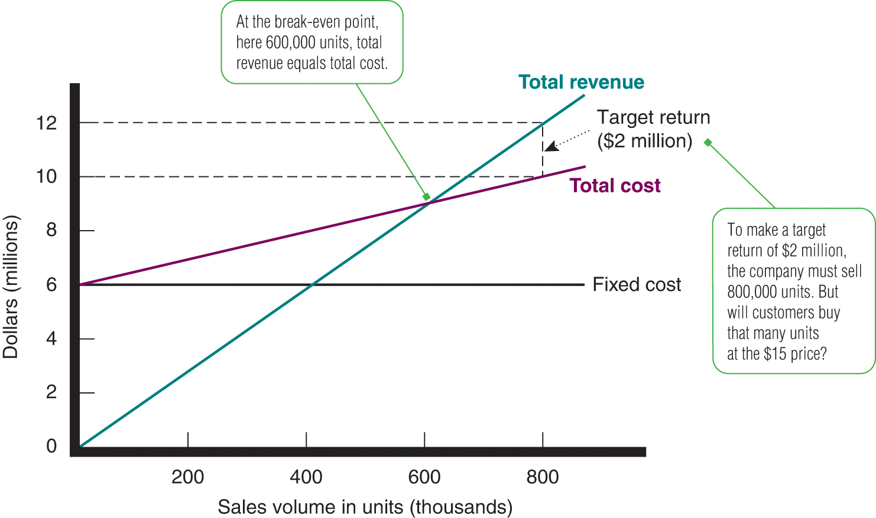
Break-Even Price
Cost-Based Pricing (detailed explanation)
1
extra
The slope of the total revenue curve reflects the price. Here, the price is $15. For example, the company’s revenue is $12 million on 800,000 units, or $15 per unit.
Although break-even analysis and target return pricing can help the company to determine the minimum prices needed to cover expected costs and profits, they do not take the price-demand relationship into account.
Notes:
This figure shows a break-even chart for a flash drive manufacturer. Fixed costs are $6 million regardless of sales volume, and variable costs are $5 per unit. Variable costs are added to fixed costs to form total costs, which rise with volume. The slope of the total revenue curve reflects the price. Here, the price is $15. For example, the company’s revenue is $12 million on 800,000 units, or $15 per unit.
At the break-even point, 600,000 units, total revenue equals total cost. To make a target return of $2 million, the company must sell 800,000 units. But will customers buy that many units at the $15 price?
Although break-even analysis and target return pricing can help the company to determine the minimum prices needed to cover expected costs and profits, they do not take the price-demand relationship into account.

Slide 16
Value-Based Pricing
2
Customer value-based pricing by using buyers’ perceptions of value as the key to pricing .
A buyers’ perceptions of value rather than on the seller’s cost
Types of value-based pricing:
  Good-value pricing, MORE For same for less offers just the right combination of quality good/ service at a fair price. more quality for a same price or same quality for less price.
  Value-added pricing MORE For MORE, offers value-added features and services to differentiate a company’s offers and then charging higher prices.
Apple differentiates company’s offers and quality then charging higher prices above competitors
Notes:
Customer value-based pricing uses buyers’ perceptions of value as the key to pricing. Price is considered along with all other marketing mix variables before the marketing program is set. The company first assesses customer needs and value perceptions. It then sets its target price based on customer perceptions of value. There are two types of value-based pricing: good-value pricing and value-added pricing.
Good-value pricing offers just the right combination of quality and good service at a fair price. This pricing method involves introducing less expensive versions of established, brand name products or new lower-price lines. It also involves redesigning existing brands to offer more quality for a given price or the same quality for less.
Value-added pricing involves attaching value-ded features and services to differentiate a company’s offers and then charging higher prices. For example, even as frugal economical consumer spending habits linger, some movie theater
]
hains are adding amenities and charging more rather than cutting services to maintain lower admission prices.

Slide 17
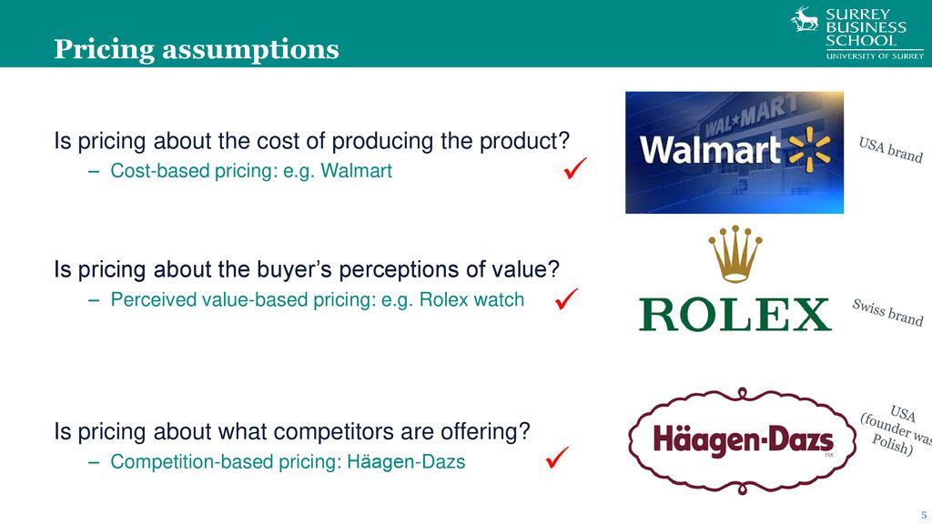
Value-Based Pricing versus Cost-Based Pricing

Slide 18

Market and Competition-Based Pricing
3
Market and Competition-Based Pricing
Pricing is handled differently in each types of Markets competition
  Pure competition
  Monopolistic competition
  Oligopolistic competition
  Pure monopoly
Prices based on assessing competitors’ pricing strategies:
  How does the company’s market offering compare in terms of customer value?
  How strong are current competitors?
the customer pays an $80,000 price premium for the Caterpillar bulldozer, it’s getting $150,000 in added value over the product’s lifetime in the form of superior reliability and durability, lower lifetime operating costs, superior service, and a longer parts warranty.
Notes:
Competition-based pricing involves setting prices based on competitors’ strategies, costs, prices, and market offerings. In assessing competitors’ pricing strategies, the company should ask several questions. First, how does the company’s market offering compare with competitors’ offerings in terms of customer value? Next, how strong are current competitors and what are their current pricing strategies?

Slide 19
Product Mix Pricing Strategies
Pricing Situation | Description
Product line pricing | Setting prices across an entire product line
Optional-product pricing | Pricing optional or accessory products sold with the main product
Captive-product pricing | Pricing products that must be used with the main product
By-product pricing | Pricing low-value by-products to get rid of or make money on them
Product bundle pricing | Pricing bundles of products sold together
Notes:
This slide summarizes the five product mix pricing strategies.
Product line pricing refers to determining the price steps to set between various products in a product line based on cost differences between the products,
customer evaluations of different features, and competitors’ prices.
Optional-product pricing refers to the pricing of optional or accessory products along with a main product.
Captive-product pricing refers to setting a price for products that must be used along with a main product, such as blades for a razor and games for a video-game console.
By-product pricing refers to setting a price for by-products in order to make the main product’s price more competitive.
Product bundle pricing refers to combining several products and offering the bundle at a reduced price.

Slide 20
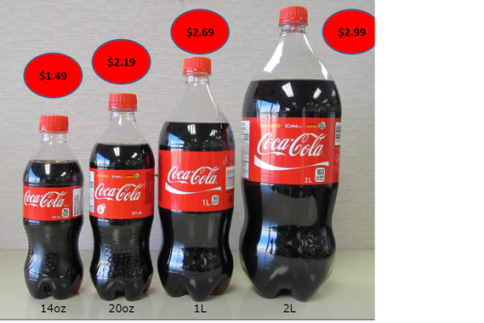
Product line pricing
SETTING PRICES ACROSS AN ENTIRE PRODUCT LINE
It considers the
cost differences between products in the line,
customer evaluation of their features,
competitors’ prices
Example : Car model that has different model types that change with performance and quality

Slide 21
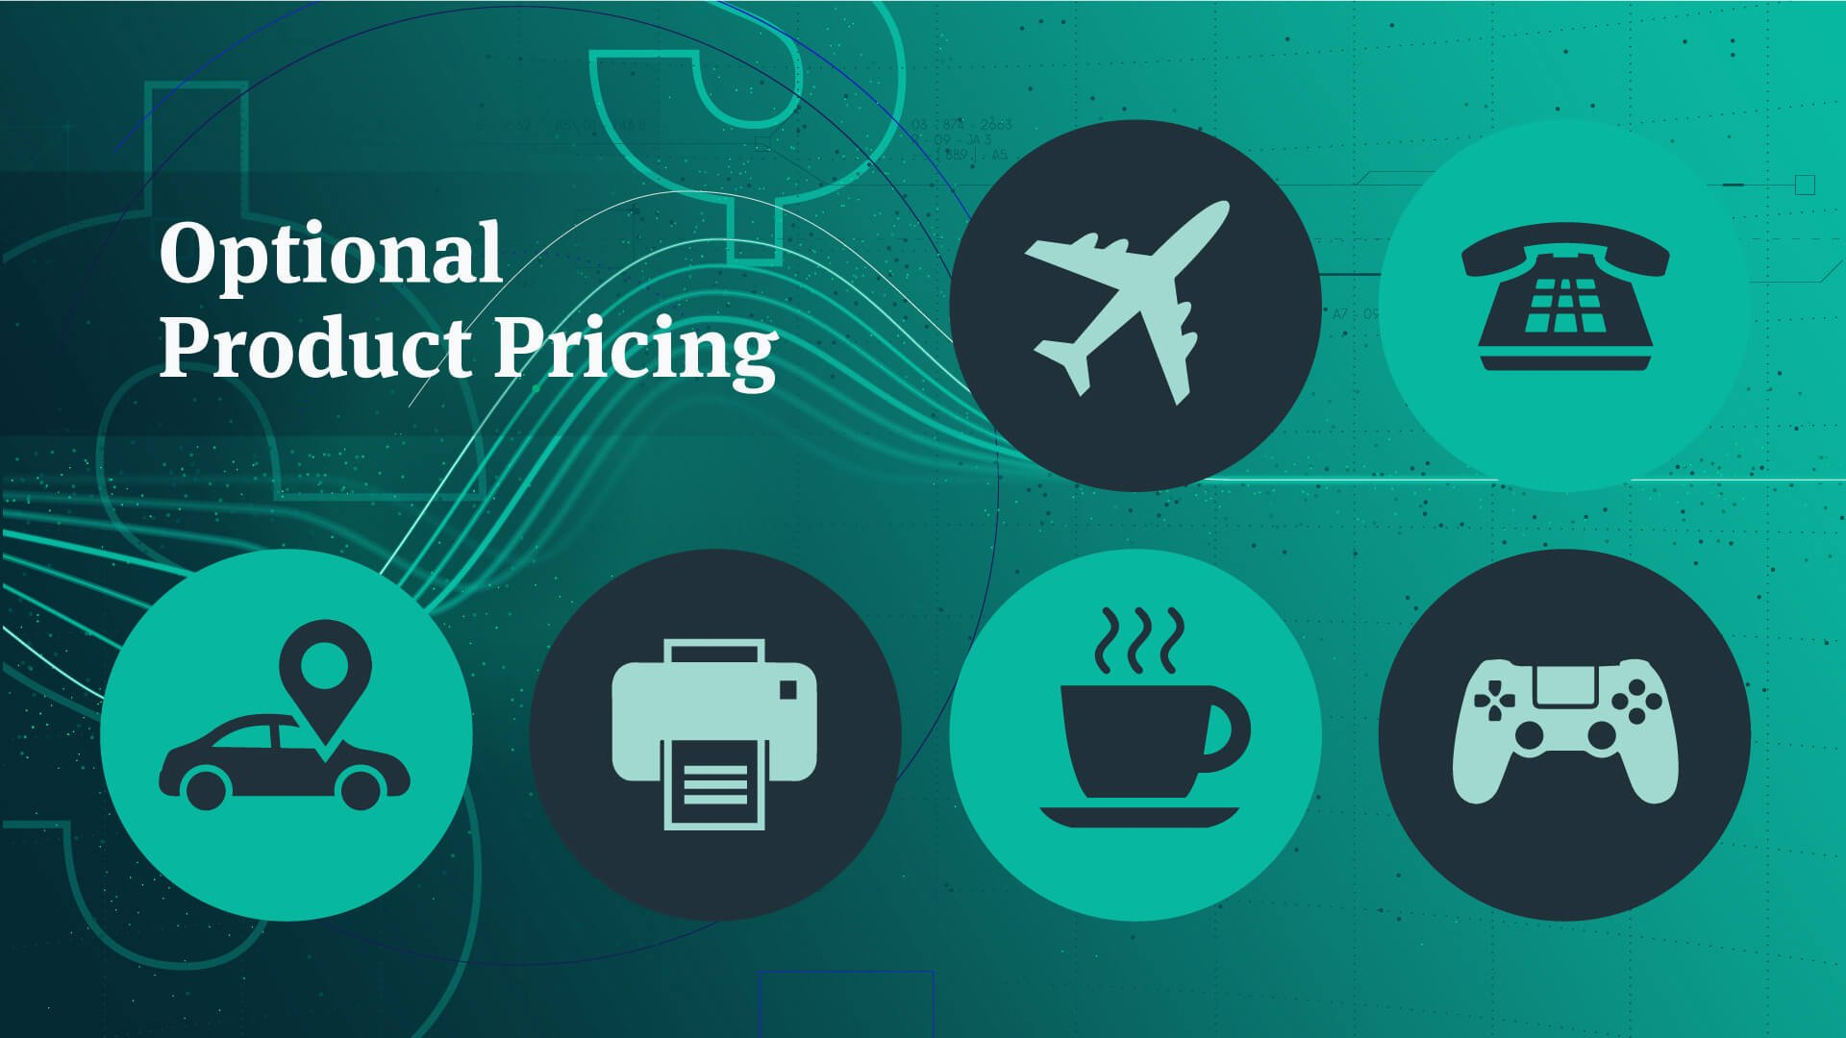
Optional-product pricing
OPTIONAL PRODUCT pricing is the pricing of optional or accessory products along with a main product. In many cases, you can buy optional or accessory products along with the main product.
For instance, when you order your new car, you may choose to order a navigation system or an advanced Entertainment system. However, for the company, pricing these options is not easy. They must decide carefully which items to include in the base price and which to offer as options.

Slide 22

Captive-product pricing
CAPTIVE-PRODUCT PRICING—main products less than other ancillary products.
Gillette has long sold razor handles at low prices and made its money on higher-price, higher margin replacement blade cartridges
Notes:
Captive products can account for a substantial portion of a brand’s sales and profits. For example, Gillette has long sold razor handles at low prices and made its money on higher-price, higher-margin replacement blade cartridges. “The razor business is all about the blades,” says an analyst. “Get consumers hooked on your razor, and they buy the highly profitable refill blades forever.” Last year, Gillette sold well over half a billion dollars’ worth of refill blades at prices ranging up to a hefty $5 per cartridge.
Gillette has lost market share in recent years as price-fatigued customers have shifted to lower-priced private-label upstarts such as Dollar Shave Club and Harry’s. To compete, it was recently forced to slash cartridge prices across the board by 15 to 20 percent.

Slide 23
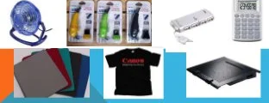
By-product pricing
BY-PRODUCT PRICING
low-value by-products to get rid of or make money on them

Slide 24
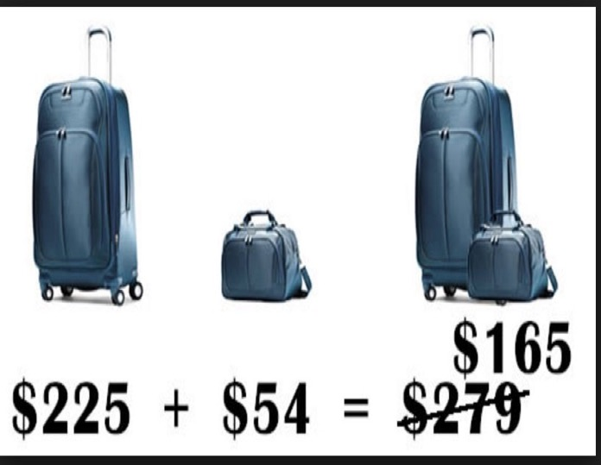
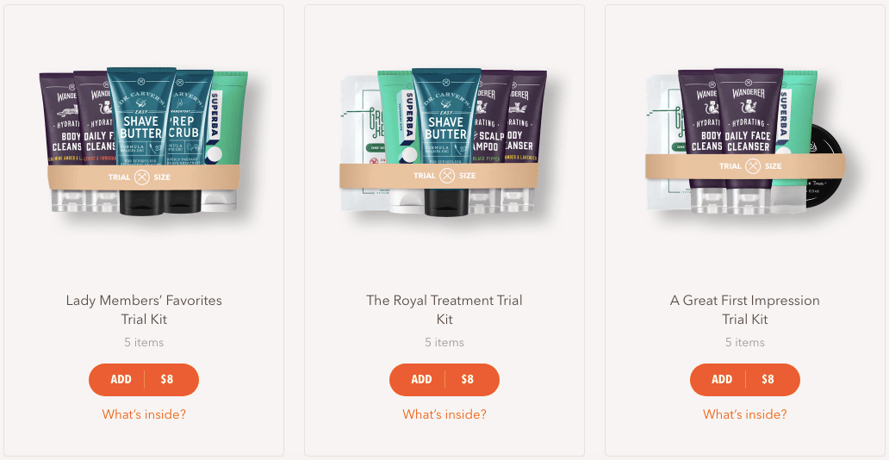
Product bundle pricing
PRODUCT-BUNDLE PRICING is a marketing strategy that combines two or more products to sell them at a lower price than if the same products were sold individually. less costly when purchased together
The bundle pricing technique is popular in retail and eCommerce as it offers more value for the price. It can also help build customer loyalty and boost product sale

Slide 25
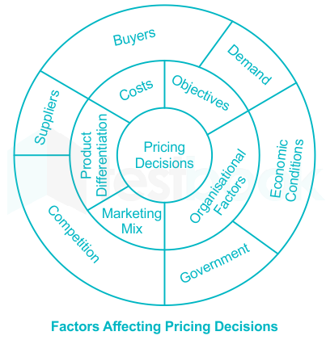

Internal Considerations Affecting Price Decisions
Pricing decisions must coordinate with overall marketing strategy, objectives, and marketing mix ,.for instance Positioning may be based on price.
Organizational considerations
  Management decides who should set prices, Varies depending on the size and type of company
  Small companies—Top management
  Large companies—Divisional or product managers
  Industries with price as the key factor—Pricing departments
Notes:
Beyond customer value perceptions, costs, and competitor strategies, the company must consider several additional internal and external factors. Each of these factors are discussed in greater detail in the following slides.
Management must decide who within the organization should set prices. Companies handle pricing in a variety of ways. In small companies, prices are often set by top management rather than by the marketing or sales departments. In large companies, pricing is typically handled by divisional or product managers. In industries in which pricing is a key factor, companies often have pricing departments to set the best prices or help others set them. These departments report to the marketing department or top management.
Beyond the market and the economy, the company must consider several other factors in its external environment when setting prices. It must know what impact its prices will have on other parties in its environment. How will resellers react to various prices? The company should set prices that give resellers a fair profit, encourage their support, and help them to sell the product effectively. The government is another important external influence on pricing decisions. Finally, social concerns may need to be taken into account. In setting prices, a company’s short-term sales, market share, and profit goals may need to be tempered by broader societal considerations.
Target costing starts with an ideal selling price, then targets costs that ensure the price is met.
Nonprice positions can be created to differentiate the marketing offer.

Slide 26
External Considerations Affecting Price Decisions
Company must consider several External factors in its external environment when setting prices as;
  Market and Competitors
  Economy
  Demand
  Impact on other parties in its environment
  Resellers
  Government
  Social concerns
Notes:
Beyond customer value perceptions, costs, and competitor strategies, the company must consider several additional internal and external factors. Each of these factors are discussed in greater detail in the following slides.
Management must decide who within the organization should set prices. Companies handle pricing in a variety of ways. In small companies, prices are often set by top management rather than by the marketing or sales departments. In large companies, pricing is typically handled by divisional or product managers. In industries in which pricing is a key factor, companies often have pricing departments to set the best prices or help others set them. These departments report to the marketing department or top management.
Beyond the market and the economy, the company must consider several other factors in its external environment when setting prices. It must know what impact its prices will have on other parties in its environment. How will resellers react to various prices? The company should set prices that give resellers a fair profit, encourage their support, and help them to sell the product effectively. The government is another important external influence on pricing decisions. Finally, social concerns may need to be taken into account. In setting prices, a company’s short-term sales, market share, and profit goals may need to be tempered by broader societal considerations.

Slide 27
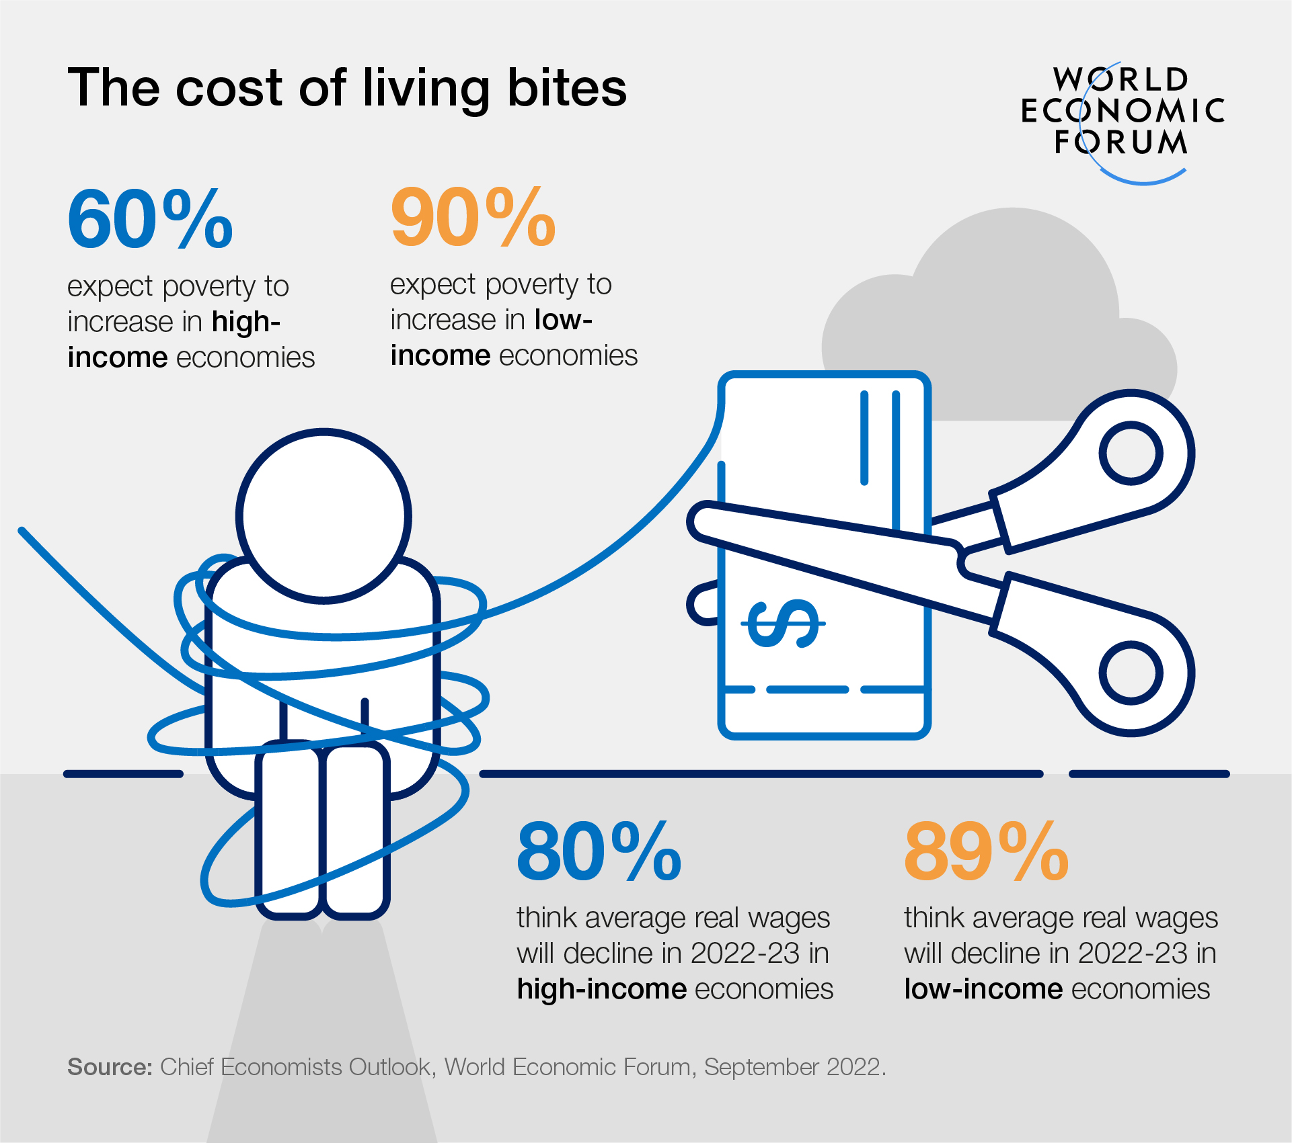
Economy
External Considerations Affecting Price Decisions
Factors impacting pricing strategies
Boom or recession
Inflation
Interest rates
Responses to the frugality of post recession consumers
Cut prices and offer discounts
Develop more affordable items
Redefine value propositions
Notes:
Economic conditions can have a strong impact on the firm’s pricing strategies. Factors such as a boom or recession, inflation, and interest rates affect pricing decisions. In the aftermath of the recent Great Recession, many consumers have rethought the price-value equation. As a result, many marketers have increased their emphasis on value-for-the-money pricing strategies.
The most obvious response to the new economic realities is to cut prices and offer discounts. Lower prices make products more affordable and help spur short-term sales. However, such price cuts can have undesirable long-term consequences. Once a company cuts prices, it’s difficult to raise them again when the economy recovers.
Rather than cutting prices, many companies have instead developed “price tiers,” adding both more affordable lines and premium lines. Other companies are holding prices but redefining the “value” in their value propositions.

Slide 28
Price Demand elasticity
External Considerations Affecting Price Decisions
Demand
Elasticity = (% change in demanded / %change in price)
  > 1 Elastic,
  <1 Inelastic
Measure of the sensitivity of demand to changes in price
  Inelastic demand: Demand hardly changes with a small change in price.
  Elastic demand: Demand changes greatly with a small change in price.
Notes:
Price elasticity refers to the measure of the sensitivity of demand to changes in price. If demand hardly changes with a small change in price, we say demand is inelastic. If demand changes greatly, we say the demand is elastic.
Each price the company might charge will lead to a different level of demand. This figure shows the relationship between the price charged and the resulting demand level. The demand curve shows the number of units the market will buy in a given time period at different prices that might be charged. In a normal case, demand and price are inversely related—that is, the higher the price, the lower the demand. Thus, the company would sell less if it raised its price from P1 to P2. In short, consumers with limited budgets probably will buy less of something if its price is too high. Understanding a brand’s price-demand curve is crucial to good pricing decisions. Most companies try to measure their demand curves by estimating demand at different prices. The type of market makes a difference in demand curves.

Slide 29
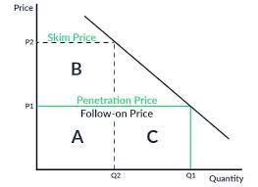
New Product Pricing Strategies (1 of 3)
Market-skimming pricing (price skimming)
Setting a high price to skim maximum revenues from the segments willing to pay the high price
Company makes fewer but more profitable sales
Market-penetration pricing
Setting a low price to attract many buyers and a large market share
Notes:
Companies bringing out a new product face the challenge of setting prices for the first time. They can choose between two broad strategies. These are market-skimming pricing and market-penetration pricing.
Market-skimming pricing or price skimming refers to setting a high price for a new product to skim maximum revenues, layer by layer, from the segments willing to pay the high price. The company makes fewer but more profitable sales. This strategy works only under certain conditions. First, the product’s quality and image must support its higher price, and enough buyers must want the product at that price. Second, the costs of producing a smaller volume cannot be so high that they cancel the advantage of charging more. Finally, competitors should not be able to enter the market easily and undercut the high price.
Market-penetration pricing refers to setting a low price for a new product in order to attract a large number of buyers and a large market share. The high sales volume results in falling costs, allowing companies to cut their prices even further. Several conditions must be met for this low-price strategy to work. First, the market must be highly price sensitive so that a low price produces more market growth. Second, production and distribution costs must decrease as sales volume increases. Finally, the low price must help keep out the competition, and the penetration pricer must maintain its low-price position. Otherwise, the price advantage may be only temporary.

Slide 30
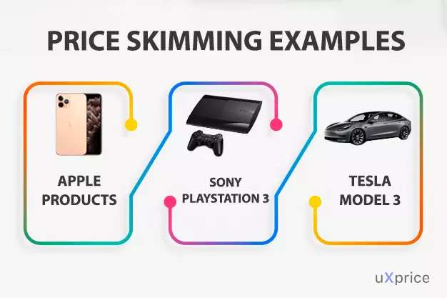
SKIMMING PRICING
New Product Pricing Strategies (2 of 3)
strategy involving the use of a high price Commonly used as a market entry price for distinctive goods or services with little or no initial competition.
Sometimes used throughout the life of the product, as with new products high end goods..

Slide 31
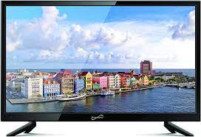
PENETRATION PRICING
New Product Pricing Strategies (3 of 3)
Under this strategy, The purpose of Penetration pricing is to capture maximum market share.
it is used after skimming price reach. To a stagnant sales pattern or used from the beginning a low in order to reach a mass market immediately.
When the product is well established in the market, the company can gradually increase the price of its products

Slide 32
PRICE ADJUSTMENT STRATEGIES
Other pricing strategies
Initiating Price Changes
Responding to Competitor Price Changes
Public Policy Issues in Pricing

Slide 33
Activity 2
What do you see

Slide 34
Price Adjustment Strategies
 | Strategy | Description
1 | Discount and allowance pricing | Reducing prices to reward customer responses such as volume purchases, paying early, or promoting the product
2 | Segmented pricing | Adjusting prices to allow for differences in customers, products, or locations
3 | Psychological pricing | Adjusting prices for psychological effect
4 | Promotional pricing | Temporarily reducing prices to spur short-run sales
5 | Geographical pricing | Adjusting prices to account for the geographic location of customers
6 | Dynamic pricing | Adjusting prices continually to meet the characteristics and needs of individual customers and situations
7 | International pricing | Adjusting prices for international markets
Notes:
Each of these strategies are discussed in greater detail in the following slides.

Slide 35
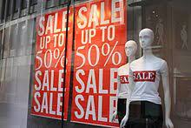
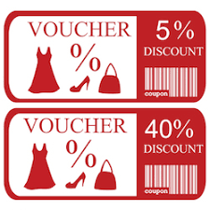
Discount and Allowance Pricing strategy:
Most companies adjust their basic price to reward customers for certain responses, such as paying bills early, volume purchases, and off-season buying.
Price Adjustment Strategies (1 of 7)
Discount—a straight reduction in price on purchases during a stated period of time or of larger quantities as Cash, quantity, functional, and seasonal discounts
Allowance—Promotional allowances are payments or price reductions that reward to customers, For example, price reductions given for turning in an old item when buying a new one.
Notes:
Most companies adjust their basic price to reward customers for certain responses, such as paying bills early, volume purchases, and off-season buying. These price adjustments—called discounts and allowances—can take many forms.
A discount is a straight reduction in price on purchases during a stated period of time or of larger quantities. One form of discount is a cash discount, a price reduction to buyers who pay their bills promptly. A quantity discount is a price reduction to buyers who buy large volumes. A seller offers a functional discount, also called a trade discount, to trade-channel members who perform certain functions, such as selling, storing, and record keeping. A seasonal discount is a price reduction to buyers who buy merchandise or services out of season.
An allowance is promotional money paid by manufacturers to retailers in return for an agreement to feature the manufacturer’s products in some way. For example, trade-in allowances are price reductions given for turning in an old item when buying a new one. Promotional allowances are payments or price reductions that reward dealers for participating in advertising and sales-support programs.

Slide 36
Segmented Pricing, the company sells a product or service at two or more prices, even though the difference in prices is not based on differences in costs. Segmented pricing takes several forms.
Price Adjustment Strategies (2 of 7 )
Forms of segmented pricing:
  Customer-segment pricing
  Product form pricing
  Location-based pricing
  Time-based pricing
Notes:
In segmented pricing, the company sells a product or service at two or more prices, even though the difference in prices is not based on differences in costs. Segmented pricing takes several forms.
With customer-segment pricing, different customers pay different prices for the same product or service. Museums and movie theaters, for example, may charge a lower admission for students and senior citizens.
With product form pricing, different versions of the product are priced differently, but not according to differences in their costs. Examples include a round-trip economy seat on a flight versus a more expensive business class seat and different prices for seats in a theater based on their location.
Location-based pricing involves a company charging different prices for different locations, even though the cost of offering each location is the same.
Time-based pricing occurs when a firm varies its price by the season, the month, the day, and even the hour. For example, movie theaters charge matinee pricing during the daytime, and resorts give weekend and seasonal discounts.
For segmented pricing to be an effective strategy, certain conditions must exist. The market must be able to be segmented, and segments must show different degrees of demand. The costs of segmenting and reaching the market cannot exceed the extra revenue obtained from the price difference. Segmented pricing should also be legal.

Slide 37
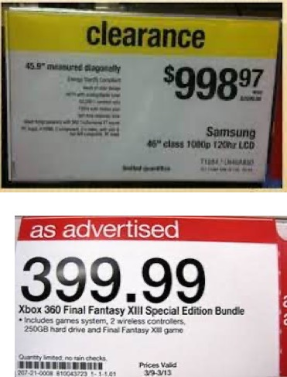
Psychological Pricing
Considers the psychology of prices and not the economics.
Price Adjustment Strategies (3 of 7)
  instead of pricing a product at $ 1020, you discount it and price it at $ 999. This 21 $ reduction will give much more turnover because people will judge the product being priced at 900 $ and not 1000 $.
Notes:
Psychological pricing refers to pricing that considers the psychology of prices and not simply the economics. The price is used to say something about the product.
Another aspect of psychological pricing is reference prices, which are the prices that buyers carry in their minds and refer to when looking at a given product. The reference price might be formed by noting current prices, remembering past prices, or assessing the buying situation. Sellers can influence or use these consumers’ reference prices when setting price.
Odd-Even pricing technique prices products at an odd number which is slightly less that a rounded off even number.
instead of pricing a product at $ 1020, you discount it and price it at $ 999. This 21 $ reduction will give much more turnover because people will judge the product being priced at 900 $ and not 1000 $.

Slide 38
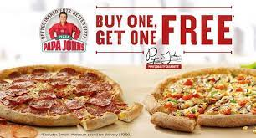
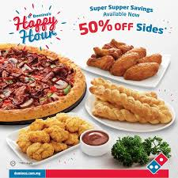
Promotional Pricing,
Temporarily pricing products below the list price to increase short-run sales
Price Adjustment Strategies (4 of 7)
Forms of promotional pricing:
  Buy one, get one free BOGOF. Consumers are offered a second item for free when they purchase the first one.
  Discounting This when the price of a product or service is lowered
  Seasonal sales This is a strategy that lowers prices for a certain time of the year.
  flash sales last at least a day, and frequently for more than that, are over much quicker
Notes:
With promotional pricing, companies will temporarily price their products below list price to create buying excitement and urgency. Promotional pricing takes several forms. A seller may simply offer discounts from normal prices to increase sales and reduce inventories. Sellers also use special-event pricing in certain seasons to draw more customers. Limited-time offers, such as online flash sales, can create buying urgency and make buyers feel lucky to have gotten in on the deal. Manufacturers sometimes offer cash rebates to consumers who buy the product from dealers within a specified time. Some manufacturers offer low-interest financing, longer warranties, or free maintenance to reduce the consumer’s price.
Promotional pricing, however, can have adverse effects. Used too frequently, price promotions can create “deal-prone” customers who wait until brands go on sale before buying them. In addition, constantly reduced prices can erode a brand’s value in the eyes of customers. Marketers sometimes become addicted to promotional pricing, especially in tight economic times. They use price promotions as a quick fix instead of sweating through the difficult process of developing effective longer-term strategies for building their brands.
promotional pricing is when companies have a sale concept when they changed prices
Buy one, get one free BOGOF. Consumers are offered a second item for free when they purchase the first one.
Discounting This when the price of a product or service is lowered
Seasonal sales This is a strategy that lowers prices for a certain time of the year.
flash sales last at least a day, and frequently for more than that, are over much quicker. Reduced prices for only 2-3 hours are common. Flash sales can create a great sense of urgency.

Slide 39
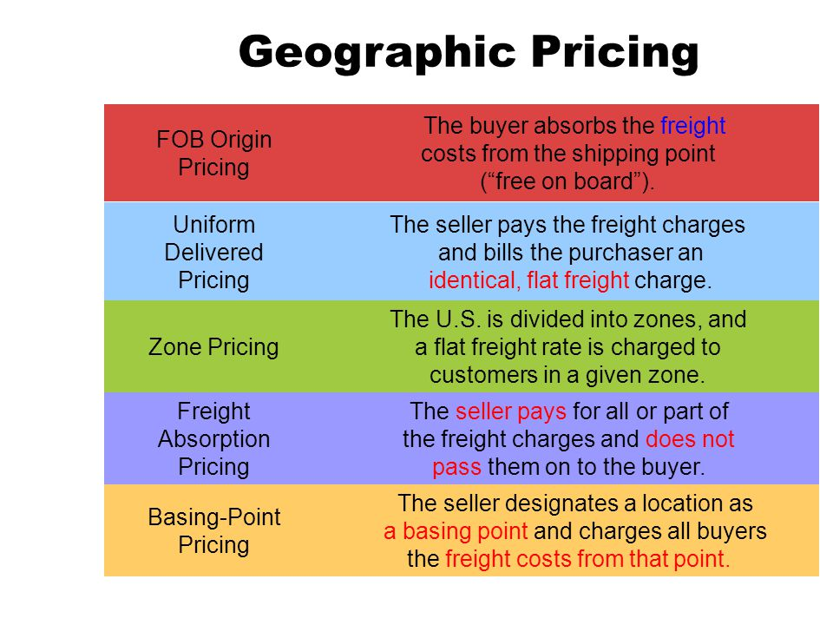
Geographical Pricing
Price Adjustment Strategies (5 of 7)
FOB-origin pricing goods placed free on board a carrier
Uniform-delivered pricing
Zone pricing
Freight-absorption pricing
Basing-point pricing
Notes:
There are five geographical pricing strategies.
FOB-origin pricing means that the goods are placed free on board a carrier, hence FOB. At that point the title and responsibility pass to the customer, who pays the freight from the factory to the destination.
Uniform-delivered pricing is the opposite of FOB pricing. Here, the company charges the same price plus freight to all customers, regardless of their location. The freight charge is set at the average freight cost.
Zone pricing falls between FOB-origin pricing and uniform-delivered pricing. The company sets up two or more zones. All customers within a given zone pay a single total price; the more distant the zone, the higher the price.
Using basing-point pricing, the seller selects a given city as a “basing point” and charges all customers the freight cost from that city to the customer location, regardless of the city from which the goods are actually shipped.
Using freight-absorption pricing, the seller absorbs all or part of the actual freight charges to get the desired business. Freight-absorption pricing is used for market penetration and to hold on to increasingly competitive markets.

Slide 40
Dynamic Pricing,
Refers to adjusting prices continually to meet the characteristics and needs of individual customers and situation and It is especially prevalent online
Price Adjustment Strategies (6 of 7)
The Dynamic Pricing, goes both ways, and consumers often benefit from online and dynamic pricing. Thanks to the Internet, consumers can get instant product and price comparisons from thousands of vendors at price comparison sites.
Notes:
Dynamic pricing refers to adjusting prices continually to meet the characteristics and needs of individual customers and situations. It is especially prevalent online, where the Internet seems to be taking us back to a new age of fluid pricing. Such pricing offers many advantages for marketers. These days, online offers and prices might well be based on what specific customers search for and buy, how much they pay for other purchases, and whether they might be willing and able to spend more.
Dynamic pricing is legal as long as companies do not discriminate based on age, gender, location, or other similar characteristics. The practice of online pricing, however, goes both ways, and consumers often benefit from online and dynamic pricing. Thanks to the Internet, consumers can get instant product and price comparisons from thousands of vendors at price comparison sites. For example, the RedLaser mobile app lets customers scan barcodes or QR codes while shopping in stores. It then searches online and at nearby stores to provide thousands of reviews and comparison prices.

Slide 41

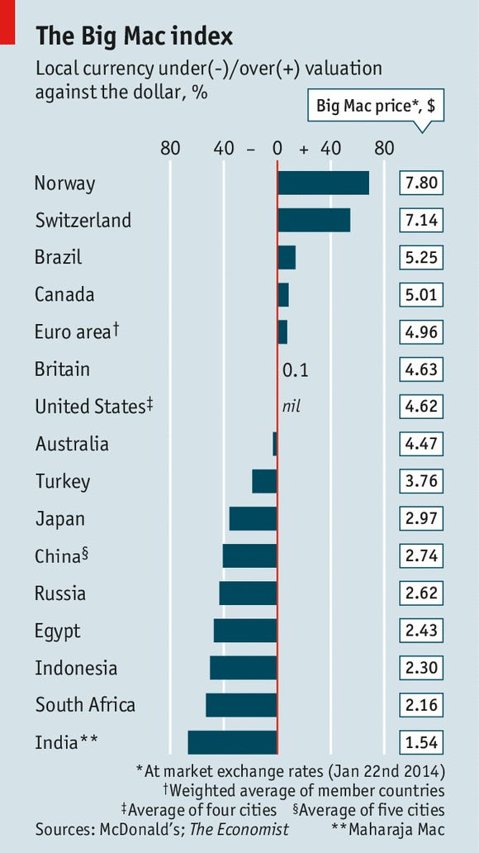
International Pricing,
Companies that market their products internationally must decide what prices to charge in different countries.
Price Adjustment Strategies (7 of 7)
Price decisions of international companies
  Set a uniform worldwide price
  Adjust prices to reflect local market conditions and cost considerations
Prices charged depend on many factors
  Economic conditions
  Competitive situations
  Laws and regulations
  Nature of the wholesaling and retailing system
  Consumer perceptions and preferences
  Company’s marketing objectives
  Costs of selling in another country
many companies are shifting their sights to include a new target—the so-called “bottom of the pyramid,” the vast untapped market consisting of the world’s poorest consumers.
Notes:
Companies that market their products internationally must decide what prices to charge in different countries. In some cases, a company can set a uniform worldwide price. The price that a company should charge in a specific country depends on many factors, including economic conditions, competitive situations, laws and regulations, and the nature of the wholesaling and retailing system. Consumer perceptions and preferences also may vary from country to country, calling for different prices. Or the company may have different marketing objectives in various world markets, which require changes in pricing strategy. Costs play an important role in setting international prices. Travelers abroad are often surprised to find that goods that are relatively inexpensive at home may carry outrageously higher price tags in other countries.
Price has become a key element in the international marketing strategies of companies attempting to enter emerging markets. Typically, entering such markets has meant targeting the exploding middle classes in developing countries. As the weakened global economy has slowed growth in both domestic and emerging markets, many companies are shifting their sights to include a new target—the so-called “bottom of the pyramid,” the vast untapped market consisting of the world’s poorest consumers.

Slide 42
Other Pricing strategies
Loss leader Pricing
Competitive {Going-Rate Pricing}
EDLP {Every day low price}
POPcorn Pricing
extra

Slide 43
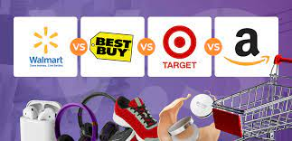
Competitive going-Rate Pricing
extra
Going-Rate Pricing
a method adopted by the firms wherein the product is priced as per the rates prevailing in the market especially on par with the competitors.
Amazon projected price changes to approximately 80 million items in preparation for the holiday season. Other retailers, including Walmart and Best Buy, announced a price-matching program.
This allowed customers of Walmart or Best Buy to receive a product at the lower price without risking customers taking their business to Amazon solely for pricing reasons.

Slide 44
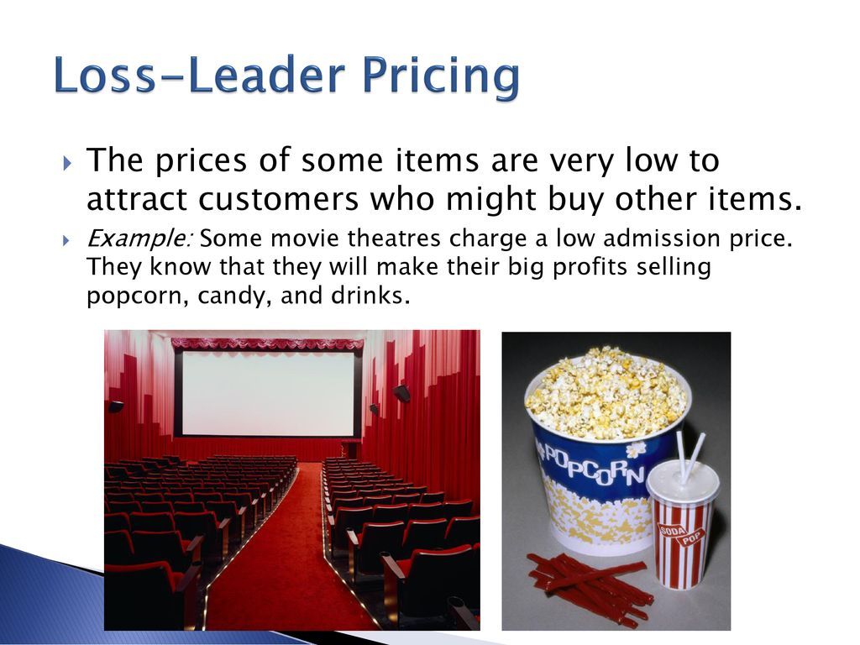
Loss leader pricing
extra
Loss leader pricing relies heavily upon the belief that the ‘loss’ incurred from selling a product so cheaply will eventually ‘lead’ to higher sales volumes and profits in the long run

Slide 45
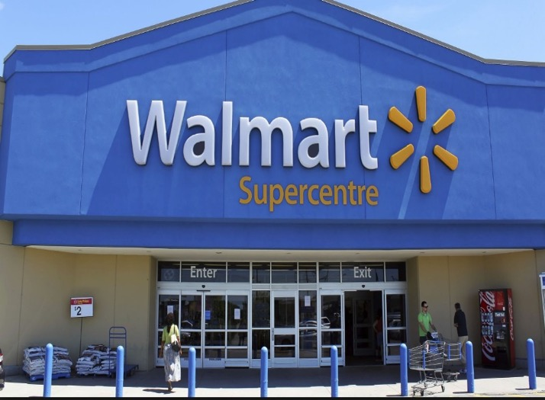
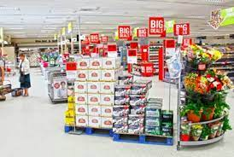
extra
EDLP
every day low price (EDLP) is a pricing strategy promising consumers a low price without the need to wait for sale price events or comparison shopping.
EDLP saves retail stores the effort and expense needed to mark down prices in the store during sale events, and is also believed to generate shopper loyalty

Slide 46
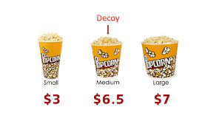
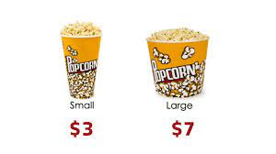
popcorn pricing strategy
extra

Slide 47
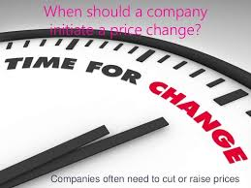
Initiating Price Changes
Reasons for price cuts:
  Excess capacity
  Falling demand
  Attempt to dominate the market
Reasons for price increases:
  Cost inflation
  Over-demand
Notes:
Several situations may lead a firm to consider cutting its price. One such circumstance is excess capacity. Another is falling demand in the face of strong price competition or a weakened economy. A company may also cut prices in a drive to dominate the market through lower costs. Either the company starts with lower costs than its competitors, or it cuts prices in the hope of gaining market share that will further cut costs through larger volume.
A successful price increase can greatly improve profits. A major factor in price increases is cost inflation. Rising costs squeeze profit margins and lead companies to pass cost increases along to customers. Another factor leading to price increases is over-demand, however, when raising prices, the company must avoid being perceived as a price gouger.

Slide 48
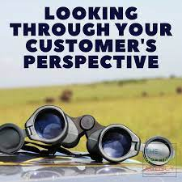
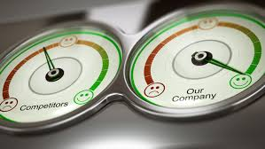
Reactions to Price Changes
Buyer’s perspective
Price increase:
  Product is more exclusive or better made.
  Company is being greedy.
Price cut:
  Product’s quality has been reduced.
  Company’s image has tarnished.
Competitor’s perspective
Price cut:
  Company is trying to grab a larger market share.
  Company is doing poorly and trying to boost its sales.
  Company wants the whole industry to cut prices to increase total demand.
Notes:
Customers do not always interpret price changes in a straightforward way. A price increase, which would normally lower sales, may have some positive meanings for buyers. For example, what would you think if Rolex raised the price of its latest watch model? On the one hand, you might think that the watch is even more exclusive or better made. On the other hand, you might think that Rolex is simply being greedy by charging what the traffic will bear.
Similarly, consumers may view a price cut in several ways. For example, what would you think if Rolex were to suddenly cut its prices? You might think that you are getting a better deal on an exclusive product. More likely, however, you’d think that quality had been reduced, and the brand’s luxury image might be tarnished.
A firm considering a price change must worry about the reactions of its competitors as well as those of its customers. The competitor can interpret a company price cut in many ways. It might think the company is trying to grab a larger market share or that it’s doing poorly and trying to boost its sales. Or it might think that the company wants the whole industry to cut prices to increase total demand.

Slide 49
Activity 3
How to respond from your marketing understanding to the price change

Slide 50
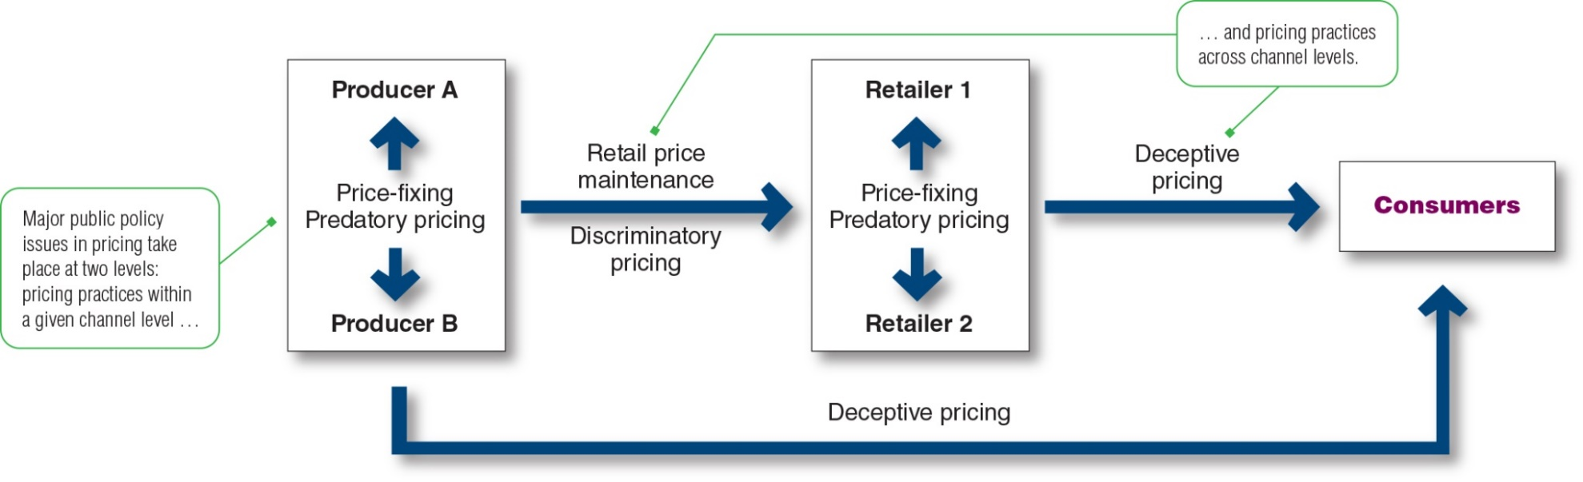
Public Policy Issues in Pricing
Price-fixing :is illegal federal legislation on price-fixing states that sellers must set prices without talking to competitors
Predatory pricing also prohibited from using predatory pricing. Predatory pricing means selling below cost with the intention of putting competitors out of business
discriminatory pricing prevent unfair price discrimination by ensuring that sellers offer the same price terms to customers at a given level of trade
Deceptive pricing seller states prices or price savings that mislead consumers or are not actually available to consumers.
Notes:
This figure shows the major public policy issues in pricing. These include potentially damaging pricing practices within a given level of the channel (price-fixing and predatory pricing) and across levels of the channel (retail price maintenance, discriminatory pricing, and deceptive pricing).
For pricing within channel levels, federal legislation on price-fixing states that sellers must set prices without talking to competitors. Price-fixing is illegal, and the companies found guilty of these practices can receive heavy fines. Sellers are also prohibited from using predatory pricing. Predatory pricing means selling below cost with the intention of punishing a competitor or gaining higher long-run profits by putting competitors out of business. This protects small sellers from larger ones that might sell items below cost temporarily or in a specific locale to drive them out of business.
For pricing across channel levels, the Robinson-Patman Act seeks to prevent unfair price discrimination by ensuring that sellers offer the same price terms to customers at a given level of trade. Laws also prohibit retail or resale price maintenance, that is, a manufacturer cannot require dealers to charge a specified retail price for its product. Deceptive pricing occurs when a seller states prices or price savings that mislead consumers or are not actually available to consumers. This might involve bogus reference or comparison prices, as when a retailer sets artificially high regular prices and then announces “sale” prices close to its previous everyday prices.

Slide 51


Slide 52



