Slide 1

Strategic marketing

Slide 2


Strategic marketing
Lecture # 6

Slide 3

QUICK RECAP ON PREVIOUS LECTURES

Slide 5
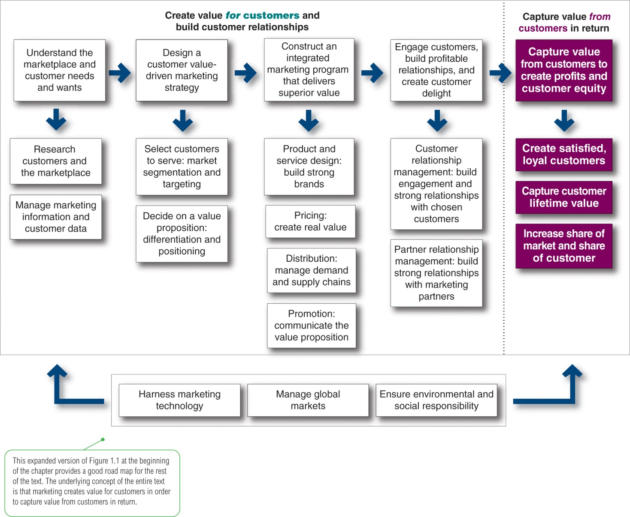
1
2
3
4
5
Expanded Marketing process
Notes:
Company-wide strategic planning guides marketing strategy and planning. Like the marketing strategy, the broader company strategy must be customer focused.
This figure illustrates the steps in strategic planning. At the corporate level, the company starts the strategic planning process by defining its overall purpose and mission. The mission is turned into detailed supporting objectives that guide the entire company. Then, headquarters decides what portfolio of businesses and products is best for the company and how much support to give each one.
In turn, each business and product develops detailed marketing and other departmental plans that support the company-wide plan. Thus, marketing planning occurs at the business-unit, product, and market levels. It supports company strategic planning
Strategic planning sets the stage for the rest of planning in the firm. Companies prepare annual plans, long-range plans, and strategic plans. The annual and long-range plans deal with the company’s current businesses and how to keep them going. In contrast, the strategic plan involves adapting the firm to take advantage of opportunities in its constantly changing environment.
with more detailed plans for specific marketing opportunities.

Slide 6
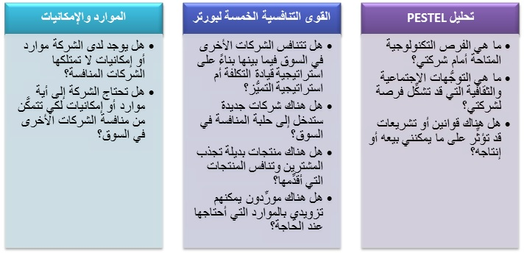
Notes:
Company-wide strategic planning guides marketing strategy and planning. Like the marketing strategy, the broader company strategy must be customer focused.
This figure illustrates the steps in strategic planning. At the corporate level, the company starts the strategic planning process by defining its overall purpose and mission. The mission is turned into detailed supporting objectives that guide the entire company. Then, headquarters decides what portfolio of businesses and products is best for the company and how much support to give each one.
In turn, each business and product develops detailed marketing and other departmental plans that support the company-wide plan. Thus, marketing planning occurs at the business-unit, product, and market levels. It supports company strategic planning
Strategic planning sets the stage for the rest of planning in the firm. Companies prepare annual plans, long-range plans, and strategic plans. The annual and long-range plans deal with the company’s current businesses and how to keep them going. In contrast, the strategic plan involves adapting the firm to take advantage of opportunities in its constantly changing environment.
with more detailed plans for specific marketing opportunities.

Slide 9
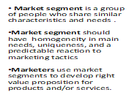
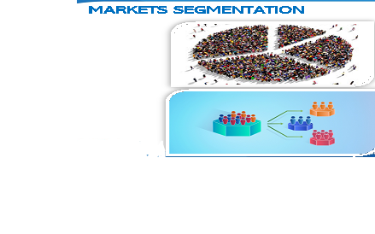
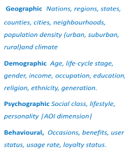
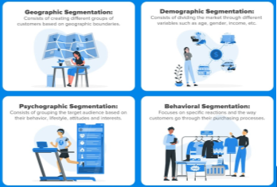
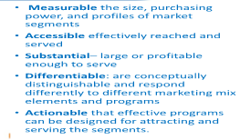
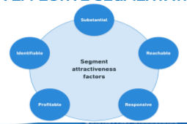

Slide 10
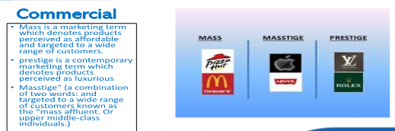
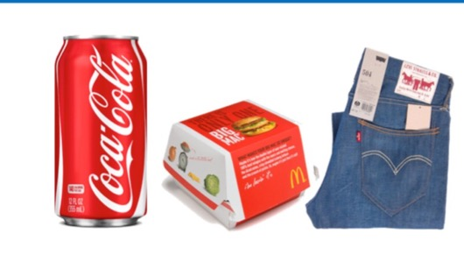
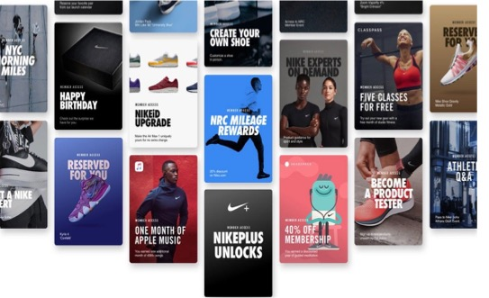
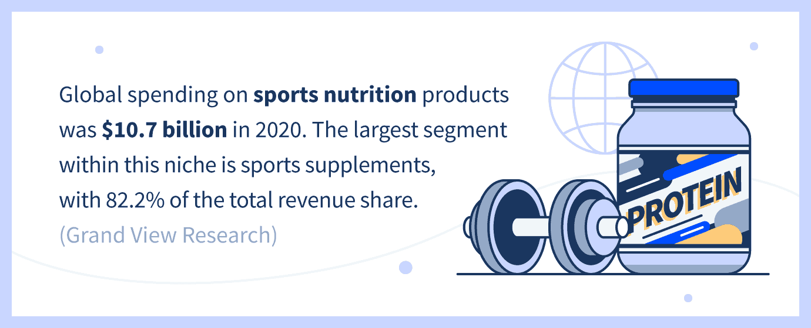
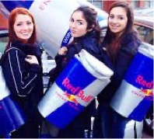
2) Targeting

Slide 11
3&4) Differentiation & Positioning

Slide 12
developing and Delivering the Chosen Position

Slide 13
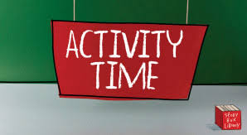

Activity #1 MCQs

Slide 14

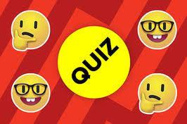
Quiz
Chose the right answer
Which of the following is true of perceptual positioning maps?
  A) They are used by marketers to divide a market into smaller groups with distinct characteristics.
  B) They are used by marketers to identify supplier and retailer perceptions of a product.
  C) They are used to analyze consumer perceptions of a brand relative to competing products.
  D) They are used to divide buyers into groups based on their perceived income and age.
  E) They are used to plot the geographic segments that a company needs to target.
Notes:
Answer: C

Slide 15
Quiz
Chose the right answer
________ consists of arranging for a market offering to occupy a clear, distinctive, and desirable place relative to competing products in the minds of target consumers.
  A) Differentiation
  B) Positioning
  C) Market targeting
  D) Market segmentation
  E) Mass marketing
Notes:
Answer: B

Slide 16
Quiz
Chose the right answer
Stores offering low-quality alternatives to luxury products at low prices most likely follow a ________ positioning strategy.
A) more-for-the-same
B) more-for-less
C) same-for-less
D) less-for-much-less
E) more-for-more
Notes:
Answer: D

Slide 17
Quiz
Chose the right answer
Port Orleans Shipping markets different services to the tourism, defense, and trade segments. The firm designs separate offers for each segment based on their needs. This approach is called ________ marketing.
A) concentrated
B) differentiated
C) individual
D) mass
E) local
Notes:
Answer: B

Slide 18
Quiz
Chose the right answer
85) Rad, a manufacturer of luxury watches, charges a higher price for its products than its competitors. Despite the high prices, the brand is popular among customers for its quality and service in comparison to cheaper alternatives available in the market. In this case, Rad offers a(n) ________ value proposition.
A) more-for-more
B) more-for-the-same
C) more-for-less
أ
D) all-or-nothing
E) same-for-less
Notes:
Answer:A

Slide 19
Quiz
True or false
Companies today are moving away from target marketing and toward mass marketing.
Creating market offerings that best serve targeted customers is called differentiation.
Notes:
Answer: FALSE
Answer: TRUE

Slide 20
Quiz
Chose the right answer
Xenon, a leading consumer-electronics manufacturing company, markets its products under the company's own brand name. In this case, Xenon has sponsored its products by promoting them as ________ brands.
  A) licensed
  B) private
  C) store
  D) national
  E) distributor
Fred's, a national supermarket chain, sells its own brand of items across all categories. Such items are considered ________ brands.
  A) national
  B) manufacturer's
  C) private
  D) extended
  E) licensed
  Flores Fashions promotes its clothing by emphasizing the durability and quality of the fabrics it uses. The company has positioned its brand based on ________.
    A) product benefits
    B) product attributes
    C) beliefs and values
    D) market share
    E) brand loyalty
Notes:
Answer: D
Answer: C

Slide 21
Quiz
Chose the right answer
  ________ occurs when two established brand names of different companies are used on the same product.
  A) Licensing
  B) Co-branding
  C) Private branding
  D) Franchising
  E) Brand positioning
  Which of the following is an example of licensing?
  A) DMX, an electronics manufacturer, acquires Z-Elex, a start-up firm, and sells all Z-Elex's products under the DMX brand name.
  B) Berry, a fruit juice company, uses a well-known cartoon character to promote the company's line of children's products and pays the creator of the cartoon character a fee.
  C) XLC, a sporting goods firm, sponsors a number of top athletes in various sports and also hosts the XLC Sporting Achievement Awards.
  D) ZetaBike, a bicycle manufacturer, teams up with VitaWater, a sports drink producer, to introduce ZetaVita, an energy drink.
  E) Mason's, a retail chain, sells a number of different products from different manufacturers under the brand name Mason's.
Notes:
Answer: B
Answer: B

Slide 22
Quiz
Chose the right answer
Brands vary in the amount of power and value they hold in the marketplace. Iconic brands like Apple, Google, and Harley-Davidson have achieved substantial brand ________.
  A) capital
  B) personality
  C) perception
  D) esteem
  E) equity
Notes:
Answer: B
Answer: B

Slide 23
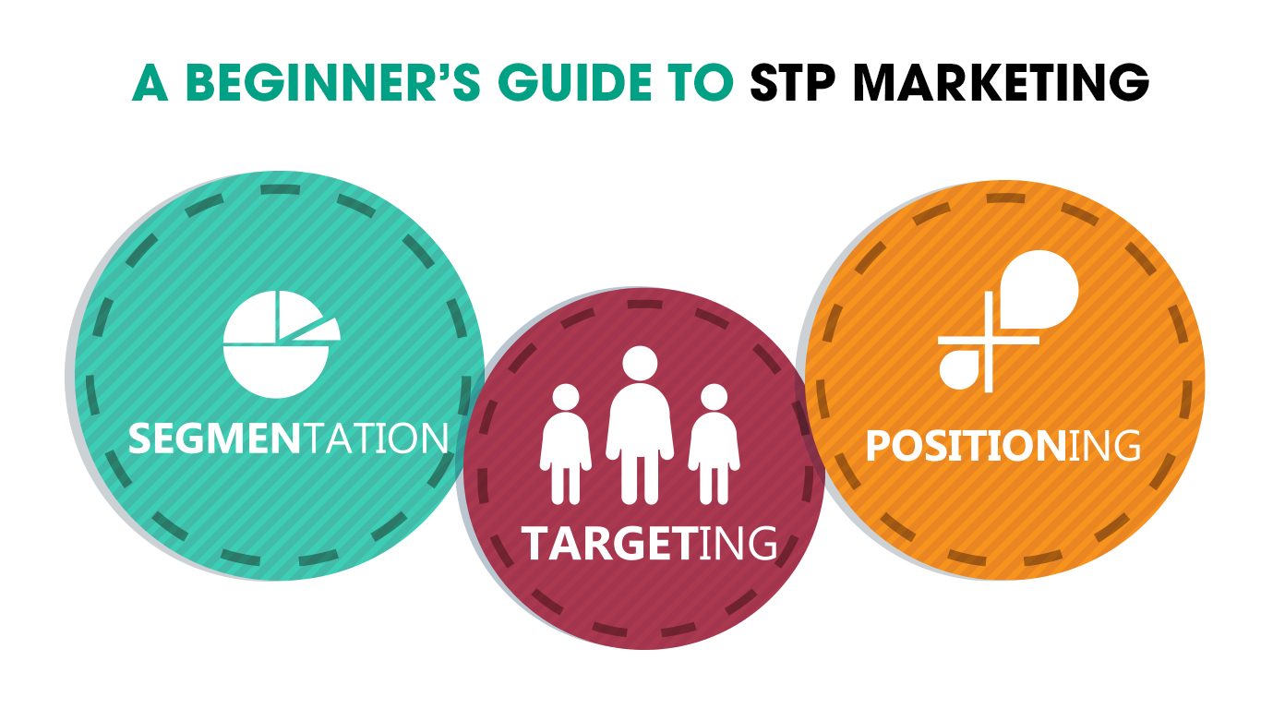
Differentiation
Branding

Slide 24
Activity #2

Slide 25
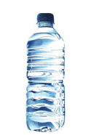
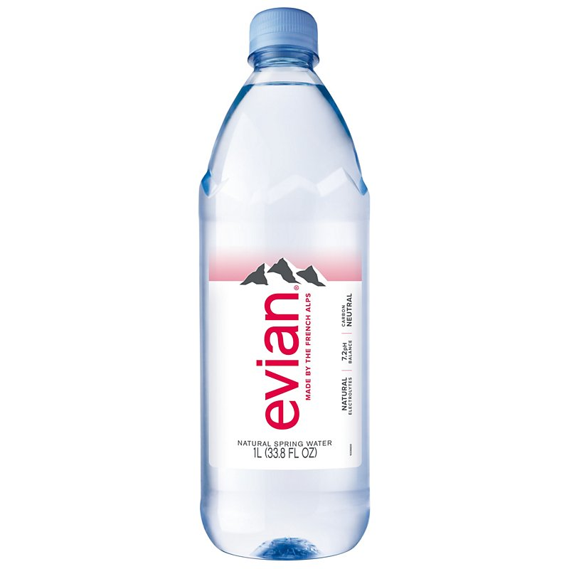
ما الفرق !
1.0$
0.1$
منتج
ماركة او علامه تجاريه

Slide 26
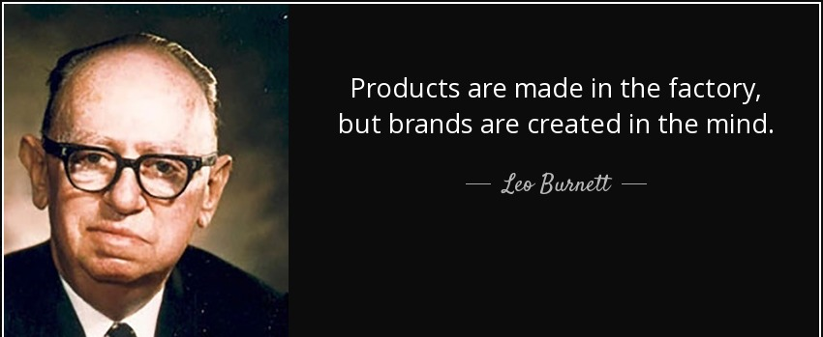
Brand versus product
“Products are made in the factory but brands are created in the mind”
Leo Burnett was an American advertising executive and the founder of Leo Burnett Company, Inc. He was responsible for creating some of advertising's most well-known characters and campaigns of the 20th
Notes:
https://digitalsynopsis.com/advertising/generic-trademark-product-brand-names/A brand is a name , a term , a symbol or any other unique element of a product.

Slide 27
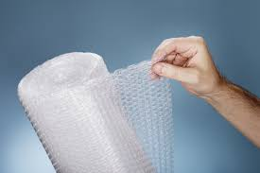
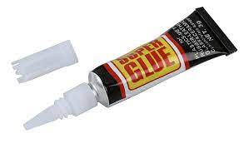
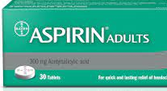
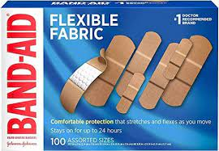
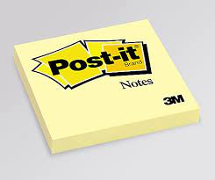
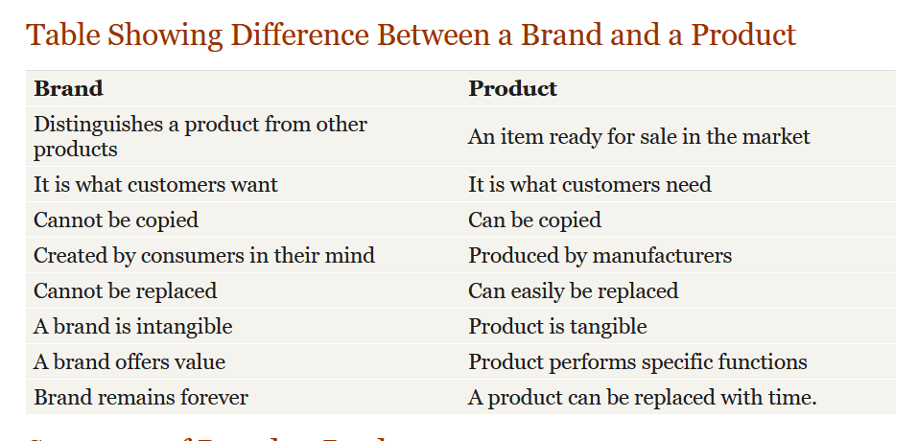
Summary of Brand vs Product

Slide 28
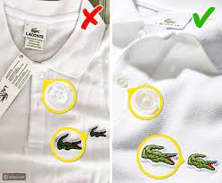
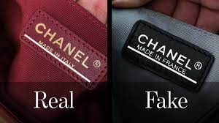
ما أهميه العلامة التجارية؟
المؤسسات تواجه منافسة شديدة وبيئة تنافسيه تتميز بالتقدم التقني والتطور الهائل في قطاع الاتصالات، وتزايد متسارع في المنتجات الجديدة وتنوعها وتشابهها،
أصبحت العلامة التجارية حجر الأساس من أجل بناء علامة الشركة وسمعتها
أداة تميز وتعزز تنافسية المؤسسة عن بقية منافسيها
وتبرز المنتجات وتميزها وتمنع حدوث لبس لدى المستهلك
تجذب العلامة التجارية انتباه المستهلك و تكون اداه لكسب ولاء العملاء .
Notes:
وأصبح بقائها مرهونا بتأقلم مع ومسايرتهاو تغيرات بيئيةمنافسة شديدة ، ،

Slide 29
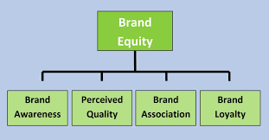
Brand Equity
Brand equity ,. It's a measure of the brand’s Values as well as its ability to capture consumer preference and loyalty
Brand value is the total financial value of a brand
https://www.forbes.com/the-worlds-most-valuable-brands/#b305959119c0
Notes:
Brands are a key element in a company’s relationships with consumers. Brands represent consumers’ perceptions and feelings about a product and its performance. A powerful brand has high brand equity. Brand equity is the differential effect that knowing the brand name has on customer response to the product and its marketing.
A brand has positive brand equity when consumers react more favorably to it than to a generic or unbranded version of the same product. It has negative brand equity if consumers react less favorably than to an unbranded version.

Slide 30
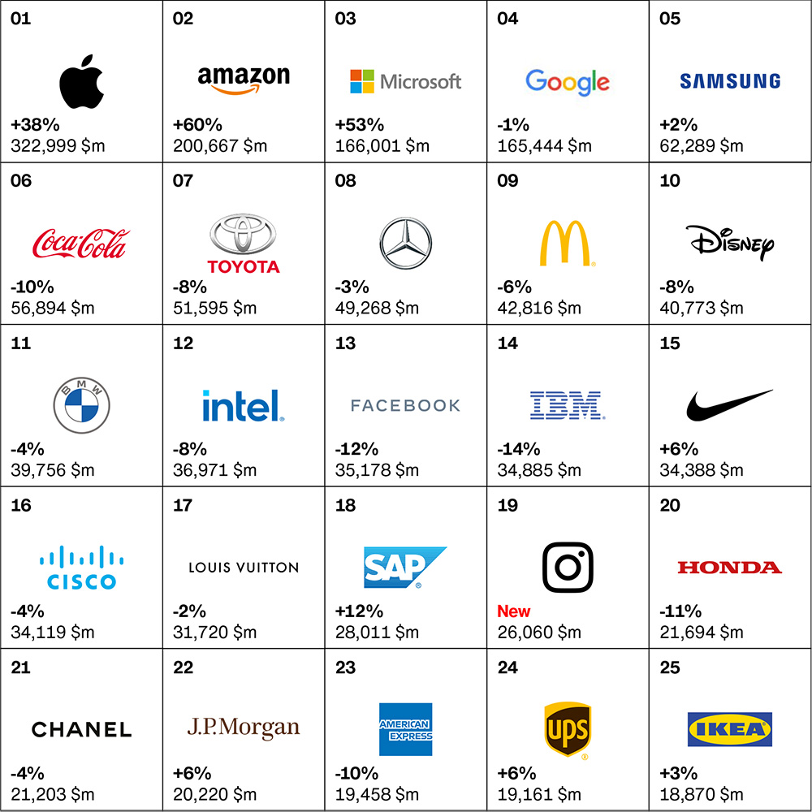
العلامات التجارية الأكثر قيمة في العالم في عام 2022 وفقا لتصنيفات Interbrand

Slide 31
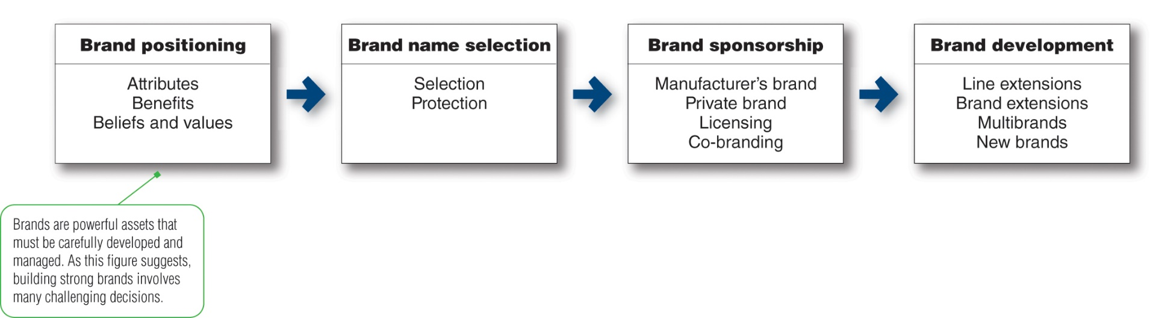
Major brand strategy decisions Major Brand Strategy Decisions
Brands are powerful assets that must be carefully developed and managed. As this figure suggests, building strong brands involves many challenging decisions
1
2
4
3
Notes:
Brands are powerful assets that must be carefully developed and managed. As this figure suggests, building strong brands involves many challenging decisions.
This figure shows that the major brand strategy decisions involve brand positioning, brand name selection, brand sponsorship, and brand development.

Slide 32
The brand positioning, attributes, benefit, Beliefs and Values
1-
A brand is the company's promise to deliver a benefits, services, and experiences consistently to buyers and must be supported by specific set of features.
Marketers can brand their products through three levels:
Product Features / Attributes,
  At the lowest level they can position the brand on product, However, attributes are the least desirable level for branding.
Product Benefits/ Consumer Rewards
  A brand can be better positioned by associating its name with a desirable benefit
Emotional Benefit. /Beliefs and values
  The strongest brands go beyond attribute or benefit positioning - they are positioned on strong Successful brands engage customers on a deep, emotional level
attributes, benefit, Beliefs and Values Laddering
Notes:
Marketers need to position their brands clearly in target customers' minds
When positioning a brand, the marketer should establish a mission for the brand and a vision of what the brand must be and do
A brand is the company's promise to deliver a specific set of features, benefits, services, and experiences consistently to buyers
The brand promise must be simple and honest
They can position brands at any of three levels:
At the lowest level they can position the brand on product attributes
However, attributes are the least desirable level for brand positioning
Competitors can easily copy attributes
A brand can be better positioned by associating its name with a desirable benefit
The strongest brands go beyond attribute or benefit positioning - they are positioned on strong beliefs and values
Successful brands engage customers on a deep, emotional level

Slide 33
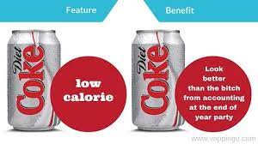
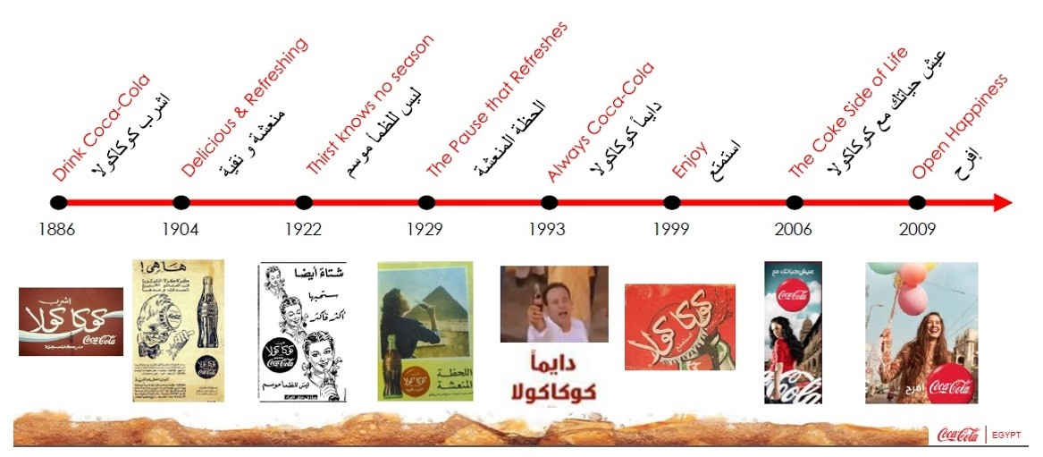
Brand attributes, benefit, Beliefs and Values
1-
Look better
شكل جذاب
خلك خفيف

Slide 34
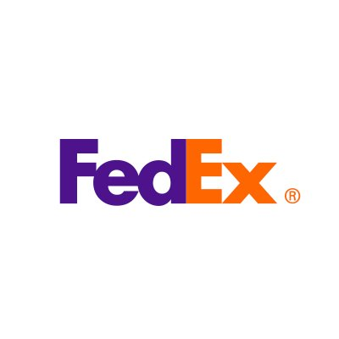
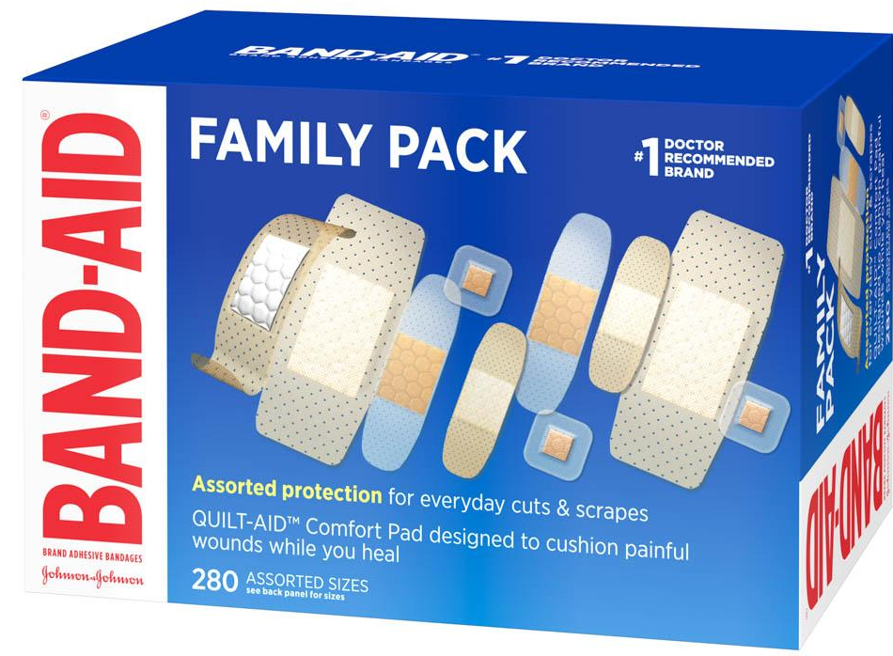
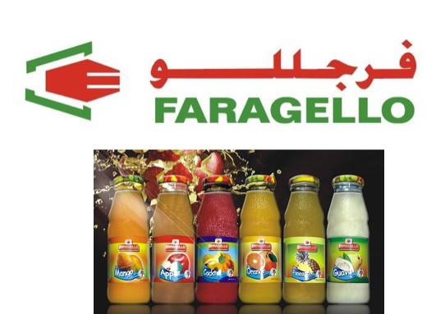
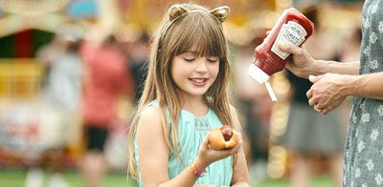

Brand Name, selection and protection
2-
A Brand name is a word used to identify or differentiate a company and its products from the others.
Desirable qualities for a brand name should be
  Based on the product’s benefits and qualities
  Easy to pronounce, recognize, and remember
  Distinctive and extendable
  Easily translated into foreign languages
  Capable of registration and legal protection

Slide 35
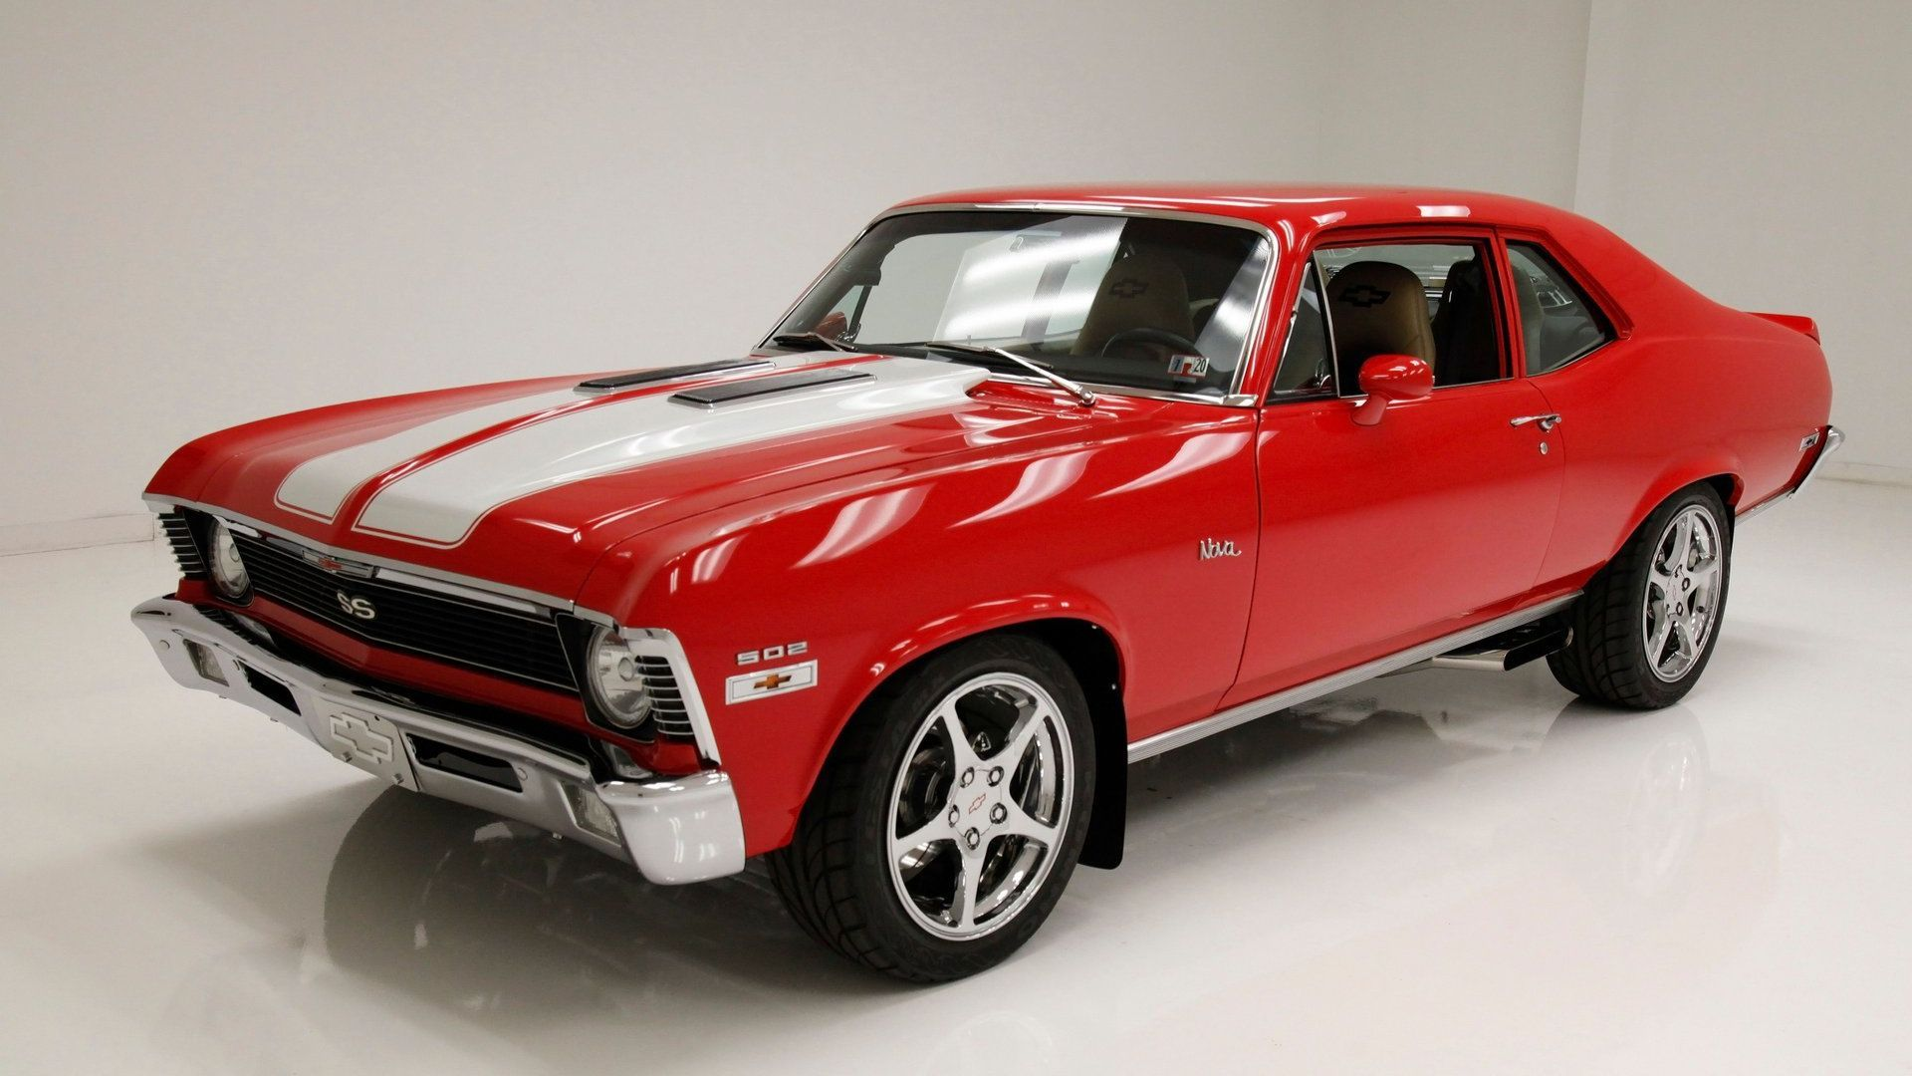
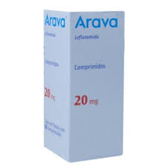
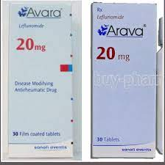
Name importance
Chevrolet Nova faced a challenge in Central and South America
In Spanish, No Va, is, simply means No Go -- or this car won’t go! ☺

Slide 36
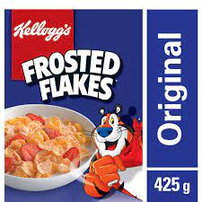
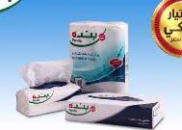
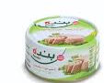
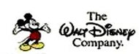
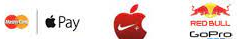
Brand Sponsorship
3-
National brands Marketed under the manufacturer’s own name
Store brands Created and owned by a reseller of a product or service
Licensing Use names and symbols created by other companies or well-known movie characters or celebrities for a fee
Co-branding Use the established brand names of two different companies on the same product
Notes:
A manufacturer has four sponsorship options:
National brands or manufacturers’ brands are marketed under the manufacturer’s own name. The Samsung Galaxy tablet or Kellogg’s Frosted Flakes are examples of national brands.
An increasing numbers of retailers and wholesalers have created their own store brands or private brands To compete with store brands, national brands must sharpen their value propositions, especially when appealing to today’s more frugal consumers.
Some companies license names or symbols previously created by other manufacturers, the names of well-known celebrities, or characters from popular movies and books. For a fee, licensing any of these can provide an instant and proven brand name. For example, consider the Kodak brand with its familiar red and yellow colors, which has retained its value even after the company went bankrupt and discontinued its consumer products.
Co-branding occurs when two established brand names of different companies are used on the same product. Because each brand dominates in a different category, the combined brands create broader consumer appeal and greater brand equity. For example, Taco Bell and Doritos teamed up to create the Doritos Locos Taco.

Slide 37
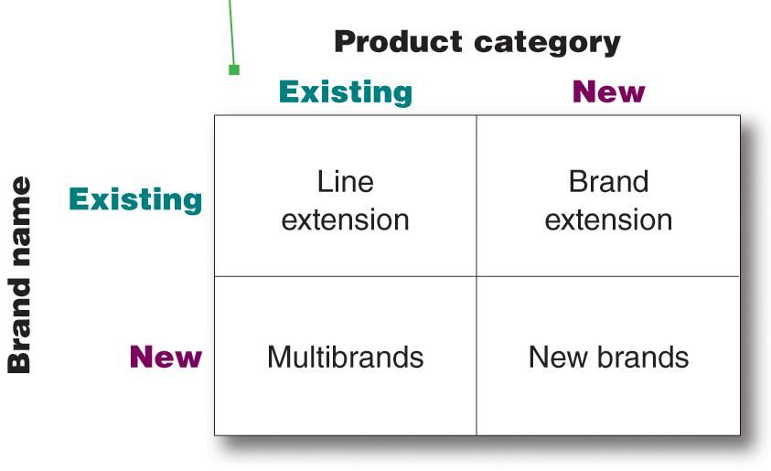
4-
Brand Development Strategies
Major strategies to develop and manage brands
Notes:
This figure illustrates the four choices that a company has when it comes to developing brands. It can introduce line extensions, brand extensions, multibrands, or new brands.
Line extensions occur when a company extends existing brand names to new forms, colors, sizes, ingredients, or flavors of an existing product category. A company might introduce line extensions as a low-cost, low-risk way to introduce new products. Or it might want to meet consumer desires for variety, use excess capacity, or command more shelf space from resellers.
A brand extension extends an existing brand name to new or modified products in a new category. It gives a new product instant recognition and faster acceptance. But an extension may also confuse the image of the main brand.
Multibranding offers a way to establish different features that appeal to different customer segments, lock up more reseller shelf space, and capture a larger market share. A major drawback of multibranding is that each brand might obtain only a small market share, and none may be very profitable.
A company might believe that the power of its existing brand name is waning, so a new brand name is needed. Or, it may create a new brand name when it enters a new product category for which none of its current brand names are appropriate. For example, Toyota created the separate Lexus brand aimed at luxury car consumers and the Scion brand, targeted toward Millennial consumers.

Slide 38
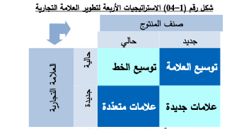
استراتيجيات العلامة التجارية - تطوير العلامة التجارية.
امتدادات الخطوط
امتدادات العلامة
Notes:
This figure illustrates the four choices that a company has when it comes to developing brands. It can introduce line extensions, brand extensions, multibrands, or new brands.
Line extensions occur when a company extends existing brand names to new forms, colors, sizes, ingredients, or flavors of an existing product category. A company might introduce line extensions as a low-cost, low-risk way to introduce new products. Or it might want to meet consumer desires for variety, use excess capacity, or command more shelf space from resellers.
A brand extension extends an existing brand name to new or modified products in a new category. It gives a new product instant recognition and faster acceptance. But an extension may also confuse the image of the main brand.
Multibranding offers a way to establish different features that appeal to different customer segments, lock up more reseller shelf space, and capture a larger market share. A major drawback of multibranding is that each brand might obtain only a small market share, and none may be very profitable.
A company might believe that the power of its existing brand name is waning, so a new brand name is needed. Or, it may create a new brand name when it enters a new product category for which none of its current brand names are appropriate. For example, Toyota created the separate Lexus brand aimed at luxury car consumers and the Scion brand, targeted toward Millennial consumers.

Slide 39
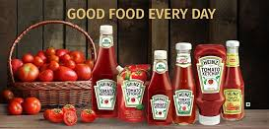
Line extensions
extends existing brand names to new forms, colors, sizes, ingredients, or flavors of an existing product category.
A company might introduce line extensions as a low-cost, low-risk way to introduce new prod
Example: Heinz Ketchup different lines extension ……..

Slide 40
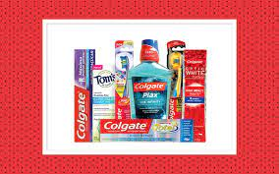
Brands extension
Companies extend an existing brand name to new or modified products in a new category.
It gives a new product instant recognition and faster acceptance.
Notes:
A brand extension extends a current brand name to new or modified products in a new category. For example, Google-owned Nest—which began as a maker of stylish, connected, learning thermostats that can be controlled remotely by phone—has extended its line with a host of smart and stylish smart-home products, including a smoke and carbon monoxide
alarm, home monitoring cameras, a home security alarm system, and a video doorbell that lets you know who’s calling.

Slide 41
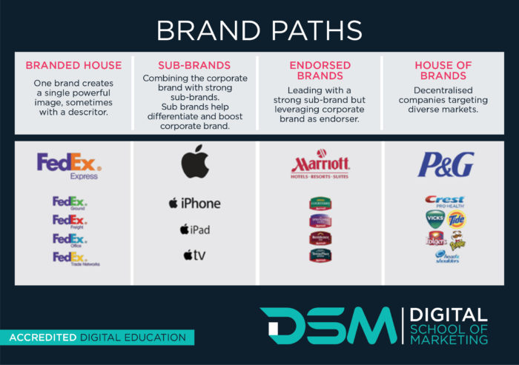
Multibranding
features that appeal to different customer segments, lock up more reseller shelf space, and capture a larger market share.
Notes:
common Brand Strategies
Brand extension: uses an existing brand name to promote a new or improved product in a company's product lineExample: Ocean Spray extended cranberry juice line by adding CranApple, CranGrape, and CranCherry
Brand licensing: companies allow other organizations to use their brand, brand mark, or trade charactersExample: NFL has licensing arrangements with Pepsi & Visa
Mixed brands: offer a combo of national, private, and generic brands to sell productsExample: Michelin manufactures its own brand of tires as well as sells them at Sears under the Sears brand name.
Co-branding: combines one or more brands in the manufacture of a product or in the delivery of a service Example: Starbucks has an agreement with Barnes & Noble to open coffee shops inside their bookstores
Product Line Decisions • Product Line • Group of products with variations (flavors/types/appeals). • Product Line Stretching • Downward • Upward • Both directions • Product Line Filling • Examples • Ice Tea • Pet Foods
Product Line Stretching - Marriott Marriott offers a full line of hotel brands, each aimed at a different market.
Product Mix Decisions • Product mix: • What combination of products do we carry? • Product mix decisions: •

Slide 42
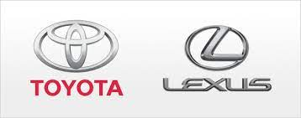

New brand
new brand name when it enters a new product category for which none of its current brand names are appropriate. For example, Toyota created the separate Lexus brand aimed at luxury car consumers.
Notes:
common Brand Strategies
Brand extension: uses an existing brand name to promote a new or improved product in a company's product lineExample: Ocean Spray extended cranberry juice line by adding CranApple, CranGrape, and CranCherry
Brand licensing: companies allow other organizations to use their brand, brand mark, or trade charactersExample: NFL has licensing arrangements with Pepsi & Visa
Mixed brands: offer a combo of national, private, and generic brands to sell productsExample: Michelin manufactures its own brand of tires as well as sells them at Sears under the Sears brand name.Co-branding: combines one or more brands in the manufacture of a product or in the delivery of a serviceExample: Starbucks has an agreement with Barnes & Noble to open coffee shops inside their bookstores
Product Line Decisions • Product Line • Group of products with variations (flavors/types/appeals). • Product Line Stretching • Downward • Upward • Both directions • Product Line Filling • Examples • Ice Tea • Pet Foods
Product Line Stretching - Marriott Marriott offers a full line of hotel brands, each aimed at a different market.
Product Mix Decisions • Product mix: • What combination of products do we carry? • Product mix decisions: •

Slide 43

Generic Branding
Extra
Generic Brand: is a no-name product that does not carry a company identity, with no identification other than a content description
Mainly in commodities
Prices are almost 30-50% lower than original.
Examples: Pancake mix, paper towels , sugar , rice, milk etc…

Slide 45
Activity #3 practice on branding

Slide 46











Slide 47

Let us continue understanding;
  How to create value for customers?
  Marketing mix

Slide 48


Understand the Startegy
Corporate strategy refers to the overall strategy used to guide a business.
Grand strategy
How to grow ?
How to differentiate your self from other ?
General Marketing Strategies, describes how marketing will achieve general objective
S.T.P.
(Where to play ) Which customers will we serve ? (segmentation and targeting)
(How to win ) how will we create value for them?
(differentiation and positioning)
Specific marketing strategies “brand level strategies”
Marketing Mix
Which products and services levels ?
Where & how customer will find them?
Communication and exchange ?

Slide 49
Expanded Marketing process
1
2
3
4
5
Notes:
Company-wide strategic planning guides marketing strategy and planning. Like the marketing strategy, the broader company strategy must be customer focused.
This figure illustrates the steps in strategic planning. At the corporate level, the company starts the strategic planning process by defining its overall purpose and mission. The mission is turned into detailed supporting objectives that guide the entire company. Then, headquarters decides what portfolio of businesses and products is best for the company and how much support to give each one.
In turn, each business and product develops detailed marketing and other departmental plans that support the company-wide plan. Thus, marketing planning occurs at the business-unit, product, and market levels. It supports company strategic planning
Strategic planning sets the stage for the rest of planning in the firm. Companies prepare annual plans, long-range plans, and strategic plans. The annual and long-range plans deal with the company’s current businesses and how to keep them going. In contrast, the strategic plan involves adapting the firm to take advantage of opportunities in its constantly changing environment.
with more detailed plans for specific marketing opportunities.

Slide 50
Constructing an Integrated Marketing Mix
Marketing mix = 4 Ps.
Set of tactical marketing tools blended to produce the response to the target market.
Product is the goods/services combination the company offers to the target market.
Price is the amount of money customers must pay to obtain the product.
Place includes the company activities that make the product available to target consumers.
Promotion refers to activities that communicate the merits of the product and persuade target customers to buy it.
An effective marketing program blends the marketing mix elements into an integrated marketing program designed to achieve the company’s marketing objectives by delivering value to consumers.
Notes:
After deciding on its overall marketing strategy, the company is ready to begin planning the details of the marketing mix, one of the major concepts in modern marketing
The marketing mix consists of everything the firm can do to influence the demand for its product
The many possibilities can be collected into four groups of variables known as the four Ps: product, price, place, and promotion.
Product means the goods-and-services combination the company offers to the target market
Price is the amount of money customers must pay to obtain the product
Place includes company activities that make the product available to target customers
Promotion means activities that communicate the merits of the product and persuade target customers to buy it
However, some critics think that the four Ps may omit or underemphasize certain important activities
The four Ps concept takes the seller's view of the market, not the buyer's view
From the buyer's viewpoint, in this age of customer value and relationships, the four Ps might be better described as the four Cs
Marketers would do well to think through the four Cs first and then build the four Ps on that platform
The marketing mix is the set of tactical marketing tools that the firm blends to produce the response it wants in the target market. This figure shows the four marketing tools, the four Ps.
Product is the goods-and-services combination the company offers to the target market.
Price is the amount of money customers must pay to obtain the product.
Place includes the company activities that make the product available to target consumers.
Promotion refers to activities that communicate the merits of the product and persuade target customers to buy it.
An effective marketing program blends the marketing mix elements into an integrated marketing program designed to achieve the company’s marketing objectives by delivering value to consumers.

Slide 51


Extra

Slide 52

Constructing an Integrated Marketing Mix
Customer is buying value added and solutions to problems
Customer cost, total costs of obtaining, using, and disposing of a product
Customer Convenience, Customer will make purchases depending on where, when, and how it is Convenient for them
Customer want two-way and regular communication also relationships with businesses

Slide 53

1st P-Products : Goods and Service
Philip Kotler: “A product is anything that can be offered to a market for attention, acquisitions, use or consumption that might satisfy a want or need. It includes physical objectives, services, persons, places, organizations and ideas”.
3
2
4
1
5

Slide 54


Goods characteristics
1
Goods is anything tangible that can be offered to a market to satisfy a want or need and it is accompanied by use consumption ownership
  Consumer Good are bought by final consumers for personal consumption.
  Industrial products are bought by organizations for further processing or for use in conducting a business.

Slide 55

Services characteristics
1
SERVICE is an intangible activity/ experience that can be offered to satisfy a want or need
service takes place in interactions with a company and/or the service provider |a personnel| where Both affect on the service outcome And consumer satisfaction.
four special service characteristics a company must consider when designing a service marketing programs:
  intangibility,
  inseparability,
  variability,
  perishability.

Slide 56





1
Service Characteristics cont.
Notes:
This figure depicts the four special service characteristics a company must consider when designing marketing programs: intangibility, inseparability, variability, and perishability.
Service intangibility means that services cannot be seen, tasted, felt, heard, or smelled before they are bought. To reduce uncertainty, buyers look for signals of service quality. They draw conclusions about quality from the place, people, price, equipment, and communications that they can see.
Service inseparability means that services cannot be separated from their providers, whether the providers are people or machines. Customer coproduction makes provider–customer interaction a special feature of services marketing. Both the provider and the customer affect the service outcome.
Service variability means that the quality of services depends on who provides them as well as when, where, and how they are provided. For example, within a Marriott hotel, one registration-counter employee may be cheerful and efficient, whereas another standing just a few feet away may be grumpy and slow.
Service perishability means that services cannot be stored for later sale or use. Some doctors charge patients for missed appointments because the service value existed only at that point and disappeared when the patient did not show up.

Slide 57
How Companies increase Service differentiation
1
Managing service differentiation
The act of distinguishing company's offering from competitors' offerings and Delivering consistently higher quality than the competitors in ways that meaningful to consumers.
Even the best companies will have an occasional late delivery, burned steak, or grumpy employee. However, good service recovery can turn angry customers into loyal ones.
Managing service differentiation, quality, and productivity
  Training current employees or hiring new ones
  Harnessing the power of technology
Notes:
Service companies face three major marketing tasks: They want to increase their service differentiation, service quality, and service productivity.
In these days of intense price competition, service marketers often complain about the difficulty of differentiating their services from those of competitors. The solution to price competition is to develop a differentiated offer, delivery, and image. For example, Dick’s Sporting Goods’ customers can sample shoes on Dick’s indoor footwear track, test golf clubs with an on-site golf swing analyzer and putting green, shoot bows in its archery range, and receive personalized fitness product guidance from an in-store team of fitness trainers.
A service firm can differentiate itself by delivering consistently higher quality than its competitors provide. Service providers need to identify what target customers expect in regard to service quality. As hard as they may try, even the best companies will have an occasional late delivery, burned steak, or grumpy employee. However, good service recovery can turn angry customers into loyal ones.
With their costs rising rapidly, service firms are under great pressure to increase service productivity. They can do so in several ways. They can train current employees better or hire new ones who will work harder or more skillfully. Or they can increase the quantity of their service by giving up some quality. Finally, a service provider can harness the power of technology.
However, companies must avoid pushing productivity so hard that doing so reduces quality. For example, many airlines in their attempts to improve productivity, have mangled customer service.

Slide 58

Levels of Product & service
2
Core customer value deals with what is bought by the customer
people who buy an Apple are buying much more than just a device
are buying entertainment, self-expression, productivity, and connectivity with friends and family
actual product. The product and service features
augmented product around additional consumer services and benefits.
Three Levels of Product & service
Notes:
Core customer value deals with what is bought by the customer. For example, people who buy an Apple iPad are buying much more than just a tablet computer. They are buying entertainment, self-expression, productivity, and connectivity with friends and family—a mobile and personal window to the world.
At the second level, product planners must turn the core benefit into an actual product. They need to develop product and service features, a design, a quality level, a brand name, and packaging. For example, the iPad is an actual product. Its name, parts, styling, operating system, features, packaging, and other attributes have all been carefully combined to deliver the core customer value of staying connected.
Finally, product planners must build an augmented product around the core benefit and actual product by offering additional consumer services and benefits. For example, when consumers buy an iPad, Apple and its resellers also might give buyers a warranty on parts and workmanship, quick repair services when needed, and a Web site to use if they have problems or questions. Apple also provides access to a huge assortment of apps and accessories.

Slide 59


Slide 60

Levels of Product and Services , example of the 3 levels
2
Core customer value Core benefit
who buys a Tablet Computer is buying much more than functions of the computer, it is entertainment, self-expression , productivity and a mobile and personal window to the world
Actual product.
Attributes as name, parts, styling, operating system, features, packaging, and other have all been carefully combined to deliver the core customer value
augmented product
Additional benefits a warranty on parts and workmanship, quick repair services when needed, and a Web site to use if they have problems or questions. also provides access to a huge assortment of apps and accessories.
Notes:
Core customer value deals with what is bought by the customer. For example, people who buy an Apple iPad are buying much more than just a tablet computer. They are buying entertainment, self-expression, productivity, and connectivity with friends and family—a mobile and personal window to the world.
At the second level, product planners must turn the core benefit into an actual product. They need to develop product and service features, a design, a quality level, a brand name, and packaging. For example, the iPad is an actual product. Its name, parts, styling, operating system, features, packaging, and other attributes have all been carefully combined to deliver the core customer value of staying connected.
Finally, product planners must build an augmented product around the core benefit and actual product by offering additional consumer services and benefits. For example, when consumers buy an iPad, Apple and its resellers also might give buyers a warranty on parts and workmanship, quick repair services when needed, and a Web site to use if they have problems or questions. Apple also provides access to a huge assortment of apps and accessories.

Slide 61
Activity#4 practice on product levels

Slide 62



Match numbers and letters with the right Answers
  AB
  C
  D
  E
  1- Augmented product
  2- Actual product
  3- Core customer value Core benefit

Slide 63
Match numbers and letters with the right Answers
  1- Augmented product {E}
  A
  B
  C
  D
  E
  2- Actual product {B,C,D}
  3- Core customer value Core benefit {A}

Slide 64








Types of consumer products
3
Convenience Products
Buy frequently & immediately
Low priced
Unsought Products
consumers don’t think about
such products,
Shopping Products
Buy less frequently
Higher price
Specialty Products
Special purchase efforts
High price
Notes:
After deciding on its overall marketing strategy, the company is ready to begin planning the details of the marketing mix, one of the major concepts in modern marketing
The marketing mix consists of everything the firm can do to influence the demand for its product
The many possibilities can be collected into four groups of variables known as the four Ps: product, price, place, and promotion.
Product means the goods-and-services combination the company offers to the target market
Price is the amount of money customers must pay to obtain the product
Place includes company activities that make the product available to target customers
Promotion means activities that communicate the merits of the product and persuade target customers to buy it
However, some critics think that the four Ps may omit or underemphasize certain important activities
The four Ps concept takes the seller's view of the market, not the buyer's view
From the buyer's viewpoint, in this age of customer value and relationships, the four Ps might be better described as the four Cs
Marketers would do well to think through the four Cs first and then build the four Ps on that platform

Slide 65

4
Marketing Considerations different types of consumer products

Slide 66
Product and service decisions
5
Product and Service Decisions
Product Line Decisions
Product Mix Decisions
Individual Product Decisions
Line stretching
Line filling
width
length
depth
consistency
product attributes
Branding
Packaging
Labels
product support services
1
2
3

Slide 67



Individual Product Decisions
5.1
A product varying features that add customer value is through distinctive product style and design.
Branding an important part of a product and can add value Consumers view a brand reflects product quality and consistency.
Packaging involves designing the container or wrapper for a product. packages must attract buyers & communicating brand positioning.
Labels help to identify and describe the product or brand as well as promote the brand, support its positioning and engage customers.
Product support services is to survey customers periodically. Once the company has assessed the quality of various support services, it can take steps to fix problems and add new services that will both delight customers and yield profits.
Notes:
This figure shows the important decisions in the development and marketing of individual products and services.
Developing a product or service involves defining the benefits that it will offer. The characteristics of a product or service that bear on its ability to satisfy stated or implied customer needs is known as product quality, one of the marketer’s major positioning tools. Total quality management (TQM) is an approach in which all of the company’s people are involved in constantly improving the quality of products, services, and business processes. A product can be offered with varying features. Another way to add customer value is through distinctive product style and design.
A brand is a name, term, sign, symbol, or design or a combination of these that identifies the maker or seller of a product or service. Consumers view a brand as an important part of a product, and branding can add value to a consumer’s purchase. Brand names help consumers identify products that might benefit them. Brands also say something about product quality and consistency.
Packaging involves designing the container or wrapper for a product. Increased competition means that packages must now perform many sales tasks—from attracting buyers to communicating brand positioning to closing the sale.
Labels help to identify and describe the product or brand as well as promote the brand, support its positioning and engage customers.
The first step in designing product support services is to survey customers periodically. Once the company has assessed the quality of various support services, it can take steps to fix problems and add new services that will both delight customers and yield profits to the company.

Slide 68






Individual Product Decisions
5.1
Apple's Pro iPhones with updated cameras, new colors, smaller notches, ProMotion display, 1TB max storage, and faster A15 chip.
tamper-proof in iPhone 13 box, packaging contents are intact during shipping, and make sure consumers get a new iPhone13 box package that has not been opened or tampered with before.
TECH FIX” column in the New York Times. “The truth is that it is the smartphones peaked a few years ago,”
https://support.apple.com/en-sa/iphone
Notes:
This figure shows the important decisions in the development and marketing of individual products and services.
Developing a product or service involves defining the benefits that it will offer. The characteristics of a product or service that bear on its ability to satisfy stated or implied customer needs is known as product quality, one of the marketer’s major positioning tools. Total quality management (TQM) is an approach in which all of the company’s people are involved in constantly improving the quality of products, services, and business processes. A product can be offered with varying features. Another way to add customer value is through distinctive product style and design.
A brand is a name, term, sign, symbol, or design or a combination of these that identifies the maker or seller of a product or service. Consumers view a brand as an important part of a product, and branding can add value to a consumer’s purchase. Brand names help consumers identify products that might benefit them. Brands also say something about product quality and consistency.
Packaging involves designing the container or wrapper for a product. Increased competition means that packages must now perform many sales tasks—from attracting buyers to communicating brand positioning to closing the sale.
Labels help to identify and describe the product or brand as well as promote the brand, support its positioning and engage customers.
The first step in designing product support services is to survey customers periodically. Once the company has assessed the quality of various support services, it can take steps to fix problems and add new services that will both delight customers and yield profits to the company.

Slide 69









Product line definition
Nestle BOTTLED WATER SBU
5
5.2
Product line is closely related products that:
  Have similar functions and customer groups
  Are sold through similar outlets
  EX, Nestle BOTTLED WATER product line.
Product line LENGTH is the number of items in the product line.
  EX, 4 lines is the length of Nestle BOTTLED WATER product line.
Product line DEPTH is Number of versions each product line as , flavor, taste,
  EX, 16 is the depth of a Nestle BOTTLED WATER product line.
PRODUCT LENGTH
4 product lines

Slide 70


Product line decisions examples
5.2
product line decisions are two
Product line filling adding more items within the present range of the line
Product line stretching company lengthens its product line beyond its current range The company can stretch its line downward, upward, or both ways.
Notes:
product line is a group of products that are closely related because they function in a similar manner, are sold to the same customer groups, are marketed through the same types of outlets, or fall within given price ranges. For example, Nike produces several lines of athletic shoes and apparel.
The major product line decision involves product line length, which is the number of items in the product line. A company can expand its product line in two ways: line filling and line stretching.
Line filling involves adding more items within the present range of the line. There are several reasons for product line filling. These reasons include reaching for extra profits, satisfying dealers, using excess capacity, being the leading full-line company, and plugging holes to keep out competitors.
Line stretching occurs when a company lengthens its product line beyond its current range. The company can stretch its line downward, upward, or both ways. A reason for downward product line stretching is to plug a market hole that would attract a potential competitor. The reason for upward product line stretching is to add prestige to the current product.

Slide 71

BMW -Product line Decisions
5.2
BMW founded in 1917 Built engines for military aircraft.
Over the years, Through skillful line stretching and filling, BMW Group has transformed itself from a single-brand, five-model automaker into a powerhouse with three brands, 14 “Series,” and dozens of distinct models.
The company has expanded downward with its MINI Cooper line and upward with Rolls-Royce.
BMW now has brands and lines that successfully appeal to the rich, the super-rich, and the hope-to-be-rich.
Notes:
A product line is a group of products that are closely related because they function in a similar manner, are sold to the same customer groups, are marketed through the same types of outlets, or fall within given price ranges. For example, Nike produces several lines of athletic shoes and apparel.
The major product line decision involves product line length, which is the number of items in the product line. A company can expand its product line in two ways: line filling and line stretching.
Line filling involves adding more items within the present range of the line. There are several reasons for product line filling. These reasons include reaching for extra profits, satisfying dealers, using excess capacity, being the leading full-line company, and plugging holes to keep out competitors.
Line stretching occurs when a company lengthens its product line beyond its current range. The company can stretch its line downward, upward, or both ways. A reason for downward product line stretching is to plug a market hole that would attract a potential competitor. The reason for upward product line stretching is to add prestige to the current product.
Over the years, BMW Group has transformed itself from a single-brand, five-model automaker into a powerhouse with three brands, 14 “Series,” and dozens of distinct models. The company has expanded downward with its MINI Cooper line and upward with Rolls-Royce.

Slide 72

Product Mix decisions
5.3
Width; Number of different product lines
Length; Total number of items a in the product lines
Depth; Number of versions each product line as , flavor, taste, etc.
Consistency how closely the product lines are related from end user. perspectives, production requirements, and distribution channels,
Nestle’s most product lines are consistent as they are consumer goods that go through the same distribution channels.

Slide 73

Product Mix decisions
5.3
company can increase its business in four ways.
add new product lines.
widening its product mix.
lengthen its existing product lines to become a more full-line company. It can add more versions of each product and thus deepen its product mix.
More product line consistency
Notes:
product line is a group of products that are closely related because they function in a similar manner, are sold to the same customer groups, are marketed through the same types of outlets, or fall within given price ranges. For example, Nike produces several lines of athletic shoes and apparel.
The major product line decision involves product line length, which is the number of items in the product line. A company can expand its product line in two ways: line filling and line stretching.
Line filling involves adding more items within the present range of the line. There are several reasons for product line filling. These reasons include reaching for extra profits, satisfying dealers, using excess capacity, being the leading full-line company, and plugging holes to keep out competitors.
Line stretching occurs when a company lengthens its product line beyond its current range. The company can stretch its line downward, upward, or both ways. A reason for downward product line stretching is to plug a market hole that would attract a potential competitor. The reason for upward product line stretching is to add prestige to the current product.

Slide 74
Product Mix Decisions examples
5.3
Colgate is a $15.2 billion consumer products company that makes and markets a full product mix consisting of dozens of familiar lines and brands. Colgate divides its overall product mix into four major lines and Each product line consists of many items:
Oral care,
Personal care,
Home care,
Pet nutrition.
Notes:
A company’s product mix has four important dimensions: width, length, depth, and consistency.
The mix width refers to the number of different product lines the company carries. Product mix length refers to the total number of items a company carries within its product lines. Product mix depth refers to the number of versions offered for each product in the line. Finally, the consistency of the product mix refers to how closely related the various product lines are in end use, production requirements, distribution channels, or some other aspect.
A company can increase its business in four ways. It can add new product lines, widening its product mix. The company can lengthen its existing product lines to become a more full-line company. It can add more versions of each product and thus deepen its product mix. Finally, the company can pursue more product line consistency or less depending on whether it wants to have a strong reputation in a single field or in several fields. Finally, a company can pursue more product line consistency—or less—depending on whether it wants to have a strong reputation in a single field or in several fields.
Colgate is a $15.2 billion consumer products company that makes and markets a full product mix consisting of dozens of familiar lines and brands. Colgate divides its overall product mix into four major lines: oral care, personal care, home care, and pet nutrition. Each product line consists of many brands and item.
Colgate full product mix

Slide 75
Activity#5 practice on product levels

Slide 76

Match numbers and letters with the right Answers
Length; Total number of items a in the product lines
Width; Number of different product lines
Consistency how closely the product lines are related from end user. perspectives, production requirements, and distribution channels,
Depth; Number of versions each product line as , flavor, taste, etc.
B
C
D
A
Notes:
product line is a group of products that are closely related because they function in a similar manner, are sold to the same customer groups, are marketed through the same types of outlets, or fall within given price ranges. For example, Nike produces several lines of athletic shoes and apparel.
The major product line decision involves product line length, which is the number of items in the product line. A company can expand its product line in two ways: line filling and line stretching.
Line filling involves adding more items within the present range of the line. There are several reasons for product line filling. These reasons include reaching for extra profits, satisfying dealers, using excess capacity, being the leading full-line company, and plugging holes to keep out competitors.
Line stretching occurs when a company lengthens its product line beyond its current range. The company can stretch its line downward, upward, or both ways. A reason for downward product line stretching is to plug a market hole that would attract a potential competitor. The reason for upward product line stretching is to add prestige to the current product.

Slide 77
Match numbers and letters with the right Answers
B
Length; Total number of items a in the product lines
Width; Number of different product lines
Consistency how closely the product lines are related from end user. perspectives, production requirements, and distribution channels,
Depth; Number of versions each product line as , flavor, taste, etc.
A
D
B
C
C
D
A-
Notes:
product line is a group of products that are closely related because they function in a similar manner, are sold to the same customer groups, are marketed through the same types of outlets, or fall within given price ranges. For example, Nike produces several lines of athletic shoes and apparel.
The major product line decision involves product line length, which is the number of items in the product line. A company can expand its product line in two ways: line filling and line stretching.
Line filling involves adding more items within the present range of the line. There are several reasons for product line filling. These reasons include reaching for extra profits, satisfying dealers, using excess capacity, being the leading full-line company, and plugging holes to keep out competitors.
Line stretching occurs when a company lengthens its product line beyond its current range. The company can stretch its line downward, upward, or both ways. A reason for downward product line stretching is to plug a market hole that would attract a potential competitor. The reason for upward product line stretching is to add prestige to the current product.

Slide 78


Slide 80
Product mix Decisions
5.3
PRODUCT WIDTH OF NESTLE
Notes:
product line is a group of products that are closely related because they function in a similar manner, are sold to the same customer groups, are marketed through the same types of outlets, or fall within given price ranges. For example, Nike produces several lines of athletic shoes and apparel.
The major product line decision involves product line length, which is the number of items in the product line. A company can expand its product line in two ways: line filling and line stretching.
Line filling involves adding more items within the present range of the line. There are several reasons for product line filling. These reasons include reaching for extra profits, satisfying dealers, using excess capacity, being the leading full-line company, and plugging holes to keep out competitors.
Line stretching occurs when a company lengthens its product line beyond its current range. The company can stretch its line downward, upward, or both ways. A reason for downward product line stretching is to plug a market hole that would attract a potential competitor. The reason for upward product line stretching is to add prestige to the current product.

Slide 81


Slide 82



Slide 83

Pricing

