Slide 1

Strategic marketing

Slide 2


Strategic marketing
Lecture # 5

Slide 3

QUICK RECAP ON PREVIOUS LECTURES

Slide 5
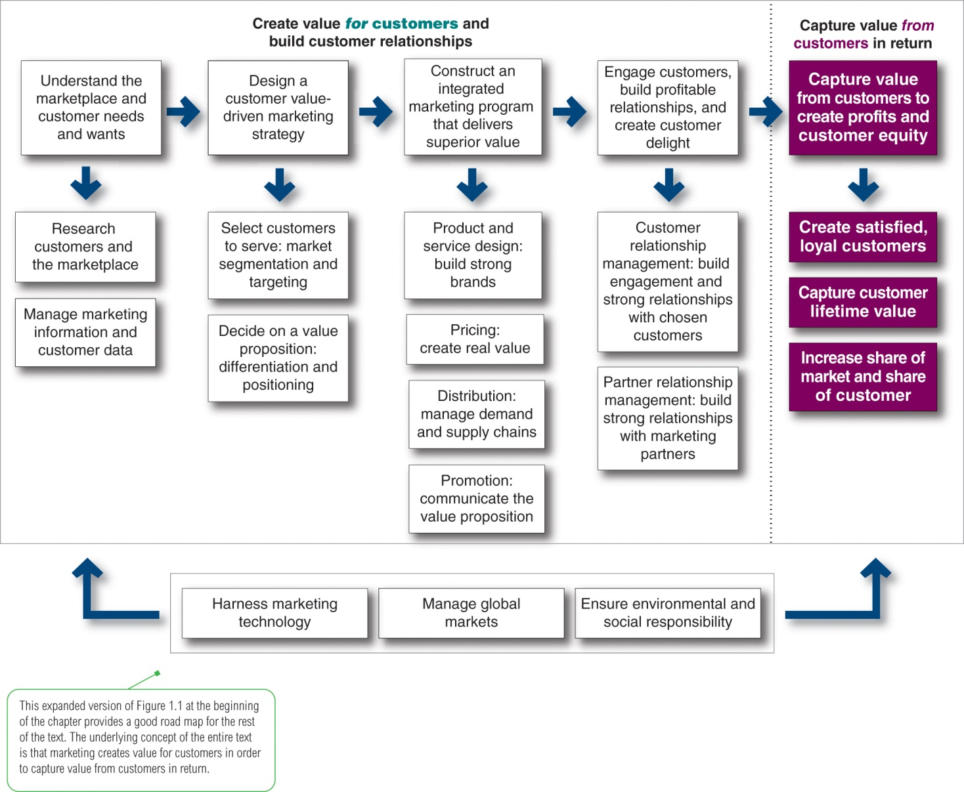
1
2
3
4
5
Expanded Marketing process
Notes:
Company-wide strategic planning guides marketing strategy and planning. Like the marketing strategy, the broader company strategy must be customer focused.
This figure illustrates the steps in strategic planning. At the corporate level, the company starts the strategic planning process by defining its overall purpose and mission. The mission is turned into detailed supporting objectives that guide the entire company. Then, headquarters decides what portfolio of businesses and products is best for the company and how much support to give each one.
In turn, each business and product develops detailed marketing and other departmental plans that support the company-wide plan. Thus, marketing planning occurs at the business-unit, product, and market levels. It supports company strategic planning
Strategic planning sets the stage for the rest of planning in the firm. Companies prepare annual plans, long-range plans, and strategic plans. The annual and long-range plans deal with the company’s current businesses and how to keep them going. In contrast, the strategic plan involves adapting the firm to take advantage of opportunities in its constantly changing environment.
with more detailed plans for specific marketing opportunities.

Slide 6
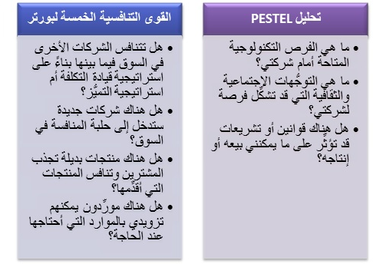
Notes:
Company-wide strategic planning guides marketing strategy and planning. Like the marketing strategy, the broader company strategy must be customer focused.
This figure illustrates the steps in strategic planning. At the corporate level, the company starts the strategic planning process by defining its overall purpose and mission. The mission is turned into detailed supporting objectives that guide the entire company. Then, headquarters decides what portfolio of businesses and products is best for the company and how much support to give each one.
In turn, each business and product develops detailed marketing and other departmental plans that support the company-wide plan. Thus, marketing planning occurs at the business-unit, product, and market levels. It supports company strategic planning
Strategic planning sets the stage for the rest of planning in the firm. Companies prepare annual plans, long-range plans, and strategic plans. The annual and long-range plans deal with the company’s current businesses and how to keep them going. In contrast, the strategic plan involves adapting the firm to take advantage of opportunities in its constantly changing environment.
with more detailed plans for specific marketing opportunities.

Slide 11
1
2
3
4
5
Expanded Marketing process
Notes:
Company-wide strategic planning guides marketing strategy and planning. Like the marketing strategy, the broader company strategy must be customer focused.
This figure illustrates the steps in strategic planning. At the corporate level, the company starts the strategic planning process by defining its overall purpose and mission. The mission is turned into detailed supporting objectives that guide the entire company. Then, headquarters decides what portfolio of businesses and products is best for the company and how much support to give each one.
In turn, each business and product develops detailed marketing and other departmental plans that support the company-wide plan. Thus, marketing planning occurs at the business-unit, product, and market levels. It supports company strategic planning
Strategic planning sets the stage for the rest of planning in the firm. Companies prepare annual plans, long-range plans, and strategic plans. The annual and long-range plans deal with the company’s current businesses and how to keep them going. In contrast, the strategic plan involves adapting the firm to take advantage of opportunities in its constantly changing environment.
with more detailed plans for specific marketing opportunities.

Slide 13


MCQs training
Activity #1

Slide 14


Quiz
Chose the right answer
Which of the following is the right order of the steps that companies generally follow in designing a customer-driven marketing strategy?
A) market segmentation, differentiation, positioning, and market targeting
B) positioning, market segmentation, mass marketing, and market targeting
C) market segmentation, market targeting, differentiation, and positioning
D) market alignment, market segmentation, differentiation, and market positioning
E) market recognition, market preference, market targeting, and market insistence
Lilly's, a furniture retailer, sells low-end furniture and accent pieces that are targeted toward lower-income consumer groups. Lilly's most likely segments the consumer market based on ________ variables.
A) demographic
B) psychographic
C) universal
D) geographic
E) behavioral
Notes:
Answer: c
Answer: A

Slide 15
Quiz
Chose the right answer
A) ________ is the process of dividing a market into distinct groups of buyers who have different needs, characteristics, or behavior.
A) Differentiation
B) Mass marketing
C) Market targeting
D) Market segmentation
E) Positioning
AHarry's caters to the clothing needs of men, manufacturing two different lines of fashion based on the purchasing power of its customers. One product line caters to the needs of affluent wealthy, middle-aged men, and the other line targets younger, up-and-coming professionals. Harry's most likely segments the consumer market based on ________ variables.
A) geographic
B) psychographic
C) universal
D) demographic
E) behavioral
Notes:
Answer: D
Answer: D

Slide 16
Quiz
Chose the right answer
Y company's, a furniture retailer, sells low-end furniture and accent pieces that are targeted toward lower-income consumer groups. Lilly's most likely segments the consumer market based on ________ variables.
  A) demographic
  B) psychographic
  C) universal
  D) geographic
  E) behavioral
Notes:
Answer: A

Slide 17
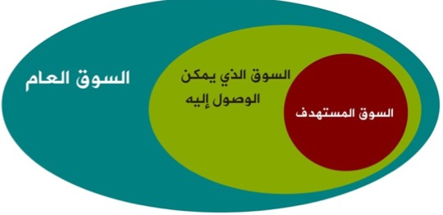
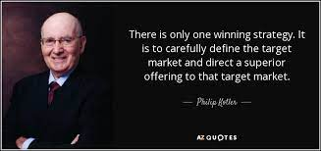
2-Market Targeting

Slide 18

Targeting,
A-Evaluating the various segments
Target market segment : Set of buyers sharing common needs or characteristics that the company decides to serve
Factors for evaluating market segments
Segments that have the right size and growth. (High Attractiveness)
Segment structural attractiveness
} potential aggressive competitors، potential new entrants, potential substitutes power of buyers, and powerful suppliers}
Company objectives and resources
{Some attractive segments can be dismissed because they do not interconnect with the company’s long-run objectives. Or the company lack the skills and resources needed .
  Factors for selecting target market segment
Notes:
Market segmentation reveals the firm’s market segment opportunities. The firm has to evaluate the various segments and decide how many and which segments it can serve best. In evaluating different market segments, a firm must look at three factors.
First, a company wants to select segments that have the right size and growth characteristics.
Second, the company needs to examine major structural factors that affect long-run segment attractiveness like strong and aggressive competitors or if it is easy for new entrants to come into the segment. The existence of actual or potential substitute products, the relative power of buyers, and powerful suppliers also affects segment attractiveness.
Finally, the company must consider its own objectives and resources. Some attractive segments can be dismissed quickly because they do not mesh with the company’s long-run objectives. Or, the company may lack the skills and resources needed to succeed in an attractive segment.
After evaluating different segments, the company must decide which and how many segments it will target. A target market consists of a set of buyers who share common needs or characteristics that the company decides to serve. Market targeting can be carried out at several different levels.
Companies need to consider many factors when choosing a market-targeting strategy. Which strategy is best depending on the company’s resources. When the firm’s resources are limited, concentrated marketing makes the most sense. The best strategy also depends on the degree of product variability. The product’s life-cycle stage also must be considered. When a firm introduces a new product, it may be practical to launch one version only, and undifferentiated marketing or concentrated marketing may make the most sense. In the mature stage of the product life cycle, however, differentiated marketing can be useful.
Another factor is market variability. If most buyers have the same tastes, buy the same amounts, and react the same way to marketing efforts, undifferentiated marketing is appropriate. Finally, competitors’ marketing strategies are important. When competitors use differentiated or concentrated marketing, undifferentiated marketing can be suicidal.

Slide 19
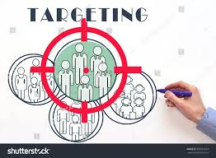
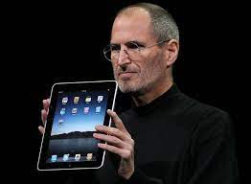
Targeting,
B-deciding which and how many segments
Marketers decide how many and which segments, to serve Based on the following factors :-
  product variability
  Product’s life-cycle
  Market variability
  Competitors’ marketing strategies
  Company resources
JOBS KILLED 70% OF APPLE’S PRODUCTS
Notes:
Companies need to consider many factors when choosing a market-targeting strategy. Which strategy is best depends on
the company’s resources. When the firm’s resources are limited, concentrated marketing makes the most sense. The best strategy also depends on the degree of
product variability. The product’s life-cycle stage also must be considered. When a firm introduces a new product, it may be practical to launch one version only, and undifferentiated marketing or concentrated marketing may make the most sense. In the mature stage of the product life cycle, however, differentiated marketing can be useful.
market variability. If most buyers have the same tastes, buy the same amounts, and react the same way to marketing efforts, undifferentiated marketing is appropriate. Finally,
competitors’ marketing strategies are important. When competitors use differentiated or concentrated marketing, undifferentiated marketing can be suicidal.

Slide 20
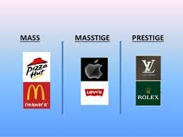
Extra
Targeting,
Commercial
Mass is a marketing term which denotes products perceived as affordable and targeted to a wide range of customers.
Prestige is a contemporary marketing term which denotes products perceived as luxurious
Masstige (a combination of two words: and targeted to a wide range of customers known as the “mass affluent Or upper middle-class individuals.)
Notes:
Affluent : a group having a great deal of money; wealthy:

Slide 21
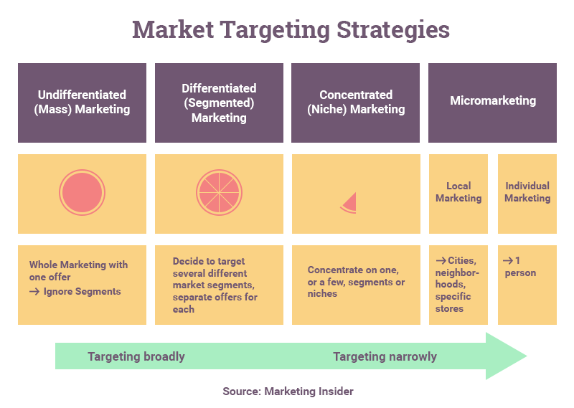

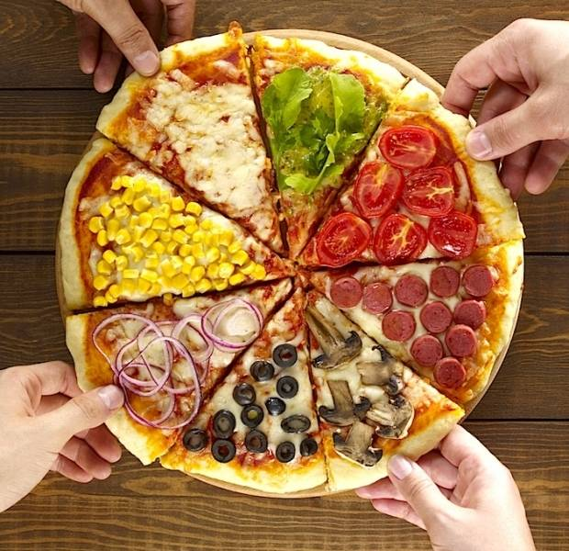

Targeting Strategies
  Undifferentiated Marketing {Mass}
  It focuses on what is common in the needs of consumers rather than on differences and provides cost economies however in contemporary marketing It is difficult to develop a product and brand that will satisfy all or even most consumers
  Differentiated Marketing
  company targets several market segments and designs separate offers for each, typically produces more total sales than undifferentiated marketing
  Concentrated Niche Marketing
  companies with limited resources Instead of going for a small share of a large market, the firm pursues a large share of one or a few small markets..
Notes:
After evaluating different segments, the company must decide which and how many segments to serve
Undifferentiated Marketing
Using an undifferentiated marketing strategy, a company ignores market segmentation differences and goes after the entire market with one market offer
It focuses on what is common in the needs of consumers rather than on differences
Undifferentiated marketing provides cost economies
Most contemporary marketers have strong doubts about the strategy in today's competitive environment
It is difficult to develop a product and brand that will satisfy all or even most consumers
Differentiated Marketing
Using a differentiated marketing strategy, a company targets several market segments and designs separate offers for each
Differentiated marketing typically produces more total sales than undifferentiated marketing
Concentrated Marketing
Concentrated marketing, is especially appealing to companies with limited resources
Instead of going for a small share of a large market, the firm pursues a large share of one or a few small markets.
Micromarketing
Differentiated and concentrated marketers tailor their offers and marketing programs to meet the needs of various market segments and niches. At the same time, however, they do not customize their offers to each individual customer.
Micromarketing is the practice of tailoring products and marketing programs to suit the tastes of specific individuals and locations. Rather than seeing a customer in every individual, micromarketers see the individual in every customer.
One form of micro marketing is Local Marketing, which tailoring brands and promotions to the needs and wants of local customer groups-cities, neighborhoods, and specific restaurant/hotel/store locations.

Slide 22
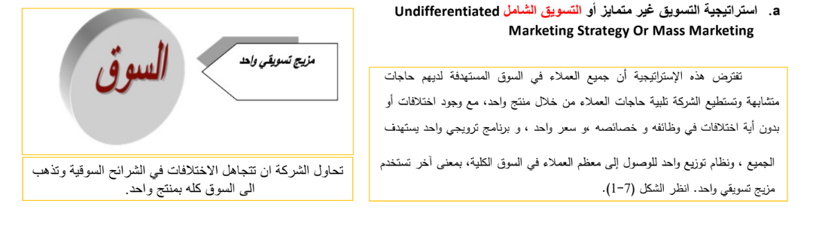

Slide 23
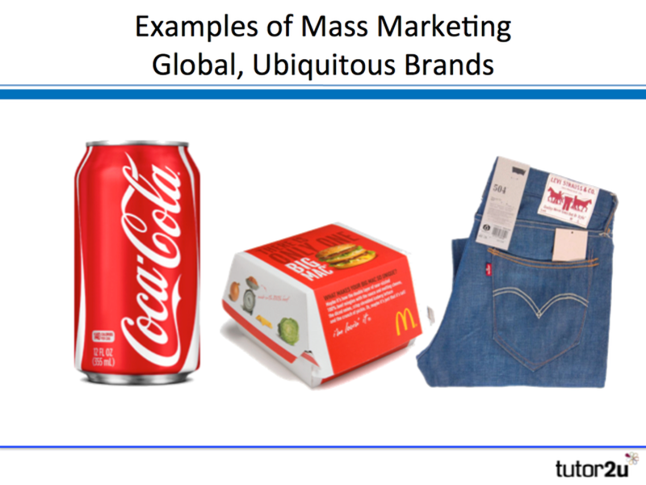
Undifferentiated
Marketing
Appeals to a broad spectrum of people
Efficient due to economies of scale
Effective when most consumers have similar needs
Example: IKEA
Notes:
undifferentiated (or mass marketing) refers to a market-coverage strategy in which a firm decides to ignore market segment differences and go after the whole market with one offer.

Slide 24
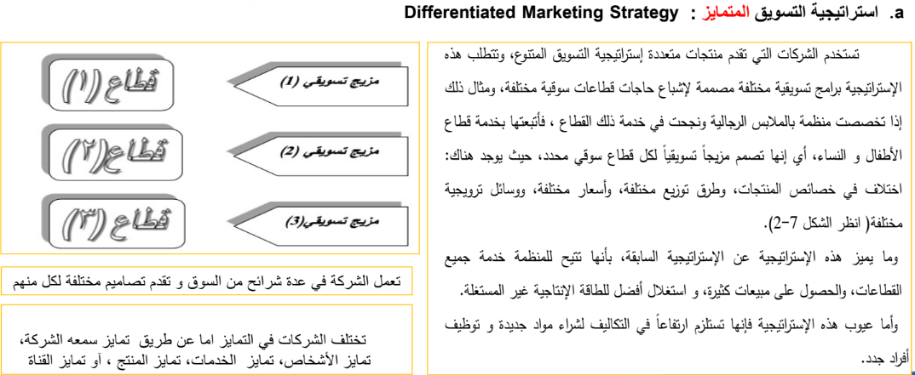
Notes:
There are many statistical techniques for developing market segments. Once the firm has identified its market-segment opportunities, it must decide how many and which ones to target. Marketers are increasingly combining several variables in an effort to identify smaller, better-defined target groups. Thus, a bank may not only identify a group of wealthy retired adults but within that group distinguish several segments depending on current income, assets, savings, and risk preferences. This has led some market researchers to advocate a needs-based market segmentation approach. Roger Best proposed the seven-step approach shown in Table 9.6.

Slide 25
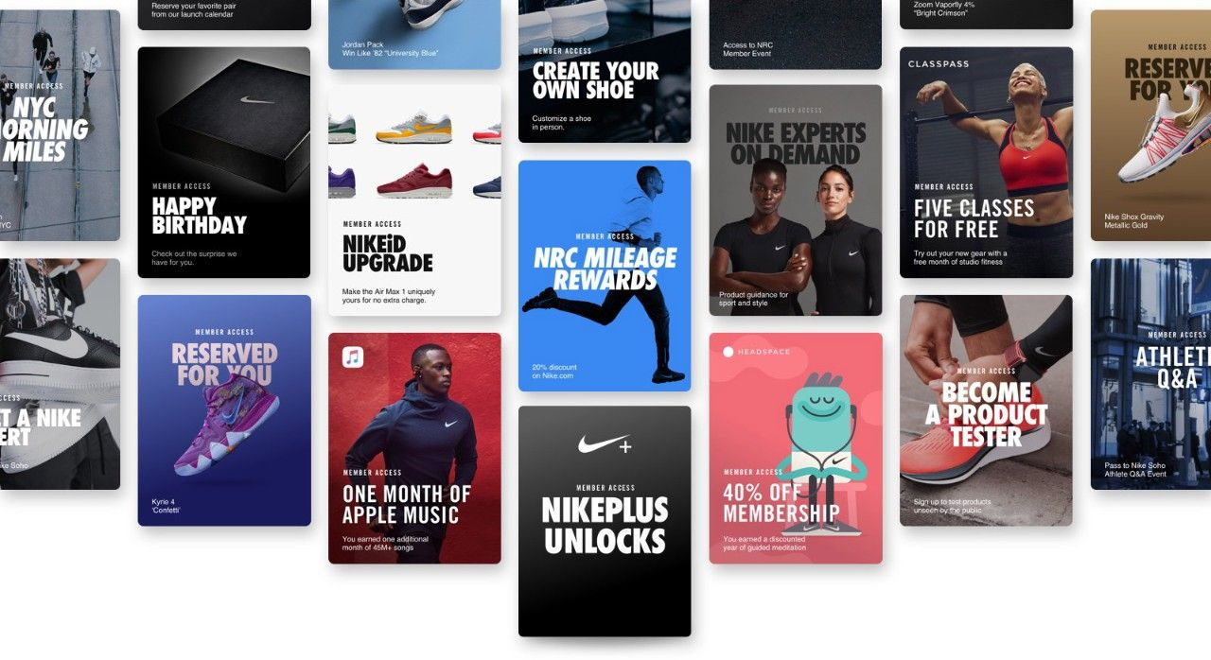
Differentiated Marketing
Develops one or more products for each of several customer groups with different product needs
Appropriate when it is possible to identify one or more segments with distinct needs for different types of products
  Example: Nike
Nike offers different products for different segments. Not advertising one, single brand ‘trainers. Like most other brands.
Notes:
Differentiated (or segmented marketing) refers to a market-coverage strategy in which a firm decides to target several market segments and designs separate offers for each

Slide 26
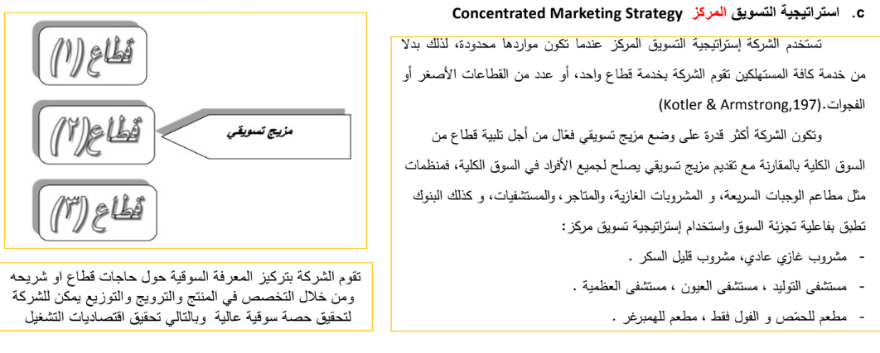
Notes:
There are many statistical techniques for developing market segments. Once the firm has identified its market-segment opportunities, it must decide how many and which ones to target. Marketers are increasingly combining several variables in an effort to identify smaller, better-defined target groups. Thus, a bank may not only identify a group of wealthy retired adults but within that group distinguish several segments depending on current income, assets, savings, and risk preferences. This has led some market researchers to advocate a needs-based market segmentation approach. Roger Best proposed the seven-step approach shown in Table 9.6.

Slide 27
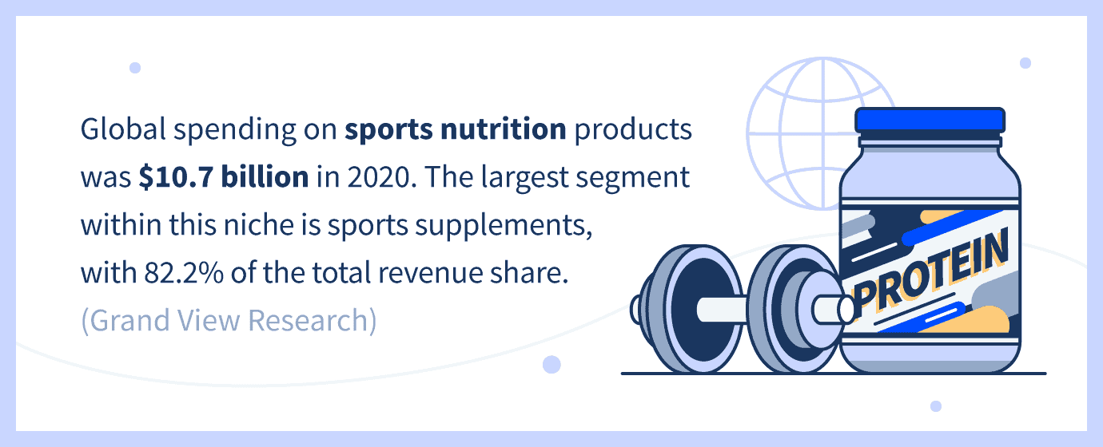

Concentrated
Marketing
focusing efforts on offering one or more products to a single segment
Useful for smaller firms that do not have their sources to serve all markets
Example:
  Rolex – Rolls Royce
Notes:
Concentrated (or niche marketing) refers to a market-coverage strategy in which a firm goes after a large share of one or a few smaller segments or niches.

Slide 28

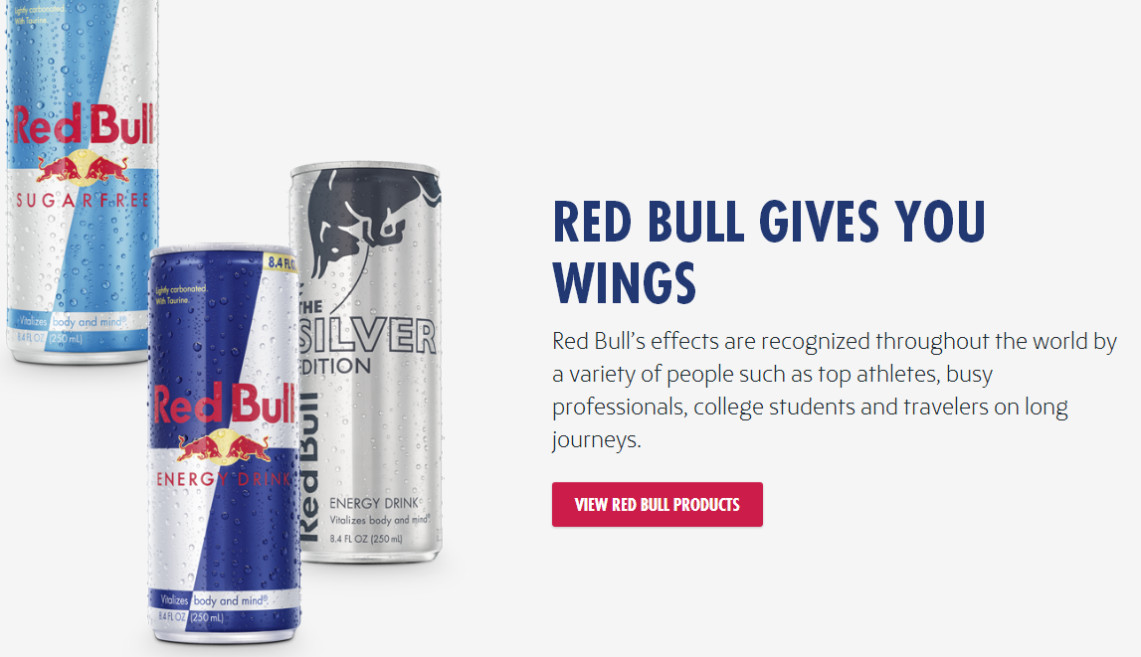
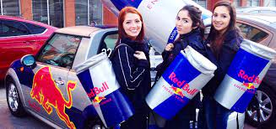
RED BUll
targeting the young,, extreme sport enthusiasts, crowd who are always in need of extra energy.
RED Bull marketed to them directly by sponsoring the events they were most likely to attend.
affiliating itself with everything from skateboarding to rock climbing.
Notes:
Micromarketing is the practice of tailoring products and marketing programs to suit the tastes of specific individuals and locations. Rather than seeing a customer in every individual, micro marketers see the individual in every customer.

Slide 29
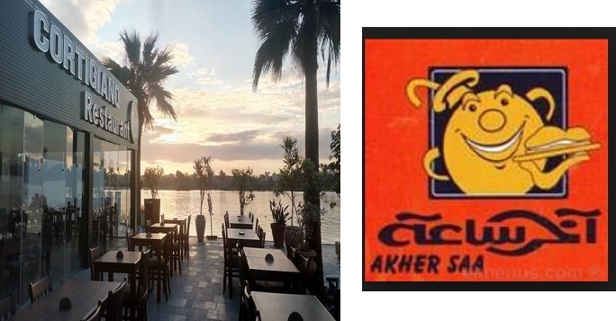
Local, Micro marketing
Extra
AkHer Saa / Cortigino are kind of restaurants that target a different needs and wants of local customer groups-cities, neighborhoods, in main cities in Egypt
Notes:
Local marketing involves tailoring brands and marketing to the needs and wants of local customer segments like cities, neighborhoods, and even specific stores. Individual marketing involves tailoring products and marketing programs to the needs and preferences of individual customers.

Slide 30
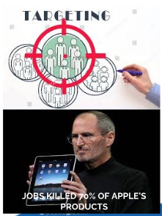
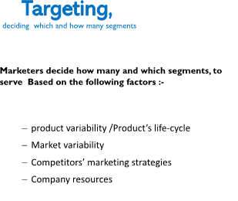
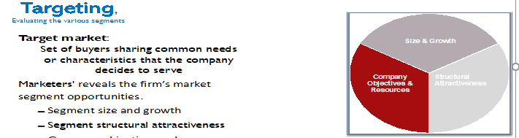

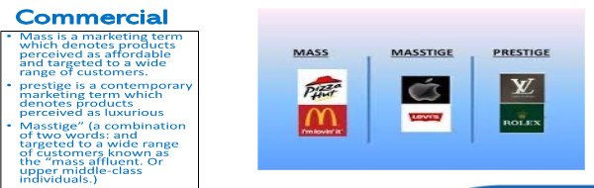
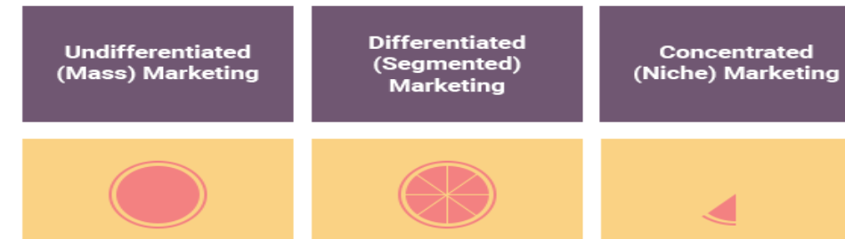
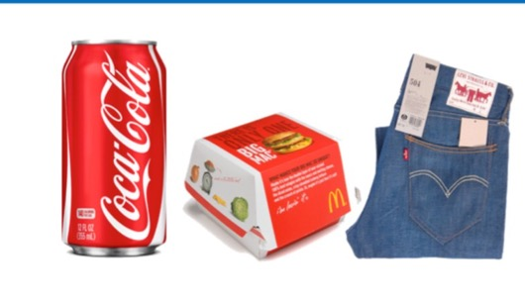
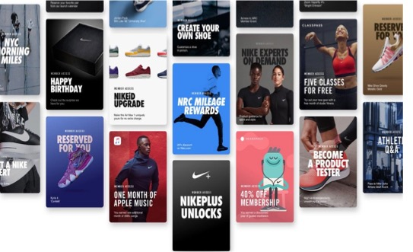
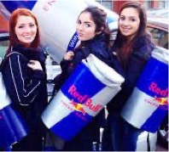

Slide 31

Activity #2
Targeting strategy check

Slide 32
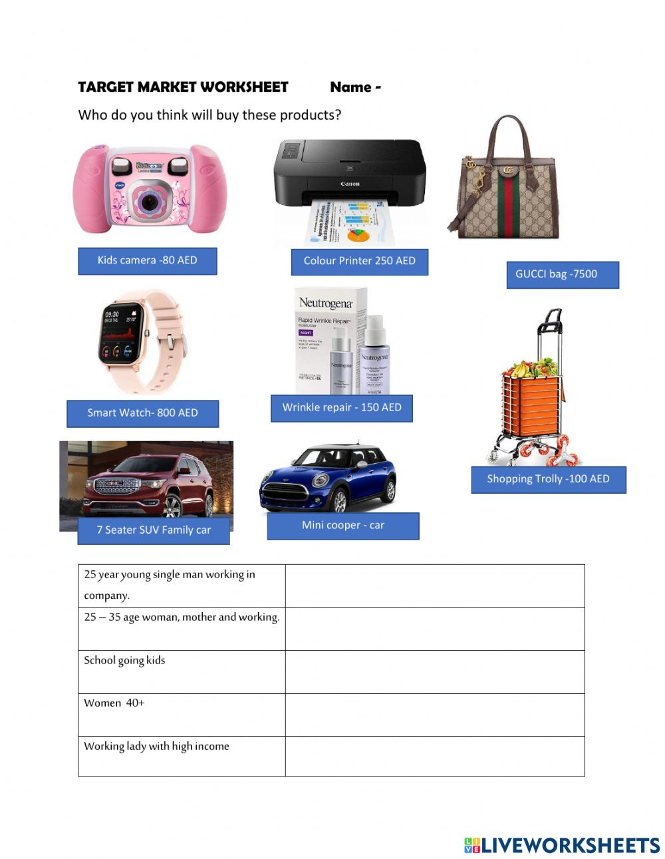

Slide 33

Let us continue understanding;
  How to differentiate, position and to brand the marketing offering ?

Slide 34
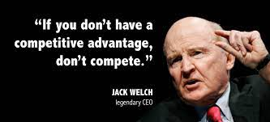
3- Differentiation
Providing customers with something unique, different and distinct from items their competitors may offer in the marketplace.
Notes:
After a company has decided which market segments to enter, it must determine how to differentiate its market offering for each targeted segment and what positions it wants to occupy in those segments. Positioning is arranging for a product to occupy a clear, distinctive, and desirable place relative to competing products in the minds of target consumers.
Effective positioning begins with differentiation. This refers to actually differentiating the market offering to create superior customer value. Once the company has chosen a desired position, it must take strong steps to deliver and communicate that position to target consumers. The company’s entire marketing program should support the chosen positioning strategy.

Slide 35
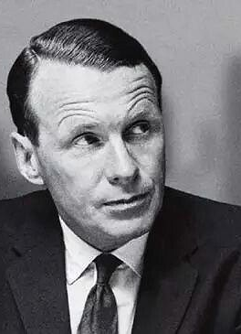
4-Positioning
Positioning is the act of designing the company’s offering and image to occupy a clear, distinctive, and desirable place in the minds of the target market.”
David Ogilvy
David Ogilvy known as the "Father of Advertising". Trained at the Gallup research organization, he attributed the success of his campaigns to meticulous research into consumer habits.

Slide 36
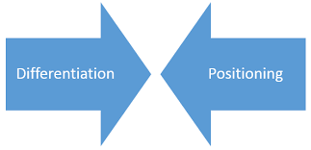

The main objective of Differentiation and Positioning is to increase competitive advantage
Differentiation
How to differentiate its market offering versus other products in the market to create superior customer value to the targeted segment
Positioning
  Positioning is arranging for a product to occupy a clear, distinctive, and desirable place relative to competing products in the minds of targeted segment .
  Effective positioning begins with A CLEAR differentiation to occupy a clear, distinctive, and desirable place relative to competing marketing offerings.
  Which creates superior customer value, makes a product unique, helps to stand out from the rest and persuades targeted segment to consider it as a distinct offering.
Notes:
After a company has decided which market segments to enter, it must determine how to differentiate its market offering for each targeted segment and what positions it wants to occupy in those segments. Positioning is arranging for a product to occupy a clear, distinctive, and desirable place relative to competing products in the minds of target consumers.
Effective positioning begins with differentiation. This refers to actually differentiating the market offering to create superior customer value. Once the company has chosen a desired position, it must take strong steps to deliver and communicate that position to target consumers. The company’s entire marketing program should support the chosen positioning strategy.
The main objective of differentiation strategy is to increase competitive advantage.

Slide 37
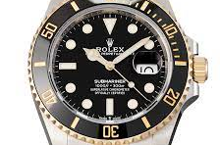


Product position
Is the way a product is defined by consumers on 2 attributes:
  Quality
  Price

Slide 38
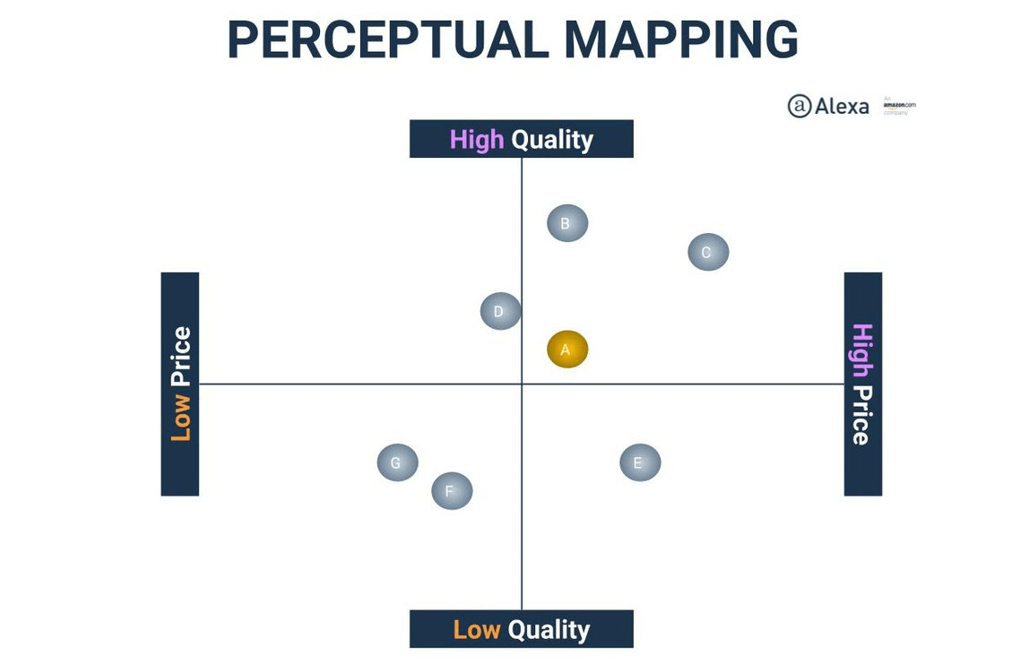
Perceptual Mapping
Perceptual mapping is a visual representation of where a brand, product, or service stands among competitors. It is also known as positional mapping.
generally, consists of two key attributes as a basis (e.g., price and quality)
Marketers chose the attributes want to focus on, then position the brands, products, or services using these attributes.
Notes:
Beyond deciding which segments of the market it will target, the company must decide on a value proposition—how it will create differentiated value for targeted segments and what positions it wants to occupy in those segments. A product position is the way a product is defined by consumers on important attributes—the place the product occupies in consumers’ minds relative to competing products.

Slide 39
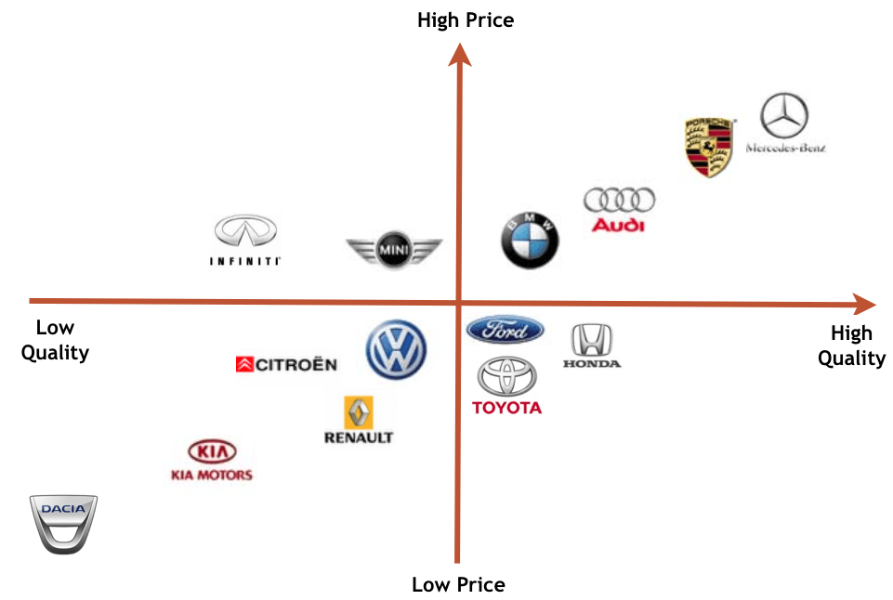

الخريطة ذهنية لموقع المنتجPerceptual mapping
هو تمثيل مرئي للمكان الذي تقف فيه العلامة التجارية أو المنتج أو الخدمة بين المنافسين.
يخطط المسوقون لاستراتيجيات التمايز /التموضع على أبعاد الشراء المهمة التي تعطي تصورات المستهلكين عن علاماتهم التجارية مقابل المنتجات المنافسة.
فولفو (الأمان)، مرسيدس (المكانة الاجتماعية)، BMW (الأداء و الرفاهية )، تويوتا (اقتصادية) لادا الروسية (الصلابة والقوة)، وهكذا..
Notes:
Perceptual mapping is a visual representation of where a brand, product, or service stands among competitors. It is also known as positional mapping.
generally, consists of two key attributes as a basis (e.g., price and quality)
Marketers chose the attributes want to focus on, then position the brands, products, or services using these attributes.
Beyond deciding which segments of the market it will target, the company must decide on a value proposition—how it will create differentiated value for targeted segments and what positions it wants to occupy in those segments. A product position is the way a product is defined by consumers on important attributes—the place the product occupies in consumers’ minds relative to competing products.
Marketers prepare perceptual positioning maps that show consumer perceptions of their brands versus those of competing products on important buying dimensions to plan their differentiation and positioning strategies.
This figure shows a positioning map for the U.S. large luxury SUV market. The position of each circle on the map indicates the brand’s perceived positioning on two dimensions: price and orientation (luxury versus performance). The size of each circle indicates the brand’s relative market share.
شركات بتطور خرايط الصور الذهنية – Positioning maps، واللى فيها بتقارن بين الشركات فى السوق، والمقارنة بتكون على أسس زى الكفاءة – الرفاهية – الامكانيات – الخصائص والمزايا - ... فى مقابل السعر، وغالباً الخريطة بيكون فيها حجم النصيب السوقى لكل شركة فى مقارنة مع الشركات المنافسة، زى ما موجود فى الشكل ده اللى بيقارن الشركات على حسب الفخامة – الكفاءة مع السعر، وحجم الشركة على الخريطة بيدل على النصيب السوقى اللى بتملكه فى
السوق.

Slide 40
Perceptual MAP examples
Marketers plan their differentiation and positioning strategies on a perceptual positioning mapping that gives consumer perceptions of their brands versus those of competing products on important buying dimensions.
Notes:
Marketers prepare perceptual positioning maps that show consumer perceptions of their brands versus those of competing products on important buying dimensions to plan their differentiation and positioning strategies.
This figure shows a positioning map for the U.S. large luxury SUV market. The position of each circle on the map indicates the brand’s perceived positioning on two dimensions: price and orientation (luxury versus performance). The size of each circle indicates the brand’s relative market share.

Slide 41
Choosing a Differentiation and Positioning Strategy
Identifying which Differences attribute to Promote
1
Identifying Competitive Advantages
2
developing the unique value proposition
3
Developing a Positioning Statement
4
Communicating and Delivering the Chosen Position
5
Notes:
The differentiation and positioning task consists of three steps, which include identifying a set of differentiating competitive advantages on which to build a position, choosing the right competitive advantages, and selecting an overall positioning strategy. The company must then effectively communicate and deliver the chosen position to the market.
The following slides discuss each of these steps in greater detail.

Slide 42

Identifying which Differences to Promote
1
Important. The difference delivers a highly valued benefit to target buyers.
Distinctive. Competitors do not offer the difference, or the company can offer it in a more distinctive way.
Superior. The difference is superior to other ways that customers might obtain the same benefit.
Communicable. The difference is communicable and visible to buyers.
Preemptive. Competitors cannot easily copy the difference.
Affordable. Buyers can afford to pay for the difference.
Profitable. The company can introduce the difference profitably.
Notes:
Each brand difference has the potential to create company costs as well as customer benefits. A difference is worth establishing to the extent that it satisfies the criteria of being important, distinctive, superior, communicable, preemptive, affordable, and profitable.
Important. The difference delivers a highly valued benefit to target buyers.
Distinctive. Competitors do not offer the difference, or the company can offer it in a more distinctive way.
Superior. The difference is superior to other ways that customers might obtain the same benefit.
Communicable. The difference is communicable and visible to buyers.
Preemptive. Competitors cannot easily copy the difference.
Affordable. Buyers can afford to pay for the difference.
Profitable. The company can introduce the difference profitably.

Slide 43



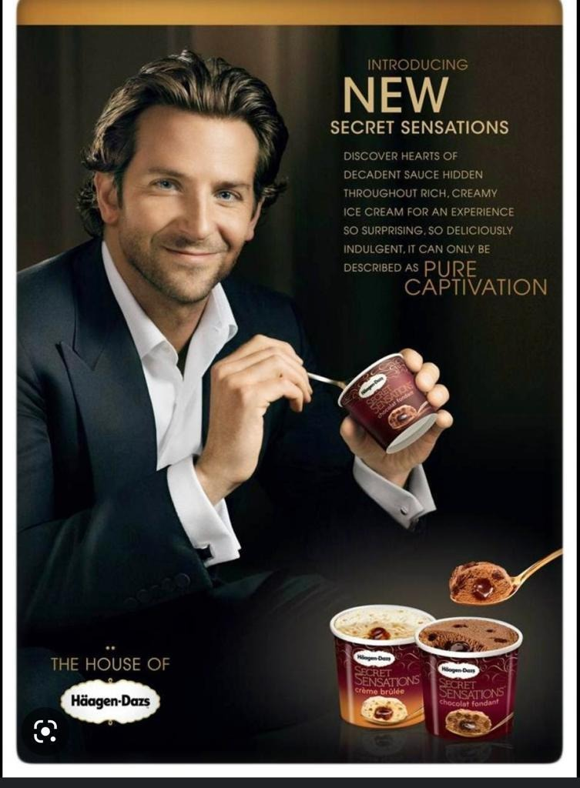


Identifying which Differences to Promote
أحيانا يختار روّاد السوق عرض قيمه يعتمد علي ميزه منافسه موجهه للعميل بكلمات مميزه مثل كلمة (أول)، مثلا كلينكس هي أول مناديل ورقية، و زيروكس هي أول ألة نسخ، و فورد هي أول عربية،
او على أساس كلمات التفضيل الأشهر، اكبر، أصغر، اجمل، اكثر راحة، أكتر امانا اوفر سعرا ،هكذا.....

Slide 44
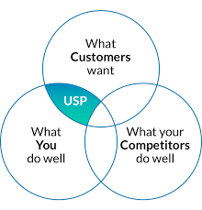
Identifying Competitive Advantages
2
Competitive advantage: An advantage over competitors gained by offering greater customer value for instance:-
  Higher quality
  lower prices
  Uniqueness
Notes:
Competitive advantage refers to an advantage over competitors gained by offering greater customer value, either by having lower prices or providing more benefits that justify higher prices.
To find points of differentiation, marketers must think through the customer’s entire experience with the company’s product or service. Through product differentiation, brands can be differentiated on features, performance, or style and design. Some companies gain services differentiation through speedy, convenient service.
Firms that practice channel differentiation gain competitive advantage through the way they design their channel’s coverage, expertise, and performance. Companies can also gain a strong competitive advantage through people differentiation that is, hiring and training better people than their competitors.
Even when competing offers look the same, buyers may perceive a difference based on company or brand image differentiation. A company or brand image should convey a product’s distinctive benefits and positioning.

Slide 45
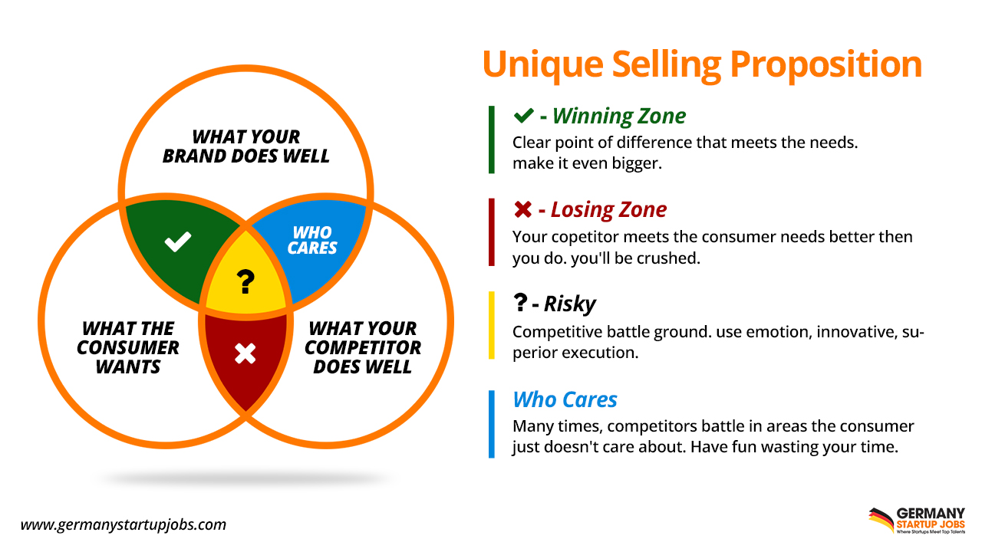
More Understand Competitive Advantages
Extra
Competitive Advantage
unique Selling Proposition
Competitive advantage: refers to an advantage over competitors gained by offering greater customer value, through :
  Providing high quality
  Providing benefits that justify higher prices
  Having lower prices
Notes:
Competitive advantage refers to an advantage over competitors gained by offering greater customer value, either by having lower prices or providing more benefits that justify higher prices.
To find points of differentiation, marketers must think through the customer’s entire experience with the company’s product or service. Through product differentiation, brands can be differentiated on features, performance, or style and design. Some companies gain services differentiation through speedy, convenient service.
Firms that practice channel differentiation gain competitive advantage through the way they design their channel’s coverage, expertise, and performance. Companies can also gain a strong competitive advantage through people differentiation that is, hiring and training better people than their competitors.
Even when competing offers look the same, buyers may perceive a difference based on company or brand image differentiation. A company or brand image should convey a product’s distinctive benefits and positioning.
Identifying Possible Value Differences

Slide 46
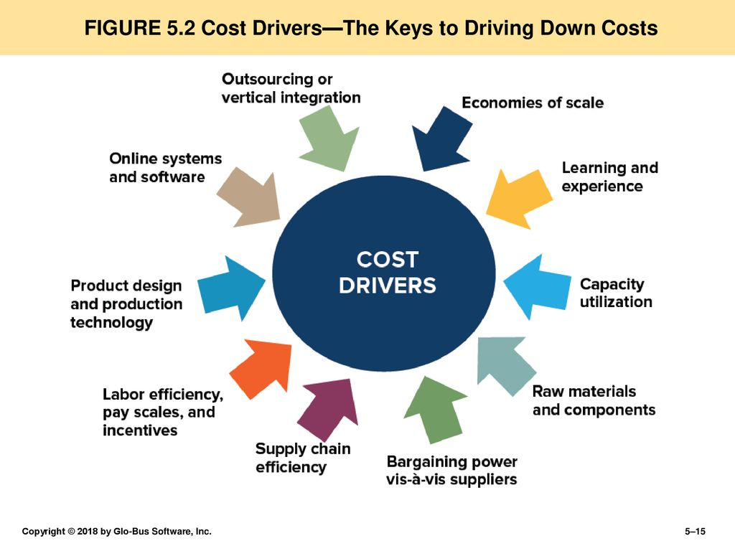
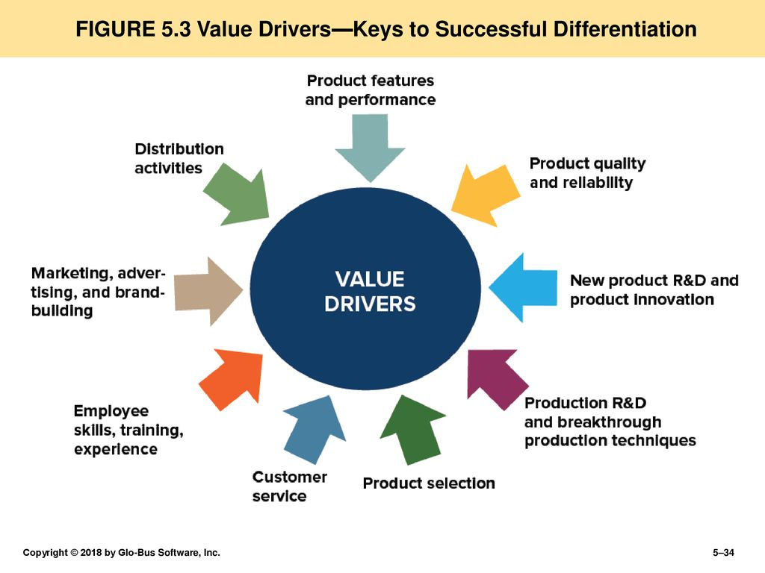
Sources of Competitive Advantages
1
2
Focus
3
Notes:
Competitive advantage refers to an advantage over competitors gained by offering greater customer value, either by having lower prices or providing more benefits that justify higher prices.
To find points of differentiation, marketers must think through the customer’s entire experience with the company’s product or service. Through product differentiation, brands can be differentiated on features, performance, or style and design. Some companies gain services differentiation through speedy, convenient service.
Firms that practice channel differentiation gain competitive advantage through the way they design their channel’s coverage, expertise, and performance. Companies can also gain a strong competitive advantage through people differentiation that is, hiring and training better people than their competitors.
Even when competing offers look the same, buyers may perceive a difference based on company or brand image differentiation. A company or brand image should convey a product’s distinctive benefits and positioning.
Identifying Possible Value Differences

Slide 47


TESLA.
Tesla decided to break into the electric vehicle (EV) marketplace with a luxury sports model. At this time, the electric vehicle market valued economy over form and function. Tesla decided not to compete with the Chevy Volt or Toyota hybrids and instead go after the high-end market.

Slide 48
3
Developing Value Propositions
Notes:
The full positioning of a brand is called the brand’s value proposition. It refers to the full mix of benefits on which a brand is differentiated and positioned.
This figure shows possible value propositions on which a company might position its products. The five blue cells on the top and right represent winning value propositions—differentiation and positioning that give the company a competitive advantage. The purple cells at the lower left, however, represent losing value propositions. The center green cell represents at best a marginal proposition.

Slide 49
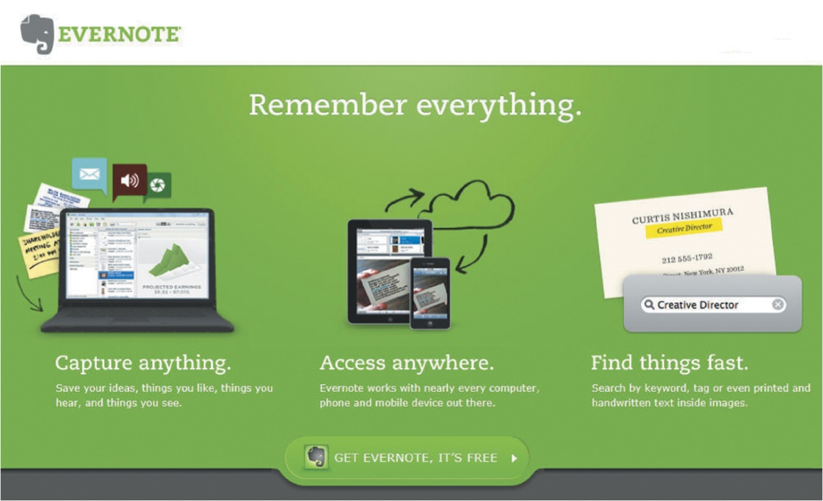
Developing a Positioning Statement
4
Positioning statement: Summarizes company or brand positioning
Format: To (target segment and need) our (brand) is (concept) that (point of difference).
“To busy multitaskers who need help remembering things,
Evernote is a digital content management application that
makes it easy to capture and remember moments and ideas
from your everyday life using your computer, phone, tablet, and the Web.”
Notes:
Placing a brand in a specific category suggests similarities that it might share with other products in the category. But the case for the brand’s superiority is made on its points of difference.
A positioning statement refers to a statement that summarizes a company or brand positioning using this form: To (target segment and need) our (brand) is (concept) that (point of difference).
An example using the popular digital information management application, Evernote, is shown on the next slide.
A positioning statement refers to a statement that summarizes a company or brand positioning using this form: To (target segment and need) our (brand) is (concept) that (point of difference).
Here is an example using the popular digital information management application Evernote: “To busy multitaskers who need help remembering things, Evernote is a digital content management application that makes it easy to capture and remember moments and ideas from your everyday life using your computer, phone, tablet, and the Web.”

Slide 50
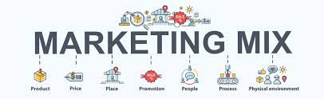
Communicating and Delivering the Chosen Position
5
All the company’s marketing mix efforts must support the positioning strategy.
Maintain the position obtained through consistent performance and communication.
The product’s position should be monitored and adapted over time.
Notes:
Once it has chosen a position, the company must take strong steps to deliver and communicate the desired position to its target consumers. All the company’s marketing mix efforts must support the positioning strategy. Companies often find it easier to come up with a good positioning strategy than to implement it.
Once a company has built the desired position, it must take care to maintain the position through consistent performance and communication.
It must closely monitor and adapt the position over time to match changes in consumer needs and competitors’ strategies. A product’s position should evolve gradually as it adapts to the ever-changing marketing environment.
Many marketers think that companies should aggressively promote only one benefit to the target market. A company should develop a unique selling proposition (USP) for each brand and stick to it. Each brand should pick an attribute and tout itself as “number one” on that attribute. Other marketers think that companies should position themselves on more than one differentiator. Today, in a time when the mass market is fragmenting into many small segments, companies and brands are trying to broaden their positioning strategies to appeal to more segments.

Slide 51



Developing a Positioning Statement
4
Uber positions itself as “Everyone’s private driver.”
Sonos does more than just sell speakers; it unleashes “All the
music on earth, in every room of your house, wirelessly.”
Notes:
Car sharing service Uber positions itself as “Everyone’s private driver.” This simple statement provides the backbone for its marketing strategy.

Slide 52
Activity #3
Developing a Positioning Statement

Slide 53
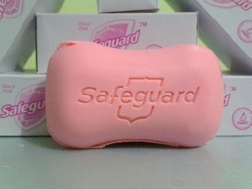
IDETIFY : (target segments and need) our (brand) is (concept) that (point of difference).
for children age range from 5-16 years and to adults’ age range from 24-40 we present Safeguard soap which will provide a 24hrs. Germ protection
as it is the number one antiseptic soap having the highest quality. The only antibacterial soap approved by the FDA.
Safeguard’s positioning

Slide 54
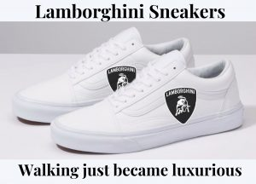

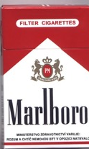
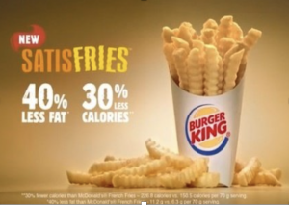
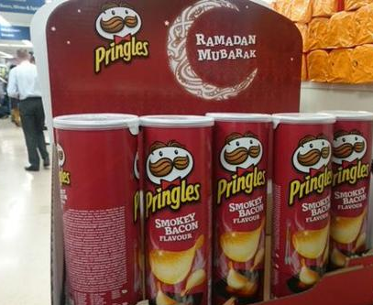
Positioning Errors
Extra
There are various positioning errors, such as-
Under positioning
Over positioning
Confused positioning
Double Positioning
Irrelevant Positioning
Notes:
As companies increase the number of claims for their brands, they risk disbelief and a loss of clear positioning
Underpositioning
Failing ever to position the company at all
Overpositioning
Giving buyers too narrow a picture of the company
Confused positioning
Leaving buyers with a confused image of a company

Slide 55
Repositioning
Extra
brand repositioning strategy is not a complete remake of company’s identity it’s a calculated adjustment aiming for a new path forward especially when growth has stalled, or to keep up with evolving customer needs.
Key brand repositioning Reasons:
  The future position may become very competitive
  Change in customer needs
  downward trend in sales
  A shrinking core audience
  Industry shakeups (new technology, new business models, new competitors)
  A disconnect between marketing and the customers
  Product line updates that are out of sync with your old brand promise
  An outdated value proposition for the current culture or market
  Lack of brand appeal to younger generations
  Need to pivot away from brand confusion or negative associations

Slide 56
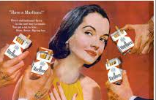
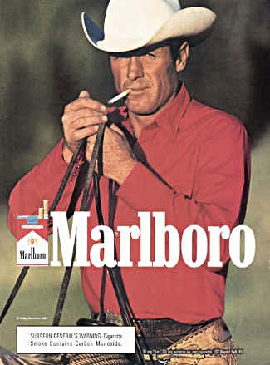
Repositioning EX1
Extra
Marlboro cigarettes was positioned as a women’s cigarette when it was first introduced – complete with a red-tipped filter to hide lipstick stain.
Marlboro adjusted its image as a male product complete with the “macho” Marlboro cowboy, where The brand really took off.

Slide 57


Repositioning EX2
Extra
كولونيا 5 خمسات في زمن كورونا.. "مطهر مش ريحة" والشراء بالدور

Slide 58


Slide 59
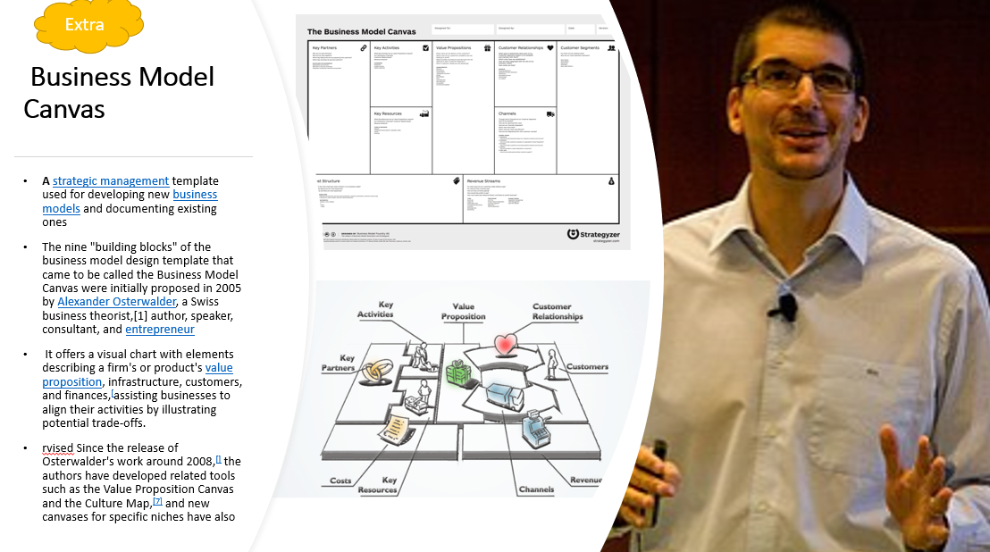

Slide 60


How could we earn revenues
if we had to offer our best
selling product or services
for free?
1ST Question
كيف يمكننا كسب المال اذا عرضنا أهم منتجاتنا/خدماتنا
بشكل مجاني للعميل؟

Slide 61

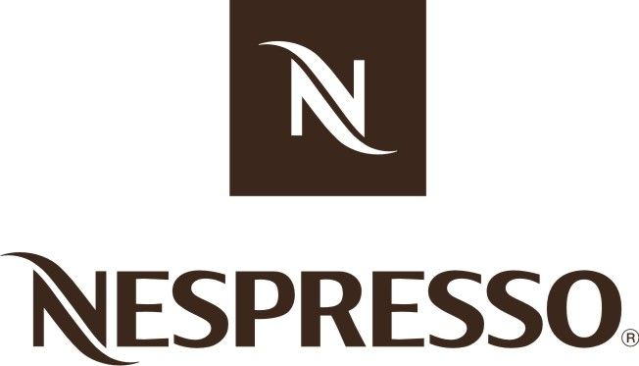


How could we generate more
recurring revenue?
2ND Question
كيف يمكننا كسب دخل متكرر (اشتراك – شراء متكرر – ايجار)

Slide 62




How could we get others
to create value for us (for free)?
(one billion Facebook user work for FB for free)
3RD Question
كيف يمكننا الاستفادة من الآخرين لتحقيق وخلق قيمة مهمة لنا (مجانًا)؟
(مليار مستخدم لـFacebook يعملون لصالحة مجانًا)

Slide 63

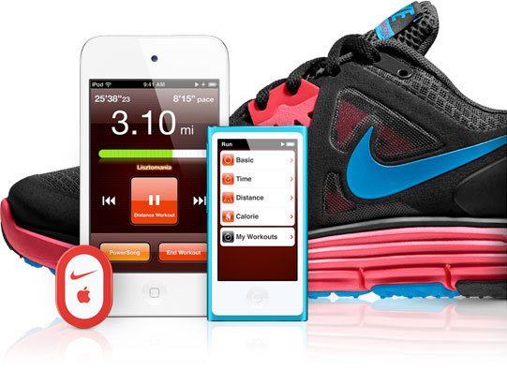
Which strategic partner
could we work with to
leverage or expand
our business model?
(think of NIKE/Apple listen to music while running)
4TH Question
أي شريك استراتيجي يمكننا العمل معه لتحسين نموذج أعمالنا أو توسيعه؟
(فكر في NIKE / Apple للاستماع إلى الموسيقى أثناء الجري)

Slide 64

How could we achieve more
scalability in your business model?
(as few limitations as possible)
5TH Question
كيف يمكننا ضمان القابلية للتوسع في نموذج عملكم من الآن ؟
(أقل عدد ممكن من القيود)

Slide 65



How could we dramatically
increase switching cost?
(the cost of leaving us to another competitor
Mercedes - coca cola)?
6TH Question
كيف يمكننا رفع تكلفة الانتقال الي المنافس بشكل كبير ؟
(تكلفة تركنا لمنافس آخر - مرسيدس - كوكا كولا)؟
طبيعي أي خدمه بتنزل جديده بعد فتره قصيره بيتم تقليدها وتكرارها في السوق

Slide 66


For which segments other than
your usual ones could you develop
a value proposition and expand
our business model?
7TH Question
لأي قطاعات من العملاء بخلاف عملائنا المعتادين
يمكنك تطوير القيمة المقدمة له وتوسيع نموذج أعمالنا؟
Self checkout software
Super markets
Market researchers
Enterprize & Vendors

Slide 67


Around which assets could we
build a platform business
(apple app store)
8TH Question
أي من منتجاتنا / خدماتنا نستطيع بناء منصة عمل حولها ؟

Slide 68



