Slide 1
Strategic marketing

Slide 2
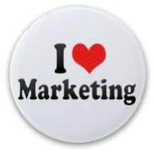
Strategic marketing
Lecture #1

Slide 4
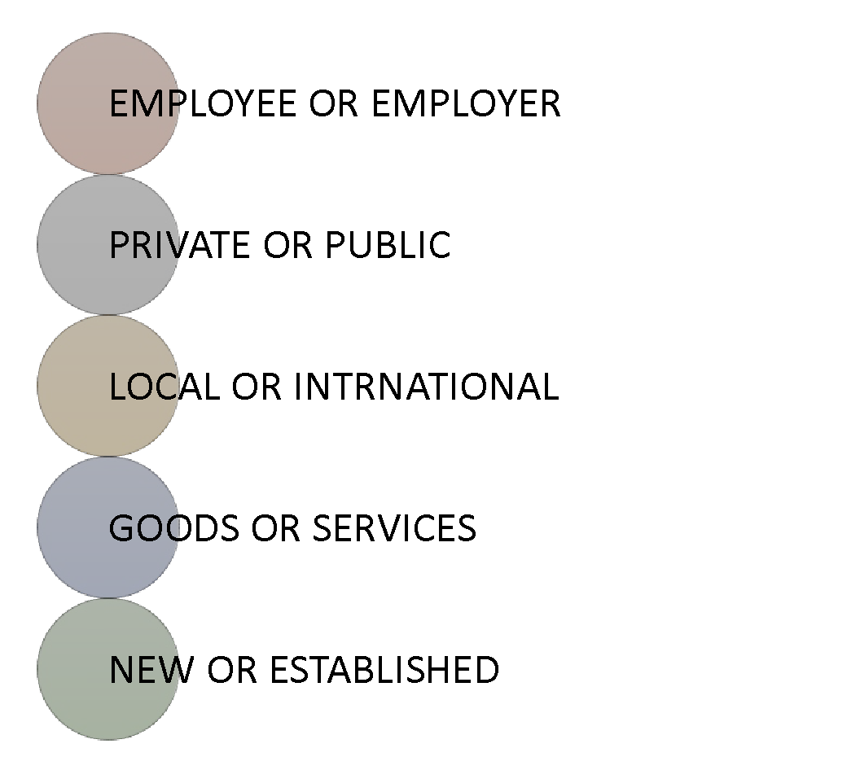
WHY TO STUDY STARTEGIC MARKETING?
It is the core of success for anyone , and We are all concerned.
Very important to integrate and reinforce other MBA modules as economics, int business , finance, management and HR.
Very informative module that redefines many perceptions and improves business acumen.

Slide 5
HOW TO STUDY STRATEGIC MARKETING?
Total Hours
27 Hrs.
Marketing understanding
PROCESS & MANAGEMENT
Pass final EXAM
Future Success
Number Of Lectures:
9 Lectures
Lecture Duration 3 hours

Slide 6
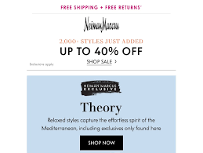
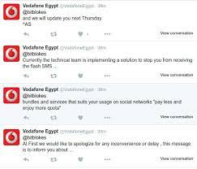
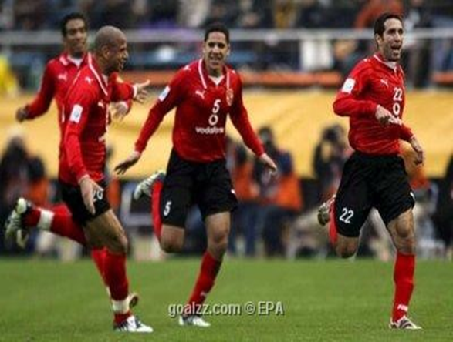
WHAT is Marketing
Marketing is all about customers how to find, engage , retain, and manage profitable relationships with customer
Notes:
Today, marketing must be understood not in the old sense of making a sale—“telling and selling”—but in the new sense of satisfying customer needs.
In the traditional form, marketing is seen in abundance at shopping malls and in magazine, television, and direct-mail advertisements. Therefore, marketing in the old sense refers to making a sale—“telling and selling.”
In the contemporary form, marketers have assembled a host of new marketing approaches—imaginative Web sites, mobile phone apps, blogs, online videos, and social media. Thus, marketing in the new sense involves satisfying customer needs.
There is much more to marketing than meets the consumer’s casual eye. Behind it all is a massive network of people, technologies, and activities competing for your attention and purchases.

Slide 7
FORMS OF MARKETING
Traditional
Telling and selling”—Making a sale
Products availability in the nearby shopping centres
Television, magazine, and printed ads
Contemporary
Understanding and Satisfying customer needs
Imaginative Web sites and mobile phone apps, blogs, online videos, and social media
Reach customers directly, personally, and interactively
Strategic marketing
Strategic Marketing is the way a firm effectively differentiates itself from its competitors by capitalizing on its strengths to provide consistently better value to customers than its competitors.
Strategic marketer should answer key questions; where and how should the business compete.
Notes:
Today, marketing must be understood not in the old sense of making a sale—“telling and selling”—but in the new sense of satisfying customer needs.
In the traditional form, marketing is seen in abundance at shopping malls and in magazine, television, and direct-mail advertisements. Therefore, marketing in the old sense refers to making a sale—“telling and selling.”
In the contemporary form, marketers have assembled a host of new marketing approaches—imaginative Web sites, mobile phone apps, blogs, online videos, and social media. Thus, marketing in the new sense involves satisfying customer needs.
There is much more to marketing than meets the consumer’s casual eye. Behind it all is a massive network of people, technologies, and activities competing for your attention and purchases.
must find the game plan for long-run survival and growth that makes the most sense given its specific situation, opportunities, objectives, and resources.
-

Slide 8
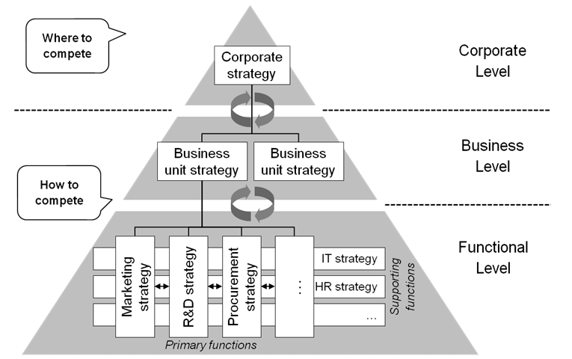
Strategic Marketing IS a Key Success Factors for business
Strategic Focus
People
Marketing
Finances
Operations
Notes:
Strategic Focus (Leadership, Management, Planning)
People (Personnel, Staff, Learning, Development)
Marketing (Customer Relations, Sales, Responsiveness)
Operations (Processes, Work)
Finances (Assets, Facilities, Equipment

Slide 9
IS MARKETING ART OR SINCE ?
Marketing is The art and science of finding, engaging , retaining, and managing profitable relationships with customer
Marketing as a science has
A Marketing process
A Marketing management
A marketing Plan

Slide 10
1- THE MARKETING PROCESS
1
2
3
4
5
The marketing process involves five steps., The first four steps create value for customers. First the final step, the company reaps the rewards of strong customer
understand the marketplace and customer needs and wants.
design a customer value-driven marketing strategy with the goal of getting, engaging, and growing target customers.
construct a marketing programs that deliver superior value.
Engaging customers, building profitable customer relationships, and creating customer delight
capturing value from customers.
Notes:
This important figure shows marketing in a nutshell. By creating value for customers, marketers capture value from customers in return. This five-step process forms the marketing framework for the rest of the chapter and the remainder of the text.
This figure presents a simple, five-step model of the marketing process for creating and capturing customer value. In the first four steps, companies work to understand consumers, create customer value, and build strong customer relationships. In the final step, companies reap the rewards of creating superior customer value. The rewards are in the form of sales, profits, and long-term customer equity.

Slide 11
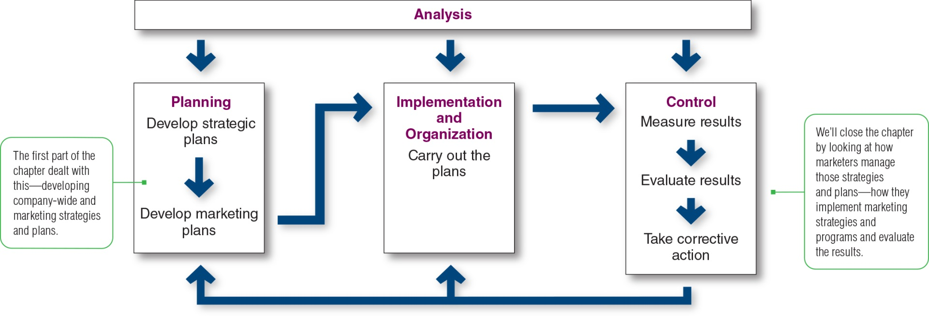
2- THE MARKETING MANAGEMENT
Analysis of the situation internally and externally provides the information and evaluations needed for planning phase.
Planning develops company-wide strategic plans and translates them into marketing plans for each division, product, and brand.
Implementation, turns the plans into actions.
Control consists of measuring and evaluating the results of marketing activities and taking corrective action where needed.
Notes:
Managing the marketing process requires the four marketing management functions as illustrated in this figure.
They include analysis, planning, implementation, and control.
The company first develops company-wide strategic plans and then translates them into marketing and other plans for each division, product, and brand.
Through implementation, the company turns the plans into actions.
Control consists of measuring and evaluating the results of marketing activities and taking corrective action where needed.
Finally, marketing analysis provides the information and evaluations needed for all the other marketing activities.

Slide 12
MARKETING PROCESS VS MARKETING MANAGEMENT
1
2
3
4
5
marketing process 5-steps model for creating and capturing customer value.
1
2
3
4
marketing Management 4- management functions:
analysis, planning, implementation, and control

Slide 13
PROCESS VS MANAGEMENT

Slide 14
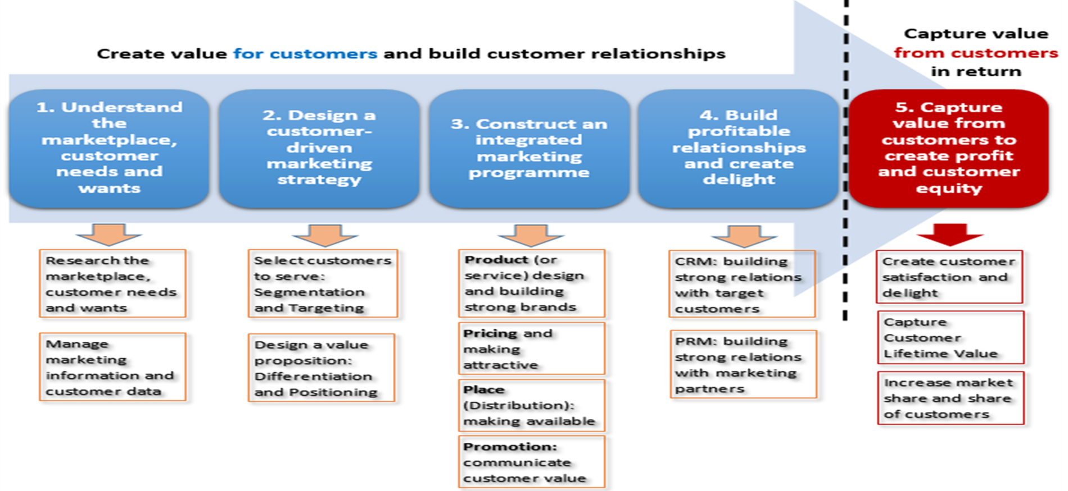
THE MARKETING PROCESS, EXPANDED .
1
2
3
4
- consumer buyer behaviour and consumer markets
- Business Buyer Behaviour and Business Markets
Needs and wants
Marketplace
Market offering
Strategic marketing analysis
Big data and MIS
Grand marketing strategies competitive and growth
STP strategies
Differentiation and branding
Marketing MIX
4Ps
CRM tools and systems
CUSTOMER RELATIONSHIP GROUPS
Marketing control
Notes:
The Marketing Process
In the first four steps, companies work to understand consumers, create customer value, and build strong customer relationships
In the final step, companies reap the rewards of creating superior customer value
By creating value for customers, companies are able capture value from customers in the form of sales, profits, and long-term customer equity

Slide 15
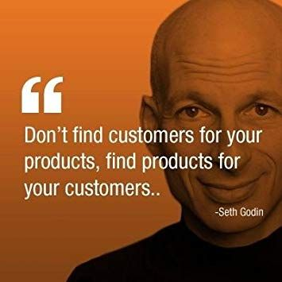
1- Understanding customer needs/wants.
Seth W. Godin is an American author and former dot com business executive.
Godin is the author of many books.
Free Prize Inside was a Forbes Business Book of the Year in 2004
Purple Cow sold over 150,000 copies in more than 23 print runs in its first two years
The Dip was a Business Week and New York Times bestseller.

Slide 16
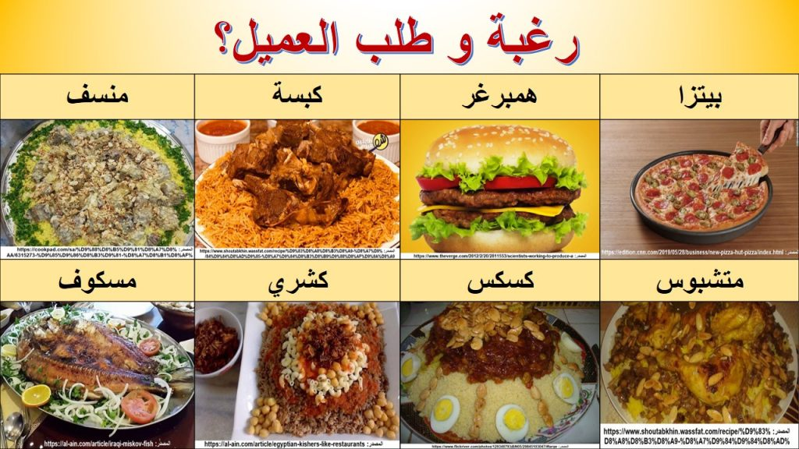
المفاهيم الأساسية للتسويق
فهم السوق واحتياجات العملاء ورغباتهم
العملاء يبحثون عن الحلول، وليس عن المنتجات
الاحتياجات: الاحتياجات الإنسانية الأساسية والمتمثلة في الهواء والغذاء والمياه والملبس والمأوى.
الرغبات: هي منتجات محددة قد تشبع الاحتياجات بناء علي مجتمعنا
الطلبات: هي الرغبة لشراء منتجات معينة مع وجود القدرة على الشراء
كثير من الناس يريدون سيارة مرسيدس. فقط عدد قليل يمكنهم شراء واحدة. يجب على الشركات قياس عدد الأشخاص الذين يريدون منتجهم ، ولكن أيضا عدد الأشخاص الراغبين والقادرين على شرائه.
عروض التسويق: هي منتجات تلبي احتياجات العملاء
Notes:
A U.S. consumer needs food but may want a Chicago-style “deep-dish” pizza and a craft beer. A person in Afghanistan needs food but may want rice, lamb, and carrots. Our wants are shaped by our society. Many people want a Mercedes; only a few c
an buy one. Companies must measure not only how many people want their product, but also how many are willing and able to buy it.

Slide 17
CONSUMERS’ NEEDS, WANTS, AND DEMANDS?
Feeling
Needs - state of felt deprivation including physical, social, and individual needs i.e hunger
Wants - form that a human need takes as shaped by culture and individual personality i.e. bread
Demands - human wants backed by buying power i.e. money= ordering
Definitive Desire
ability to act
Notes:
As a first step, marketers need to understand customer needs and wants and the marketplace within which they operate.
Needs
A human need is a state of felt deprivation
Included are:
The basic physical needs for food, clothing, warmth, and safety
Social needs for belonging, affection, fun, and relaxation
Esteem needs for prestige, recognition, and fame
Individual needs for knowledge and self-expression
Wants
The form human needs take as they are shaped by culture and individual personality
As a society evolves, the wants of its members expand
Be careful not to confuse wants with needs
For example: a manufacturer of drill bits may think that customers need a drill bit, but what the customers really need is a hole (aka "marketing myopia")
Demands
People have almost unlimited wants, but limited resources
Therefore, wants become demands when backed by buying power

Slide 18
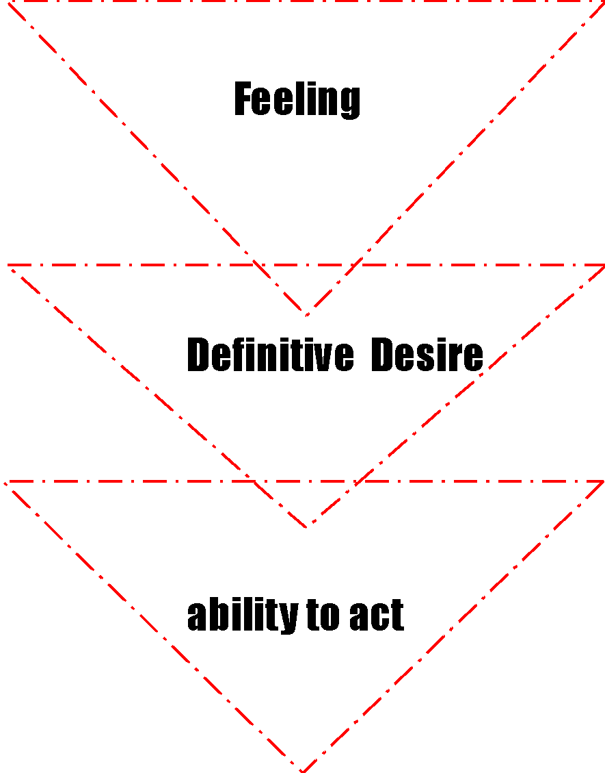
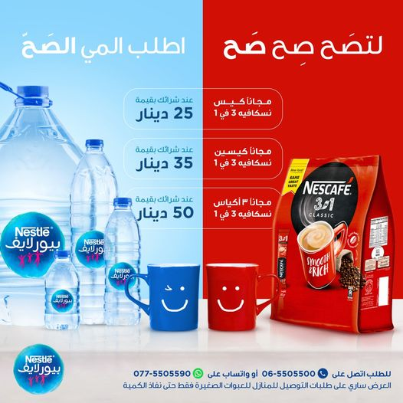
Notes:
As a first step, marketers need to understand customer needs and wants and the marketplace within which they operate.
Needs
A human need is a state of felt deprivation
Included are:
The basic physical needs for food, clothing, warmth, and safety
Social needs for belonging, affection, fun, and relaxation
Esteem needs for prestige, recognition, and fame
Individual needs for knowledge and self-expression
Wants
The form human needs take as they are shaped by culture and individual personality
As a society evolves, the wants of its members expand
Be careful not to confuse wants with needs
For example: a manufacturer of drill bits may think that customers need a drill bit, but what the customers really need is a hole (aka "marketing myopia")
Demands
People have almost unlimited wants, but limited resources
Therefore, wants become demands when backed by buying power

Slide 19
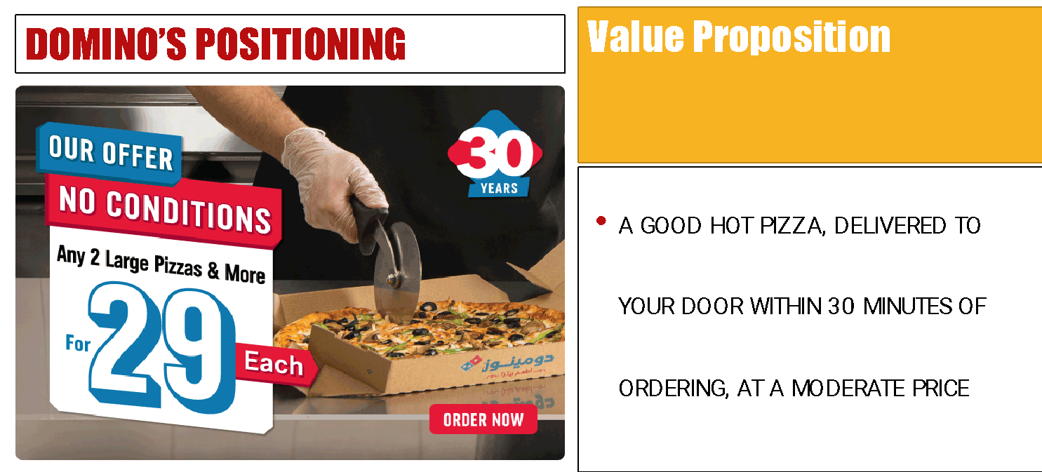
MARKETING OFFERINGS
Product that fulfills Customer needs
products are goods or services could be Events, Persons, Places, Organizations, and or Ideas.
Sometimes customer needs are fulfilled through Hybrid, products combination of tangible goods and intangible services. such as a cell phones, with an internet Services,
The firm can succeed only if consumers see a need that its product can solve, become aware of the product and its capabilities, decide that it is the best available solution, proceed to buy it, and become satisfied with the result of the purchase.
Notes:
A market offering includes much more than just physical goods or services. Consumers decide which events to experience, which tourist destinations to visit, which hotels to stay in, and which restaurants to patronize. To the consumer these are all products.

Slide 20
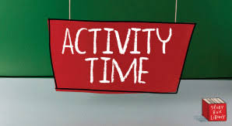
Activity #1

Slide 21
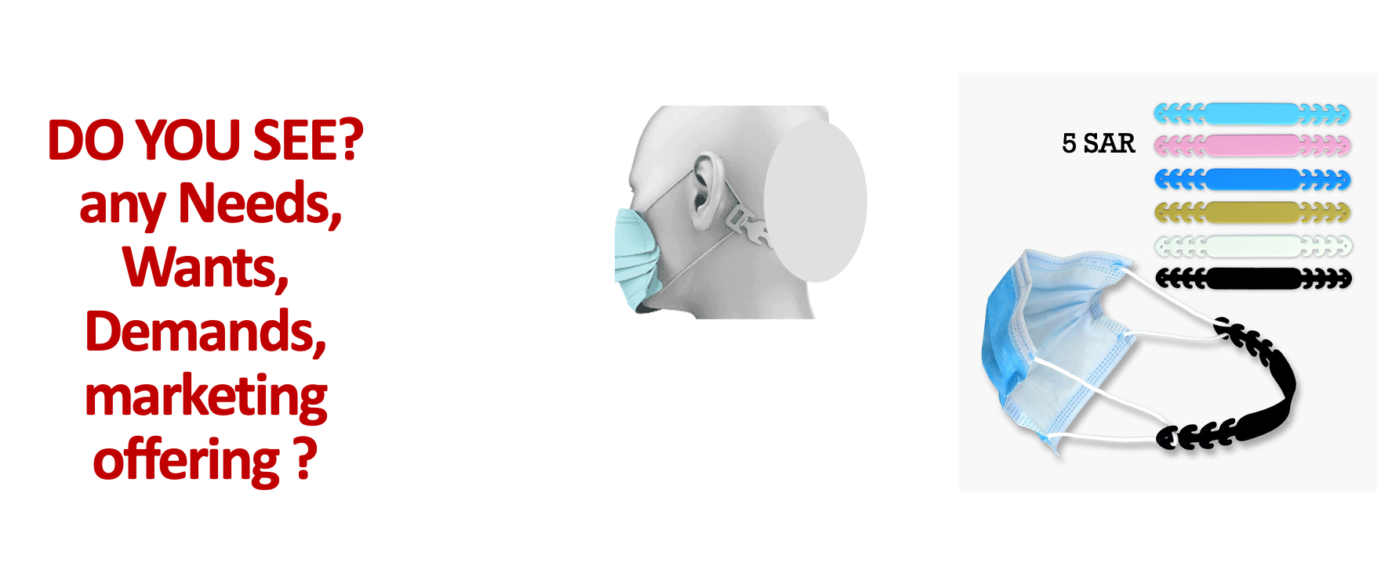

Slide 23
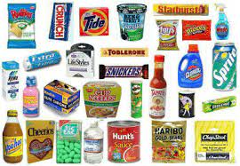
UNDERSTANDING GOODS
Goods is anything tangible that can be offered to a market to satisfy a want or need and it is accompanied by use, consumption, and ownership.

Slide 24
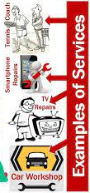
UNDERSTANDING SERVICES
SERVICE is anything intangible that can be offered to satisfy a want or need and do not result in the ownership.
Examples include:
Hospital
Insurance
Internet
Barber shop

Slide 25
Activity #2

Slide 28
UNDERSTANDING MARKETPLACE

Slide 29
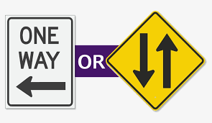
Does the Marketing Offerings are a one-way communication ! exchange? relationship? Where does this happen?
UNDERSTANDING MARKETPLACE.

Slide 30
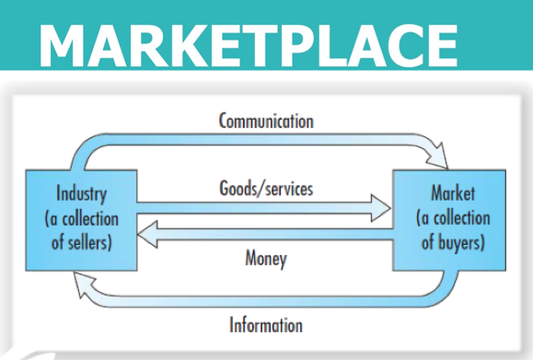
MARKETING IS ALL ABOUT EXCHANGE RELATIONSHIPS WITH TARGET AUDIENCES
Marketing consists of actions taken to create, maintain, and grow desirable exchange relationships with target audiences .
Exchange is the act of obtaining a desired object by offering something in return.
Strong relationships are built by consistently delivering superior customer value.
All the above interactions took place in the marketplace
Notes:
Marketing occurs when people decide to satisfy their needs and wants through exchange relationships. Exchange is the act of obtaining a desired object from someone by offering something in return.
Marketing consists of actions taken to create, maintain, and grow desirable exchange relationships with target audiences involving a product, service, idea, or other object. Companies want to build strong relationships by consistently delivering superior customer value.
In the broadest sense, the marketer tries to bring about a response to some market offering. The response may be more than simply buying or trading products and services. For example, a political candidate wants votes; a church wants membership; an orchestra wants an audience; and a social action group wants idea acceptance.

Slide 31
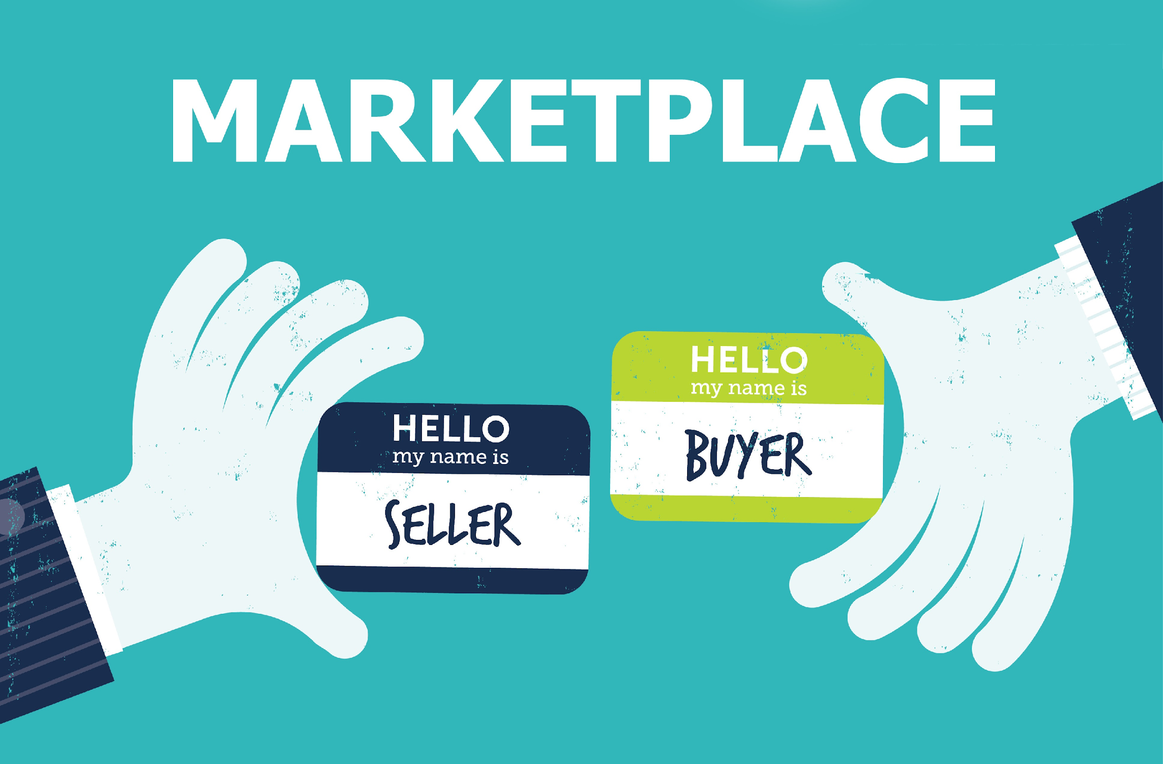
WHAT IS THE MARKETPLACE?
A marketplace is any location, whether in person or online, that facilitates the exchange of goods between buyers and sellers where transactions happen in both directions.

Slide 32
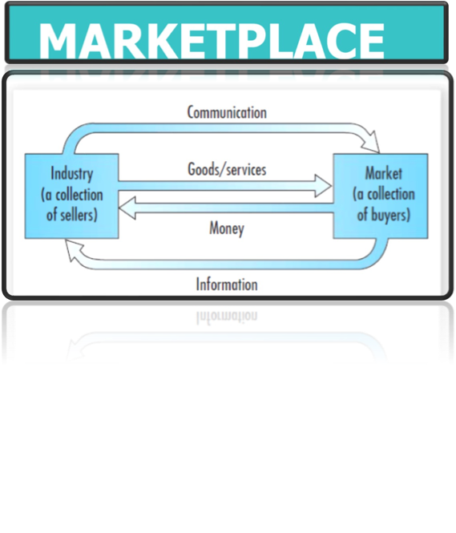
WHAT IS THE MARKETING ENVIRONMENT ?

Slide 33
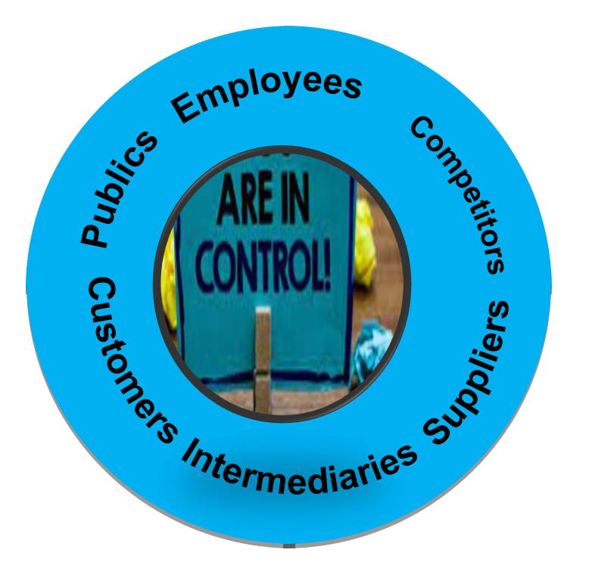
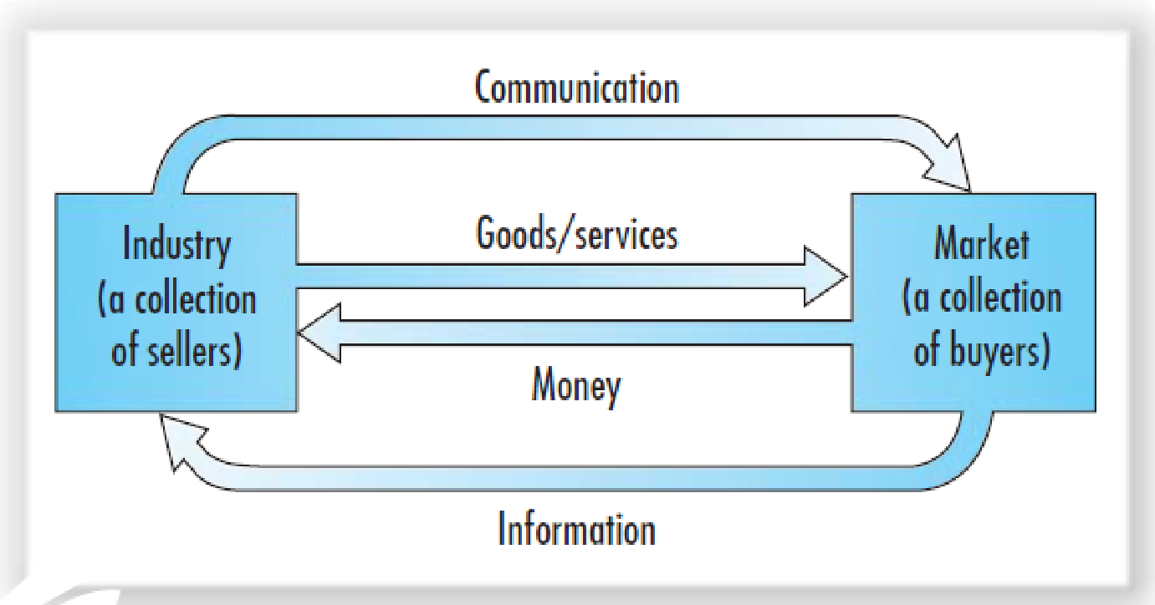
WHAT IS THE MARKETING MICROENVIRONMENT
Intermediaries = Distributors~ subagents ~wholesalers ~Broker
Public = PBULIC RELATION

Slide 34
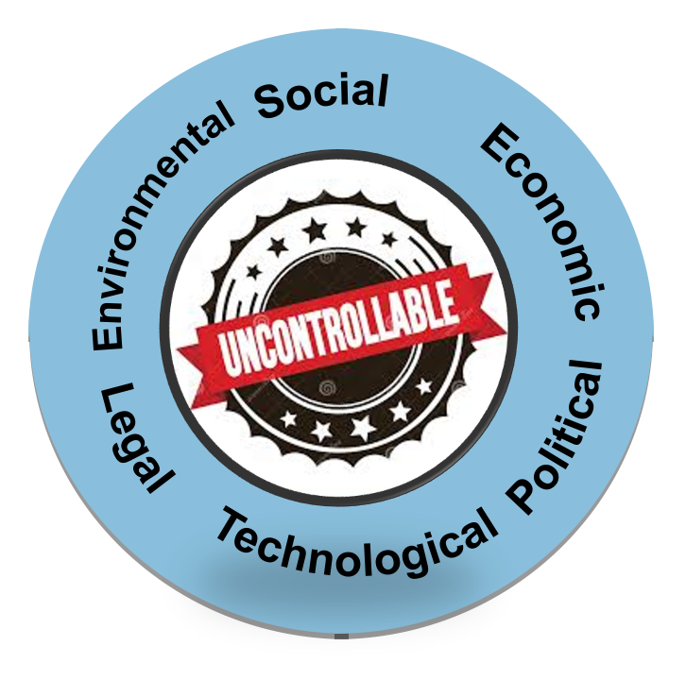
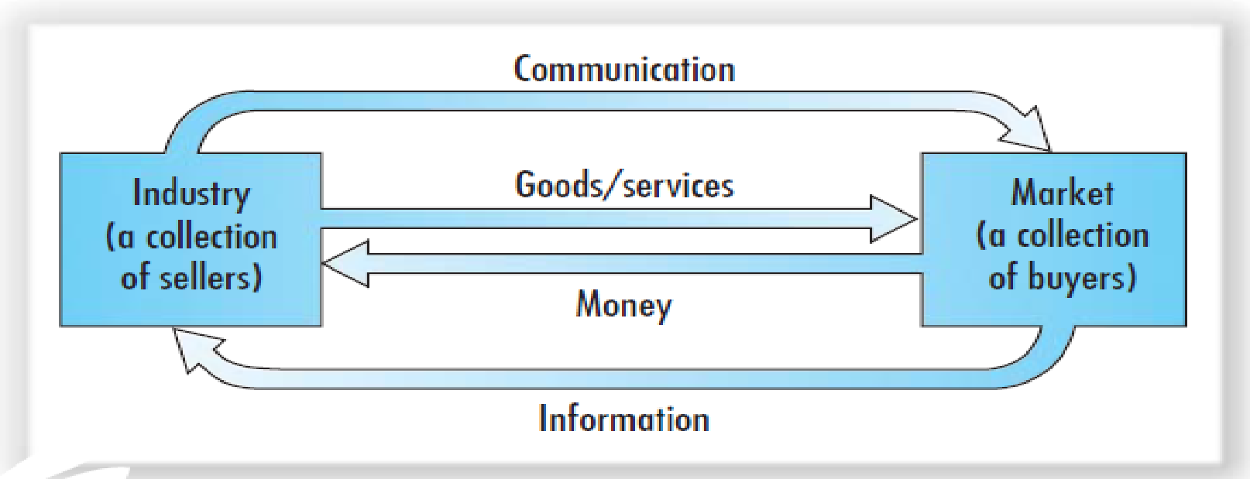
WHAT IS THE MARKETING MACROENVIRONMENT
PESTLE analysis= Macroenvironmental analysis = Political, Economic, Social, Technological, Legal and Environmental

Slide 35
- Firms operate within an unpredictable and dynamic Marketing environment. - This dynamic has an impact on organization, customers, and their relationship.
WHY IT IS IMPORTANT TO STUDY THE MARKETING ENVIRONMENT?
Notes:
Strategic Marketing is a systematic process that enables organizational to achieving vision mission and goals
Continuous process of assessing , determining the needs and wants of target markets and delivering desired satisfactions more effectively and efficiently than competitors.

Slide 36
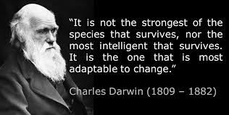
What is The goal of strategic marketing?
The goal of strategic marketing is to cope with dynamic Marketing environment It is the task of the marketing is to put a Continuous process of assessing , determining, the needs and wants of target markets and to link the resources of the organization to the requirements of customers, delivering desired satisfactions more effectively and efficiently than competitors.
Notes:
Strategic Marketing is a systematic process that enables organizational to achieving vision mission and goals
Continuous process of assessing , determining the needs and wants of target markets and delivering desired satisfactions more effectively and efficiently than competitors.

Slide 37
Strategic Marketing & strategic planning
THE MARKETPLACE , THE CUSTOMER NEEDS AND THE MARKETING ENVIORNEMNT ARE IN CONTINOUS CHANGING
Strategic planning & Strategic Marketing should be aligned to adapt to such change and consistently providing better value to customers than its competitors.
First company executives decides the vision and mission based on firm’s capabilities and aspirations .
Then the Role of Strategic Marketing is to Answers 2 key questions; where and how should the business compete based on understanding, customers, market , the competitive landscape and the. marketing environment.
Then marketers put a Strategic Marketing Plan that decides.
Where to compete {Which markets to compete in}
how to compete {the firm’s competitive advantage}
At last , taking this marketing planning into implementation , analysis and control .

Slide 38
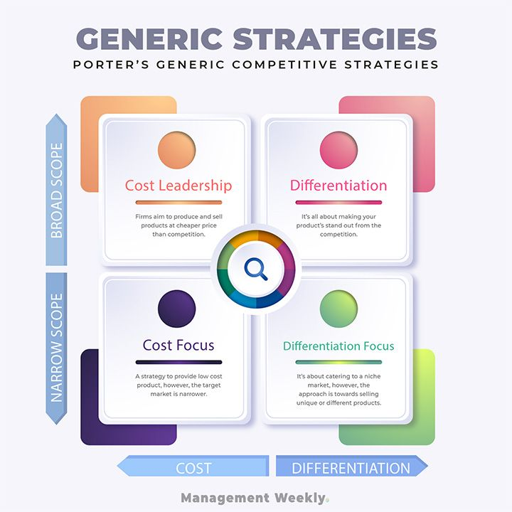
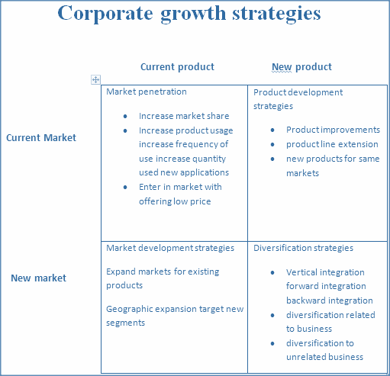
Understand the Startegy
Growth strategy
Corporate strategy refers to the overall strategy used to guide a business.
PORTER’S

Slide 39
Understand the Startegy
Corporate strategy refers to the overall strategy used to guide a business.
Grand strategy
How to grow ?
How to differentiate your self from other ?
General Marketing Strategies, describes how marketing will achieve general objective
S.T.P.
(Where to play ) Which customers will we serve ? (segmentation and targeting)
(How to win ) how will we create value for them?
(differentiation and positioning)
Specific marketing strategies “brand level strategies”
Which products and services levels ?
Where & how customer will find them?
Communication and exchange ?
Marketing Mix

Slide 40
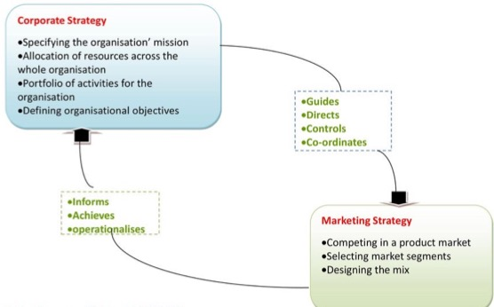
WHAT IS THE RELATIONSHIP BETWEEN CORPORATE STRATEGY & MARKETING STRATEGY
Corporate strategy the overall strategy for the long-term growth of the company, it is broader than marketing strategy, focuses on the business’ high-level objectives
Marketing Strategy a business level strategy to achieve the organization's goals and it definies how a company will target, position, market, and sell its products.
A marketing strategy and a corporate strategy,- should be synchronized to attract, retain and optimize value from customers

Slide 42
Understand STRATEGIC PLANNING
1
2
4
3
4. steps in strategic planning.
defining company’s overall purpose and mission.
The mission is turned into detailed objectives.
Then, decides businesses portfolio of and products.
DECIDING THE STRATEGY per each function
Goal of Strategic Planning is Adapting the firm to take advantage of changing marketing opportunities
Notes:
Companies must find the game plan for long-run survival and growth that makes the most sense given its specific situation, opportunities, objectives, and resources. This is the focus of strategic planning—the process of developing and maintaining a strategic fit between the organization’s goals, capabilities and its changing marketing opportunities.
Strategic planning sets the stage for the rest of planning in the firm. Companies prepare annual plans, long-range plans, and strategic plans. The annual and long-range plans deal with the company’s current businesses and how to keep them going. In contrast, the strategic plan involves adapting the firm to take advantage of opportunities in its constantly changing environment.

Slide 43
INTRODUCTION TO STRATEGIC MARKETING,
VISION STATEMENT
1
DEFINING THE COMPANY MISSION
Vision Statement is A brief description of what a company desires to achieve in the future
Notes:
A mission statement refers to the organization’s purpose. What it wants to accomplish in the larger environment. Forging a sound mission begins with the following questions: What is our business? Who is the customer? What do consumers value? What should our business be? Successful companies continuously raise these questions and answer them carefully and completely.
Mission statements should be market oriented and defined in terms of satisfying basic customer needs.
Mission statements should be meaningful and specific, yet motivating. They should emphasize the company’s strengths and tell forcefully how it intends to win in the marketplace. For example, Google’s mission is to give people a window into the world’s information, wherever it may be found.
Finally, a company’s mission should focus on customers and the customer experience it seeks to create. For example, Buffalo Wild Wings chain’s mission is to provide a total eating and social environment that “fuels the sports fan experience.”

Slide 44
INTRODUCTION TO STRATEGIC MARKETING
MISSION STATEMENT
1
DEFINING THE COMPANY MISSION
Market-Oriented Definition
A purposeful, Statement that specifying what an organization wants to accomplish in the larger environment.
Focus on customers and the customer experience
should be Market oriented—defined in terms of satisfying basic customer needs
should not be product oriented—!
Product-Oriented Definition
We sell coffee and snacks.
Notes:
A mission statement refers to the organization’s purpose. What it wants to accomplish in the larger environment. Forging a sound mission begins with the following questions: What is our business? Who is the customer? What do consumers value? What should our business be? Successful companies continuously raise these questions and answer them carefully and completely.
Mission statements should be market oriented and defined in terms of satisfying basic customer needs.
Mission statements should be meaningful and specific, yet motivating. They should emphasize the company’s strengths and tell forcefully how it intends to win in the marketplace. For example, Google’s mission is to give people a window into the world’s information, wherever it may be found.
Finally, a company’s mission should focus on customers and the customer experience it seeks to create. For example, Buffalo Wild Wings chain’s mission is to provide a total eating and social environment that “fuels the sports fan experience.”

Slide 45
INTRODUCTION TO STRATEGIC MARKETING,
MISSION STATEMENT
1
Market-Oriented Mission Statement examples
Google: “To organize the world's information and make it universally accessible and useful.”
Microsoft: “To empower every person and every organization on the planet to achieve more.”
LinkedIn: “Connect the world’s professionals to make them more productive and successful.”
TED: “Spread ideas.”
Notes:
A mission statement refers to the organization’s purpose. What it wants to accomplish in the larger environment. Forging a sound mission begins with the following questions: What is our business? Who is the customer? What do consumers value? What should our business be? Successful companies continuously raise these questions and answer them carefully and completely.
Mission statements should be market oriented and defined in terms of satisfying basic customer needs.
Mission statements should be meaningful and specific, yet motivating. They should emphasize the company’s strengths and tell forcefully how it intends to win in the marketplace. For example, Google’s mission is to give people a window into the world’s information, wherever it may be found.
Finally, a company’s mission should focus on customers and the customer experience it seeks to create. For example, Buffalo Wild Wings chain’s mission is to provide a total eating and social environment that “fuels the sports fan experience.”

Slide 46
2
SETTING GOALS, AND OBJECTIVES
GOAL IS DEFINED AS THE DESTINATION , A BROAD PLAN TOWARDS WHICH THE ACTIONS ARE DIRECTED.
OBJECTIVES: ARE QUANTIFIED GOALS SMART SPECIFIC, MEASURABLE W/MEASUREMENT, ACHIEVABLE, RELEVANT AND TIME ORIENTED

Slide 47
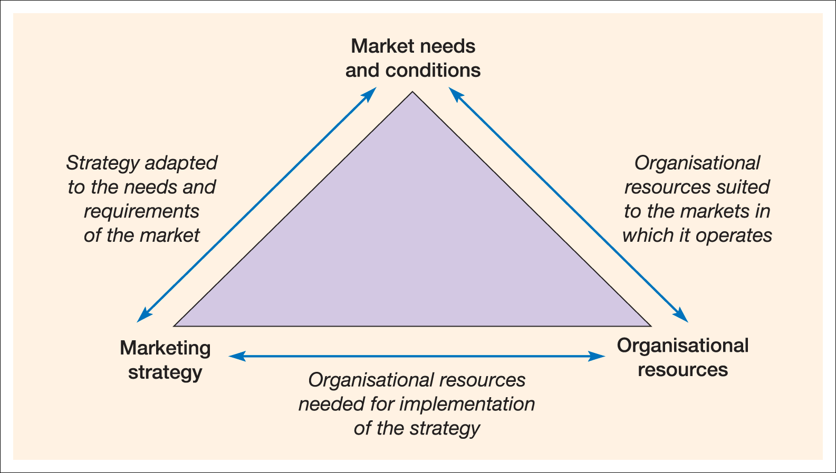
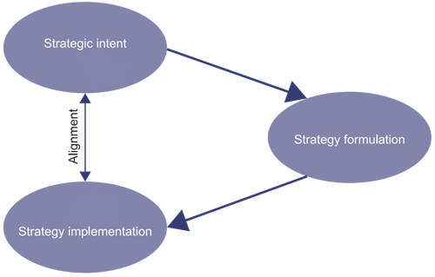
SETTING GOALS, AND OBJECTIVES
2
Strategic planning
Game plan for long-run goals of survival and growth
Helps to maintain a strategic fit between COMPANY goals and capabilities and changing marketing opportunities.
The process of developing and maintaining a strategic fit between the organization’s goals, capabilities and its changing marketing opportunities.
Strategic intent, Strategic assessment, & Strategic choice
Strategic intent : Aspirational plans, overarching purpose or intended direction to reach an organizational vision.
Strategic assessment refers to the decision process to decide “Where shall we go (A SWOT analysis is conducted to examine the strengths and weaknesses of the firm and opportunities that can be exploited are also determined)
Strategic choice a goal that helps in achieving an intended direction to reach the organizational vision
Notes:
Companies must find the game plan for long-run survival and growth that makes the most sense given its specific situation, opportunities, objectives, and resources. This is the focus of strategic planning—the process of developing and maintaining a strategic fit between the organization’s goals, capabilities and its changing marketing opportunities.
Strategic planning sets the stage for the rest of planning in the firm. Companies prepare annual plans, long-range plans, and strategic plans. The annual and long-range plans deal with the company’s current businesses and how to keep them going. In contrast, the strategic plan involves adapting the firm to take advantage of opportunities in its constantly changing environment.
This is the focusof strategic planning—the process of developing and maintaining a strategic fit between the organization’s goals, capabilities and its changing marketing opportunities.
Game plan for long-run survival and growth
The process of developing and maintaining a strategic fit between the organization’s goals, capabilities and its changing marketing opportunities.
helps to maintain a strategic fit between its goals and capabilities and changing marketing opportunities.
.

Slide 48
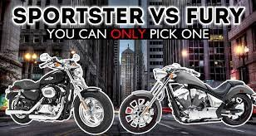
Honda’s strategic intent
SETTING GOALS, AND OBJECTIVES, EXAMPLE
2
Honda made the decision to enter the motorcycle market. initial aspirations strategic intent upon entry in 1959 had been aspired to lead this market and to capture 10 percent of a market estimated at 550,000 units per year with annual growth of 5 percent.
rather than look to imitate Harley Davidson or Yamaha’s success, Honda chose to start with small efficient and economic bikes that were intentionally different strategic choice .
Honda’s competitors didn’t see Honda as a threat initially because there was no risk on their core business.
Honda developed a loyal customer base and strong brand recognition.
Then Honda became able to attack competitors from a position of strength.
By 1975 the market had grown 16 percent per year to 5,000,000 annual units

Slide 49
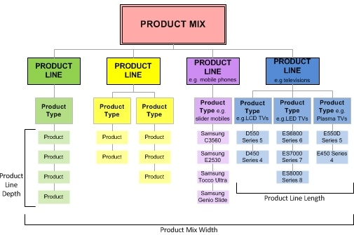
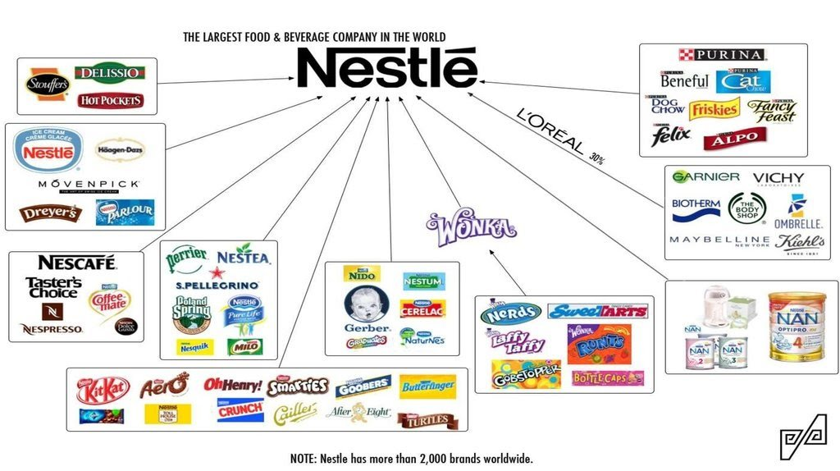
3
DESIGNING BUSINESS PORTFOLIO
WIDTH, LENGTH, AND DEPTH
Business Portfolio
Business Portfolio is a Collection of businesses and products that make up the company
Steps in business portfolio planning:
Analyze the firm’s current business portfolio
Identify the strategic business units (SBUs)
Assess SBUs’ attractiveness and decide on the level of support SBU deserves
Develop strategies to shape the future portfolio, resources toward more profitable businesses and phase down or drop its weaker ones

Slide 50
4
PLANNING MARKETING STRATEGIES
STRATEGY, AND TACTICS
STRATEGY: THE METHOD USED TO ACHIEVE OBJECTIVES E.G. WE WILL ACHIEVE OUR OBJECTIVE OF INCREASING PROFITS BY GROWING MARKET SHARE IN EXISTING MARKET
TACTICS: HOW RESOURCES ARE DEPLOYED IN AN AGREED STRATEGY. WE WILL SET UP A NEW TELEPHONE CALL CENTER AND TARGET NEW CUSTOMERS

Slide 51
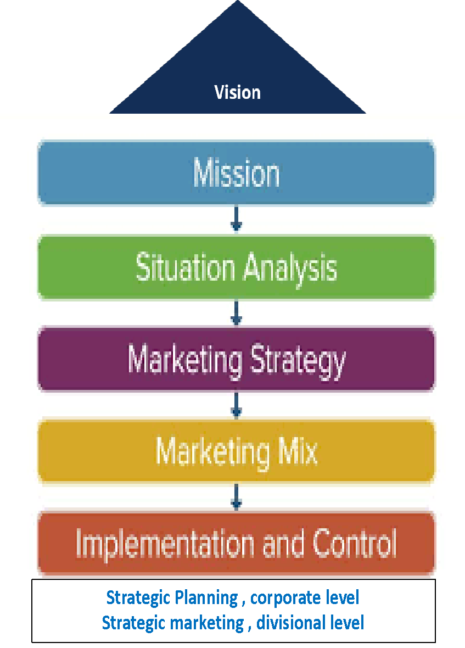
PLANNING MARKETING STRATEGIES
4
Marketing strategy formulation / development ;
The marketing logic/how the company creates the customer value and achieves these profitable relationships
CORPORATE MISSION -VISION & VALUES
SITUATION ANALYSIS
EXTERNAL (MACRO/MICRO)
INTERNAL ANALYSIS (BCG& PORTFOLIO ANALYSIS )
IDENTIFY OPPORTUNITIES, THREATS WEAKNESSES AND STRENGTHS (SOWT)
CONSTRUCT OBJECTIVE'S & GOALS,
FORMULATE STRATEGY THAT CREATES CUSTOMER VALUE
DECIDE THE MARKING MIX
MARKETING IMPLEMENTATION AND CONTROL
Notes:
Companies must find the game plan for long-run survival and growth that makes the most sense given its specific situation, opportunities, objectives, and resources. This is the focus of strategic planning—the process of developing and maintaining a strategic fit between the organization’s goals, capabilities and its changing marketing opportunities.
Strategic planning sets the stage for the rest of planning in the firm. Companies prepare annual plans, long-range plans, and strategic plans. The annual and long-range plans deal with the company’s current businesses and how to keep them going. In contrast, the strategic plan involves adapting the firm to take advantage of opportunities in its constantly changing environment.

Slide 52
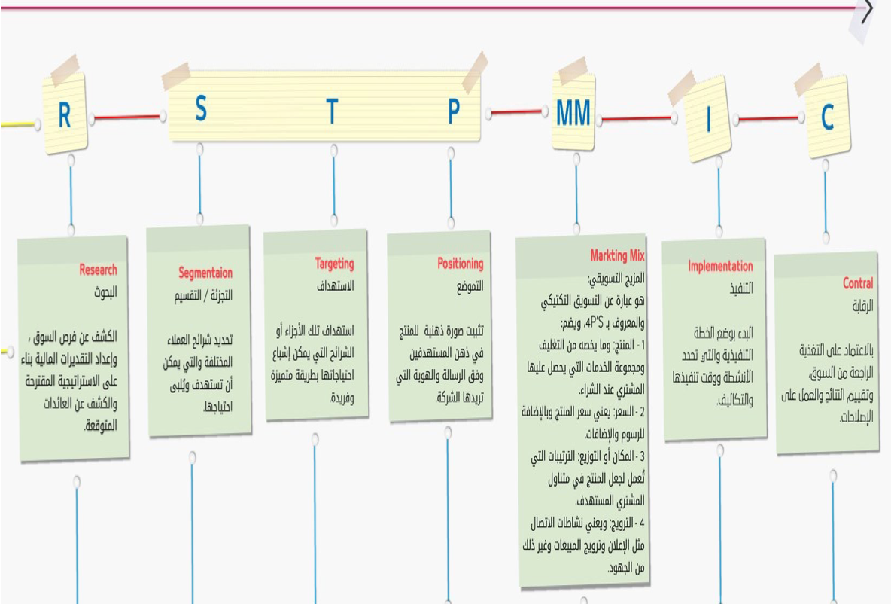
marketing Plan
Research (SITUATION ANALYSIS)
EXTERNAL (MACRO/MICRO)
INTERNAL ANALYSIS (BCG& PORTFOLIO ANALYSIS )
IDENTIFY OPPORTUNITIES, THREATS WEAKNESSES AND STRENGTHS (SOWT)
CONSTRUCT OBJECTIVE'S & GOALS,
FORMULATE STRATEGY THAT CREATES CUSTOMER VALUE (STP)
DECIDE THE MARKING MIX 4Ps
MARKETING IMPLEMENTATION AND CONTROL

Slide 53
Activity #3

Slide 56
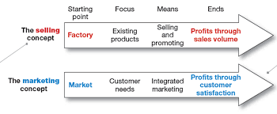
Understanding of Marketing Concepts
MARKETING offerings of a products Goods or services & managing profitable relationship the with the target customers
In fact, not all businesses approach the market in the same way.
Organizations have a few different approaches, These approaches are called marketing concepts,

Slide 57
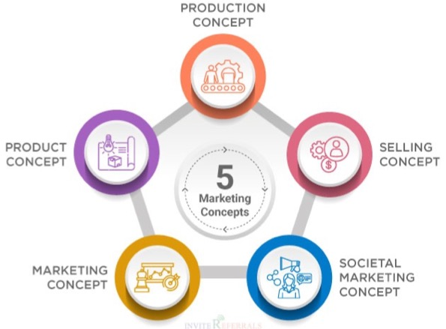
Marketing Concepts
1
2
4
MARKETING IS offerings of a products Goods or services to target customers & managing profitable relationship to the audience to have a
However, not all businesses approach the market in the same way.
Organizations have a few different approaches, These approaches are called marketing concepts,
3
5

Slide 58
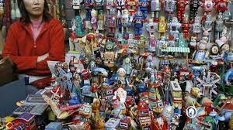
Production concept
1
The production concept holds that consumers will prefer products that are widely available and inexpensive.

Slide 59
Product concept
2
Assume that consumers will favour those products that offer the most quality, performance, or innovative features
Then, to compete effectively, products are designed to incorporate many features to meet the different needs of many consumers.

Slide 60
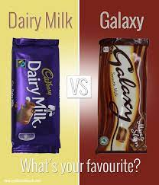
Marketing concept
3
The marketing concept holds that the key to achieving organizational goals consists of the company being more effective than competitors in creating, delivering, and communicating superior customer value to its chosen target markets.

Slide 61
Selling concept
4
The selling concept holds that consumers and businesses will ordinarily not buy enough of the organization’s products; therefore, the organization must undertake an aggressive selling and promotion effort.

Slide 62
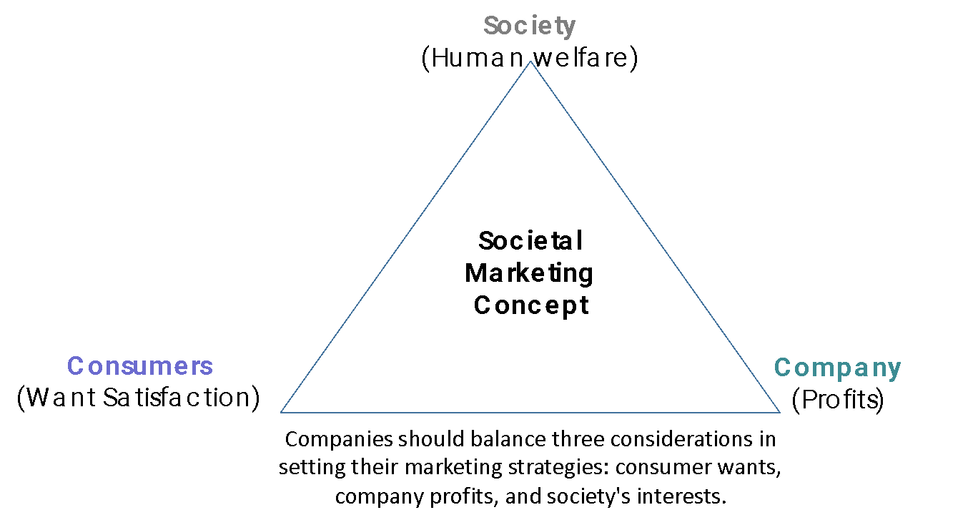
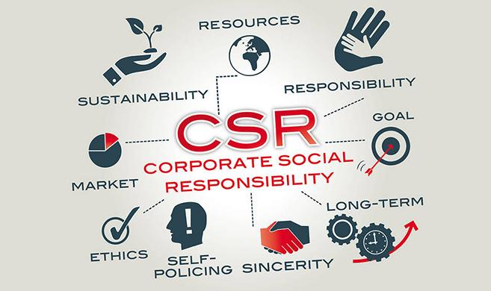
Societal Marketing Concept
5
The idea that an organization considers consumer’s needs, wants, and interests in a way that maintains or improves the consumer's and society's well-being on long term interests
Many leading businesses are now advocating the concept of shared value, which recognizes that societal needs, not just economic needs, for instance Green marketing.
Notes:
Many leading business and marketing thinkers are now preaching the concept of shared value, which recognizes that societal needs, not just economic needs, define markets
A growing number of companies known for their hardnosed approaches to business are rethinking the interactions between society and corporate performance.
They are concerned not just with short-term economic gains but also with the well-being of their customers, the depletion of natural resources vital to their businesses, the viability of key suppliers, and the economic well-being of the communities in which they produce and sell.
One prominent marketer calls this Marketing 3.0. "Marketing 3.0 organizations are values-driven," he says. "I'm not talking about being value-driven. I'm talking about 'values' plural, where values amount to caring about the state of the world."
As this slide shows [Figure 1–4 in the text] shows, companies should balance three considerations in setting their marketing strategies: consumer wants, company profits, and society's interests.

Slide 63
Activity #4

Slide 66
MARKETING
Marketing is the art and science of engaging customers and managing profitable customer relationships.
1-Marketing process
2-Marketingmanagement
3- Marketing plan
Understand customer needs and wants and design marketing programs that create superior value.
Marketing Offerings
The fulfillment of Customer needs and wants through a tangible and/or intangible product {goods and services} or through a combination of them .
Notes:
Marketing is the process by which companies create value for customers and build strong customer relationships in order to capture value from customers in return. The dual goal of marketing is to attract new customers by promising superior value and to keep and grow current customers by delivering satisfaction.
Sound marketing is critical to the success of every organization. Marketing is used by large for-profit firms, such as Google, Target, Coca-Cola and Microsoft as well as not-for-profit organizations, such as colleges, hospitals, museums, symphony orchestras, and even churches.

Slide 67
PLANNING MARKETING STRATEGIES
4
Marketing strategy formulation / development ;
The marketing logic/how the company creates the customer value and achieve these profitable relationships
CORPORATE MISSION -VISION & VALUES
SITUATION ANALYSIS
EXTERNAL (MACRO/MICRO)
INTERNAL ANALYSIS (BCG& PORTFOLIO ANALYSIS )
IDENTIFY OPPORTUNITIES, THREATS WEAKNESSES AND STRENGTHS (SOWT)
CONSTRUCT OBJECTIVE'S & GOALS,
FORMULATE STRATEGY THAT CREATES CUSTOMER VALUE
DECIDE THE MARKING MIX
MARKETING IMPLEMENTATION AND CONTROL
Notes:
Companies must find the game plan for long-run survival and growth that makes the most sense given its specific situation, opportunities, objectives, and resources. This is the focus of strategic planning—the process of developing and maintaining a strategic fit between the organization’s goals, capabilities and its changing marketing opportunities.
Strategic planning sets the stage for the rest of planning in the firm. Companies prepare annual plans, long-range plans, and strategic plans. The annual and long-range plans deal with the company’s current businesses and how to keep them going. In contrast, the strategic plan involves adapting the firm to take advantage of opportunities in its constantly changing environment.

Slide 70
Thank you

