Slide 1

Strategic marketing

Slide 2


Strategic marketing
Lecture # 3

Slide 3

QUICK RECAP ON PREVIOUS LECTURES

Slide 5
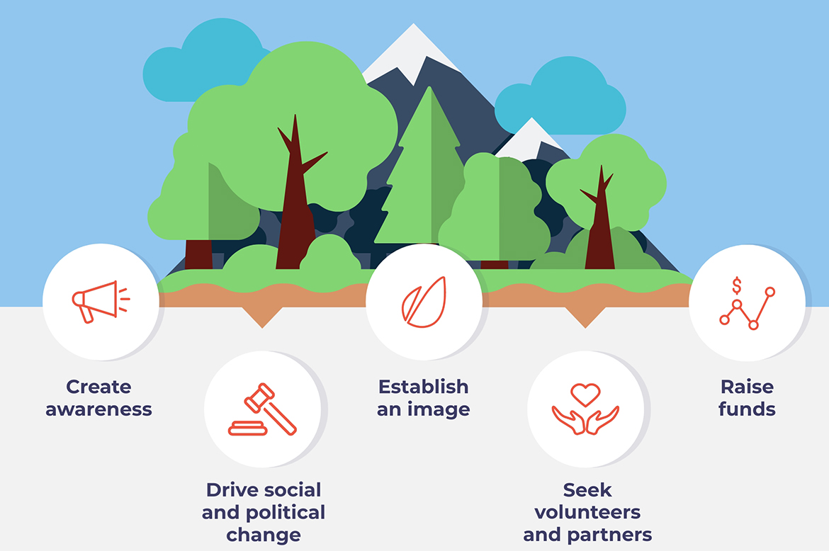



Marketing in Nonprofit organizations
Nonprofit marketing. nonprofit marketing refers to activities and strategies that spread the message of the organization, as well as solicit donations and call for volunteers. Nonprofit marketing involves the creation of logos, slogans, as well as the development of a media campaign to expose the organization to an outside audience.
The goal of nonprofit marketing is:
  To spread & promote the organization's ideals
  To get the attention of potential volunteers and donors
  To ask donations and call for volunteers
Notes:
https://www.investopedia.com/terms/n/nonprofit-marketing.asponprofit marketing involves the creation of logos, slogans, and copy, as well as the development of a media campaign to expose the organization to an outside audience. The goal of nonprofit marketing is to promote the organization's ideals and causes to get the attention of potential volunteers and donors.
KEY TAKEAWAYS
Nonprofit marketing refers to the tactics and strategies nonprofit organizations use to raise donations and spread their message.
Nonprofit marketing includes a wide range of activities, such as direct mail marketing, mobile marketing, content marketing, and social media marketing.
A point-of-sale campaign relies on asking for a donation at the same time the potential donor is making a purchase.
In a message-focused campaign, the nonprofit ties its fundraising efforts to a high-profile current event that has already captured the public's attention.
In a transactional campaign, the nonprofit organization partners with a corporate sponsor to encourage consumers to use their purchases to assist in funding the nonprofit's mission.

Slide 7
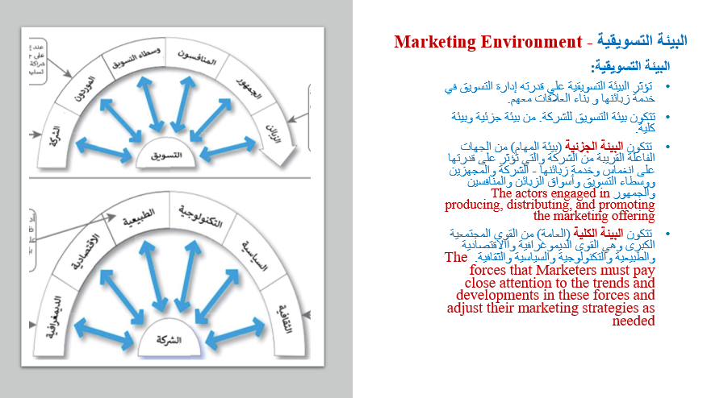

Slide 8
Macroenvironment analysis |PESTEL|
SWOT Analysis |integration of internal and external analyses|
Microenvironmental analysis |Porter 5 forces|
business portfolio analysis |internal environmental analysis|
PLC |product life cycle|
BCG |Growth share matrix|
Portfolio analysis
Marketing Environment |external environmental analysis|.
1
Strategic environmental analysis
2
3

Slide 9
Marketing Environment |external environmental analysis favorable or unfavorable

Slide 10


Activity #1 practice

Slide 11
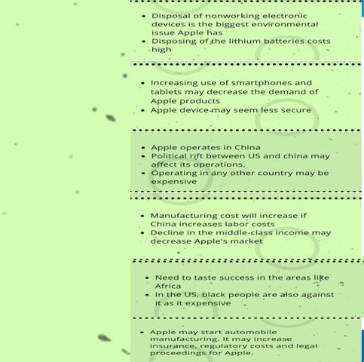

Political forces
Economical forces
Social/cultural forces
Technological forces
Environmental forces
Legal forces
Notes:
https://pestleanalysis.com/examples-of-pestle-analysis/
1-E
2-Tech
3- P
4-Econmuy
5-social
6-ergal

Slide 12
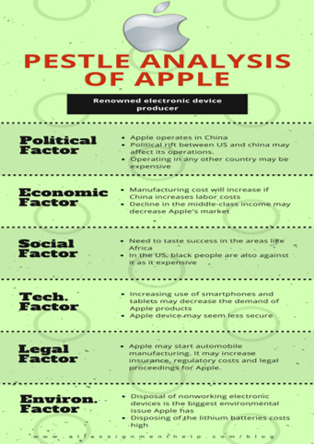
Notes:
https://pestleanalysis.com/examples-of-pestle-analysis/

Slide 13
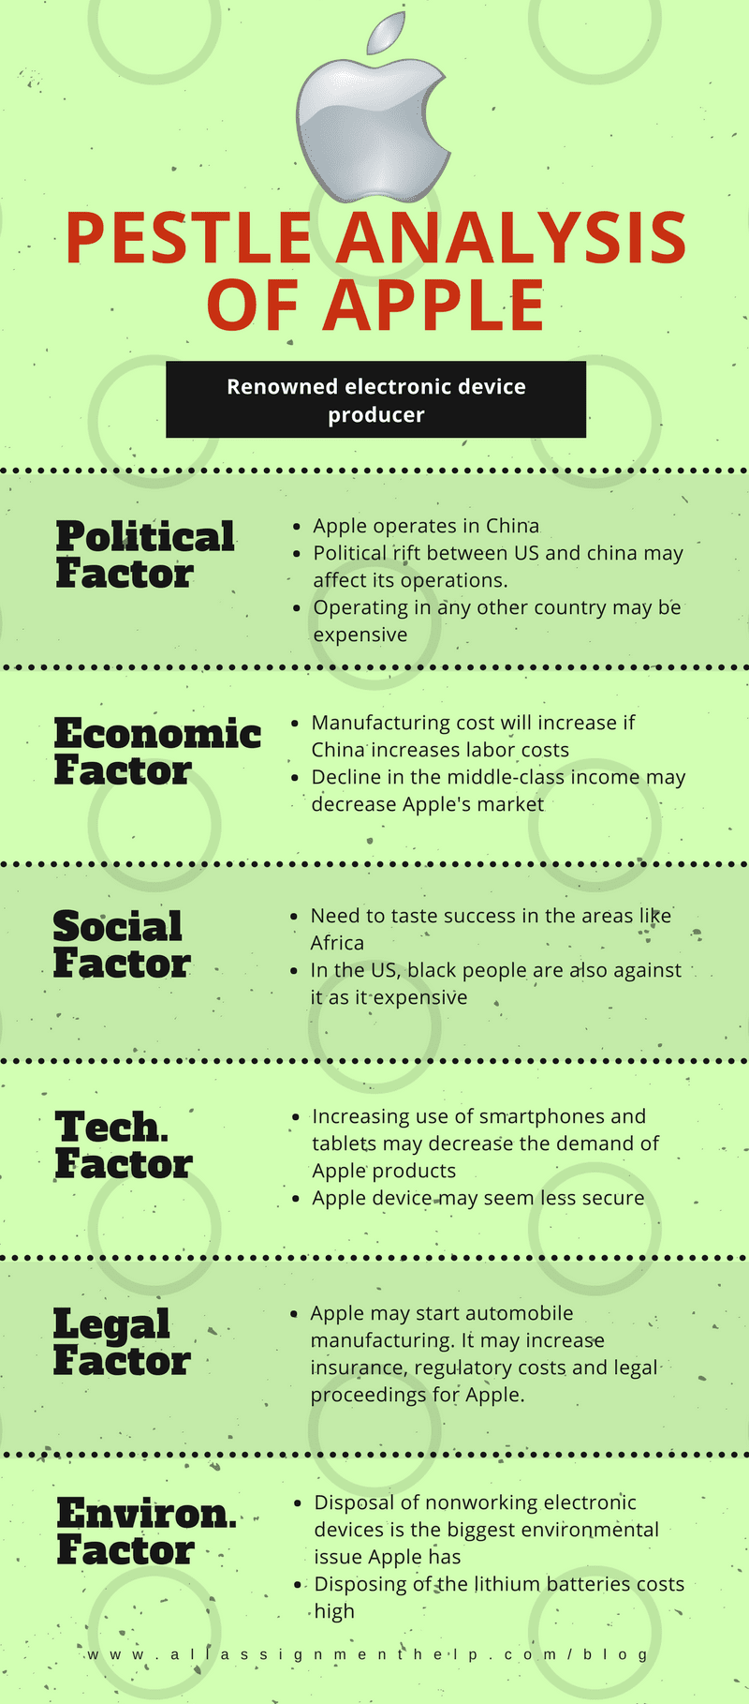
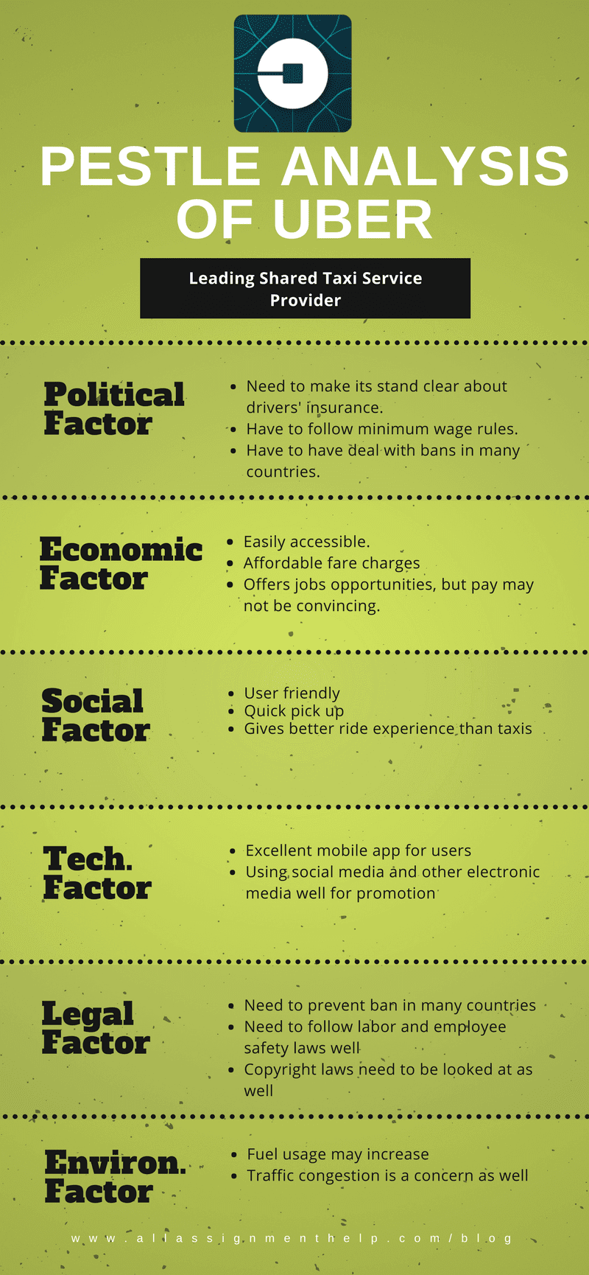
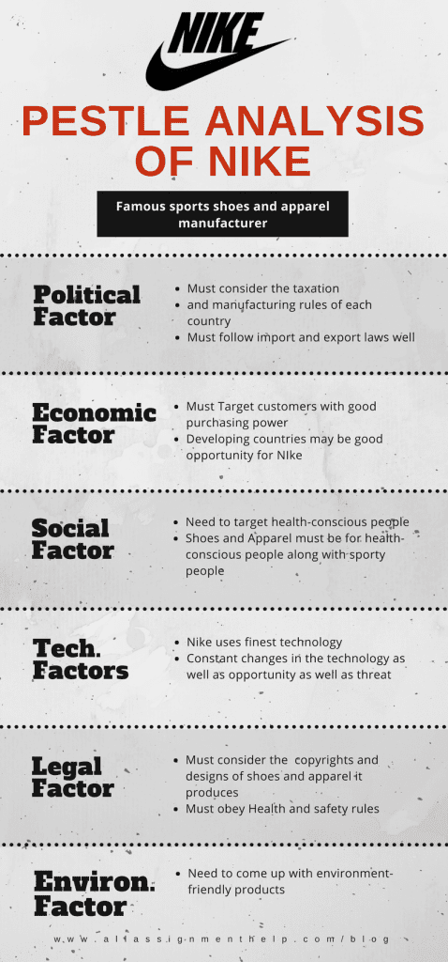
https://pestleanalysis.com/examples-of-pestle-analysis/
PESTEL Examples

Slide 14
Activity #2
MCQs training

Slide 15


Quiz
Which of the following is part of the microenvironment of a firm's marketing environment?
  A) the political state of the country in which the firm exists
  B) the cultural forces that exist in a society
  C) the suppliers who work with the company
  D) the technological resources available to the company
  E) the different demographic trends in the market
Which of the following is part of the microenvironment of a company's marketing environment?
  A) building close relationships with its extensive network of suppliers
  B) a set of laws that require the company to scale down its telemarketing calls to customers
  C) a changing demographic picture that requires the firm to make product adaptations
  D) a new technology that would ensure significant cost-cutting if implemented in the firm
  E) a set of environmental sustainability laws that significantly impact the company's production processes
Notes:
Answer: C
Answer: A
Describe the environmental forces that affect the company's ability to serve its customers

Slide 16
Quiz
Demographic, economic, natural, technological, political, and cultural forces form the ________ of an organization.
  A) supply chain
  B) macroenvironment
  C) marketing intermediary network
  D) internal environment
  E) microenvironment
5) American Honda purchases over $20 billion worth of auto parts and materials every year. ________ are key players in the company's success.
  A) Wholesalers
  B) Suppliers
  C) Physical distribution firms
  D) Media firms
  E) Retailers
Notes:
Answer: B

Slide 17
Quiz
) ________ are distribution channel firms that help a company find customers or make sales to them.
A) Resellers
B) Suppliers
C) Producers
D) Logistics firms
E) Credit companies
A marketing intermediary would most likely help a firm by ________.
A) negotiating with labor unions regarding wages, hours, and benefits
B) providing technical expertise on the production and design of goods
C) competing directly with the firm in a certain product category
D) supplying the raw materials needed for manufacturing the firm's products
E) moving the firm's goods from production points to distribution centers
12) Which of the following is an example of a media public?
A) community organization
B) minority group
C) television station
D) banking institution
E) federal government
Notes:
Answer: A
AAnswer: E
Answer: C

Slide 18
business portfolio analysis ( internal analysis)
PLC |product life cycle|
BCG |Growth share matrix|
Portfolio analysis
Strategic environmental analysis
3
3.1
3.2
3.3

Slide 19
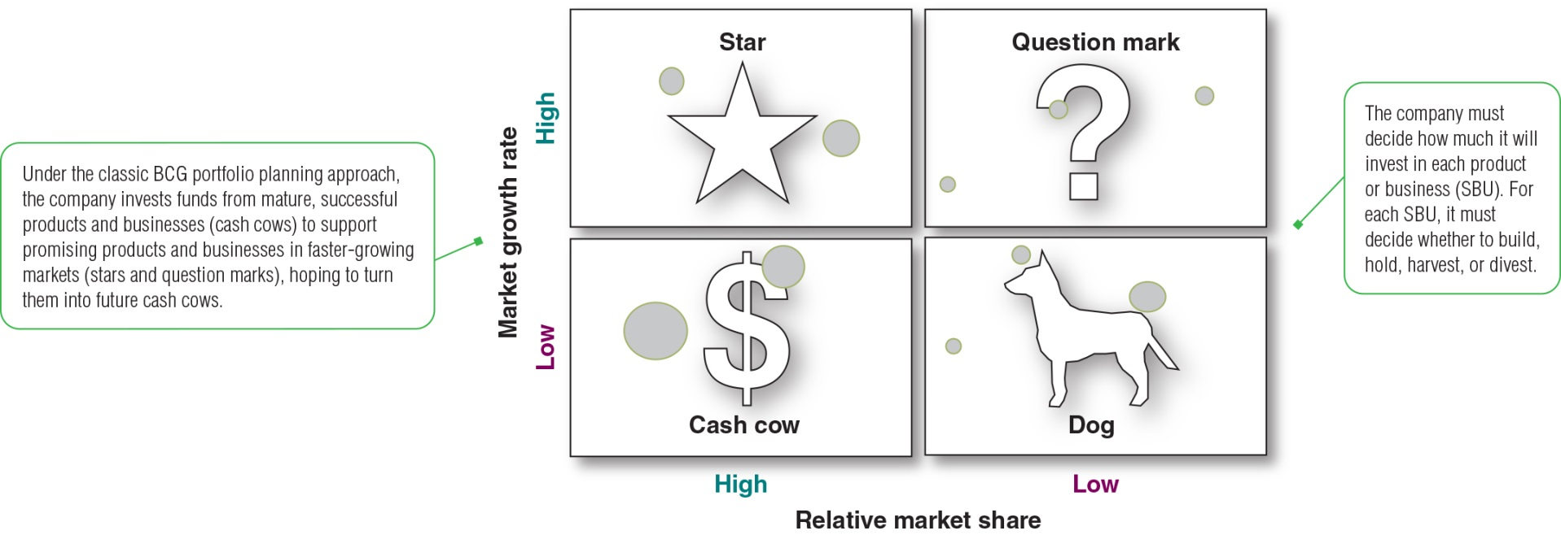
Growth-Share Matrix|BCG Matrix|
2.1
The best-known portfolio-planning method was developed by the Boston Consulting Group (BCG), a leading management consulting firm.
This BCG Growth-Share matrix shows the classification of company’s SBUs. Market growth rate provides a measure of market attractiveness. Relative market share serves as a measure of company strength in the market.
The Growth-Share Matrix defines four types of Products/ SBUs:
Stars are high-growth, high-share businesses or products.
Cash cows are low-growth, high-share businesses or products.
Question marks, are low-share business units in high-growth markets.
Dogs are low-growth, low-share businesses and products.
Notes:
The best-known portfolio-planning method was developed by the Boston Consulting Group (BCG), a leading management consulting firm. This BCG Growth-Share matrix shows the classification of company’s SBUs. Market growth rate provides a measure of market attractiveness. Relative market share serves as a measure of company strength in the market.
The Growth-Share Matrix defines four types of SBUs:
Stars are high-growth, high-share businesses or products.
Cash cows are low-growth, high-share businesses or products.
Question marks, are low-share business units in high-growth markets.
Dogs are low-growth, low-share businesses and products.
The 10 circles in this growth-share matrix would represent a company’s 10 current SBUs. The company must decide how much it will invest in each product or business SBU. It must decide whether to build, hold, harvest or divest.

Slide 20
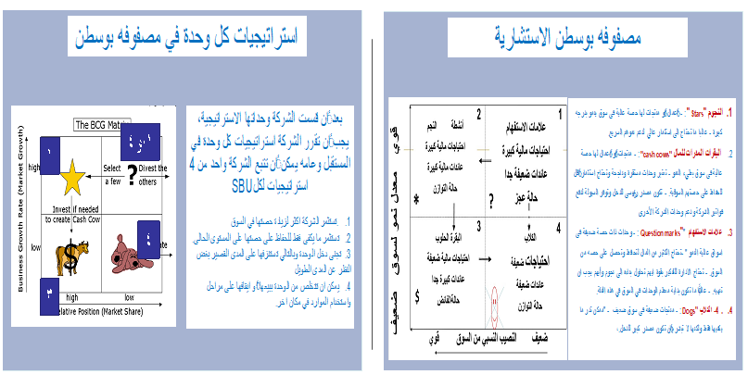

Slide 21
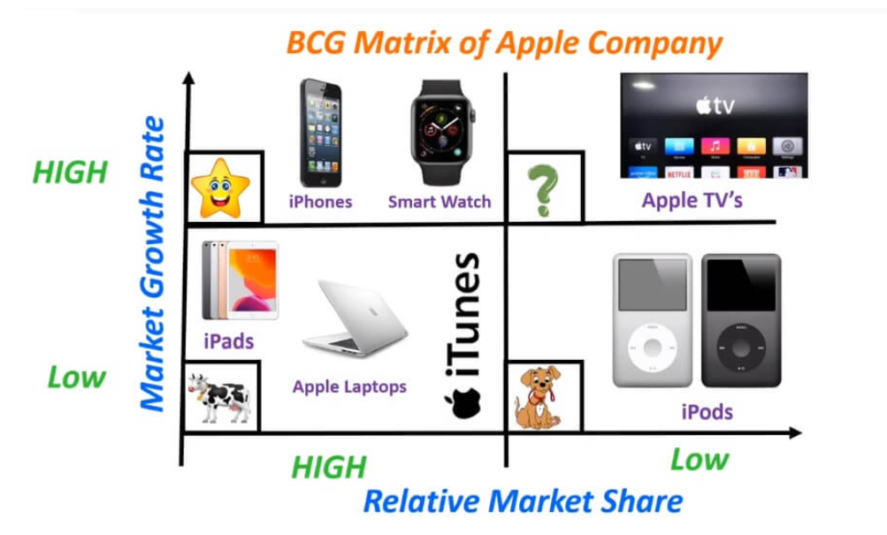
BCG Matrix Example

Slide 22
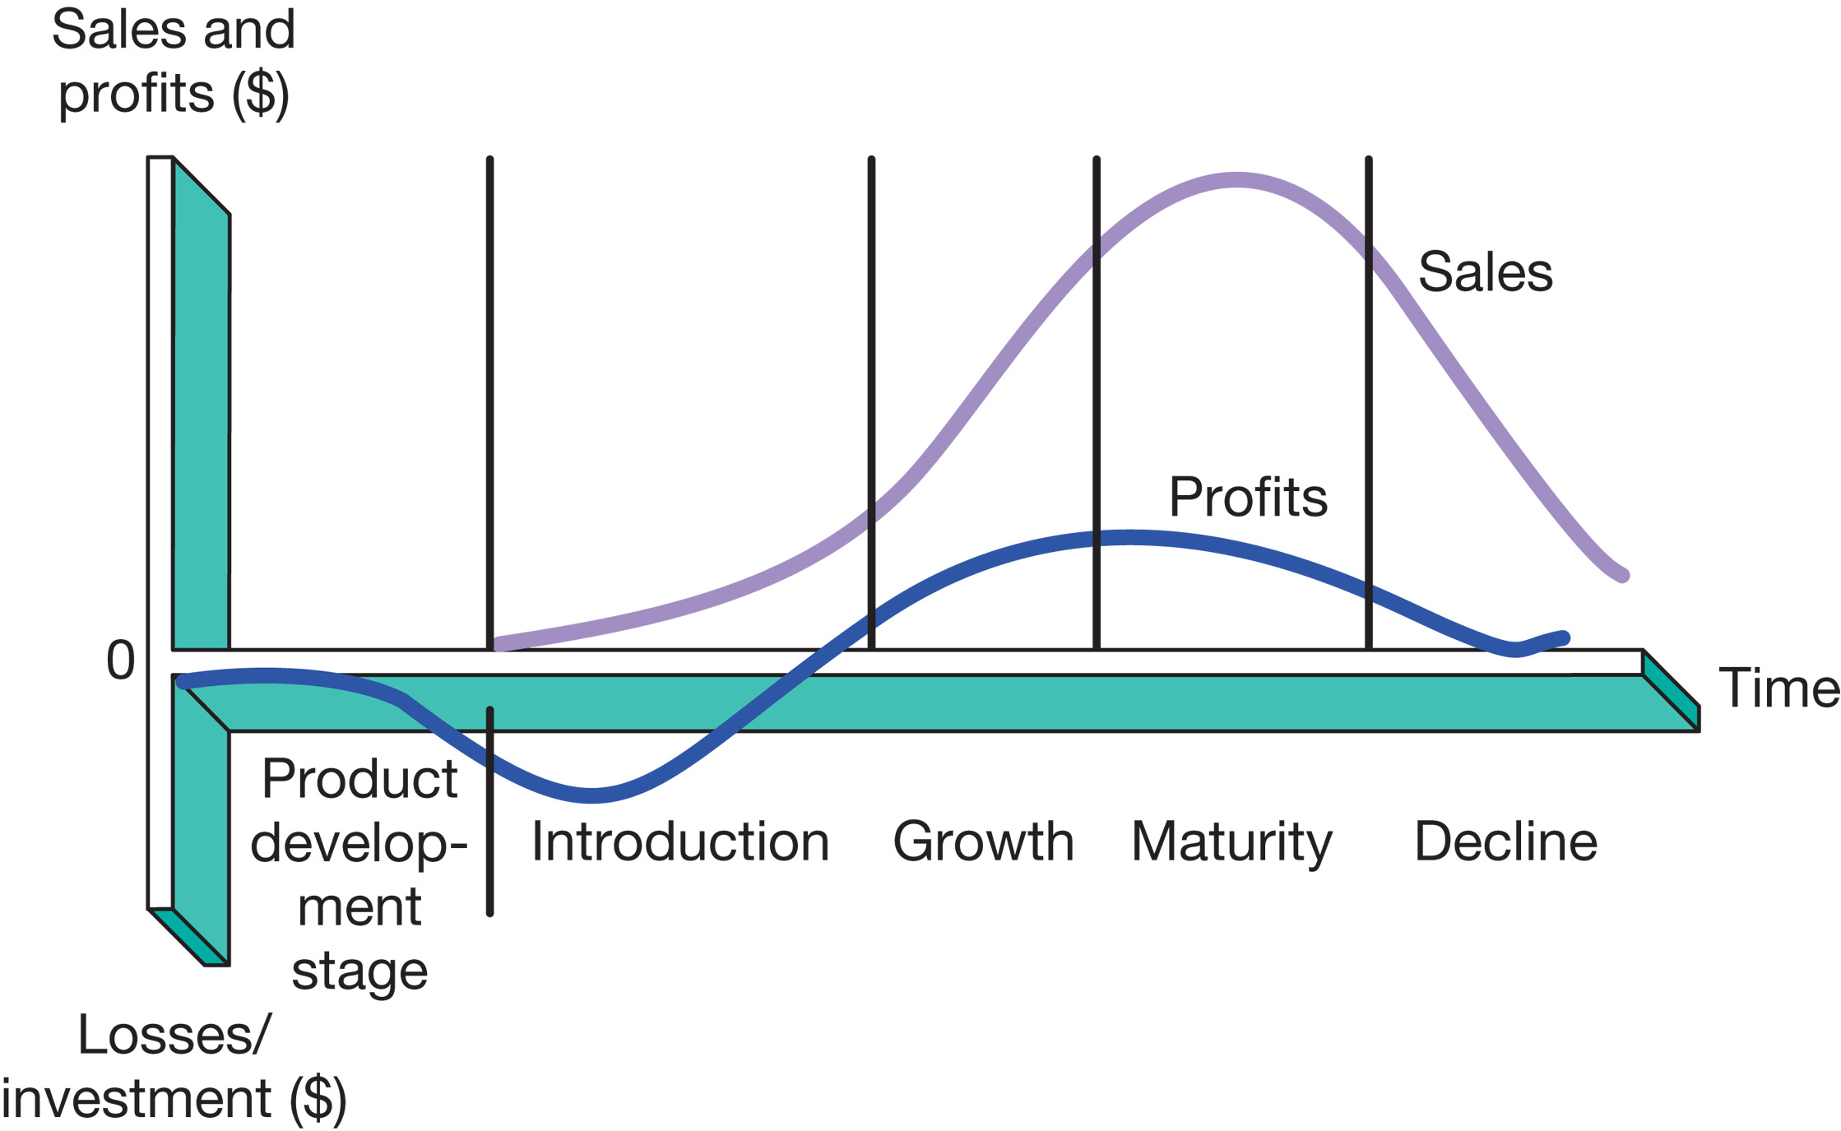

PLC-Product life cycle
2.2
  Product development
    Begins when the company finds and develops a new product idea
    During product development, sales are zero and the company's investment costs add up
  Introduction
    A period of slow sales growth as the product is being introduced into the market
    Profits are nonexistent at this stage because of the heavy expenses of product introduction
  Growth
    A period of rapid market acceptance and increasing profits
  Maturity
    A period of slowdown in sales growth because the product has achieved acceptance by most of its potential buyers
    Although sales are still high, profits level off or decline because of increased marketing outlays to defend the product against competition
  Decline
    The period when sales fall off quickly and profits drop

Slide 23


Slide 24
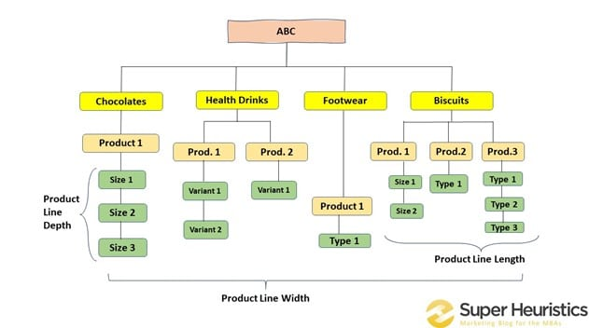
Business Portfolio, (product mix)
2.3
Business Portfolio is a Collection of businesses and products that make up the company
Steps in business portfolio planning:
  Analyze the firm’s current business portfolio
  Identify the strategic business units (SBUs)
  Assess SBUs’ attractiveness and decide on the level of support SBU deserves
  Develop strategies to shape the future portfolio, resources toward more profitable businesses and phase down or drop its weaker ones
Biscuits
chocolates
3
3
ABC
8
Notes:
A business portfolio is a collection of businesses and products that make up the company. The best business portfolio is the one that best fits the company’s strengths and weaknesses to opportunities in the environment.
Business portfolio planning involves two steps. First, the company must analyze its current business portfolio and determine which businesses should receive more, less, or no investment. Second, it must shape the future portfolio by developing strategies for growth and downsizing.
The major activity in strategic planning is business portfolio analysis, which is the process by which management evaluates the products and businesses that make up the company.
There are two steps for analyzing portfolios. Management’s first step is to identify the key businesses that make up the company, called strategic business units (SBUs). An SBU can be a company division, a product line within a division, or sometimes a single product or brand. The company next assesses the attractiveness of its various SBUs and decides how much support each deserves.
The purpose of strategic planning is to find ways in which the company can best use its strengths to take advantage of attractive opportunities in the environment. For this reason, most standard portfolio analysis methods evaluate SBUs on two important dimensions: the attractiveness of the SBU’s market or industry and the strength of the SBU’s position in that market or industry.

Slide 25
SWOT Analysis |integration of internal and external analyses|
Strategic environmental analysis
3

Slide 26
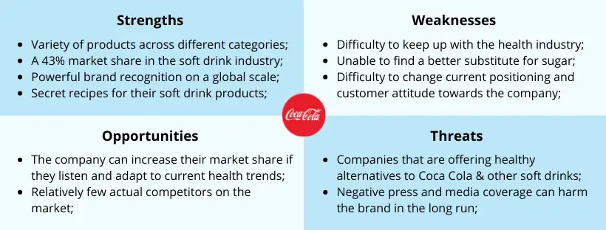
SWOT Analysis
Strengths Unique resources, competencies, capabilities superior to competition AND relevant to consumers NOT a long list, but the most customer-relevant and competitively distinct
Internal Focus

Slide 27

SWOT Analysis
Weaknesses Resources, capabilities, competencies, inferior to competition Based on understanding customer needs/ requirements and distinctive competencies

Slide 28

SWOT Analysis
Opportunities Summarizes favorable trends or developments that lead to higher sales, profits or new business opportunities Describe external situation, not desired action/strategy

Slide 29
SWOT Analysis
Threats Summarizes unfavorable trends or developments that threaten sales, profits or limits new business opportunities Recognize threats to avoid or limit impact

Slide 30
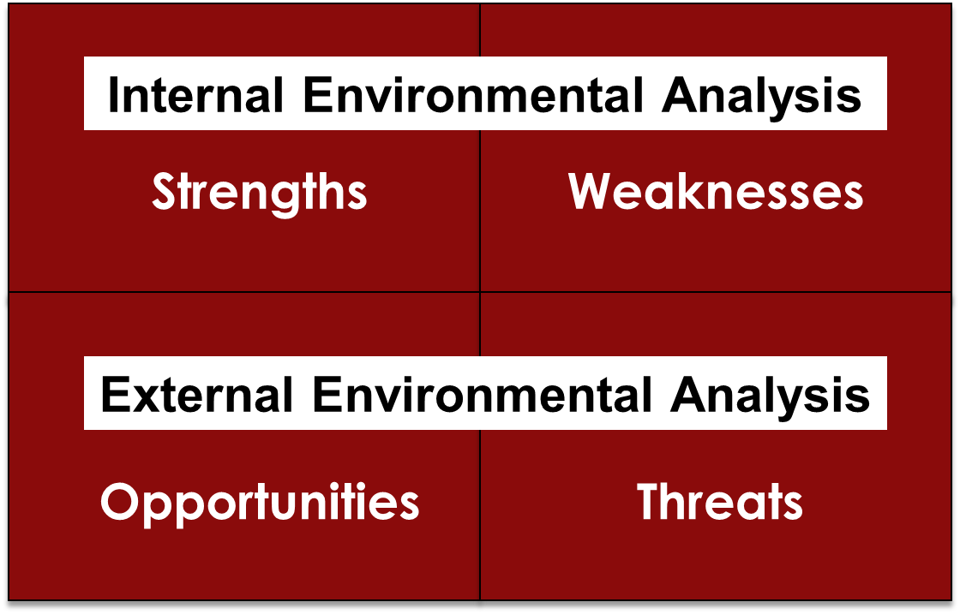
SWOT Analysis
Notes:
SWOT analysis evaluates the company's overall strengths (S), weaknesses (W), opportunities (0), and threats (T)
Strengths
Internal capabilities, resources, and positive situational factors that may help the company to serve its customers and achieve its objectives
Weaknesses
Internal limitations and negative situational factors that may interfere with the company's performance
Opportunities
Favorable factors or trends in the external environment that the company may be able to exploit to its advantage
Threats
Unfavorable external factors or trends that may present challenges to performance.
Internal Environmental Analysis (Strengths and Weaknesses Analysis)
Each business needs to evaluate its strengths and weaknesses periodically
Management or an outside consultant reviews the business's marketing, financial, manufacturing, and organizational competencies
External Environmental Analysis (Opportunity and Threat Analysis)
The business manager now knows the parts of the environment to monitor if the business is to achieve its goals
Macroenvironmental forces
Demographic-economic
Technological
Political-legal
Social-cultural
Microenvironmental forces
Customers
Competitors
Distribution channels
Supplies

Slide 31
Activity #3
SOWT practice

Slide 32
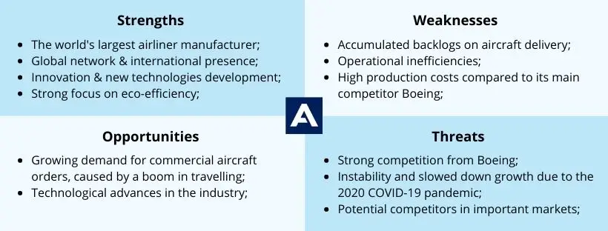

AIRBUS SWOT

Slide 33
AIRBUS SWOT

Slide 34

٣
الوضع السياسي
اعتمادهم على المواد الخام الخارجية أي تذبذب في هذه المواد سيحدث آثارًا واضحة على الشركة.
ظهور منافسين الجدد في الأسواق لهم منتجات عالية الجودة ومنافسة لمنتجات شركة المراعي، الأمر الذي يجعلهم يكتسبون سمعة جيدة
١
نمو سوق الحليب في الدولة الخليجية.
كثرة السياح الذين يزورون السعودية لأداء الحج والعمرة، الأمر الذي أدى إلى زيادة الطلب على منتجات المراعي.
٤
ارتفاع المصاريف الخاصة بتشغيل آلات منتجات الشركة.
التركيز المفرط على إنتاج الألبان والعصائر بشكل كبير الأمر الذي يشير إلى أنه في حالة تأثر هذا الإنتاج بشكل ضئيل سوف تتأثر الشركة بشكل كبير جدًا.
الاعتماد على المواد الخام الخارجية، فإن أي هذا يؤدي إلى ارتفاع مصاريف الإنتاج
إن الشركة لا تقيم الكثير من الأبحاث كما تفعل الشركات العالمية.
استخدام التكنولوجيا القديمة، وكذلك الآلات.
٢
تعتبر شركة المراعي من الشركات المتميزة في سوق صناعة الألبان في دول الخليج، وهي من أكبر الشركات في مجال إنتاج الحليب، والمنتجات المشتقة منه.
تمتاز منتجات شركة المراعي بجودتها العالية، وذلك باعتراف عالمي ومحلي، كما أنها تعد من أوائل الشركات التي حصلت على شهادة الأيزو العالمية لضمان الجودة.
تصل منتجاتها إلى العديد من دول العالم من خلال شركة التوزيع القوية الخاصة بها.
إن الظروف المناخية الساخنة في الخليج العربي تعمل على ازدهار سوق المشروبات.
تمتاز شركة المراعي بالسمعة الجيدة التي تتمتع بها.
يوجد بالشركة عمالة ماهرة ومدربة على أكمل وجه.
توجد حصة جيدة لشركة المراعي من السوق

Slide 35
٣تهديدات
الوضع السياسي
اعتمادهم على المواد الخام الخارجية أي تذبذب في هذه المواد سيحدث آثارًا واضحة على الشركة.
ظهور منافسين الجدد في الأسواق لهم منتجات عالية الجودة ومنافسة لمنتجات شركة المراعي، الأمر الذي يجعلهم يكتسبون سمعة جيدة
١فرص
نمو سوق الحليب في الدولة الخليجية.
كثرة السياح الذين يزورون السعودية لأداء الحج والعمرة، الأمر الذي أدى إلى زيادة الطلب على منتجات المراعي.
٢نقاط القوة
تعتبر شركة المراعي من الشركات المتميزة في سوق صناعة الألبان في دول الخليج، وهي من أكبر الشركات في مجال إنتاج الحليب، والمنتجات المشتقة منه.
تمتاز منتجات شركة المراعي بجودتها العالية، وذلك باعتراف عالمي ومحلي، كما أنها تعد من أوائل الشركات التي حصلت على شهادة الأيزو العالمية لضمان الجودة.
تصل منتجاتها إلى العديد من دول العالم من خلال شركة التوزيع القوية الخاصة بها.
إن الظروف المناخية الساخنة في الخليج العربي تعمل على ازدهار سوق المشروبات.
تمتاز شركة المراعي بالسمعة الجيدة التي تتمتع بها.
يوجد بالشركة عمالة ماهرة ومدربة على أكمل وجه.
توجد حصة جيدة لشركة المراعي من السوق
٤- نقاط الضعف
ارتفاع المصاريف الخاصة بتشغيل آلات منتجات الشركة.
التركيز المفرط على إنتاج الألبان والعصائر بشكل كبير الأمر الذي يشير إلى أنه في حالة تأثر هذا الإنتاج بشكل ضئيل سوف تتأثر الشركة بشكل كبير جدًا.
الاعتماد على المواد الخام الخارجية، فإن أي هذا يؤدي إلى ارتفاع مصاريف الإنتاج
إن الشركة لا تقيم الكثير من الأبحاث كما تفعل الشركات العالمية.
استخدام التكنولوجيا القديمة، وكذلك الآلات.
Notes:
`الفرص
نقاط القوة
نقاط الضعف

Slide 36


Slide 37
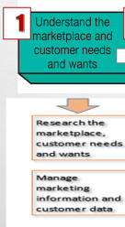
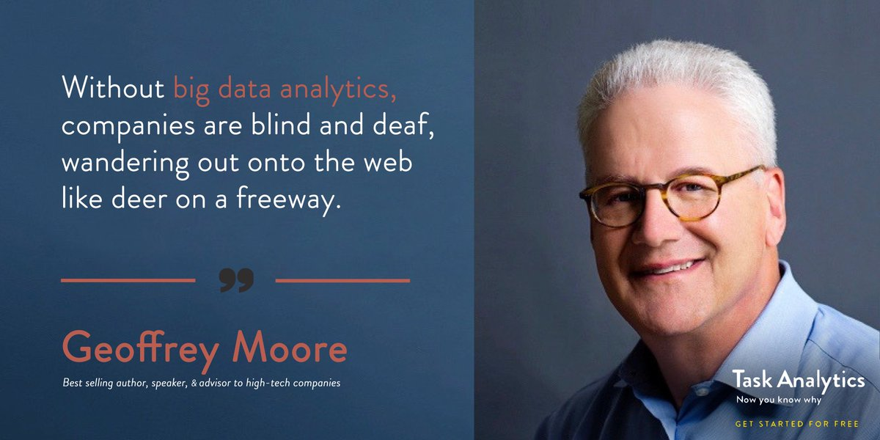
1- Understanding customer needs/wants.
Geoffrey Moore is an American organizational theorist, management consultant and author, known for his work Crossing the Chasm: Marketing and Selling High-Tech Products to Mainstream

Slide 38

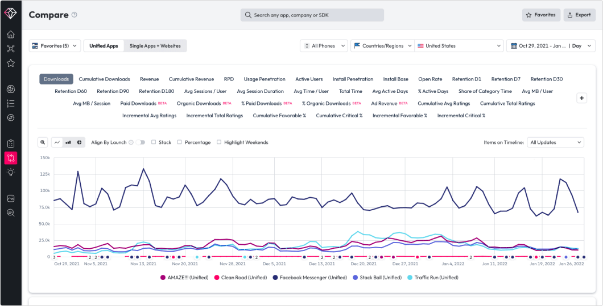
Big data
Big data refers to the huge data sets generated by sophisticated information generation, collection, storage, and analysis technologies. .
An average of 6 million public conversations a day, more than 2 billion a year arch and marketing information lies in how it is used and in the customer insights that it provides.
Analyzing the wealth of data about customers as Browsing history, purchase. patterns, returns, campaign response patterns etc.
Companies that effectively tap this glut of big data can gain rich, timely customer insights
The 1st Unified Data AI Company to combine consumer and market data with the power of artificial intelligence to fuel insights.
Notes:
Most marketing managers are overloaded with data and often overwhelmed by it. Marketers don’t need more information; they need better information. And they need to make better use of the information they already have.
The real value of marketing res
Big data presents marketers with both big opportunities and big challenges. Companies that effectively tap this glut of big data can gain rich, timely customer insights.
Far from lacking information, most marketing managers are overloaded with data. Accessing and sifting through so much data is a daunting task. For example, when a large consumer brand such as Coca-Cola or Apple monitors online discussions about its brand in Tweets, blogs, social media posts, and other sources, it might take in a stunning 6 million public conversations a day, more than 2 billion a year arch and marketing information lies in how it is used—in the customer insights that it provides.

Slide 39
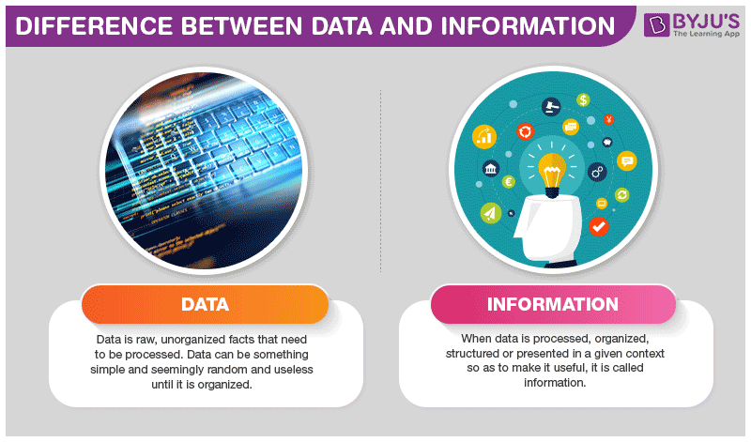
Marketing Information
Information is generated by Big Data could help marketers in decision making
Right information, in the right form, at the right time help Marketer to create customer value, engagement and stronger customer relationships.
For example, Coca-Cola or Apple monitors online discussions about its brand in Tweets, blogs, social media posts, and other sources, to gain valuable information about
  Customer insights about the current and future products
  Market insights
Notes:
Most marketing managers are overloaded with data and often overwhelmed by it. Marketers don’t need more information; they need better information. And they need to make better use of the information they already have.
The real value of marketing res
Big data presents marketers with both big opportunities and big challenges. Companies that effectively tap this glut of big data can gain rich, timely customer insights.
Far from lacking information, most marketing managers are overloaded with data. Accessing and sifting through so much data is a daunting task. For example, when a large consumer brand such as Coca-Cola or Apple monitors online discussions about its brand in Tweets, blogs, social media posts, and other sources, it might take in a stunning 6 million public conversations a day, more than 2 billion a year arch and marketing information lies in how it is used—in the customer insights that it provides.

Slide 40



Customer and Market insights.
It is important to understand Customer needs, but it is crucial to understand CUSTOMER AND MARKET INSIGHTS .
It is an interpretation of consumer and market trends through having a deep understanding customers, needs, behaviors and preferences
Marketers can communicate with customers in a highly personalized way provide them with added value that leads to long-term relationships.
It has Became the basis for creating customer value, engagement, and relationships.
Notes:
Most marketing managers are overloaded with data and often overwhelmed by it. Marketers don’t need more information; they need better information. And they need to make better use of the information they already have.
The real value of marketing res
Big data presents marketers with both big opportunities and big challenges. Companies that effectively tap this glut of big data can gain rich, timely customer insights.
Far from lacking information, most marketing managers are overloaded with data. Accessing and sifting through so much data is a daunting task. For example, when a large consumer brand such as Coca-Cola or Apple monitors online discussions about its brand in Tweets, blogs, social media posts, and other sources, it might take in a stunning 6 million public conversations a day, more than 2 billion a year arch and marketing information lies in how it is used—in the customer insights that it provides.

Slide 41
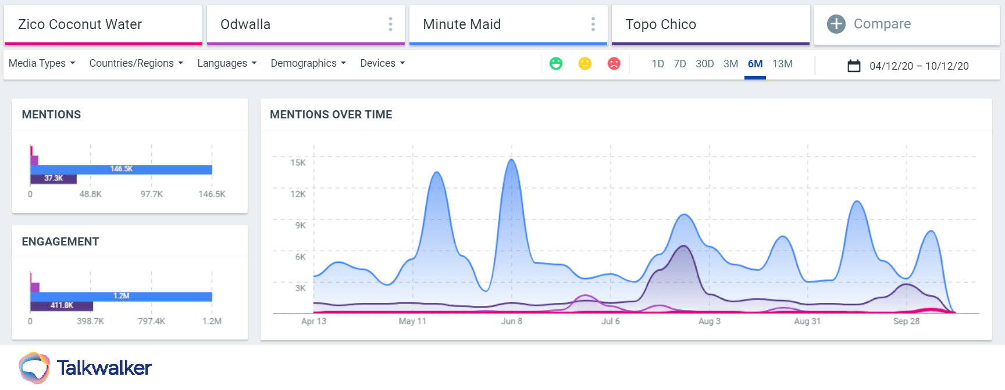
Successful companies took decisions Customer and Market insights.
Coca-Cola a result of revenue, but with social listening tools, announced it would be removing Zico, its coconut water product, just as they did with Odwalla, as they had not grown over a three-year period. By sacrificing these beverages, This decision is often the brand has decided to bet on more successful ranges like Minute Maid and Topo Chico.
Notes:
| Identify what’s holding you back
One simple fact of the consumer goods industry is that businesses have to quickly identify and cut underperforming products in order to survive. analyzing a product line can provide early indicators as to which products should be taken off the shelves and which products consumers are coming back for.

Slide 42
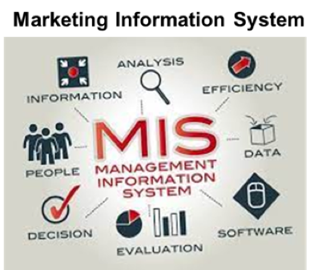
Marketing Information System
(MIS)
It is essential for companies to design effective marketing information systems that consists of people , systems , and procedures to
  Assess information needs
  Develop the needed information
  Help decision makers with the right
information, in the right form, at the right time to help them to create customer value, engagement and stronger customer relationships.
Notes:
It is essential for companies to design effective marketing information systems that give managers the right information, in the right form, at the right time and help them to use this information to create customer value, engagement and stronger customer relationships. generate and validate actionable customer and market insights

Slide 43
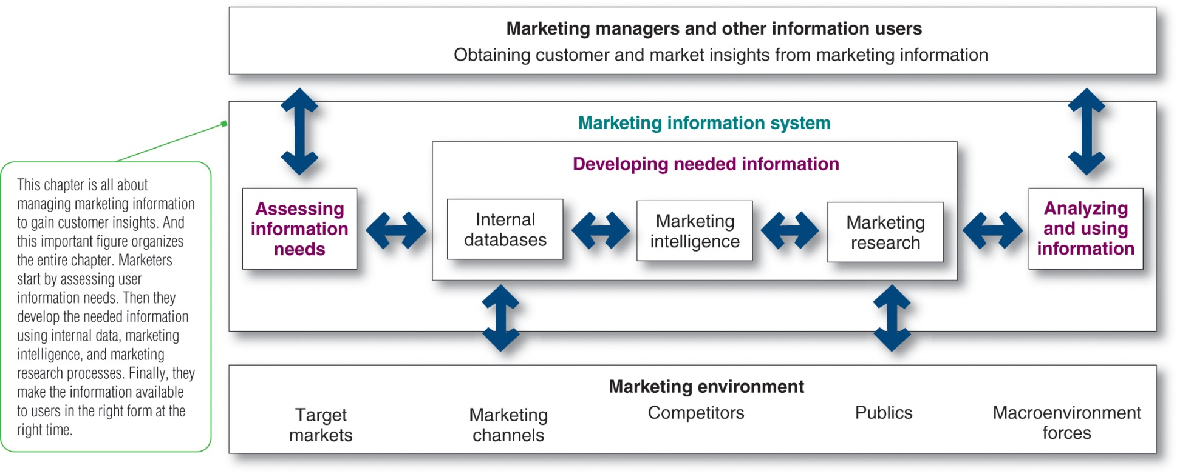
The Marketing Information System
Notes:
This figure shows that the MIS begins and ends with information users.
The information users are marketing managers, internal and external partners, and others who need marketing information. Marketers start by assessing user information needs. Next, they develop needed information using internal company databases, marketing intelligence activities, and marketing research. Finally, the MIS helps users to analyze and use the information to develop customer insights, make marketing decisions, and manage customer engagement and relationships.

Slide 44


Internal Databases
IMS - developing needed information
1
Internal databases are collections of consumer and market information obtained within the company from
  Company Record
  Point-of-Sale
  Employees' feedback
Pros :
  Data can be accessed more quickly and cheaply than other information sources,
Cons :
  Data also ages quickly; keeping the database current requires a major effort.
  Data may be incomplete or in the wrong form for making marketing decisions
Notes:
Internal databases usually can be accessed more quickly and cheaply than other information sources, but they also present some problems. Because internal information is often collected for other purposes, it may be incomplete or in the wrong form for making marketing decisions. Data also ages quickly; keeping the database current requires a major effort. Finally, managing and mining the mountains of information that a large company produces requires highly sophisticated equipment and techniques.

Slide 45

Amazon is very successful in using personalized marketing
Examples of using Internal Databases
Amazon’s recommendation algorithm consistently makes headlines for its strategic approach to personalized marketing
Cleverly encouraging impulse buying by highlighting key tastes and products to match, it’s a tactic that pays off.
The company reported a 29% sales increase to $12.83 billion during its second fiscal quarter, up from $9.9 billion during the same time the previous year.

Slide 46
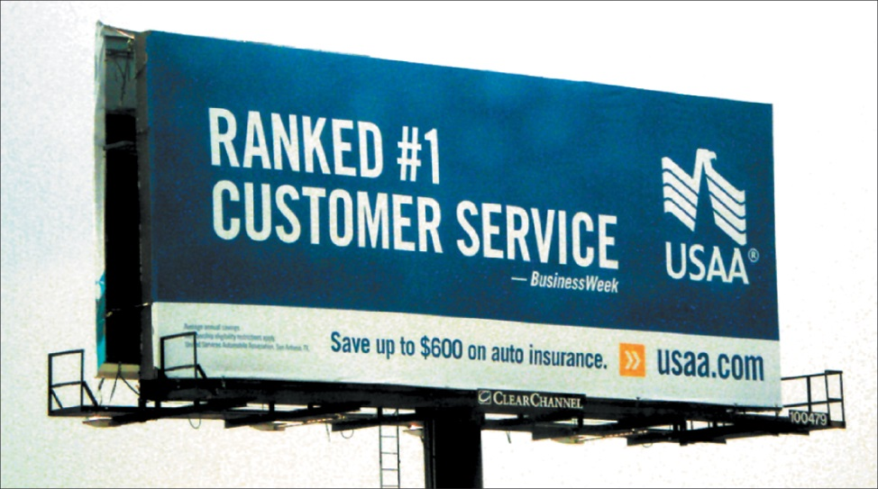
Examples of using Internal Databases
USAA a Financial services provider uses its extensive database to tailor its services to the specific needs of individual customers, creating incredible loyalty.
It maintains a huge customer database built from customer purchasing histories and information collected directly through customer surveys, transaction data, and browsing behavior at its web and social media sites.
USAA uses the database to tailor direct marketing offers to the needs of individual customers.
The United Services Automobile Association is a diversified financial services group of companies
Notes:
Internal databases usually can be accessed more quickly and cheaply than other information sources, but they also present some problems. Because internal information is often collected for other purposes, it may be incomplete or in the wrong form for making marketing decisions. Data also ages quickly; keeping the database current requires a major effort. Finally, managing and mining the mountains of information that a large company produces requires highly sophisticated equipment and techniques.
USAA provides financial services to U.S. military personnel and their families, largely through direct marketing via the phone, the internet, and mobile channels. It maintains a huge customer database built from customer purchasing histories and information collected directly through customer surveys, transaction data, and browsing behavior at its web and social media sites. USAA uses the database to tailor direct marketing offers to the needs of individual customers

Slide 47
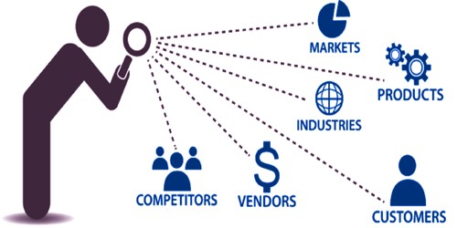
Competitive Marketing Intelligence
IMS - developing needed information
2
Systematic monitoring, collection, and analysis of information about consumers, competitors, and developments in the marketing environment
Offers insights about consumer opinions and their association with the brand
Provides early warnings of competitor strategies and potential competitive strengths and weaknesses
Techniques
Observing consumers first-hand
Quizzing the company’s own employees
Benchmarking competitors’ products
Monitoring social media buzz
Mystery shopping
Notes:
The goal of competitive marketing intelligence is to improve strategic decision making by understanding the consumer environment, assessing and tracking competitors’ actions, and providing early warnings of opportunities and threats.
Good marketing intelligence can help marketers gain insights into how consumers talk about and engage with their brands. Many companies send out teams of trained observers to mix and mingle personally with customers as they use and talk about the company’s products. Other companies, like MasterCard, have set up sophisticated digital command centers that routinely monitor brand-related online consumer and marketplace activity.
Companies can monitor competitors’ Web sites and use the Internet to search specific competitor names, events, or trends and see what turns up. Tracking consumer conversations about competing brands is often as revealing as tracking conversations about the company’s own brands.
Companies can obtain important intelligence information from suppliers, resellers, and key customers. Intelligence seekers can pour through any of the thousands of online databases. For example, the U.S. Security and Exchange Commission’s database provides a huge stockpile of financial information on public competitors, and the U.S. Patent Office and Trademark database reveals patents that competitors have filed.
Some intelligence gathering techniques may involve questionable ethics. With all the legitimate intelligence sources now available, a company does not need to break the law or accepted codes of ethics to get good intelligence.

Slide 48

The Marketing Research
IMS - developing needed information
3
Systematic design, collection, analysis, and reporting of data relevant to a specific marketing situation facing an organization
تعريف أبحاث التسويق من الجمعية الأمريكية للتسويق :AMAانها الأداة التي تربط المُسوقين باللعملاء وذلك من خلال جمع المعلومات التي تساعد المسوقين في اكتشاف فرص آوحلول مشاكل تسويقيه. كما يمكن استخدام هذه الأبحاث في تقييم الإجراءات المتبعة في عملية التسويق، ومراقبة الأداء بها وتحسينها.
Notes:
Companies use marketing research in a wide variety of situations. For example, marketing research gives marketers insights into customer motivations, purchase behavior, and satisfaction. It can help them to assess market potential and market share or measure the effectiveness of pricing, product, distribution, and promotion activities.

Slide 49

The need for Marketing Research
To Forecast future trends & anticipate future customer need
To have an always update on the vast changes :
    Changes in technology
    Changes in consumer tastes
    Changes in Market demand
    Changes in the product ranges of competitors
    Changes in economic conditions
  Changes Distribution channels
To Reduce the risk of new product business failure
To Forecast future trends & anticipate future customer need
To have an always update on the vast changes :
    Changes in technology
    Changes in consumer tastes
    Changes in Market demand
    Changes in the product ranges of competitors
    Changes in economic conditions
  Changes Distribution channels
To Reduce the risk of new product business failure:

Slide 50

Marketing Research Approaches
  Companies might Use their own research departments
  Companies might Purchase data collected by outside firms
  Companies might Hire outside research specialists
List Of Top Market Research Companies
Nielsen.
IQVIA.
Kantar.
Gartner.
IPSOS.
GfK.
IRI.
Dynata.
تجاوز الإنفاق على أبحاث التسويق 70 مليار دولار على مستوى العالم في عام 2022 ، وفقا ل ، ESOMAR وهي المنظمة العالمية التي تتولى تحديد أسس وإجراءات إعداد بحوث التسويق ودراسات السوق، حيث أصدرت “الكود المهني لبحوث التسويق.

Slide 51

Case study # 1

Slide 52

THE NEED FOR MARKETING RESEARCH
في احدي المدن الأمريكية حاولت ماكدونالدز مضاعفه مبيعات الفترة الصباحية و لم تنجح أي طريقه من طرقهم المعروفة كالعروض ومهاره البائعين وغيره .يا تري ماذا فعلت ماكدونالدز

Slide 53
حاولت ماكدونالدز تزود مبيعات الفترة الصباحية في احدي المدن الأمريكية و لم تنجح أي طريقه من طرقهم المعروفة كالعروض ومهاره البائعين.
.ماكدونالدز طلبوا من Harvard Business School يساعدوهم،
هارفارد قامت بعمل بحث ثانوي ( بحث مكتبي ) بتحليل المبيعات ووجدوا أن عينة كبيرة من مبيعات الفترة الصباحية بتكون من مبيعات الميلك شيك.
هارفارد كملت بعمل بحث آولي (بحث في السوق) وعملت مقابلات مع العملاء وسألوا العملاء خلال الدراسة كالاتي
    "لماذا تشتري الميلك شيك في الصباح الباكر جدا "،
      فالعملاء قالوا لهم أن مشوار الشغل طويل وممل جدا، ومحتاجين حاجة تسليهم على الطريق وتشبعهم لحد ما يفطروا.
    وكان السؤال الثاني، طب لو ما اشتريت ميلك شيك ممكن تشتري إيه؟
    فالعملاء قالوا ومحتاجين حاجه سهل يمسكوها وهم يفودوا السيارة
    وكان السؤال الثالث هل ممكن احد الاختيارات الأتية سندوتشات (فالعملاء قالوا صعبة في التناول للسائق)
    هل ممكن دونات أو قهوة (فالعملاء قالوا ممكن خطر جد وقد ونصل الشغل ببقع)
    وكان السؤال الرابع ايه البديل فالعملاء ردوا ممكن حاجات جافه مثل بسكوت اوشوكولاتة سنيكرز مثلا (بس بتخلص بسرعة).
    وكان السؤال الاخير ايه التحسينات المطلوبة . هل ممكن تخليه أكبر حجما، يزودوا الشوكولاتة، يعملوا منتج السكر فيه قليل، يخلوه خفيف أكتر، تقيل أكتر، يعملوه صحيا و تزود فيه قطعة فاكهة زاي وكمان اخدت اقتراحات بتنفيذ الطلب والدفع أسرع حتي لا تتعطل الموظفين علي أوقات الدوام،
    وهنا فقط استطاعت ماكدونالدز فهم المشكلة و فهم حلها و ما هو احتياج العملاء ، وقدرت تزود مبيعاته ٧ اضعاف
Notes:
من معلومات لم مقابلات مع العملاء تسألهم عن إيه اللي ممكن يشجعهم يشتروا زيادة. هل يزودوا الشوكولاتة، يعملوا منتج السكر فيه قليل، يخلوه خفيف أكتر، تقيل أكتر، يعملوه صحيعنبتكون في الصباح الباكر جدا"الميلك شيك" أوقات الشراءتتراوح بينالناس بيشتروا المنتج ليهماهي

Slide 54
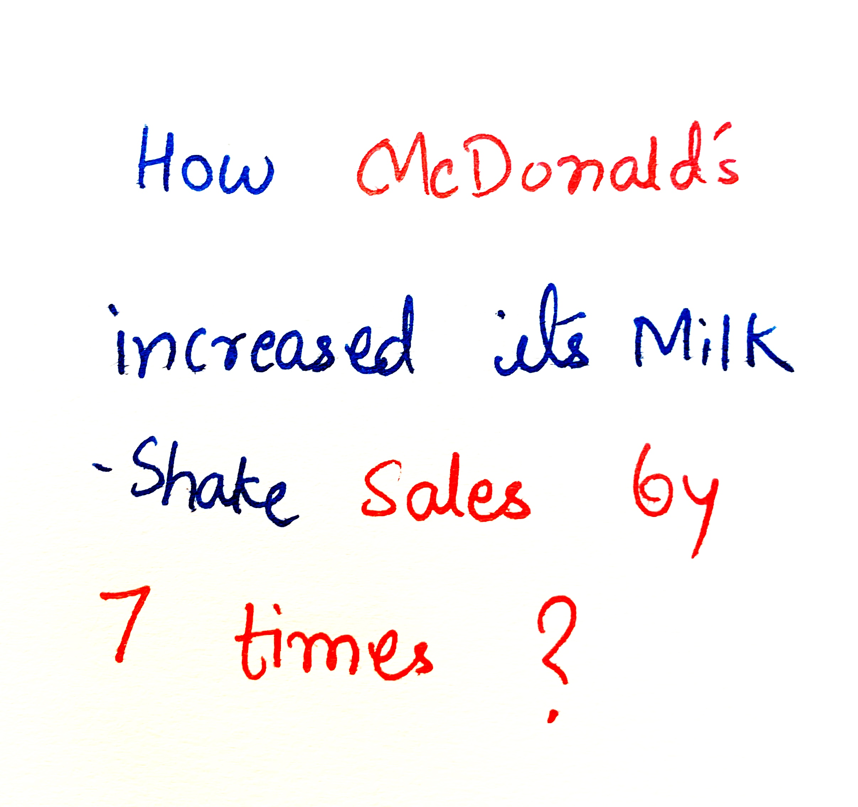
THE NEED FOR MARKETINGRESEARCH

Slide 55
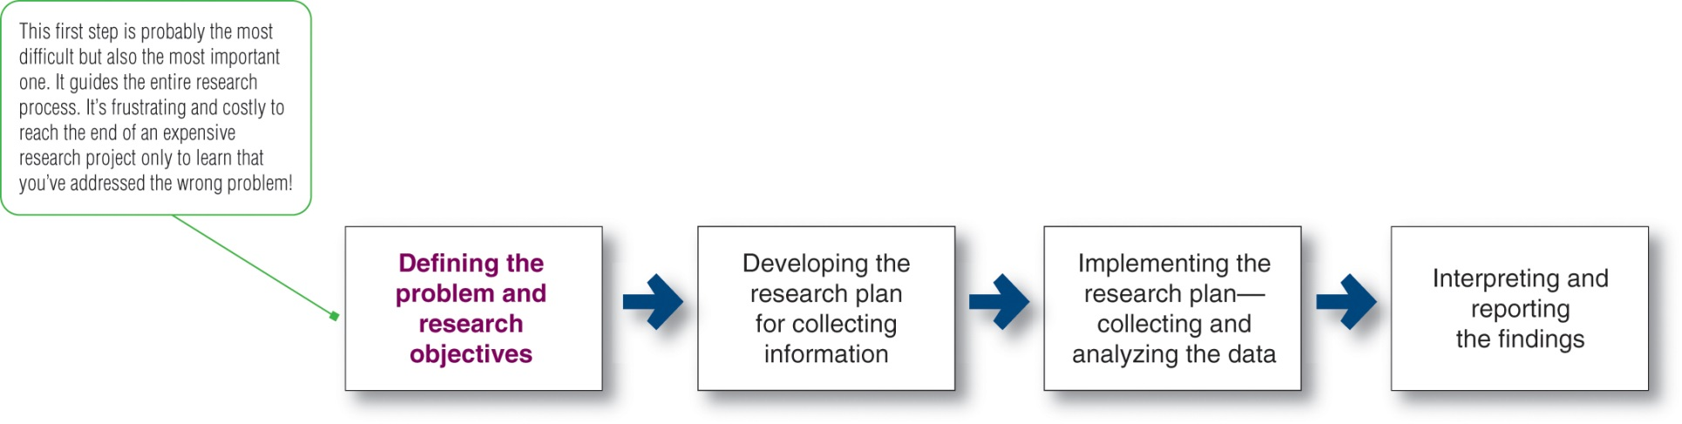
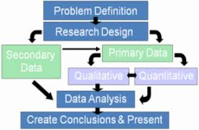
The Marketing Research Process
Expanded Marketing research Process
  Define the problem
  Define research objectives
  Develop Research plan
  Choose data sources
  Choose research methods |Approaches|
  Construct sample
  Implement the research plan (Undertake research)
  Analysis of results
  Interpretation and report the findings
Notes:
Marketing research follows a process that has four steps: defining the problem and research objectives; developing the research plan; implementing the research plan; and interpreting and reporting the findings. Each of these stages is discussed in detail in the following slides.

Slide 56
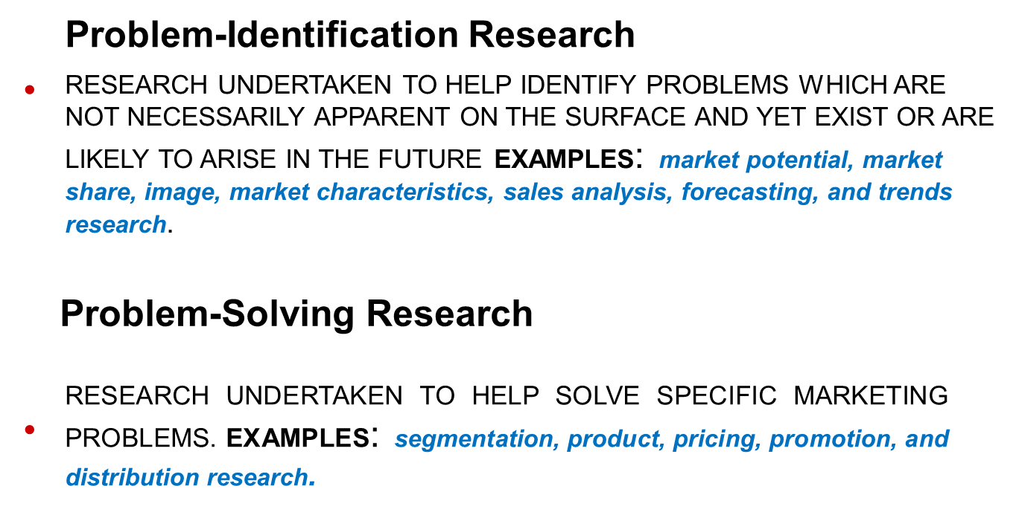

1- Define the Research Problem

Slide 57
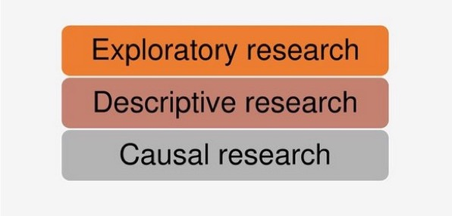
2- Define Research Objectives
Exploratory research
Qualitative,, gathering preliminary information
Helps to define problem or to develop hypotheses
Generally small number of respondents and not statistically reliable
Could not be generalized to the whole population
Descriptive research
Used to better describe the market potential for a product or the demographics and attitudes of consumers
Causal research
Quantitative marketing research
involves higher number of respondents and statistically reliable and could be generalized to the whole population
Used to test hypotheses about cause-and-effect relationship
Results are specific and draw conclusions .
Notes:
Marketing managers and researchers must work together closely to define the problem and agree on research objectives. The manager best understands the decision for which information is needed, whereas the researcher best understands marketing research and how to obtain the information. Defining the problem and research objectives is often the hardest step in the research process.
After the problem has been defined carefully, the manager and the researcher must set the research objectives.
Managers often start with exploratory research and later follow with descriptive or causal research. The statement of the problem and research objectives guides the entire research process. The manager and the researcher should put the statement in writing to be certain that they agree on the purpose and expected results of the research.

Slide 58

3- Develop Research Plan
Research plan. should be presented as a
written proposal:
  Problems and Specific research objectives
  How results will help decision making
  Type of data required, Information to be obtained
  sources of data
  Instruments that researchers will use to gather new data
  Contact methods
  Sampling plans
  Estimated research costs
Notes:
Once researchers have defined the research problem and objectives, they must determine the exact information needed, develop a plan for gathering information efficiently, and present the plan to management.
Research objectives must be translated into specific information needs. For example, suppose that Chipotle Mexican Grill wants to know how consumers would react to the addition of drive-thru service to its restaurants. The proposed research might call for the following specific information:
Demographic, economic, and lifestyle characteristics of current Chipotle customers
Characteristics and usage patterns of the broader population of fast-food and fast-casual diners
Impact on the Chipotle customer experience
Chipotle employee reactions to drive-thru service
Forecasts of both inside and drive-thru sales and profits
The research plan should be presented in a written proposal. A written proposal is important when the research project is large and complex or when an outside firm carries it out.
The proposal should cover the management problems addressed, the research objectives, the information to be obtained, and how the results will help management’s decision making. The proposal should also include estimated research costs.
To meet the manager’s information needs, the research plan can call for gathering secondary data, primary data, or both.

Slide 59
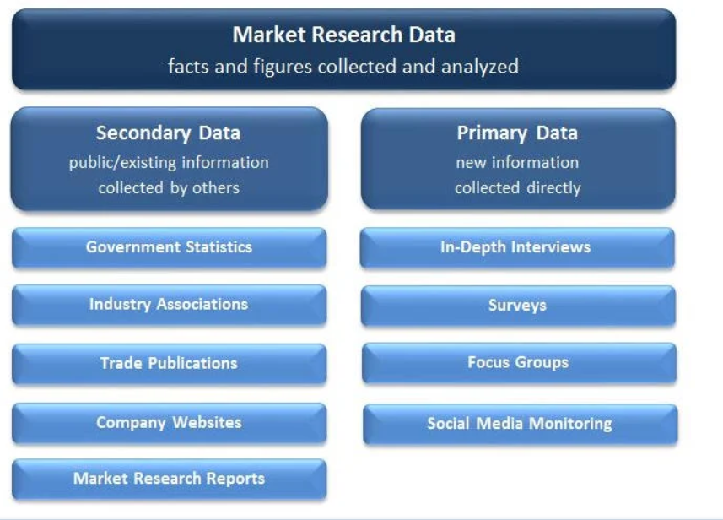
4-choosing Data sources
Notes:
Researchers usually start by gathering secondary data. The company’s internal database provides a good starting point. Companies can buy secondary data from outside firms that supply high-quality data to suit a wide variety of marketing information needs.
The company can also utilize the wide assortment of external information sources. Using commercial online databases, marketing researchers can conduct their own searches of secondary data sources. Internet search engines can also help in locating relevant secondary information sources. However, they can also be very frustrating and inefficient.

Slide 60
4-choosing Data sources
4.1 Secondary Data (1/2)
Information that already exists
Collected for another purpose
Sources:
Company’s internal database
Purchased from outside suppliers
Commercial online databases
Internet search engines
Sources: of Secondary Data
Notes:
Researchers usually start by gathering secondary data. The company’s internal database provides a good starting point. Companies can buy secondary data from outside firms that supply high-quality data to suit a wide variety of marketing information needs.
The company can also utilize the wide assortment of external information sources. Using commercial online databases, marketing researchers can conduct their own searches of secondary data sources. Internet search engines can also help in locating relevant secondary information sources. However, they can also be very frustrating and inefficient.

Slide 61
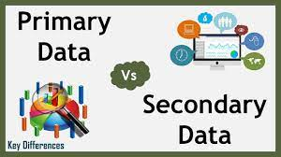
4-choosing Data sources
4.1 Secondary Data (2/2)
Advantages
Low cost
Obtained quickly
Cannot collect otherwise
Disadvantages
Potentially Irrelevant
Inaccurate
Dated
Biased
Notes:
Secondary data can usually be obtained more quickly and at a lower cost than primary data. Also, secondary sources can sometimes provide data an individual company cannot collect on its own, like data that is not available directly or would be too expensive to collect. For example, it would be too expensive for Red Bull’s marketers to conduct a continuing retail store audit to find out about the market shares, prices, and displays of competitors’ brands.
However, secondary data can also present problems. Researchers can rarely obtain all the data they need from secondary sources. For example, Chipotle will not find existing information regarding consumer reactions about new drive-thru service that it has not yet installed. Even when data can be found, the information might not be very usable.
The researcher must evaluate secondary information carefully to make certain it is relevant, accurate, up-to-date, and impartial.

Slide 62
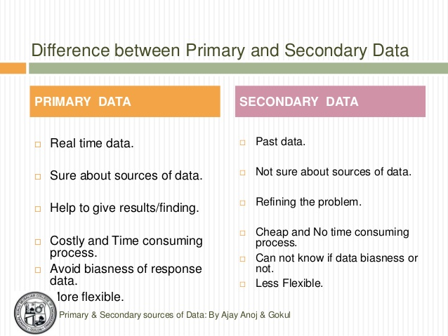
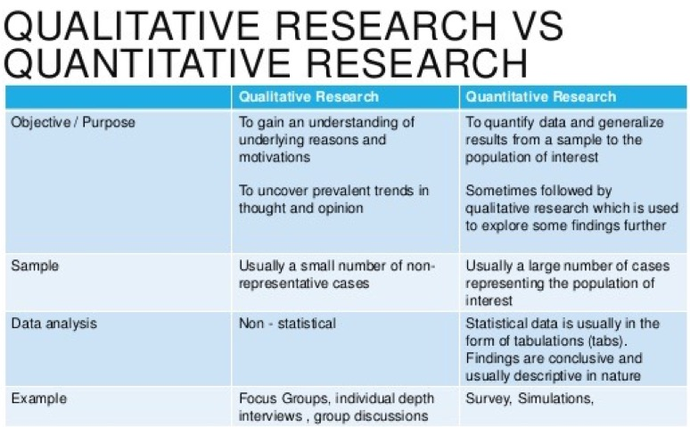
4-choosing Data sources
4.2 Primary Data & Data Collection Plan
Notes:
This table shows that designing a plan for primary data collection calls for a number of decisions on research approaches, contact methods, the sampling plan, and research instruments. The following slides discuss each of these decisions in detail.
Increasingly, researchers are collecting primary data through online marketing research. The Internet is especially well suited to quantitative research. Advantages of Internet-based surveys are speed and low costs. Researchers can quickly and easily distribute surveys to thousands of respondents and responses can be almost instantaneous. Internet-based surveys also tend to be more interactive and engaging, easier to complete, and less intrusive.
A primary qualitative Internet-based research approach is online focus groups. For example, FocusVision’s InterVu service lets focus group participants at remote locations see, hear, and react to each other in real-time, face-to-face discussions.
Both quantitative and qualitative Internet-based research have some drawbacks. One major problem is controlling who’s in the online sample. To overcome such sample and context problems, many online research firms use opt-in communities and respondent panels. Alternatively, many companies are now developing their own custom social networks and using them to gain customer inputs and insights.

Slide 63
5-Chose Research methods
Experimental research
Selecting matched groups of subjects, giving them different treatments, controlling related factors, and checking for differences in group responses
Observational research
Gathering primary data by observing relevant people, actions, and situations
Survey research
Asking people questions about their knowledge, attitudes, preferences, and buying behaviors
Mail questionnaires are used to collect large amounts of information at a low cost per respondent
Interviewing research methods include;
  Individual interviewing
  Group interviewing
  F-F or Telephone interviewing
Notes:
Observational and ethnographic research yield the kinds of details that don’t emerge from traditional research questionnaires or focus groups. For instance, Fisher-Price has established an observation lab in which it can observe the reactions children have to new toys.
A wide range of companies now use ethnographic research. For example, Coors insights teams frequent bars and other locations in a top-secret, small-town location—they call it the “Outpost”—within a day’s drive of Chicago. The researchers use the town as a real-life lab.
Survey research is the approach best suited for gathering descriptive information. The major advantage of survey research is its flexibility. Surveys addressing almost any marketing question or decision can be conducted by phone or mail, in person, or online. The disadvantages of survey research are that people may be unwilling to respond to unknown interviewers or answer questions about topics they consider private.
Whereas observation is best suited for exploratory research and surveys for descriptive research, experimental research is best suited for gathering causal information. Experimental research tries to explain cause-and-effect relationships. For example, before adding a new sandwich to its menu, McDonald’s might use experiments to test the effects on sales of two different prices it might charge.
questionnaires can be used to collect large amounts of information at a low cost per respondent. Respondents may give more honest answers to more personal questions on a mail questionnaire than to an unknown interviewer. However, mail questionnaires are not very flexible.
Telephone interviewing is one of the best methods for gathering information quickly, and it provides greater flexibility than mail questionnaires. Interviewers can explain difficult questions and, depending on the answers they receive, skip some questions or probe on others. However, the method introduces interviewer bias, which is the way interviewers talk, how they ask questions, and other differences that may affect respondents’ answers.
Personal interviewing takes two forms: individual interviewing and group interviewing. Individual interviewing involves talking with people in their homes or offices, on the street, or in shopping malls. Such interviewing is flexible. Group interviewing consists of inviting 6 to 10 people to meet with a trained moderator to talk about a product, service, or organization. Group interviewing is also referred to as focus group interviewing.
Some companies use immersion groups, which are small groups of consumers who interact directly and informally with product designers without a focus group moderator present. For example, The Mom Complex uses “Mom Immersion Sessions” to help brand marketers understand and connect directly with their “mom customers” on important brand issues

Slide 64
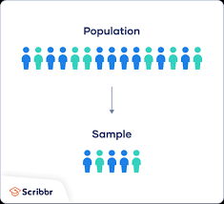
6-Construct sample
A sample is a segment of the population selected to represent the population.
Decisions required for sampling design:
  Sampling unit - People to be studied
  Sample size - Number of people to be studied
  Sampling procedure - Methods of choosing the people to be studied fall under two basic categories:
    probability samples
    nonprobability samples
Notes:
Marketing researchers usually draw conclusions about large groups of consumers by studying a small sample of the total consumer population. The sample should be representative of the population so that the researcher can make accurate estimates. Designing the sample requires three decisions. First, who is to be studied (unit)? Second, how many people should be included (size)? Finally, how should the people in the sample be chosen (procedure)?

Slide 65
Type of samples
 | Types of Samples
Probability Sample
Simple random sample | Every member of the population has a known and equal chance of selection.
Stratified random sample | The population is divided into mutually exclusive groups (such as age groups), and random samples are drawn from each group.
Cluster (area) sample | The population is divided into mutually exclusive groups (such as blocks), and the researcher draws a sample of the groups to interview.
Nonprobability Sample
Convenience sample | The researcher selects the easiest population members from which to obtain information.
Judgment sample | The researcher uses his or her judgment to select population members who are good prospects for accurate information.
Quota sample | The researcher finds and interviews a prescribed number of people in each of several categories.
Notes:
The different types of samples fall under two basic categories: probability samples and nonprobability samples.
Probability samples include the following.
Simple random sample: Every member of the population has a known and equal chance of selection.
Stratified random sample: The population is divided into mutually exclusive groups (such as age groups), and random samples are drawn from each group.
Cluster (area) sample: The population is divided into mutually exclusive groups (such as blocks), and the researcher draws a sample of the groups to interview.
Nonprobability samples include the following.
Convenience sample: The researcher selects the easiest population members from which to obtain information.
Judgment sample: The researcher uses his or her judgment to select population members who are good prospects for accurate information.
Quota sample: The researcher finds and interviews a prescribed number of people in each of several categories.
When probability sampling costs too much or takes too much time, marketing researchers take nonprobability samples, even though their sampling error cannot be measured. The best method to use depends on the needs of the research project.

Slide 66
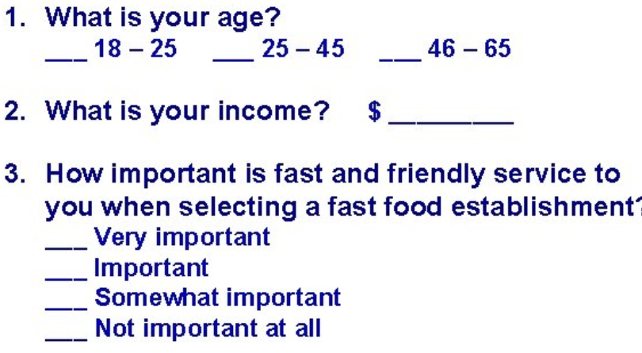
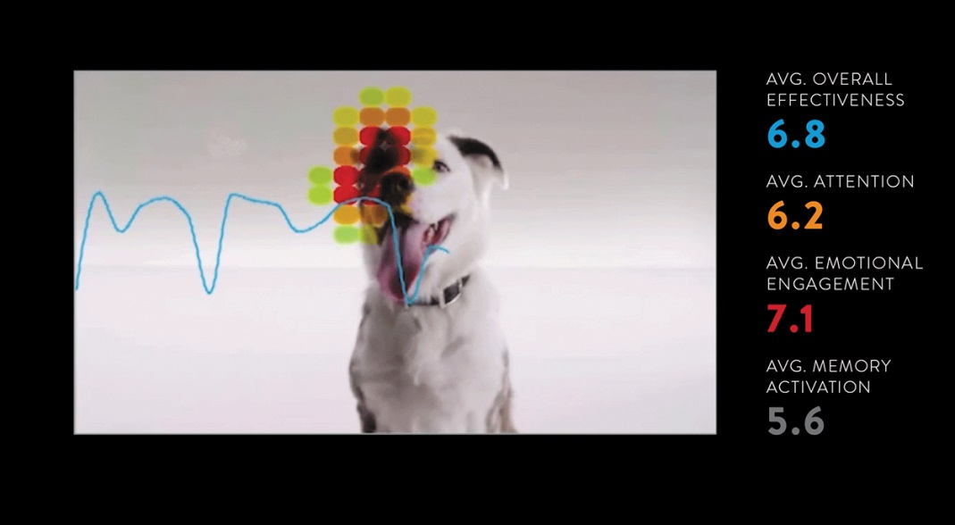
7-Implementing the Research Plan
Data collection
Research Instruments could be a Questionnaires that either administered in person F-F, by phone, by e-mail, or online
  Closed-ended questions
  Open-ended question
  Likert scale
Mechanical instruments include
  People meters
  Neuromarketing
  Checkout scanners
Some researchers are applying neuromarketing, which involves measuring brain activity to learn how consumers feel and respond.
Notes:
The researcher next puts the marketing research plan into action. This involves collecting, processing, and analyzing the information. Data collection can be carried out by the company’s marketing research staff or outside firms. Researchers make sure that the plan is implemented correctly and must guard against problems with data collection techniques and technologies, data quality, and timeliness.
Researchers must also process and analyze the collected data to isolate important information and insights. They need to check data for accuracy and comple
In collecting primary data, marketing researchers have a choice of two main research instruments: questionnaires and mechanical instruments.
A questionnaire is by far the most common instrument used for research. Closed-ended questions include all the possible answers, and subjects make choices among them. Open-ended questions allow respondents to answer in their own words. Open-ended questions are especially useful in exploratory research, when the researcher is trying to find out what people think but is not measuring how many people think in a certain way. Closed-ended questions, on the other hand, provide answers that are easier to interpret and tabulate. Researchers should use care in the wording and ordering of questions.
Mechanical instruments are used to monitor consumer behavior. For example, Time Warner’s MediaLab uses high-tech observation to capture the changing ways that today’s viewers are using and reacting to television and Web content.
Some researchers are applying neuromarketing, which involves measuring brain activity to learn how consumers feel and respond. For example, PepsiCo’s Frito-Lay worked with Nielsen’s NeuroFocus to assess consumer motivations underlying the success of its Cheetos snack brand.
teness and code it for analysis. The researchers then tabulate the results and compute statistical measures.

Slide 67
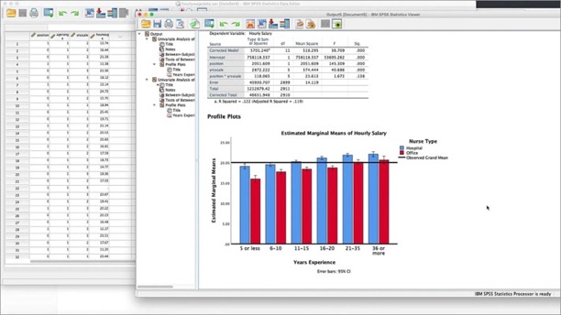
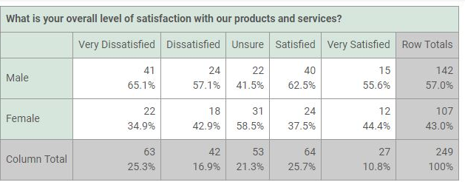
8-Analysing the Research results
Analyzing the data
  Compute statistical measures
  SPSS is the dominant used software statistical package.
  Tabulate results
Notes:
The researcher next puts the marketing research plan into action. This involves collecting, processing, and analyzing the information. Data collection can be carried out by the company’s marketing research staff or outside firms. Researchers make sure that the plan is implemented correctly and must guard against problems with data collection techniques and technologies, data quality, and timeliness.
Researchers must also process and analyze the collected data to isolate important information and insights. They need to check data for accuracy and comple
In collecting primary data, marketing researchers have a choice of two main research instruments: questionnaires and mechanical instruments.
A questionnaire is by far the most common instrument used for research. Closed-ended questions include all the possible answers, and subjects make choices among them. Open-ended questions allow respondents to answer in their own words. Open-ended questions are especially useful in exploratory research, when the researcher is trying to find out what people think but is not measuring how many people think in a certain way. Closed-ended questions, on the other hand, provide answers that are easier to interpret and tabulate. Researchers should use care in the wording and ordering of questions.
Mechanical instruments are used to monitor consumer behavior. For example, Time Warner’s MediaLab uses high-tech observation to capture the changing ways that today’s viewers are using and reacting to television and Web content.
Some researchers are applying neuromarketing, which involves measuring brain activity to learn how consumers feel and respond. For example, PepsiCo’s Frito-Lay worked with Nielsen’s NeuroFocus to assess consumer motivations underlying the success of its Cheetos snack brand.
teness and code it for analysis. The researchers then tabulate the results and compute statistical measures.

Slide 68
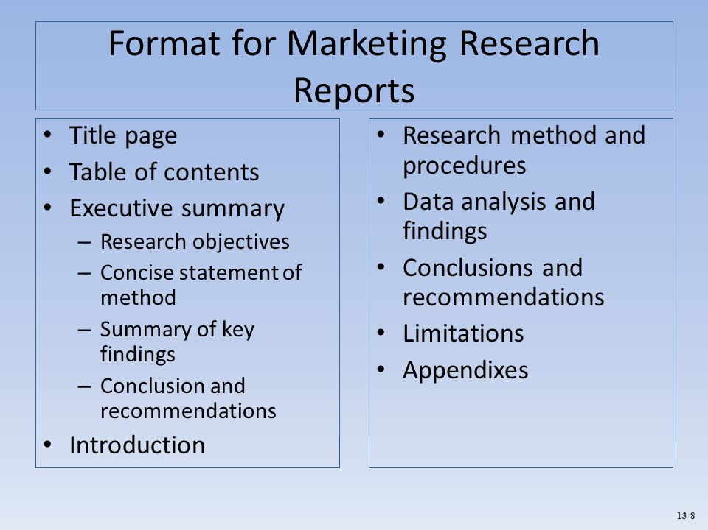
9-Interpreting and Reporting Findings
Responsibilities of the market researcher:
  Interpret the findings
  Draw conclusions
  Report findings to management
Responsibilities of managers and researchers:
  Work together closely when interpreting research results
  Share responsibility for the research process and resulting decisions
Notes:
The market researcher must interpret the findings, draw conclusions, and report them to management. The researcher should present important findings and insights that are useful in the major decisions faced by management.
The best research means little if the manager blindly accepts faulty interpretations from the researcher. In many cases, findings can be interpreted in different ways, and discussions between researchers and managers will help point to the best interpretations. Thus, managers and researchers must work together closely when interpreting research results, and both must share responsibility for the research process and resulting decisions.

Slide 69
Distributing and Using Marketing Information
MIS must make information readily available for decision making.
  Routine information for decision making
  Non-routine information for special situations
Intranets and extranets facilitate the information-sharing process.
Notes:
The marketing information system must make information readily available to managers and others who need it, when they need it. In some cases, this means providing managers with routine information such as performance reports, intelligence updates, and reports on the results of research studies. But, marketing managers also require non-routine information to make on-the-spot decisions. For example, a sales manager having trouble with a large customer may want a summary of the account’s sales and profitability over the past year.
Many firms use company intranet and internal CRM systems to facilitate the distribution and use of marketing information. Companies are also increasingly allowing key customers and value-network members to access account, product, and other data on demand through extranets.

Slide 70
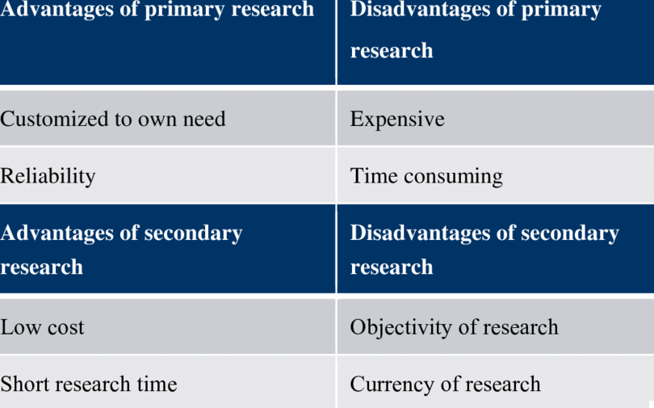
Research Advantages and Disadvantages
Notes:
Secondary data can usually be obtained more quickly and at a lower cost than primary data. Also, secondary sources can sometimes provide data an individual company cannot collect on its own, like data that is not available directly or would be too expensive to collect. For example, it would be too expensive for Red Bull’s marketers to conduct a continuing retail store audit to find out about the market shares, prices, and displays of competitors’ brands.
However, secondary data can also present problems. Researchers can rarely obtain all the data they need from secondary sources. For example, Chipotle will not find existing information regarding consumer reactions about new drive-thru service that it has not yet installed. Even when data can be found, the information might not be very usable.
The researcher must evaluate secondary information carefully to make certain it is relevant, accurate, up-to-date, and impartial.

Slide 71
Marketing Research in Small Businesses and Nonprofit Organizations and International Marketing Research
It is the Responsibility of managers to conduct the research systematically
• Think carefully about the research objectives
• Formulate questions in advance
• Recognize the biases introduced by smaller samples and less skilled researchers
Small businesses and not-for-profit organizations can
obtain good marketing insights through
• observation or informal surveys using small
convenience samples.
• They can collect a considerable amount of
information at very little cost online.
• They can scour competitor and customer Web sites
and use Internet search engines to research specific
companies and issues.
International Marketing Research follows the same steps
as domestic researchers However, it is challenging due to
problems faced include
• Dealing with diverse markets
• Finding good secondary data in foreign markets
• Developing good samples
• Reaching respondents
• Handling differences in culture, language, and
attitudes toward marketing research
The cost of research is
high, but the cost of not
doing it is higher.
Notes:
Just like larger firms, small organizations need market information and the customer insights that it can provide. Many marketing research techniques can be used by smaller organizations in a less formal manner and at little or no expense.
Small businesses and not-for-profit organizations can obtain good marketing insights through observation or informal surveys using small convenience samples. They can collect a considerable amount of information at very little cost online. They can scour competitor and customer Web sites and use Internet search engines to research specific companies and issues.
Although these informal research methods are less complex and less costly, they still must be conducted with care. Managers must think carefully about the objectives of the research, formulate questions in advance, recognize the biases introduced by smaller samples and less skilled researchers, and conduct the research systematically.

Slide 72

Issues in market Research
1- Intrusions on Consumer Privacy
• Failure to address privacy issues
results in. Angry, less cooperative
consumers as well as leads to
government intervention.
• Target made some customers upset
by using their buying histories to
figure out “private” things about them
• Best approaches for researchers:
  • Asking only for the information needed
  • Using the information responsibly to provide customer value
  • Avoiding sharing the information without
  the customer’s permission.
2- Misuse of Research Findings
Several associations as American Marketing
Association, the Marketing Research Association, and the Council of American Survey Research
Organizations (CASRO)—have developed codes of research ethics and standards of conduct. For
example, the CASRO Code outlines researcher
responsibilities to respondents, including
confidentiality, privacy, and avoidance of harassment.
• Few advertisers rig their research designs or deliberately
misrepresent the findings.
• Solutions:
• Development of codes of research ethics and
standards of conduct
• Companies must accept responsibility to protect
consumers’ best interests and their own.

Slide 73


Slide 74

Case study

Slide 75


Slide 76

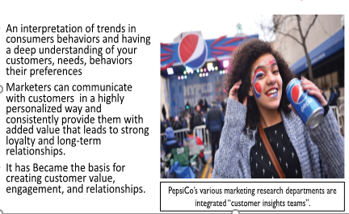
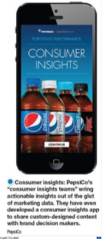
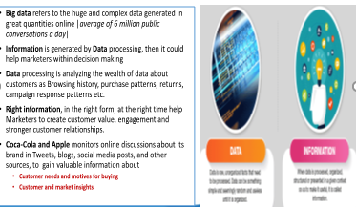
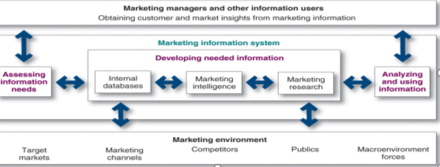
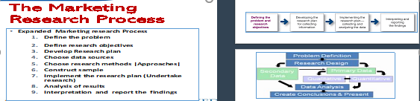
Internal databases are collections of consumer and market information obtained within the company from
Company Record
Point-of-Sale
Employees' feedback
Systematic monitoring, collection, and analysis of information about consumers, competitors, and developments in the marketing environment
Systematic design, collection, analysis, and reporting of data relevant to a specific marketing situation facing an organization and collecting an update on changes in customer needs ,customers’ behaviors and market trends.

Slide 77


Slide 78



