Slide 1

Strategic marketing

Slide 2


Strategic marketing
Lecture # 2

Slide 3

Quick recap on previous lecture

Slide 8


Activity # 1

Slide 9
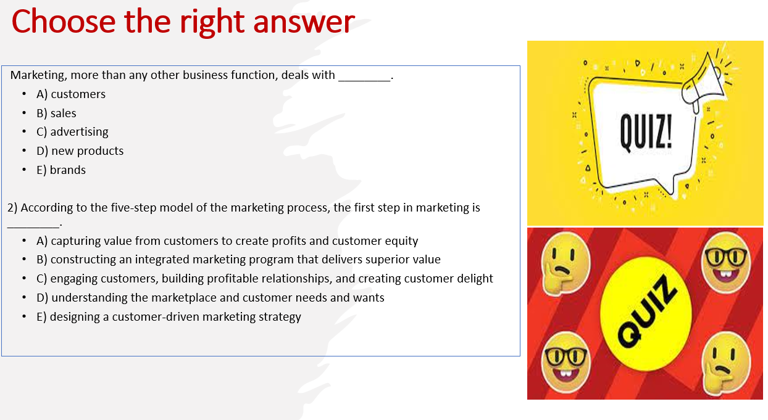

Slide 10
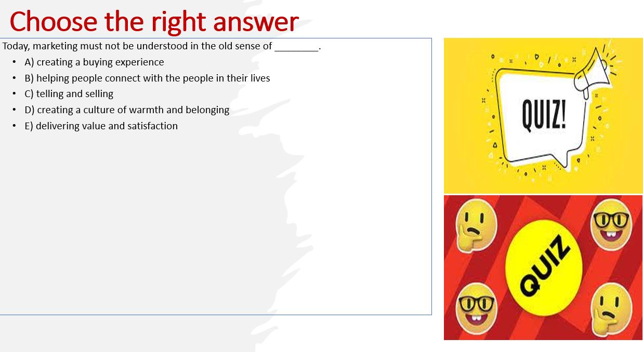

Slide 11
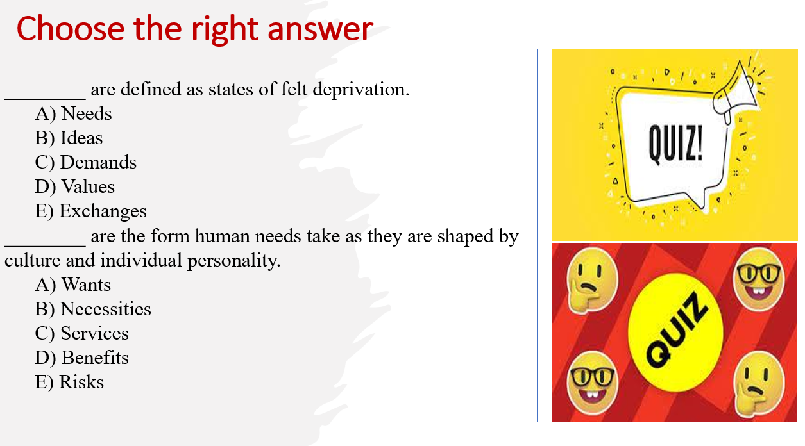

Slide 12
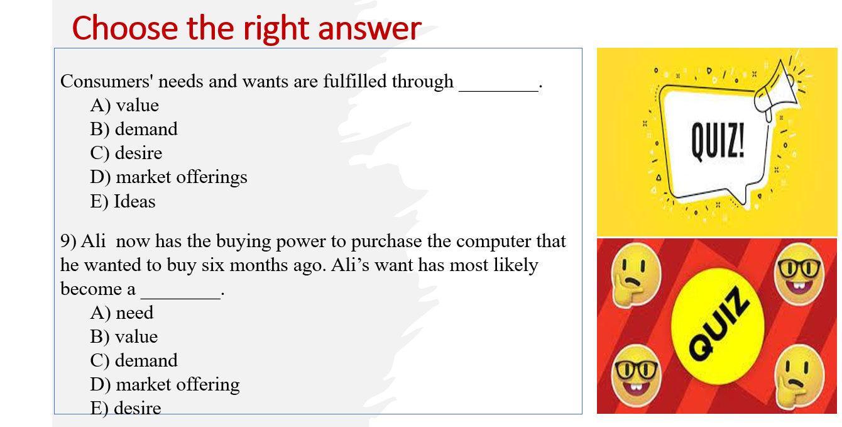

Slide 13
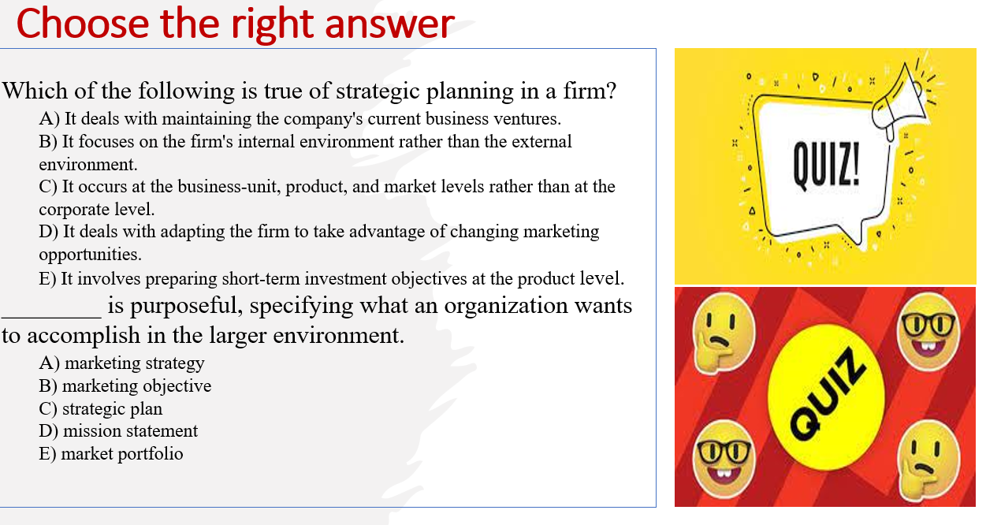

Slide 14
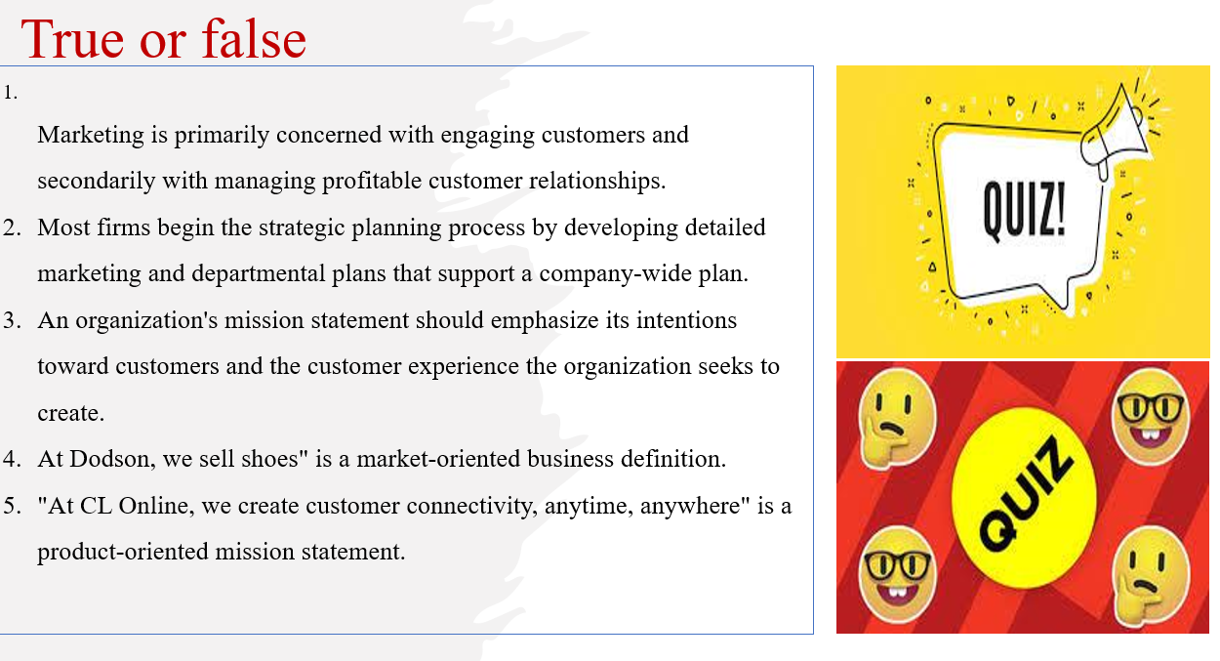

Slide 15
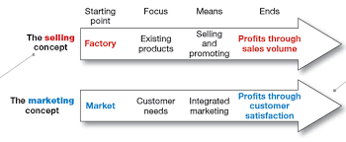
Understanding of Marketing Concepts

Slide 16
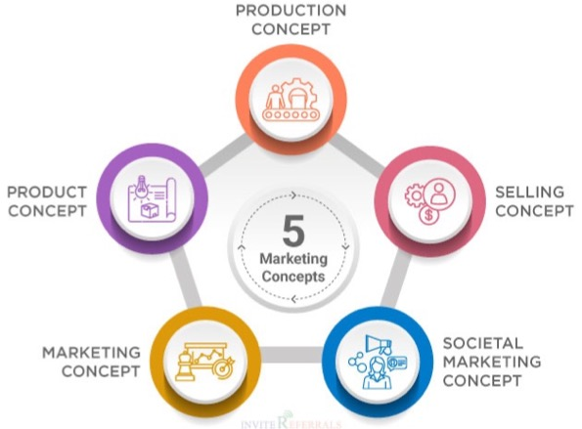
Marketing Concepts
1
2
MARKETING offerings of a products Goods or services & managing profitable relationship the with the target customers
In fact, not all businesses approach the market in the same way.
Organizations might have a few different approaches, These approaches are called marketing concepts,
4
3
5
Notes:
MARKETING IS offerings of a products Goods or services to target customers & to have and to mange a profitable relationship to the audience However, not all businesses approach the market in the same way.
Organizations have a few different approaches, These approaches are called marketing concepts,

Slide 17
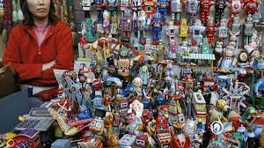
Production concept
1
The production concept holds that consumers will prefer products that are widely available and inexpensive.

Slide 18

Product concept
2
Assume that consumers will favour those products that offer the most quality, performance, or innovative features
Then, to compete effectively, products are designed to incorporate many features to meet the different needs of many consumers.

Slide 19

Marketing concept
3
The marketing concept holds that the key to achieving organizational goals consists of the company being more effective than competitors in creating, delivering, and communicating superior customer value to its chosen target markets.

Slide 20

Selling concept
4
The selling concept holds that consumers and businesses will ordinarily not buy enough of the organization’s products; therefore, the organization must undertake an aggressive selling and promotion effort.

Slide 21
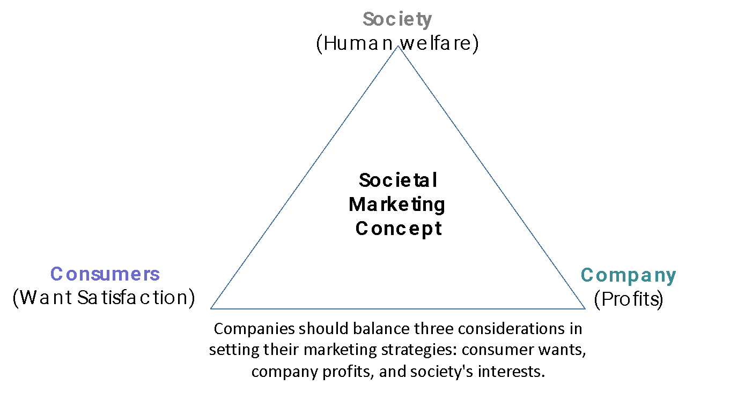

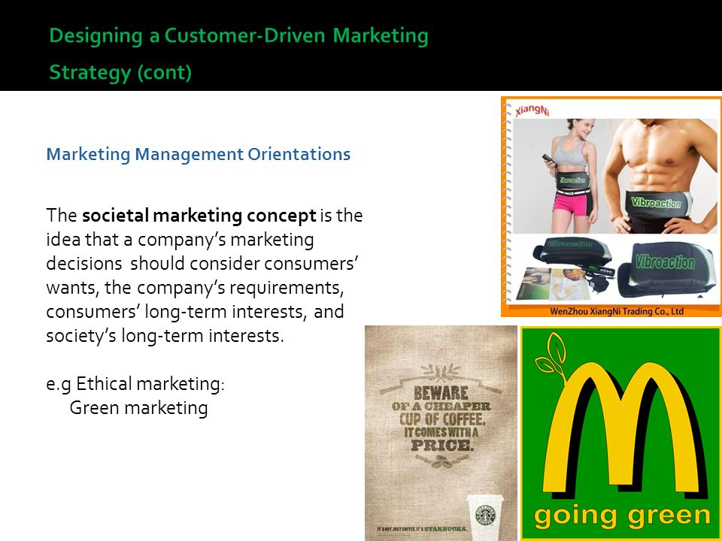
Societal Marketing Concept
5
  The idea that an organization considers consumer’s needs, wants, and interests in a way that maintains or improves the consumer's and society's well-being on long term interests
  Many leading businesses are now advocating the concept of shared value, which recognizes that societal needs, not just economic needs, for instance Green marketing.
Notes:
Many leading business and marketing thinkers are now preaching the concept of shared value, which recognizes that societal needs, not just economic needs, define markets
A growing number of companies known for their hardnosed approaches to business are rethinking the interactions between society and corporate performance.
They are concerned not just with short-term economic gains but also with the well-being of their customers, the depletion of natural resources vital to their businesses, the viability of key suppliers, and the economic well-being of the communities in which they produce and sell.
One prominent marketer calls this Marketing 3.0. "Marketing 3.0 organizations are values-driven," he says. "I'm not talking about being value-driven. I'm talking about 'values' plural, where values amount to caring about the state of the world."
As this slide shows [Figure 1–4 in the text] shows, companies should balance three considerations in setting their marketing strategies: consumer wants, company profits, and society's interests.

Slide 22


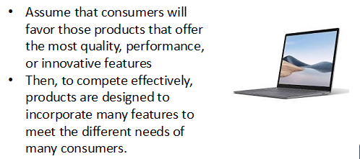

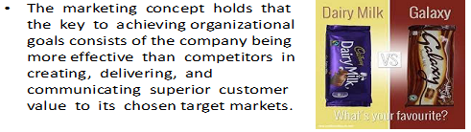
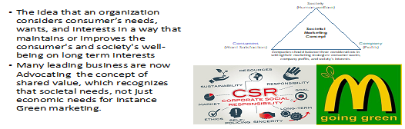
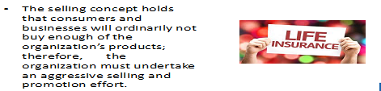

Slide 23
Activity #2
Practice

Slide 24
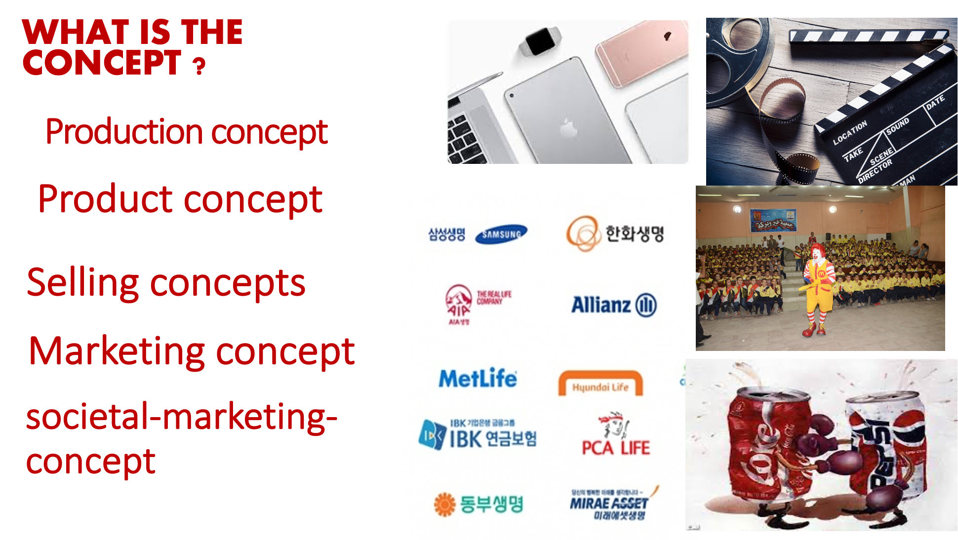
1
2
4
3

Slide 25
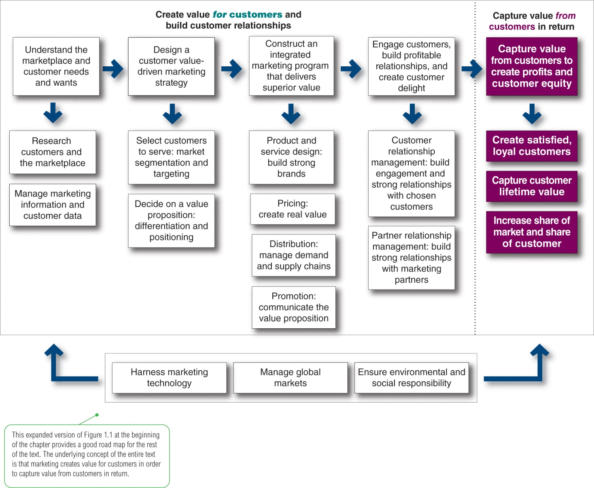
1
2
3
4
5
Expanded Marketing process
Notes:
Company-wide strategic planning guides marketing strategy and planning. Like the marketing strategy, the broader company strategy must be customer focused.
This figure illustrates the steps in strategic planning. At the corporate level, the company starts the strategic planning process by defining its overall purpose and mission. The mission is turned into detailed supporting objectives that guide the entire company. Then, headquarters decides what portfolio of businesses and products is best for the company and how much support to give each one.
In turn, each business and product develops detailed marketing and other departmental plans that support the company-wide plan. Thus, marketing planning occurs at the business-unit, product, and market levels. It supports company strategic planning
Strategic planning sets the stage for the rest of planning in the firm. Companies prepare annual plans, long-range plans, and strategic plans. The annual and long-range plans deal with the company’s current businesses and how to keep them going. In contrast, the strategic plan involves adapting the firm to take advantage of opportunities in its constantly changing environment.
with more detailed plans for specific marketing opportunities.

Slide 26

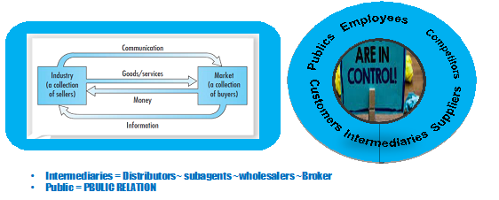
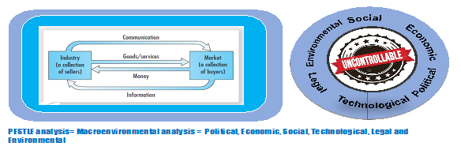
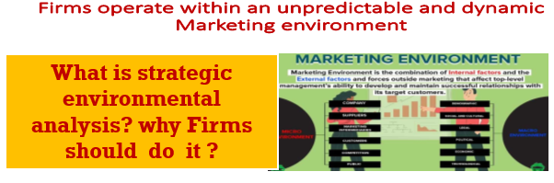

Slide 27
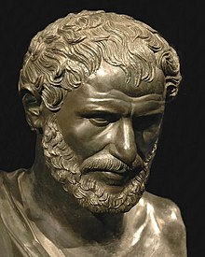
What is strategic environmental analysis? why Firms should do it ?
The only thing that is constant
is that things will change.
" No man ever steps in the same river twice, for it's not the same river and he's not the same man.
Heraclitus, an ancient Greek, philosopher 535 BC- 475 BC

Slide 28
Macroenvironment analysis |PESTEL|
SWOT Analysis |integration of internal and external analyses|
Microenvironmental analysis |Porter 5 forces|
business portfolio analysis |internal environmental analysis|
PLC |product life cycle|
BCG |Growth share matrix|
Portfolio analysis
Marketing Environment |external environmental analysis|.
1
Strategic environmental analysis
2
3

Slide 29
Analyzing the Marketing Environment
1.1
External Environment
Microenvironmental analysis
|Porter 5 forces|

Slide 30
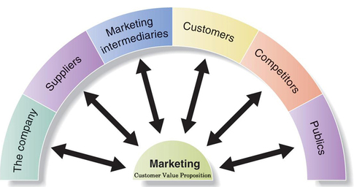
Major Forces in the Company’s Microenvironment
forces that affect marketing management’s ability to build and maintain successful relationships with target customers
Notes:
This figure shows the major actors in the marketer’s microenvironment.
Each of these actors are discussed in greater detail in the following slides.

Slide 31
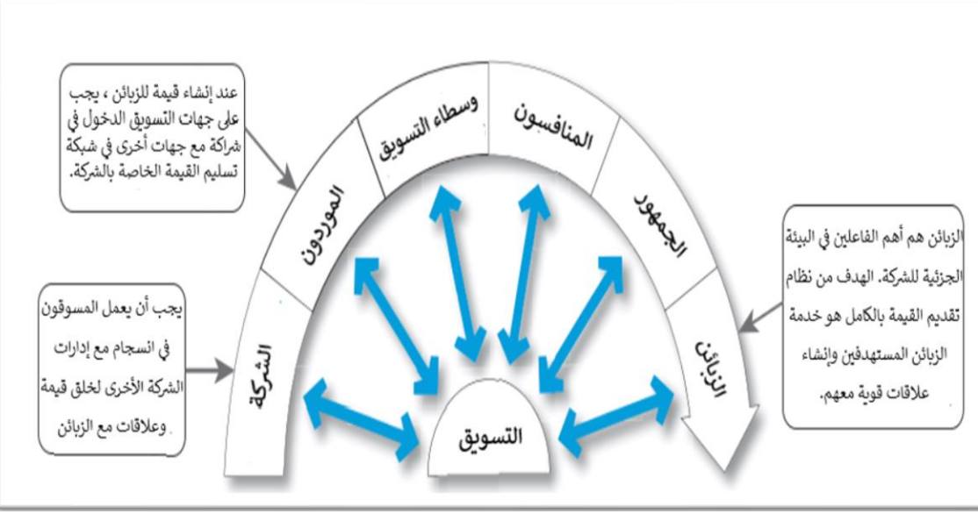
البيئة الجزئية
القوى التي تؤثر على قدرة مهمه إدارة التسويق وعلي قدره المنظمة في بناء علاقات ناجحة مع العملاء المستهدفين والحفاظ عليها
لا يمكن لمديري التسويق القيام بذلك بمفردهم و يتطلب نجاح التسويق بناء علاقات مع أقسام الشركة الأخرى، والمجهزين ، ووسطاء التسويق، والمنافسين، ومختلف الجماهير والزبائن ، والتي تتحد لتشكيل شبكة تسليم القيمة للشركة.
Notes:
This figure shows the major actors in the marketer’s microenvironment.
Each of these actors are discussed in greater detail in the following slides.
يوضح هذا الشكل الجهات الفاعلة الرئيسية في البيئة المكروية للمسوق. تتم مناقشة كل من هذه الجهات الفاعلة بمزيد من التفصيل في الشرائح التالية

Slide 32
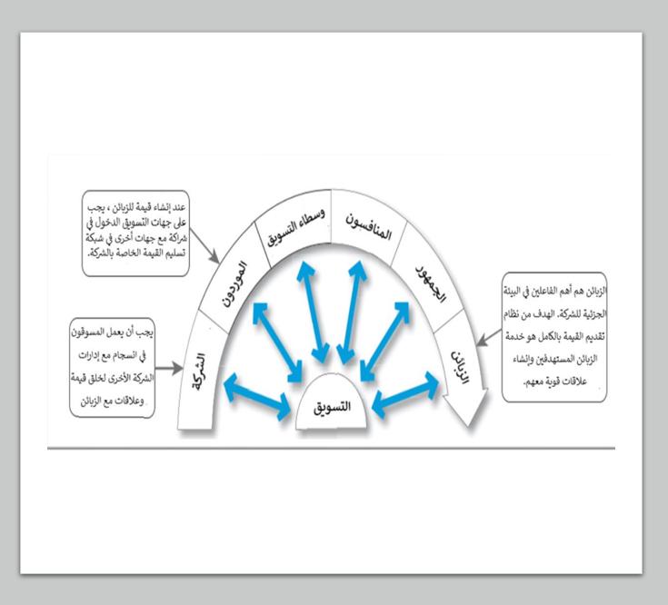
البيئة الجزئية
القوى التي تؤثر على قدرة مهمه إدارة التسويق وعلي قدره المنظمة في بناء علاقات ناجحة مع العملاء المستهدفين والحفاظ عليها
لا يمكن لمديري التسويق القيام بذلك بمفردهم و يتطلب نجاح التسويق بناء علاقات مع أقسام الشركة الأخرى، والمجهزين ، ووسطاء التسويق، والمنافسين، ومختلف الجماهير والزبائن ، والتي تتحد لتشكيل شبكة تسليم القيمة للشركة.

Slide 33

The Customers
Five types of customer markets
  Consumer markets
  Business markets
  Reseller markets
  Government markets
  International markets
Notes:
Consumer markets consist of individuals and households that buy goods and services for personal consumption.
Business markets buy goods and services for further processing or use in their production process.
Reseller markets buy goods and services to resell at a profit.
Government markets consist of government agencies that buy goods and services to produce public services.
International markets consist of buyers in other countries, including consumers, producers, resellers, and governments.

Slide 34
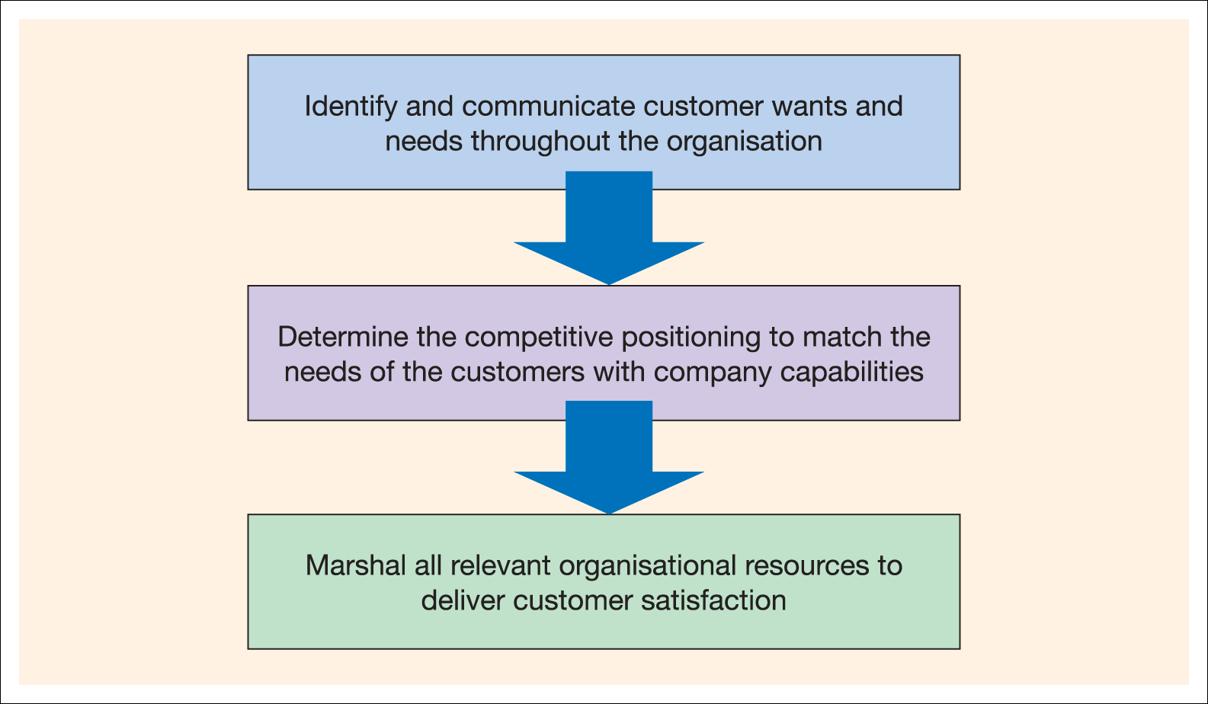
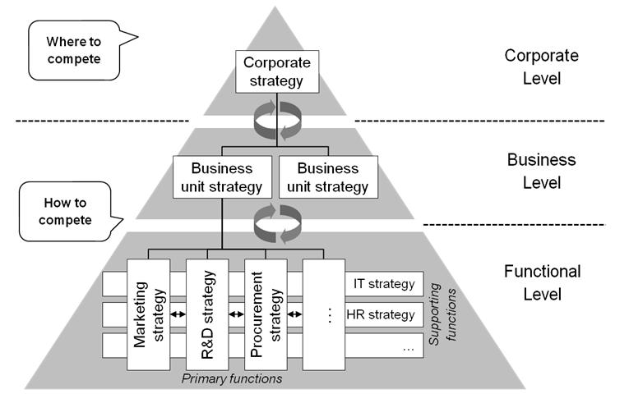
The Company
The Interrelated departments in a company form the internal environment
marketing management takes other company groups into account
With marketing taking the lead, all departments share the responsibility for understanding customer needs and creating customer value
Notes:
In designing marketing plans, marketing management takes other company groups into account—groups such as top management, finance, research and development (R&D), purchasing, operations, human resources, and accounting. All of these interrelated groups form the internal environment.
With marketing taking the lead, all—from manufacturing and finance to legal and human resources—share the responsibility for understanding customer needs and creating customer value.
Departments
Marshal

Slide 35
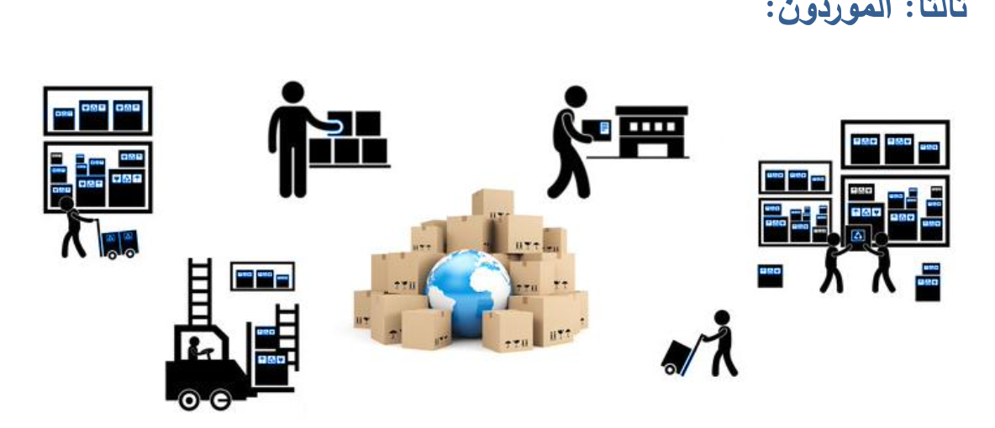
The Suppliers
Suppliers form an important link in the company’s overall customer value delivery network. They provide the resources needed by the company to produce its goods and services.
Supplier problems can seriously affect marketing. Marketing managers must watch supply availability and costs. Supply shortages or delays can cost sales in the short run and damage customer satisfaction in the long run. Rising supply costs may force price increases that can harm the company’s sales vol
Notes:
Suppliers form an important link in the company’s overall customer value delivery network. They provide the resources needed by the company to produce its goods and services.
Supplier problems can seriously affect marketing. Marketing managers must watch supply availability and costs. Supply shortages or delays can cost sales in the short run and damage customer satisfaction in the long run. Rising supply costs may force price increases that can harm the company’s sales volume.

Slide 36

تتمثل مهمة ايكيا في خلق حياة يومية أفضل للعملاء من خلال تقديم مفروشات منزلية عصرية بسيطة وعملية بأسعار مناسبه للغاية بحيث يستطيع غالبيه العملاء تحمل تكاليفها.
ولكي تتمكن ايكيا من بيع منتجاتها عالميا بمليارات الدولارات، يجب على ايكيا أولا تطوير شبكة قوية وموثوقة من الموردين والشركاء الذين يمكنهم مساعدتها في تصميم وصنع كل هذه المنتجات في المقام الأول .
تدرك شركة ايكيا لبيع المفروشات المنزلية أهمية بناء علاقات وثيقة مع شبكتها الواسعة من الموردين

Slide 37
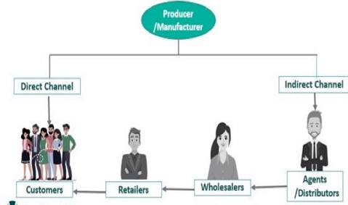
Marketing Intermediaries
Marketing intermediaries help the company to promote, sell, and distribute its products to final buyers.
  Resellers wholesalers and retailers.
  Marketing services agencies, advertising agencies, media firms
  Financial intermediaries; banks, credit companies, insurance companies, and other businesses that help finance transactions or insure against the risks associated with the buying and selling of goods.
Notes:
Resellers are distribution channel firms that help the company find customers or make sales to them. These include wholesalers and retailers.
Physical distribution firms help the company stock and move goods from their points of origin to their destinations.
Marketing services agencies are the marketing research firms, advertising agencies, media firms, and marketing consulting firms that help the company target and promote its products to the right markets.
Financial intermediaries include banks, credit companies, insurance companies, and other businesses that help finance transactions or insure against the risks associated with the buying and selling of goods.

Slide 38
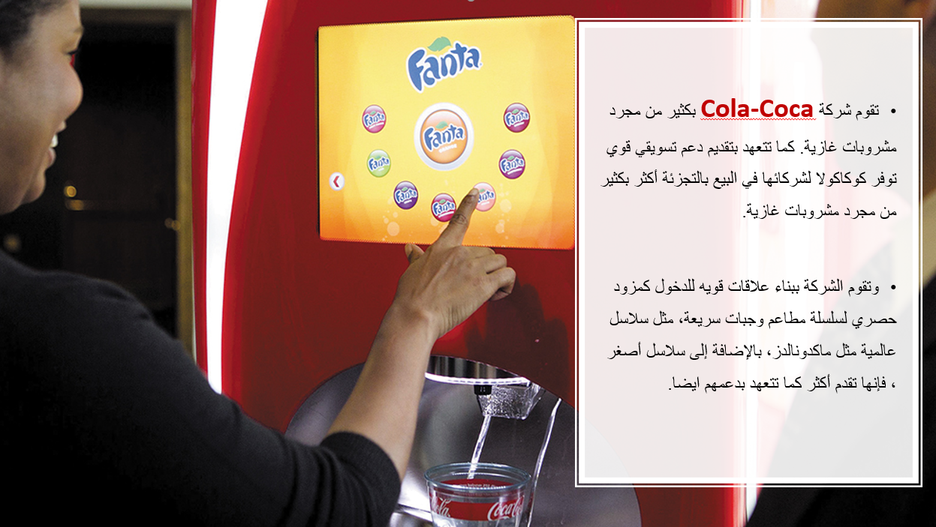

Slide 39
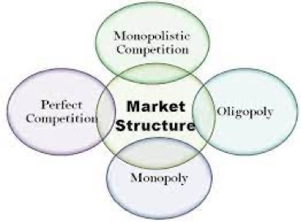
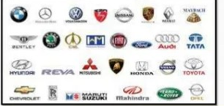

Competitors
One seller, Or a single firm
The marketing concept states that, to be successful, a company must provide greater customer value and satisfaction than its competitors do
Marketers must gain strategic advantage by positioning products strongly against competitors.
No single strategy is best for all companies.
Each firm should consider its own size and industry position compared with those of its competitors
large number of firms.
Few firms in the market.
Notes:
The marketing concept states that, to be successful, a company must provide greater customer value and satisfaction than its competitors do. Thus, marketers must do more than simply adapt to the needs of target consumers. They also must gain strategic advantage by positioning their offerings strongly against competitors’ offerings in the minds of consumers.
No single competitive marketing strategy is best for all companies. Each firm should consider its own size and industry position compared with those of its competitors. Large firms with dominant positions in an industry can use certain strategies that smaller firms cannot afford. However, small firms can also develop winning strategies.

Slide 40
Market analysis
A market forward-looking, aims to anticipate the future via examine the history.
Size
Growth
Tends the direction
prices
Forecast

Slide 41

Publics
Publics: any group that has an actual or potential interest in or impact on an organization’s ability to achieve its objectives
  Financial
  Media
  Government
  Citizen action
  Local
  General
  Internal
Notes:
Financial publics influence the company’s ability to obtain funds.
Media publics carry news, features, and editorial opinions.
Government publics: Management must take government developments into account.
Citizen-action publics: A company’s marketing decisions may be questioned by consumer organizations, environmental groups, etc.
Local publics include neighborhood residents and community organizations.
General public: The general public’s image of the company affects its buying.
Internal publics include workers, managers, volunteers, and the board of directors.

Slide 42
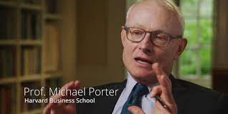
Porter’s Five Forces
Michael Porter is a famous academic known for his theories on economics, business strategy, and competitive advantages.

Slide 43
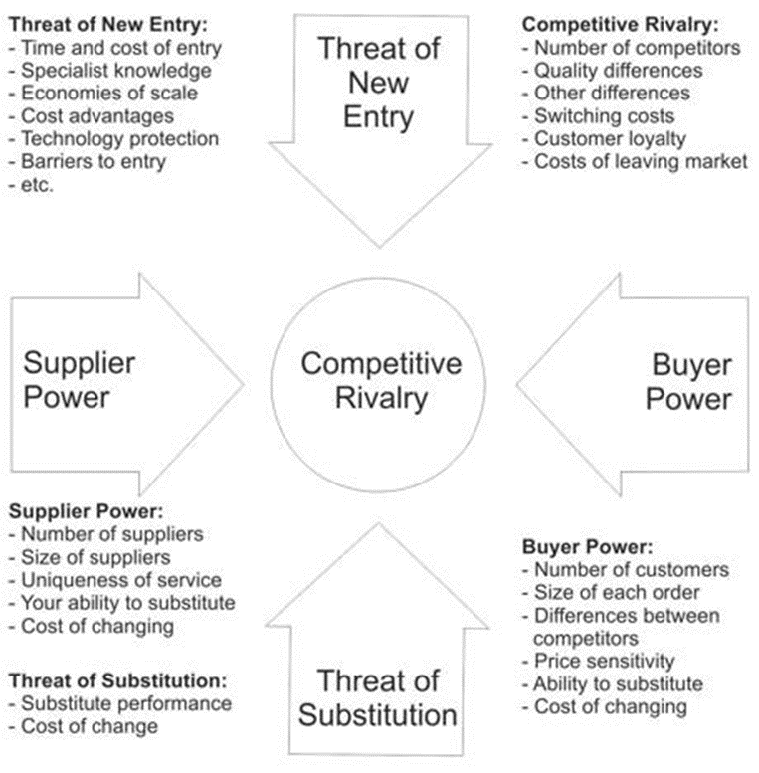
Porter’s Five Forces

Slide 44
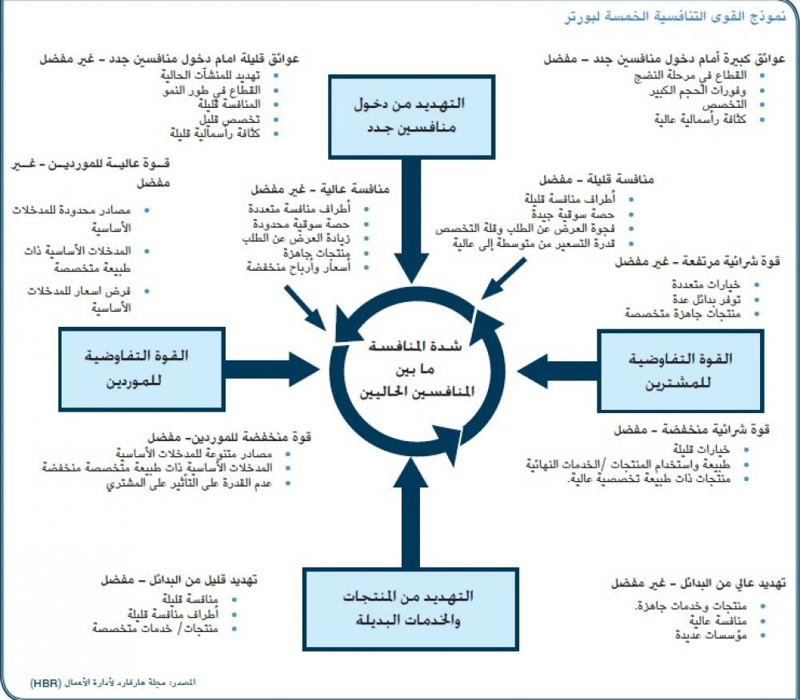

Slide 45
Activity #3
Practice

Slide 46
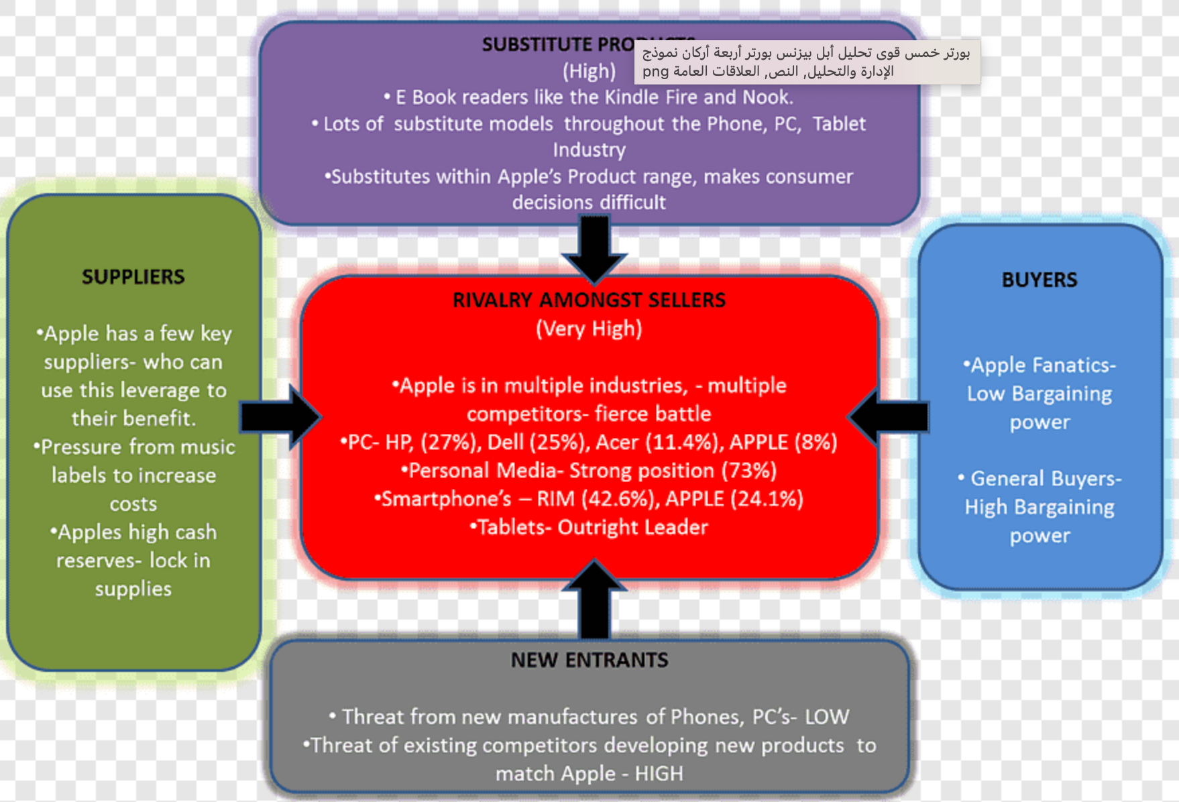

رتب القوى التنافسية الخمسة لمايكل بورتر
تهديد الوافدين الجدد|Threat of new entrants|
القوه التفاوضية للموردين |Bargaining power of suppliers|
القوه التفاوضية للمشترين |Bargaining power of buyers|
تهديد البدائل |Threat of substitute|
شدة المنافسة داخل القطاع |Rivalry among existing competitors|
Notes:
Purple substitute
Red completion
Blue pyers
Grey new entrans
Green supplier

Slide 47
Notes:
Purple substitute
Red completion
Blue pyers
Grey new entrans
Green supplier

Slide 48



Slide 49
Analyzing the Marketing Environment
1.2
Marketing Environment
Macroenvironment analysis
|PESTEL|

Slide 50
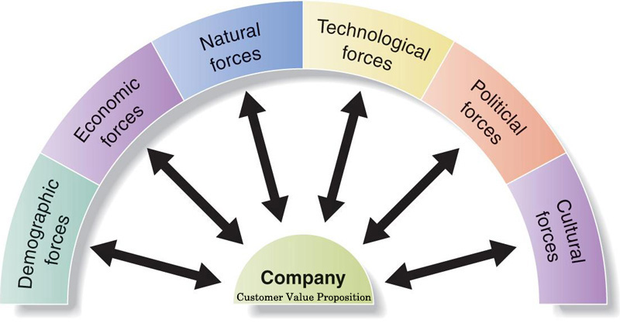
Major Forces in the Company’s Macroenvironment
1.1
Outside forces that affect marketing management’s ability to build and maintain successful relationships with target customers
Notes:
This figure shows the six major forces in the company’s macroenvironment.
Each of these forces are discussed in greater detail in the following slides.

Slide 51
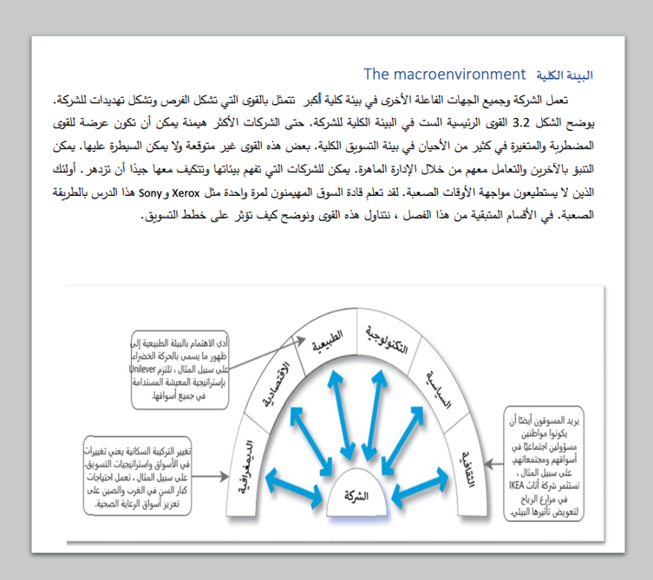
البيئة الكلية
ست قوى رئيسية تتحكم في البيئة الكليه ستؤدي تفاعلاتهم إلى فرص وتهديدات جديدة.
  القوى الديموغرافية.
  القوى الاقتصادية.
  القوى الاجتماعية الثقافية
  القوى الطبيعية.
  القوى التكنولوجية.
  القوى السياسية والقانونية.

Slide 52
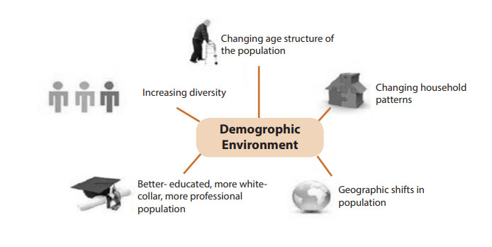
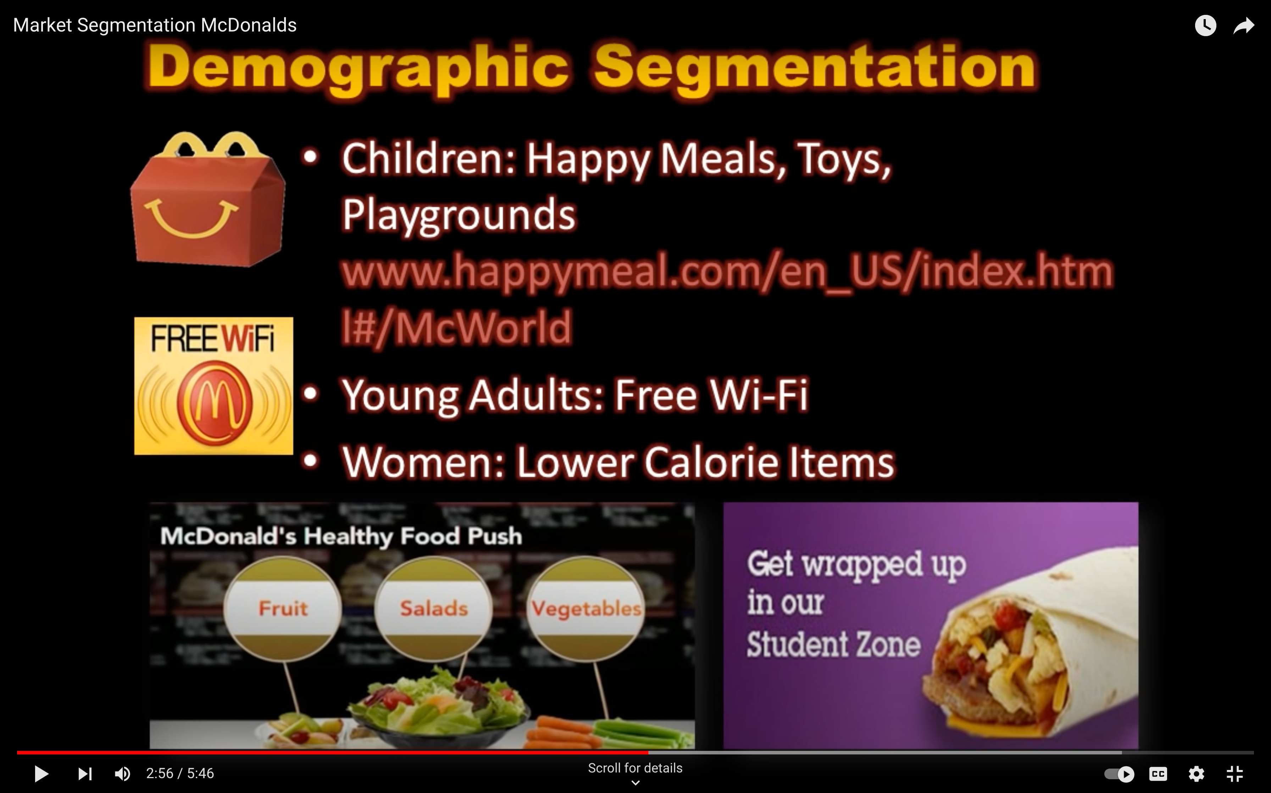
Demographic Forces
Demography is the study of human populations in terms of size, density, location, age, gender, race, occupation, and other statistics.
Marketers analyze:
  Changing age and family structures
  Geographic population shifts
  Educational characteristics
  Population diversity
Notes:
Demography is the study of human populations in terms of size, density, location, age, gender, race, occupation, and other statistics. Marketers analyze several important factors that affect the marketing environment.
The first factor is the changing age and family structures. The U.S. population contains several generational groups. These include the Baby Boomers, Generation X, Generation Y or Millennials, and Generation Z. These are discussed in more detail on the next slide.
The second factor is the changing American household. More people are divorcing or separating, choosing not to marry, marrying later, or marrying without intending to have children. Marketers must increasingly consider the special needs of nontraditional households because they are now growing more rapidly than traditional households. Each group has distinctive needs and buying habits.
The third factor is geographic shifts in population. Population shifts interest marketers because people in different regions buy differently. For example, people in the Midwest buy more winter clothing than people in the Southeast.
And the final factor is increasing diversity. Marketers face increasingly diverse marke
ts as their operations become more international in scope. Some major companies also explicitly target gay and lesbian consumers.
https://www.youtube.com/watch?v=XVpZA2bect8

Slide 53
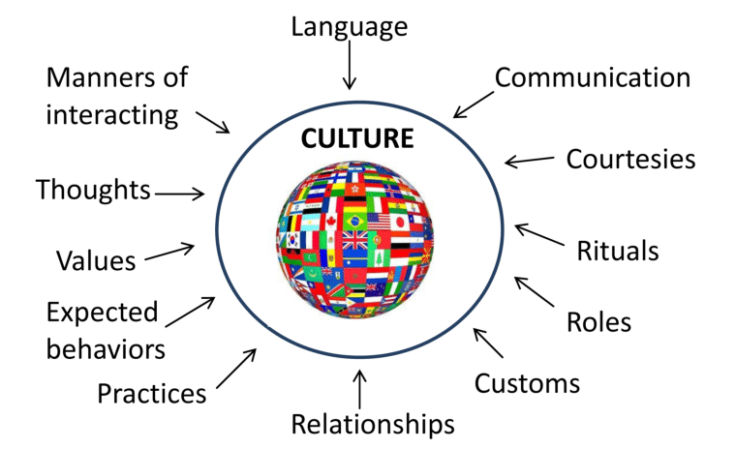
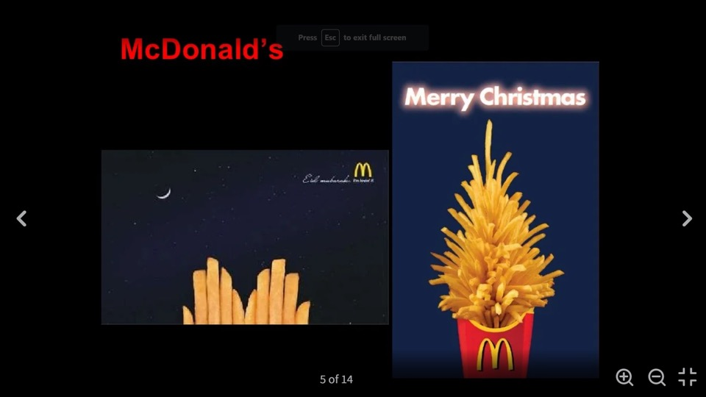
Cultural Forces
SOCIOCULTURAL ELEMENTS
Cultural Forces are the characteristics that can affect marketing decision making
Cultural Forces affect a society’s basic values, perceptions, preferences, and behaviors. shapes basic beliefs and values.
For example, most Americans believe in individual freedom, hard work, getting married, achievement, and success. These beliefs shape more specific attitudes and behaviors found in everyday life.

Slide 54
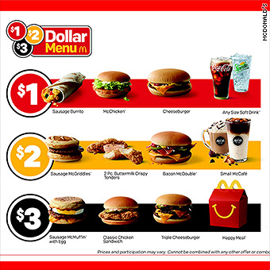
Economic Forces
Economic growth
Employment
Disposable income
Interest rate
Inflation
FX
Economic factors affect consumer purchasing power and spending
  Differences in income distributions well as income levels. Over the past several decades, the rich have grown richer, the middle class has shrunk, and the poor have remained poor.
  Consumers have now adopted a back-to-basics sensibility
  Consumers are buying less and looking for greater value in the things they do buy.
  Marketers should pay attention to income distribution as well as income levels to tailor their marketing offers across a range of markets, from the affluent to the less affluent.
Notes:
The economic environment consists of economic factors that affect consumer purchasing power and spending patterns.
Economic factors can have a dramatic effect on consumer spending and buying behavior. Consumers have now adopted a back-to-basics sensibility in their lifestyles and spending patterns that will likely persist for years to come. They are buying less and looking for greater value in the things they do buy. In turn, value marketing has become the watchword for many marketers. Marketers in all industries are looking for ways to offer today’s frugal buyers greater value.
Marketers should pay attention to income distribution as well as income levels. Over the past several decades, the rich have grown richer, the middle class has shrunk, and the poor have remained poor. This distribution of income has created a tiered market. Many companies aggressively target the affluent, while other firms target those with more modest means. Still other companies tailor their marketing offers across a range of markets, from the affluent to the less affluent.
Disposable income is total personal income minus current income taxes. In national accounts definitions, personal income minus personal current taxes equals disposable personal income.

Slide 55
Technological forces
Emerging Technologies
Copyright and Patents
Production and Distribution
Research and Development
Marketers should adopt the new Digital Technologies and capture new markets and opportunities.
  Online marketing
  Online retail
  Radio-frequency identification (RFID) is technology to track products through various points in the distribution channel.
Notes:
Radio Frequency Identification (RFID) refers to a wireless system comprised of two components: tags and readers. The reader is a device that has one or more antennas that emit radio waves and receive signals back from the RFID tag

Slide 56
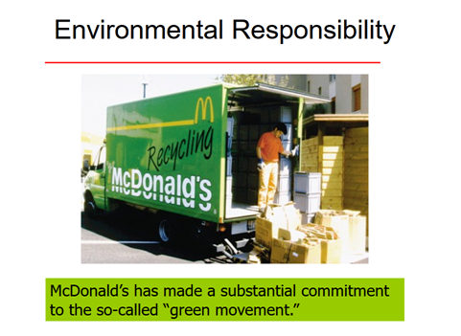

Natural Forces
Pollution
Natural resource management
Climate change
environmental sustainability
Marketers should be aware of several trends in the natural environment.
  Shortages of raw materials
  Increased pollution
  Increased government intervention
environmental sustainability. This refers to the effort to create a world economy that the planet can support indefinitely.
Timberland is on a mission to do everything it can to reduce its impact on the planet while at the same time making better outdoor gear
Notes:
The natural environment involves the physical environment and the natural resources that are needed as inputs by marketers or that are affected by marketing activities. Marketers should be aware of several trends in the natural environment.
The first involves growing shortages of raw materials. Firms making products that require scarce resources face large cost increases, even if the materials remain available. The second trend is increased pollution. The third trend is increased government intervention in natural resource management. The governments of different countries vary in their concern and efforts to promote a clean environment.
Today, enlightened companies adopt practices that support environmental sustainability. This refers to the effort to create a world economy that the planet can support indefinitely.

Slide 57

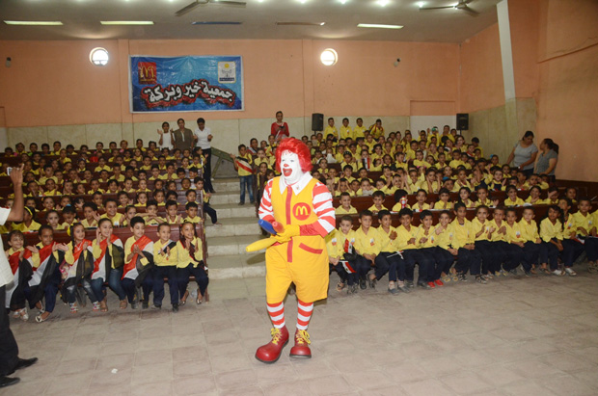
Socially Responsible Behavior
Socially responsible companies actively seek out ways to protect the long-run interests of consumers and the environment. {Corporate giving}
Companies develop policies, guidelines, and other responses to complex social responsibility issues.
Notes:
Socially responsible firms actively seek out ways to protect the long-run interests of their consumers and the environment. Almost every aspect of marketing involves ethics and social responsibility issues. Companies are now developing policies, guidelines, and other responses to complex social responsibility issues.
Enlightened companies encourage their managers to look beyond what the regulatory system allows and simply “do the right thing.”

Slide 58
Political Forces
Consumer Protection Laws
Anti-trust Laws
Political Stability
Taxation/Tariffs policy
Foreign Trade policy
Pressure group
The political factors refer to laws, government agencies, and pressure groups that influence, limit, or affect a specific strategic option , organizations and individuals in each country.
For instance, when launching a new product or looking to expand abroad, it is important to recognize political issues that may add cost, time, and effort to the project.

Slide 59
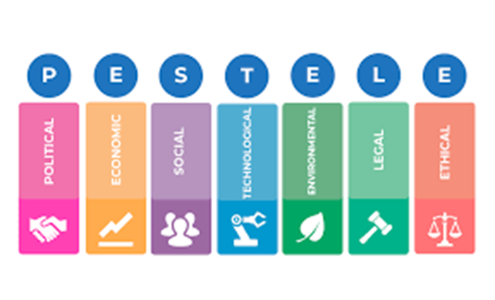
PESTEL
Very important for international and local companies to analyze the external factors that influencing marketing in business

Slide 60


Slide 61


Slide 62


Slide 63



